Slide 1
CS 466/666 - Algorithm Design and Analysis
Maximum Flow and Laplacian Solver
Waterloo, 30 July 2020

Slide 2
Today’s Plan
Last lecture
Maximum flow
Laplacian solver
Review and Preview
Please do the course review at evaluate.uwaterloo.ca.
Last office hour today.
No late days for project report (Aug 14, 11pm).
Have sent all feedback for project proposal.
HW5 due Monday.
HW4 solutions posted.

Slide 3

Solving LP by Multiplicative Weight Update
Initially, $p_{i}^{\left(1\right)}=1/m$ for each $1≤i≤m$.
For $1≤t≤T$ do
  Use the oracle to find a solution $x^{\left(t\right)}$ that satisfies $p^{\left(t\right)}Ax^{\left(t\right)}≥p^{\left(t\right)}b$ and $x^{\left(t\right)}≥0$,
    and furthermore $\left|A_{i}x^{\left(t\right)}−b_{i}\right|≤w$ for $1≤i≤m.$
  Set the outcome $m_{i}^{\left(t\right)}≔\frac{A_{i}x^{\left(t\right)}−b_{i}}{w}$ for $1≤i≤m$.
  Use $m_{i}^{\left(t\right)}$to apply the multiplicative weight update method to compute $p^{\left(t+1\right)}$,
    i.e. $w_{i}^{\left(t+1\right)}≔\left(1−ηm_{i}^{\left(t\right)}\right){⋅w}_{i}^{\left(t\right)}$ and $p_{i}^{\left(t+1\right)}=w_{i}^{\left(t+1\right)}/Φ^{\left(t+1\right)}$.

Slide 4
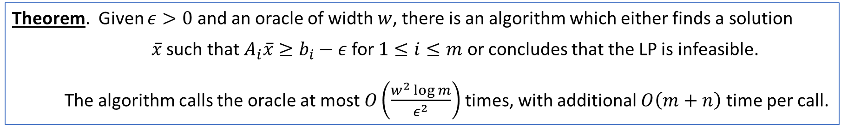
Performance Guarantee
Theorem. Given $ε>0$ and an oracle of width $w$, there is an algorithm which either finds a solution
$\overline{x}$ such that $A_{i}\overline{x}≥b_{i}−ε$ for $1≤i≤m$ or concludes that the LP is infeasible.
The algorithm calls the oracle at most $O\left(\frac{w^{2}\log{m}}{ε^{2}}\right)$ times, with additional $O\left(m+n\right)$ time per call.

Slide 5
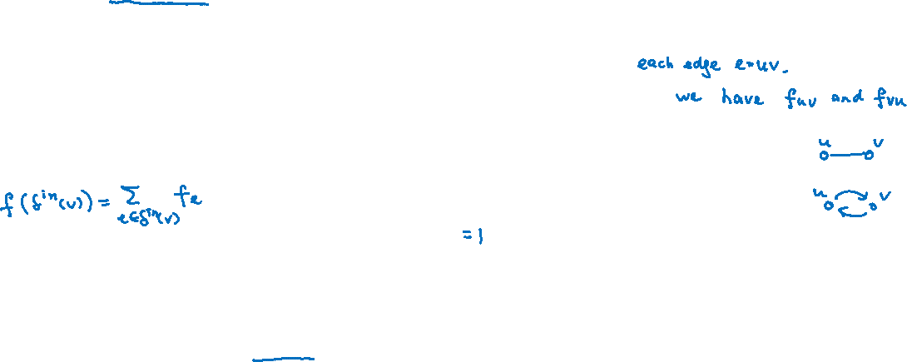





Maximum Flow in Undirected Graphs
Given an undirected graph $G=(V,E)$ where each edge $e$ has a capacity $c_{e}$ and two vertices $s,t$,
our goal is to find a maximum $s$-$t$ flow subject to capacity and flow conservation constraints.
The linear programming relaxation is
For simplicity we assume $c_{e}=1$ for $e∈E$. So the optimal value is in $[0,m]$.
Doing binary search, we can reduce the optimization problem to $O\left(\log{m}\right)$ decision problem,
where we replace the objective function by the constraint $f\left(δ^{out}\left(s\right)\right)−f\left(δ^{in}\left(s\right)\right)=k.$
$$\max{ f\left(δ^{out}\left(s\right)\right)−f\left(δ^{in}\left(s\right)\right)}$$
$$f\left(δ^{in}\left(v\right)\right)=f\left(δ^{out}\left(v\right)\right)$$
$$f_{e}≤c_{e}$$
$$f_{e}≥0$$
$$∀v∈V−\{s,t\}$$
$$∀e∈E$$
$$∀e∈E$$

Slide 6
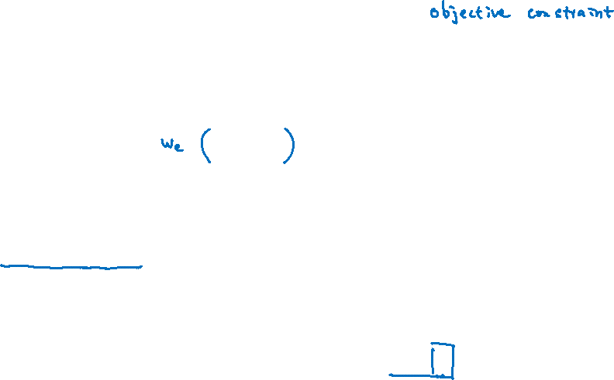


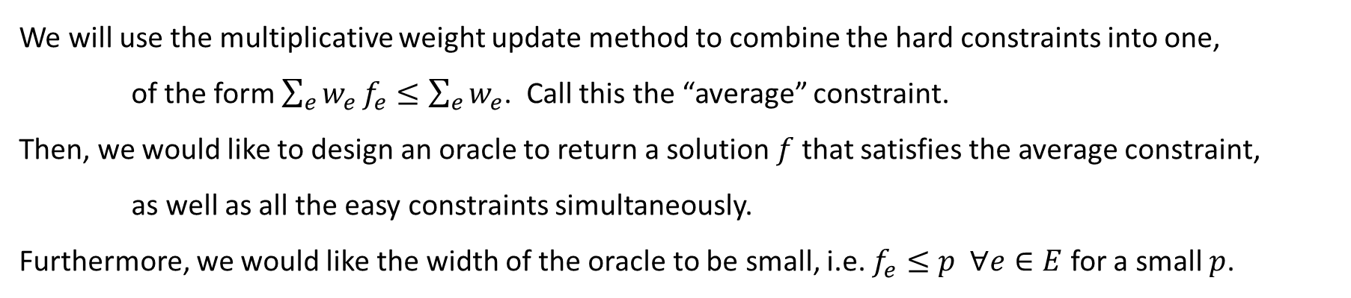


Multiplicative Weight Update Method
To apply the multiplicative weight update method, we divide the constraints into “easy” and “hard”.
$$f\left(δ^{out}\left(s\right)\right)=k+f\left(δ^{in}\left(s\right)\right)$$
$$f\left(δ^{in}\left(v\right)\right)=f\left(δ^{out}\left(v\right)\right)$$
$$f_{e}≥0$$
$$f_{e}≤1$$
Easy constraints
$$∀v∈V−\{s,t\}$$
$$∀e∈E$$
Hard constraints
$$∀e∈E$$
We will use the multiplicative weight update method to combine the hard constraints into one,
of the form $\sum_{e}{w_{e}}f_{e}≤\sum_{e}{w_{e}}$. Call this the “average” constraint.
Then, we would like to design an oracle to return a solution $f$ that satisfies the average constraint,
as well as all the easy constraints simultaneously.
Furthermore, we would like the width of the oracle to be small, i.e. $f_{e}≤p ∀e∈E$ for a small $p$.

Slide 7

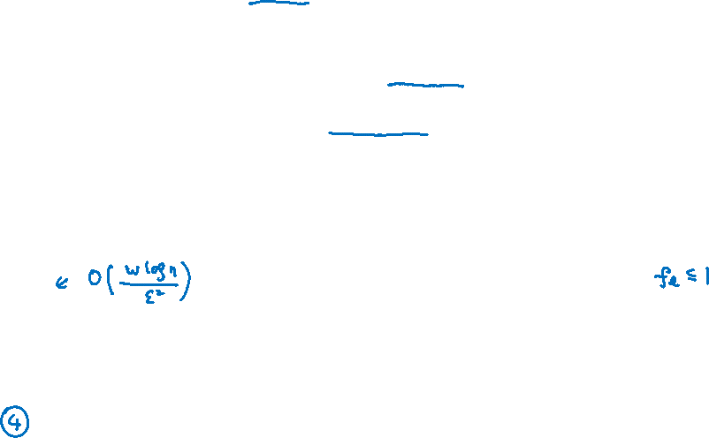
Oracle and Performance Guarantee
More precisely, given $w_{e}$ on each edge and $ε>0$, we will design an oracle to return a “flow” $f∈ℝ^{\left|E\right|}$ s.t.
$f$ satisfies flow conservation constraints, non-negative constraints, and objective value constraint.
When the problem is feasible, $f$ satisfies $\sum_{e}{w_{e}}f_{e}≤(1+ε)\sum_{e}{w_{e}}$.
When the problem is feasible, $f$ satisfies $f_{e}≤O(\sqrt{m/ε})$ for all $e∈E$.
The runtime of the oracle is $\tilde{O}\left(m\right)$.
If such an oracle exists, the multiplicative weight update method implies that by calling the oracle
$O\left(\frac{\sqrt{m}\log{n}}{ε^{2.5}}\right)$ times, the average solution will satisfy all the constraints with $f_{e}≤1+O(ε) ∀e∈E$.
Now, if we scale $f_{e}←\frac{f_{e}}{1+O(ε)}$, then it will satisfy the capacity constraints and with objective value $\frac{k}{1+O(ε)}$.
To conclude, there is a $\tilde{O}\left(m^{\frac{3}{2}}/ε^{2.5}\right)$-time algorithm to return a $\left(1−O\left(ε\right)\right)$-approximate solution.

Slide 8
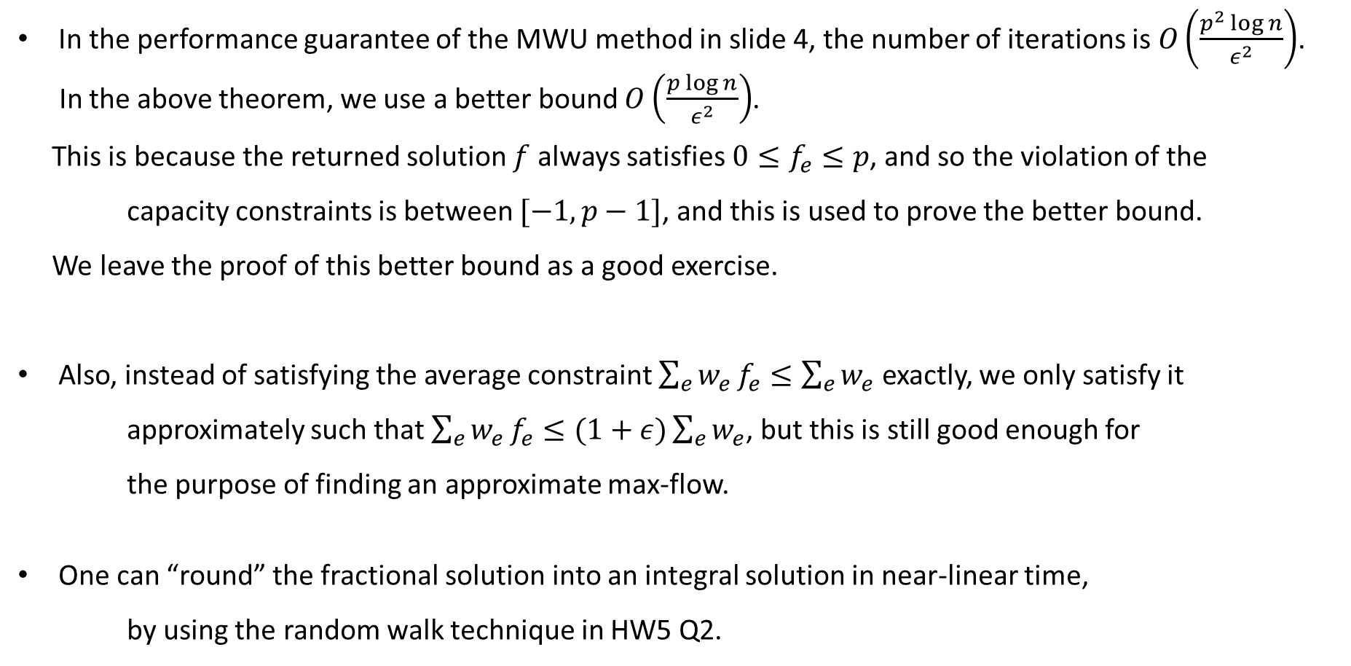
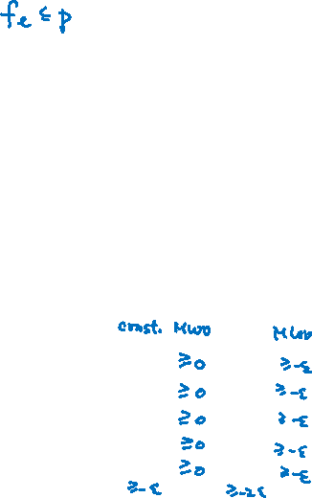
Remarks
In the performance guarantee of the MWU method in slide 4, the number of iterations is $O\left(\frac{p^{2}\log{n}}{ε^{2}}\right)$.
In the above theorem, we use a better bound $O\left(\frac{p\log{n}}{ε^{2}}\right)$.
This is because the returned solution $f$ always satisfies $0≤f_{e}≤p$, and so the violation of the
capacity constraints is between $[−1,p−1]$, and this is used to prove the better bound.
We leave the proof of this better bound as a good exercise.
Also, instead of satisfying the average constraint $\sum_{e}{w_{e}}f_{e}≤\sum_{e}{w_{e}}$ exactly, we only satisfy it
approximately such that $\sum_{e}{w_{e}}f_{e}≤(1+ε)\sum_{e}{w_{e}}$, but this is still good enough for
the purpose of finding an approximate max-flow.
One can “round” the fractional solution into an integral solution in near-linear time,
by using the random walk technique in HW5 Q2.

Slide 9

Electrical Flow as Oracle
Given $w_{e}$ on each edge and $ε>0$, we will design an oracle to return a “flow” $f∈ℝ^{\left|E\right|}$ s.t.
$f$ satisfies flow conservation constraints, non-negative constraints, and objective value constraint.
When the problem is feasible, $f$ satisfies $\sum_{e}{w_{e}}f_{e}≤(1+ε)\sum_{e}{w_{e}}$.
When the problem is feasible, $f$ satisfies $f_{e}≤O(\sqrt{m/ε})$ for all $e∈E$.
The runtime of the oracle is $\tilde{O}\left(m\right)$.
Interestingly, we will use an electrical flow algorithm as the oracle!
Electrical flow oracle
Given $w_{e}$ on each edge and $ε>0$, we set the resistance of edge $e$ to be $r_{e}≔w_{e}+\frac{εW}{m}$, where $W≔\sum_{e}{w_{e}}$.
Return the electrical flow $f$ that sends $k$ units of flow from $s$ to $t$, with resistance $r_{e}$ on each edge $e$.

Slide 10
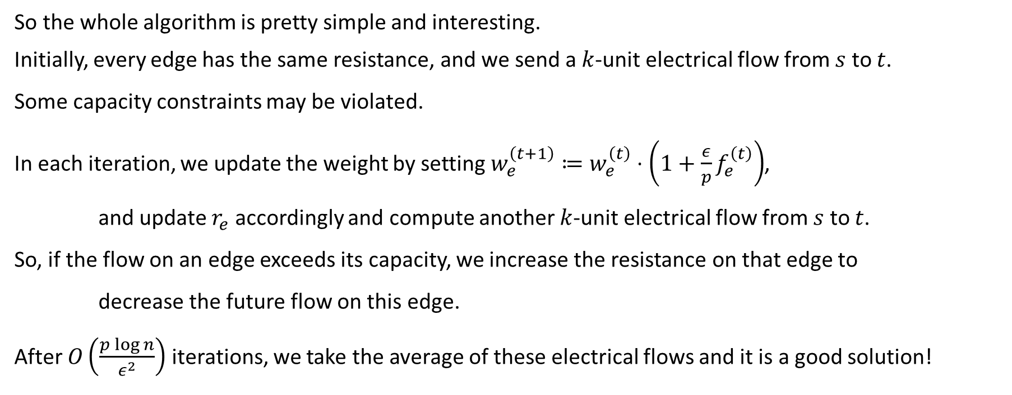
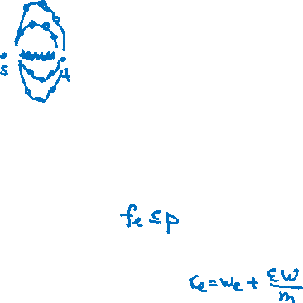
Algorithm
So the whole algorithm is pretty simple and interesting.
Initially, every edge has the same resistance, and we send a $k$-unit electrical flow from $s$ to $t$.
Some capacity constraints may be violated.
In each iteration, we update the weight by setting $w_{e}^{\left(t+1\right)}≔w_{e}^{\left(t\right)}⋅\left(1+\frac{ε}{p}f_{e}^{\left(t\right)}\right)$,
and update $r_{e}$ accordingly and compute another $k$-unit electrical flow from $s$ to $t$.
So, if the flow on an edge exceeds its capacity, we increase the resistance on that edge to
decrease the future flow on this edge.
After $O\left(\frac{p\log{n}}{ε^{2}}\right)$ iterations, we take the average of these electrical flows and it is a good solution!

Slide 11


Analysis
Given $w_{e}$ on each edge and $ε>0$, we will design an oracle to return a “flow” $f∈ℝ^{\left|E\right|}$ s.t.
$f$ satisfies flow conservation constraints, non-negative constraints, and objective value constraint.
When the problem is feasible, $f$ satisfies $\sum_{e}{w_{e}}f_{e}≤(1+ε)\sum_{e}{w_{e}}$.
When the problem is feasible, $f$ satisfies $f_{e}≤O(\sqrt{m})$ for all $e∈E$.
The runtime of the oracle is $\tilde{O}\left(m\right)$.
Electrical flow oracle
Given $w_{e}$ on each edge and $ε>0$, we set the resistance of edge $e$ to be $r_{e}≔w_{e}+\frac{εW}{m}$, where $W≔\sum_{e}{w_{e}}$.
Return the electrical flow $f$ that sends $k$ units of flow from $s$ to $t$, with resistance $r_{e}$ on each edge $e$.
Property (1) is clear. Property (4) is a breakthrough result by Spielman and Teng that we will discuss soon.
So we focus on properties (2) and (3).

Slide 12
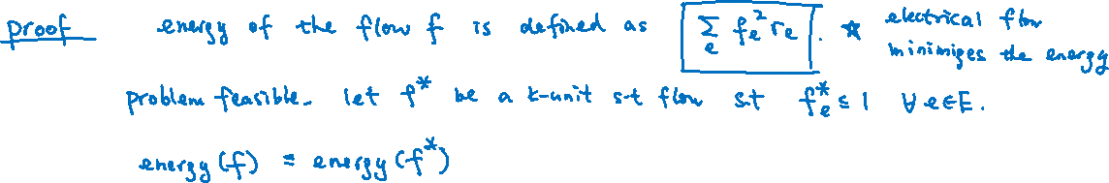

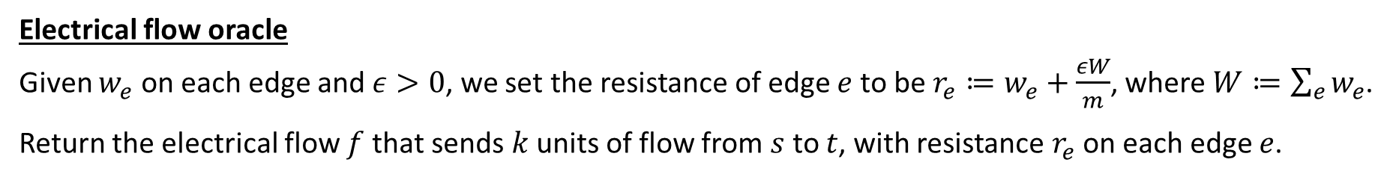
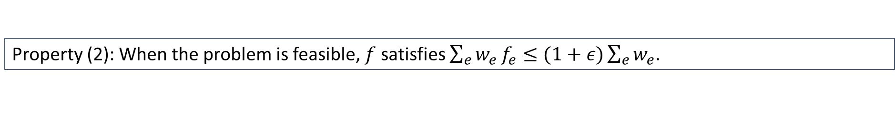
Analysis
Electrical flow oracle
Given $w_{e}$ on each edge and $ε>0$, we set the resistance of edge $e$ to be $r_{e}≔w_{e}+\frac{εW}{m}$, where $W≔\sum_{e}{w_{e}}$.
Return the electrical flow $f$ that sends $k$ units of flow from $s$ to $t$, with resistance $r_{e}$ on each edge $e$.
Property (2): When the problem is feasible, $f$ satisfies $\sum_{e}{w_{e}}f_{e}≤(1+ε)\sum_{e}{w_{e}}$.

Slide 13



Analysis
Electrical flow oracle
Given $w_{e}$ on each edge and $ε>0$, we set the resistance of edge $e$ to be $r_{e}≔w_{e}+\frac{εW}{m}$, where $W≔\sum_{e}{w_{e}}$.
Return the electrical flow $f$ that sends $k$ units of flow from $s$ to $t$, with resistance $r_{e}$ on each edge $e$.
Property (3): When the problem is feasible, $f$ satisfies $f_{e}≤O(\sqrt{m/ε})$ for all $e∈E$.

Slide 14
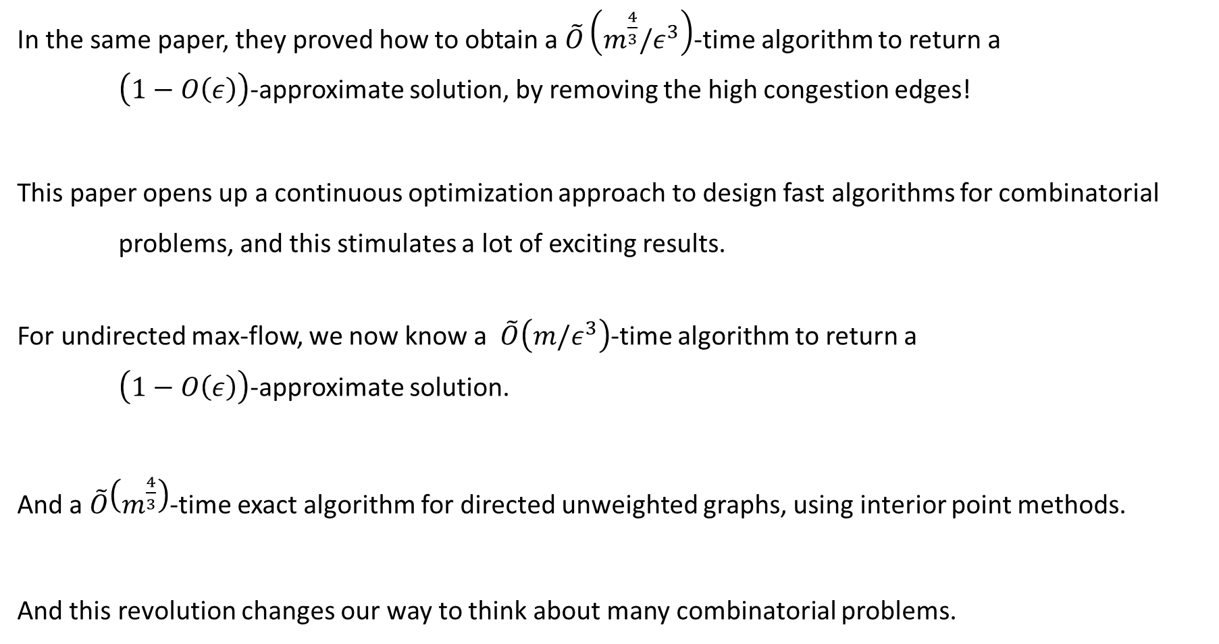
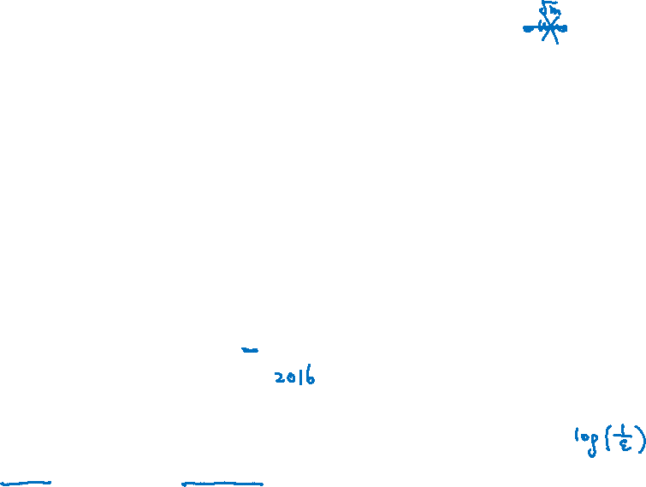
Subsequent Revolution
In the same paper, they proved how to obtain a $\tilde{O}\left(m^{\frac{4}{3}}/ε^{3}\right)$-time algorithm to return a
$\left(1−O\left(ε\right)\right)$-approximate solution, by removing the high congestion edges!
This paper opens up a continuous optimization approach to design fast algorithms for combinatorial
problems, and this stimulates a lot of exciting results.
For undirected max-flow, we now know a $\tilde{O}\left(m/ε^{3}\right)$-time algorithm to return a
$\left(1−O\left(ε\right)\right)$-approximate solution.
And a $\tilde{O}\left(m^{\frac{4}{3}}\right)$-time exact algorithm for directed unweighted graphs, using interior point methods.
And this revolution changes our way to think about many combinatorial problems.

Slide 15
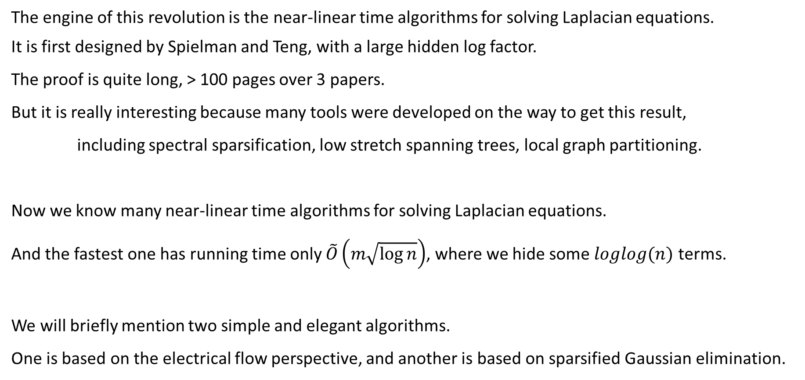
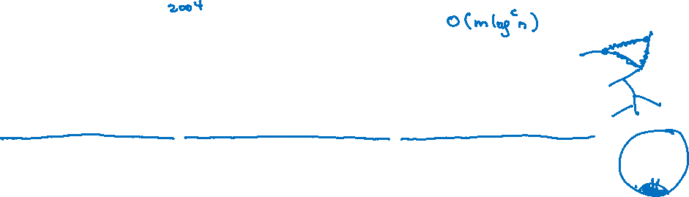
Laplacian Solver
The engine of this revolution is the near-linear time algorithms for solving Laplacian equations.
It is first designed by Spielman and Teng, with a large hidden log factor.
The proof is quite long, > 100 pages over 3 papers.
But it is really interesting because many tools were developed on the way to get this result,
including spectral sparsification, low stretch spanning trees, local graph partitioning.
Now we know many near-linear time algorithms for solving Laplacian equations.
And the fastest one has running time only $\tilde{O}\left(m\sqrt{\log{n}}\right)$, where we hide some $loglog(n)$ terms.
We will briefly mention two simple and elegant algorithms.
One is based on the electrical flow perspective, and another is based on sparsified Gaussian elimination.

Slide 16
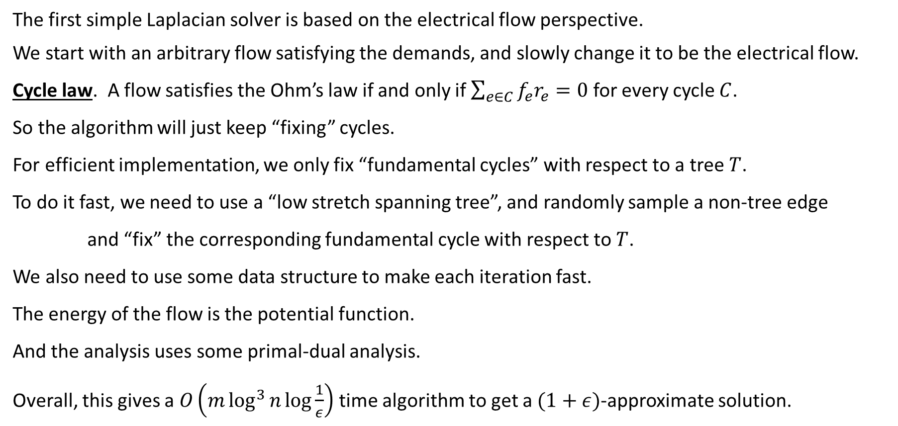
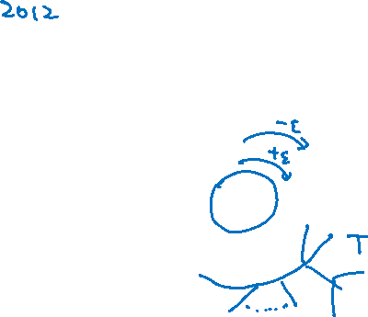
Simple Laplacian Solver 1
The first simple Laplacian solver is based on the electrical flow perspective.
We start with an arbitrary flow satisfying the demands, and slowly change it to be the electrical flow.
Cycle law. A flow satisfies the Ohm’s law if and only if $\sum_{e∈C}{f_{e}r_{e}=0}$ for every cycle $C$.
So the algorithm will just keep “fixing” cycles.
For efficient implementation, we only fix “fundamental cycles” with respect to a tree $T$.
To do it fast, we need to use a “low stretch spanning tree”, and randomly sample a non-tree edge
and “fix” the corresponding fundamental cycle with respect to $T$.
We also need to use some data structure to make each iteration fast.
The energy of the flow is the potential function.
And the analysis uses some primal-dual analysis.
Overall, this gives a $O\left(m\log^{3}{n}\log{\frac{1}{ε}}\right)$ time algorithm to get a $(1+ε)$-approximate solution.

Slide 17
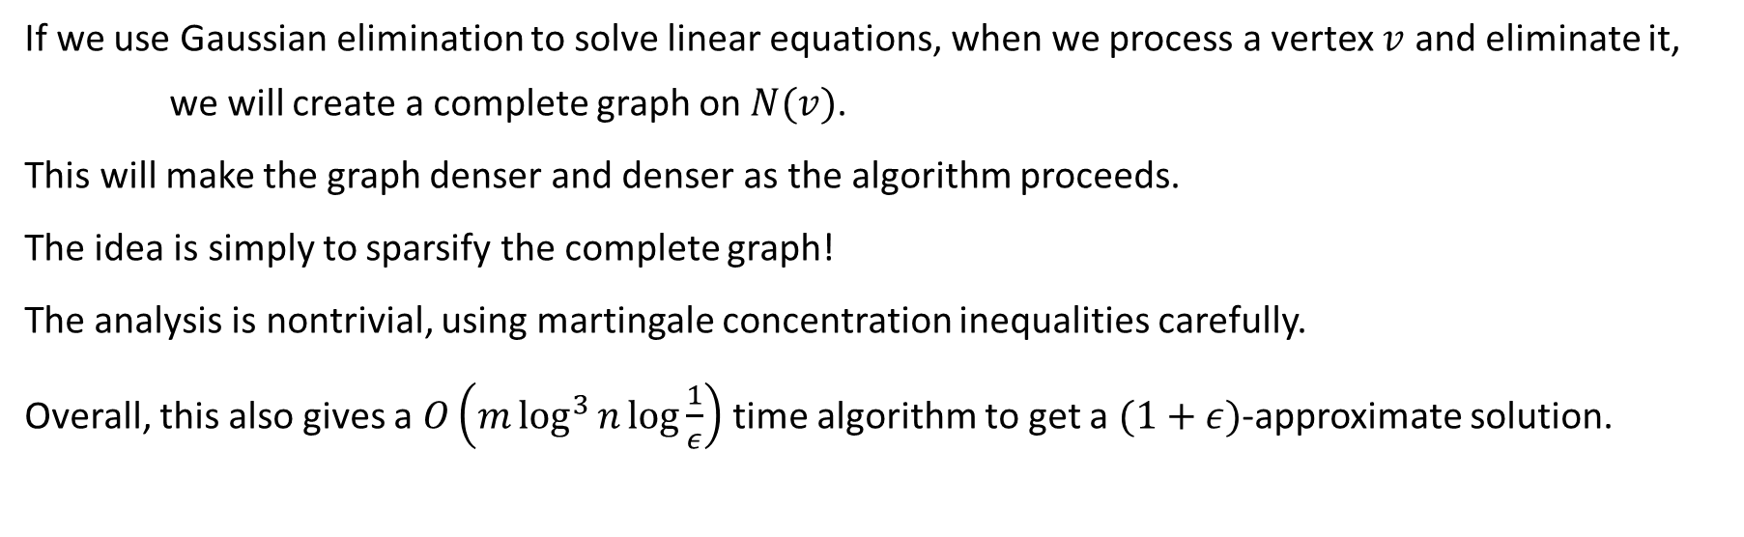
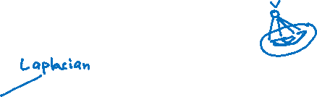
Simple Laplacian Solver 2
If we use Gaussian elimination to solve linear equations, when we process a vertex $v$ and eliminate it,
we will create a complete graph on $N(v)$.
This will make the graph denser and denser as the algorithm proceeds.
The idea is simply to sparsify the complete graph!
The analysis is nontrivial, using martingale concentration inequalities carefully.
Overall, this also gives a $O\left(m\log^{3}{n}\log{\frac{1}{ε}}\right)$ time algorithm to get a $(1+ε)$-approximate solution.

Slide 18

Course Review: Randomized Algorithms
Concentration inequalities, graph sparsification, dimension reduction.
  Martingales, matrix versions
Balls and bins, k-wise independence, hashing, data streaming
  Compressed sensing
Polynomial identity testing, Schwartz-Zippel lemma, parallel matching, distributed network coding
  Interactive proofs, probabilistic checkable proofs (PCP)
Probabilistic methods, local lemma, algorithmic version.
  General local lemma, more algorithmic versions
Random walks, fundamental theorem, mixing time, hitting time, cover time.
  Coupling method, random sampling

Slide 19
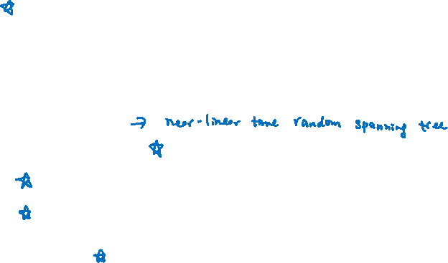
Course Review: Spectral Graph Theory
Basic spectral graph theory, Laplacian matrix, Rayleigh quotient
  Singular values, tensors
Cheeger’s inequality, spectral partitioning algorithm
  Generalizations of Cheeger’s inequality
Mixing time, spectral analysis, random sampling
  High dimensional expanders
Electrical networks, effective resistance, energy, commute time, cover time
  Laplacian solvers
Spectral sparsification, random sampling
  Randomized linear algebra

Slide 20
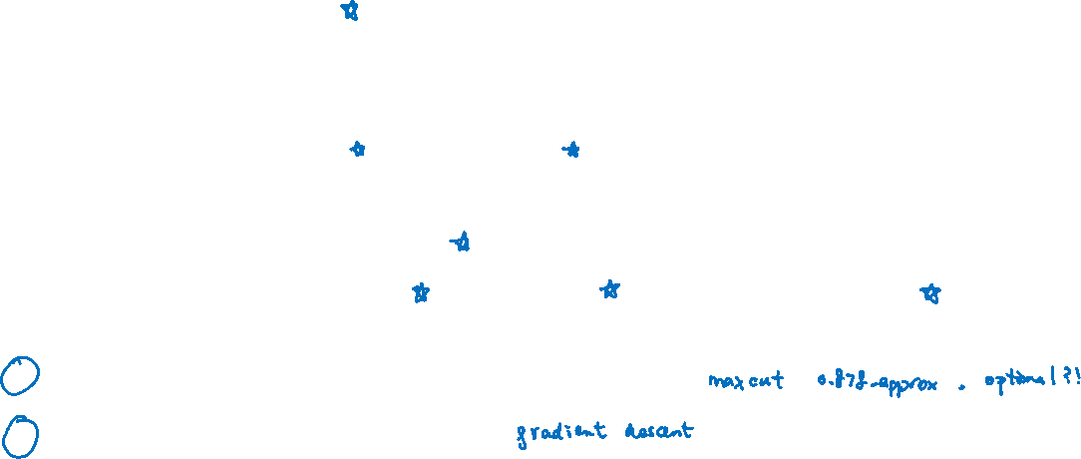
Course Review: Linear Programming
Linear programming, corner points, efficient algorithms
  Interior point methods
Matching polytopes, spanning tree polytopes, approximation algorithms, iterative rounding
  Randomized rounding
Linear programming duality, minimax theorems
  Primal dual algorithms, a new minimax theorem!
Multiplicative weight update method, online expert model
  Online primal dual algorithms, online matching, regret minimization method
Semidefinite programming in approximation algorithms.
Convex optimization in fast algorithms.

Slide 21
Course Outcome
As said before, it is not the specific theorems that are important.
But the ideas and techniques used to design and analyze algorithms.
Have learnt many fundamental and important/breakthrough results in algorithms.
Familiar and comfortable with modern techniques in algorithm design and analysis,
including probability, linear algebra, and continuous optimization.
Be able to apply these ideas in relatively simple new settings.
Gain more knowledge in a specific topic of your choice through the course project.
Open up new ways of thinking and inspire further study and new research ideas!

Slide 22
Feedback
Please do the course survey in evaluate.uwaterloo.ca.
It is particularly important to know what works and what doesn’t in this new online teaching setting.
Tell me what can be done better for online learning, and what are the difficulties that you are facing.
Tell me what you like and what you don’t like about this course.
Do you prefer the course project or you prefer exams?
Give me some suggestions if you have.
Tell me what you wanted to learn but not covered in this course.
Tell me what are the favorite topics in this course.
Thank you! It has been a great term.
Hope to see you in person in future!

