Slide 1
CS 466/666 - Algorithm Design and Analysis
Multiplicative Weight Update Method
Waterloo, 28 July 2020

Slide 2
Today’s Plan
Multiplicative weight update method
Online expert model
Solving linear programs
Please do the course review at evaluate.uwaterloo.ca.
Have sent all feedback for project proposal.
HW5 due Monday.
HW4 solutions posted.

Slide 3
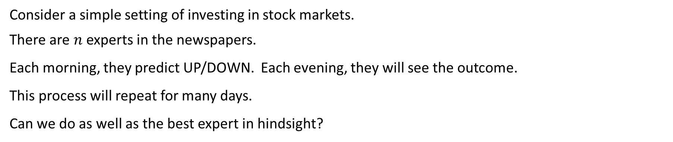
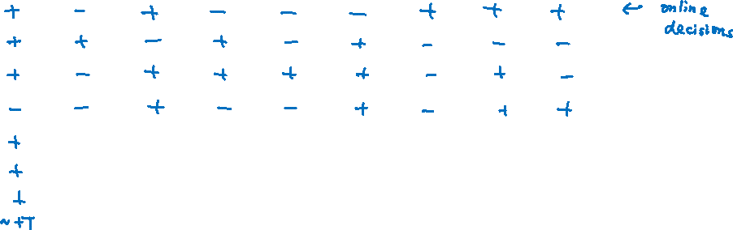
Online Decisions
Consider a simple setting of investing in stock markets.
There are $n$ experts in the newspapers.
Each morning, they predict UP/DOWN. Each evening, they will see the outcome.
This process will repeat for many days.
Can we do as well as the best expert in hindsight?
 | 1 | 2 | 3 |  |  |  |  |  | n
1
2
3
4
T

Slide 4
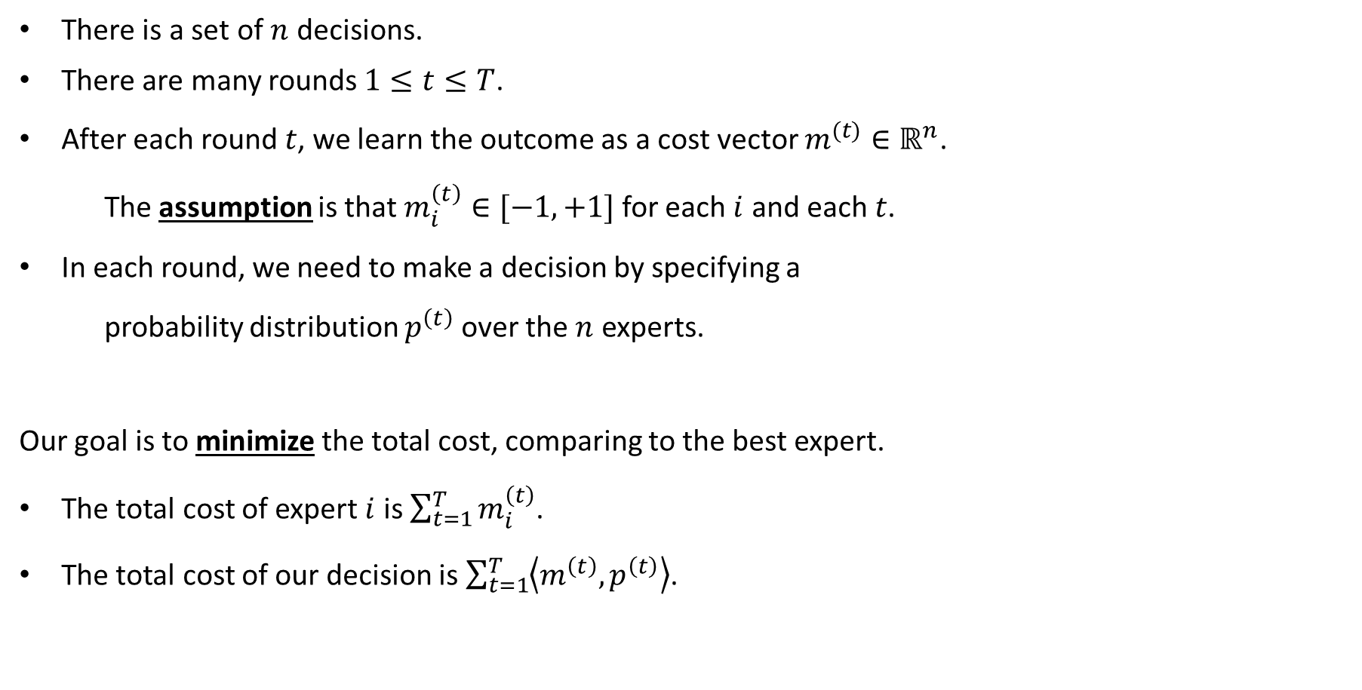
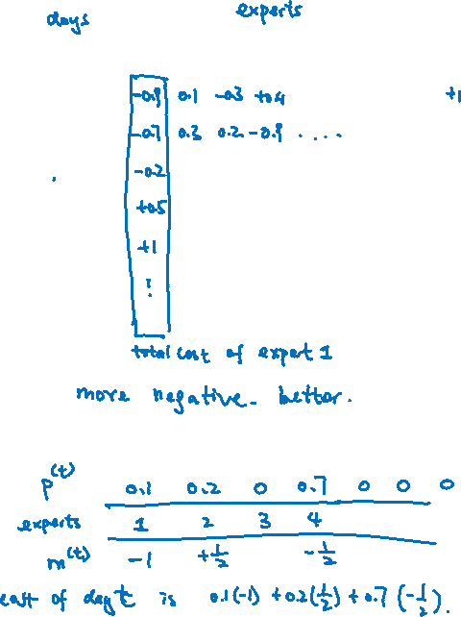
Online Expert Model
There is a set of $n$ decisions.
There are many rounds $1≤t≤T$.
After each round $t$, we learn the outcome as a cost vector $m^{(t)}∈ℝ^{n}$.
The assumption is that $m_{i}^{\left(t\right)}∈[−1,+1]$ for each $i$ and each $t$.
In each round, we need to make a decision by specifying a
probability distribution $p^{\left(t\right)}$ over the $n$ experts.
Our goal is to minimize the total cost, comparing to the best expert.
The total cost of expert $i$ is $\sum_{t=1}^{T}{m_{i}^{\left(t\right)}}$.
The total cost of our decision is $\sum_{t=1}^{T}{\left\langle m^{\left(t\right)},p^{\left(t\right)}\right\rangle }$.
 | 1 | 2 | 3 |  |  |  |  |  | n
1
2
3
4
T

Slide 5

Multiplicative Weight Update Method
We keep a weight $w_{i}^{\left(t\right)}$ on each expert, representing our trust on expert $i$ at time $t$.
Initially, we set $w_{i}^{\left(1\right)}$ for $1≤i≤n$, since we have no information about who is good.
In each round, we observe the outcome and update the weights based on their performance.
  Algorithm
  Fix a parameter $η≤1/2$. Set $w_{i}^{\left(1\right)}=1$ for each $1≤i≤n$.
  For $1≤t≤T$ do
    Let $Φ^{\left(t\right)}=\sum_{i=1}^{n}{w_{i}^{\left(t\right)}}$. Set $p_{i}^{\left(t\right)}=w_{i}^{\left(t\right)}/Φ^{\left(t\right)}$.
    Observe $m^{\left(t\right)}$.
    Update $w_{i}^{\left(t+1\right)}≔\left(1−ηm_{i}^{\left(t\right)}\right){⋅w}_{i}^{\left(t\right)}$.

Slide 6
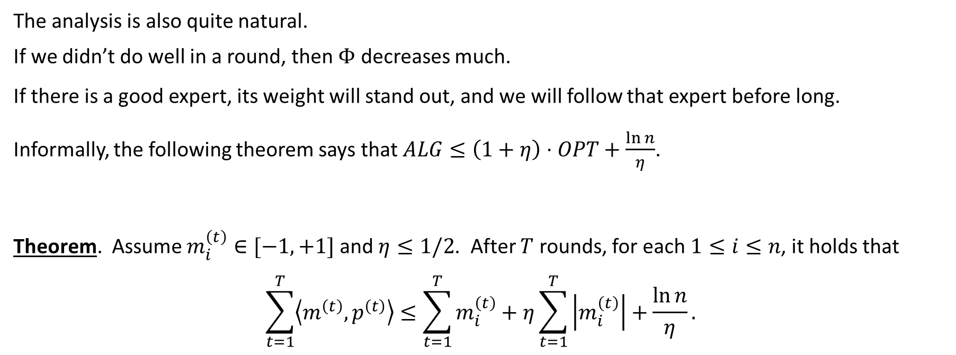
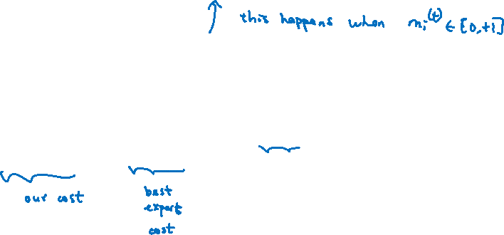
Regret Minimization Theorem
The analysis is also quite natural.
If we didn’t do well in a round, then $Φ$ decreases much.
If there is a good expert, its weight will stand out, and we will follow that expert before long.
Informally, the following theorem says that $ALG≤\left(1+η\right)⋅OPT+\frac{\ln{n}}{η}$.
Theorem. Assume $m_{i}^{\left(t\right)}∈[−1,+1]$ and $η≤1/2$. After $T$ rounds, for each $1≤i≤n$, it holds that
$$\sum_{t=1}^{T}{\left\langle m^{\left(t\right)},p^{\left(t\right)}\right\rangle }≤\sum_{t=1}^{T}{m_{i}^{\left(t\right)}}+η\sum_{t=1}^{T}{\left|m_{i}^{\left(t\right)}\right|}+\frac{\ln{n}}{η}.$$

Slide 7

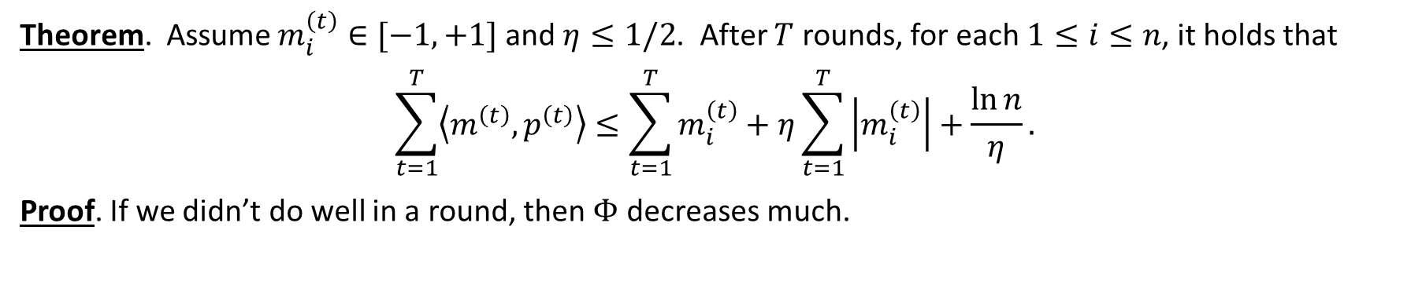
Proof: Upper Bound on $Φ$
Theorem. Assume $m_{i}^{\left(t\right)}∈[−1,+1]$ and $η≤1/2$. After $T$ rounds, for each $1≤i≤n$, it holds that
$$\sum_{t=1}^{T}{\left\langle m^{\left(t\right)},p^{\left(t\right)}\right\rangle }≤\sum_{t=1}^{T}{m_{i}^{\left(t\right)}}+η\sum_{t=1}^{T}{\left|m_{i}^{\left(t\right)}\right|}+\frac{\ln{n}}{η}.$$
Proof. If we didn’t do well in a round, then $Φ$ decreases much.

Slide 8


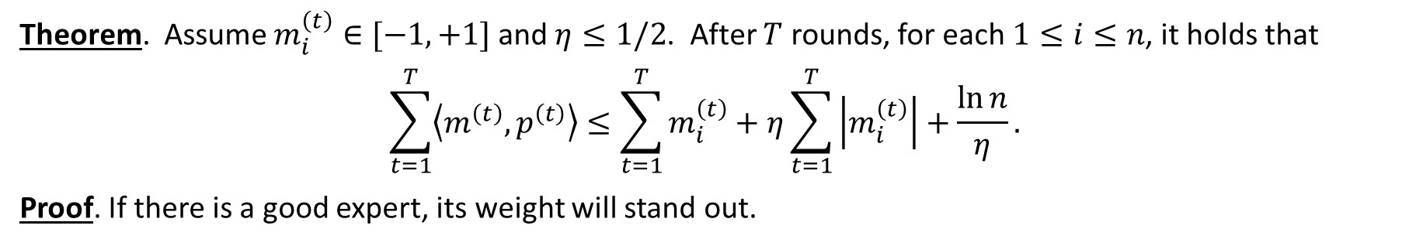
Proof: Lower Bound on $Φ$
Theorem. Assume $m_{i}^{\left(t\right)}∈[−1,+1]$ and $η≤1/2$. After $T$ rounds, for each $1≤i≤n$, it holds that
$$\sum_{t=1}^{T}{\left\langle m^{\left(t\right)},p^{\left(t\right)}\right\rangle }≤\sum_{t=1}^{T}{m_{i}^{\left(t\right)}}+η\sum_{t=1}^{T}{\left|m_{i}^{\left(t\right)}\right|}+\frac{\ln{n}}{η}.$$
Proof. If there is a good expert, its weight will stand out.

Slide 9


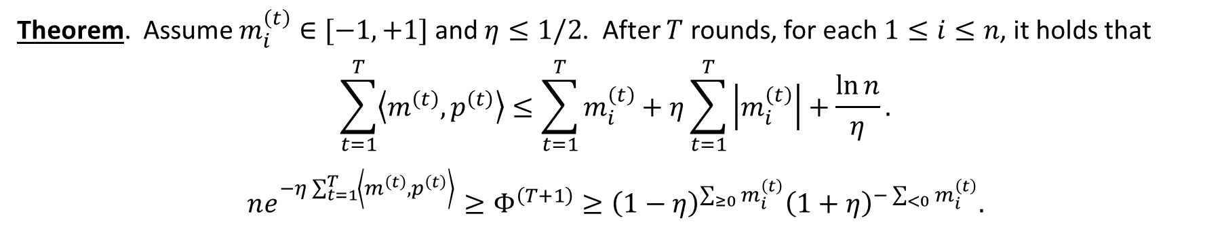


Proof: Combining the Upper and Lower Bounds
Theorem. Assume $m_{i}^{\left(t\right)}∈[−1,+1]$ and $η≤1/2$. After $T$ rounds, for each $1≤i≤n$, it holds that
$$\sum_{t=1}^{T}{\left\langle m^{\left(t\right)},p^{\left(t\right)}\right\rangle }≤\sum_{t=1}^{T}{m_{i}^{\left(t\right)}}+η\sum_{t=1}^{T}{\left|m_{i}^{\left(t\right)}\right|}+\frac{\ln{n}}{η}.$$
$$ne^{−η\sum_{t=1}^{T}{\left\langle m^{\left(t\right)},p^{\left(t\right)}\right\rangle }}≥Φ^{\left(T+1\right)}≥{\left(1−η\right)}^{\sum_{≥0}{m_{i}^{\left(t\right)}}}{\left(1+η\right)}^{−\sum_{<0}{m_{i}^{\left(t\right)}}}.$$
Proof. Combining,

Slide 10
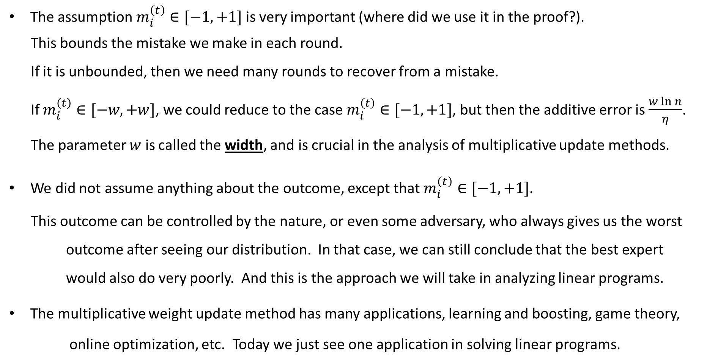
Remarks
The assumption $m_{i}^{\left(t\right)}∈[−1,+1]$ is very important (where did we use it in the proof?).
This bounds the mistake we make in each round.
If it is unbounded, then we need many rounds to recover from a mistake.
If $m_{i}^{\left(t\right)}∈[−w,+w]$, we could reduce to the case $m_{i}^{\left(t\right)}∈[−1,+1]$, but then the additive error is $\frac{w\ln{n}}{η}$.
The parameter $w$ is called the width, and is crucial in the analysis of multiplicative update methods.
We did not assume anything about the outcome, except that $m_{i}^{\left(t\right)}∈[−1,+1]$.
This outcome can be controlled by the nature, or even some adversary, who always gives us the worst outcome after seeing our distribution. In that case, we can still conclude that the best expert
would also do very poorly. And this is the approach we will take in analyzing linear programs.
The multiplicative weight update method has many applications, learning and boosting, game theory,
online optimization, etc. Today we just see one application in solving linear programs.

Slide 11
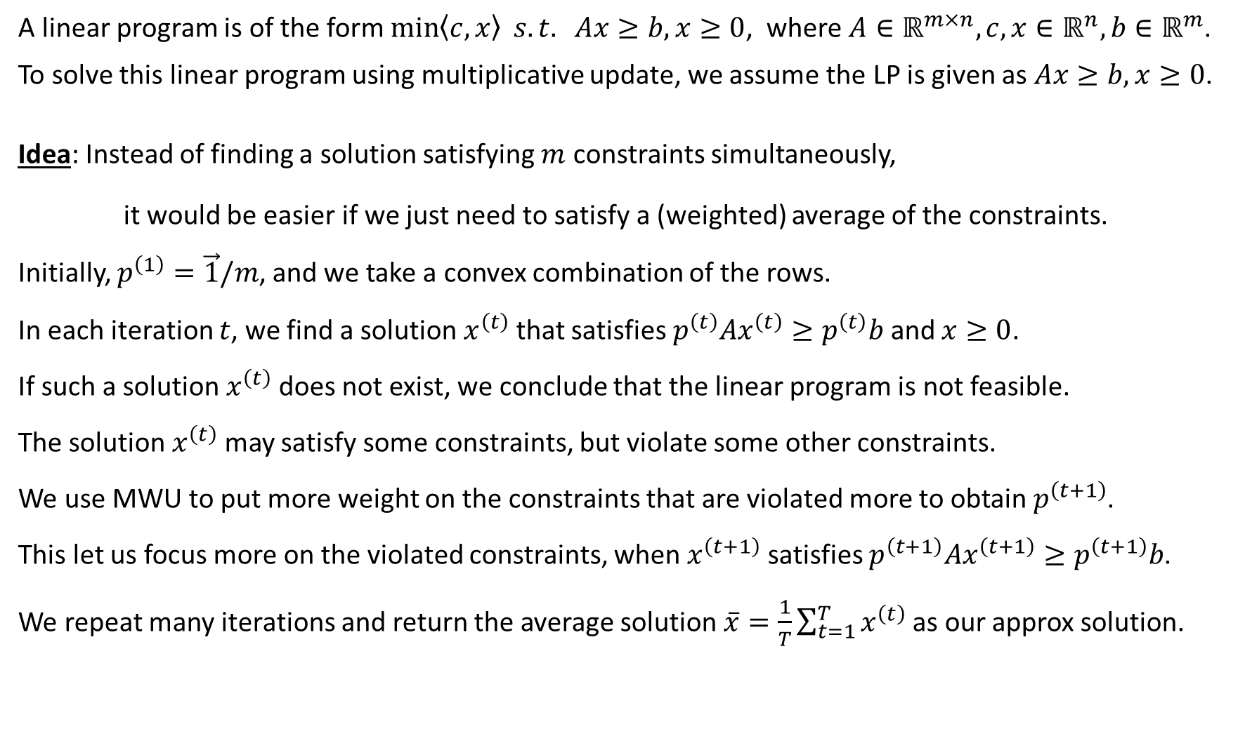
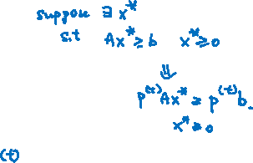
Solving Linear Programs using Multiplicative Update
A linear program is of the form $\min\left\langle c,x\right\rangle s.t. Ax≥b, x≥0$, where $A∈ℝ^{m×n},c,x∈ℝ^{n},b∈ℝ^{m}$.
To solve this linear program using multiplicative update, we assume the LP is given as $Ax≥b, x≥0$.
Idea: Instead of finding a solution satisfying $m$ constraints simultaneously,
it would be easier if we just need to satisfy a (weighted) average of the constraints.
Initially, $p^{\left(1\right)}=\vec{1}/m$, and we take a convex combination of the rows.
In each iteration $t$, we find a solution $x^{\left(t\right)}$ that satisfies $p^{\left(t\right)}Ax^{\left(t\right)}≥p^{\left(t\right)}b$ and $x≥0$.
If such a solution $x^{\left(t\right)}$ does not exist, we conclude that the linear program is not feasible.
The solution $x^{\left(t\right)}$ may satisfy some constraints, but violate some other constraints.
We use MWU to put more weight on the constraints that are violated more to obtain $p^{\left(t+1\right)}$.
This let us focus more on the violated constraints, when $x^{\left(t+1\right)}$ satisfies $p^{\left(t+1\right)}Ax^{\left(t+1\right)}≥p^{\left(t+1\right)}b$.
We repeat many iterations and return the average solution $\overline{x}=\frac{1}{T}\sum_{t=1}^{T}{x^{\left(t\right)}}$as our approx solution.

Slide 12
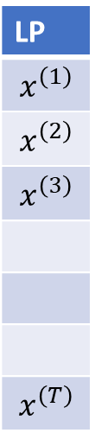
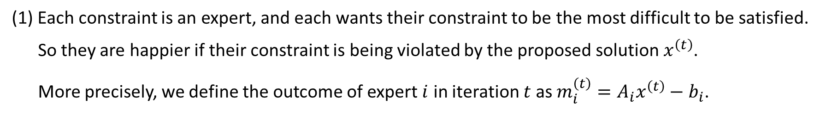
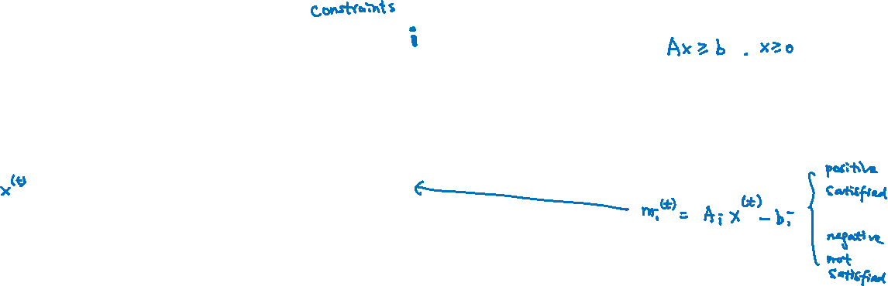
Reduction to the Online Expert Model (1)
The above idea to solve linear programs can be analyzed using the regret minimization theorem.
We can reduce the problem of solving a linear program to the online expert model.
LP
$$x^{\left(1\right)}$$
$$x^{\left(2\right)}$$
$$x^{\left(3\right)}$$
$$x^{\left(T\right)}$$
 | 1 | 2 | 3 |  |  |  |  |  | m
1
2
3
4
T
(1) Each constraint is an expert, and each wants their constraint to be the most difficult to be satisfied.
So they are happier if their constraint is being violated by the proposed solution $x^{\left(t\right)}$.
More precisely, we define the outcome of expert $i$ in iteration $t$ as ${m_{i}^{\left(t\right)}=A}_{i}x^{\left(t\right)}−b_{i}$.

Slide 13

Reduction to the Online Expert Model (2)
LP
$$x^{\left(1\right)}$$
$$x^{\left(2\right)}$$
$$x^{\left(3\right)}$$
$$x^{\left(T\right)}$$
 | 1 | 2 | 3 |  |  |  |  |  | m
1
2
3
4
T
(2) We, the LP solver, would like to propose a solution that satisfy all the constraints (make them unhappy).
It is difficult to find a solution that satisfy all the constraints simultaneously.
It would be much easier to deal with only one constraint (not necessarily an original constraint).

Slide 14
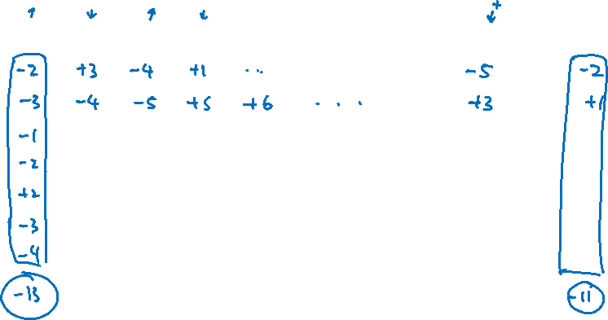
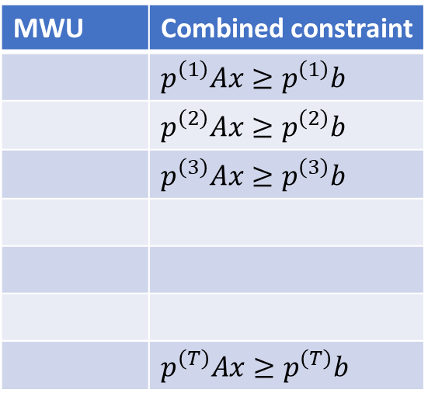
Reduction to the Online Expert Model (3)
LP
$$x^{\left(1\right)}$$
$$x^{\left(2\right)}$$
$$x^{\left(3\right)}$$
$$x^{\left(T\right)}$$
 | 1 | 2 | 3 |  |  |  |  |  | m
1
2
3
4
T
MWU | Combined constraint
 | $p^{\left(1\right)}Ax≥p^{\left(1\right)}b$
 | $p^{\left(2\right)}Ax≥p^{\left(2\right)}b$
 | $p^{\left(3\right)}Ax≥p^{\left(3\right)}b$
 | $p^{\left(T\right)}Ax≥p^{\left(T\right)}b$
(3) The multiplicative update method provides a way to combine the constraints into one.
We know that the “multiplicative expert” is “smart”, as he/she will be almost as happy as the best expert.
So, the total violation of these “multiplicative constraints” will be close to the total violation of the
“happiest constraint” (as it will put higher weights on the happier constraints).

Slide 15
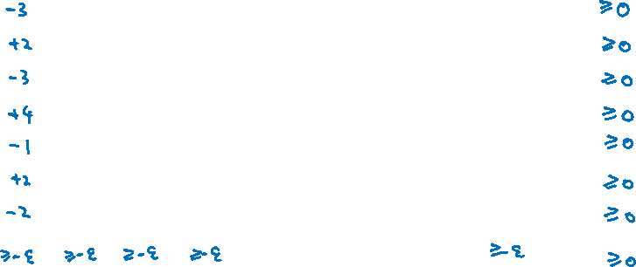
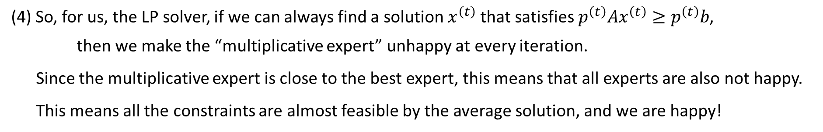
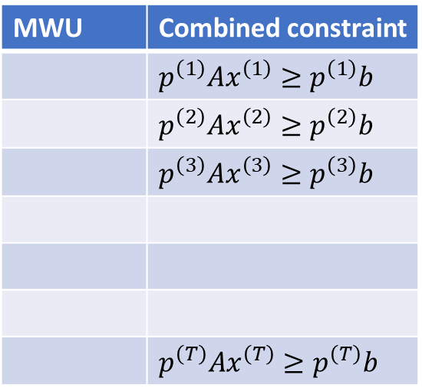
Reduction to the Online Expert Model (4)
LP
$$x^{\left(1\right)}$$
$$x^{\left(2\right)}$$
$$x^{\left(3\right)}$$
$$x^{\left(T\right)}$$
 | 1 | 2 | 3 |  |  |  |  |  | m
1
2
3
4
T
MWU | Combined constraint
 | $p^{\left(1\right)}Ax^{\left(1\right)}≥p^{\left(1\right)}b$
 | $p^{\left(2\right)}Ax^{\left(2\right)}≥p^{\left(2\right)}b$
 | $p^{\left(3\right)}Ax^{\left(3\right)}≥p^{\left(3\right)}b$
 | $p^{\left(T\right)}Ax^{\left(T\right)}≥p^{\left(T\right)}b$
(4) So, for us, the LP solver, if we can always find a solution $x^{\left(t\right)}$ that satisfies $p^{\left(t\right)}Ax^{\left(t\right)}≥p^{\left(t\right)}b$,
then we make the “multiplicative expert” unhappy at every iteration.
Since the multiplicative expert is close to the best expert, this means that all experts are also not happy.
This means all the constraints are almost feasible by the average solution, and we are happy!

Slide 16
Feasibility
How to find a solution satisfying $p^{\left(t\right)}Ax≥p^{\left(t\right)}b$ and $x≥0$?

Slide 17
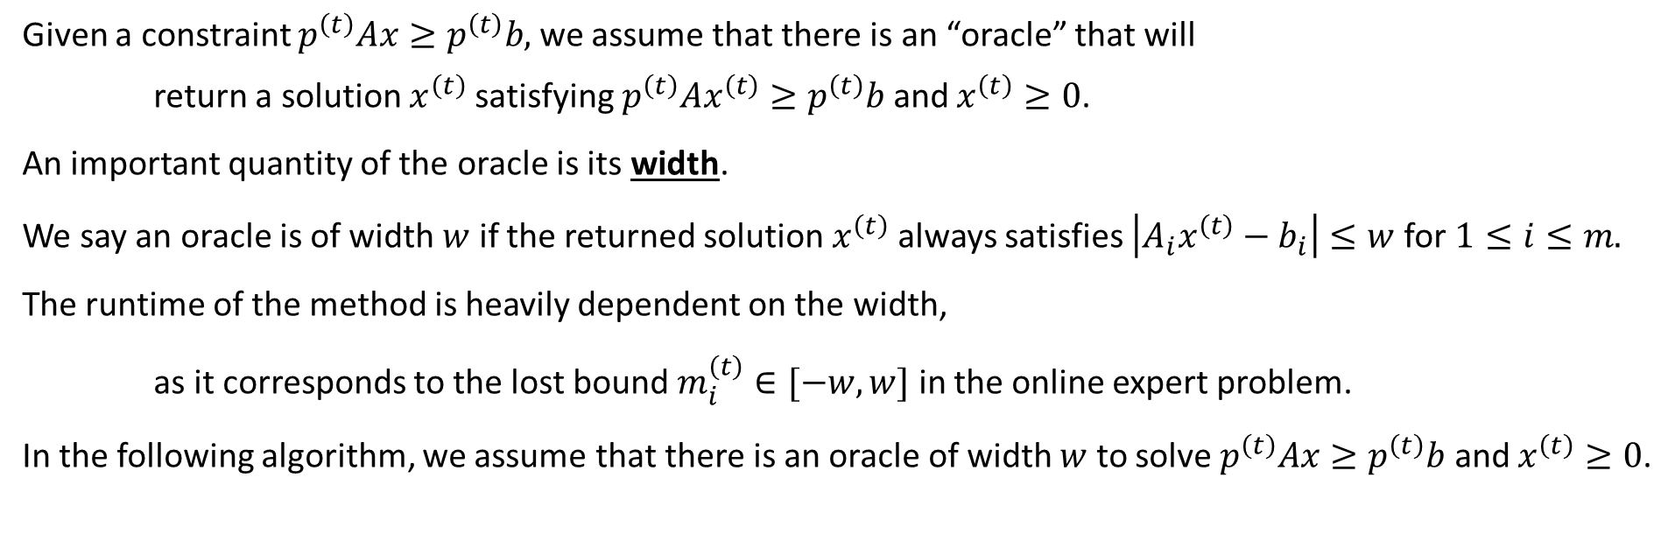
Oracle and Width
Given a constraint $p^{\left(t\right)}Ax≥p^{\left(t\right)}b,$ we assume that there is an “oracle” that will
return a solution $x^{\left(t\right)}$ satisfying $p^{\left(t\right)}Ax^{\left(t\right)}≥p^{\left(t\right)}b$ and $x^{\left(t\right)}≥0$.
An important quantity of the oracle is its width.
We say an oracle is of width $w$ if the returned solution $x^{\left(t\right)}$ always satisfies $\left|A_{i}x^{\left(t\right)}−b_{i}\right|≤w$ for $1≤i≤m.$
The runtime of the method is heavily dependent on the width,
as it corresponds to the lost bound $m_{i}^{\left(t\right)}∈[−w,w]$ in the online expert problem.
In the following algorithm, we assume that there is an oracle of width $w$ to solve $p^{\left(t\right)}Ax≥p^{\left(t\right)}b$ and $x^{\left(t\right)}≥0$.

Slide 18

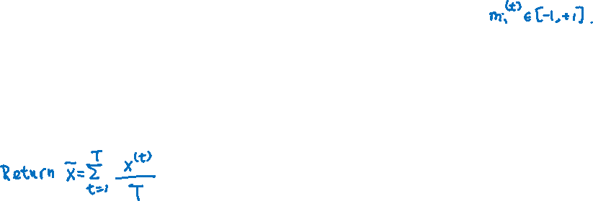
Algorithm
Initially, $p_{i}^{\left(1\right)}=1/m$ for each $1≤i≤m$.
For $1≤t≤T$ do
  Use the oracle to find a solution $x^{\left(t\right)}$ that satisfies $p^{\left(t\right)}Ax^{\left(t\right)}≥p^{\left(t\right)}b$ and $x^{\left(t\right)}≥0$,
    and furthermore $\left|A_{i}x^{\left(t\right)}−b_{i}\right|≤w$ for $1≤i≤m.$
  Set the outcome $m_{i}^{\left(t\right)}≔\frac{A_{i}x^{\left(t\right)}−b_{i}}{w}$ for $1≤i≤m$.
  Use $m_{i}^{\left(t\right)}$to apply the multiplicative weight update method to compute $p^{\left(t+1\right)}$,
    i.e. $w_{i}^{\left(t+1\right)}≔\left(1−ηm_{i}^{\left(t\right)}\right){⋅w}_{i}^{\left(t\right)}$ and $p_{i}^{\left(t+1\right)}=w_{i}^{\left(t+1\right)}/Φ^{\left(t+1\right)}$.

Slide 19
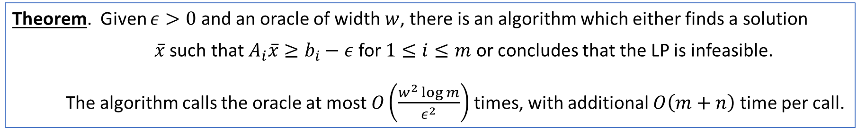
Performance Guarantee
Theorem. Given $ε>0$ and an oracle of width $w$, there is an algorithm which either finds a solution
$\overline{x}$ such that $A_{i}\overline{x}≥b_{i}−ε$ for $1≤i≤m$ or concludes that the LP is infeasible.
The algorithm calls the oracle at most $O\left(\frac{w^{2}\log{m}}{ε^{2}}\right)$ times, with additional $O\left(m+n\right)$ time per call.

Slide 20



Performance Guarantee
Theorem. Given $ε>0$ and an oracle of width $w$, there is an algorithm which either finds a solution
$\overline{x}$ such that $A_{i}\overline{x}≥b_{i}−ε$ for $1≤i≤m$ or concludes that the LP is infeasible.
The algorithm calls the oracle at most $O\left(\frac{w^{2}\log{m}}{ε^{2}}\right)$ times, with additional $O\left(m+n\right)$ time per call.

Slide 21
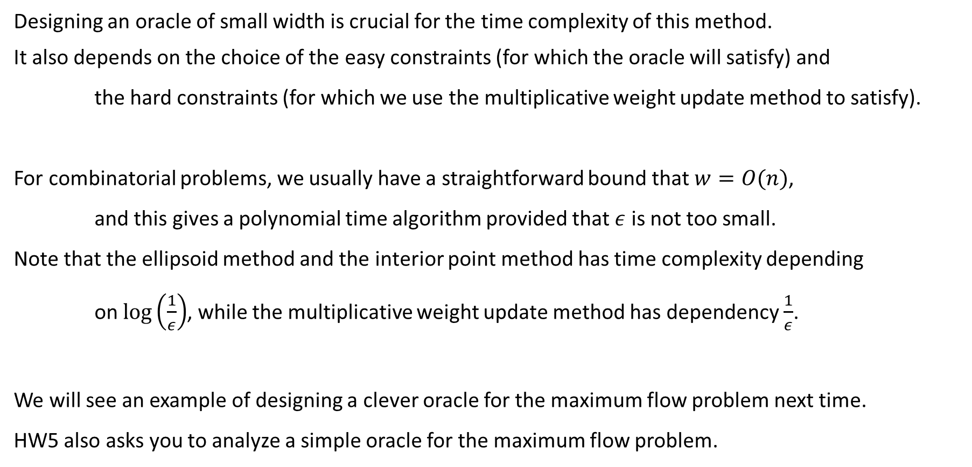
Discussion
Designing an oracle of small width is crucial for the time complexity of this method.
It also depends on the choice of the easy constraints (for which the oracle will satisfy) and
the hard constraints (for which we use the multiplicative weight update method to satisfy).
For combinatorial problems, we usually have a straightforward bound that $w=O(n)$,
and this gives a polynomial time algorithm provided that $ε$ is not too small.
Note that the ellipsoid method and the interior point method has time complexity depending
on $\log\left(\frac{1}{ε}\right)$, while the multiplicative weight update method has dependency $\frac{1}{ε}$.
We will see an example of designing a clever oracle for the maximum flow problem next time.
HW5 also asks you to analyze a simple oracle for the maximum flow problem.

