Slide 1
CS 466/666 - Algorithm Design and Analysis
Linear Programming Duality
Waterloo, 23 July 2020

Slide 2
Today’s Plan
Linear programming duality
Weak duality, complementary slackness
Separation theorem
Farkas lemma, strong duality
Min-max theorems in combinatorial optimization
Minimax theorems in game theory
Have sent all feedback for project proposal?
HW5 posted.
HW4 solutions to be posted next Monday.

Slide 3
Upper Bounding Objective Value
$$\max{2x_{1}+3x_{2}}$$
$$4x_{1}+8x_{2}≤12$$
$$2x_{1}+x_{2}≤3$$
$$3x_{1}+{2x}_{2}≤6$$
$$x_{1},x_{2}≥0.$$
It is a maximization problem. It is easy to show a lower bound on the objective value.
But how to show an upper bound on the objective value?

Slide 4
Upper Bounding Objective Value
$$\max{ \left\langle c,x\right\rangle }$$
$$\left\langle a_{1},x\right\rangle ≤b_{1}$$
$$…$$
$$\left\langle a_{m},x\right\rangle ≤b_{m}$$
$$x≥0.$$
We can extend the argument to give an upper bound on the objective value of a maximization problem.

Slide 5
Weak Duality Theorem
$$\max{ \left\langle c,x\right\rangle }$$
$$Ax≤b$$
$$x≥0.$$
(Primal LP)
$$\max{ \left\langle c,x\right\rangle }$$
$$\left\langle a_{1},x\right\rangle ≤b_{1}$$
$$…$$
$$\left\langle a_{m},x\right\rangle ≤b_{m}$$
$$x≥0.$$
$$\min{ \left\langle b,y\right\rangle }$$
$$\sum_{i=1}^{m}{y_{i}a_{i}}≥c$$
$$y≥0.$$
$$\min{ \left\langle b,y\right\rangle }$$
$$y^{T}A≥c$$
$$y≥0.$$
(Dual LP)
How to find the best upper bound? This is itself a linear programming problem!
The leftmost is called the primal LP in matrix form, and the rightmost is called the dual LP in matrix form.
From the previous discussions, it should be clear that we have the following weak duality theorem.
Theorem. For any feasible $x$ in primal and any feasible $y$ in dual, it holds that $\left\langle c,x\right\rangle ≤\left\langle b,y\right\rangle .$

Slide 6
Complementary Slackness Conditions
How to prove that a primal feasible solution $x$ is an optimal solution?
One way is to give a dual feasible solution $y$ and show that $\left\langle c,x\right\rangle =\left\langle b,y\right\rangle .$
Then $x$ is a primal optimal solution and $y$ is a dual optimal solution.
When will $\left\langle c,x\right\rangle =\left\langle b,y\right\rangle$?
In fact, these are necessary and sufficient conditions for $x,y$ to be optimal.
Complementary slackness conditions. Let $x$ be a primal feasible solution and $y$ be a dual feasible solution.
Then $x$ and $y$ are optimal if and only if
Primal conditions: If $x_{j}>0$, then $\left\langle a^{j},x\right\rangle =c_{j}$, where $a^{j}$ is the $j$-th column of $A$.
Dual conditions: If $y_{i}>0$, then $\left\langle a_{i},y\right\rangle =b_{i}$, where $a_{i}$ is the $i$-th row of $A$.

Slide 7
Primal-Dual Algorithms
These are algorithms that try to satisfy the complementary slackness conditions directly,
without solving the linear program.
A classical example is the Hungarian algorithm for finding a minimum weight perfect matching
in a bipartite graph.
There are also “approximate” complementary slackness conditions, which are used for
the design of approximation algorithms.
Some well-known examples are for facility location problems and network design problems.
See Williamsons-Shmoys.
There is a framework called online primal-dual algorithms that is very interesting and very useful
in designing online competitive algorithms that unfortunately we won’t cover at all.

Slide 8
Strong Duality Theorem
We have derived necessary and sufficient conditions for a primal-dual pair to be optimal.
But we have not proved that such an optimal primal-dual pair must exist.
This is the content of the strong duality theorem, which says that the dual program always
provides a tight upper bound on the primal program.
There are different ways to prove the strong duality theorem for LP.
One way is to use the simplex method, which is elementary but not as insightful.
Instead, we will see a general approach for convex programming duality.
This is more insightful but we need to assume some basic results in analysis.

Slide 9
Separation Theorem
All the duality theorems for convex programs follow from an intuitive result for convex geometry.
Definition. A set $S$ is convex if $x,y∈S,$ then $αx+\left(1−α\right)y∈S$ for any $α∈[0,1]$.
Definition. A set $S$ is closed if every limit point of $S$ is in $S$.
Separation theorem. Let $S⊆ℝ^{n}$ be a closed convex set. Let $v∉S$.
Then there exists $w∈ℝ^{n}$ such that $\left\langle w,v\right\rangle >\left\langle w,x\right\rangle$ for all $x∈S$.

Slide 10
Proof Sketch
Separation theorem. Let $S⊆ℝ^{n}$ be a closed convex set. Let $v∉S$.
Then there exists $w∈ℝ^{n}$ such that $\left\langle w,v\right\rangle >\left\langle w,x\right\rangle$ for all $x∈S$.
Lemma. There is a unique point $x^{∗}∈S$ that is closest to $v$.
Lemma. $x^{∗}$ is the minimizer if and only if $\left\langle x−x^{∗},v−x^{∗}\right\rangle ≤0$ for all $x∈S$.
Proof.

Slide 11
Farkas Lemma
Farkas lemma tells us exactly when a set of linear inequalities has no feasible solutions.
Farkas Lemma. The system $Ax=b, x≥0$ has no solutions if and only if
there exists $y$ such that $y^{T}A≥0$ and $y^{T}b<0$.
This is often called a theorem of alternatives, in either case there is a short proof (or easy certificate).

Slide 12
Strong Duality for Linear Programming
Strongly LP duality theorem. If the primal and the dual are feasible,
then they have the same objective value.
Proof.
$$\max{ \left\langle c,x\right\rangle }$$
$$Ax=b$$
$$x≥0.$$
$$\min{ \left\langle b,y\right\rangle }$$
$$y^{T}A≥c$$

Slide 13
Strong Duality for Linear Programming
Strongly LP duality theorem. If the primal and the dual are feasible,
then they have the same objective value.

Slide 14
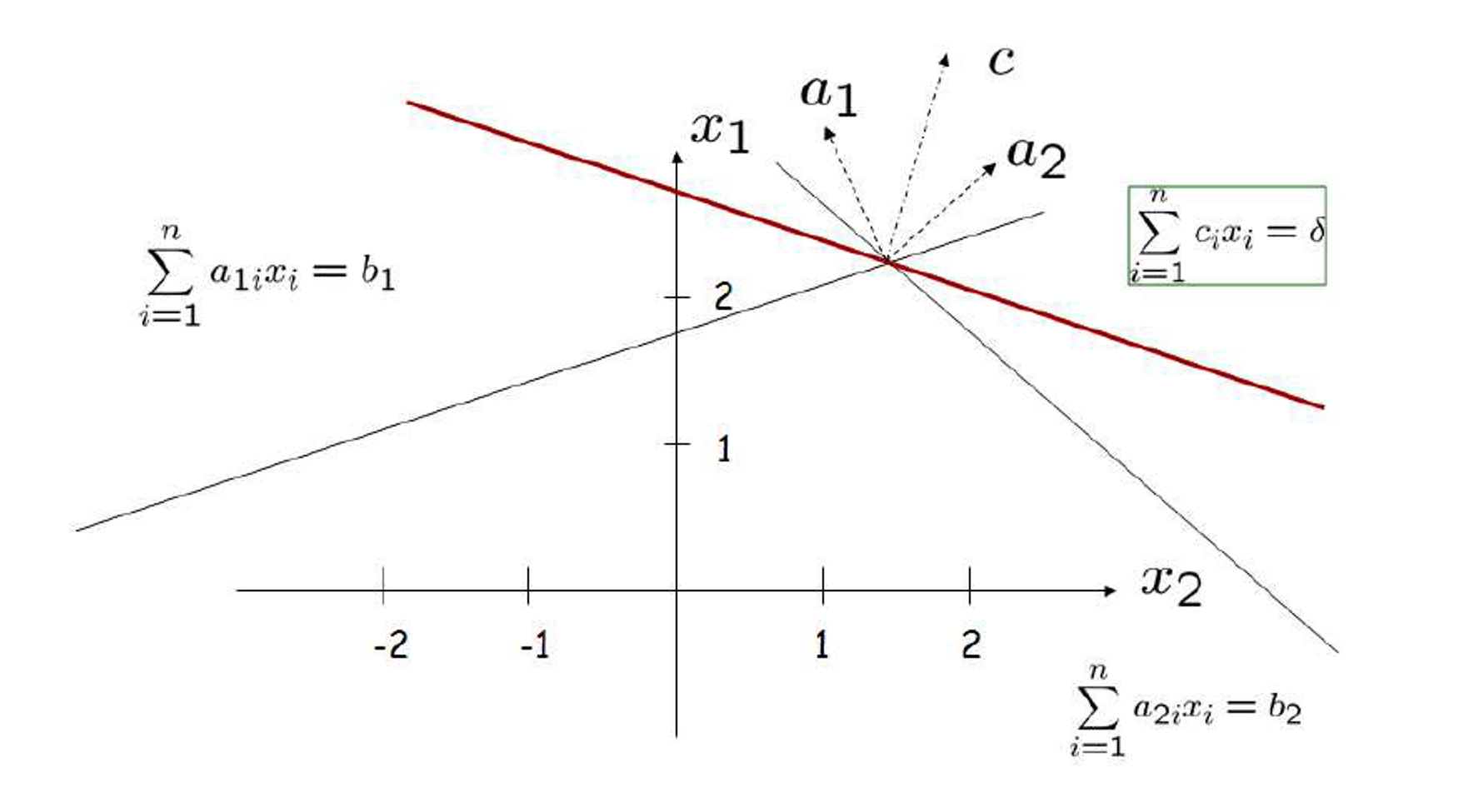
Geometric Interpretation
If $x$ is an optimal solution in the direction $c$, then the objective function should be in the cone
of the tight constraints, i.e. $∃y≥0$and $y^{T}A=c$.
Otherwise, we could find an improved solution in the direction of $c$, and thus $x$ is not optimal.

Slide 15
Min-Max Theorems in Combinatorial Optimization
They are some of the most beautiful results in combinatorial optimization.
The following are two well-known examples.
Max-bipartite-matching min-vertex-cover
For any bipartite graph, the size of a maximum matching is equal to the size of a minimum vertex cover.
Note that Hall’s theorem can be derived from this.
Max-flow min-cut theorem
For any directed graph and any two vertices $s,t$, the maximum value of an $s$-$t$ flow
is equal to the minimum value of an $s$-$t$ cut.
They both can be derived routinely from strong LP-duality.

Slide 16
Max-Bipartite-Matching Min-Vertex-Cover
Note that any integral solution for the dual corresponds to a vertex cover.
In HW5, you are asked to prove that the dual is integral.
So the min-max theorem follows from strong LP duality.
$$\max{\sum_{e∈E}{x_{e}}}$$
$$x\left(δ\left(v\right)\right)≤1$$
$$x_{e}≥0$$
$$\min{\sum_{v∈V}{y_{v}}}$$
$$y_{u}+y_{v}≥1$$
$$x_{v}≥0$$
$$∀v∈V$$
$$∀e∈E$$
$$∀e∈E$$
$$∀v∈V$$

Slide 17
Max-Flow Min-Cut Theorem
Note that any integral solution for the dual corresponds to an $s$-$t$ cut.
It can be proved that both the primal and the dual programs are integral.
So the min-max theorem follows from strong LP duality.
$$\max{f_{ts}}$$
$$f\left(δ^{in}\left(v\right)\right)−f\left(δ^{in}\left(v\right)\right)≤0$$
$$f_{e}≤1$$
$$f_{e}≥0$$
$$\min{\sum_{e∈E}{d_{e}}}$$
$$d_{uv}+y_{u}−y_{v}≥0$$
$$y_{s}−y_{t}≥1$$
$$y_{v}≥0$$
$$∀v∈V$$
$$∀uv∈E$$
$$∀e∈E$$
$$∀e∈E$$
$$∀v∈V$$

Slide 18
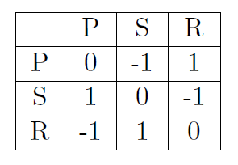
Two-Player Zero-Sum Game
A two-player zero-sum game can be described by a matrix, where each row corresponds to a strategy
of the row player, and each column corresponds to a strategy of the column player.
If the row player chooses strategy $i$ and the column player chooses strategy $j,$
then their payoff is the $(i,j)$-th entry of the matrix.
The row player’s goal is to maximize the payoff,
while the column player’s goal is to minimize the payoff.
A Nash equilibrium is a pair of strategies such that even if a player knows the strategy of the other player,
he/she cannot gain by changing his/her strategy.

Slide 19
Minimax Theorem in Game Theory
We now show that any two-player zero-sum game has a mixed strategy equilibrium solution.
Let $A∈ℝ^{m×n}$ be the payoff matrix.
Let $x∈ℝ^{m}$ be a probability distribution of the row player. We denote $x∈Δ^{m}$.
Let $y∈ℝ^{m}$ be a probability distribution of the column player. We denote $y∈Δ^{n}$.
If row player plays $x$ and column player plays $y$, the payoff is simply $x^{T}Ay.$
The minimax theorem says that if both players play optimally, then it doesn’t matter who announces
their mixed strategy first, and thus they form an equilibrium solution.
Von-Neumann Minimax Theorem. $\max_{x∈Δ^{m}}{\min_{y∈Δ^{n}}{x^{T}Ay}}=\min_{y∈Δ^{n}}{\max_{x∈Δ^{m}}{x^{T}Ay}}$

Slide 20
Proof of Minimax Theorem
Von-Neumann Minimax Theorem. $\max_{x∈Δ^{m}}{\min_{y∈Δ^{n}}{x^{T}Ay}}=\min_{y∈Δ^{n}}{\max_{x∈Δ^{m}}{x^{T}Ay}}$

Slide 21
Yao’s Minimax Principle
Yao observed that the minimax principle can be used to prove lower bound on randomized algorithms.
The worst case running time of a randomized algorithm is its expected running time on its worst input.
Suppose we want to prove a lower bound on the time complexity of any randomized algorithm.
Note that a randomized algorithm can be thought of as a distribution of deterministic algorithm.
Think of it as a two-player zero-sum game where the algorithm player plays the best distribution of
deterministic algorithms to minimize the running time, while the adversary player plays
the best distribution of inputs to maximize the running time.

Slide 22
Yao’s Minimax Principle
The complexity that we are interested in analyzing is $\min_{r∈Δ^{n}}{\max_{i∈Δ^{m}}{i^{T}Ar}}.$
The minimax theorem tells us that it is equal to $\max_{i∈Δ^{m}}{\min_{r∈Δ^{n}}{i^{T}Ar}}$.
So, to prove a lower bound, it is enough to come up with a distribution of input, and prove that
any deterministic algorithm would take a long time to solve the problem.
This is usually much easier to argue about a (single) deterministic algorithm,
and so the minimax theorem is widely used in proving lower bounds.
Read a new minimax theorem for randomized algorithm by Ben-David and Blais:
https://arxiv.org/abs/2002.10802

Slide 23
Tolls for Multicommodity Flow
Suppose there is a traffic network.
There are $n$ users in the network, where user $i$ wants to send $d_{i}$ units of data from $s_{i}$ to $t_{i}$.
If we let the users to choose their own paths to send their information, they may all send along
the shortest paths, but this may cause high congestions on some edges.
Instead of directly controlling their behaviors, what we could do is to give prices on each edge,
and charge the users on the edges they used, and the hope is that it is possible to do it
in a way to avoid congestion, and thus to achieve a better social welfare.
This may seem like a really difficult problem to solve.
But it turns out that if we write an LP to find a global optimal solution to minimize congestions,
and then we look at the dual LP, the prices are just the dual variables on the edges!

