Slide 1
CS 466/666 - Algorithm Design and Analysis
Spanning Tree Polytopes
Waterloo, 21 July 2020

Slide 2
Today’s Plan
Spanning Tree Polytopes
Laminar basis
Uncrossing technique
Minimum bounded degree spanning tree
Have sent all feedback for project proposal?
HW5 posted.
HW4 solutions to be posted next Monday.

Slide 3

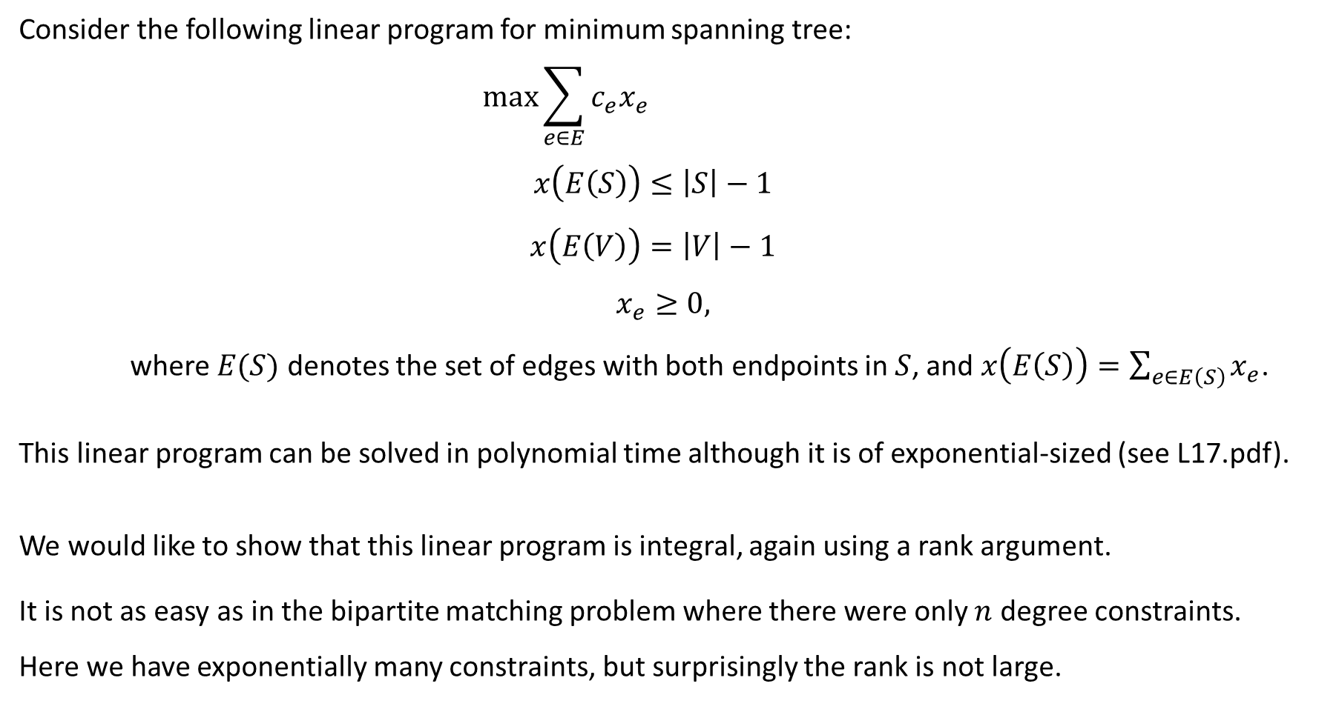
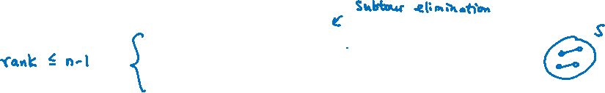
Linear Program for Spanning Trees
Consider the following linear program for minimum spanning tree:
$$\max{\sum_{e∈E}{c_{e}x_{e}}}$$
$$x\left(E\left(S\right)\right)≤\left|S\right|−1$$
$$x\left(E\left(V\right)\right)=\left|V\right|−1$$
$$x_{e}≥0,$$
where $E(S)$ denotes the set of edges with both endpoints in $S$, and $x\left(E\left(S\right)\right)=\sum_{e∈E\left(S\right)}{x_{e}}$.
This linear program can be solved in polynomial time although it is of exponential-sized (see L17.pdf).
We would like to show that this linear program is integral, again using a rank argument.
It is not as easy as in the bipartite matching problem where there were only $n$ degree constraints.
Here we have exponentially many constraints, but surprisingly the rank is not large.
$$∀S⊂V$$

Slide 4

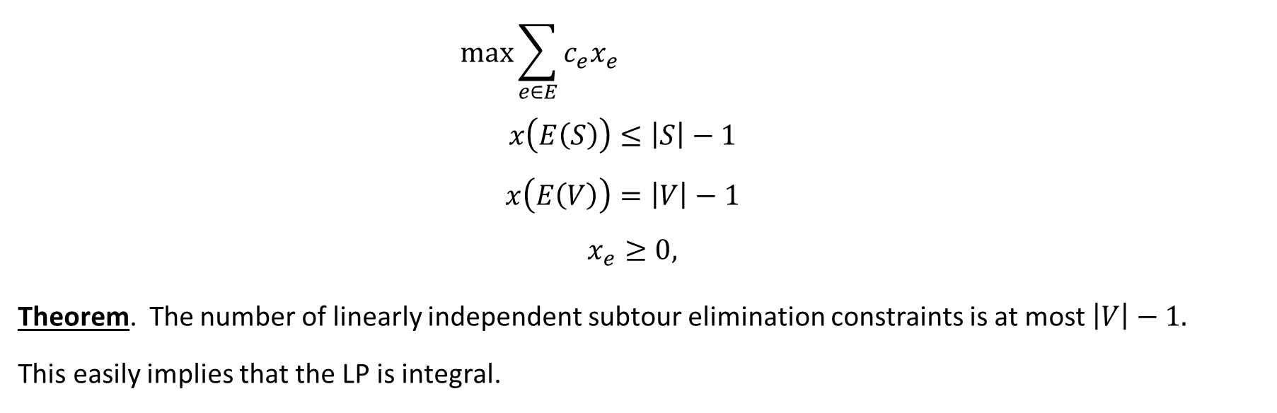

Rank Argument
$$\max{\sum_{e∈E}{c_{e}x_{e}}}$$
$$x\left(E\left(S\right)\right)≤\left|S\right|−1$$
$$x\left(E\left(V\right)\right)=\left|V\right|−1$$
$$x_{e}≥0,$$
Theorem. The number of linearly independent subtour elimination constraints is at most $\left|V\right|−1.$
This easily implies that the LP is integral.
$$∀S⊂V$$

Slide 5
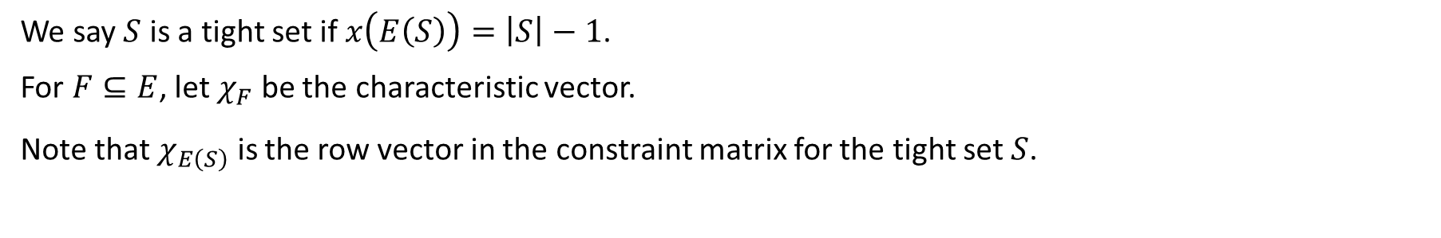

Basis of Tight Constraints
We say $S$ is a tight set if $x\left(E\left(S\right)\right)=\left|S\right|−1$.
For $F⊆E$, let $χ_{F}$ be the characteristic vector.
Note that $χ_{E\left(S\right)}$ is the row vector in the constraint matrix for the tight set $S$.

Slide 6
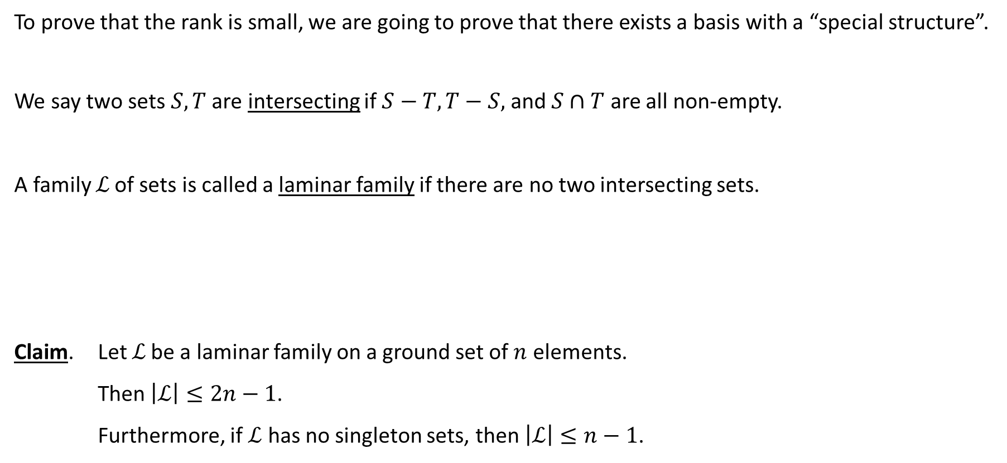
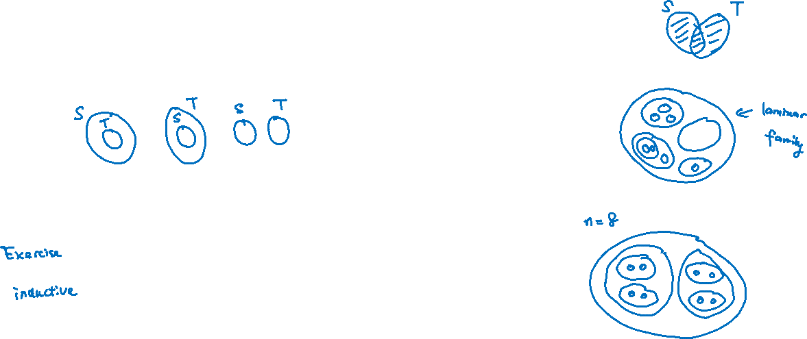
Laminar Family
To prove that the rank is small, we are going to prove that there exists a basis with a “special structure”.
We say two sets $S,T$ are intersecting if $S−T, T−S,$ and $S∩T$ are all non-empty.
A family ℒ of sets is called a laminar family if there are no two intersecting sets.
Claim. Let ℒ be a laminar family on a ground set of $n$ elements.
Then $\left|ℒ\right|≤2n−1$.
Furthermore, if $ℒ$ has no singleton sets, then $\left|ℒ\right|≤n−1$.

Slide 7
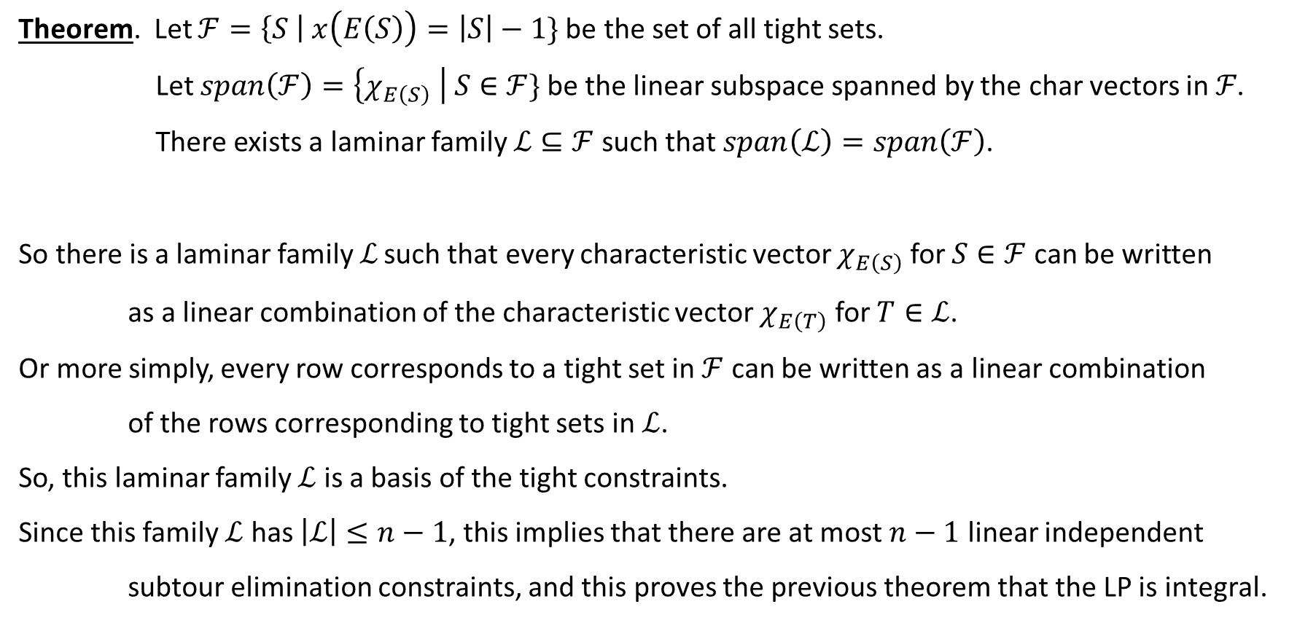


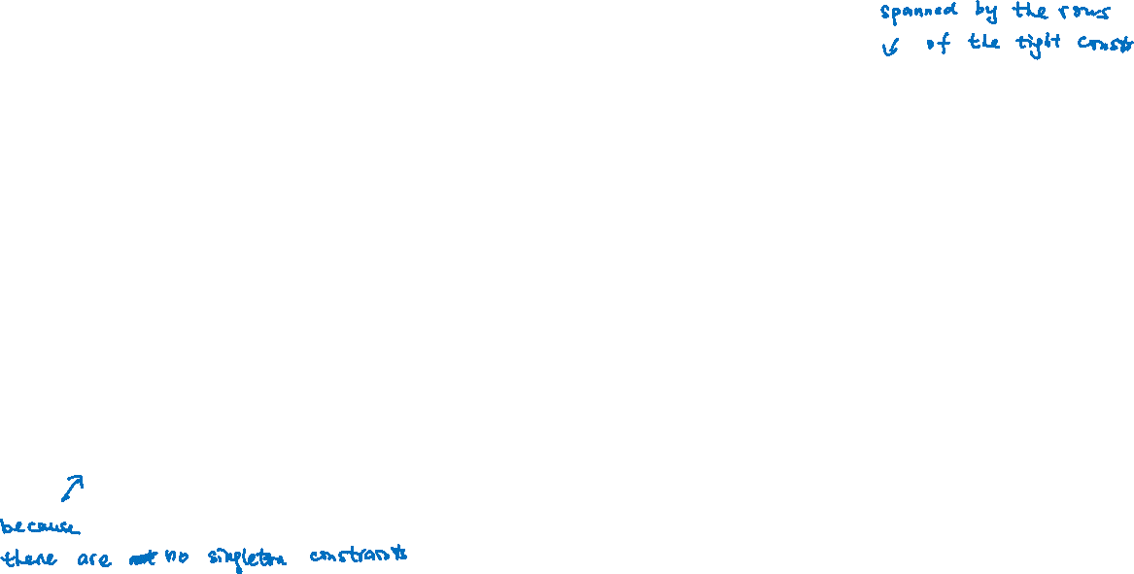
Laminar Basis
Theorem. Let $ℱ=\left\{S \right| x\left(E\left(S\right)\right)=\left|S\right|−1\}$be the set of all tight sets.
Let $span\left(ℱ\right)=\left\{χ_{E\left(S\right)} \right| S∈ℱ\}$be the linear subspace spanned by the char vectors in ℱ.
There exists a laminar family $ℒ⊆ℱ$ such that$span\left(ℒ\right)=span\left(ℱ\right)$.
So there is a laminar family ℒ such that every characteristic vector $χ_{E\left(S\right)}$ for $S∈ℱ$ can be written
as a linear combination of the characteristic vector $χ_{E\left(T\right)}$ for $T∈ℒ$.
Or more simply, every row corresponds to a tight set in $ℱ$ can be written as a linear combination
of the rows corresponding to tight sets in $ℒ$.
So, this laminar family $ℒ$ is a basis of the tight constraints.
Since this family $ℒ$ has $\left|ℒ\right|≤n−1$, this implies that there are at most $n−1$ linear independent
subtour elimination constraints, and this proves the previous theorem that the LP is integral.

Slide 8

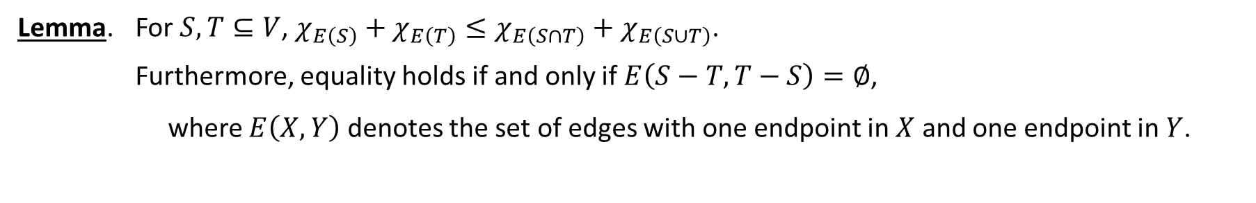
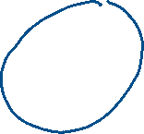


Graph Structure
Lemma. For $S,T⊆V$, $χ_{E\left(S\right)}+χ_{E\left(T\right)}≤χ_{E\left(S∩T\right)}+χ_{E\left(S∪T\right)}$.
Furthermore, equality holds if and only if $E\left(S−T,T−S\right)=∅$,
where $E\left(X,Y\right)$ denotes the set of edges with one endpoint in $X$ and one endpoint in $Y$.

Slide 9


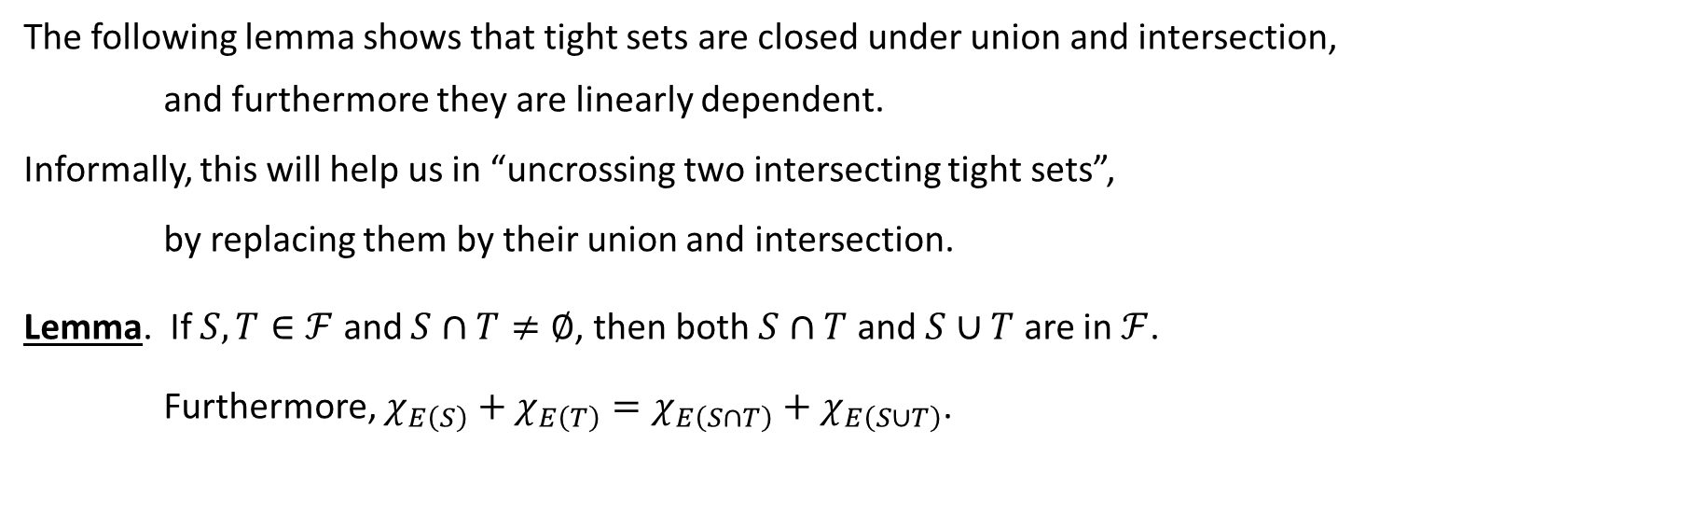





Uncrossing Technique
The following lemma shows that tight sets are closed under union and intersection,
and furthermore they are linearly dependent.
Informally, this will help us in “uncrossing two intersecting tight sets”,
by replacing them by their union and intersection.
Lemma. If $S,T∈ℱ$ and $S∩T≠∅$, then both $S∩T$ and $S∪T$ are in $ℱ$.
Furthermore, $χ_{E\left(S\right)}+χ_{E\left(T\right)}=χ_{E\left(S∩T\right)}+χ_{E\left(S∪T\right)}$.

Slide 10


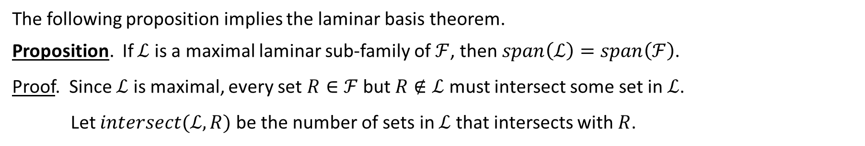



Maximal Laminar Subfamily
The following proposition implies the laminar basis theorem.
Proposition. If $ℒ$ is a maximal laminar sub-family of $ℱ$, then $span\left(ℒ\right)=span\left(ℱ\right)$.
Proof. Since $ℒ$ is maximal, every set $R∈ℱ$ but $R∉ℒ$ must intersect some set in $ℒ$.
Let $intersect(ℒ,R)$ be the number of sets in $ℒ$ that intersects with $R$.

Slide 11
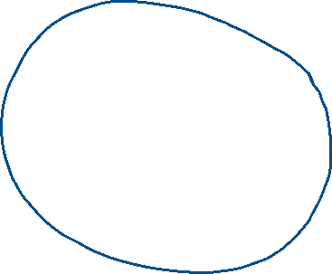

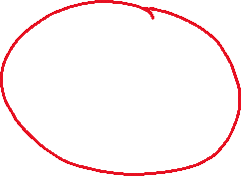


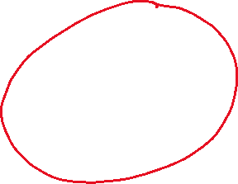

Intersecting Number
Claim. If $R$ intersects $S∈ℒ$, then both $intersect\left(ℒ,S∩R\right), intersect(ℒ,S∪R)<intersect(ℒ,R)$.

Slide 12

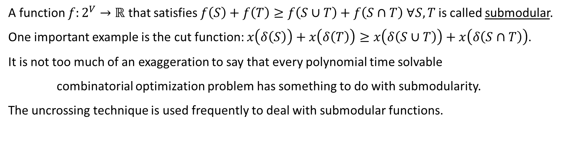
Submodular Function
A function $f:2^{V}→ℝ$ that satisfies $f\left(S\right)+f\left(T\right)≥f\left(S∪T\right)+f\left(S∩T\right)$ $∀S,T$ is called submodular.
One important example is the cut function: $x\left(δ\left(S\right)\right)+x\left(δ\left(T\right)\right)≥x\left(δ\left(S∪T\right)\right)+x\left(δ\left(S∩T\right)\right)$.
It is not too much of an exaggeration to say that every polynomial time solvable
combinatorial optimization problem has something to do with submodularity.
The uncrossing technique is used frequently to deal with submodular functions.

Slide 13
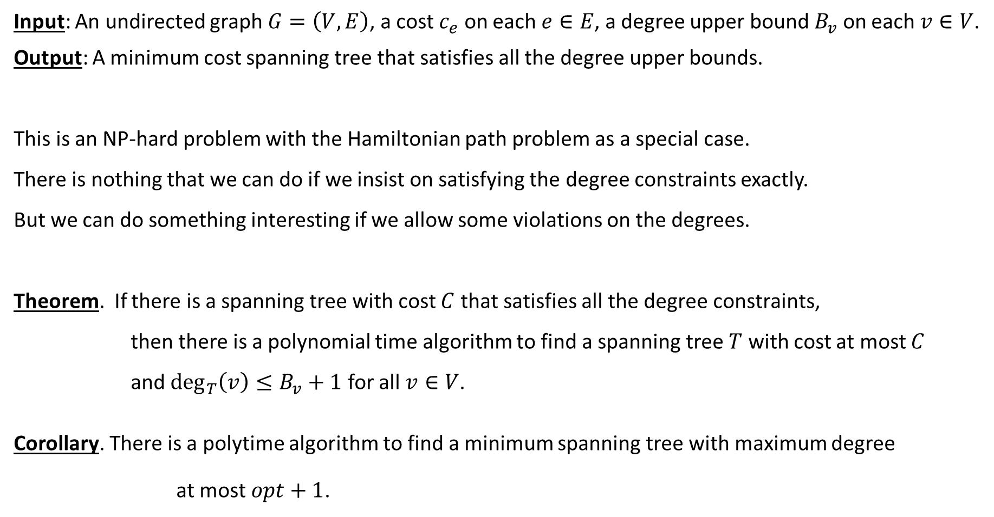
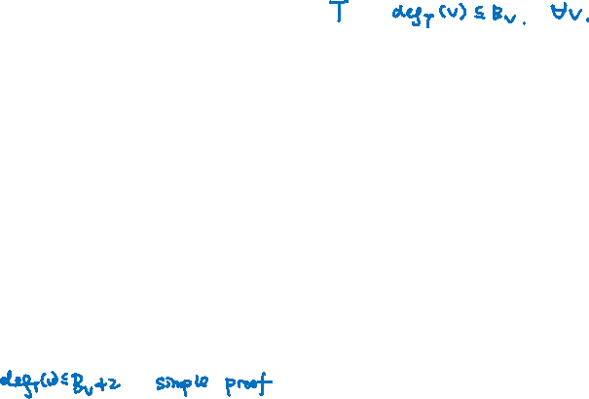
Minimum Bounded Degree Spanning Tree
Input: An undirected graph $G=\left(V,E\right)$, a cost $c_{e}$ on each $e∈E$, a degree upper bound $B_{v}$ on each $v∈V$.
Output: A minimum cost spanning tree that satisfies all the degree upper bounds.
This is an NP-hard problem with the Hamiltonian path problem as a special case.
There is nothing that we can do if we insist on satisfying the degree constraints exactly.
But we can do something interesting if we allow some violations on the degrees.
Theorem. If there is a spanning tree with cost $C$ that satisfies all the degree constraints,
then there is a polynomial time algorithm to find a spanning tree $T$ with cost at most $C$
and $\deg_{T}\left(v\right)≤B_{v}+1$ for all $v∈V$.
Corollary. There is a polytime algorithm to find a minimum spanning tree with maximum degree
at most $opt+1$.

Slide 14
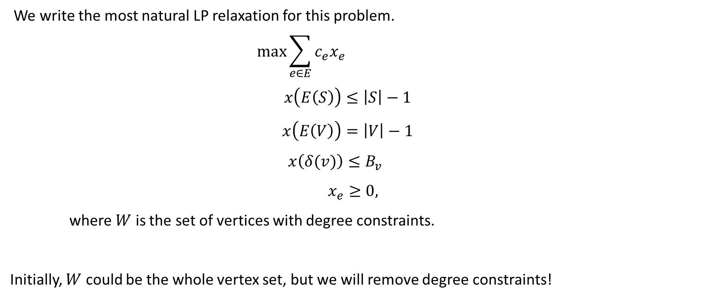

Linear Programming Relaxation
We write the most natural LP relaxation for this problem.
$$\max{\sum_{e∈E}{c_{e}x_{e}}}$$
$$x\left(E\left(S\right)\right)≤\left|S\right|−1$$
$$x\left(E\left(V\right)\right)=\left|V\right|−1$$
$$x\left(δ(v)\right)≤B_{v}$$
$$x_{e}≥0,$$
where $W$ is the set of vertices with degree constraints.
Initially, $W$ could be the whole vertex set, but we will remove degree constraints!
$$∀S⊂V$$
$$∀v∈W$$

Slide 15

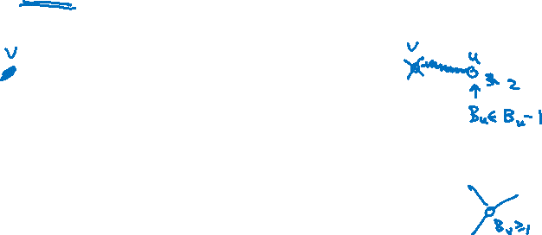
Iterative Relaxation Algorithm
Initially $F=∅$. ($F$ is the partial solution that we have so far, $F$ is a forest.)
While $\left|V\right|≥2$ do
(1) Compute an optimal basic solution $x$. If infeasible, return “impossible”.
(2) Remove all edges with $x_{e}=0$ from $E$.
(3) If there is a vertex $u$ with only one edge $uv$ incident on it,
then $F←F∪\left\{uv\right\}, V←V−\left\{v\right\}, B_{u}←B_{u}−1$.
(4) If there is a vertex $v$ with $\deg\left(v\right)≤3$,
then remove the degree constraint on $v$, i.e. $W←W−\{v\}$.
Return $F$.
Informally, this algorithm iteratively identifies a leaf of the spanning tree and remove it from the graph.
We will prove that the only reason that we don’t have a leaf is because of case (4)!

Slide 16
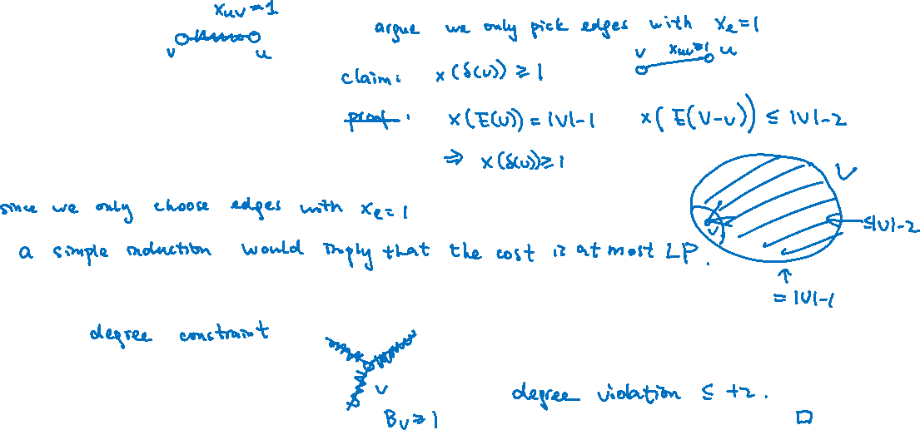
Approximation Guarantee
First we prove the theorem, assuming that the algorithm will always terminate successfully.

Slide 17


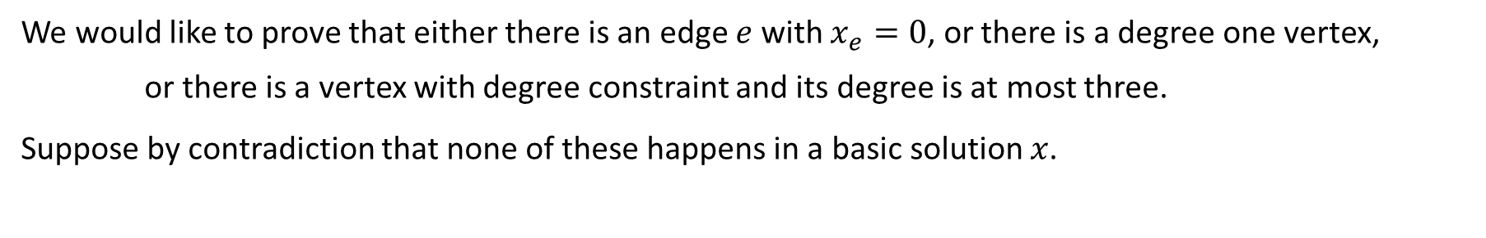


Analysis of Basic Solutions
We would like to prove that either there is an edge $e$ with $x_{e}=0$, or there is a degree one vertex,
or there is a vertex with degree constraint and its degree is at most three.
Suppose by contradiction that none of these happens in a basic solution $x$.

Slide 18
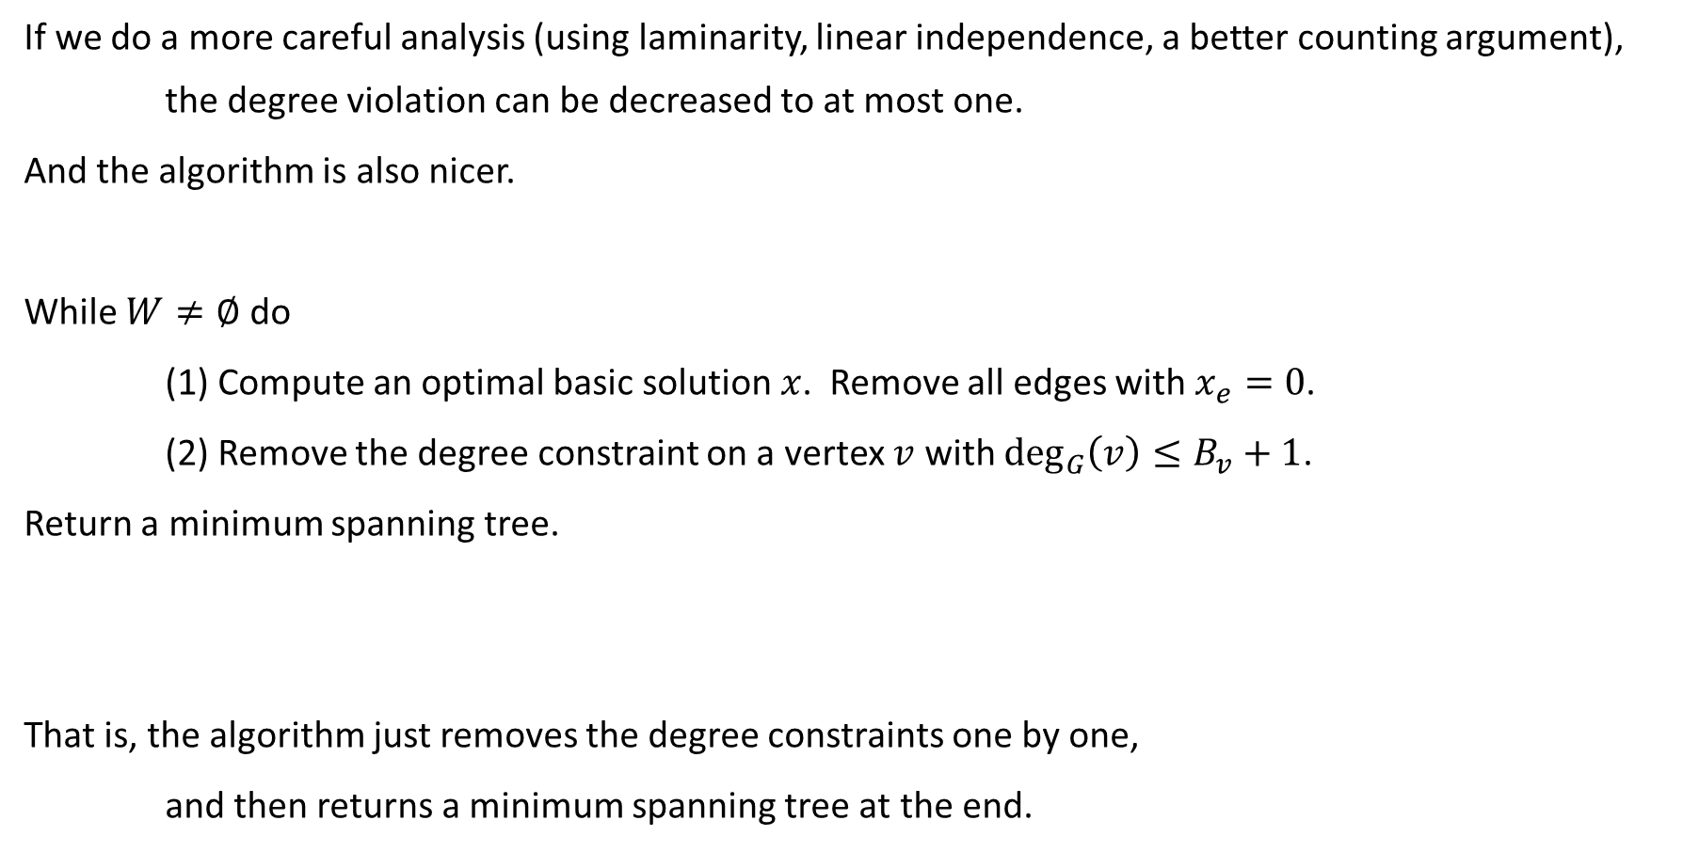
Optimal Algorithm
If we do a more careful analysis (using laminarity, linear independence, a better counting argument),
the degree violation can be decreased to at most one.
And the algorithm is also nicer.
While $W≠∅$ do
(1) Compute an optimal basic solution $x$. Remove all edges with $x_{e}=0$.
(2) Remove the degree constraint on a vertex $v$ with $\deg_{G}\left(v\right)≤B_{v}+1$.
Return a minimum spanning tree.
That is, the algorithm just removes the degree constraints one by one,
and then returns a minimum spanning tree at the end.

Slide 19
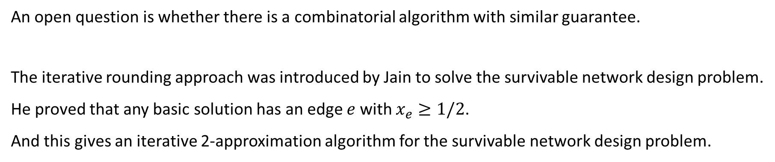
Concluding Remarks
An open question is whether there is a combinatorial algorithm with similar guarantee.
The iterative rounding approach was introduced by Jain to solve the survivable network design problem.
He proved that any basic solution has an edge $e$ with $x_{e}≥1/2$.
And this gives an iterative 2-approximation algorithm for the survivable network design problem.

