Slide 1
CS 466/666 - Algorithm Design and Analysis
Matching Polytopes
Waterloo, 16 July 2020

Slide 2
Today’s Plan
Matching Polytopes
Bipartite matching
3-dimensional matching
Generalized assignment problem
Non-bipartite matching
Feedback for proposal will come slowly.
HW5 to be posted by Friday.
HW4 due next Monday.

Slide 3
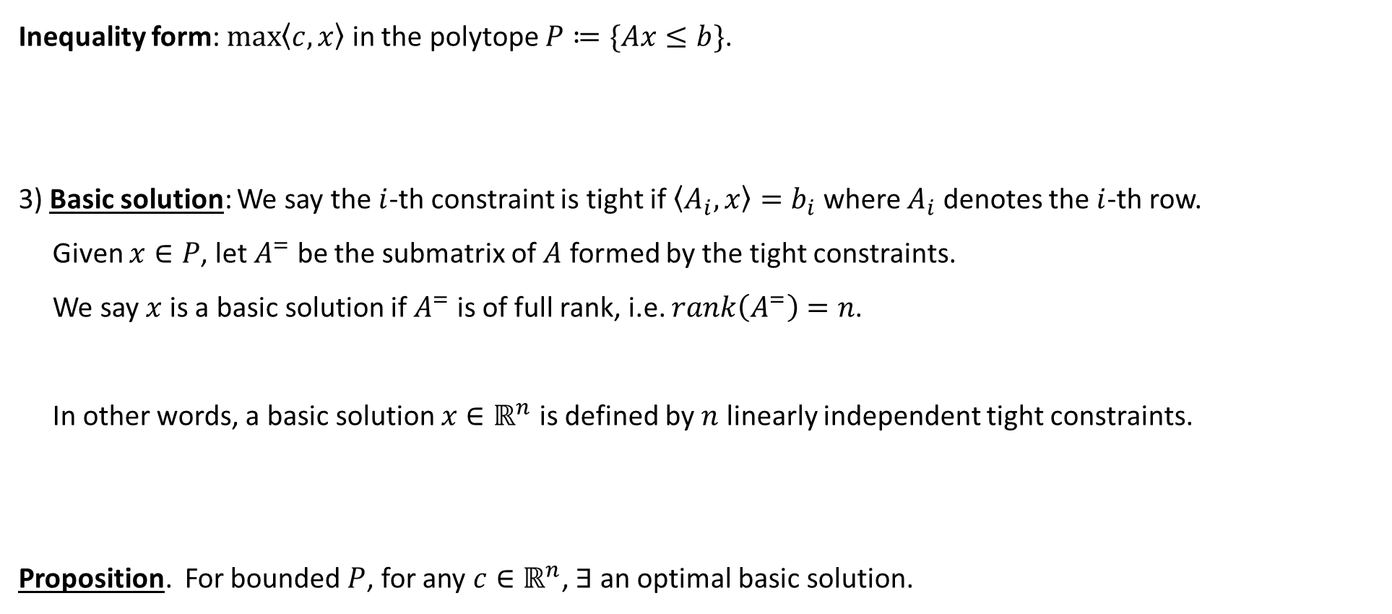
Optimal Corner Points for Inequality Form
Inequality form: $\max\left\langle c,x\right\rangle$ in the polytope $P≔\{Ax≤b\}$.
3) Basic solution: We say the $i$-th constraint is tight if $\left\langle A_{i},x\right\rangle =b_{i}$ where $A_{i}$ denotes the $i$-th row.
Given $x∈P$, let $A^{=}$ be the submatrix of $A$ formed by the tight constraints.
We say $x$ is a basic solution if $A^{=}$ is of full rank, i.e. $rank\left(A^{=}\right)=n$.
In other words, a basic solution $x∈ℝ^{n}$ is defined by $n$ linearly independent tight constraints.
Proposition. For bounded $P$, for any $c∈ℝ^{n}$, $∃$ an optimal basic solution.

Slide 4

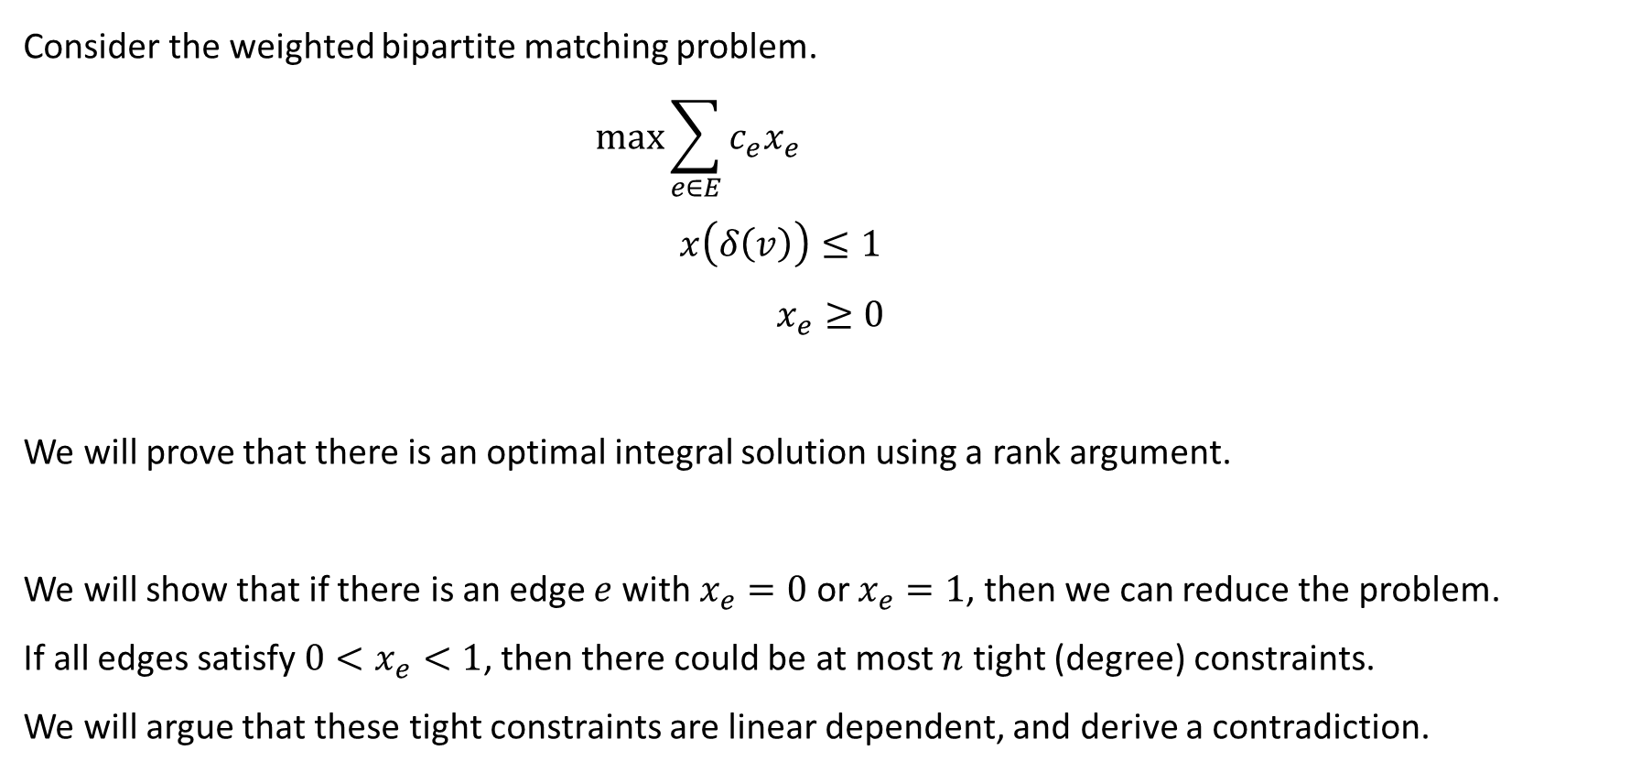
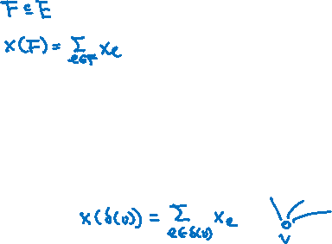

Bipartite Matching
Consider the weighted bipartite matching problem.
$$\max{\sum_{e∈E}{c_{e}x_{e}}}$$
$$x\left(δ\left(v\right)\right)≤1$$
$$x_{e}≥0$$
We will prove that there is an optimal integral solution using a rank argument.
We will show that if there is an edge $e$with $x_{e}=0$ or $x_{e}=1$, then we can reduce the problem.
If all edges satisfy $0<x_{e}<1$, then there could be at most $n$ tight (degree) constraints.
We will argue that these tight constraints are linear dependent, and derive a contradiction.
$$∀v∈V$$
$$∀e∈E$$

Slide 5



Reduction
Case 1: There is an edge $e$ with $x_{e}=0.$
Just delete it from the graph. Doesn’t change the LP value and the graph becomes smaller.
By induction, there is an integral optimal solution in the smaller graph, and we’re done.
Case 2: There is an edge $uv$ with $x_{uv}=1$.
To summarize, the reduction is very simple, just follow the LP to choose an edge or remove an edge.

Slide 6

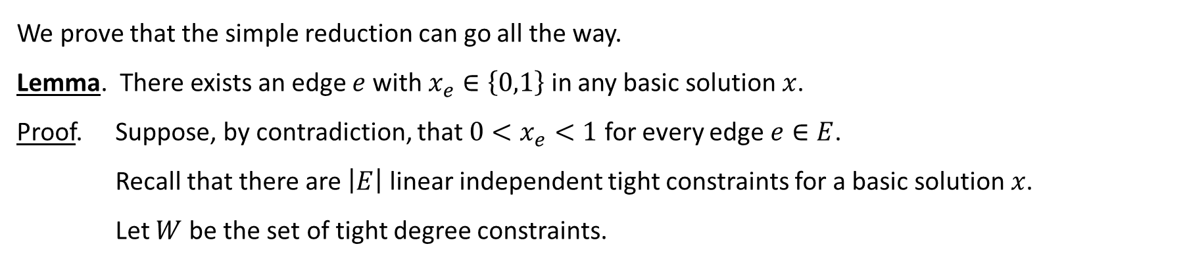




Rank Argument
We prove that the simple reduction can go all the way.
Lemma. There exists an edge $e$ with $x_{e}∈\left\{0,1\right\}$ in any basic solution $x$.
Proof. Suppose, by contradiction, that $0<x_{e}<1$ for every edge $e∈E$.
Recall that there are $\left|E\right|$ linear independent tight constraints for a basic solution $x$.
Let $W$ be the set of tight degree constraints.

Slide 7
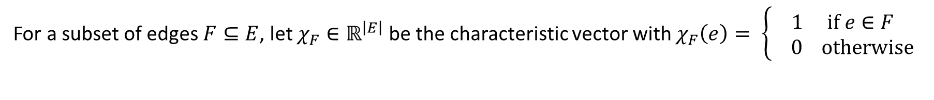






Linear Dependence
For a subset of edges $F⊆E$, let $χ_{F}∈ℝ^{\left|E\right|}$ be the characteristic vector with $χ_{F}\left(e\right)= \left\{\begin{aligned}1 if e∈F \\ 0 otherwise\end{aligned}\right.$

Slide 8
Approximation Algorithms
We extend the rank argument to design approximation algorithms for NP-hard variants of bipartite matching.
The high level idea is to show that the basic solutions (although not integral) are “close” to integral.
There are variables with large fractional value.
If there are no integral variable, then there are constraints almost satisfied by integral solutions.
We will see one example for each of these two scenarios.

Slide 9

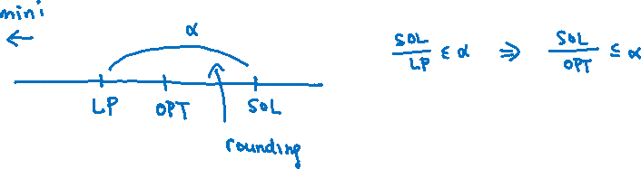
LP Rounding
For a minimization problem, we say an algorithm is an $α$-approximation algorithm if $\frac{SOL}{OPT}≤α$ with $α>1$.
For a maximization problem, we say an algorithm is an $α$-approximation algorithm if $\frac{SOL}{OPT}≥α$ with $α<1$.
How do we prove the approximation ratio if we don’t know the optimal value??
There are many different approaches to design rounding algorithms.
We will focus on one approach by analyzing the basic solutions.

Slide 10

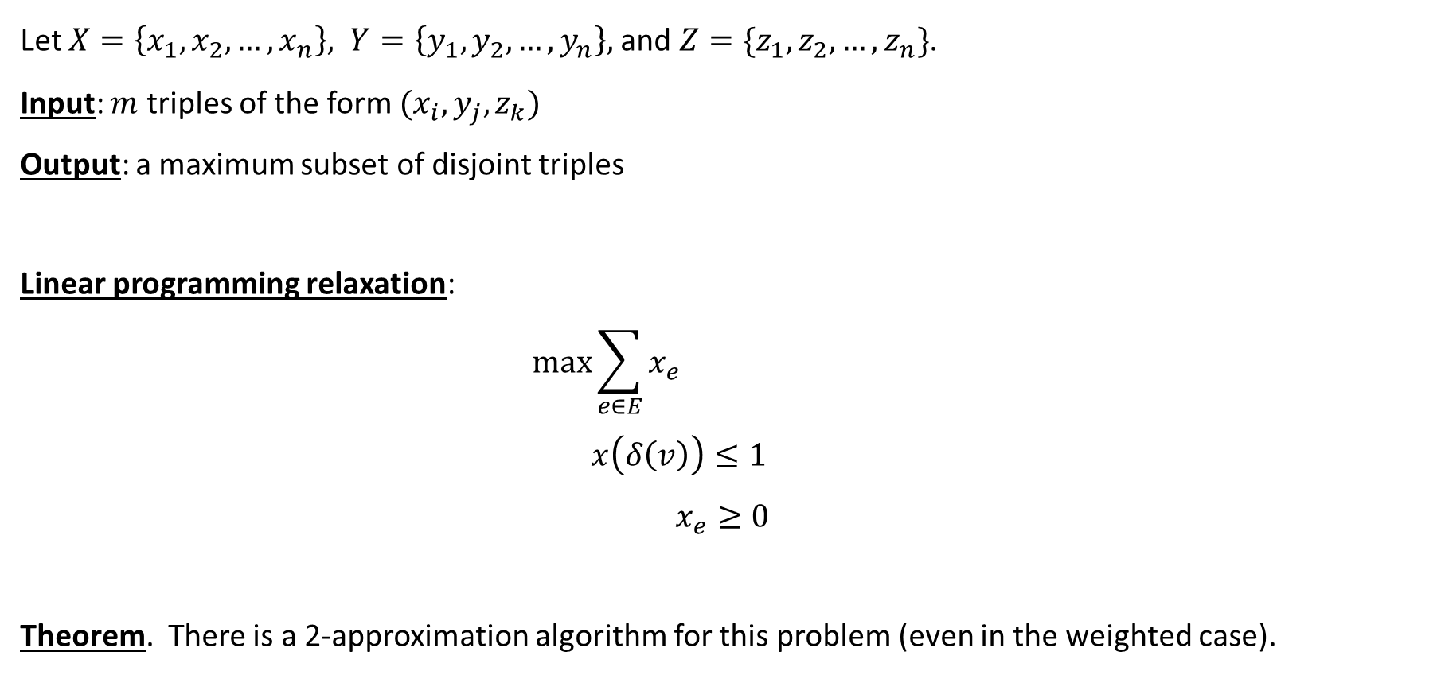
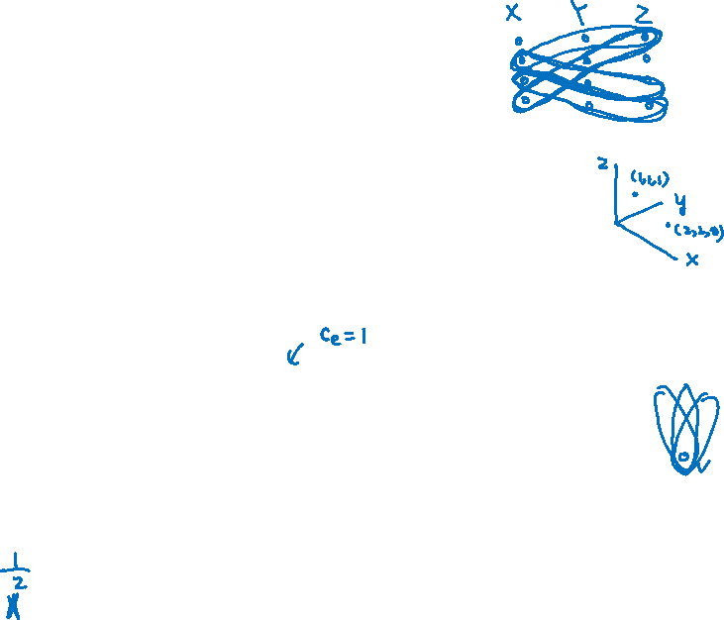

3-Dimensional Matching
Let $X=\left\{x_{1},x_{2},…,x_{n}\right\}, Y=\left\{y_{1},y_{2},…,y_{n}\right\},$and $Z=\{z_{1},z_{2},…,z_{n}\}$.
Input: $m$ triples of the form $(x_{i},y_{j},z_{k})$
Output: a maximum subset of disjoint triples
Linear programming relaxation:
$$\max{\sum_{e∈E}{x_{e}}}$$
$$x\left(δ\left(v\right)\right)≤1$$
$$x_{e}≥0$$
Theorem. There is a 2-approximation algorithm for this problem (even in the weighted case).
$$∀v∈V$$
$$∀e∈E$$

Slide 11


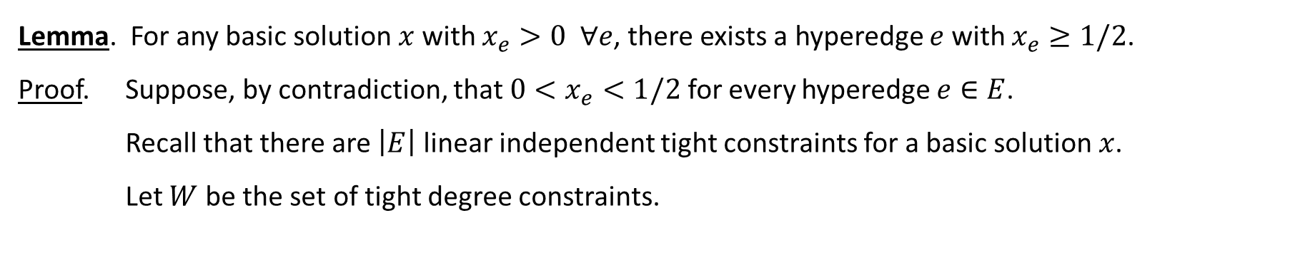



Basic Solution
Lemma. For any basic solution $x$ with $x_{e}>0 ∀e$, there exists a hyperedge $e$ with $x_{e}≥1/2$.
Proof. Suppose, by contradiction, that $0<x_{e}<1/2$ for every hyperedge $e∈E$.
Recall that there are $\left|E\right|$ linear independent tight constraints for a basic solution $x$.
Let $W$ be the set of tight degree constraints.

Slide 12

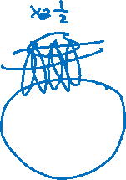
Iterative Rounding Algorithm
While $E≠∅$ do
(1) Compute an optimal basic solution $x$.
(2) If there is a hyperedge $e$ with $x_{e}=0$,
delete $e$ from the hypergraph.
(3) If there is a hyperedge $e$ with $x_{e}≥\frac{1}{2}$,
add $e$ to the solution, delete all hyperedges that intersect $e$.
Return the solution.
Note that the algorithm will always terminate successfully, because of the previous lemma.

Slide 13



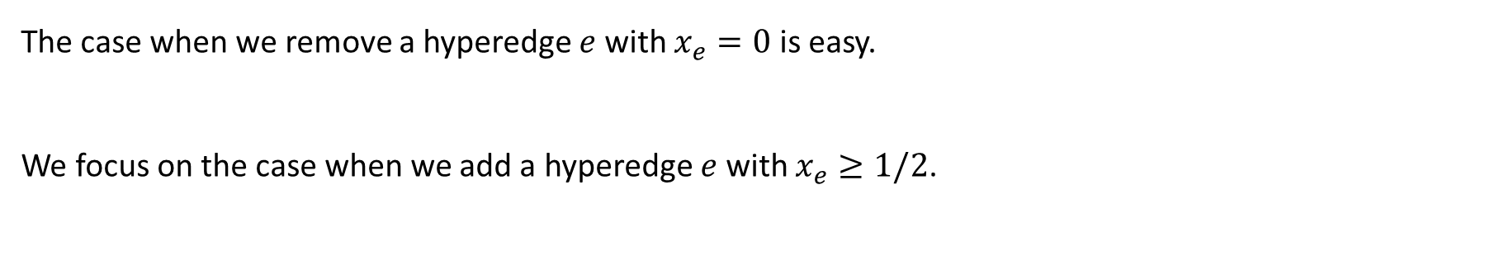


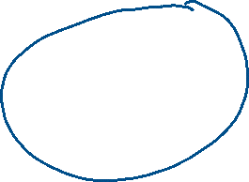

Approximation Guarantee
The case when we remove a hyperedge $e$ with $x_{e}=0$ is easy.
We focus on the case when we add a hyperedge $e$ with $x_{e}≥1/2$.

Slide 14
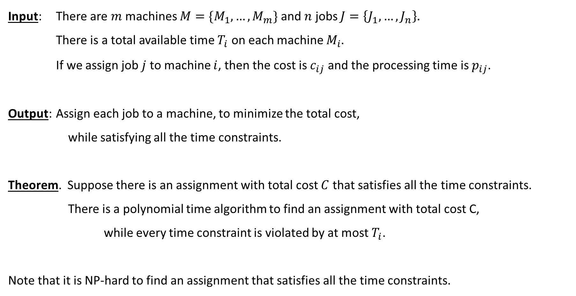

General Assignment Problem
Input: There are $m$ machines $M=\{M_{1},…,M_{m}\}$ and $n$ jobs $J=\left\{J_{1},…,J_{n}\right\}.$
There is a total available time $T_{i}$ on each machine $M_{i}$.
If we assign job $j$ to machine $i$, then the cost is $c_{ij}$ and the processing time is $p_{ij}$.
Output: Assign each job to a machine, to minimize the total cost,
while satisfying all the time constraints.
Theorem. Suppose there is an assignment with total cost $C$ that satisfies all the time constraints.
There is a polynomial time algorithm to find an assignment with total cost C,
while every time constraint is violated by at most $T_{i}$.
Note that it is NP-hard to find an assignment that satisfies all the time constraints.

Slide 15





Linear Programming Relaxation
There is a variable $x_{ij}$ which indicates whether job $j$ is assigned to machine $i$.
Let $E$ be the set of all possible pairs $i,j$. Initially, every pair is possible, but we will delete pairs.
$$\min{\sum_{i∈M, j∈J}{c_{ij}{ x}_{ij}}}$$
$$\sum_{i∈M : ij∈E}{x_{ij}}=1$$
$$\sum_{j∈J : ij∈E}{p_{ij} x_{ij}}≤T_{i}$$
$$x_{ij}≥0$$
Preprocessing: Remove all pairs $i,j$ with $p_{ij}>T_{i}$.
$$∀ j∈J$$
$$∀ i∈M$$
$$∀ ij∈E$$

Slide 16

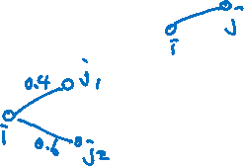
Iterative Relaxation Algorithm
While $J≠∅$ do
(1) Compute an optimal basic solution $x$. If infeasible, return “impossible”.
(2) Delete all pairs $i,j$ with $x_{ij}=0$ from $E$.
(3) If $x_{ij}=1$, assign job $j$ to machine $i$. Update $T_{i}←T_{i}−p_{ij}$ and $J←J−\{j\}$.
(4) If there is a machine $i$ with degree 1, remove the time constraint from machine $i$.
(5) If there is a machine $i$ with degree 2 and fractional degree at least 1,
remove the time constraint from machine $i$.
Return the assignment.
New idea is to remove constraints.

Slide 17













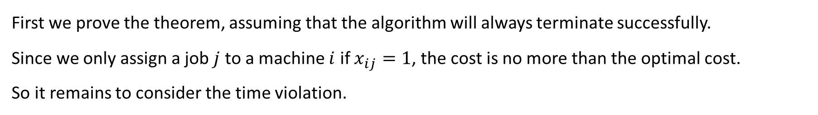
Performance Guarantee
First we prove the theorem, assuming that the algorithm will always terminate successfully.
Since we only assign a job $j$ to a machine $i$ if $x_{ij}=1$, the cost is no more than the optimal cost.
So it remains to consider the time violation.

Slide 18



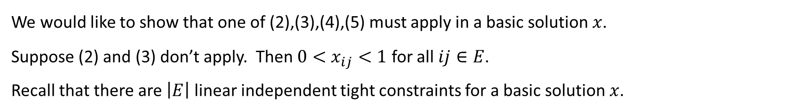


Basic Solution
We would like to show that one of (2),(3),(4),(5) must apply in a basic solution $x$.
Suppose (2) and (3) don’t apply. Then $0<x_{ij}<1$ for all $ij∈E$.
Recall that there are $\left|E\right|$ linear independent tight constraints for a basic solution $x$.

Slide 19
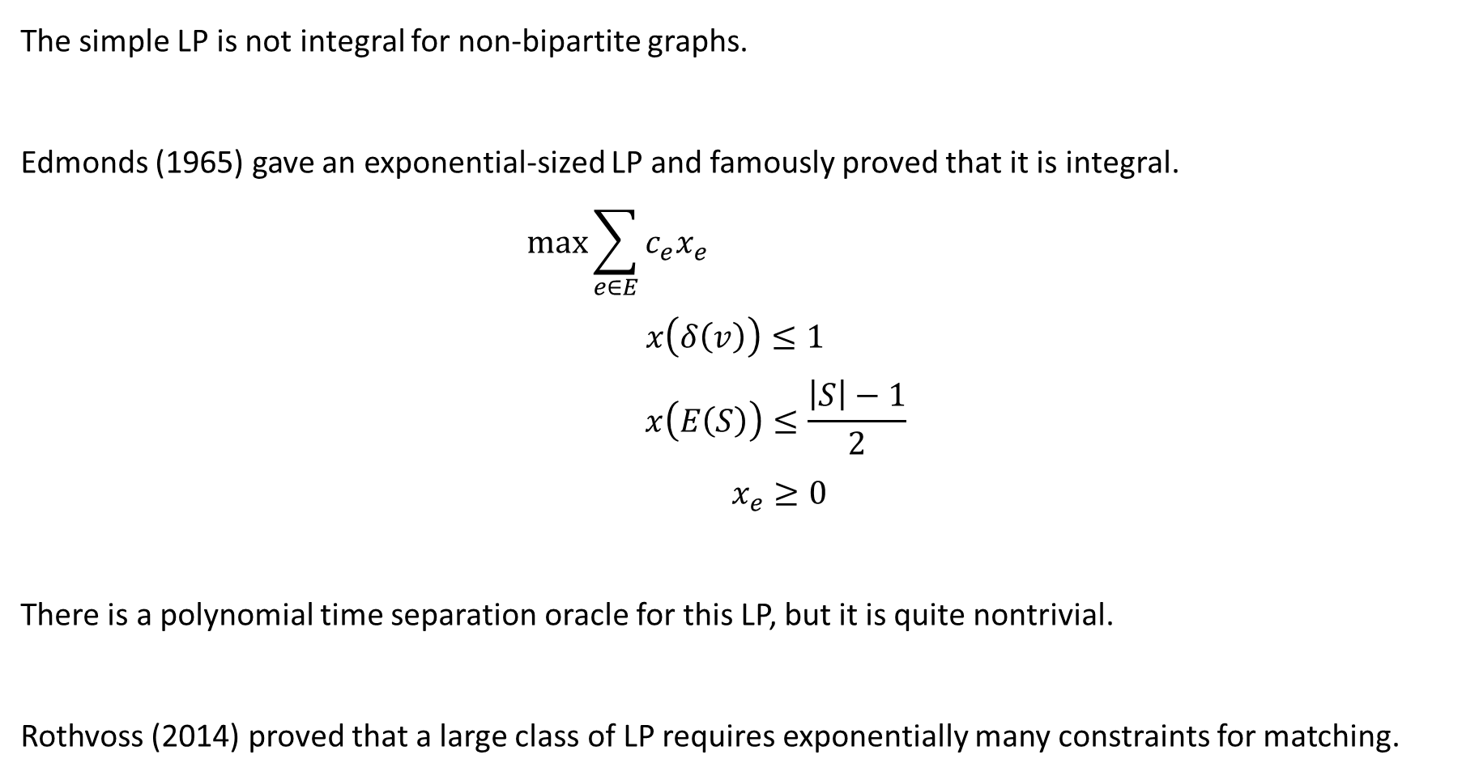




Non-Bipartite Matching and Edmonds’ LP
The simple LP is not integral for non-bipartite graphs.
Edmonds (1965) gave an exponential-sized LP and famously proved that it is integral.
$$\max{\sum_{e∈E}{c_{e}x_{e}}}$$
$$x\left(δ\left(v\right)\right)≤1$$
$$x\left(E\left(S\right)\right)≤\frac{\left|S\right|−1}{2}$$
$$x_{e}≥0$$
There is a polynomial time separation oracle for this LP, but it is quite nontrivial.
Rothvoss (2014) proved that a large class of LP requires exponentially many constraints for matching.
$$∀ v∈V$$
$$∀ S⊆V, \left|S\right| odd$$
$$∀ e∈E$$

Slide 20
Summary
We have seen how to use the rank argument to analyze the basic solutions,
to prove that an LP is integral,
or to prove that it is “close” to integral and use it to design approximation algorithms.
Next time we will see the spanning tree polytopes (lecture 21).
Then we will talk about LP duality and its many applications (lecture 22).
Then we will talk about an online multiplicative weight update method (lecture 23).
Finally, we will finish the course with some interesting results (lecture 24).

