Slide 1
CS 466/666 - Algorithm Design and Analysis
Linear Programming
Waterloo, 14 July 2020

Slide 2
Today’s Plan
Introduction to Linear Programming
LP, relaxation, geometric interpretation
Corner points: basic, vertex, extreme point
Optimal corner points, bipartite matching
Algorithms, optimization via separation
Feedback for proposal will come slowly.
HW5 to be posted by Friday.
HW4 due next Monday.
HW3 well done.

Slide 3
Linear Programs
In a linear program, we have a set of variables, say $x_{1},x_{2},…,x_{n}∈ℝ$.
We can add linear constraints to these variables.
We can optimize a linear objective function.
$$\max{ 3x_{1}+2x_{2}−7x_{3}}$$
$$x_{1}+x_{2}≤7$$
$$x_{1}+x_{3}=6$$
$$3x_{2}−5x_{3}≥−4$$
$$x_{2}≤1$$
$$x_{3}≥0$$
No strict inequalities allowed.

Slide 4
Equality and Inequality Form
We can write the constraints in a matrix form.
If there are $m$ constraints and $n$ variables, then we use a constraint matrix $A∈ℝ^{m×n}$,
where the $i$-th row is the $i$-th constraint.
The objective function is written as $c∈ℝ^{n}$, and the right hand side is written as $b∈ℝ^{m}$.
These two forms are equivalent (why?) and they are general.
We expect $m≥n$ in the inequality form, and $m≤n$ in the equality form.
$$\max{ \left\langle c,x\right\rangle }$$
$$Ax≤b$$
$$\max{ \left\langle c,x\right\rangle }$$
$$Ax=b$$
$$x≥0$$

Slide 5
Integer Linear Programs
Many combinatorial optimization problems can easily be formulated as an integer linear program.
For example, maximum weight bipartite matching can be written as
$$\max{\sum_{e∈E}{c_{e}x_{e}}}$$
$$\sum_{e∈δ\left(v\right)}{x_{e}}≤1$$
$$x_{e}∈\{0,1\}$$
For another example, maximum independent set can be written as
$$\max{\sum_{v∈V}{c_{v}x_{v}}}$$
$$x_{u}+x_{v}≤1$$
$$x_{v}∈\{0,1\}$$
But this shows that solving integer linear programs is an NP-hard problem.
$$∀v∈V$$
$$∀e∈E$$

Slide 6
Linear Programming Relaxations
A natural idea is to relax the integral constraints $x_{v}∈\{0,1\}$ to linear constraints $0≤x_{v}≤1$,
and hope for the best.
Then maximum independent set is “relaxed” as
$$\max{\sum_{v∈V}{c_{v}x_{v}}}$$
$$x_{u}+x_{v}≤1$$
$$0≤x_{v}≤1$$
We are searching over a larger domain ${\left[0,1\right]}^{n}$ instead of ${\left\{0,1\right\}}^{n}$.
This relaxation could be very “loose”, e.g. consider the complete graph on $n$ vertices.

Slide 7
Linear Programming Relaxations
But surprisingly, for many polynomial time solvable combinatorial optimization problems,
we can actually extract optimal integral solutions for the linear programming relaxations.
$$\max{\sum_{e∈E}{c_{e}x_{e}}}$$
$$\sum_{e∈δ\left(v\right)}{x_{e}}≤1$$
$$0≤x_{e}≤1$$
This approach is widely accepted as a unifying algorithmic framework for polynomial time solvable
combinatorial optimization problems.
$$∀v∈V$$
$$∀e∈E$$

Slide 8
Geometric Interpretation
Optimize over $ℝ^{n}$.
Each constraint is a halfspace.
Interested in the integral points in the feasible space.
Optimizing a linear function is to find a point
furthest in that direction in the feasible space.
Given any direction, there are some “corner” points
that achieve optimality.
So, if all corner points are integral points,
then LP always has optimal integral solutions.

Slide 9
Corner Points for Equality Form
Equality form: $\max\left\langle c,x\right\rangle$ in the polytope $P≔\{Ax=b, x≥0\}$.
There are three possible definitions of corner points.
1) Vertex solution: A solution $x$ is a vertex solution if there does not exist $y≠0$ s.t.$x+y∈P$ and $x−y∈P$.
This is a geometric definition that a vertex solution is not the average of two feasible points.
2) Extreme point solution: A solution $x$ is an extreme point solution if $∃c$ s.t. $x$ is the unique optimal solution.
This is an optimization definition that a corner point is the unique optimal for some direction.
3) Basic solution: Let $supp\left(x\right)≔\left\{i | x_{i}≠0\right\}$ be the set of nonzero variables.
Note that $x_{i}$ corresponds to the $i$-th column of $A$.
We say $x$ is a basic solution if the columns corresponding to $supp\left(x\right)$ are linearly independent.
This is an algebraic definition that is easier to deal with when we do calculations.
Theorem. The three definitions are equivalent. (See the notes for proof.)

Slide 10
Corner Points for Inequality Form
Inequality form: $\max\left\langle c,x\right\rangle$ in the polytope $P≔\{Ax≤b\}$.
There are three possible definitions of corner points.
1) Vertex solution: A solution $x$ is a vertex solution if there does not exist $y≠0$ s.t.$x+y∈P$ and $x−y∈P$.
2) Extreme point solution: A solution $x$ is an extreme point solution if $∃c$ s.t. $x$ is the unique optimal solution.
3) Basic solution: We say the $i$-th constraint is tight if $\left\langle A_{i},x\right\rangle =b_{i}$ where $A_{i}$ denotes the $i$-th row.
Given $x∈P$, let $A^{=}$ be the submatrix of $A$ formed by the tight constraints.
We say $x$ is a basic solution if $A^{=}$ is of full rank, i.e. $rank\left(A^{=}\right)=n$.
Theorem. The three definitions are equivalent.

Slide 11
Vertex Solutions are Basic Solutions
Inequality form: $\max\left\langle c,x\right\rangle$ in the polytope $P≔\{Ax≤b\}$.
1) Vertex solution: A solution $x$ is a vertex solution if there does not exist $y≠0$ s.t.$x+y∈P$ and $x−y∈P$.
3) Basic solution: Tight constraints are of full rank, i.e. $rank\left(A^{=}\right)=n$.

Slide 12
Basic Solutions are Vertex Solutions
Inequality form: $\max\left\langle c,x\right\rangle$ in the polytope $P≔\{Ax≤b\}$.
1) Vertex solution: A solution $x$ is a vertex solution if there does not exist $y≠0$ s.t.$x+y∈P$ and $x−y∈P$.
3) Basic solution: Tight constraints are of full rank, i.e. $rank\left(A^{=}\right)=n$.

Slide 13
Optimal Corner Points
Proposition. For bounded $P$, for any $c∈ℝ^{n}$, $∃$ a basic feasible solution s.t. $\left\langle c,x\right\rangle ≥\left\langle c,y\right\rangle$ for any $y∈P$.

Slide 14
Perfect Bipartite Matching
Theorem. The following LP is integral for perfect matching in a bipartite graph.
$$\max{\sum_{e∈E}{c_{e}x_{e}}} s.t. \sum_{e∈δ\left(v\right)}{x_{e}}=1 ∀v∈V and {0≤x}_{e}≤1 ∀e∈E$$
Next time we will use the rank argument to prove this result again, and then generalize to other problems.

Slide 15
Algorithms for Solving Linear Programs
There are three main methods to solve linear programs.
Simplex method
Ellipsoid method
Interior point method
We will very briefly discuss each of these.

Slide 16
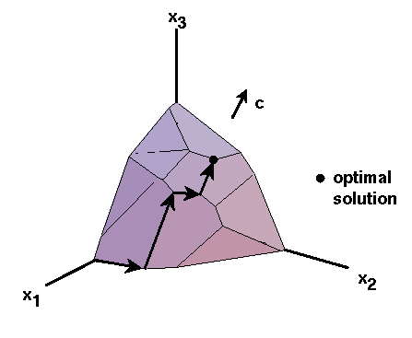
Simplex Method
Work in the equality form.
Start from an arbitrary basic solution.
Move to a “neighboring” basic solution by adding one and deleting one column.
If there is a neighbor as good, choose one and go there.
If all neighbors are worse, then the current solution is optimal,
because local optimal is global optimal for convex programs.
There are many rules to choose which neighbor to go.
For most rules, there are examples showing that exponentially many steps are needed.
Major open problem: Is there a polynomial time simplex algorithm?
Major open problem: Is the diameter of a polytope polynomial in $n$ and $m$?
Remark: Many combinatorial algorithms (e.g. augmenting path) can be understood as a simplex algorithm.
Remark: Simplex algorithms are competitive, and there is a theory of smoothed analysis to explain it.

Slide 17
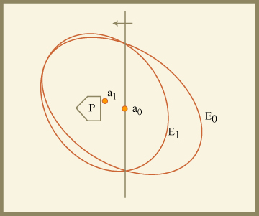
Ellipsoid Method
First polynomial time algorithm for LP, by Khachiyan in 1979.
First, reduce optimization to decision, i.e. check whether $P$ is empty.
Start with a big ellipsoid $E_{0}$ that guarantees to contain $P$.
In each step, check whether the center $a_{i}$ belongs to $P$.
If so, we find a point in $P$, and we are done.
Otherwise, the algorithm requires a hyperplane $H$ that separates $a_{i}$ from $P$.
Given $H$, the algorithm finds a ellipsoid $E_{i+1}$ that contains $E_{i}∩H$, in particular $P⊆E_{i+1}$.
Repeat until the ellipsoid becomes too small, that it is impossible to contain $P$.
The key of the analysis shows that $\frac{vol\left(E_{i+1}\right)}{vol\left(E_{i}\right)}≤e^{−\frac{1}{2\left(n+1\right)}}$,
and so after $O(n)$ steps the volume has decreased by a constant fraction.
This belongs to the class of algorithms called cutting plane methods.

Slide 18
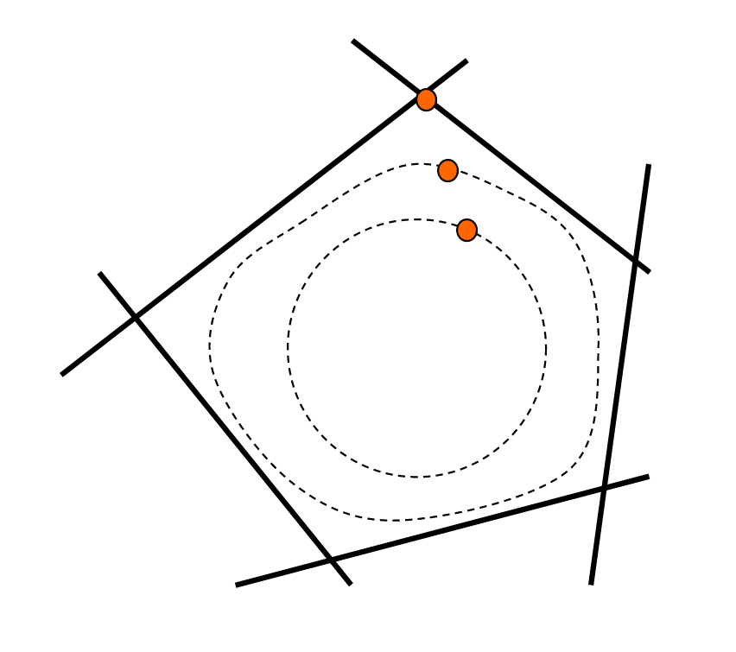
Interior Point Method
Another class of polytime algorithms, first discovered by Karmarkar in 1984.
The problem is reduced to an unconstrained optimization problem,
by using barrier functions to ensure that an optimal solution stays in the polytope.
Initially, we start from the “center” of the polytope.
In each step, we decrease the “force” of the barrier,
update the current point using Newton’s method,
and moves closer to an optimal solution of the original problem.
Recently, there are exciting progress giving fast interior point algorithms
for solving combinatorial optimization problems, e.g. maxflow.

Slide 19
Optimization via Separation
An important feature of the ellipsoid method is that it only requires a
“separation oracle” for it to work.
In particular, it does not require us to write down the LP explicitly,
and can be used to solve exponential-sized LP in polynomial time.
Consider the following linear program for minimum spanning tree:
$$\max{\sum_{e∈E}{c_{e}x_{e}}}$$
$$\sum_{e∈E(S)}{x_{e}}≤\left|S\right|−1$$
$$\sum_{e∈E(V)}{x_{e}}=\left|V\right|−1$$
$$0≤x_{v}≤1$$
This linear program can be solved in polynomial time although it is of exponential-sized (see notes).

Slide 20
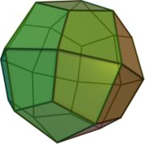
Summary
Understand the geometric interpretation of LP relaxations.
Remember the basic solutions for inequality form.
We will use it intensively next times.
We will assume that linear programs can be solved in polynomial time.
See my notes for CS 798 Spring 2017 for proofs,
e.g. L12-L15 in https://cs.uwaterloo.ca/~lapchi/cs798/notes.html.
Keep in mind that optimization can be reduced to separation.

