Slide 1
CS 466/666 - Algorithm Design and Analysis
Spectral Sparsification
Waterloo, 9 July 2020

Slide 2
Today’s Plan
Effective Resistance
Cover time
Spectral sparsification
No office hour today.
Proposal to be submitted July 13 (4 received!).
HW4 posted.
HW3 solution posted.

Slide 3

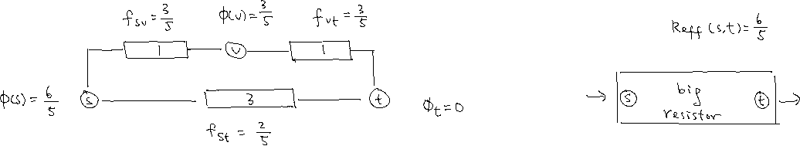
Effective Resistance
The effective resistance $R_{eff}\left(s,t\right)$between vertices $s$ and $t$ is defined as $φ\left(s\right)−φ(t)$,
when one unit of electrical flow is sent from $s$ to $t$.
We should think of it as the resistance of the whole graph as a single big resistor.
Claim. $R_{eff}\left(s,t\right)=b_{st}^{T}L^{†}b_{st}$ where $b_{st}∈ℝ^{n}$ with $b_{st}\left(s\right)=1,b_{st}\left(t\right)=−1$, and zero otherwise.

Slide 4
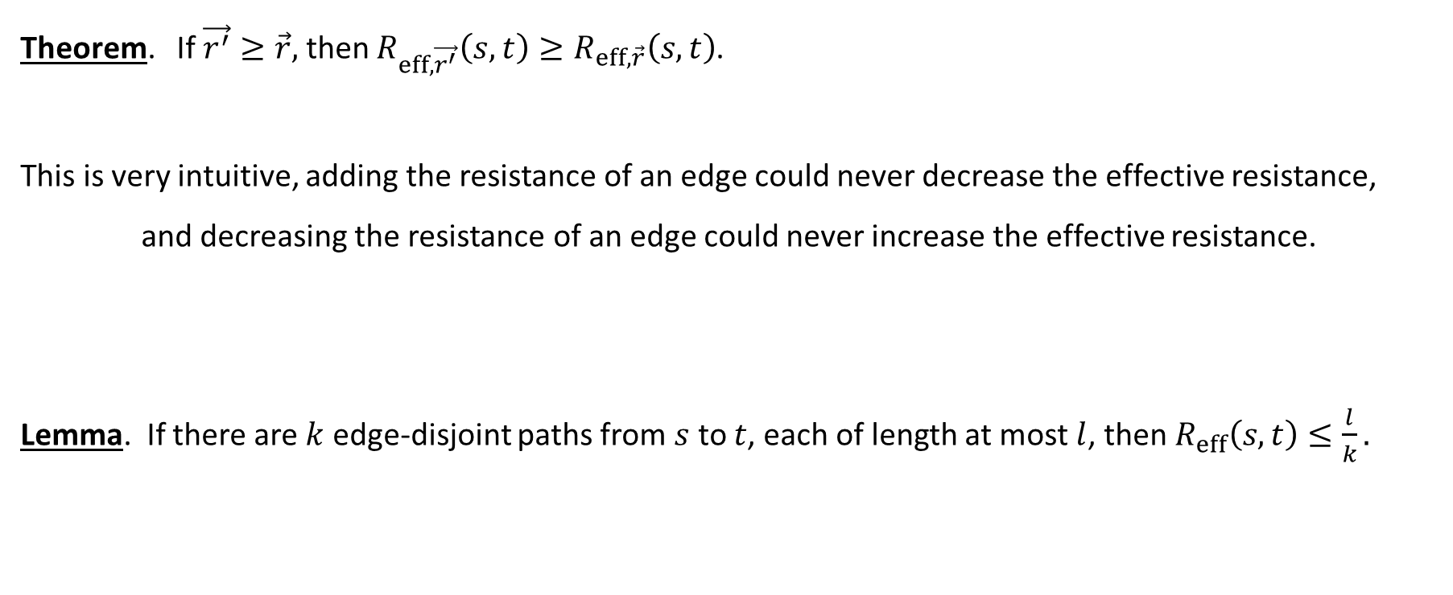

Rayleigh’s Monotonicity Principle
Theorem. If $\vec{r^{′}}≥\vec{r},$ then $R_{eff,\vec{r^{′}}}\left(s,t\right)≥R_{eff,\vec{r}}\left(s,t\right)$.
This is very intuitive, adding the resistance of an edge could never decrease the effective resistance,
and decreasing the resistance of an edge could never increase the effective resistance.
Lemma. If there are $k$ edge-disjoint paths from $s$ to $t$, each of length at most $l$, then $R_{eff}\left(s,t\right)≤\frac{l}{k}.$

Slide 5
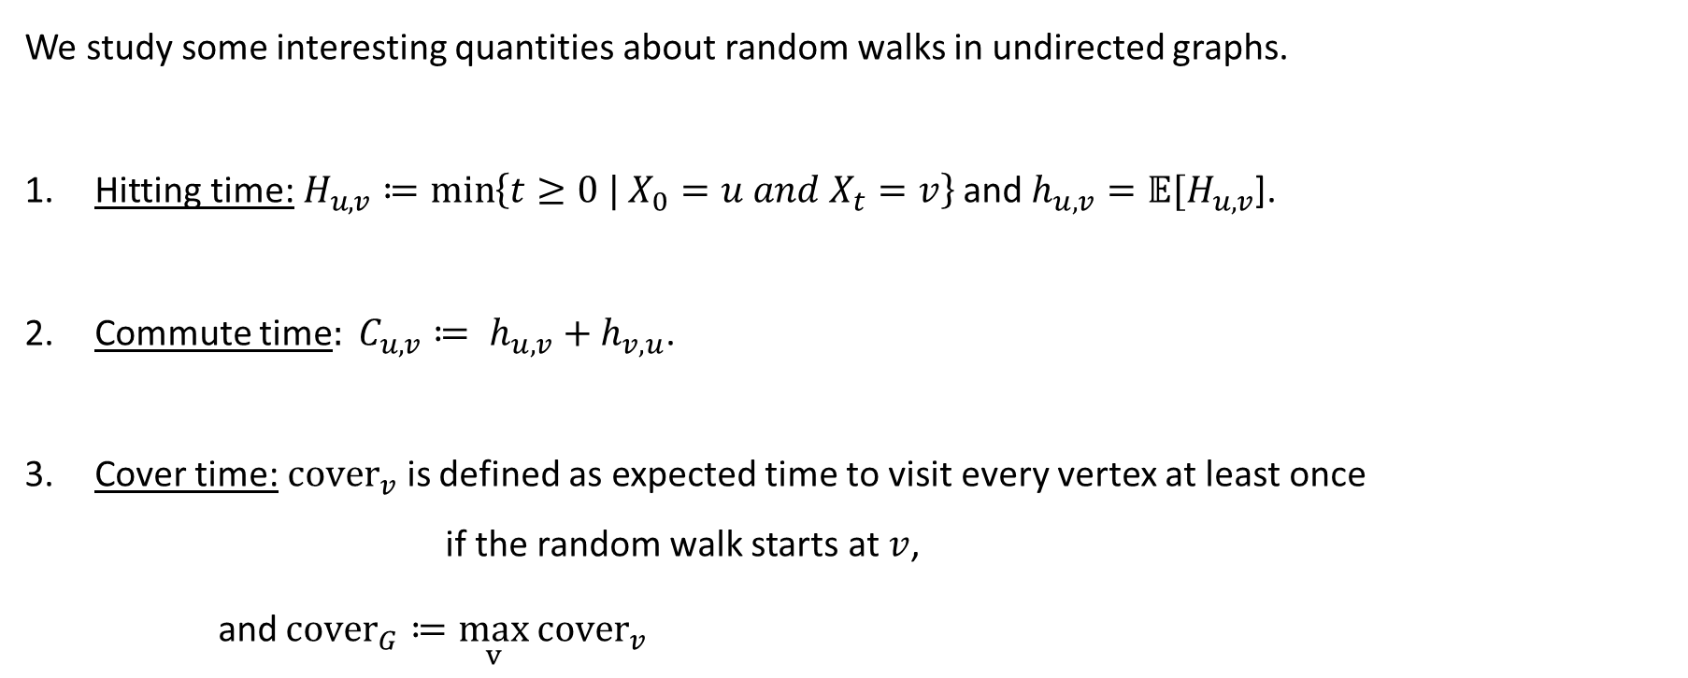
Random Walks on Undirected Graphs
We study some interesting quantities about random walks in undirected graphs.
Hitting time:$H_{u,v}≔\min\left\{t≥0 | X_{0}=u and X_{t}=v\right\}$ and $h_{u,v}=𝔼[H_{u,v}$].
Commute time$: C_{u,v}≔ h_{u,v}+h_{v,u}$.
Cover time:${cover}_{v}$is defined as expected time to visit every vertex at least once
if the random walk starts at $v$,
and ${cover}_{G}≔\max_{v}$ ${cover}_{v}$

Slide 6


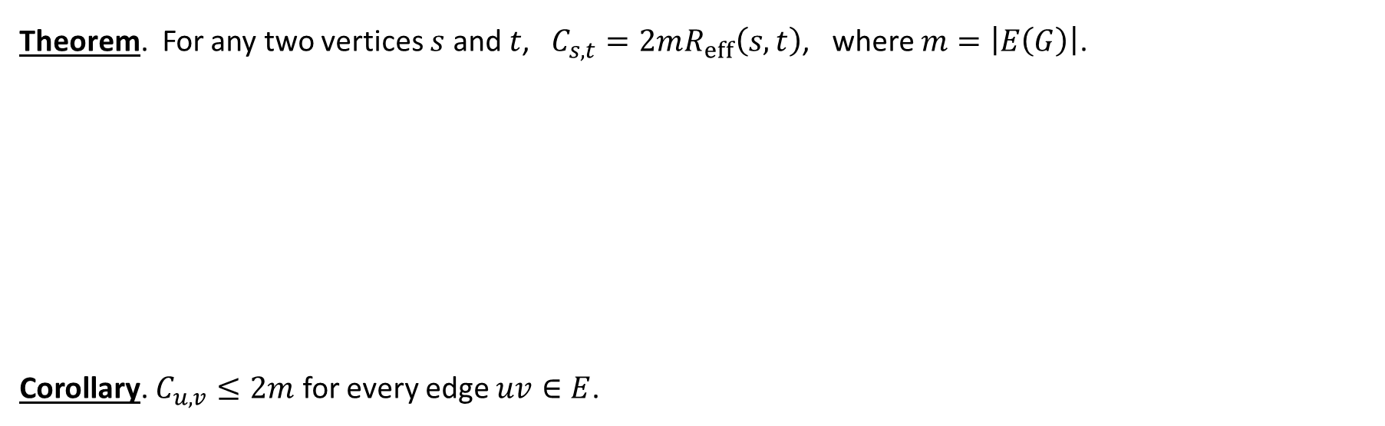
Commute Time
Theorem. For any two vertices $s$ and $t$, $C_{s,t}=2mR_{eff}\left(s,t\right)$, where $m=\left|E\left(G\right)\right|$.
Corollary. $C_{u,v}≤2m$ for every edge $uv∈E$.

Slide 7



Cover Time
Theorem. The cover time of a connected graph is at most $2m(n−1)$.
For the complete graph on $n$ vertices, the cover time should be $Θ\left(n\log{n}\right).$ (Why?)

Slide 8

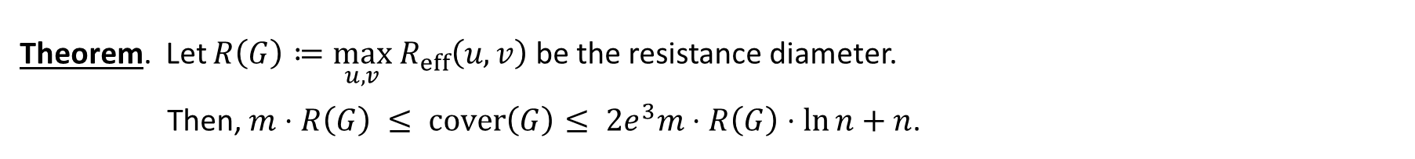
Approximating Cover Time by Resistance Diameter
Theorem. Let $R\left(G\right)≔\max_{u,v}{ R}_{eff}\left(u,v\right)$ be the resistance diameter.
Then, $m⋅R\left(G\right) ≤ cover\left(G\right)≤ 2e^{3}m⋅R\left(G\right)⋅\ln{n}+n$.

Slide 9

Approximating Cover Time by Resistance Diameter
Theorem. Let $R\left(G\right)≔\max_{u,v}{ R}_{eff}\left(u,v\right)$ be the resistance diameter.
Then, $m⋅R\left(G\right) ≤ cover\left(G\right)≤ 2e^{3}m⋅R\left(G\right)⋅\ln{n}+n$.

Slide 10




Graph Connectivity
There is an $O\left(n^{3}\right)$ time algorithm to solve $s$-$t$ connectivity using only $O(\log{n)}$ space.

Slide 11



Cut Sparsifiers
Definition. A graph $H$ is an $ε$-cut approximator of a graph $G$ if for all $S⊆V$,
$$\left(1−ε\right)⋅w\left(δ_{G}\left(S\right)\right)≼w\left(δ_{H}\left(S\right)\right)≼\left(1+ε\right)⋅w\left(δ_{G}\left(S\right)\right).$$
Theorem. [Benczur, Karger] Any graph $G$ has an $ε$-cut approximator $H$ with $O\left(\frac{n\log{n}}{ε^{2}}\right)$ edges.

Slide 12


Spectral Sparsification
Definition. [Spielman, Teng] A graph $H$ is an $ε$-spectral approximator of a graph $G$ if
$$\left(1−ε\right)L_{G}≼L_{H}≼\left(1+ε\right)L_{G}.$$
Observation. An $ε$-spectral approximator is an $ε$-cut approximator.
Theorem. [Spielman, Srivastava] Any graph $G$ has an $ε$-spectral approximator $H$ with $O\left(\frac{n\log{n}}{ε^{2}}\right)$ edges.

Slide 13
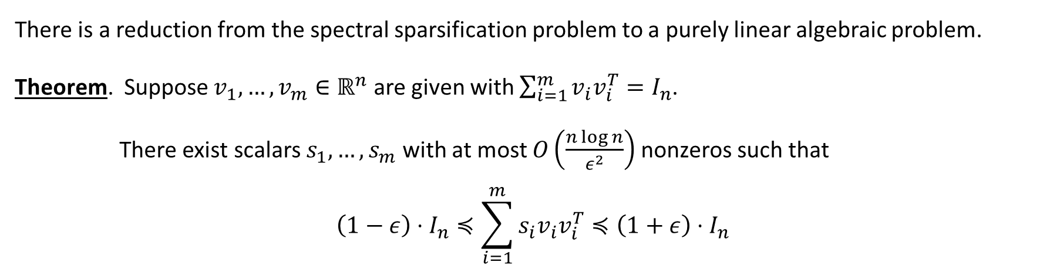
Linear Algebraic Problem
There is a reduction from the spectral sparsification problem to a purely linear algebraic problem.
Theorem. Suppose $v_{1},…,v_{m}∈ℝ^{n}$ are given with $\sum_{i=1}^{m}{v_{i}v_{i}^{T}}=I_{n}$.
There exist scalars $s_{1},…,s_{m}$ with at most $O\left(\frac{n\log{n}}{ε^{2}}\right)$nonzeros such that
$$\left(1−ε\right)⋅I_{n}≼\sum_{i=1}^{m}{s_{i}v_{i}v_{i}^{T}}≼\left(1+ε\right)⋅I_{n}$$

Slide 14




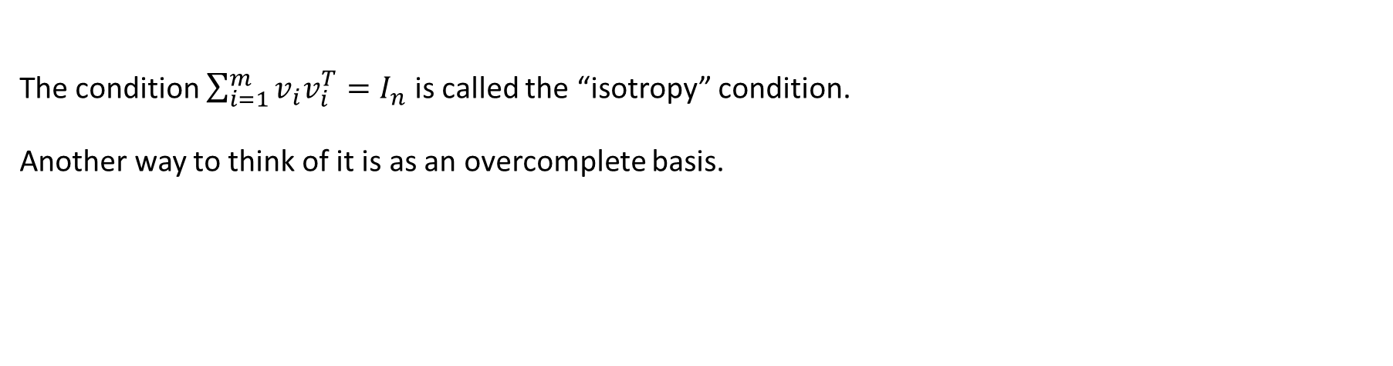
Isotropy Condition
The condition $\sum_{i=1}^{m}{v_{i}v_{i}^{T}}=I_{n}$ is called the “isotropy” condition.
Another way to think of it is as an overcomplete basis.

Slide 15





Intuition
Idea: Random Sampling (from Karger).
Uniform sampling won’t work.
Non-uniform sampling?

Slide 16
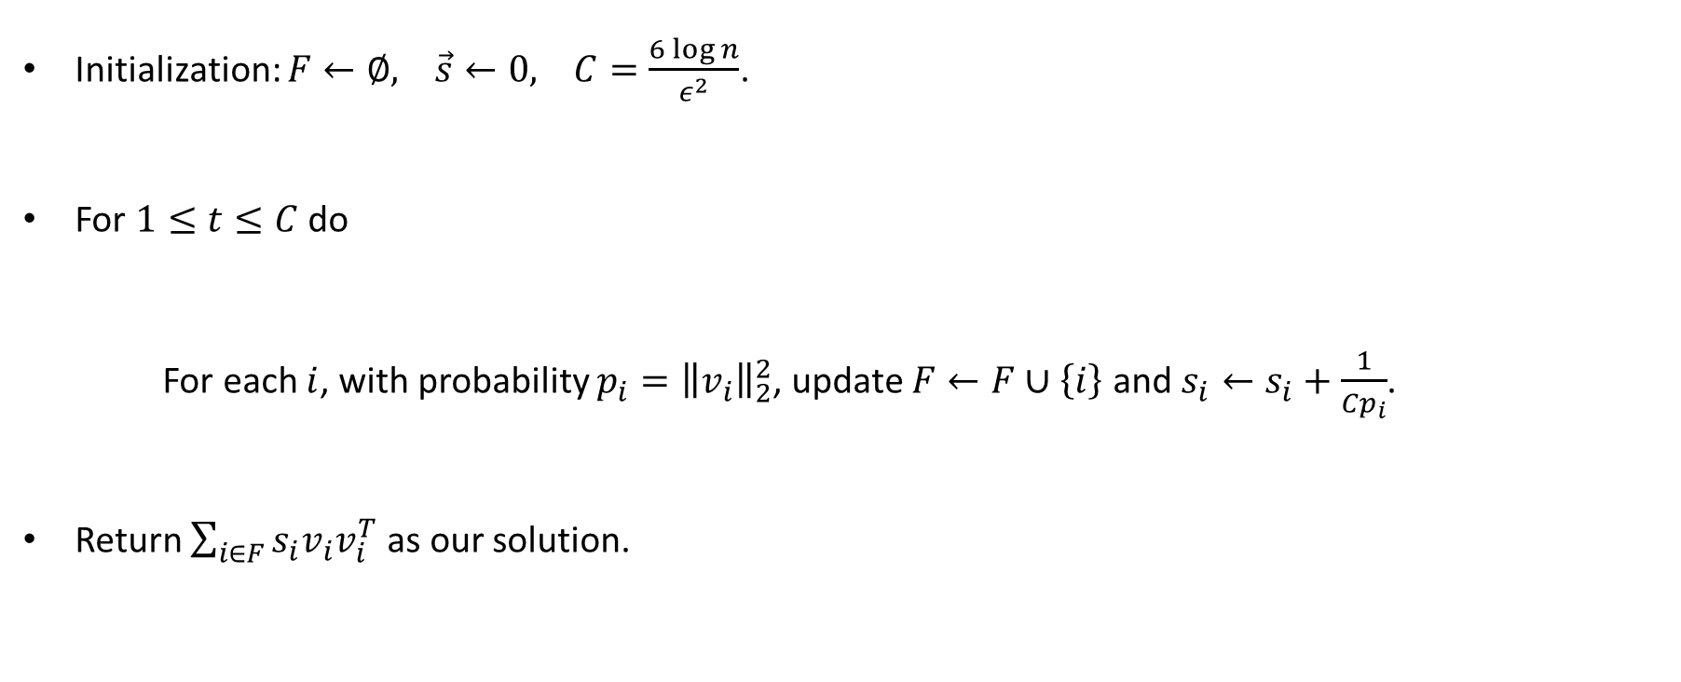

Sampling Algorithm
Initialization: $F←∅, \vec{s}←0, C=\frac{6\log{n}}{ε^{2}}$.
For $1≤t≤C$ do
For each $i$, with probability ${p_{i}=\left\|v_{i}\right\|}_{2}^{2}$, update $F←F∪\left\{i\right\}$ and $s_{i}←s_{i}+\frac{1}{Cp_{i}}$.
Return $\sum_{i∈F}{s_{i}v_{i}v_{i}^{T}}$ as our solution.

Slide 17
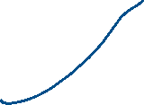



Number of Vectors
Lemma. With probability at least $0.9$, $\left|F\right|=O\left(\frac{n\log{n}}{ε^{2}}\right)$.

Slide 18

Matrix Chernoff Bound
There is an elegant generalization of Chernoff bound to the matrix setting.
Theorem. Let $X_{1},…,X_{m}$ be independent $n×n$ symmetric matrices with $0≼X_{i}≼R⋅I$ for some $R∈ℝ$.
Let $μ_{min}I≼\sum_{i=1}^{m}{E\left[X_{i}\right]}≼μ_{max}I$. For any $0<ε≤1$,
$$\operatorname{Pr}\left(λ_{max}\left(\sum_{i=1}^{m}{X_{i}}\right)≥(1+ε)μ_{max}\right)≤ne^{−\frac{ε^{2}μ_{max}}{3R}}$$
$$\operatorname{Pr}\left(λ_{min}\left(\sum_{i=1}^{m}{X_{i}}\right)≤(1+ε)μ_{min}\right)≤ne^{−\frac{ε^{2}μ_{min}}{2R}}.$$

Slide 19







Concentration
The random variables are $X_{i,t}=\frac{v_{i}v_{i}^{T}}{Cp_{i}}$ with probability $p_{i}$ and zero otherwise.

Slide 20
Effective Resistance
What is the sampling probability?
In the graph case, it is possible to compute good approximations of the sampling probabilities
in near-linear time. The idea is to do dimension reduction.

Slide 21
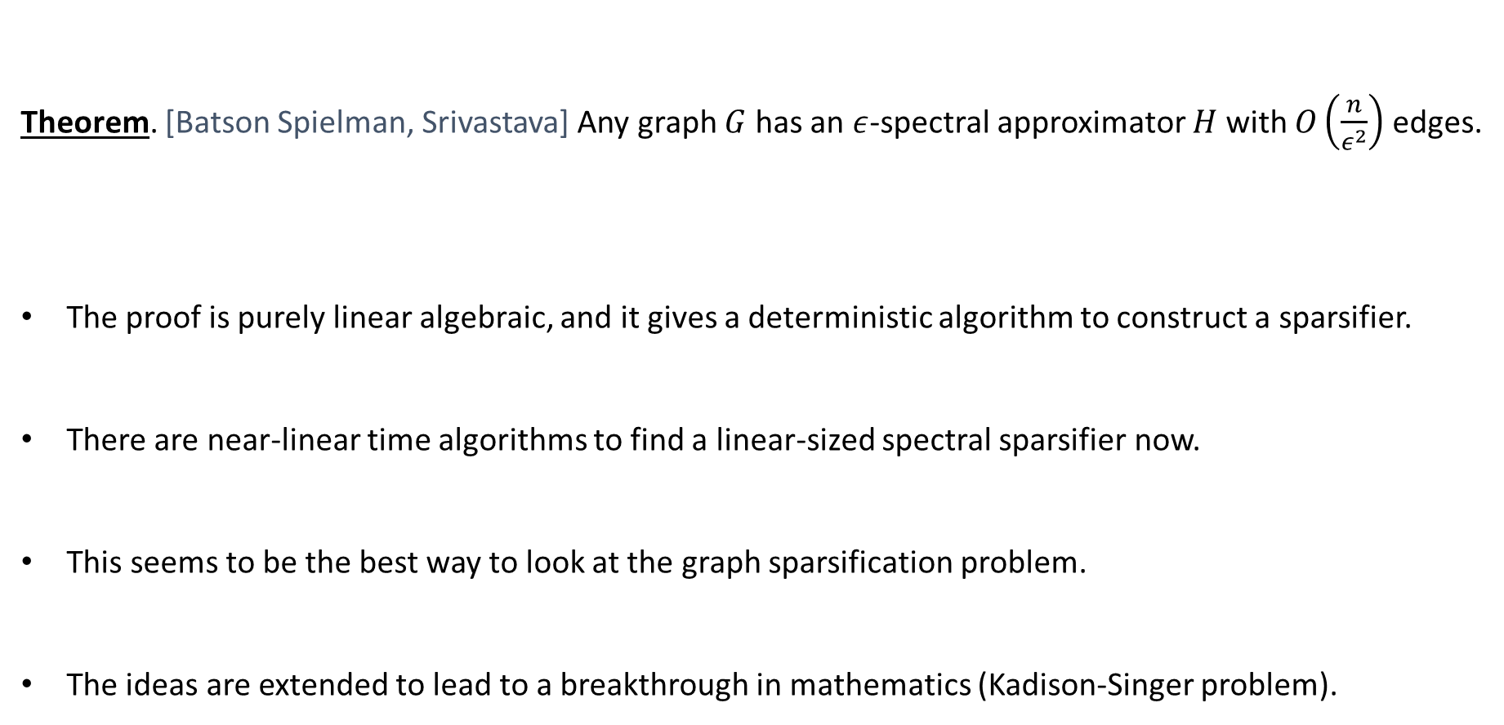
Linear-Sized Spectral Sparsifiers
Theorem. [Batson Spielman, Srivastava] Any graph $G$ has an $ε$-spectral approximator $H$ with $O\left(\frac{n}{ε^{2}}\right)$ edges.
The proof is purely linear algebraic, and it gives a deterministic algorithm to construct a sparsifier.
There are near-linear time algorithms to find a linear-sized spectral sparsifier now.
This seems to be the best way to look at the graph sparsification problem.
The ideas are extended to lead to a breakthrough in mathematics (Kadison-Singer problem).

Slide 22
Spectral Graph Theory
This is the end of the spectral graph theory part of the course.
One great result that we haven’t discussed is a near-linear time algorithm to solve Laplacian equations.
This leads to a revolution in designing fast algorithm for combinatorial problems
using techniques from convex optimization.
For example, this leads to an interior point algorithm to compute maximum flow.
It is good to see this viewpoint to study graph problems.

