Slide 1
CS 466/666 - Algorithm Design and Analysis
Electrical networks
Waterloo, 7 July 2020

Slide 2
Today’s Plan
Electrical networks
Electrical flow
Effective resistance
Hitting time
Cover time
No office hour today.
Proposal to be submitted July 13 (3 received!).
HW4 posted.
HW3 solution will be posted tonight 11pm.

Slide 3
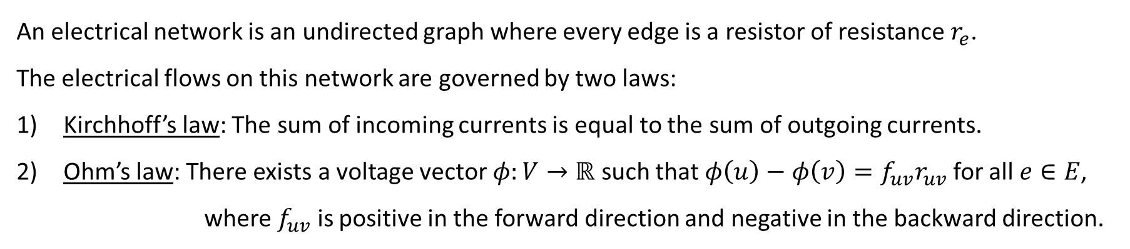
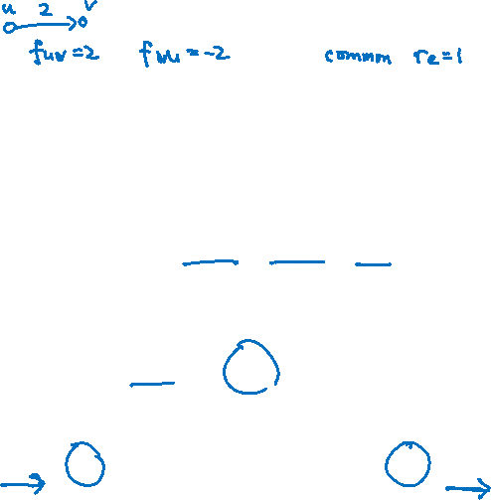
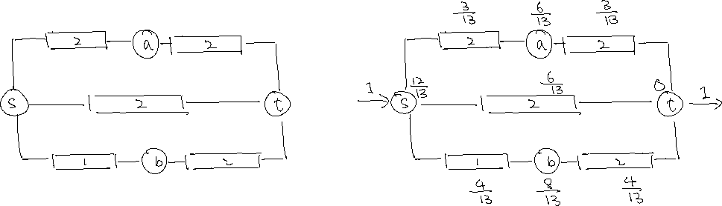
Electrical Flow
An electrical network is an undirected graph where every edge is a resistor of resistance $r_{e}$.
The electrical flows on this network are governed by two laws:
Kirchhoff’s law: The sum of incoming currents is equal to the sum of outgoing currents.
Ohm’s law: There exists a voltage vector $φ:V→ℝ$ such that $φ\left(u\right)−φ\left(v\right)=f_{uv}r_{uv}$ for all $e∈E$,
    where $f_{uv}$ is positive in the forward direction and negative in the backward direction.

Slide 4
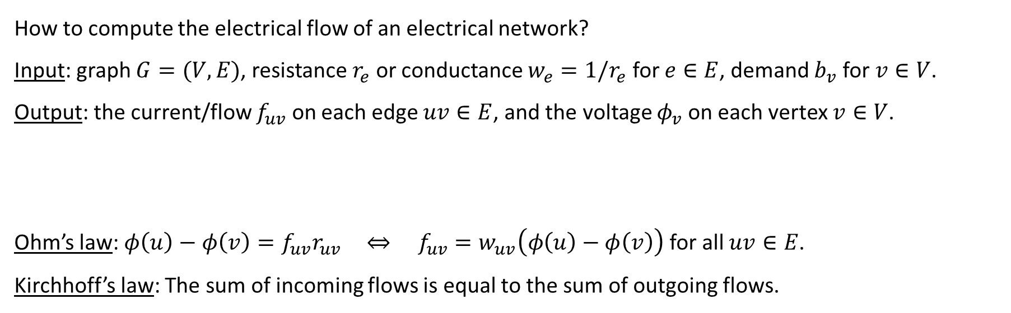
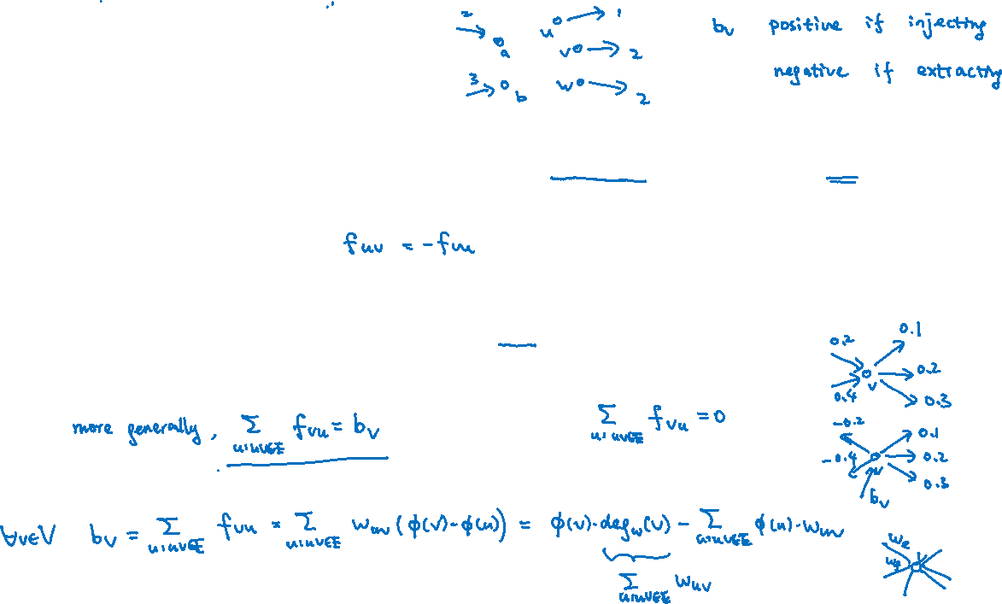
Linear Equations
How to compute the electrical flow of an electrical network?
Input: graph $G=(V,E)$, resistance $r_{e}$ or conductance $w_{e}=1/r_{e}$ for $e∈E$, demand $b_{v}$ for $v∈V$.
Output: the current/flow $f_{uv}$ on each edge $uv∈E$, and the voltage $φ_{v}$ on each vertex $v∈V$.
Ohm’s law: $φ\left(u\right)−φ\left(v\right)=f_{uv}r_{uv}$ $⇔ f_{uv}=w_{uv}\left(φ\left(u\right)−φ\left(v\right)\right)$ for all $uv∈E$.
Kirchhoff’s law: The sum of incoming flows is equal to the sum of outgoing flows.

Slide 5

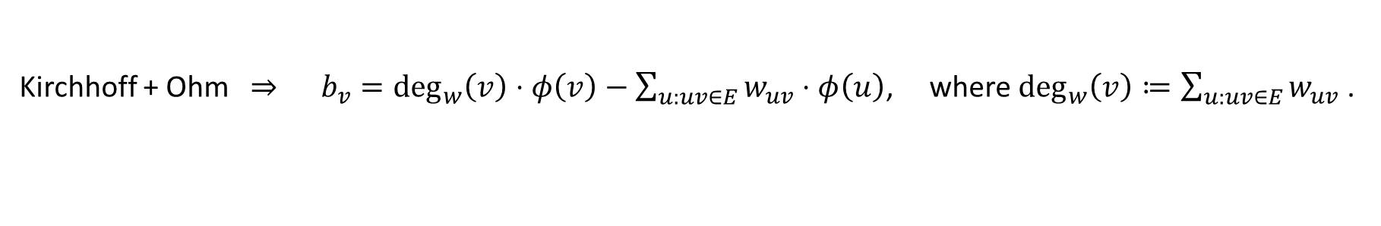
Matrix Formulation
Kirchhoff + Ohm ⇒ $b_{v}=\deg_{w}\left(v\right)⋅φ\left(v\right)−\sum_{u:uv∈E}{w_{uv}}⋅φ\left(u\right)$, where $\deg_{w}\left(v\right)≔\sum_{u:uv∈E}{w_{uv} }$.

Slide 6
Computing Voltages and Flows
We can compute the voltages by solving the Laplacian system of linear equations.
Then the flow on each edge is also completely determined.
Many problems are related to electrical flows because they share the same system of linear equations!
For example, some quantities about random walks as we will soon see.

Slide 7

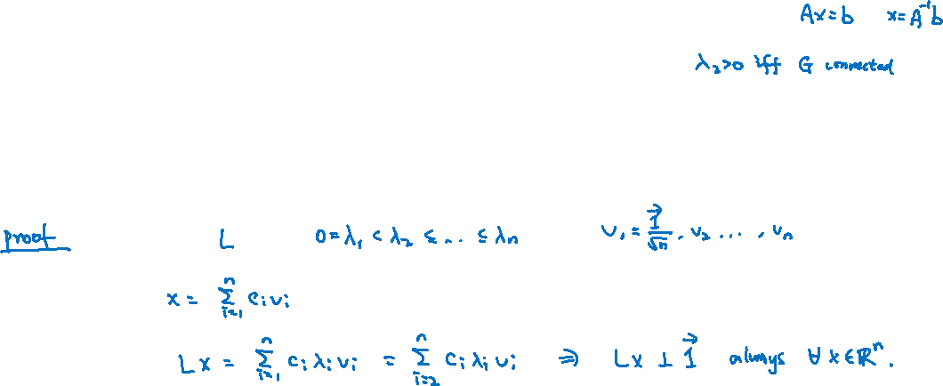
Solution Space and Pseudo-inverse of Laplacian
$L$ is not of full rank, so inverse doesn’t exist, e.g. can’t say $x=L^{−1}b$ is the unique solution.
But if $G$ is connected (wlog), then nullspace of $L$ is spanned by $\vec{1}$, and we can characterize the solutions.
Claim. If $Lx=b$, then $b⊥\vec{1}$.
This makes sense for electrical flow, because the sum of demands should be equal to zero.

Slide 8
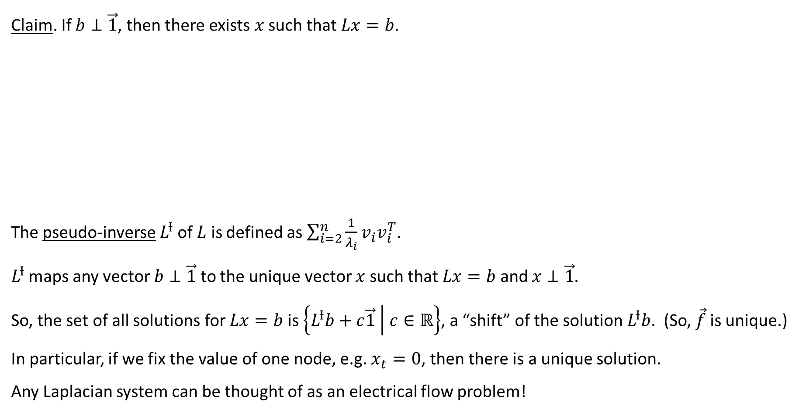
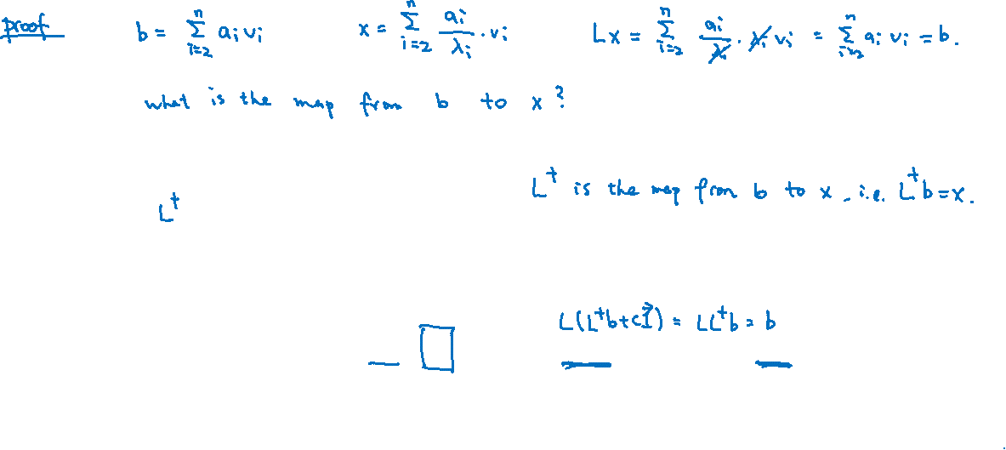
Solution Space and Pseudo-inverse of Laplacian
Claim. If $b⊥\vec{1}$, then there exists $x$ such that $Lx=b$.
The pseudo-inverse $L^{Ɨ}$ of $L$ is defined as $\sum_{i=2}^{n}{\frac{1}{λ_{i}}}v_{i}v_{i}^{T}$.
$L^{Ɨ}$ maps any vector $b⊥\vec{1}$ to the unique vector $x$ such that $Lx=b$ and $x⊥\vec{1}$.
So, the set of all solutions for $Lx=b$ is $\left\{L^{Ɨ}b+c\vec{1} | c∈ℝ\right\}$, a “shift” of the solution $L^{Ɨ}b$. (So, $\vec{f}$ is unique.)
In particular, if we fix the value of one node, e.g. $x_{t}=0$, then there is a unique solution.
Any Laplacian system can be thought of as an electrical flow problem!

Slide 9

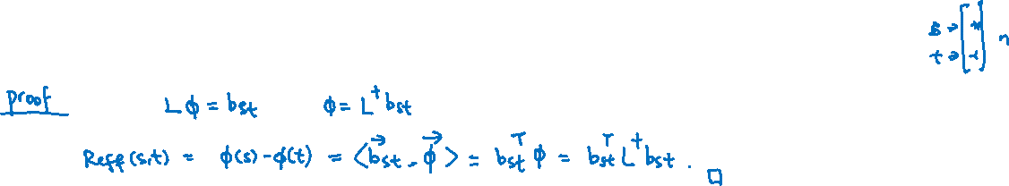
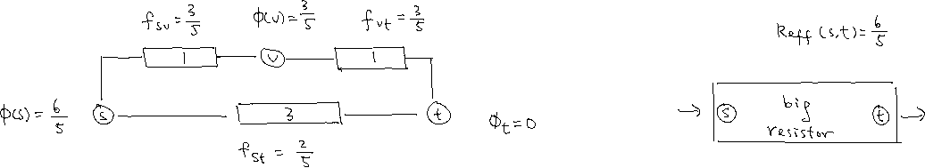
Effective Resistance
The effective resistance $R_{eff}\left(s,t\right)$between vertices $s$ and $t$ is defined as $φ\left(s\right)−φ(t)$,
when one unit of electrical flow is sent from $s$ to $t$.
We should think of it as the resistance of the whole graph as a single big resistor.
Claim. $R_{eff}\left(s,t\right)=b_{st}^{T}L^{Ɨ}b_{st}$ where $b_{st}∈ℝ^{n}$ with $b_{st}\left(s\right)=1,b_{st}\left(t\right)=−1$, and zero otherwise.

Slide 10



Energy
The energy of an electrical flow is defined as $Ɛ\left(\vec{f}\right)≔\sum_{e∈E}{f_{e}^{2}⋅r_{e}}$.
Intuitively, if we think of the graph as a big resistor, then $Ɛ\left(\vec{f}\right)=R_{eff}\left(s,t\right)$.
Claim. $Ɛ\left(\vec{f}\right)=R_{eff}\left(s,t\right)$, where $f$ is a one-unit electrical flow from $s$ to $t$.
In words, the effective resistance between $s$ and $t$ is the energy of a one-unit electrical $s$-$t$ flow.

Slide 11

Thompson’s Principle
Theorem. $R_{eff}\left(s,t\right)≤Ɛ\left(\vec{g}\right)$ where $\vec{g}$ is a one-unit $s$-$t$ flow.
So, the one unit $s$-$t$ electrical flow is the flow that minimizes the energy among all one unit $s$-$t$ flow.

Slide 12


Rayleigh’s Monotonicity Principle
Theorem. If $\vec{r^{′}}≥\vec{r},$ then $R_{eff,\vec{r^{′}}}\left(s,t\right)≥R_{eff,\vec{r}}\left(s,t\right)$.
This is very intuitive, adding the resistance of an edge could never decrease the effective resistance,
and decreasing the resistance of an edge could never increase the effective resistance.

Slide 13









Short Disjoint Paths
Lemma. If there are $k$ edge-disjoint paths from $s$ to $t$, each of length at most $l$, then $R_{eff}\left(s,t\right)≤\frac{l}{k}.$

Slide 14












Effective Resistances as Distances
Effective resistance is probably a better distance function to measure how close are two nodes.
It is known that effective resistances satisfy the triangle inequality.
Lemma. $R_{eff}\left(a,b\right)+R_{eff}\left(b,c\right)≥R_{eff}\left(a,c\right)$ for any $a,b,c$.

Slide 15
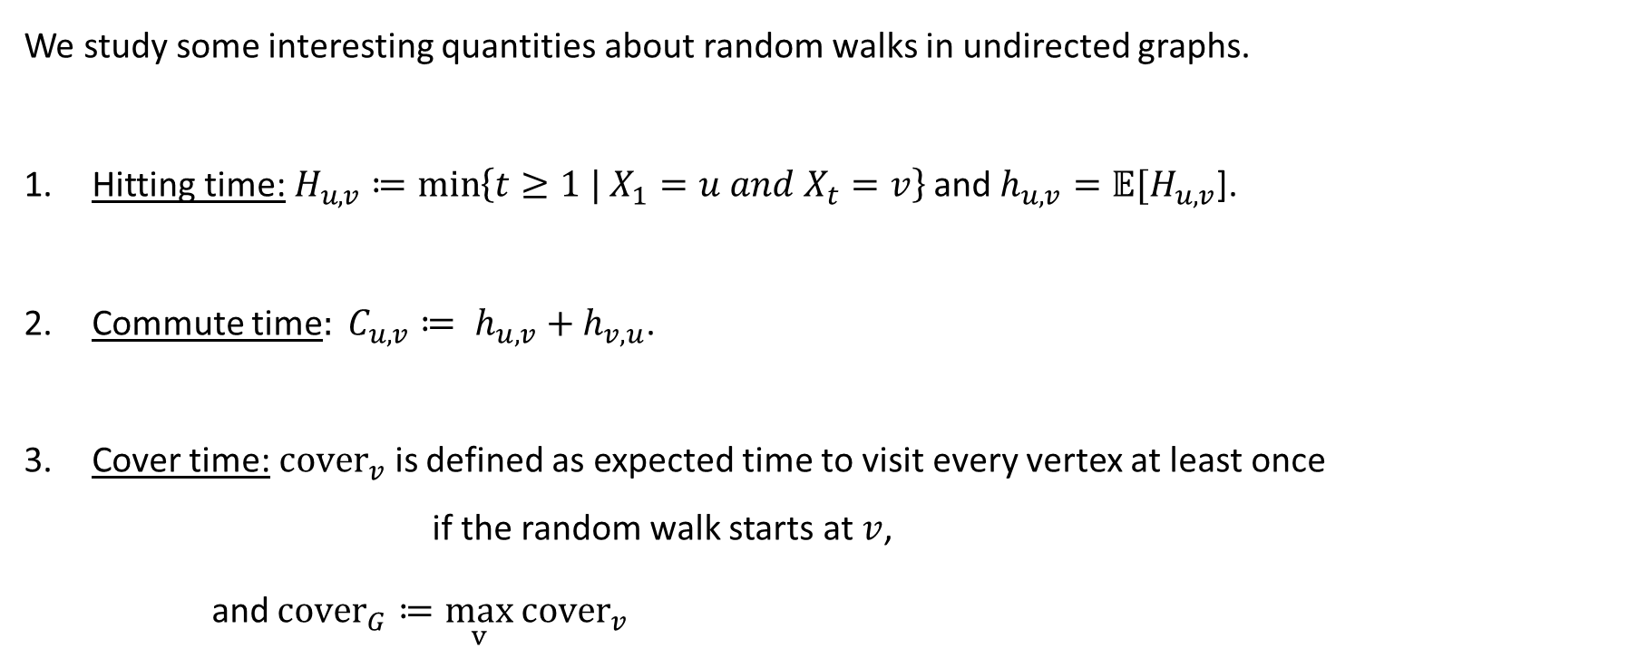
Random Walks on Undirected Graphs
We study some interesting quantities about random walks in undirected graphs.
Hitting time:$H_{u,v}≔\min\left\{t≥1 | X_{1}=u and X_{t}=v\right\}$ and $h_{u,v}=𝔼[H_{u,v}$].
Commute time$: C_{u,v}≔ h_{u,v}+h_{v,u}$.
Cover time:${cover}_{v}$is defined as expected time to visit every vertex at least once
if the random walk starts at $v$,
and ${cover}_{G}≔\max_{v}$ ${cover}_{v}$

Slide 16

Commute Time
Theorem. For any two vertices $s$ and $t$, $C_{s,t}=2mR_{eff}\left(s,t\right)$, where $m=\left|E\left(G\right)\right|$.

Slide 17



Commute Time
Theorem. For any two vertices $s$ and $t$, $C_{s,t}=2mR_{eff}\left(s,t\right)$, where $m=\left|E\left(G\right)\right|$.

Slide 18
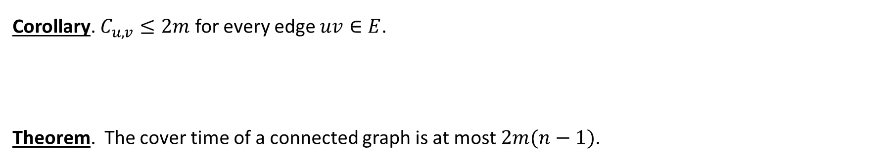
Cover Time
Corollary. $C_{u,v}≤2m$ for every edge $uv∈E$.
Theorem. The cover time of a connected graph is at most $2m(n−1)$.

Slide 19
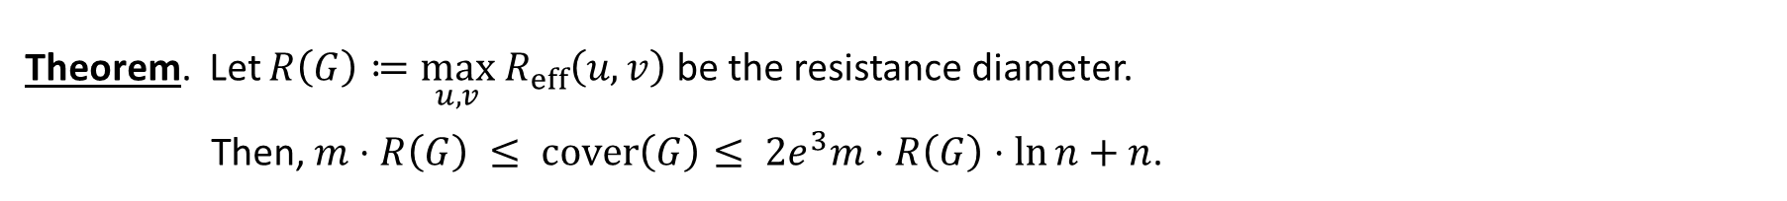
Approximating Cover Time by Resistance Diameter
Theorem. Let $R\left(G\right)≔\max_{u,v}{ R}_{eff}\left(u,v\right)$ be the resistance diameter.
Then, $m⋅R\left(G\right) ≤ cover\left(G\right)≤ 2e^{3}m⋅R\left(G\right)⋅\ln{n}+n$.

Slide 20
Graph Connectivity
There is an $O\left(n^{3}\right)$ time algorithm to solve $s$-$t$ connectivity using only $O(\log{n)}$ space.

