Slide 1
CS 466/666 - Algorithm Design and Analysis
Mixing time
Waterloo, 2 July 2020

Slide 2
Today’s Plan
Random walks on undirected graphs
Fundamental theorem of Markov chains
Spectral analysis
Mixing time
Random sampling
Proposal to be submitted July 13 (1 received!).
HW4 to be posted by Friday.
HW3 solution will be posted on Monday 11pm.

Slide 3
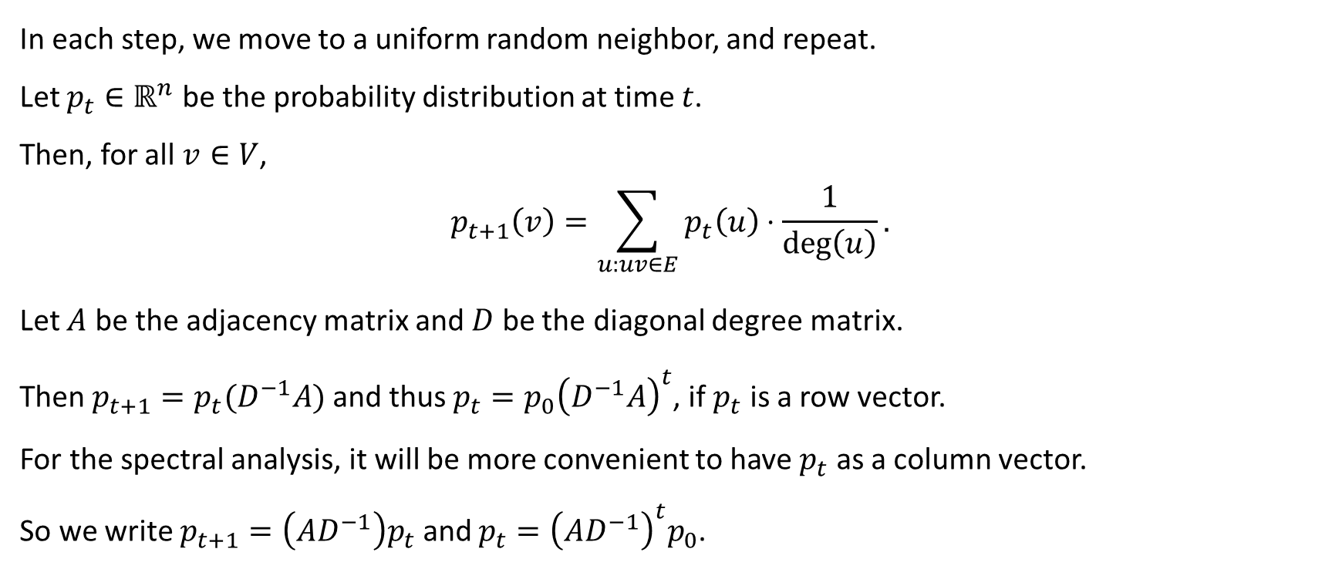
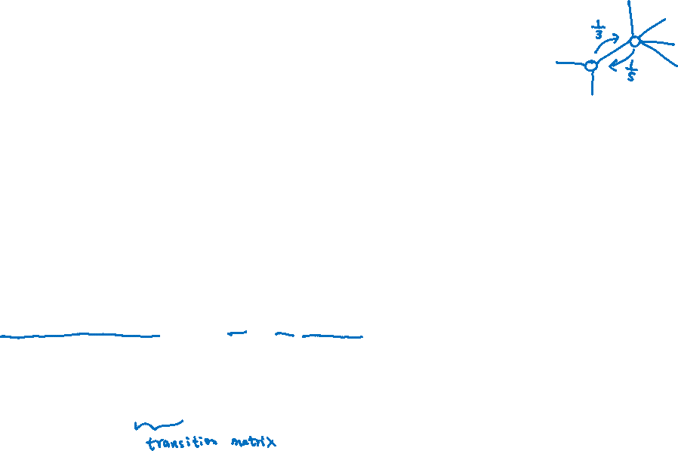
Matrix Formulation
In each step, we move to a uniform random neighbor, and repeat.
Let $p_{t}∈ℝ^{n}$ be the probability distribution at time $t$.
Then, for all $v∈V$,
$$p_{t+1}\left(v\right)=\sum_{u:uv∈E}{p_{t}\left(u\right)⋅\frac{1}{\deg\left(u\right)}}.$$
Let $A$ be the adjacency matrix and $D$ be the diagonal degree matrix.
Then $p_{t+1}=p_{t}(D^{−1}A)$ and thus $p_{t}=p_{0}{\left(D^{−1}A\right)}^{t}$, if $p_{t}$ is a row vector.
For the spectral analysis, it will be more convenient to have $p_{t}$ as a column vector.
So we write $p_{t+1}=\left(AD^{−1}\right)p_{t}$ and $p_{t}={\left(AD^{−1}\right)}^{t}p_{0}$.

Slide 4

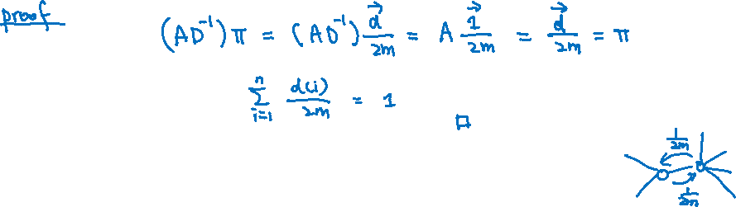
Stationary Distribution
As in Eulerian directed graph, the stationary distribution of undirected graphs is easy to describe.
Let $\vec{d}∈ℝ^{n}$ be the degree vector and $m=\left|E\right|$.
Claim. The distribution $\vec{π}=\frac{\vec{d}}{2m}$ is a stationary distribution of the random walk on undirected graphs.
In the stationary distribution, the probability of transiting an edge is the same for every edge.

Slide 5
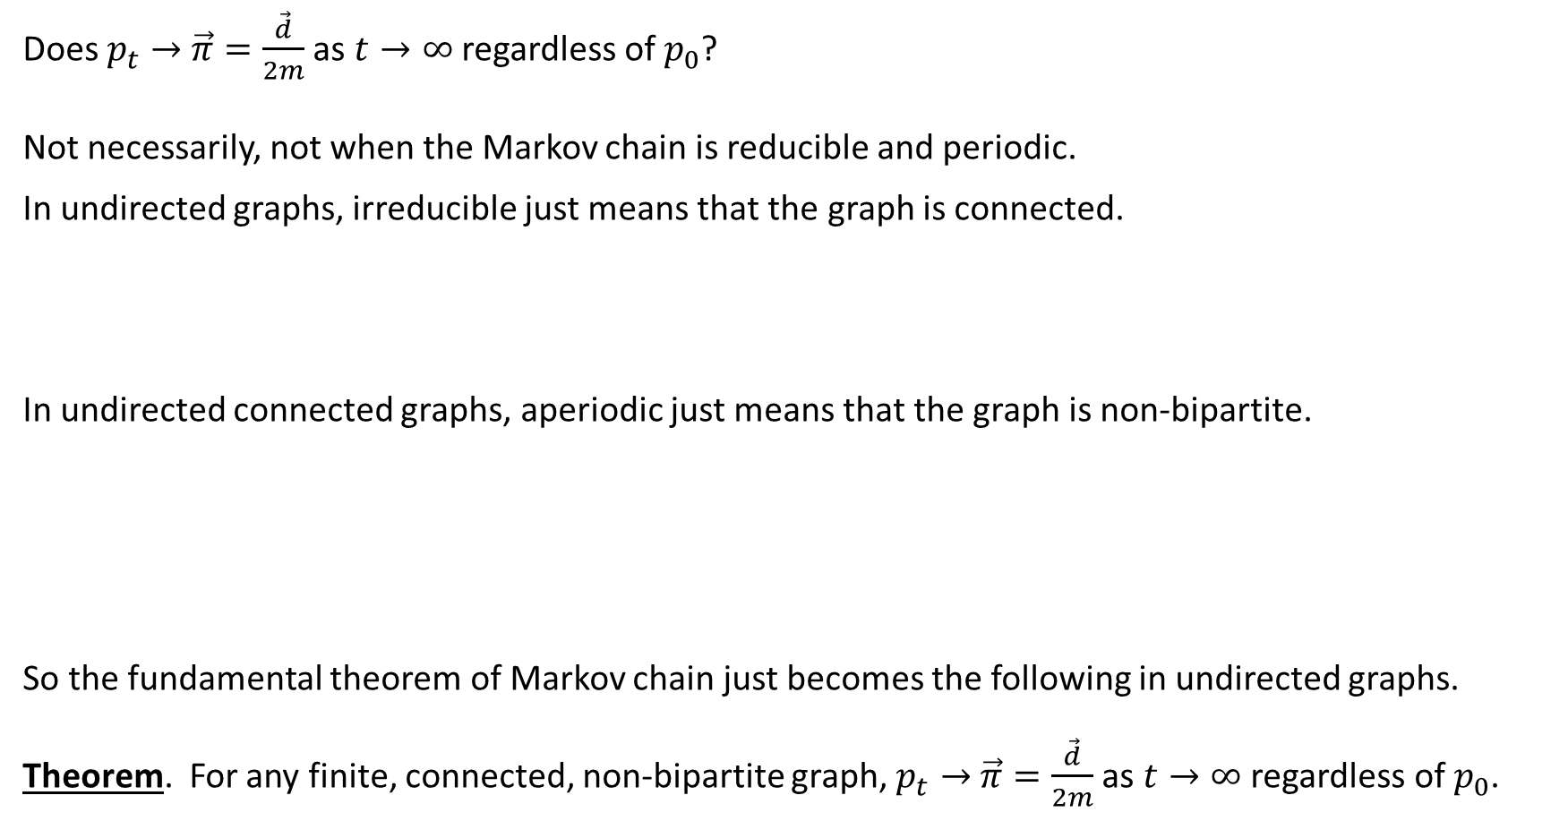
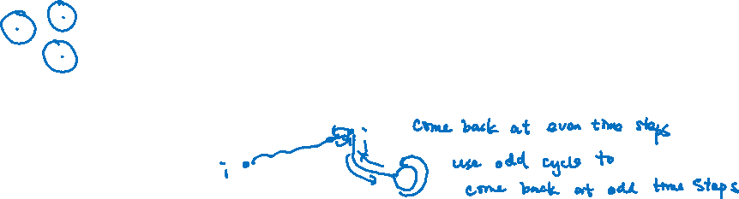
Fundamental Theorem of Markov Chains
Does $p_{t}→$ $\vec{π}=\frac{\vec{d}}{2m}$ as $t→∞$ regardless of $p_{0}$?
Not necessarily, not when the Markov chain is reducible and periodic.
In undirected graphs, irreducible just means that the graph is connected.
In undirected connected graphs, aperiodic just means that the graph is non-bipartite.
So the fundamental theorem of Markov chain just becomes the following in undirected graphs.
Theorem. For any finite, connected, non-bipartite graph, $p_{t}→$ $\vec{π}=\frac{\vec{d}}{2m}$ as $t→∞$ regardless of $p_{0}$.

Slide 6
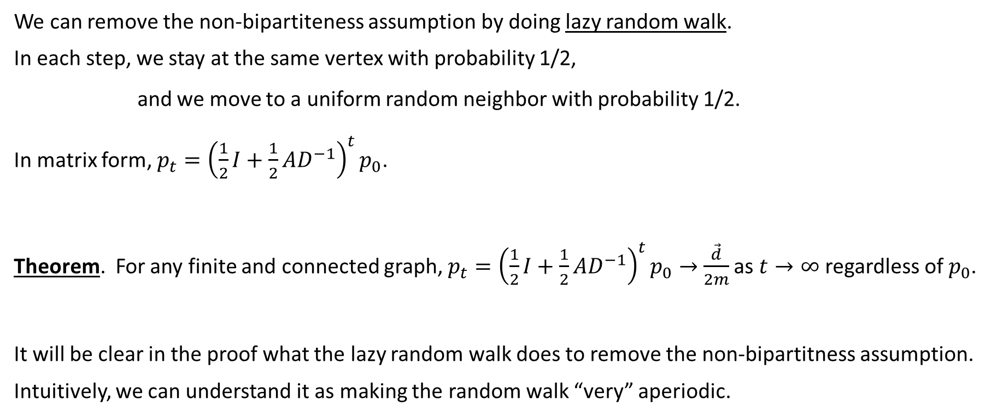
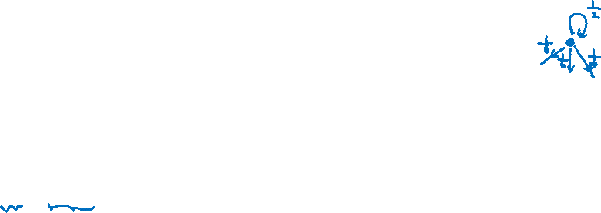
Lazy Random Walks
We can remove the non-bipartiteness assumption by doing lazy random walk.
In each step, we stay at the same vertex with probability 1/2,
and we move to a uniform random neighbor with probability 1/2.
In matrix form, $p_{t}={\left(\frac{1}{2}I+\frac{1}{2}AD^{−1}\right)}^{t}p_{0}$.
Theorem. For any finite and connected graph, $p_{t}={\left(\frac{1}{2}I+\frac{1}{2}AD^{−1}\right)}^{t}p_{0}→$ $\frac{\vec{d}}{2m}$ as $t→∞$ regardless of $p_{0}$.
It will be clear in the proof what the lazy random walk does to remove the non-bipartitness assumption.
Intuitively, we can understand it as making the random walk “very” aperiodic.

Slide 7
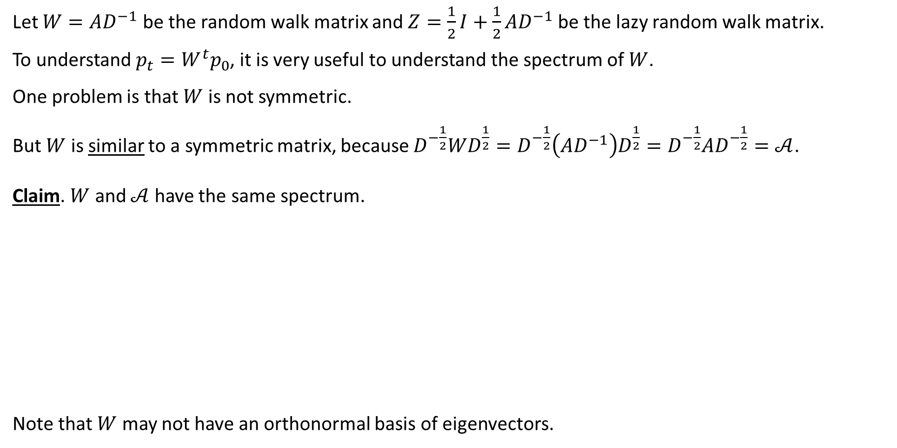
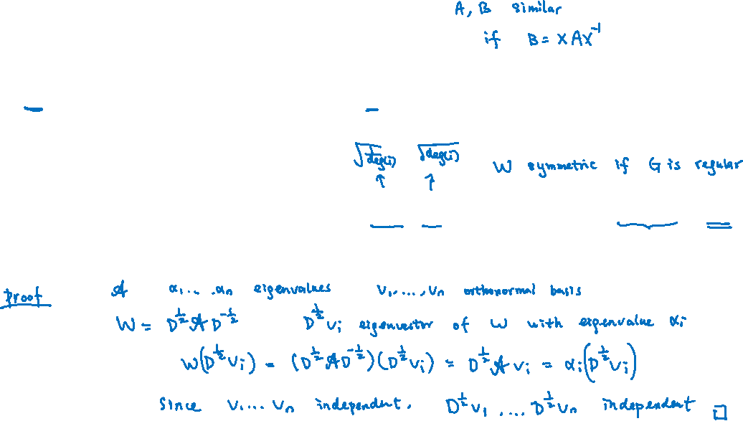
Spectra Analysis
Let $W=AD^{−1}$ be the random walk matrix and $Z=\frac{1}{2}I+\frac{1}{2}AD^{−1}$ be the lazy random walk matrix.
To understand $p_{t}=W^{t}p_{0}$, it is very useful to understand the spectrum of $W$.
One problem is that $W$ is not symmetric.
But $W$ is similar to a symmetric matrix, because $D^{−\frac{1}{2}}WD^{\frac{1}{2}}=D^{−\frac{1}{2}}\left(AD^{−1}\right)D^{\frac{1}{2}}=D^{−\frac{1}{2}}AD^{−\frac{1}{2}}=𝒜$.
Claim. $W$ and $𝒜$ have the same spectrum.
Note that $W$ may not have an orthonormal basis of eigenvectors.

Slide 8
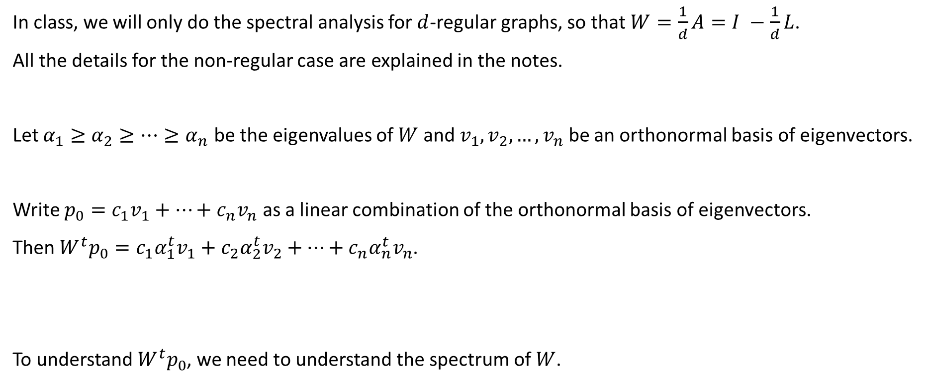
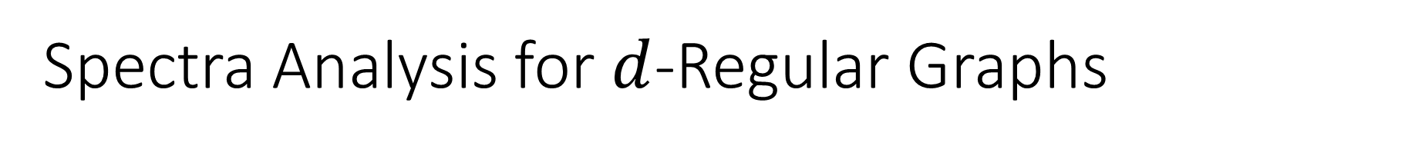
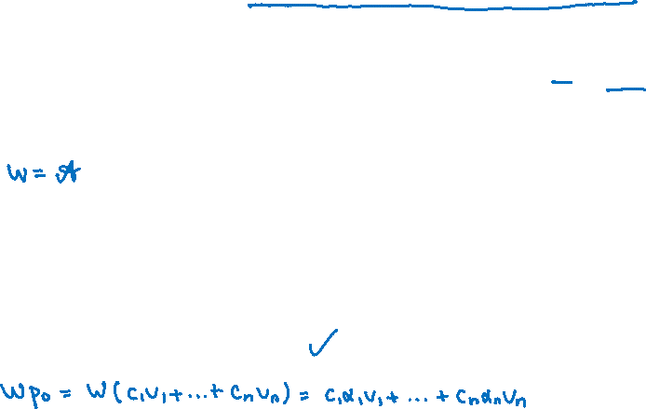
Spectra Analysis for $d$-Regular Graphs
In class, we will only do the spectral analysis for $d$-regular graphs, so that $W=\frac{1}{d}A=I −\frac{1}{d}L$.
All the details for the non-regular case are explained in the notes.
Let $α_{1}≥α_{2}≥…≥α_{n}$ be the eigenvalues of $W$ and $v_{1},v_{2},…, v_{n}$ be an orthonormal basis of eigenvectors.
Write $p_{0}=c_{1}v_{1}+⋯+c_{n}v_{n}$ as a linear combination of the orthonormal basis of eigenvectors.
Then $W^{t}p_{0}=c_{1}α_{1}^{t}v_{1}+c_{2}α_{2}^{t}v_{2}+⋯+c_{n}α_{n}^{t}v_{n}$.
To understand $W^{t}p_{0}$, we need to understand the spectrum of $W$.

Slide 9

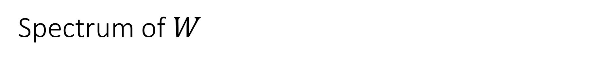
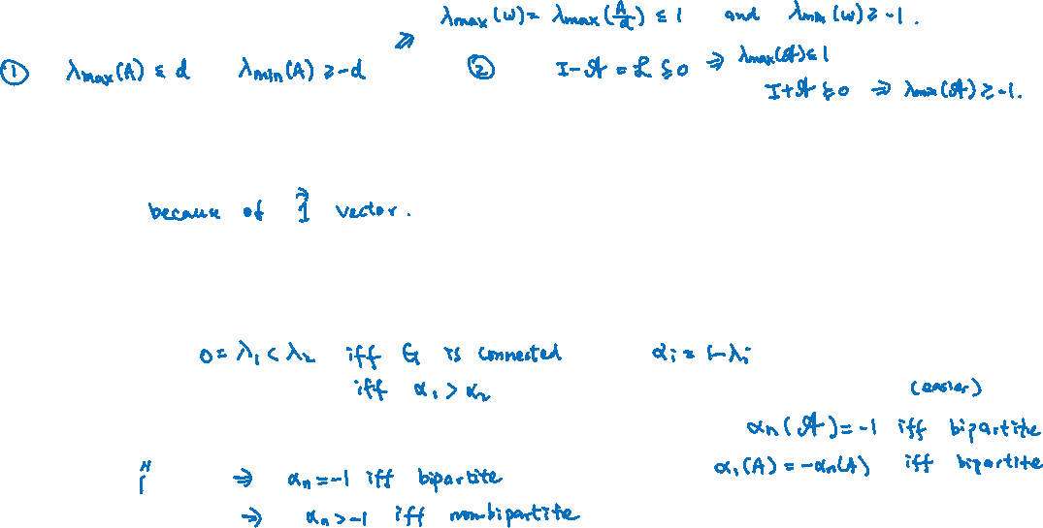
Spectrum of $W$
Let $W=\frac{1}{d}A=I −\frac{1}{d}L$. What do we know about the spectrum $α_{1}≥α_{2}≥…≥α_{n}$?
We know that $1≥α_{1}$ and $α_{n}≥−1$.
We know that $1=α_{1}$.
We know that $α_{1}>α_{2}$ if and only if the graph is connected.
We know that $α_{1}=−α_{n}$ if and only if the graph is bipartite (HW4).

Slide 10
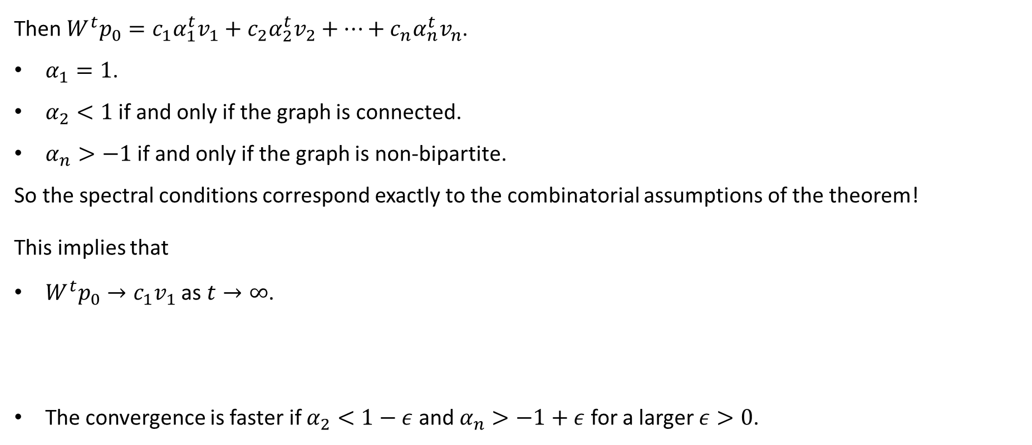
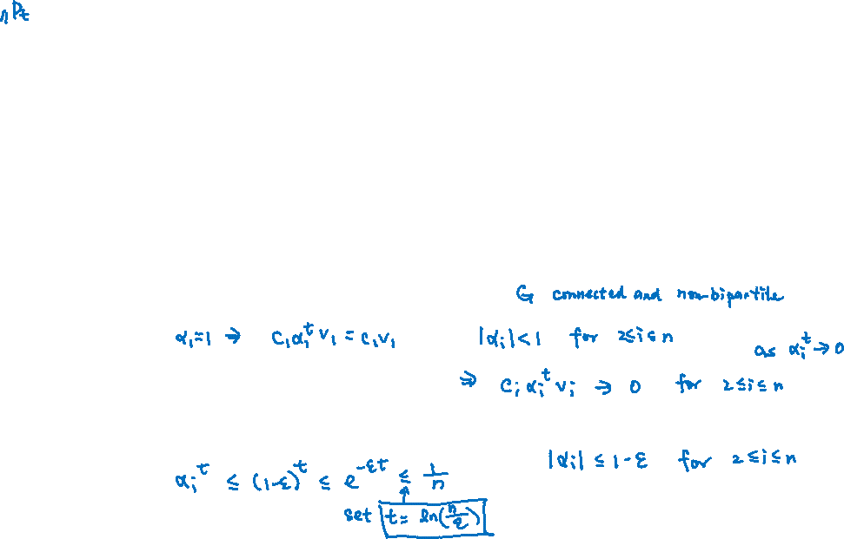
Outline
Then $W^{t}p_{0}=c_{1}α_{1}^{t}v_{1}+c_{2}α_{2}^{t}v_{2}+⋯+c_{n}α_{n}^{t}v_{n}$.
$α_{1}=1$.
$α_{2}<1$ if and only if the graph is connected.
$α_{n}>−1$ if and only if the graph is non-bipartite.
So the spectral conditions correspond exactly to the combinatorial assumptions of the theorem!
This implies that
$W^{t}p_{0}→c_{1}v_{1}$ as $t→∞$.
The convergence is faster if $α_{2}<1−ε$ and $α_{n}>−1+ε$ for a larger $ε>0$.

Slide 11
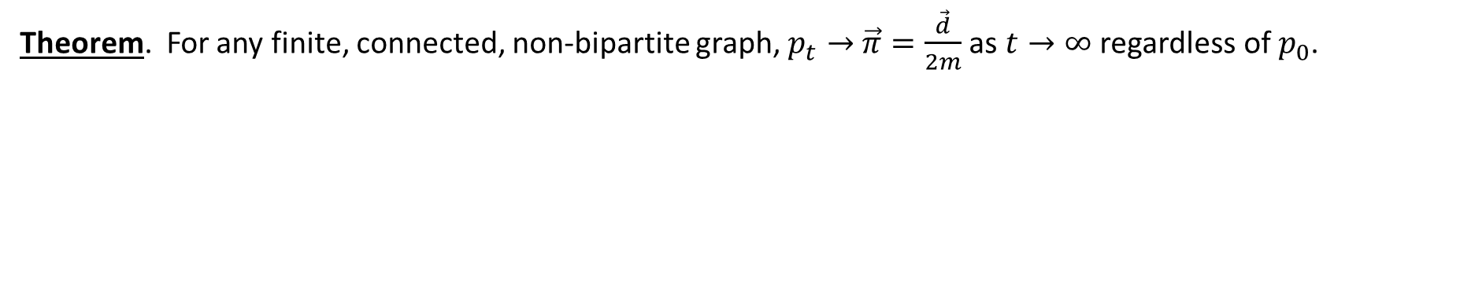
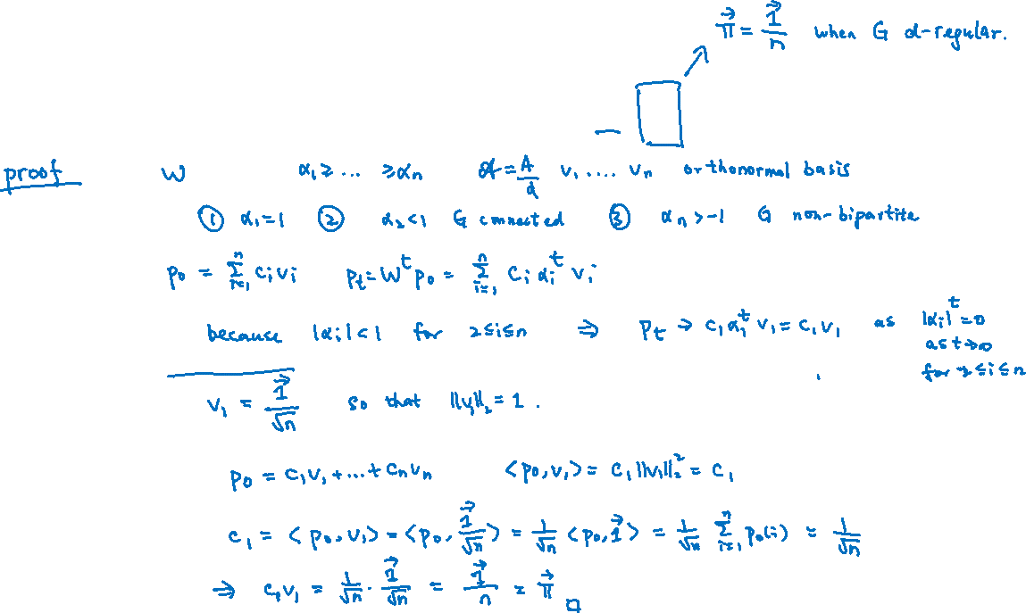
Proof of Fundamental Theorem
Theorem. For any finite, connected, non-bipartite graph, $p_{t}→$ $\vec{π}=\frac{\vec{d}}{2m}$ as $t→∞$ regardless of $p_{0}$.

Slide 12
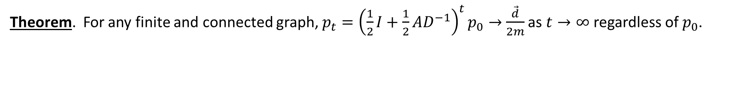
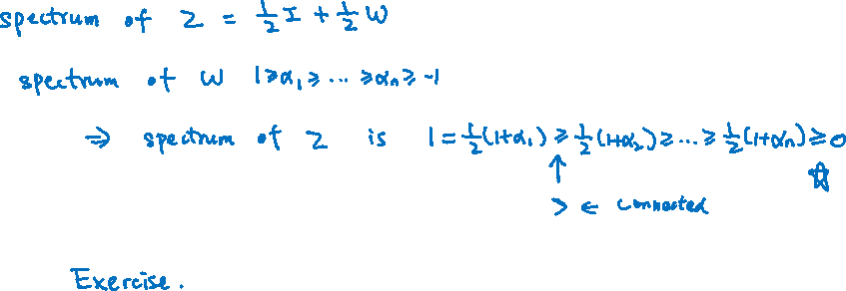
Proof for Lazy Random Walks
Theorem. For any finite and connected graph, $p_{t}={\left(\frac{1}{2}I+\frac{1}{2}AD^{−1}\right)}^{t}p_{0}→$ $\frac{\vec{d}}{2m}$ as $t→∞$ regardless of $p_{0}$.

Slide 13
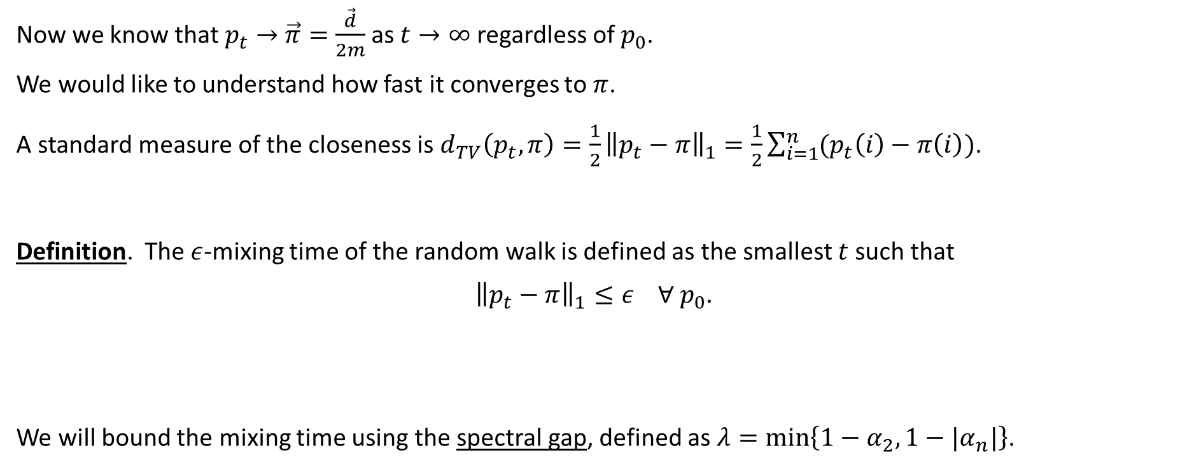
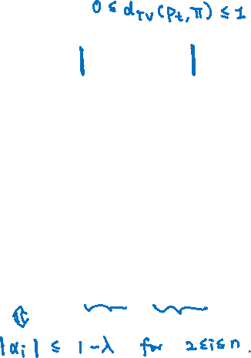
Mixing Time
Now we know that $p_{t}→$ $\vec{π}=\frac{\vec{d}}{2m}$ as $t→∞$ regardless of $p_{0}$.
We would like to understand how fast it converges to $π$.
A standard measure of the closeness is $d_{TV}\left(p_{t},π\right)=\frac{1}{2}{\left\|p_{t}−π\right\|}_{1}=\frac{1}{2}\sum_{i=1}^{n}{{(p}_{t}\left(i\right)−π\left(i\right))}$.
Definition. The $ε$-mixing time of the random walk is defined as the smallest $t$ such that
$${\left\|p_{t}−π\right\|}_{1}≤ε ∀ p_{0}.$$
We will bound the mixing time using the spectral gap, defined as $λ=\min\left\{1−α_{2},1−|α_{n}|\right\}$.

Slide 14




Mixing Time by Spectral Gap
Theorem. The $ε$-mixing time is upper bounded by $\frac{1}{λ}\log\left(\frac{n}{ε}\right)$, where $λ=\min\left\{1−α_{2},1−|α_{n}|\right\}$.

Slide 15



Mixing Time by Spectral Gap
Theorem. The $ε$-mixing time is upper bounded by $\frac{1}{λ}\log\left(\frac{n}{ε}\right)$, where $λ=\min\left\{1−α_{2},1−|α_{n}|\right\}$.
When the spectral gap is a constant (i.e. $λ=Ω(1)$), then the random walk converges in $O\left(\log{\frac{n}{ε}}\right)$ steps.
When the graph is regular with $λ=Ω(1)$, we can sample an almost uniform vertex in $O(\log{n})$ steps.

Slide 16
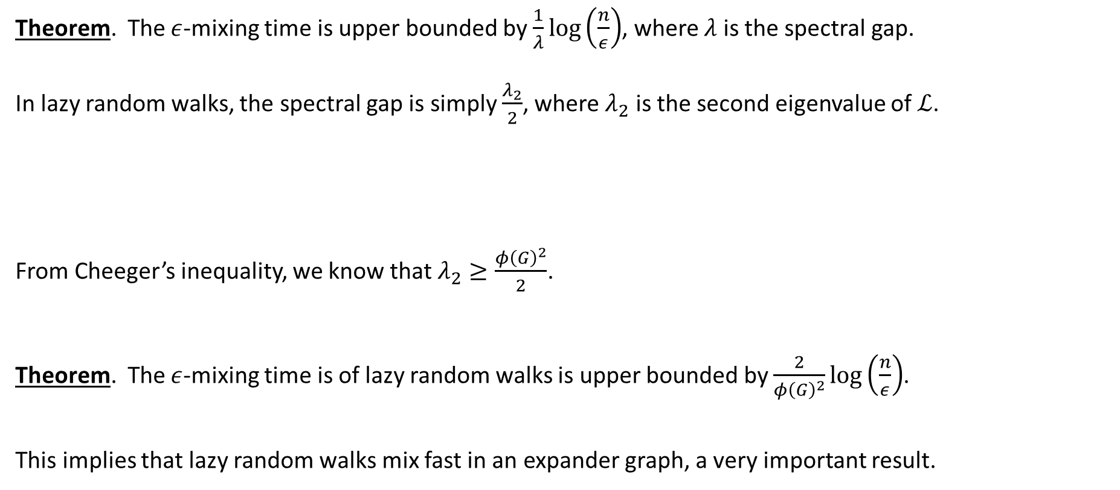
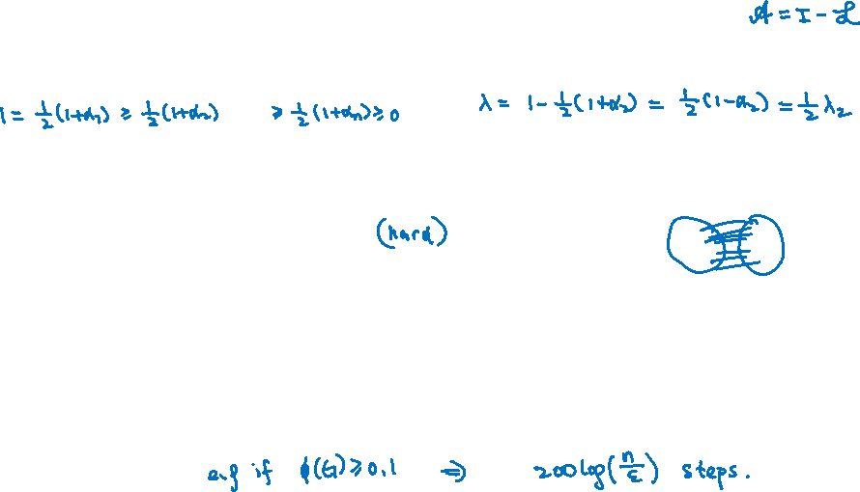
Mixing Time for Lazy Random Walks
Theorem. The $ε$-mixing time is upper bounded by $\frac{1}{λ}\log\left(\frac{n}{ε}\right)$, where $λ$ is the spectral gap.
In lazy random walks, the spectral gap is simply $\frac{λ_{2}}{2}$, where $λ_{2}$ is the second eigenvalue of $ℒ$.
From Cheeger’s inequality, we know that $λ_{2}≥\frac{φ{\left(G\right)}^{2}}{2}$.
Theorem. The $ε$-mixing time is of lazy random walks is upper bounded by $\frac{2}{φ{\left(G\right)}^{2}}\log\left(\frac{n}{ε}\right)$.
This implies that lazy random walks mix fast in an expander graph, a very important result.

Slide 17
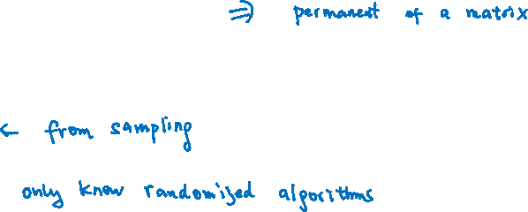
Random Sampling
One of the most important applications for random walks is in designing fast sampling algorithms.
For examples,
Card shuffling
Random perfect matching in a bipartite graph
Random spanning tree
Approximate counting

Slide 18
Card Shuffling
We have a deck of 52 cards. How to obtain a random permutation using simple operations?
Let’s say the simple operation is to choose a random card and put it at the top of the deck.
Does it converge to the uniform distribution of all permutations?
How many steps are enough to get an almost uniform distribution?
These questions can be understood as questions about random walks on the big “state” graph.
Then the first question is about stationary distribution, and the second question is about mixing time.
A famous result is 7 “riffle” shuffling will get an almost uniform permutation.

Slide 19
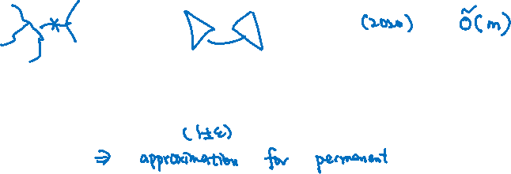
Random Combinatorial Objects
We can design a Markov chain to generate a random combinatorial object efficiently.
For example, the simple random “swap” algorithm to generate a random spanning tree.
And there are sampling algorithms for many combinatorial objects (e.g. random perfect matching).
It is usually easy to construct the Markov chain so that the limiting distribution is uniform.
But it is usually difficult to prove that the mixing time is fast.
There are books just focus on mixing time.
Many methods are developed, including coupling, conductance, second eigenvalue, etc.

Slide 20
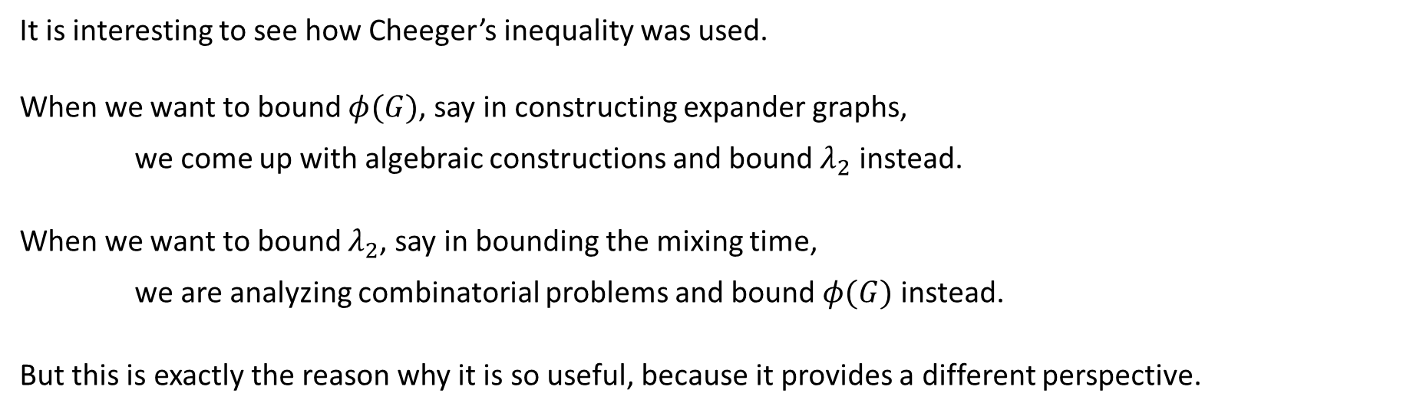
Cheeger’s Inequality
It is interesting to see how Cheeger’s inequality was used.
When we want to bound $φ(G)$, say in constructing expander graphs,
we come up with algebraic constructions and bound $λ_{2}$ instead.
When we want to bound $λ_{2}$, say in bounding the mixing time,
we are analyzing combinatorial problems and bound $φ(G)$ instead.
But this is exactly the reason why it is so useful, because it provides a different perspective.

