Slide 1
CS 466/666 - Algorithm Design and Analysis
Cheeger’s inequality
Waterloo, 25 June 2020

Slide 2
Today’s Plan
Rayleigh quotient
Largest eigenvalue
Spectral partitioning algorithm
Cheeger’s inequality
Proposal instruction will be posted soon.
HW3 due Monday, from L07.pdf – L10.pdf.
HW2 solution posted.

Slide 3
Second eigenvalue
We order the eigenvalues of the adjacency matrix as $α_{1}≥α_{2}≥⋯≥α_{n}$.
We order the eigenvalues of the Laplacian matrix as $0=λ_{1}≤λ_{2}≤⋯≤λ_{n}$.
We showed that $G$ is disconnected if and only if $λ_{2}=0$,
or $G$ is connected if and only if $λ_{2}>0$.
Homework. $λ_{k}=0$ if and only if $G$ has at least $k$ connected components.

Slide 4
Robust generalizations
It is easy to characterize connectedness and bipartiteness anyway, so why spectral graph theory?
It turns out that these spectral characterizations can be generalized in a non-trivial quantitative way!
$λ_{2}$ is “small” if and only if $G$ is “close” to be disconnected (i.e. the existence of a “sparse” cut).
$λ_{k}$ is “small” if and only if $G$ is “close” to having $k$ disconnected components (i.e. $k$ disjoint “sparse” cuts).
$α_{n}≈−α_{1}$ if and only if $G$ has a “close-to-bipartite-component”.
We will try to prove the first item today and try to make precise the other statements next time.

Slide 5
Rayleigh quotient
The main concept in relating eigenvalues to optimization is the Rayleigh quotient, which is defined as
$$R_{A}\left(x\right)≔\frac{x^{T}Ax}{x^{T}x}.$$
Lemma. Let $A$ be real symmetric with eigenvalue $α_{1}≥α_{2}≥⋯≥α_{n}$. Then
$$α_{1}=\max_{x∈ℝ^{n}}{\frac{x^{T}Ax}{x^{T}x}}.$$

Slide 6
Rayleigh quotient
Lemma. Let $A$ be real symmetric with eigenvalue $α_{1}≥α_{2}≥⋯≥α_{n}$. Then
$$α_{k}=\max_{x∈T_{k}}{\frac{x^{T}Ax}{x^{T}x}},$$
where $T_{k}$ is defined as the set of vectors orthogonal to $v_{1},v_{2},…,v_{k−1}$.
See notes for the Courant-Fischer theorem that is more general (i.e. bounding $α_{k}$ without knowing $T_{k}$).

Slide 7
Largest eigenvalue of adjacency matrix
Lemma. Let $α$ be the largest eigenvalue of the adjacency matrix. Then, $α≤d_{max}$, max degree of $G$.

Slide 8
Perron-Frobenius theorem
This is a general theorem about the largest eigenvalue of a non-negative matrix.
Theorem. Let $A$ be a non-negative, irreducible and aperiodic matrix (not necessarily symmetric).
The largest (in absolute value) eigenvalue $α_{1}$ is of multiplicity one.
All entries of the eigenvector corresponding to $α_{1}$ are non-zero and have the same sign.
$\left|α_{i}\right|<α_{1}$ for $2≤i≤n$.
You may need this theorem for some homework problems.
See chapter 8 of “Algebraic graph theory” by Godsil and Royle for a proof.

Slide 9
Summary of L12
Background: spectral theorem for real symmetric matrices,
eigendecomposition, positive semidefinite matrices.
Adjacency matrix: bipartiteness, largest eigenvalue
Laplacian matrix: all-one vector, positive semidefiniteness,
quadratic form, decomposition
connectedness
Rayleigh quotient: connect eigenvalues to optimization problems.
Perron-Frobenius theorem.

Slide 10
Graph conductance
Recall that $G$ is disconnected if and only if $λ_{2}=0$.
Cheeger’s inequality will show that $G$ is “close” to be disconnected if and only if $λ_{2}$ is “small”.
We will first define precisely what it means to be close to be disconnected.
The conductance of a set $S⊆V$ is defined as
$$φ\left(S\right)≔\frac{\left|δ\left(S\right)\right|}{vol\left(S\right)},$$
where $vol\left(S\right)≔\sum_{v∈S}{\deg\left(v\right)}.$
When the graph is $d$-regular, $φ\left(S\right)≔\frac{\left|δ\left(S\right)\right|}{d\left|S\right|}.$
The conductance of a graph $G$ is defined as $φ\left(G\right)≔\min_{S:vol\left(S\right)≤m}{φ\left(S\right)}$.
Note that $0≤φ\left(G\right)≤1$.

Slide 11
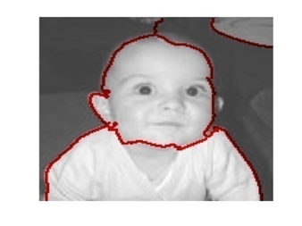
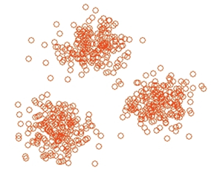
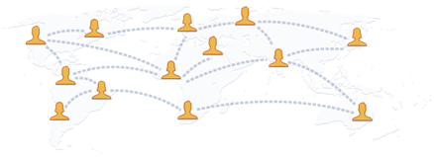
Expander graphs and sparse cuts
A graph $G$with constant $φ\left(G\right)$ (e.g. $φ\left(G\right)=0.1$) is called an expander graph.
A set $S$ with small $φ(S)$ is called a sparse cut.
Both concepts are very useful.
We have seen that sparse expander graphs are “magical” and have algorithmic applications.
They are also useful in random sampling and derandomization.
Finding a sparse cut is useful in designing divide-and-conquer algorithms, and have applications in
image segmentation, data clustering, community detection, VLSI-design, etc.

Slide 12
Spectral partitioning algorithm
A popular heuristic used in practice.
Compute an eigenvector $x∈ℝ^{n}$ corresponding to the second smallest eigenvalue of $ℒ$.
Sort the vertices so that $x_{1}≥x_{2}≥…≥x_{n}$.
Let $S_{i}≔\left\{\begin{aligned}\left\{1,…,i\right\} if i≤\frac{n}{2} \\ \left\{i+1,…,n\right\} if i≥\frac{n}{2}\end{aligned}\right.$
Return $\min_{1≤i≤n}{φ\left(S_{i}\right)}$.
This is simple and can be implemented in near-linear time.
It performs very well in practice, especially in image segmentation.

Slide 13
Normalized matrices
To state Cheeger’s inequality nicely, we introduce normalized adjacency and Laplacian matrices.
Let $𝒜=D^{−\frac{1}{2}}AD^{−\frac{1}{2}}$ be the normalized adjacency matrix.
Let $ℒ=D^{−\frac{1}{2}}AD^{−\frac{1}{2}}$ be the normalized Laplacian matrix.
Note that $ℒ=I − 𝒜$.
When the graph is $d$-regular, $𝒜=\frac{1}{d}A$ and $ℒ=\frac{1}{d}L$.
Claim. Let $α_{1}≥⋯≥α_{n}$ be the eigenvalues of $𝒜$, and $λ_{1}≤⋯≤λ_{n}$ be the eigenvalues of $ℒ$.
Then, $1=α_{1}≥⋯≥α_{n}≥−1$, and $0=λ_{1}≤⋯≤λ_{n}≤2$.

Slide 14
Cheeger’s inequality
The first inequality is called the easy direction, and the second inequality is called the hard direction.
We will only prove Cheeger’s inequality in the case when $G$ is a $d$-regular graph.
This simplifies the algebraic manipulation a bit, but all the main ideas are here.
Cheeger’s Inequality [Cheeger 70, Alon-Milman 85]

Slide 15
Second eigenvalue and graph conductance
The second eigenvalue of the normalized Laplacian matrix of a $d$-regular graph is:
For intuition, consider $S$ with $\left|S\right|=n/2$.

Slide 16
Proof of the easy direction
We should think of $λ_{2}$ is a “relaxation” of the graph conductance problem.
One consequence of the easy direction is that if $λ_{2}$ is large, then the graph is an expander graph.

Slide 17
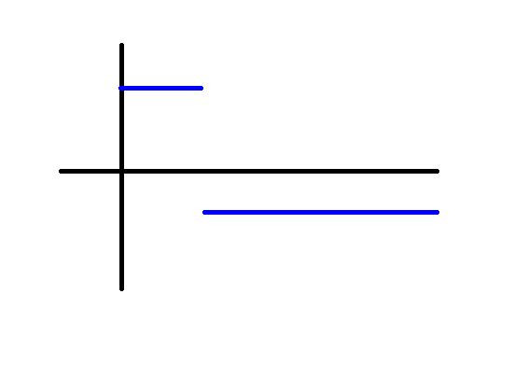
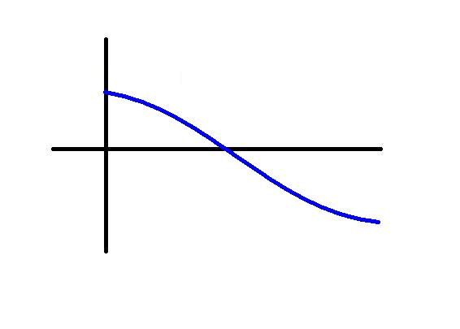
Hard direction: Examples
➔
vertices
➔
➔
vertices
➔

Slide 18
Hard direction: Intuition
The second eigenvector gives us an embedding on a line so that most edges are short.

Slide 19
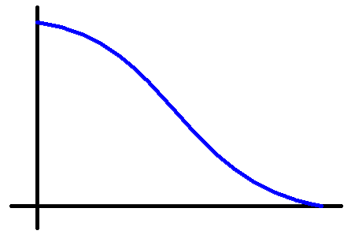
Hard direction: Preprocessing
Without loss, assume the number of positive entries in $x$ is at most the number of negative entries.
We simply zero out the negative entries of $x$ to obtain $y$.
Lemma. $R\left(y\right)≤R(x)$.
Working with $y$, we will ensure that the output set $S$ satisfies $\left|S\right|≤n/2$.

Slide 20
Hard direction: Plan
Proposition. Given any $y$, there exists a subset $S⊆supp(y)$ such that $φ\left(S\right)≤\sqrt{2R\left(y\right)}≤\sqrt{2λ_{2}}$,
where $supp\left(y\right)≔\left\{i \right| y\left(i\right)≠0\}$.
Proof plan. By scaling, assume that $\max_{i} y\left(i\right)=1$.
For $0<t≤1$, we consider the “threshold set” $S_{t}≔\left\{i \right| y{\left(i\right)}^{2}≥t\}$.
We want to prove that there exists a $t$ such that $φ\left(S_{t}\right)≤\sqrt{2R\left(y\right)}$.
The idea is to choose $t$ uniformly randomly from $\left(0,1\right)$!
We will show that $\frac{𝔼_{t}\left[\left|δ\left(S_{t}\right)\right|\right]}{𝔼_{t}\left[d\left|S_{t}\right|\right]}≤\sqrt{2R\left(y\right)}$.
This would imply that there exists $t$ such that $\frac{\left|δ\left(S_{t}\right)\right|}{d\left|S_{t}\right|}≤\sqrt{2R\left(y\right)}$, as desired.

Slide 21
Hard direction: Proof
Proposition. Given any $y$, there exists a subset $S⊆supp(y)$ such that $φ\left(S\right)≤\sqrt{2R\left(y\right)}≤\sqrt{2λ_{2}}$,
where $supp\left(y\right)≔\left\{i \right| y\left(i\right)≠0\}$.
Proof. Choose a random “threshold set” $S_{t}≔\left\{i \right| y{\left(i\right)}^{2}≥t\}$.
We will show that $\frac{𝔼_{t}\left[\left|δ\left(S_{t}\right)\right|\right]}{𝔼_{t}\left[d\left|S_{t}\right|\right]}≤\sqrt{2R\left(y\right)}$.
Let’s first calculate $𝔼_{t}\left[d\left|S_{t}\right|\right]$.

Slide 22
Hard direction: Proof
Proof (cont.) Choose a random “threshold set” $S_{t}≔\left\{i \right| y{\left(i\right)}^{2}≥t\}$.
It remains to show that $𝔼_{t}\left[\left|δ\left(S_{t}\right)\right|\right]≤\sqrt{2R\left(y\right)}⋅\left(d\sum_{i∈V}{y_{i}^{2}}\right)$.

Slide 23
Summary of the proof
Easy direction is to show that $λ_{2}=\min_{x∈ℝ^{n}}{\frac{\sum_{ij∈E}{{\left(x_{i}−x_{j}\right)}^{2}}}{d\sum_{i∈V}{x_{i}^{2}}}}$ is a “relaxation” of $φ\left(G\right)≈\min_{x:x "binary"}{\frac{\sum_{ij∈E}{{\left(x_{i}−x_{j}\right)}^{2}}}{d\sum_{i∈V}{x_{i}^{2}}}}$.
For the hard direction, given an optimizer $x$ for $λ_{2}$, we want to produce a set $S$ with $φ\left(S\right)≤\sqrt{2λ_{2}}$.
The idea is simply to try all “threshold” sets of $x$.
We truncate the vector $x$ to obtain $y$ to ensure that the output set is of size at most $n/2$.
In the analysis, we choose a random threshold for $y$ and prove that $\frac{𝔼_{t}\left[\left|δ\left(S_{t}\right)\right|\right]}{𝔼_{t}\left[d\left|S_{t}\right|\right]}≤\sqrt{2R\left(y\right)}$.
In general, this is called a “rounding” algorithm, where we turn a “fractional” solution to an integral solution.
This is the most common way to design approximation algorithms for NP-hard optimization problems.
And today we have seen an example of “randomized rounding”, a useful technique in rounding algorithms.

