Slide 1
CS 466/666 - Algorithm Design and Analysis
Spectral graph theory
Waterloo, 23 June 2020

Slide 2
Today’s Plan
Spectral graph theory
Linear algebra background
Adjacency matrix, bipartiteness
Laplacian matrix, connectedness
Rayleigh quotient
Proposal instruction will be posted.
HW3 due Monday, from L07.pdf – L10.pdf.
HW2 solution posted.

Slide 3
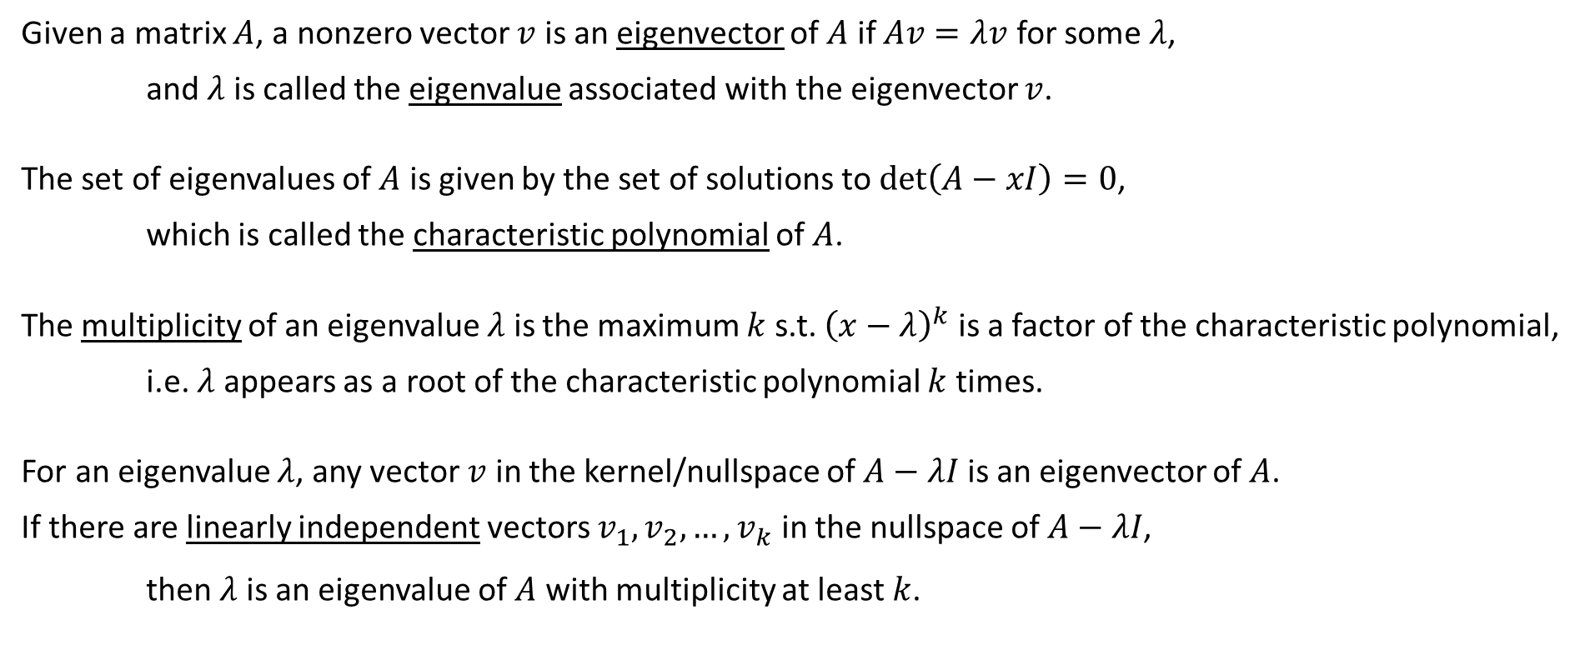
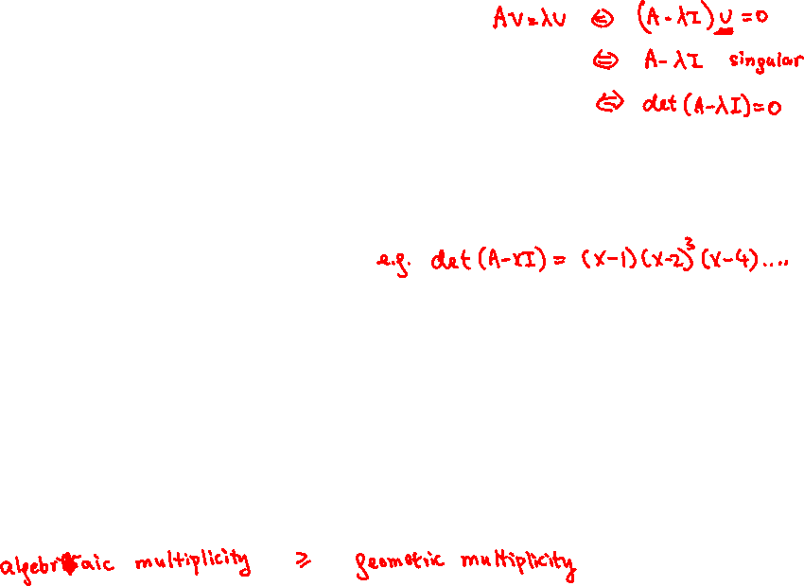
Eigenvalues and eigenvectors
Given a matrix $A$, a nonzero vector $v$ is an eigenvector of $A$ if $Av=λv$ for some $λ$,
and $λ$ is called the eigenvalue associated with the eigenvector $v$.
The set of eigenvalues of $A$ is given by the set of solutions to $\det\left(A−xI\right)=0$,
which is called the characteristic polynomial of $A$.
The multiplicity of an eigenvalue $λ$ is the maximum $k$ s.t. ${\left(x−λ\right)}^{k}$ is a factor of the characteristic polynomial,
i.e. $λ$ appears as a root of the characteristic polynomial $k$ times.
For an eigenvalue $λ$, any vector $v$ in the kernel/nullspace of $A−λI$ is an eigenvector of $A$.
If there are linearly independent vectors $v_{1},v_{2},…,v_{k}$ in the nullspace of $A−λI$,
then $λ$ is an eigenvalue of $A$ with multiplicity at least $k$.

Slide 4
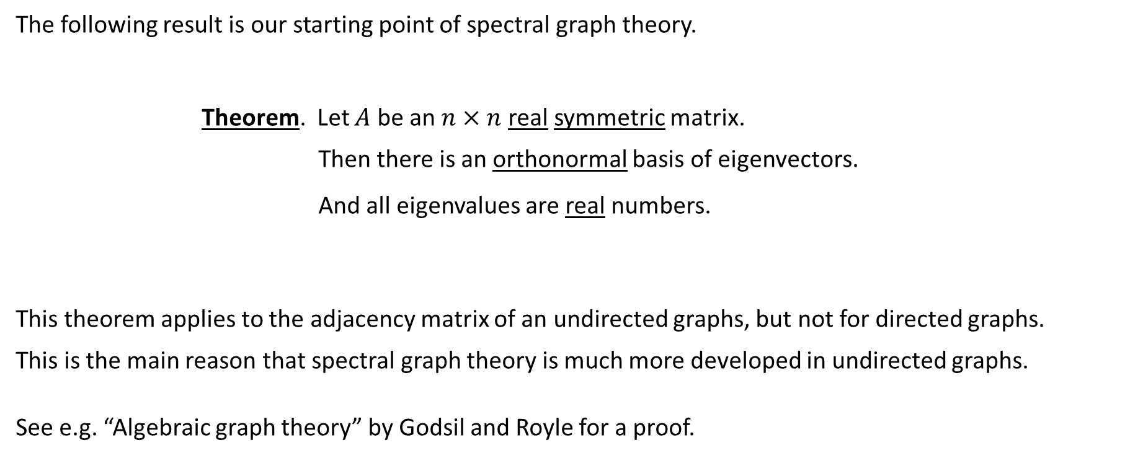
Spectral theorem for real symmetric matrices
The following result is our starting point of spectral graph theory.
Theorem. Let $A$ be an $n×n$ real symmetric matrix.
Then there is an orthonormal basis of eigenvectors.
And all eigenvalues are real numbers.
This theorem applies to the adjacency matrix of an undirected graphs, but not for directed graphs.
This is the main reason that spectral graph theory is much more developed in undirected graphs.
See e.g. “Algebraic graph theory” by Godsil and Royle for a proof.

Slide 5


Eigen-decomposition of a real symmetric matrix
Let $v_{1},v_{2},…,v_{n}$ be an orthonormal basis of eigenvectors of $A$, and $λ_{1},λ_{2},…,λ_{n}$ be corresponding eigenvalues.
This decomposition is very useful in computations.

Slide 6

Power of matrices
It is easy to compute $A^{k}$ if we have the eigen-decomposition.
This is very useful in analyzing random walks, because $p_{t}=P^{t}p_{0}$ where $P$ is the transition matrix.
We will use the eigenvalues of $P$ to prove the fundamental theorem and bound the mixing time.

Slide 7

Orthonormal basis of eigenvectors
We can write any vector $x$ as a linear combination of an orthonormal basis of eigenvectors.

Slide 8

Orthonormal basis of eigenvectors
We can write any vector $x$ as a linear combination of an orthonormal basis of eigenvectors.
We can write $I, A, A^{−1}$ using the real eigenvalues and the orthonormal eigenvectors of real symmetric $A$.

Slide 9









Positive semidefinite matrices
Proposition. Let $A∈ℝ^{n×n}$ be a real symmetric matrix. The following conditions are equivalent.
  $A$ is positive semidefinite, i.e. all eigenvalues of $A$ are non-negative.
  For any $x∈ℝ^{n}$, we have $x^{T}Ax≥0$, i.e. all quadratic forms are non-negative.
  $A=UU^{T}$ for some matrix $U∈ℝ^{n×m}$.
We use the notation $A≽0$ for $A$ being PSD, an analog of a matrix being non-negative.

Slide 10
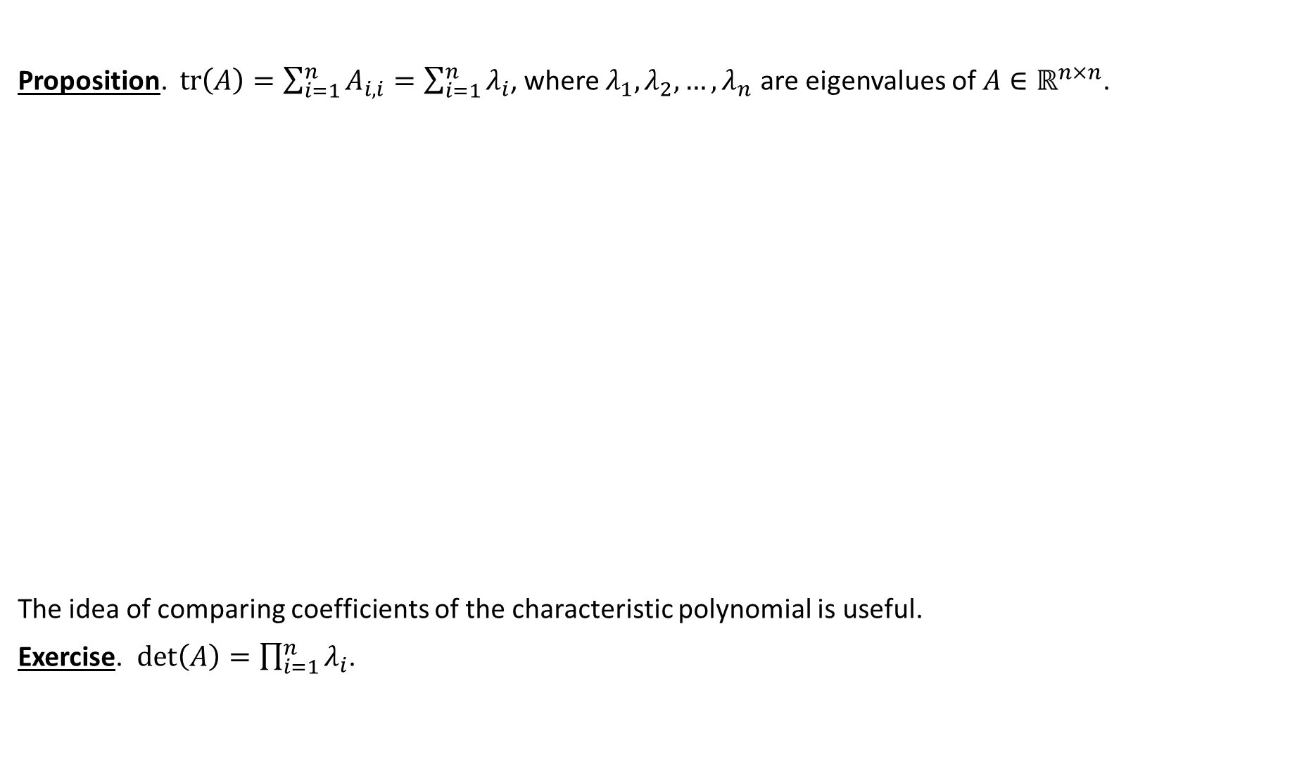
Some identities for eigenvalues
Proposition. $tr\left(A\right)=\sum_{i=1}^{n}{A_{i,i}}=\sum_{i=1}^{n}{λ_{i}}$, where $λ_{1},λ_{2},…,λ_{n}$ are eigenvalues of $A∈ℝ^{n×n}$.
The idea of comparing coefficients of the characteristic polynomial is useful.
Exercise. $\det\left(A\right)=\prod_{i=1}^{n}{λ_{i}}$.

Slide 11
Graph spectrum
In computer science, we treat the adjacency matrix of a graph simply as a 2-dimensional array.
In algebraic/spectral graph theory, we respect the adjacency matrix of a graph as a matrix, and relate
its algebraic properties (e.g. rank, determinant, eigenvalues) to its combinatorial properties.

Slide 12

Complete graphs
What is the spectrum of the adjacency matrix of the complete graph on $n$ vertices?
This is an example with the largest gap between the largest eigenvalue and the second largest eigenvalue.

Slide 13
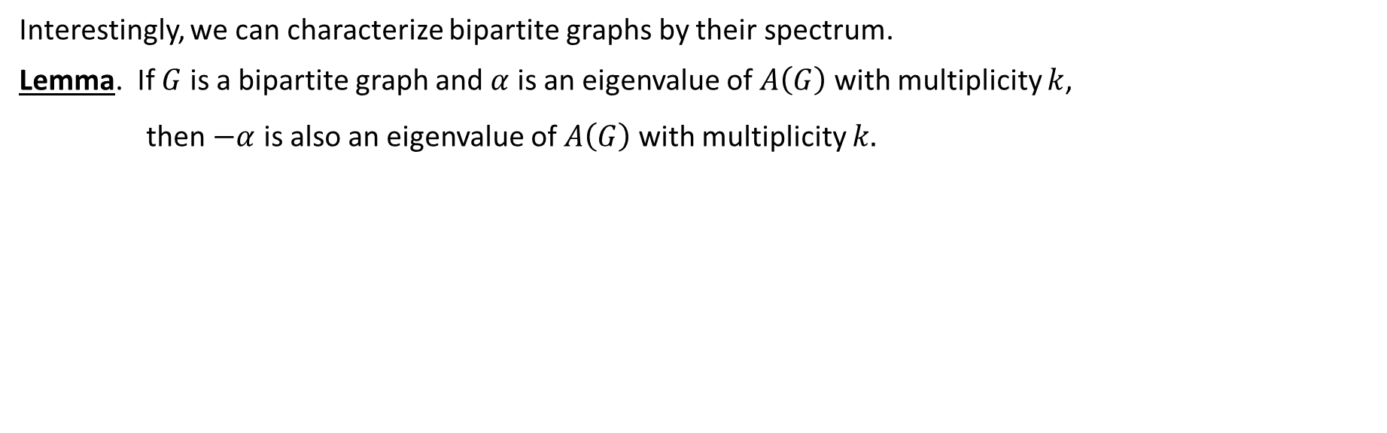
Bipartite graphs
Interestingly, we can characterize bipartite graphs by their spectrum.
Lemma. If $G$ is a bipartite graph and $α$ is an eigenvalue of $A\left(G\right)$ with multiplicity $k$,
then $−α$ is also an eigenvalue of $A\left(G\right)$with multiplicity $k.$

Slide 14
Bipartite graphs
Interestingly, we can characterize bipartite graphs by their spectrum.
Lemma. If $G$ is a bipartite graph and $α$ is an eigenvalue of $A\left(G\right)$ with multiplicity $k$,
then $−α$ is also an eigenvalue of $A\left(G\right)$with multiplicity $k.$

Slide 15

Bipartite graphs
The converse is also true!
Lemma. Let $α_{1}, …,α_{n}$ be the eigenvalue of $A(G)$. If $α_{i}=α_{n−i+1}$ for all $i$, then $G$ is bipartite.

Slide 16




Bipartite graphs
The converse is also true!
Lemma. Let $α_{1}, …,α_{n}$ be the eigenvalue of $A(G)$. If $α_{i}=α_{n−i+1}$ for all $i$, then $G$ is bipartite.
Theorem. $G$ is bipartite if and only if the spectrum of $A\left(G\right)$ is symmetric around the origin.

Slide 17
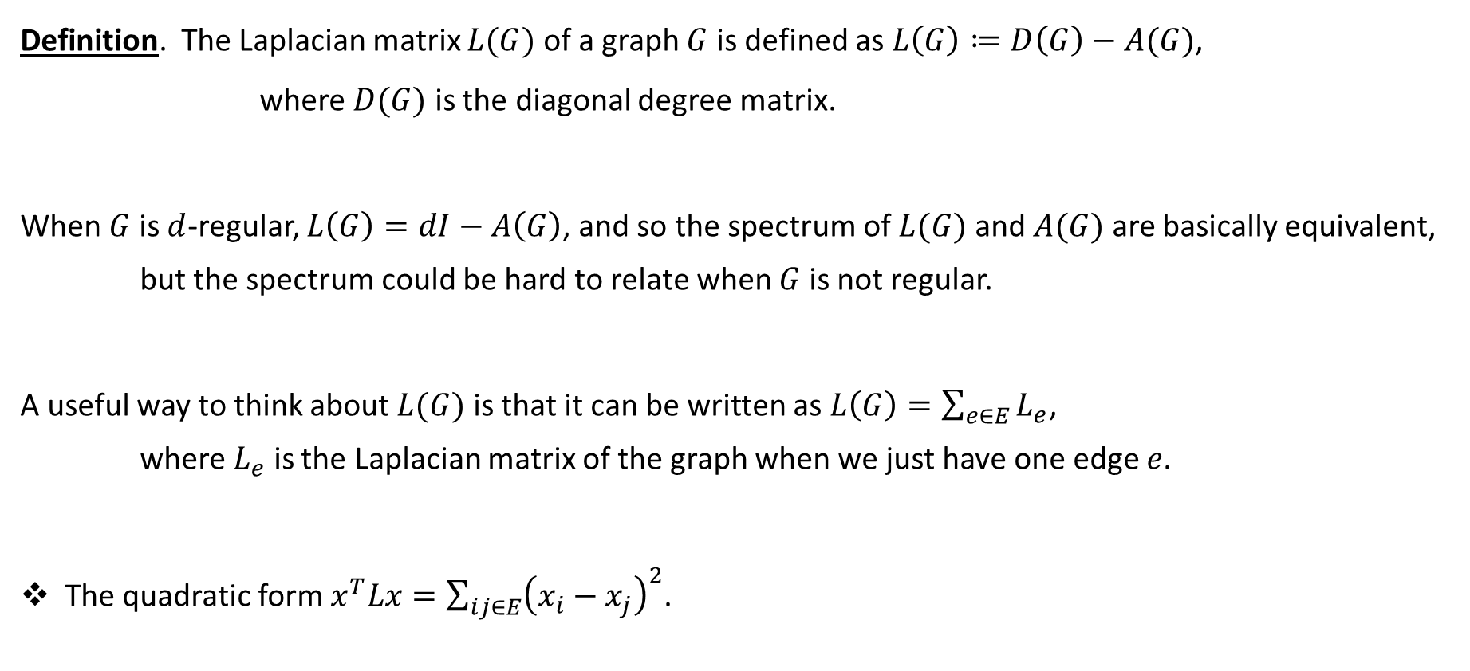
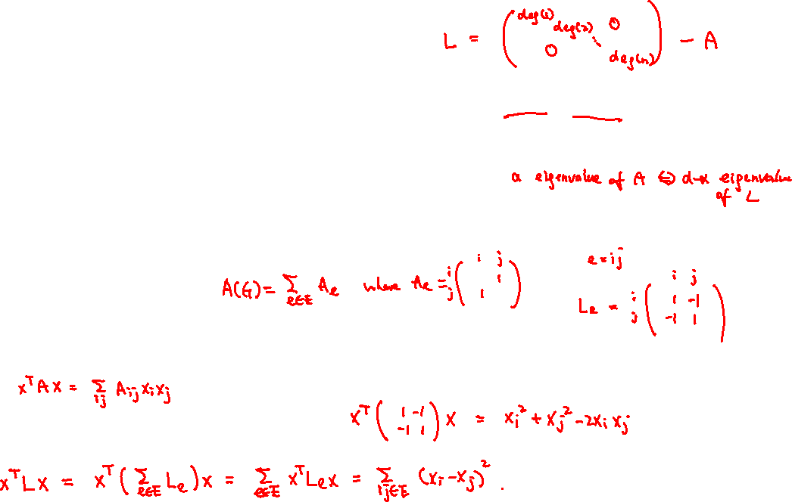
Laplacian matrix
Definition. The Laplacian matrix $L(G)$ of a graph $G$ is defined as $L\left(G\right)≔D\left(G\right)−A(G)$,
where $D(G)$ is the diagonal degree matrix.
When $G$ is $d$-regular, $L\left(G\right)=dI−A\left(G\right)$, and so the spectrum of $L(G)$ and $A(G)$ are basically equivalent,
but the spectrum could be hard to relate when $G$ is not regular.
A useful way to think about $L(G)$ is that it can be written as $L\left(G\right)=\sum_{e∈E}{L_{e}}$,
where $L_{e}$ is the Laplacian matrix of the graph when we just have one edge $e$.
The quadratic form $x^{T}Lx=\sum_{ij∈E}{{\left(x_{i}−x_{j}\right)}^{2}}$.

Slide 18


Spectrum of the Laplacian matrix
Claim. The all-one vector $\vec{1}$ is an eigenvector of $L$ with eigenvalue $0$.
Claim. The smallest eigenvalue of $L$ is $0$.
One advantage of the Laplacian matrix is that we know its smallest eigenvalue and its eigenvector $\vec{1}$.

Slide 19



Connectedness
Proposition. A graph $G$ is connected if and only if $0$ is an eigenvalue of $L(G)$ with multiplicity one.

Slide 20


Connectedness
Proposition. A graph $G$ is connected if and only if $0$ is an eigenvalue of $L(G)$ with multiplicity one.

Slide 21

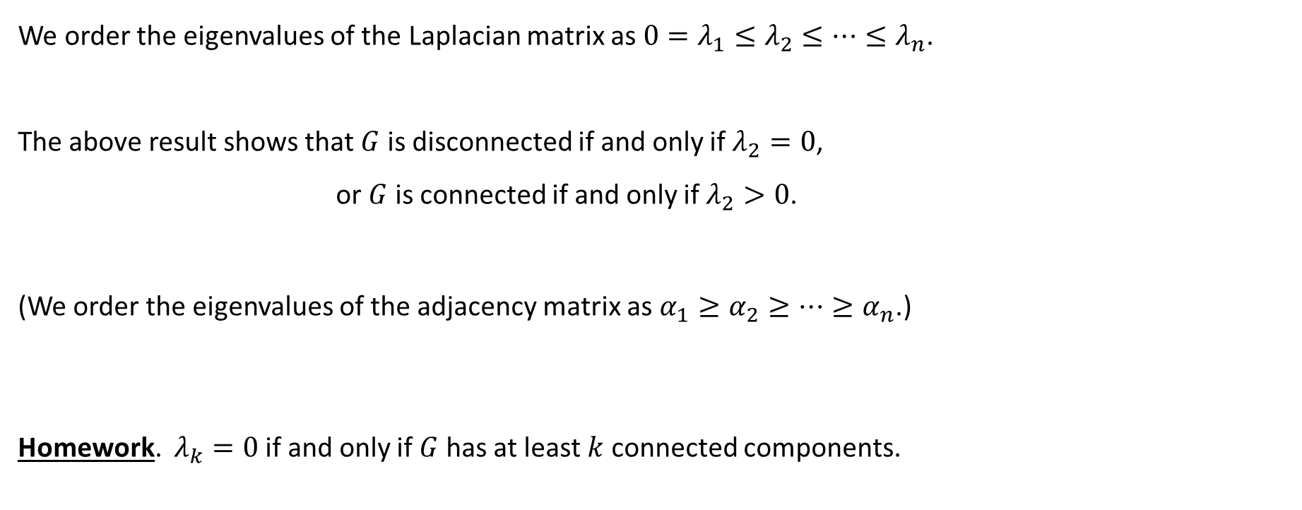




Second eigenvalue
We order the eigenvalues of the Laplacian matrix as $0=λ_{1}≤λ_{2}≤⋯≤λ_{n}$.
The above result shows that $G$ is disconnected if and only if $λ_{2}=0$,
or $G$ is connected if and only if $λ_{2}>0$.
(We order the eigenvalues of the adjacency matrix as $α_{1}≥α_{2}≥⋯≥α_{n}$.)
Homework. $λ_{k}=0$ if and only if $G$ has at least $k$ connected components.

Slide 22
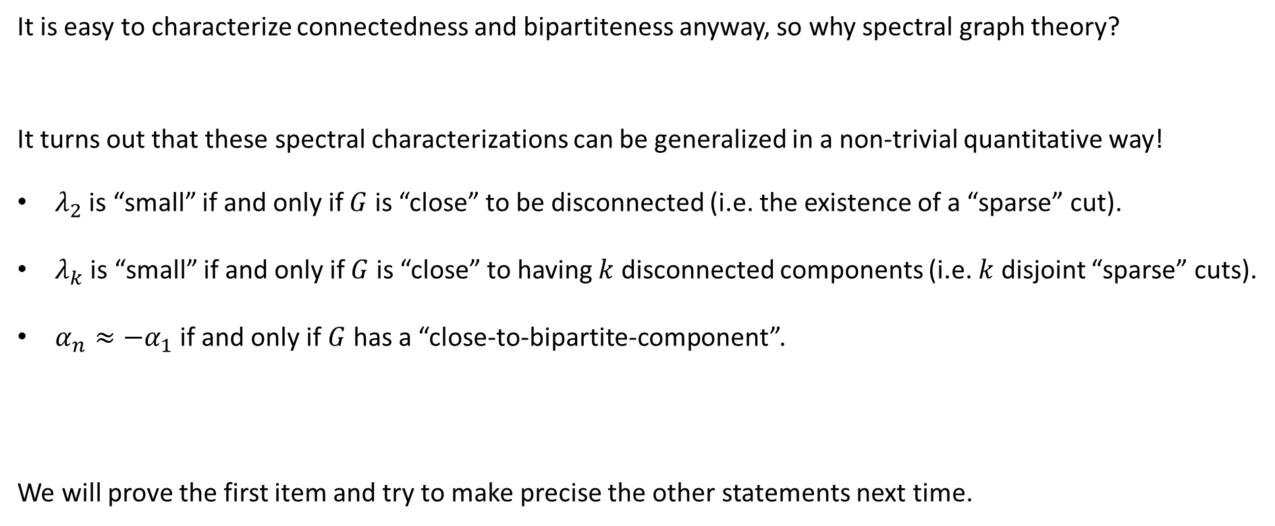
Robust generalizations
It is easy to characterize connectedness and bipartiteness anyway, so why spectral graph theory?
It turns out that these spectral characterizations can be generalized in a non-trivial quantitative way!
$λ_{2}$ is “small” if and only if $G$ is “close” to be disconnected (i.e. the existence of a “sparse” cut).
$λ_{k}$ is “small” if and only if $G$ is “close” to having $k$ disconnected components (i.e. $k$ disjoint “sparse” cuts).
$α_{n}≈−α_{1}$ if and only if $G$ has a “close-to-bipartite-component”.
We will prove the first item and try to make precise the other statements next time.

Slide 23
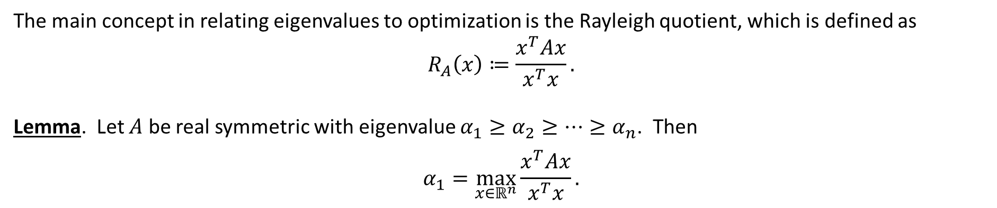
Rayleigh quotient
The main concept in relating eigenvalues to optimization is the Rayleigh quotient, which is defined as
$$R_{A}\left(x\right)≔\frac{x^{T}Ax}{x^{T}x}.$$
Lemma. Let $A$ be real symmetric with eigenvalue $α_{1}≥α_{2}≥⋯≥α_{n}$. Then
$$α_{1}=\max_{x∈ℝ^{n}}{\frac{x^{T}Ax}{x^{T}x}}.$$

Slide 24

Rayleigh quotient
Lemma. Let $A$ be real symmetric with eigenvalue $α_{1}≥α_{2}≥⋯≥α_{n}$. Then
$$α_{k}=\max_{x∈T_{k}}{\frac{x^{T}Ax}{x^{T}x}},$$
where $T_{k}$ is defined as the vectors orthogonal to $v_{1},v_{2},…,v_{k−1}$.
See notes for the Courant-Fischer theorem that is more general (i.e. bounding $α_{k}$ without knowing $T_{k}$).

Slide 25
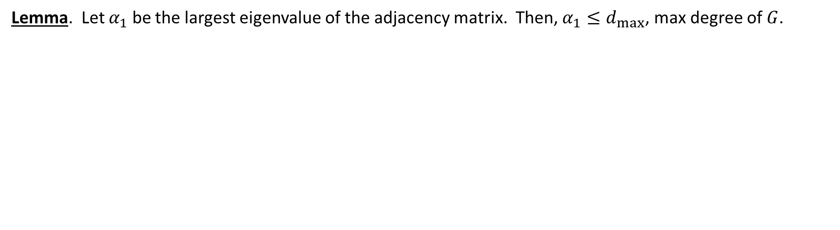
Largest eigenvalue of adjacency matrix
Lemma. Let $α_{1}$ be the largest eigenvalue of the adjacency matrix. Then, $α_{1}≤d_{max}$, max degree of $G$.

Slide 26
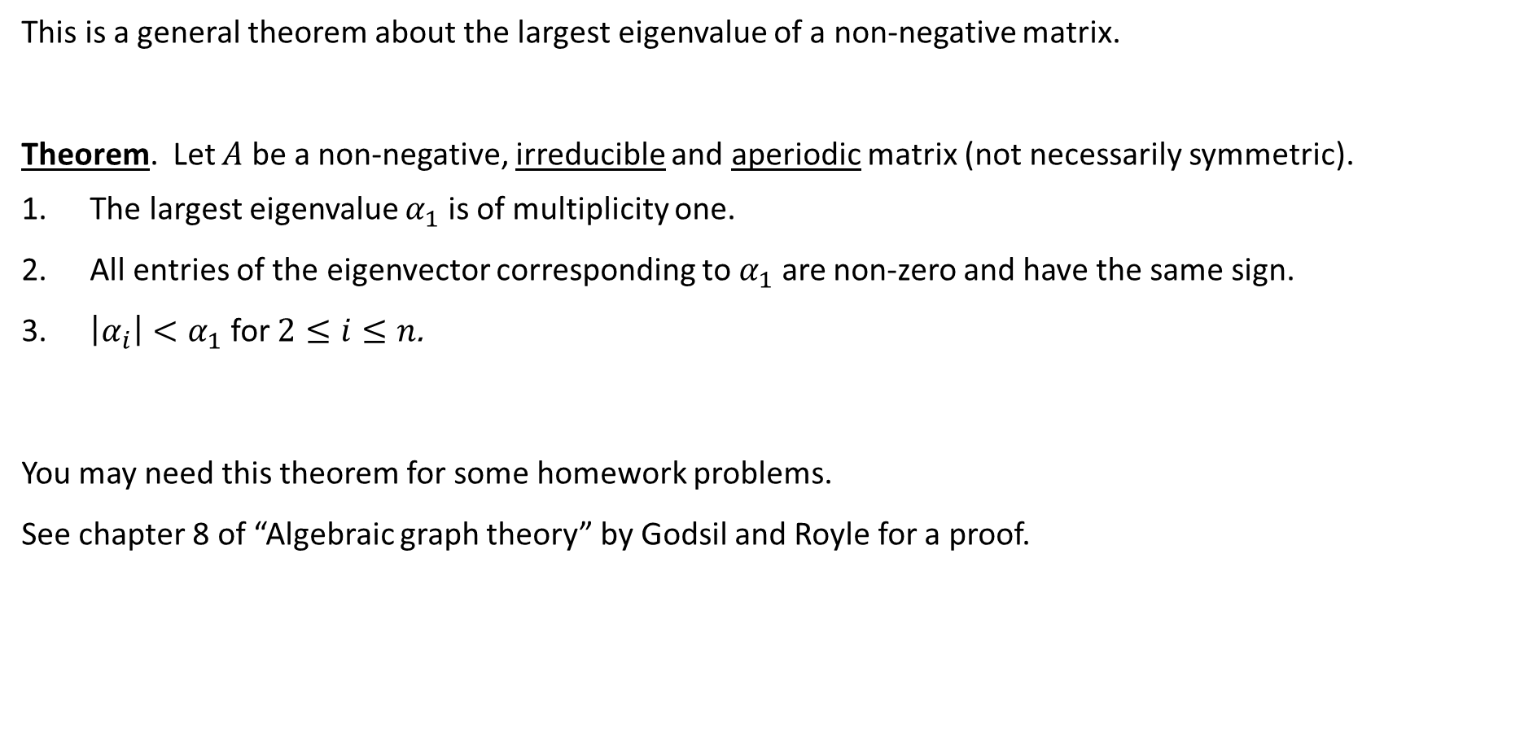
Perron-Frobenius theorem
This is a general theorem about the largest eigenvalue of a non-negative matrix.
Theorem. Let $A$ be a non-negative, irreducible and aperiodic matrix (not necessarily symmetric).
The largest eigenvalue $α_{1}$ is of multiplicity one.
All entries of the eigenvector corresponding to $α_{1}$ are non-zero and have the same sign.
$\left|α_{i}\right|<α_{1}$ for $2≤i≤n$.
You may need this theorem for some homework problems.
See chapter 8 of “Algebraic graph theory” by Godsil and Royle for a proof.

Slide 27
Summary
Background: spectral theorem for real symmetric matrices,
eigendecomposition, positive semidefinite matrices.
Adjacency matrix: bipartiteness, largest eigenvalue
Laplacian matrix: all-one vector, positive semidefiniteness,
quadratic form, decomposition
connectedness
Rayleigh quotient: connect eigenvalues to optimization problems.
Perron-Frobenius theorem.

