Slide 1
CS 466/666 - Algorithm Design and Analysis
Random Walks
Waterloo, 18 June 2020

Slide 2
Today’s Plan
Fundamental theorem of Markov chains
Pagerank
Perfect matching in regular bipartite graphs
HW3 posted, from L07.pdf – L10.pdf.
(short break after HW3, project proposal)
HW2 passed, will post solution Monday.
HW1 returned (well done).

Slide 3

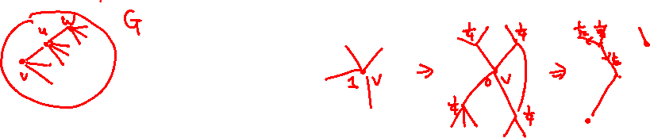
Random Walks on Graphs
Random walk is a simple random process.
Start from some vertex.
In each step, move from the current vertex to a uniformly random neighbor of the current vertex.
Repeat many steps.
We are interested in the long term behavior of this random process.
For example, what is the probability of being in a specific vertex at a time $t$?

Slide 4
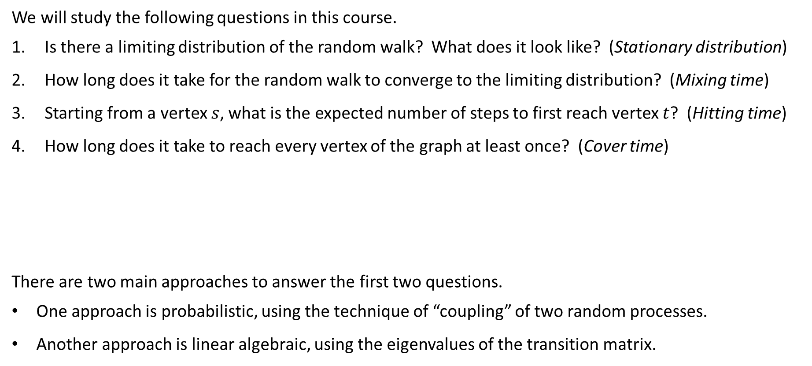
Some Basic Questions
We will study the following questions in this course.
Is there a limiting distribution of the random walk? What does it look like? (Stationary distribution)
How long does it take for the random walk to converge to the limiting distribution? (Mixing time)
Starting from a vertex $s$, what is the expected number of steps to first reach vertex $t$? (Hitting time)
How long does it take to reach every vertex of the graph at least once? (Cover time)
There are two main approaches to answer the first two questions.
One approach is probabilistic, using the technique of “coupling” of two random processes.
Another approach is linear algebraic, using the eigenvalues of the transition matrix.

Slide 5
Plan
We will study the spectral approach to answer the first two questions.
And we will begin spectral graph theory next time.
The last two questions are best answered by viewing the graph as an “electrical network”.
We will also study this point of view when we study spectral graph theory.
Today, we are just going to see the statement of the fundamental theorem of Markov chains.
Then we see two applications of the fundamental theorem, one is very interesting!

Slide 6
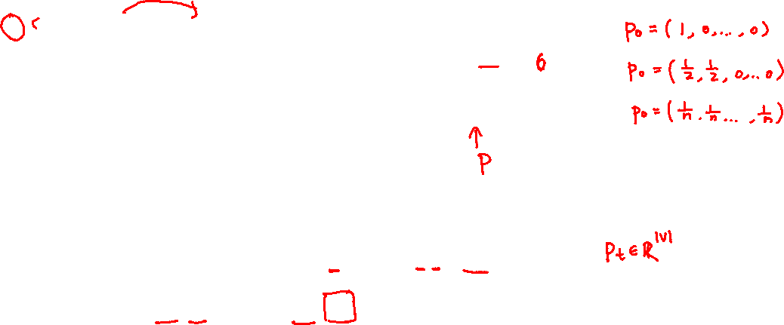

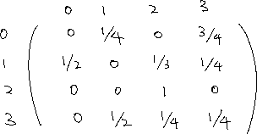
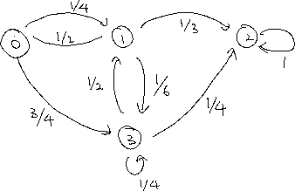
Markov Chains
We consider the general problem of random walks on a weighted directed graph.
Let $p_{t}(i)$ be the probability at state $i$ at time $t$. Then, for all $0≤j≤n−1$,
$$p_{t+1}\left(j\right)=\sum_{i=0}^{n−1}{p_{t}(i)}⋅P_{i,j}$$
More compactly, $\vec{p_{t+1}}=\vec{p_{t}}⋅P$, and $\vec{p_{t}}=\vec{p_{0}}⋅P^{t}$.
This is called a Markov chain because it forgets about the past.

Slide 7
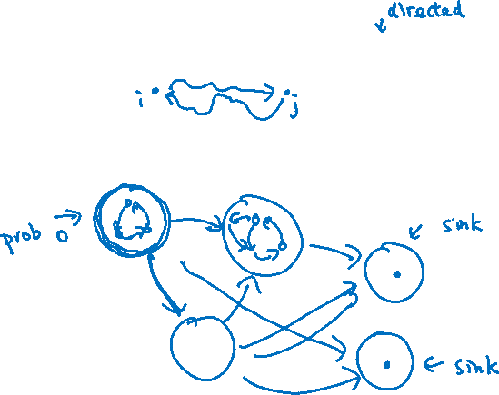
Irreducible Markov Chains
We assume all Markov chains are finite in this course.
A Markov chain is called irreducible if the underlying graph is strong connected.

Slide 8






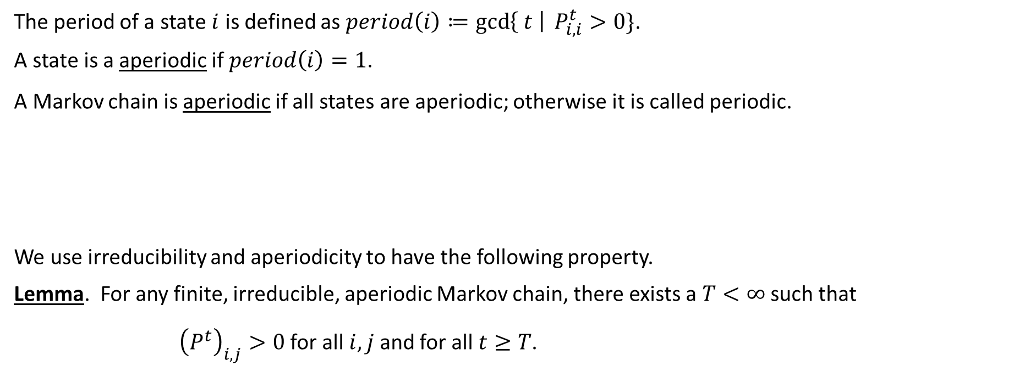


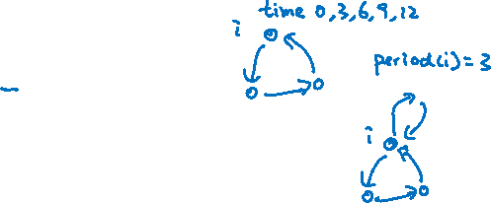
Aperiodic Markov Chains
The period of a state $i$ is defined as $period\left(i\right)≔\gcd\left\{ t \right| P_{i,i}^{t}>0\}$.
A state is a aperiodic if $period\left(i\right)=1$.
A Markov chain is aperiodic if all states are aperiodic; otherwise it is called periodic.
We use irreducibility and aperiodicity to have the following property.
Lemma. For any finite, irreducible, aperiodic Markov chain, there exists a $T<∞$ such that
${\left(P^{t}\right)}_{i,j}>0$ for all $i,j$ and for all $t≥T$.

Slide 9
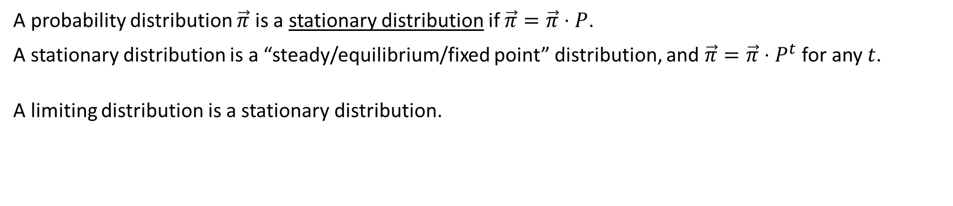
Stationary Distribution
A probability distribution $\vec{π}$ is a stationary distribution if $\vec{π}=\vec{π}⋅P$.
A stationary distribution is a “steady/equilibrium/fixed point” distribution, and $\vec{π}=\vec{π}⋅P^{t}$ for any $t$.
A limiting distribution is a stationary distribution.

Slide 10
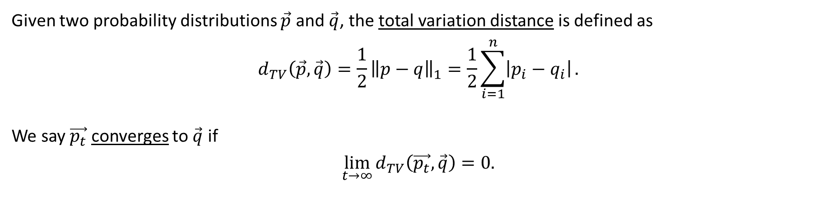
Distance and Convergence
Given two probability distributions $\vec{p}$ and $\vec{q}$, the total variation distance is defined as
$$d_{TV}\left(\vec{p},\vec{q}\right)=\frac{1}{2}{\left\|p−q\right\|}_{1}=\frac{1}{2}\sum_{i=1}^{n}{\left|p_{i}−q_{i}\right|}.$$
We say $\vec{p_{t}}$ converges to $\vec{q}$ if
$$\lim_{t→∞}{d_{TV}\left(\vec{p_{t}},\vec{q}\right)}=0.$$

Slide 11
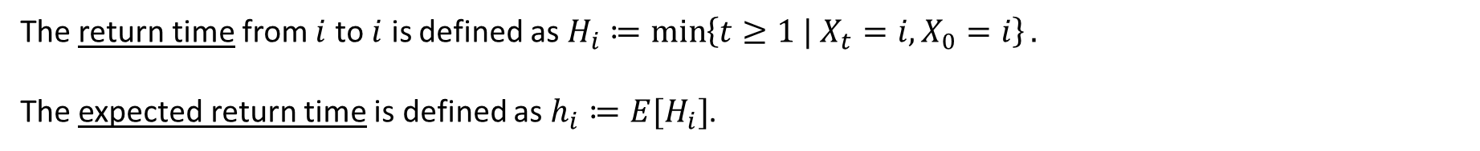

Return Time
The return time from $i$ to $i$ is defined as $H_{i}≔\min\left\{t≥1 | X_{t}=i, X_{0}=i\right\}.$
The expected return time is defined as $h_{i}≔E[H_{i}]$.

Slide 12

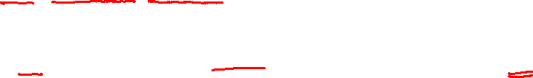


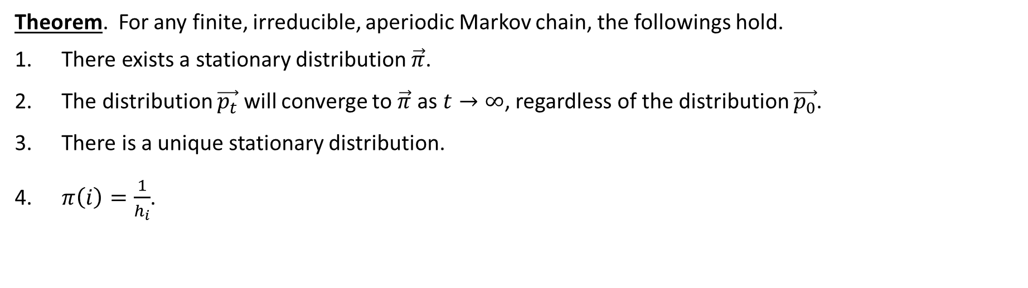

Fundamental Theorem of Markov Chains
Theorem. For any finite, irreducible, aperiodic Markov chain, the followings hold.
There exists a stationary distribution $\vec{π}$.
The distribution $\vec{p_{t}}$ will converge to $\vec{π}$ as $t→∞$, regardless of the distribution $\vec{p_{0}}$.
There is a unique stationary distribution.
$π\left(i\right)=\frac{1}{h_{i}}$.

Slide 13
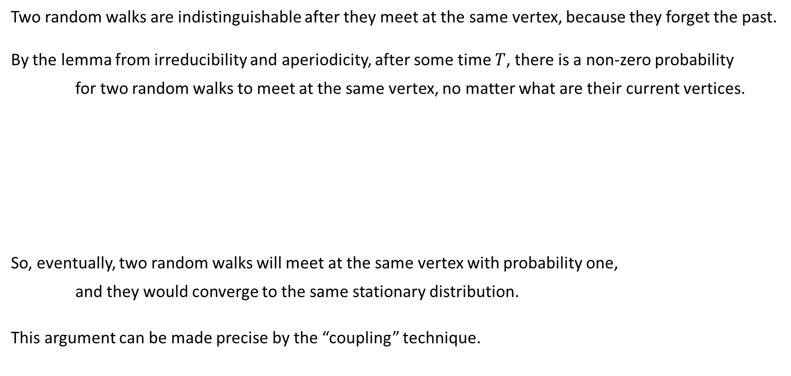
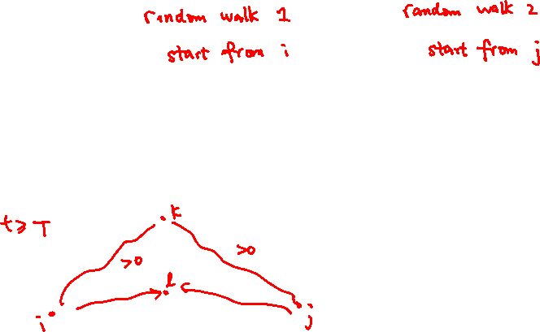
Intuition
Two random walks are indistinguishable after they meet at the same vertex, because they forget the past.
By the lemma from irreducibility and aperiodicity, after some time $T$, there is a non-zero probability
for two random walks to meet at the same vertex, no matter what are their current vertices.
So, eventually, two random walks will meet at the same vertex with probability one,
and they would converge to the same stationary distribution.
This argument can be made precise by the “coupling” technique.

Slide 14
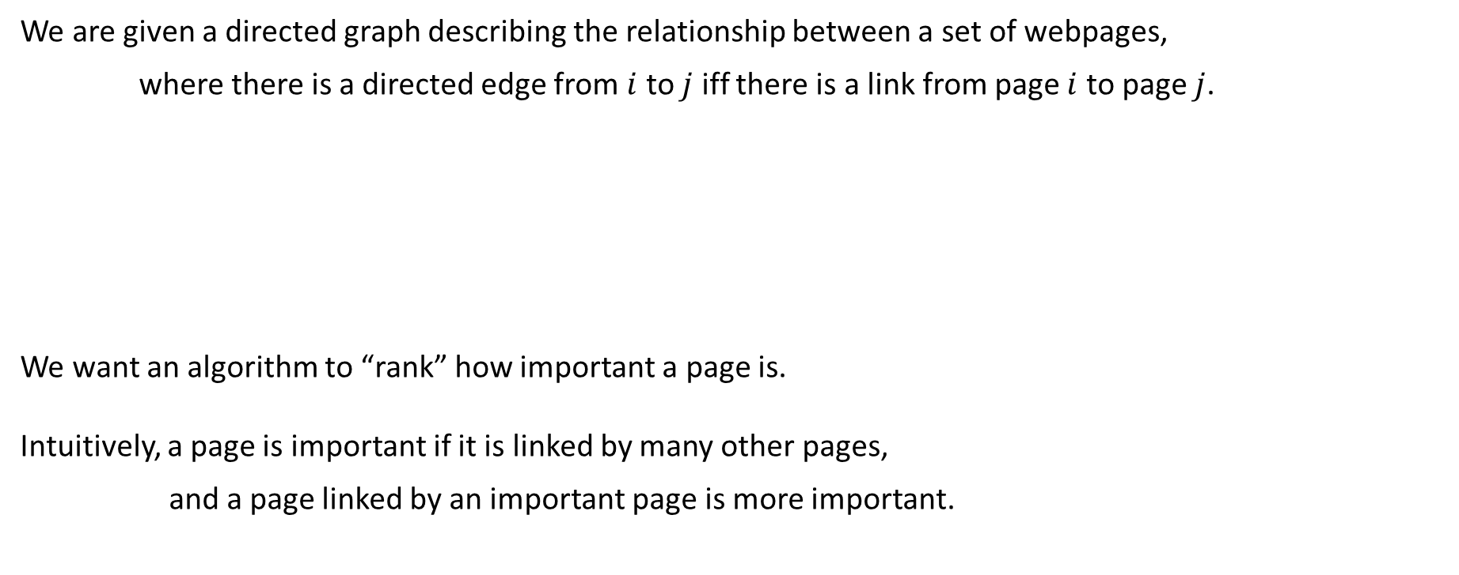
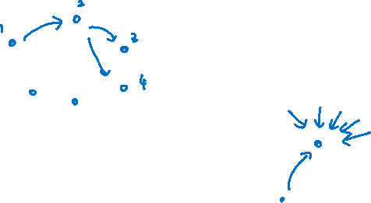
Pagerank
We are given a directed graph describing the relationship between a set of webpages,
where there is a directed edge from $i$ to $j$ iff there is a link from page $i$ to page $j$.
We want an algorithm to “rank” how important a page is.
Intuitively, a page is important if it is linked by many other pages,
and a page linked by an important page is more important.

Slide 15
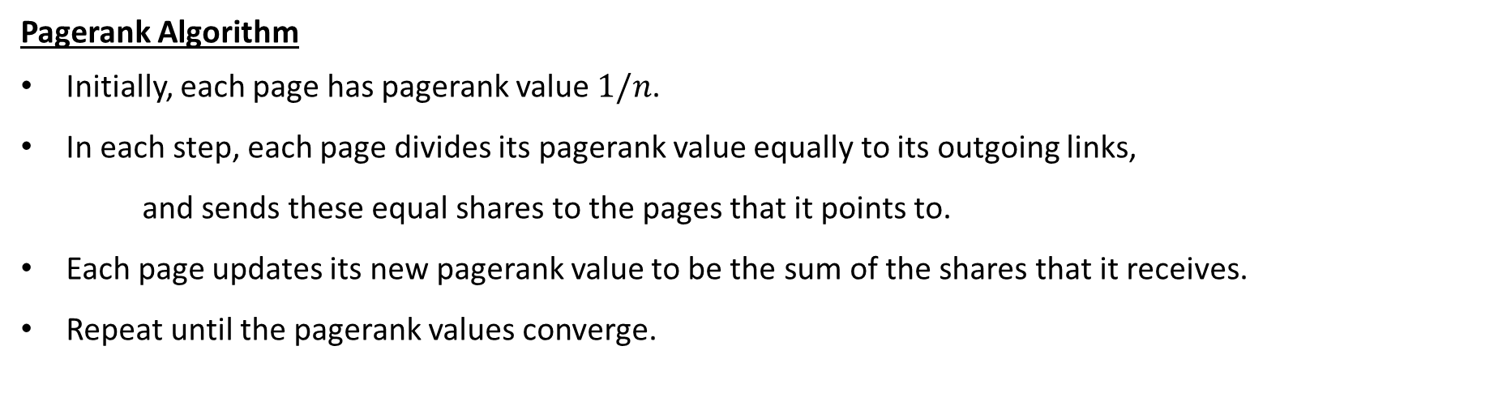
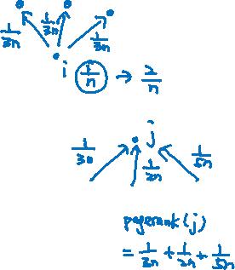
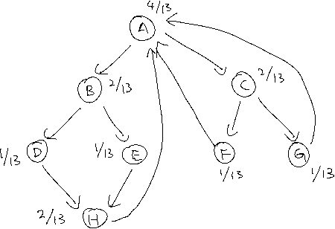
Iterative Refinement Algorithm
Pagerank Algorithm
Initially, each page has pagerank value $1/n$.
In each step, each page divides its pagerank value equally to its outgoing links,
and sends these equal shares to the pages that it points to.
Each page updates its new pagerank value to be the sum of the shares that it receives.
Repeat until the pagerank values converge.

Slide 16



Pagerank Values and Stationary Distribution
Claim. The equilibrium pagerank values are the probabilities in the stationary distribution.
When the graph is finite, irreducible, aperiodic, the pagerank values are unique by the fundamental thm.
This shows that the pagerank values is a function of the graph structure, not based on initial values.
Also, we have some intuition about pagerank values, which are the reciprocal of the expected return time.

Slide 17
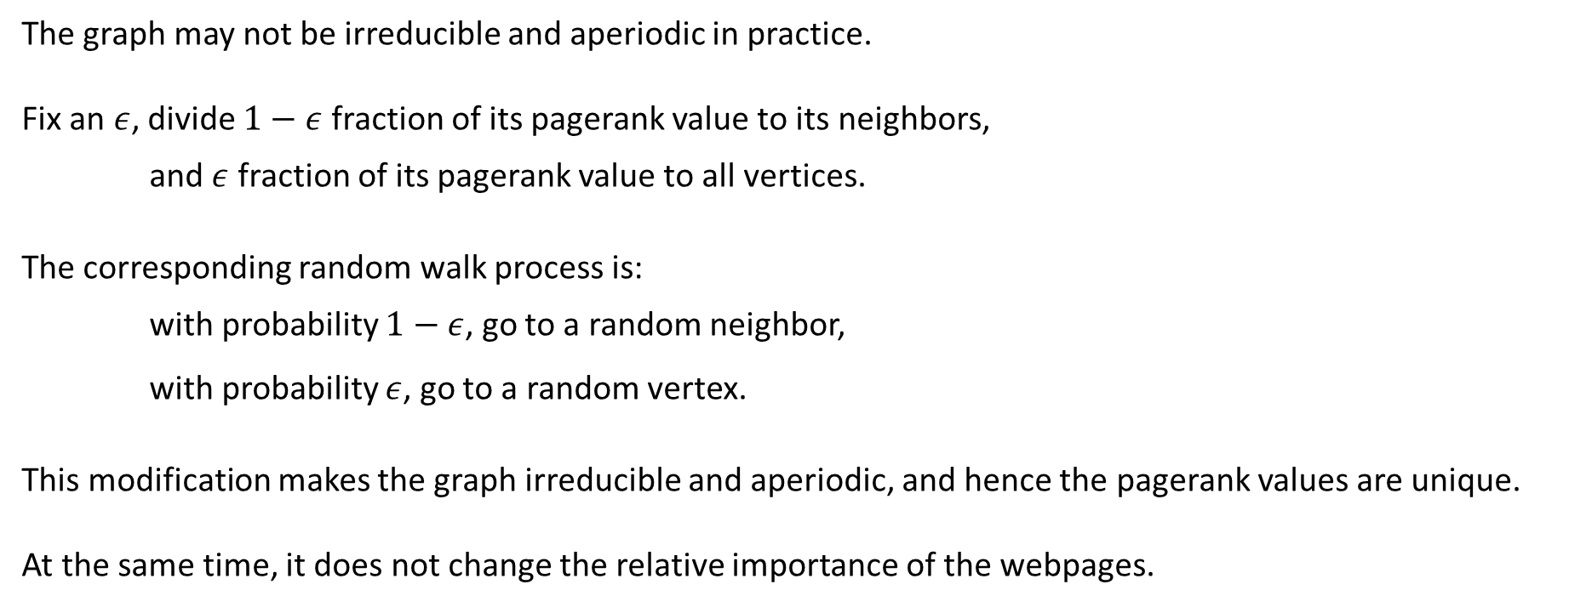
Practical Modification
The graph may not be irreducible and aperiodic in practice.
Fix an $ε$, divide $1−ε$ fraction of its pagerank value to its neighbors,
and $ε$ fraction of its pagerank value to all vertices.
The corresponding random walk process is:
with probability $1−ε$, go to a random neighbor,
with probability $ε$, go to a random vertex.
This modification makes the graph irreducible and aperiodic, and hence the pagerank values are unique.
At the same time, it does not change the relative importance of the webpages.

Slide 18


Perfect Matching in Regular Bipartite Graphs
It is a well-known consequence of Hall’s theorem that every regular bipartite graph has a perfect matching.
There are deterministic algorithms to find a perfect matching in $O(m)$ time.
We present a randomized algorithm (2010) to find a perfect matching in $O(n\log{n})$ time,
which is sublinear when the graph is dense!

Slide 19



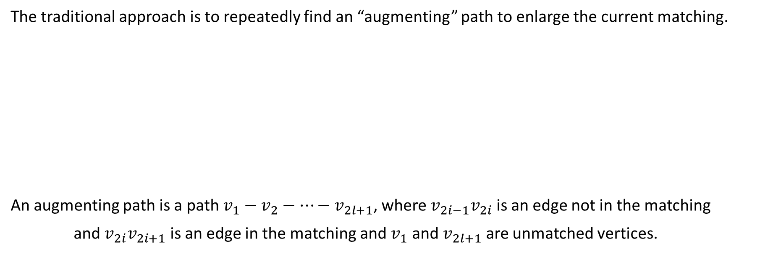






Traditional Approach
The traditional approach is to repeatedly find an “augmenting” path to enlarge the current matching.
An augmenting path is a path $v_{1}−v_{2}−⋯−v_{2l+1}$, where $v_{2i−1}v_{2i}$ is an edge not in the matching
and $v_{2i}v_{2i+1}$ is an edge in the matching and $v_{1}$ and $v_{2l+1}$ are unmatched vertices.

Slide 20







Augmenting Path Method
Theorem. The current matching is maximum if and only if there is no augmenting path wrt it.
Equivalently, the current matching is not maximum if and only if there is an augmenting path wrt it.

Slide 21

Augmenting Path Algorithm
Algorithm.
Start from the empty matching.
While there is an augmenting path do
Use the augmenting path to enlarge the current matching.
Return the current matching.
Complexity. This is an $O\left(mn\right)$ time algorithm.

Slide 22

























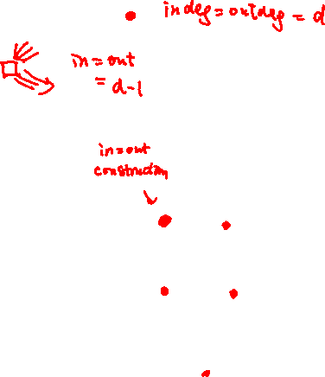




Random Walk Algorithm
The new idea is to replace BFS/DFS by a random walk!

Slide 23
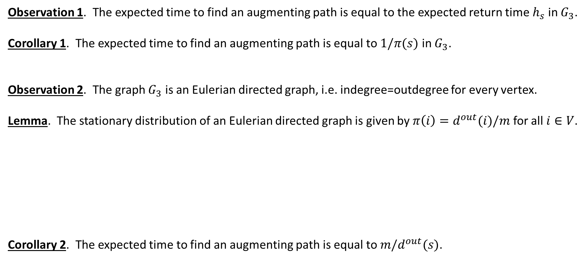
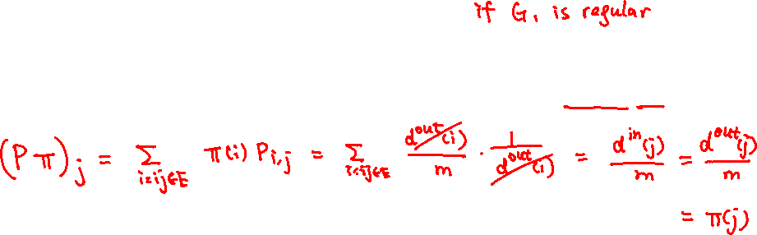
Analysis
Observation 1. The expected time to find an augmenting path is equal to the expected return time $h_{s}$ in $G_{3}$.
Corollary 1. The expected time to find an augmenting path is equal to $1/π(s)$ in $G_{3}$.
Observation 2. The graph $G_{3}$ is an Eulerian directed graph, i.e. indegree=outdegree for every vertex.
Lemma. The stationary distribution of an Eulerian directed graph is given by $π\left(i\right)=d^{out}(i)/m$ for all $i∈V$.
Corollary 2. The expected time to find an augmenting path is equal to ${m/d}^{out}(s)$.

Slide 24
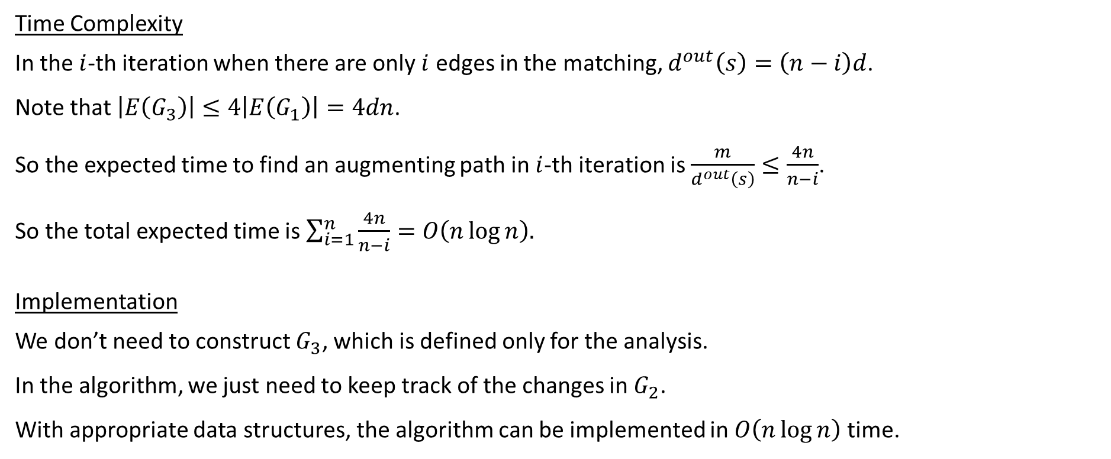
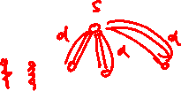
Time Complexity and Implementation
Time Complexity
In the $i$-th iteration when there are only $i$ edges in the matching, $d^{out}\left(s\right)=\left(n−i\right)d$.
Note that $\left|E\left(G_{3}\right)\right|≤4\left|E\left(G_{1}\right)\right|=4dn$.
So the expected time to find an augmenting path in $i$-th iteration is $\frac{m}{d^{out}\left(s\right)}≤\frac{4n}{n−i}$.
So the total expected time is $\sum_{i=1}^{n}{\frac{4n}{n−i}}=O\left(n\log{n}\right).$
Implementation
We don’t need to construct $G_{3}$, which is defined only for the analysis.
In the algorithm, we just need to keep track of the changes in $G_{2}$.
With appropriate data structures, the algorithm can be implemented in $O\left(n\log{n}\right)$ time.

