Slide 1
CS 466/666 - Algorithm Design and Analysis
Local Lemma
Waterloo, 16 June 2020

Slide 2
Today’s Plan
Local lemma
Simple applications
Moser’s algorithmic proof
HW3 posted.
HW2 passed.
HW1 returned.

Slide 3
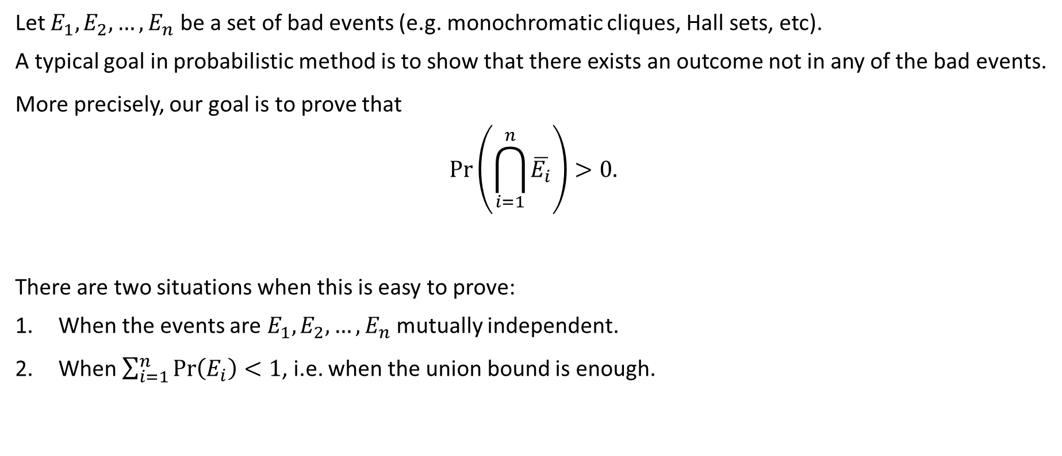
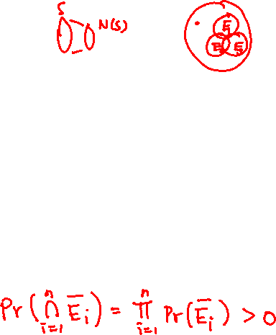
Finding a Good Outcome
Let $E_{1},E_{2},…,E_{n}$ be a set of bad events (e.g. monochromatic cliques, Hall sets, etc).
A typical goal in probabilistic method is to show that there exists an outcome not in any of the bad events.
More precisely, our goal is to prove that
$$\operatorname{Pr}\left(\bigcap_{i=1}^{n}{\overline{E_{i}}}\right)>0.$$
There are two situations when this is easy to prove:
When the events are $E_{1},E_{2},…,E_{n}$ mutually independent.
When $\sum_{i=1}^{n}{\operatorname{Pr}\left(E_{i}\right)}<1$, i.e. when the union bound is enough.

Slide 4
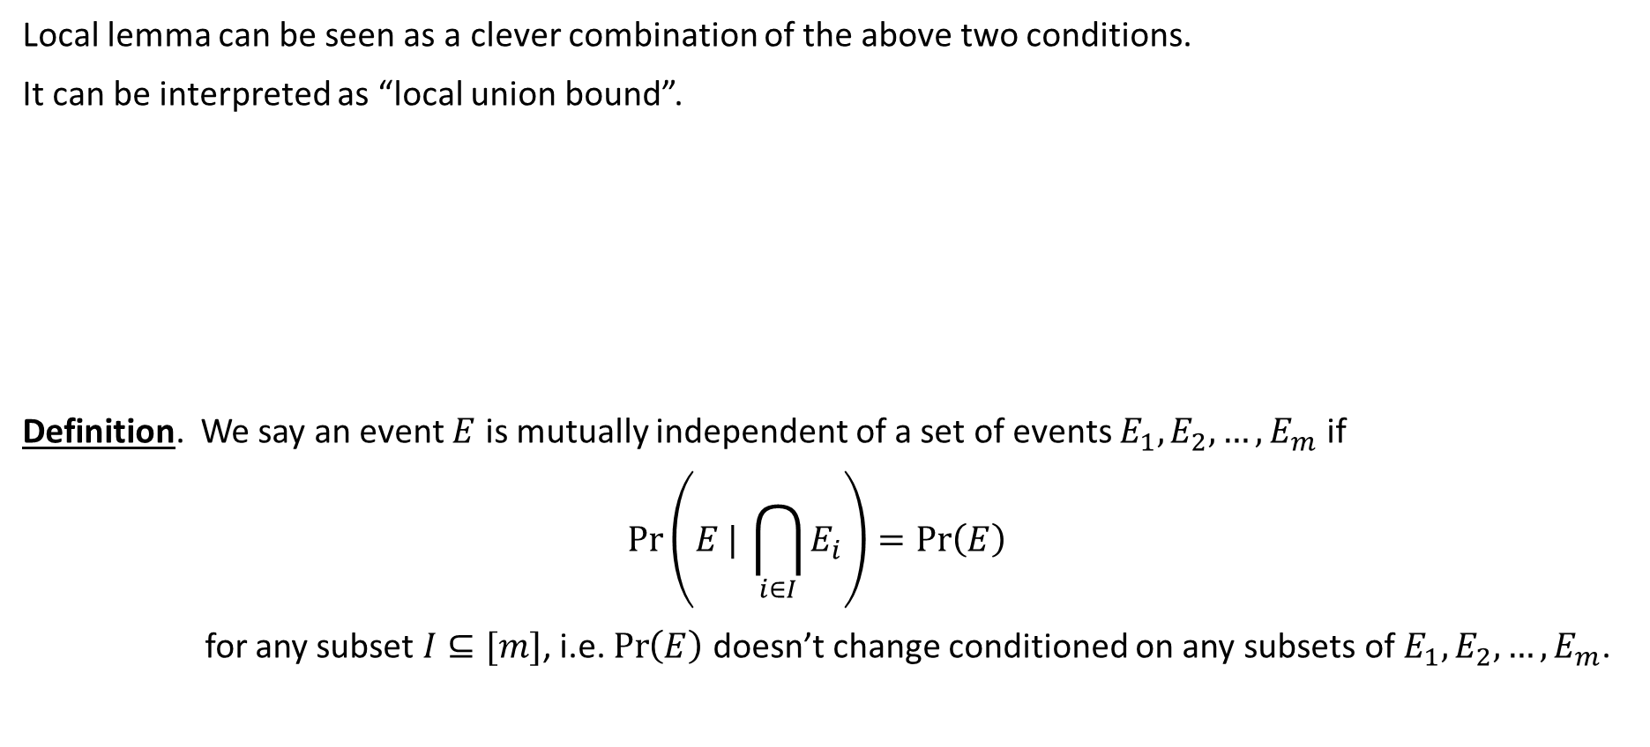
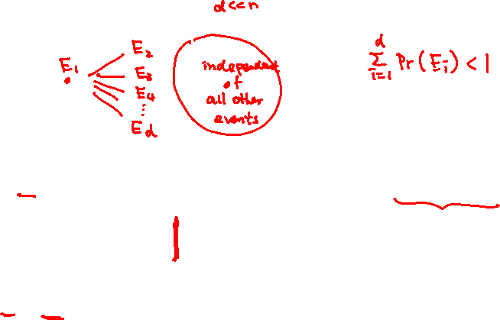
Local Union Bound
Local lemma can be seen as a clever combination of the above two conditions.
It can be interpreted as “local union bound”.
Definition. We say an event $E$ is mutually independent of a set of events $E_{1},E_{2},…,E_{m}$ if
$$\operatorname{Pr}\left(E | \bigcap_{i∈I}{E_{i}}\right)=\operatorname{Pr}\left(E\right)$$
for any subset $I⊆[m]$, i.e. $\operatorname{Pr}\left(E\right)$ doesn’t change conditioned on any subsets of $E_{1},E_{2},…,E_{m}$.

Slide 5

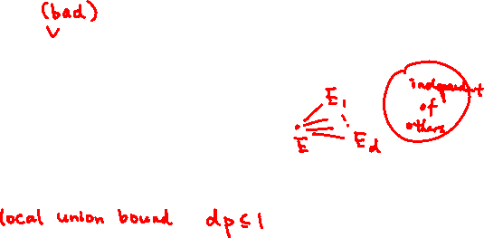
Lovász Local Lemma
Lemma. Let $E_{1},E_{2},…,E_{n}$ be a set of events.
Suppose the following conditions hold:
    $\operatorname{Pr}\left(E_{i}\right)≤p$ for $1≤i≤n$.
    Every event is mutually independent of all but at most $d$ other events.
    $4dp≤1$.
    Then
    $$\operatorname{Pr}\left(\bigcap_{i=1}^{n}{\overline{E_{i}}}\right)>0.$$
    We sometimes call $d$ the maximum degree of the “dependency graph”.
    This is the simplest form; there are various generalizations of this lemma.

Slide 6
Non-Constructive Proof
The original proof by Lovász is non-constructive.
It is an inductive proof that gives no idea how to find such an outcome efficiently.
In fact, the probability of a good outcome can be exponentially small.
So it was generally believed that the task is as difficult as “finding a needle in a haystack”.
We come back to this algorithmic question after seeing two simple examples.

Slide 7

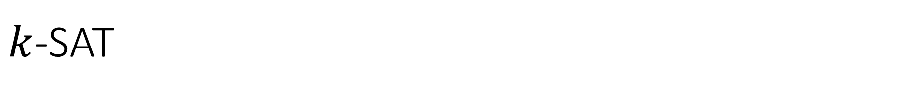


$k$-SAT
Problem. Given a Boolean formula where each clause has exactly $k$ literals,
the goal is to find a satisfying assignment to the variables when it exists.
This problem is NP-hard, but we can use local lemma to prove that a formula always has a
satisfying assignment when it is “under constrained”.

Slide 8
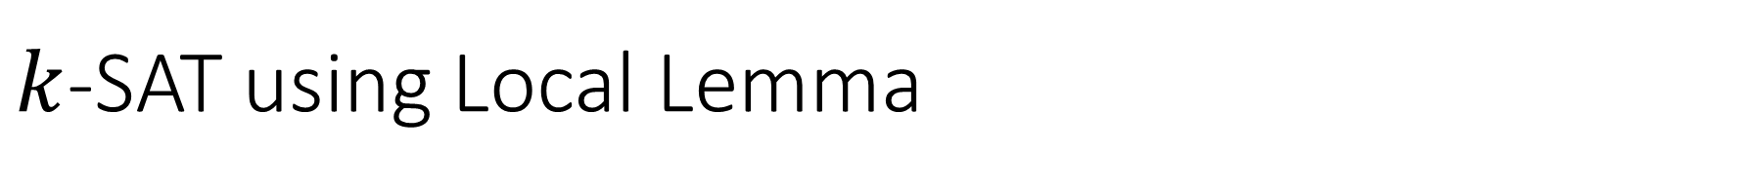





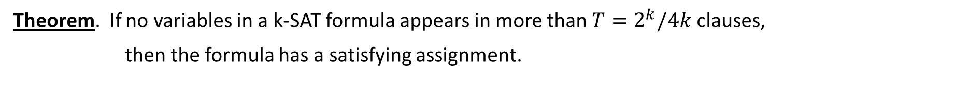
$k$-SAT using Local Lemma
Theorem. If no variables in a k-SAT formula appears in more than $T=2^{k}/4k$ clauses,
then the formula has a satisfying assignment.

Slide 9





Edge-Disjoint Paths
Problem. Given a graph with $k$ pairs $\{\left(s_{1},t_{1}\right), \left(s_{2},t_{2}\right), …,\left(s_{k},t_{k}\right)\}$, we would like to
find a path $P_{i}$ connecting $s_{i}$ and $t_{i}$ such that $\{P_{1},P_{2},…,P_{k}\}$ are edge-disjoint.
This problem is also NP-hard, but we can use local lemma to prove that such edge-disjoint paths
always exist if each path does not share edges with too many paths.

Slide 10




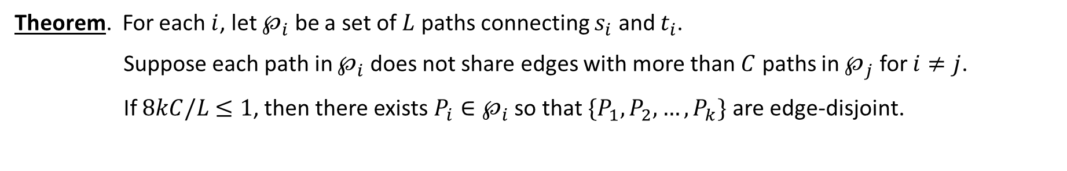









Edge-Disjoint Paths using Local Lemma
Theorem. For each $i$, let $℘_{i}$ be a set of $L$ paths connecting $s_{i}$ and $t_{i}$.
Suppose each path in $℘_{i}$ does not share edges with more than $C$ paths in $℘_{j}$ for $i≠j$.
If $8kC/L$ $≤1$, then there exists ${P_{i}∈℘}_{i}$ so that $\{P_{1},P_{2},…,P_{k}\}$ are edge-disjoint.

Slide 11
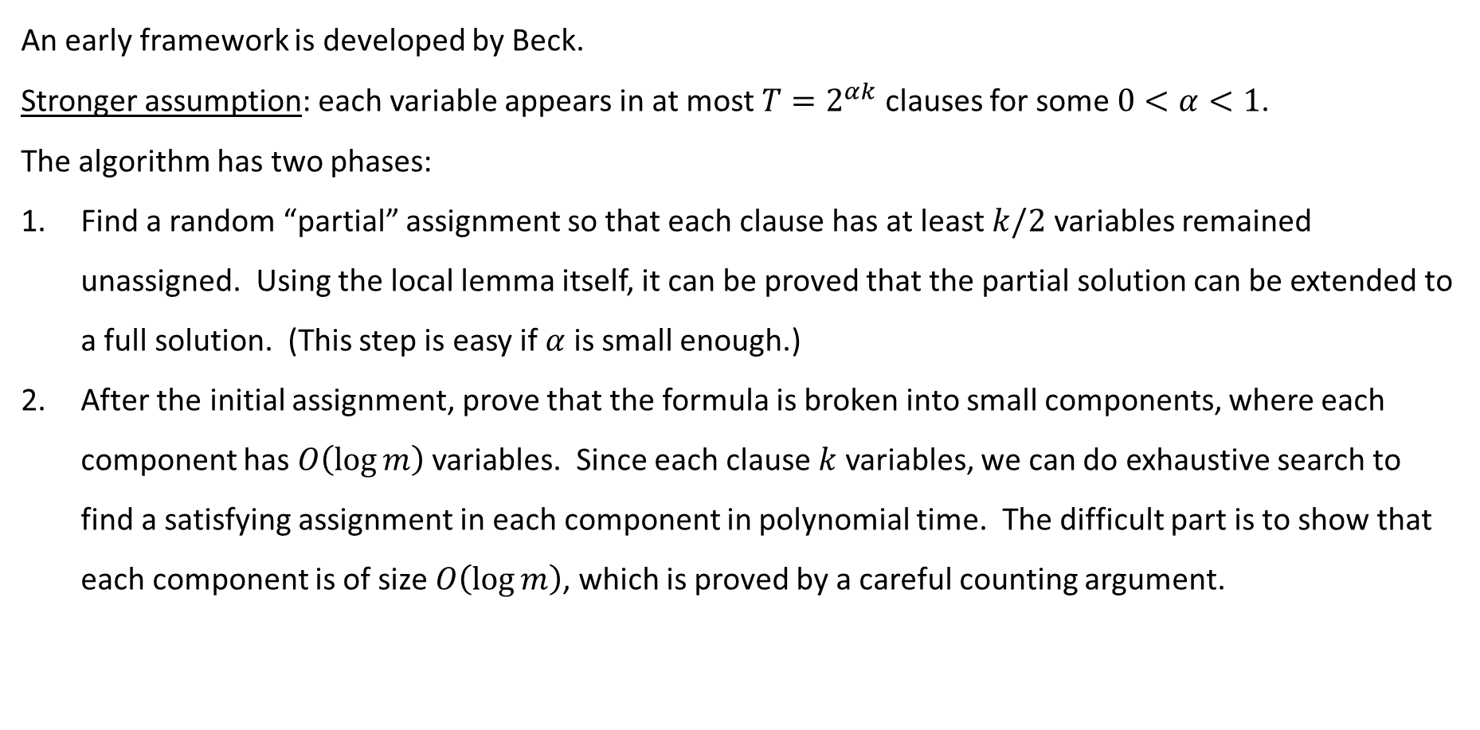
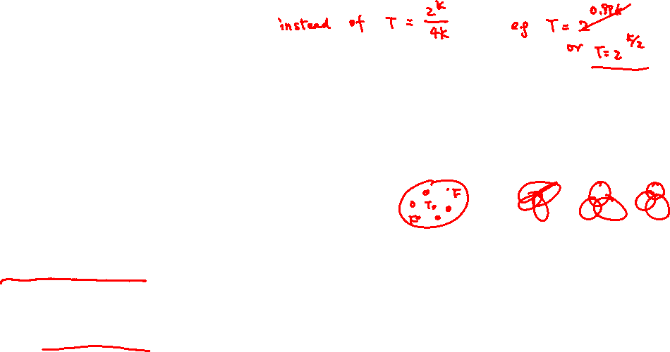
Efficient Algorithms for Local Lemma
An early framework is developed by Beck.
Stronger assumption: each variable appears in at most $T=2^{αk}$ clauses for some $0<α<1$.
The algorithm has two phases:
Find a random “partial” assignment so that each clause has at least $k/2$ variables remained unassigned. Using the local lemma itself, it can be proved that the partial solution can be extended to a full solution. (This step is easy if $α$ is small enough.)
After the initial assignment, prove that the formula is broken into small components, where each component has $O\left(\log{m}\right)$ variables. Since each clause $k$ variables, we can do exhaustive search to find a satisfying assignment in each component in polynomial time. The difficult part is to show that each component is of size $O\left(\log{m}\right)$, which is proved by a careful counting argument.

Slide 12
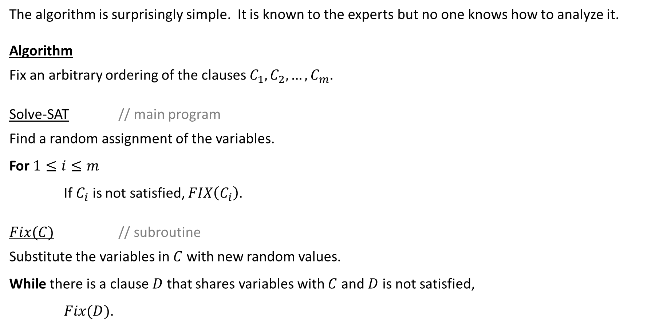
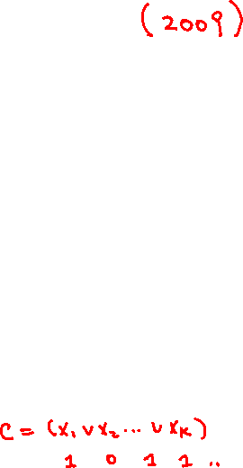
Recent Breakthrough by Moser
The algorithm is surprisingly simple. It is known to the experts but no one knows how to analyze it.
Algorithm
Fix an arbitrary ordering of the clauses $C_{1},C_{2},…,C_{m}$.
Solve-SAT // main program
Find a random assignment of the variables.
For $1≤i≤m$
If $C_{i}$ is not satisfied, $FIX\left(C_{i}\right)$.
$Fix(C)$ // subroutine
Substitute the variables in $C$ with new random values.
While there is a clause $D$ that shares variables with $C$ and $D$ is not satisfied,
$Fix(D)$.

Slide 13










Illustration
How to analyze such a “random” algorithm?

Slide 14
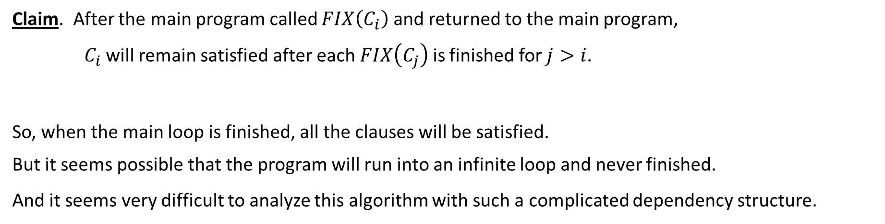
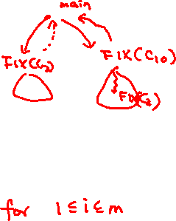
Analysis
Claim. After the main program called $FIX\left(C_{i}\right)$ and returned to the main program,
$C_{i}$ will remain satisfied after each $FIX\left(C_{j}\right)$ is finished for $j>i$.
So, when the main loop is finished, all the clauses will be satisfied.
But it seems possible that the program will run into an infinite loop and never finished.
And it seems very difficult to analyze this algorithm with such a complicated dependency structure.

Slide 15
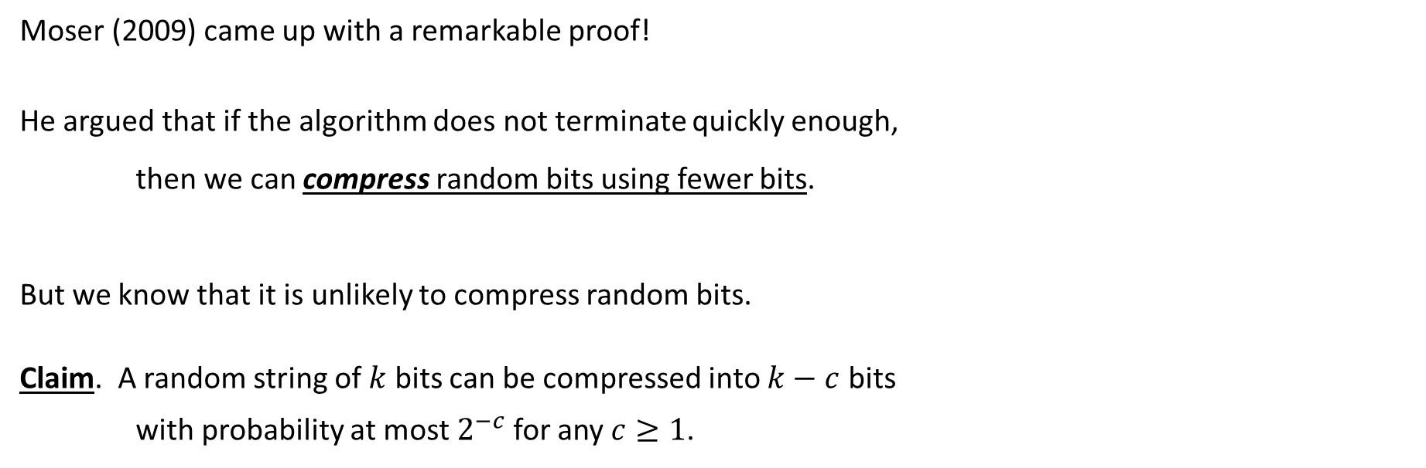
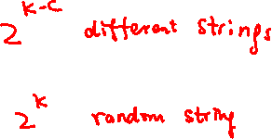
Idea
Moser (2009) came up with a remarkable proof!
He argued that if the algorithm does not terminate quickly enough,
then we can compress random bits using fewer bits.
But we know that it is unlikely to compress random bits.
Claim. A random string of $k$ bits can be compressed into $k−c$ bits
with probability at most $2^{−c}$ for any $c≥1$.

Slide 16

Random Bits Used
Suppose the algorithm runs for $t$ steps but not stopped yet, how many random bits are used?

Slide 17

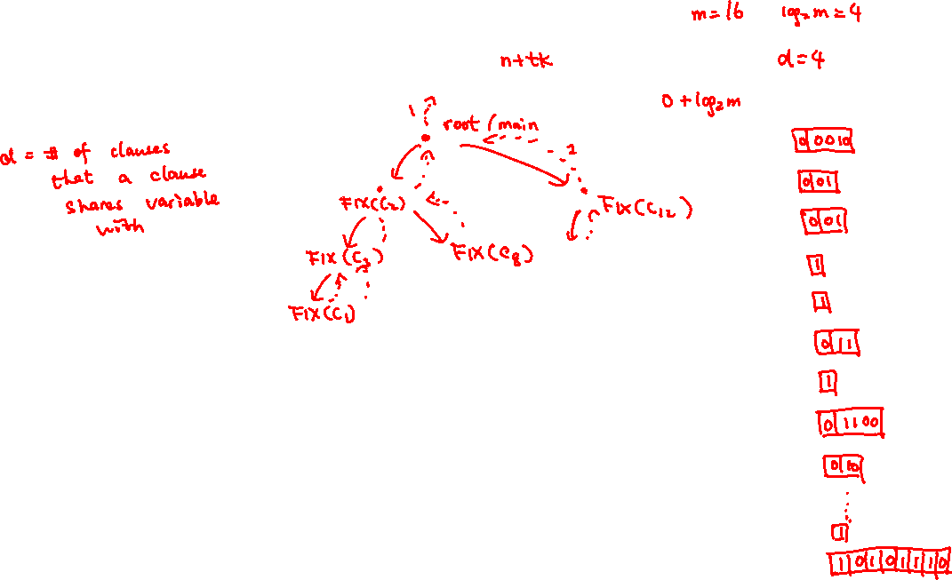
Encoding
We encode the execution tree in order to recover the random bits.
$0+\log_{2}{m}$ bits to represent going from the root to a clause.
$0+\log_{2}{d}$ bits to represent going from the current clause to a neighbor clause.
use $1$ to represent going up.
when the algorithm terminates, remember the $n$ bits in the variables.

Slide 18



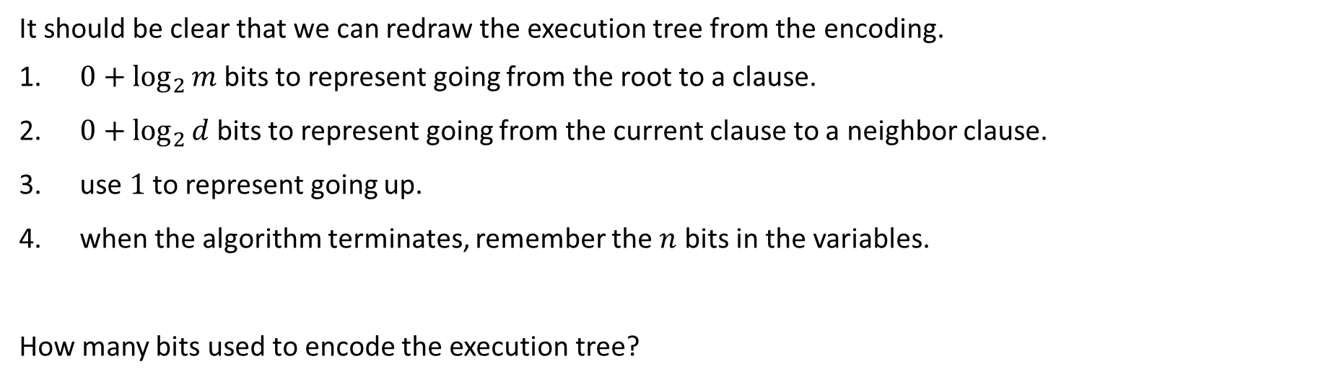


Encoding Length
It should be clear that we can redraw the execution tree from the encoding.
$0+\log_{2}{m}$ bits to represent going from the root to a clause.
$0+\log_{2}{d}$ bits to represent going from the current clause to a neighbor clause.
use $1$ to represent going up.
when the algorithm terminates, remember the $n$ bits in the variables.
How many bits used to encode the execution tree?

Slide 19





Compression
Suppose we can prove that the original random bits can be recovered from the encoding.

Slide 20










Decoding
Given a formula and the execution tree/log, we show how to recover the random bits.

Slide 21
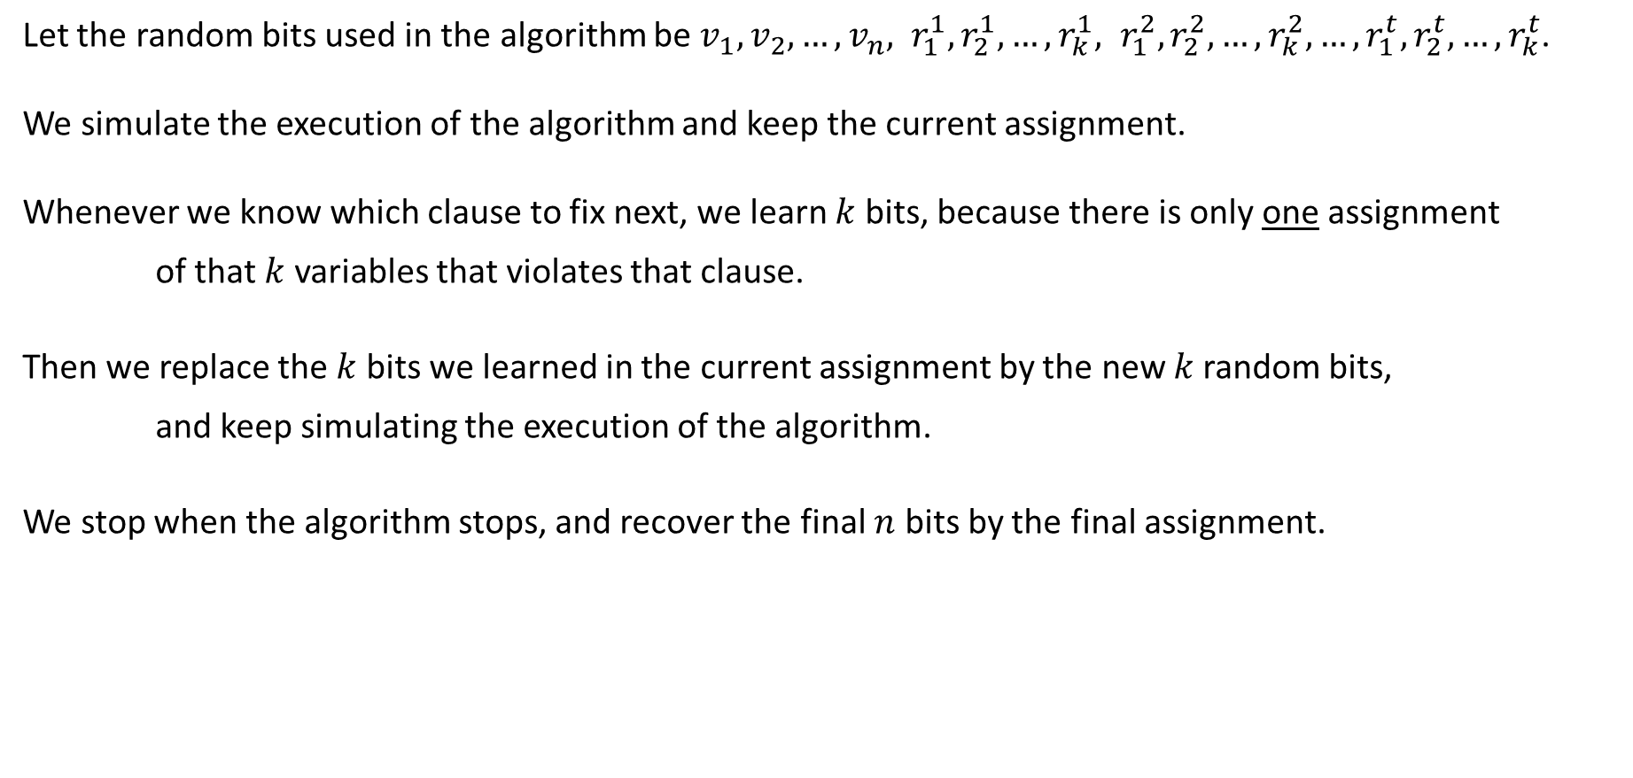
Decoding
Let the random bits used in the algorithm be $v_{1},v_{2},…,v_{n}, r_{1}^{1},r_{2}^{1},…,r_{k}^{1}, r_{1}^{2},r_{2}^{2},…,r_{k}^{2}, …, r_{1}^{t},r_{2}^{t},…,r_{k}^{t}$.
We simulate the execution of the algorithm and keep the current assignment.
Whenever we know which clause to fix next, we learn $k$ bits, because there is only one assignment
of that $k$ variables that violates that clause.
Then we replace the $k$ bits we learned in the current assignment by the new $k$random bits,
and keep simulating the execution of the algorithm.
We stop when the algorithm stops, and recover the final $n$ bits by the final assignment.

Slide 22
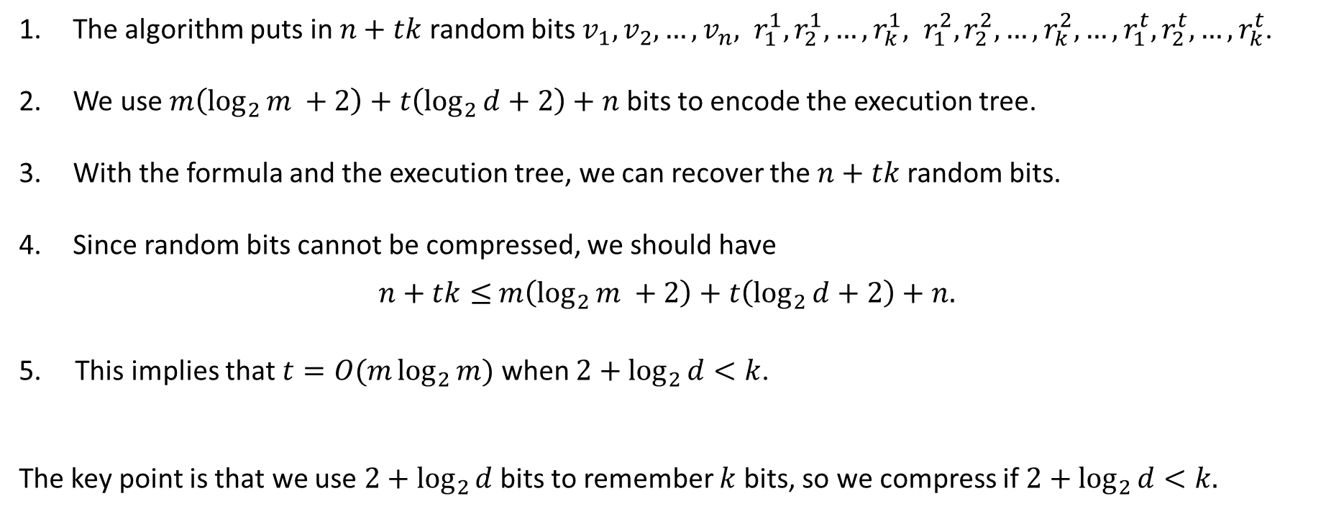
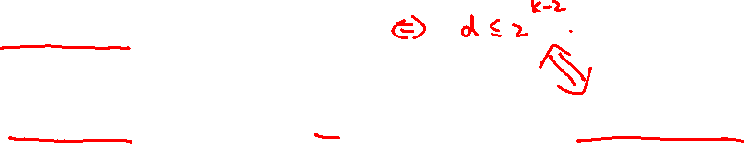
Summary
The algorithm puts in $n+tk$ random bits $v_{1},v_{2},…,v_{n}, r_{1}^{1},r_{2}^{1},…,r_{k}^{1}, r_{1}^{2},r_{2}^{2},…,r_{k}^{2}, …, r_{1}^{t},r_{2}^{t},…,r_{k}^{t}$.
We use $m\left(\log_{2}{m }+2\right)+t\left(\log_{2}{d}+2\right)+n$ bits to encode the execution tree.
With the formula and the execution tree, we can recover the $n+tk$ random bits.
Since random bits cannot be compressed, we should have
$n+tk≤$ $m\left(\log_{2}{m }+2\right)+t\left(\log_{2}{d}+2\right)+n.$
5. This implies that $t=O(m\log_{2}{m})$ when ${2+log}_{2}{d}<k$.
The key point is that we use ${2+log}_{2}{d}$ bits to remember $k$ bits, so we compress if ${2+log}_{2}{d}<k.$

Slide 23
Discussion
Moser’s work has sparked a LOT of follow-up work.
It is very interesting that probabilistic methods can be turned to efficient algorithms.
So, now local lemma is not only a powerful probabilistic method, but also a powerful algorithmic tool!

