Slide 1
CS 466/666 - Algorithm Design and Analysis
Probabilistic Methods
Waterloo, 11 June 2020

Slide 2
Today’s Plan
First moment method
Superconcentrator
Second moment method
Threshold phenomenon
HW3 will be posted soon.
HW2 due Monday.
HW1 will be returned soon.
HW1 solutions posted.

Slide 3
Probabilistic Methods
Broadly speaking, probabilistic methods use ideas and techniques from probability to prove
mathematical statement (that otherwise don’t seem to relate to probability at all).
We have seen one example in bounding the number of minimum cuts using Karger’s ideas.
Today, we are going to see more examples.
One main use of probabilistic methods is to prove the existence of an object satisfying strong
properties (that is difficult to imagine that they exist).
We will see one such example in constructing superconcentrators.
We will also see the second moment method and discuss the threshold phenomenon in many
random structures (e.g. random graphs, random formulas, etc).

Slide 4

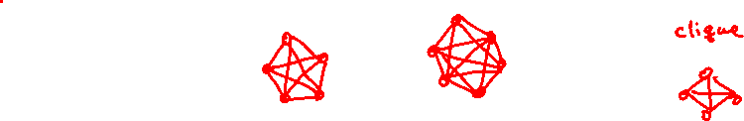


Ramsey Graphs
Can we find a 2-coloring of the edges of the complete graph on $n$ vertices so that there are
no “large” monochromatic cliques?
Theorem. If $\left({n \atop k}\right)2^{−\left({k \atop 2}\right)+1}<1$, then it is possible to color the edges of the complete graph on $n$ vertices
so that there are no monochromatic cliques of size $k$.

Slide 5

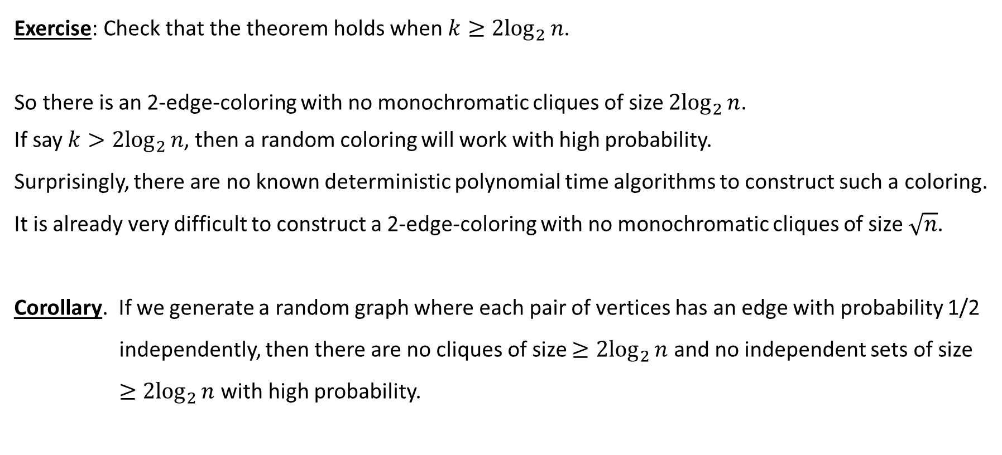


Ramsey Graphs
Exercise: Check that the theorem holds when $k≥{2log}_{2}{n}$.
So there is an 2-edge-coloring with no monochromatic cliques of size ${2log}_{2}{n}$.
If say $k>2\log_{2}{n}$, then a random coloring will work with high probability.
Surprisingly, there are no known deterministic polynomial time algorithms to construct such a coloring.
It is already very difficult to construct a 2-edge-coloring with no monochromatic cliques of size $\sqrt{n}$.
Corollary. If we generate a random graph where each pair of vertices has an edge with probability 1/2
independently, then there are no cliques of size $≥{2log}_{2}{n}$ and no independent sets of size
$≥{2log}_{2}{n}$ with high probability.

Slide 6





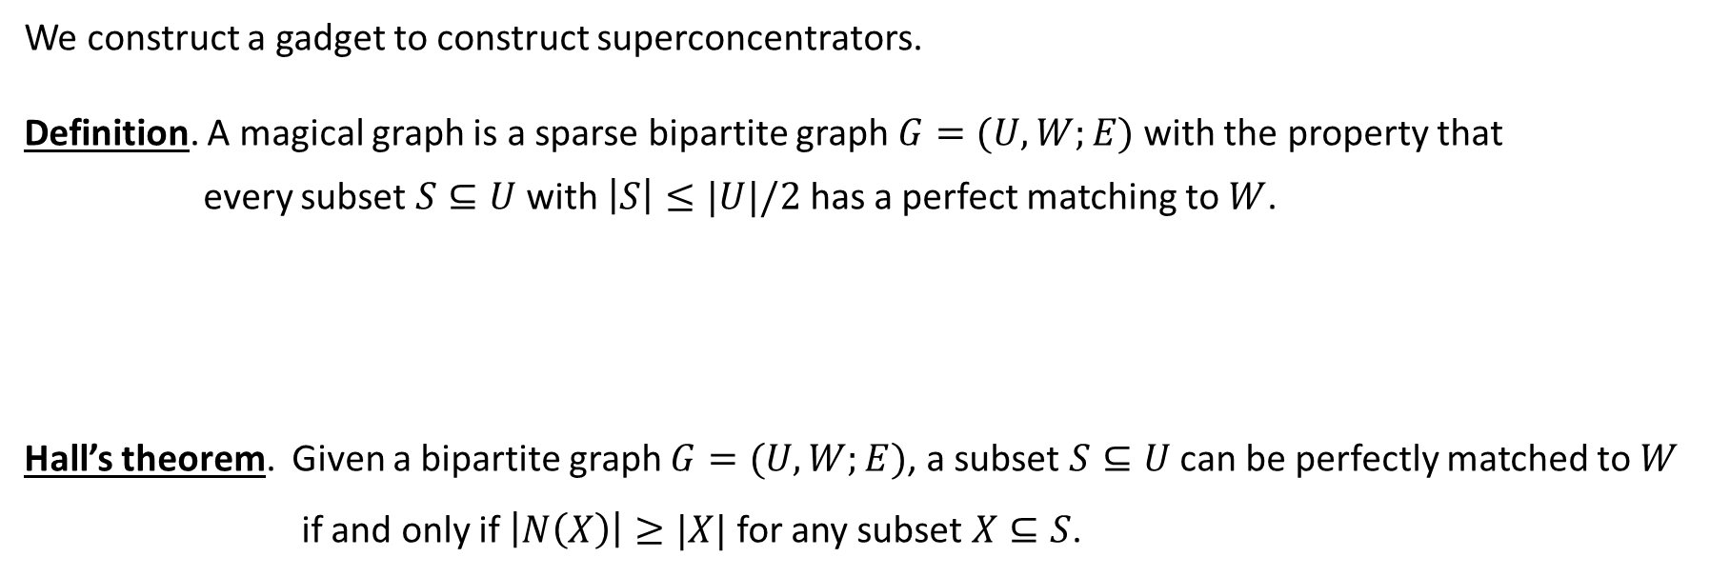

Magical Graphs
We construct a gadget to construct superconcentrators.
Definition. A magical graph is a sparse bipartite graph $G=(U,W;E)$with the property that
every subset $S⊆U$ with $\left|S\right|≤|U|/2$ has a perfect matching to $W$.
Hall’s theorem. Given a bipartite graph $G=(U,W;E)$, a subset $S⊆U$ can be perfectly matched to $W$ if and only if $\left|N\left(X\right)\right|≥|X|$ for any subset $X⊆S$.

Slide 7

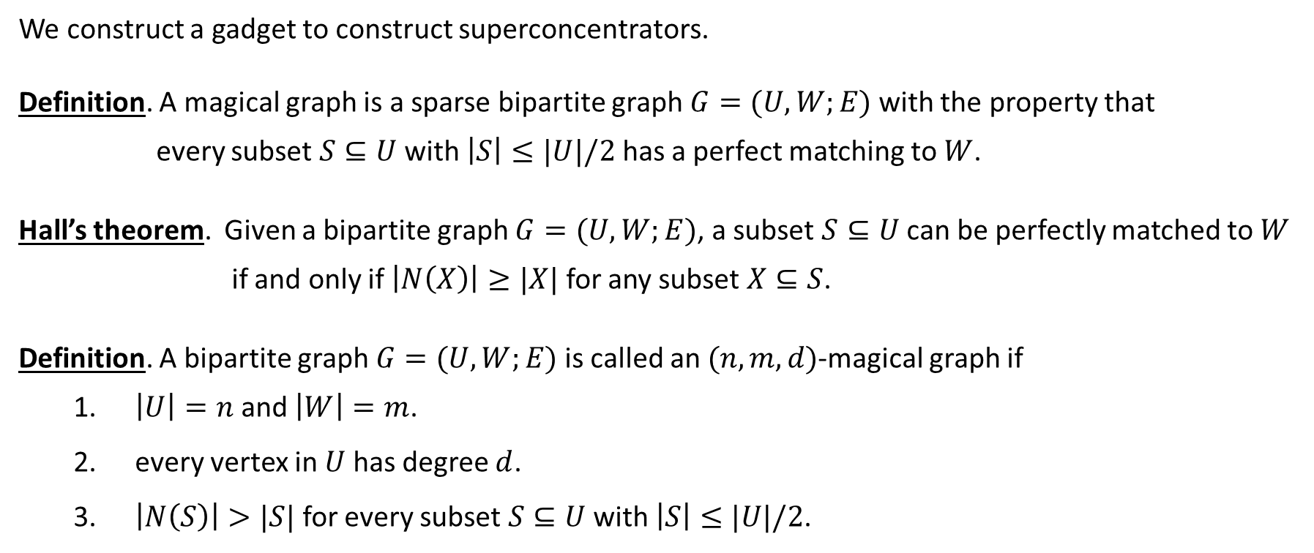
Magical Graphs
We construct a gadget to construct superconcentrators.
Definition. A magical graph is a sparse bipartite graph $G=(U,W;E)$with the property that
every subset $S⊆U$ with $\left|S\right|≤|U|/2$ has a perfect matching to $W$.
Hall’s theorem. Given a bipartite graph $G=(U,W;E)$, a subset $S⊆U$ can be perfectly matched to $W$
if and only if $\left|N\left(X\right)\right|≥|X|$ for any subset $X⊆S$.
Definition. A bipartite graph $G=(U,W;E)$is called an $(n,m,d)$-magical graph if
  $\left|U\right|=n$ and $\left|W\right|=m$.
  every vertex in $U$ has degree $d$.
  $\left|N\left(S\right)\right|>|S|$ for every subset $S⊆U$ with $\left|S\right|≤|U|/2$.

Slide 8
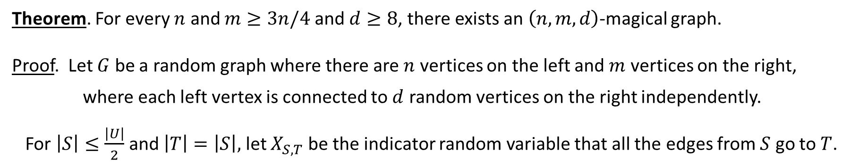




Magical Graphs
Theorem. For every $n$ and $m≥3n/4$ and $d≥8$, there exists an $\left(n,m,d\right)$-magical graph.
Proof. Let $G$ be a random graph where there are $n$ vertices on the left and $m$ vertices on the right,
where each left vertex is connected to $d$ random vertices on the right independently.
For $\left|S\right|≤\frac{\left|U\right|}{2}$ and $\left|T\right|=\left|S\right|,$ let $X_{S,T}$ be the indicator random variable that all the edges from $S$ go to $T$.

Slide 9



Magical Graphs
Theorem. For every $n$ and $m≥3n/4$ and $d≥8$, there exists an $\left(n,m,d\right)$-magical graph.

Slide 10








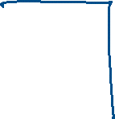













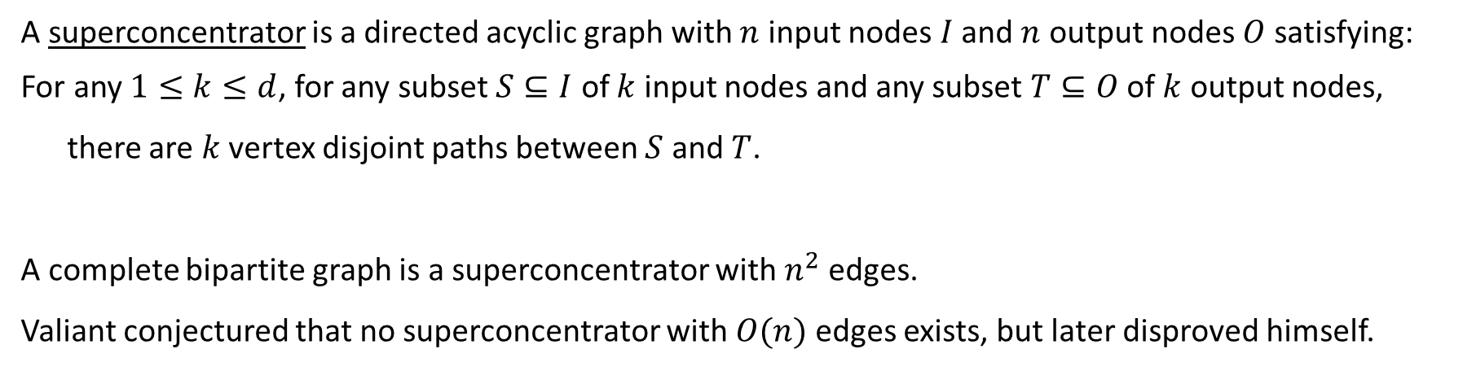

Superconcentrators
A superconcentrator is a directed acyclic graph with $n$ input nodes $I$ and $n$ output nodes $O$ satisfying:
For any $1≤k≤d$, for any subset $S⊆I$ of $k$ input nodes and any subset $T⊆O$ of $k$ output nodes,
there are $k$ vertex disjoint paths between $S$ and $T$.
A complete bipartite graph is a superconcentrator with $n^{2}$ edges.
Valiant conjectured that no superconcentrator with $O(n)$ edges exists, but later disproved himself.

Slide 11







Superconcentrators
The construction is recursive and deterministic.

Slide 12

















Superconcentrators
The number of edges required is $O\left(n\right)$.

Slide 13
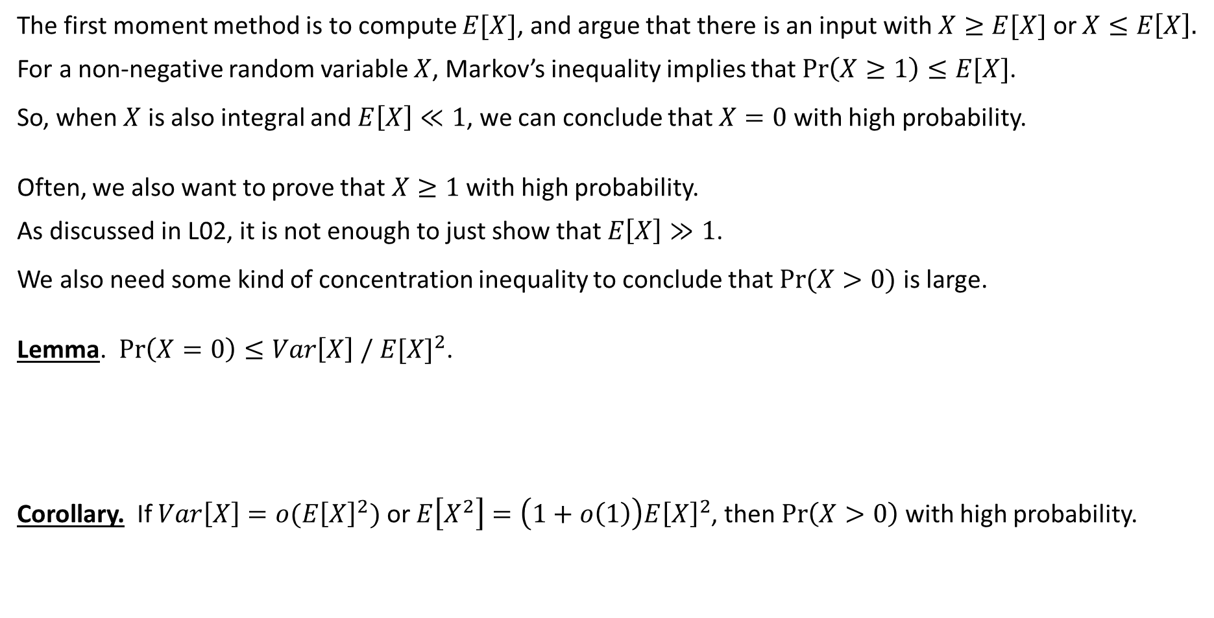
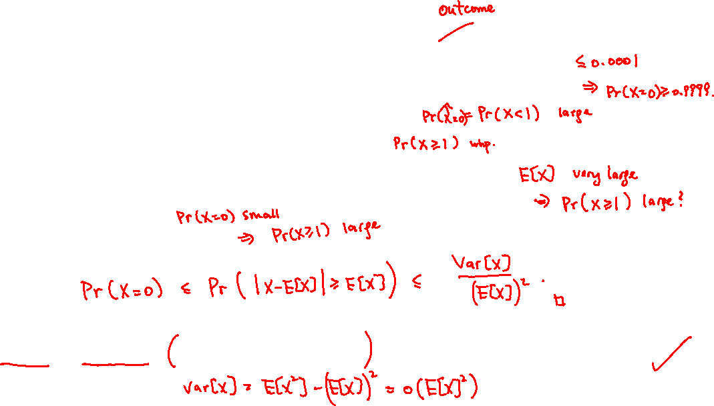

Second Moment Method
The first moment method is to compute $E[X]$, and argue that there is an input with $X≥E[X]$ or $X≤E\left[X\right].$
For a non-negative random variable $X$, Markov’s inequality implies that $\operatorname{Pr}\left(X≥1\right)≤E[X]$.
So, when $X$ is also integral and $E\left[X\right]≪1$, we can conclude that $X=0$ with high probability.
Often, we also want to prove that $X≥1$ with high probability.
As discussed in L02, it is not enough to just show that $E\left[X\right]≫1$.
We also need some kind of concentration inequality to conclude that $Pr⁡(X>0)$ is large.
Lemma. $\operatorname{Pr}\left(X=0\right)≤Var\left[X\right] /{ E[X]}^{2}$.
Corollary. If $Var\left[X\right]=o(E{\left[X\right]}^{2})$ or $E\left[X^{2}\right]=\left(1+o\left(1\right)\right)E{\left[X\right]}^{2}$, then $\operatorname{Pr}\left(X>0\right)$ with high probability.

Slide 14

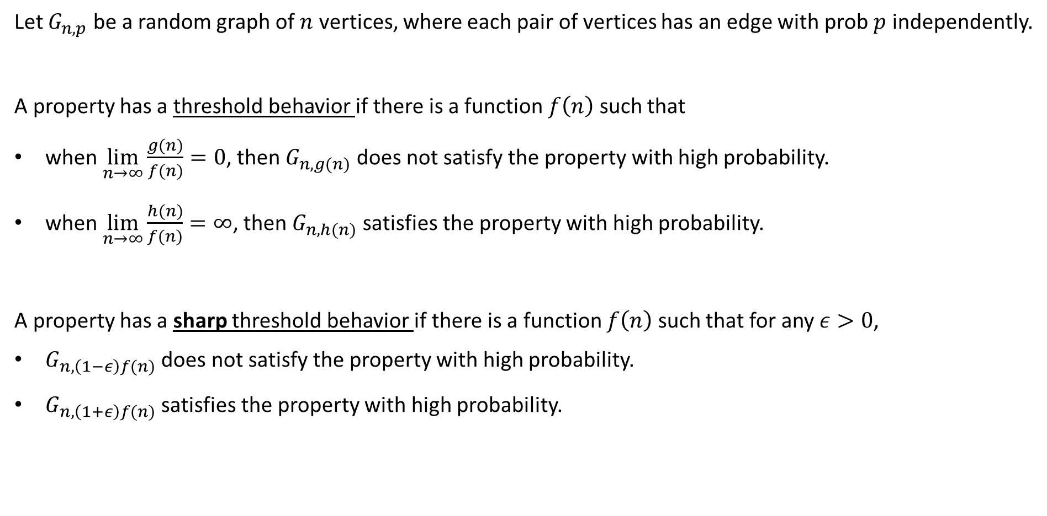
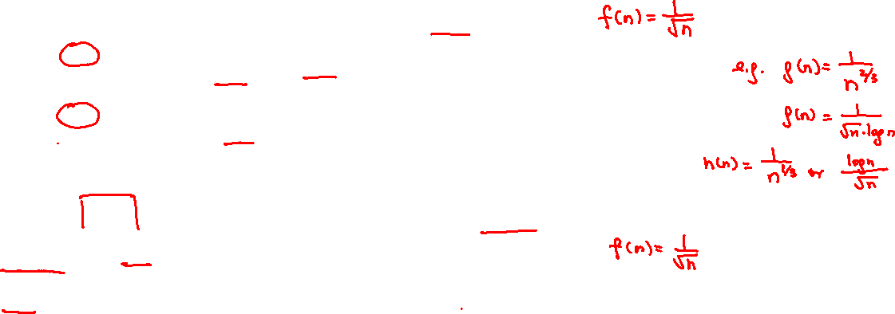
Threshold Behavior in Random Graphs
Let $G_{n,p}$ be a random graph of $n$ vertices, where each pair of vertices has an edge with prob $p$ independently.
A property has a threshold behavior if there is a function $f\left(n\right)$ such that
when $\lim_{n→∞}{\frac{g(n)}{f(n)}}=0$, then $G_{n,g(n)}$ does not satisfy the property with high probability.
when $\lim_{n→∞}{\frac{h(n)}{f(n)}}=∞$, then $G_{n,h(n)}$ satisfies the property with high probability.
A property has a sharp threshold behavior if there is a function $f\left(n\right)$ such that for any $ε>0$,
$G_{n,\left(1−ε\right)f(n)}$ does not satisfy the property with high probability.
$G_{n,\left(1+ε\right)f(n)}$ satisfies the property with high probability.

Slide 15
Cliques of Size 4: First Moment Method
Theorem. The property of having a clique of size 4 has a threshold function $f\left(n\right)=n^{−\frac{2}{3}}$.

Slide 16
















Cliques of Size 4: Second Moment Method
Theorem. The property of having a clique of size 4 has a threshold function $f\left(n\right)=n^{−\frac{2}{3}}$.

Slide 17
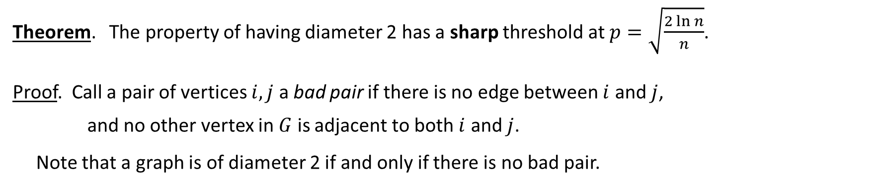
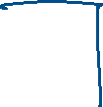

Diameter 2: First Moment Method
Theorem. The property of having diameter 2 has a sharp threshold at $p=\sqrt{\frac{2\ln{n}}{n}}$.
Proof. Call a pair of vertices $i,j$ a bad pair if there is no edge between $i$ and $j$,
and no other vertex in $G$ is adjacent to both $i$ and $j$.
Note that a graph is of diameter 2 if and only if there is no bad pair.

Slide 18


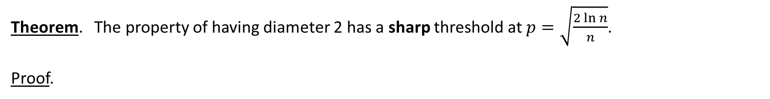
Diameter 2: Second Moment Method
Theorem. The property of having diameter 2 has a sharp threshold at $p=\sqrt{\frac{2\ln{n}}{n}}$.
Proof.

Slide 19
Diameter 2: Second Moment Method
Theorem. The property of having diameter 2 has a sharp threshold at $p=\sqrt{\frac{2\ln{n}}{n}}$.
Proof.

Slide 20
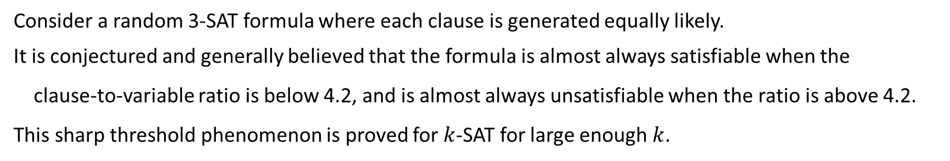
Random Structures
Consider a random 3-SAT formula where each clause is generated equally likely.
It is conjectured and generally believed that the formula is almost always satisfiable when the
clause-to-variable ratio is below 4.2, and is almost always unsatisfiable when the ratio is above 4.2.
This sharp threshold phenomenon is proved for $k$-SAT for large enough $k$.

Slide 21
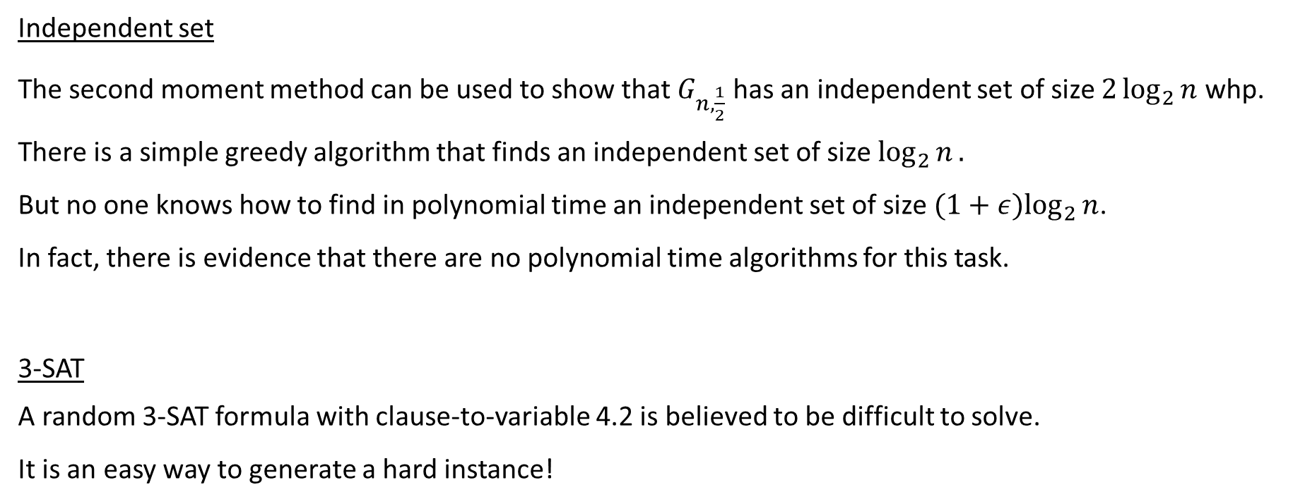
Algorithmic Issue
Independent set
The second moment method can be used to show that $G_{n,\frac{1}{2}}$ has an independent set of size $2\log_{2}{n}$ whp.
There is a simple greedy algorithm that finds an independent set of size $\log_{2}{n}.$
But no one knows how to find in polynomial time an independent set of size ${(1+ε)log}_{2}{n}$.
In fact, there is evidence that there are no polynomial time algorithms for this task.
3-SAT
A random 3-SAT formula with clause-to-variable 4.2 is believed to be difficult to solve.
It is an easy way to generate a hard instance!

