Slide 1
CS 466/666 - Algorithm Design and Analysis
Network Coding
Waterloo, 9 June 2020

Slide 2
Today’s Plan
Max-information-flow min-cut theorem
Distributed algorithm
Fast implementation by superconcentrator
HW2 posted, from L04-L06.
HW1 solutions posted.

Slide 3
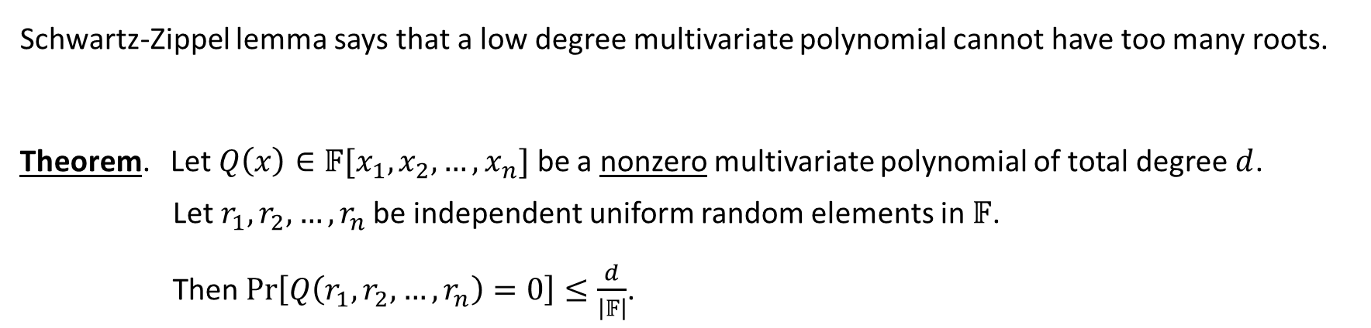
Schwartz-Zippel Lemma
Schwartz-Zippel lemma says that a low degree multivariate polynomial cannot have too many roots.
Theorem. Let $Q\left(x\right)∈𝔽[x_{1},x_{2},…,x_{n}]$ be a nonzero multivariate polynomial of total degree $d$.
Let$r_{1},r_{2},…,r_{n}$ be independent uniform random elements in $𝔽$.
Then $\operatorname{Pr}\left[Q\left(r_{1},r_{2},…, r_{n}\right)=0\right]≤\frac{d}{\left|𝔽\right|}$.

Slide 4
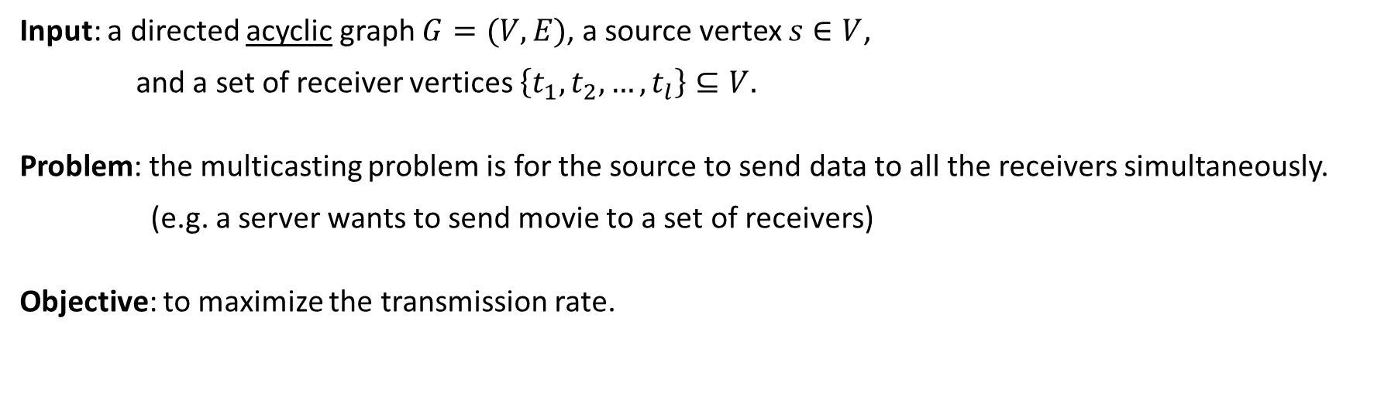



Network Multicasting
Input: a directed acyclic graph $G=(V,E)$, a source vertex $s∈V$,
and a set of receiver vertices $\left\{t_{1},t_{2},…,t_{l}\right\}⊆V.$
Problem: the multicasting problem is for the source to send data to all the receivers simultaneously.
(e.g. a server wants to send movie to a set of receivers)
Objective: to maximize the transmission rate.

Slide 5










Traditional Setting
In traditional computer network setting, each intermediate node is used to store and forward data.
Assume each edge is of capacity one, i.e. transmitting one unit of data per second (e.g. 1M/s).
To increase the transmission rate, we need to find edge-disjoint trees connecting the source to the receivers.

Slide 6




















(Steiner) Tree Packing
The problem of finding the maximum number of edge-disjoint (Steiner) trees is NP-hard.
Also, there are graphs with high connectivity from the source to each receiver, but there are
very few edge-disjoint trees connecting the source to all receivers.
That is, while it is easy for the source to send data quickly to each individual receiver,
it becomes difficult for the source to send data quickly to all receivers simultaneously.

Slide 7








Butterfly Network
The idea of network coding is that information flow is different from standard commodity flow.
We could do encoding in intermediate nodes and decoding at the receivers to improve the speed!
Let’s see how this can be done for the butterfly network.

Slide 8



Network Coding
More generally, network coding allows:
arithmetic operations over a larger field (not just bit-wise operation).
data sent on an edge is an arbitrary function of its predecessors (not just xor).
Surprisingly, the rate of transmission rate can be significantly improved if network coding is used.
In fact, it can always achieve the optimal rate for multicasting!

Slide 9
Max-Information-Flow Min-Cut Theorem
Theorem. If the source has at least k edge-disjoint paths to each receiver, then
the source can send k units of data to all receivers simultaneously using network coding.
This is clearly optimal. It is an amazing result that opens up a new area.
There are examples showing that the ratio of the rate achieved by network coding to
the rate achieved without network coding is unbounded.
3. The original proof uses information theory.

Slide 10





Linear Network Coding
An important algorithmic question is to construct an optimal encoding and decoding scheme.
The next major result is that linear network coding is enough to achieve optimal rate for multicasting.

Slide 11
Polynomial Time Algorithms
Deterministic algorithm
Polynomial time algorithms are designed for finding the optimal scheme.
But the algorithm is “centralized”, difficult to be used in practice.
Randomized algorithm
The algorithm is very simple and totally decentralized, a key feature to be practical.
The proof also provides a proof of the max-flow min-cut theorem and the linear coding theorem.

Slide 12




















Setup
The source has exactly $k$ outgoing edges.
Each receiver has exactly $k$ incoming edges.
The source wants to send $k$ messages $x_{1},x_{2},…,x_{k}$ to the receivers.

Slide 13







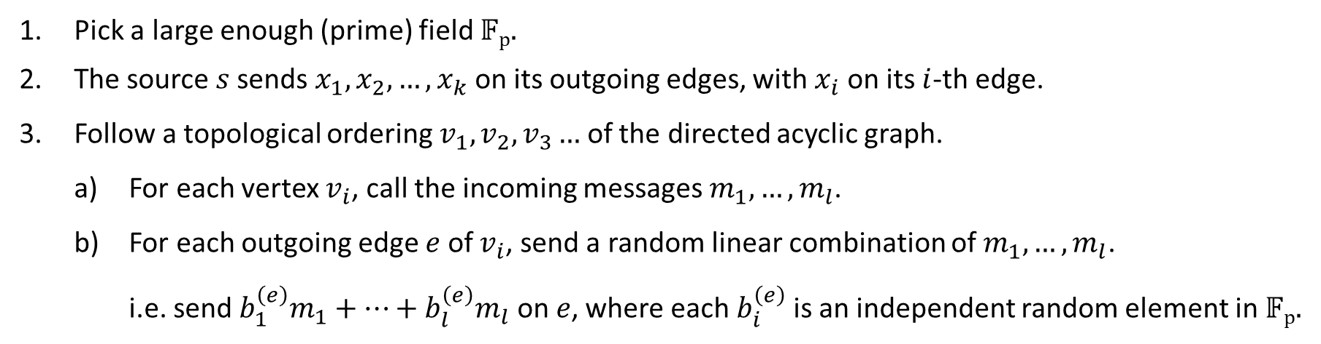
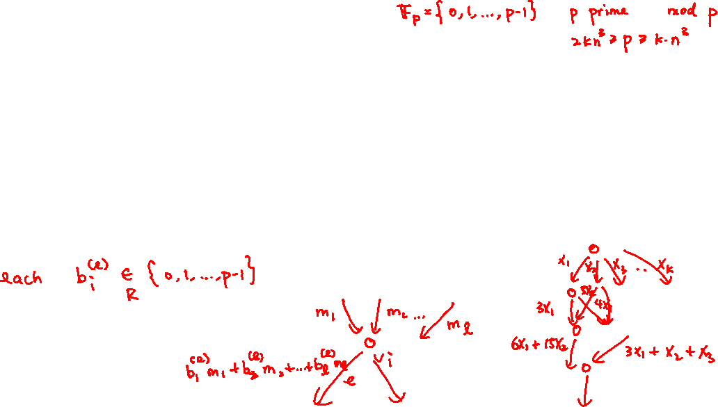


Random Linear Network Coding Algorithm
Pick a large enough (prime) field 𝔽_{p}.
The source $s$sends $x_{1},x_{2},…,x_{k}$ on its outgoing edges, with $x_{i}$ on its $i$-th edge.
Follow a topological ordering $v_{1}, v_{2},v_{3}…$ of the directed acyclic graph.
  For each vertex $v_{i}$, call the incoming messages $m_{1},…,m_{l}$.
  For each outgoing edge $e$ of $v_{i}$, send a random linear combination of $m_{1},…,m_{l}$.
  i.e. send ${b_{1}^{\left(e\right)}m}_{1}+…+b_{l}^{\left(e\right)}m_{l}$ on $e$, where each $b_{i}^{\left(e\right)}$ is an independent random element in 𝔽_{p}.

Slide 14
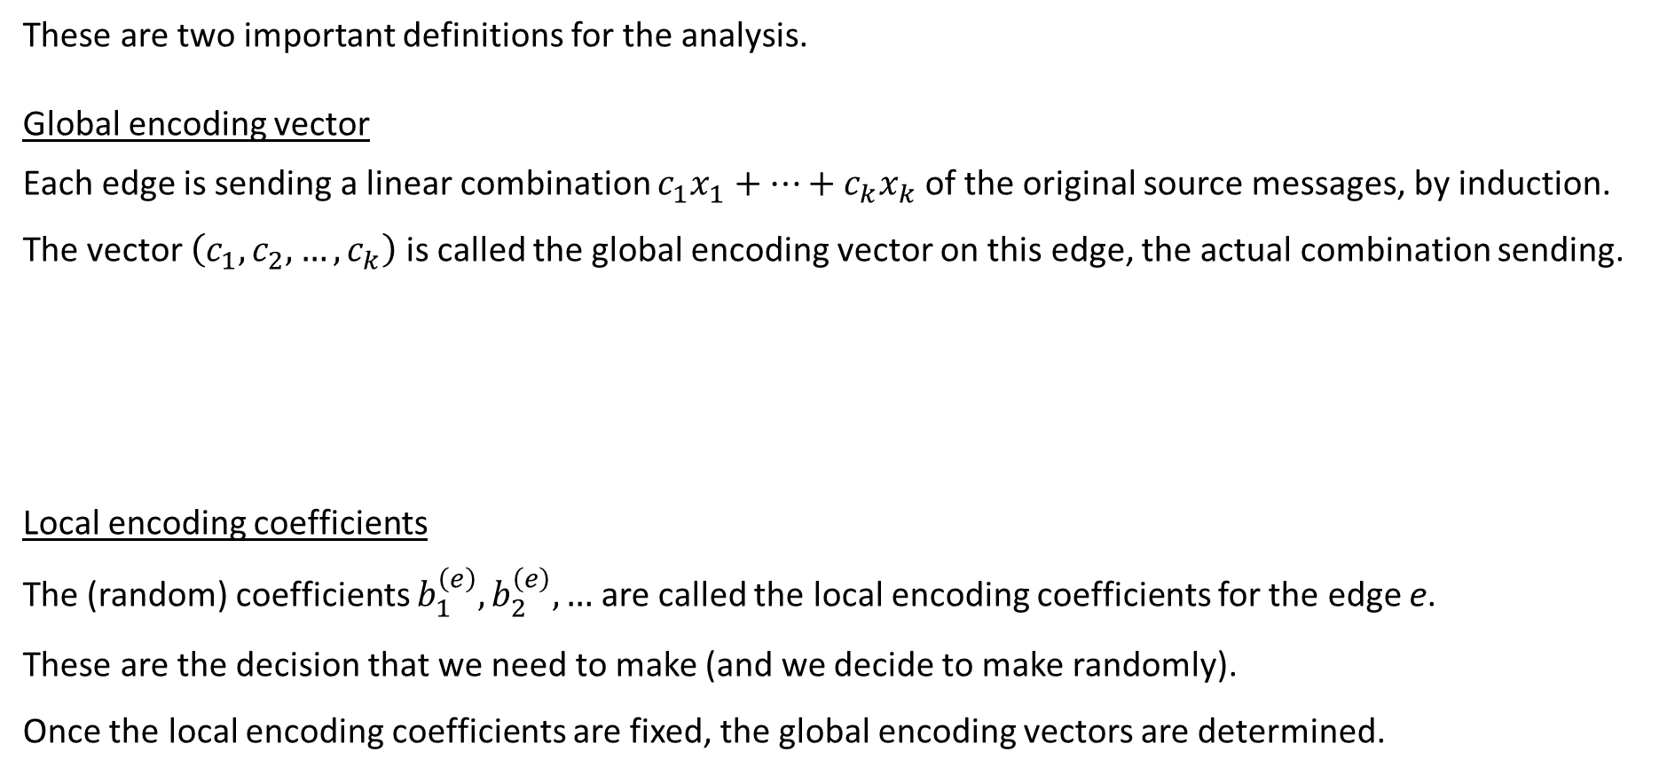

Global Coefficients and Local Coefficients
These are two important definitions for the analysis.
Global encoding vector
Each edge is sending a linear combination $c_{1}x_{1}+…+c_{k}x_{k}$ of the original source messages, by induction.
The vector $\left(c_{1},c_{2},…,c_{k}\right)$ is called the global encoding vector on this edge, the actual combination sending.
Local encoding coefficients
The (random) coefficients $b_{1}^{\left(e\right)},b_{2}^{\left(e\right)},…$ are called the local encoding coefficients for the edge e.
These are the decision that we need to make (and we decide to make randomly).
Once the local encoding coefficients are fixed, the global encoding vectors are determined.

Slide 15



Decodability
For a receiver $t$ with $k$ incoming vectors, let $m_{i}$ be the $i$-th incoming message and
let the global encoding vector of the $i$-th incoming edge be $(c_{i1},c_{i2},…,c_{ik})$.
Decodable ⇔ the $k$ incoming vectors are linear independent $⇔$ $C$ is invertible ⇔ $\det\left(C\right)≠0$.

Slide 16




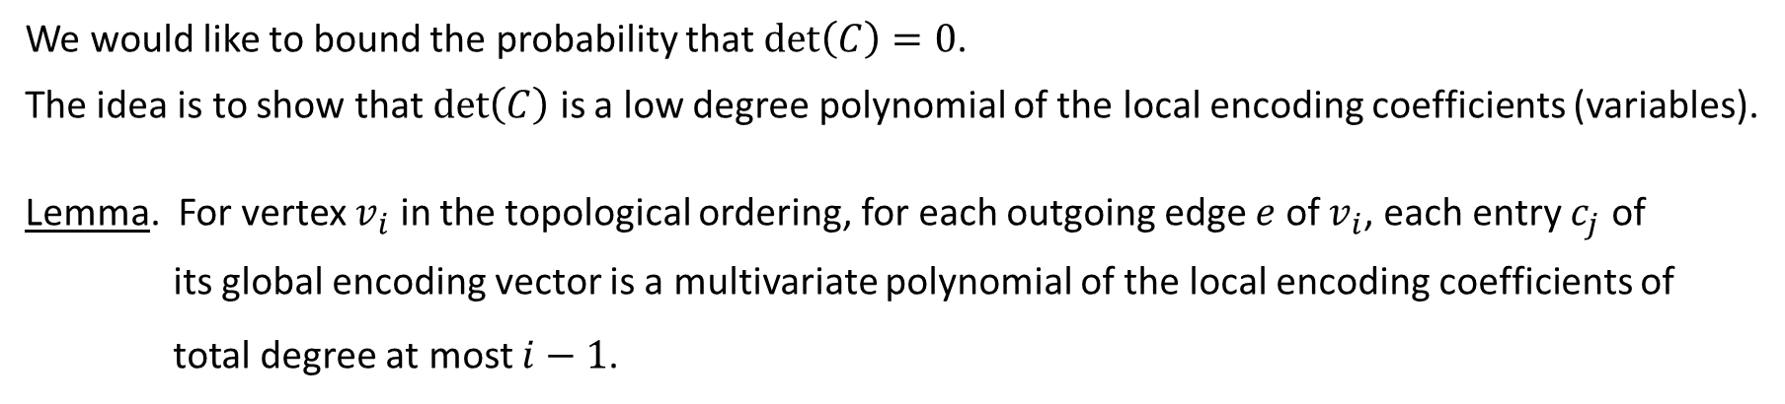



Analysis
We would like to bound the probability that $\det\left(C\right)=0$.
The idea is to show that $\det\left(C\right)$ is a low degree polynomial of the local encoding coefficients (variables).
Lemma. For vertex $v_{i}$ in the topological ordering, for each outgoing edge $e$ of $v_{i}$, each entry $c_{j}$ of
its global encoding vector is a multivariate polynomial of the local encoding coefficients of
total degree at most $i−1$.

Slide 17



Analysis
By the lemma, each entry in a receiver matrix $C$is a multivariate polynomial of the
local encoding coefficients of total degree at most $n$.

Slide 18










Edge Disjoint Paths
Finally, we need to prove that $\det\left(C\right)≢0$, using the assumption that there are $k$ edge-disjoint paths.
Claim. If the source has $k$ edge-disjoint paths to a receiver, then the receiver matrix $C$ satisfies $\det\left(C\right)≢0$.

Slide 19
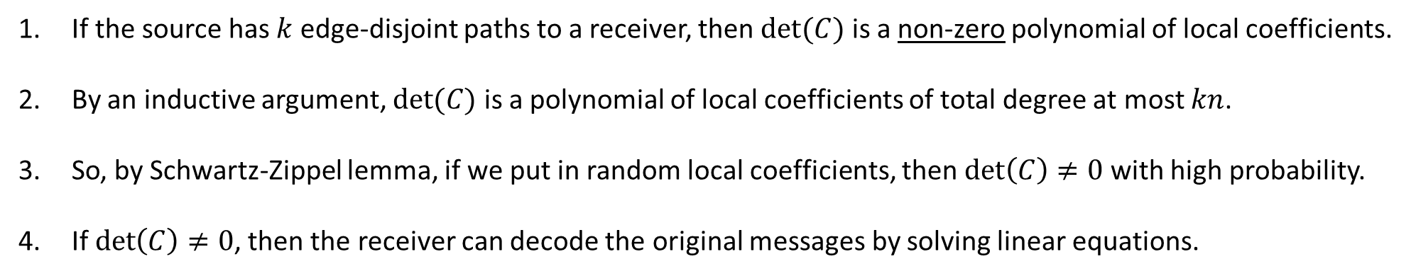
Proof Summary
If the source has $k$ edge-disjoint paths to a receiver, then $det⁡(C)$ is a non-zero polynomial of local coefficients.
By an inductive argument, $det⁡(C)$ is a polynomial of local coefficients of total degree at most $kn$.
So, by Schwartz-Zippel lemma, if we put in random local coefficients, then $\det\left(C\right)≠0$ with high probability.
If $\det\left(C\right)≠0$, then the receiver can decode the original messages by solving linear equations.

Slide 20






Efficient Encoding
In a node with indegree $d$ and outdegree $d$, how to do the encoding efficiently?
Encoding is efficient if the indegree is small. Is there a reduction to the case where the indegree is small?

Slide 21

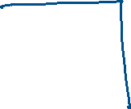












Superconcentrator
A superconcentrator is a directed acyclic graph with $d$ input nodes and $d$ output nodes with
total $O(d)$ internal nodes and each internal node has constant indegree and constant outdegree;
For any $1≤k≤d$, for any subset $X$ of $k$ input nodes and any subset $Y$ of $k$ output nodes,
there are $k$ vertex disjoint paths between $X$ and $Y$.
It is a magical object that is as well connected as complete bipartite graph, but has only $O(d)$ edges in total.
We will see the construction of superconcentrator next time using probabilistic method!

Slide 22

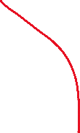









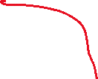


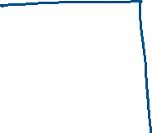


Reduction
Superconcentrator is an efficient object to reduce the indegree of a vertex while maintaining connectivity.
In HW3, you will use superconcentrator and network coding to design fast algorithms for some problems.

Slide 23
Concluding Remarks
An important discovery that opens up a new area.
An interesting example of distributed algorithms.
The proof is clean and elegant, and recovers all previous results.
A great example of how Schwartz-Zippel lemma implies nontrivial and substantial results.

Slide 24
Further References
More and more results using algebraic techniques to design fast algorithms for combinatorial problems.
Polynomial identity testing is very useful in designing efficient “interactive proofs”.
In general, randomness is very useful in checking things efficiently.
A famous example is the PCP theorem (probabilistically checkable proofs).
These are all great project topics.

