Slide 1
CS 466/666 - Algorithm Design and Analysis
Lecture 7: Polynomial Identity Testing
Waterloo, 4 June 2020

Slide 2
Today’s Plan
String equality
Schwartz-Zippel lemma
Algebraic formulations for matchings
Isolation lemma
Parallel algorithm for matchings
HW2 posted, from L04-L06.
HW1 solutions will be posted on June 8,
will not accept submissions after June 8 11pm.

Slide 3
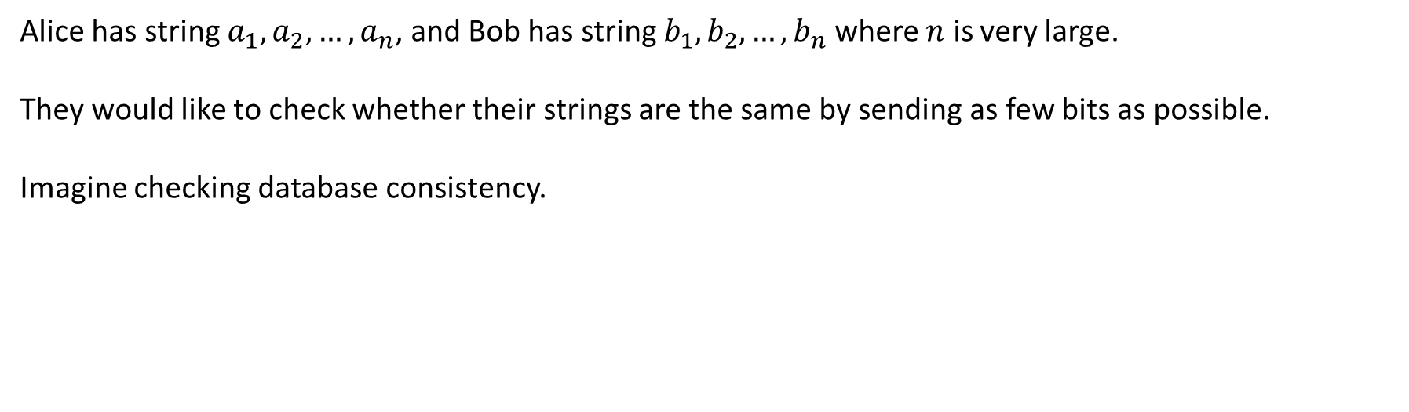
String Equality
Alice has string $a_{1},a_{2},…,a_{n}$, and Bob has string $b_{1},b_{2},…,b_{n}$ where $n$ is very large.
They would like to check whether their strings are the same by sending as few bits as possible.
Imagine checking database consistency.

Slide 4

Deterministic Algorithm
It is easy if Alice and Bob send n+1 bits.
There are no deterministic algorithms that can do better.
This can be formally proved by techniques developed in communication complexity.

Slide 5
Randomized Algorithm
Surprisingly, there is a randomized algorithm using only O(log n) bits!
The idea is to think of the strings as polynomials.

Slide 6
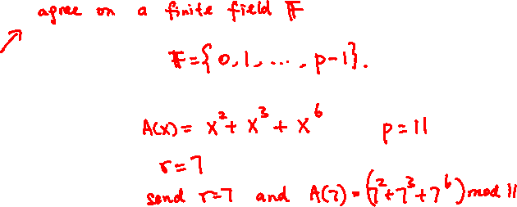

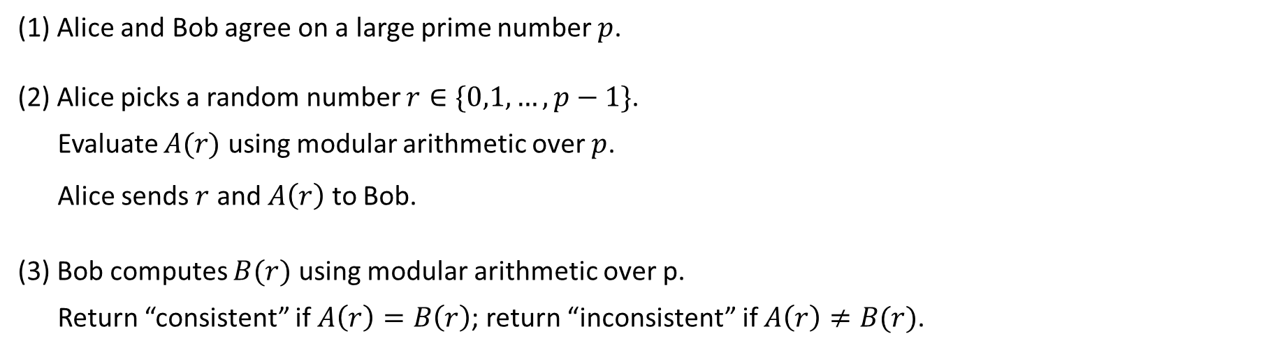
Algorithm
(1) Alice and Bob agree on a large prime number $p$.
(2) Alice picks a random number $r∈\{0,1,…,p−1\}$.
Evaluate $A(r)$ using modular arithmetic over $p$.
Alice sends $r$ and $A\left(r\right)$ to Bob.
(3) Bob computes $B(r)$ using modular arithmetic over p.
Return “consistent” if $A\left(r\right)=B\left(r\right)$; return “inconsistent” if $A\left(r\right)≠B(r)$.

Slide 7

Analysis
If the two strings are the same, then $A\left(x\right)≡B(x)$, and so Bob always returns consistent.
So we only need to bound that probability that the two strings are not the same but Bob returns consistent.

Slide 8
Analysis
If the two strings are the same, then $A\left(x\right)≡B(x)$, and so Bob always returns consistent.
So we only need to bound that probability that the two strings are not the same but Bob returns consistent.

Slide 9
Improving the Success Probability

Slide 10
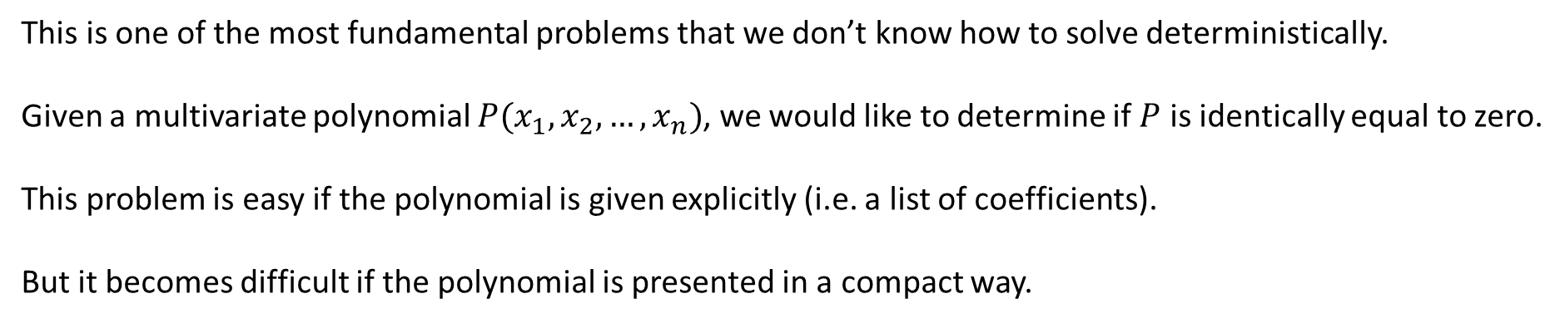
Polynomial Identity Testing
This is one of the most fundamental problems that we don’t know how to solve deterministically.
Given a multivariate polynomial $P(x_{1},x_{2},…,x_{n})$, we would like to determine if $P$ is identically equal to zero.
This problem is easy if the polynomial is given explicitly (i.e. a list of coefficients).
But it becomes difficult if the polynomial is presented in a compact way.

Slide 11
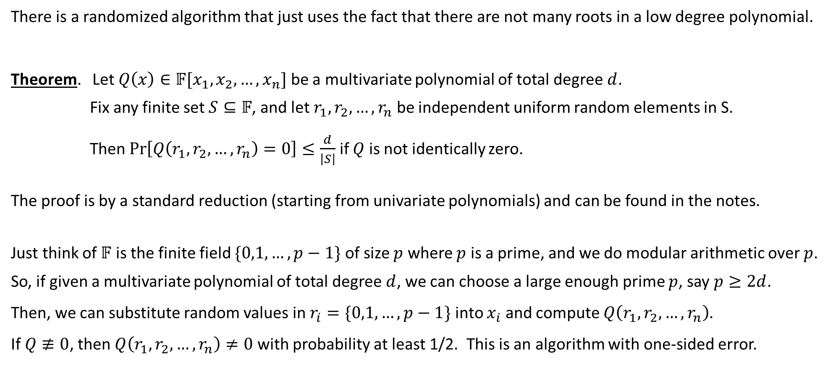
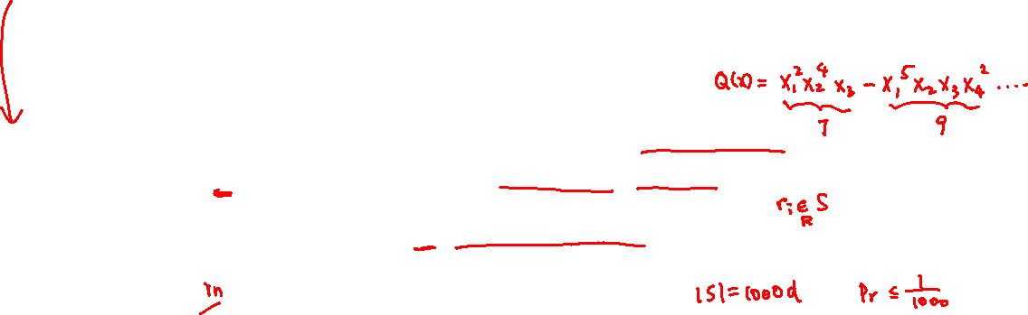
Schwartz-Zippel Lemma
There is a randomized algorithm that just uses the fact that there are not many roots in a low degree polynomial.
Theorem. Let $Q\left(x\right)∈𝔽[x_{1},x_{2},…,x_{n}]$ be a multivariate polynomial of total degree $d$.
Fix any finite set $S⊆𝔽$, and let $r_{1},r_{2},…,r_{n}$ be independent uniform random elements in S.
Then $\operatorname{Pr}\left[Q\left(r_{1},r_{2},…, r_{n}\right)=0\right]≤\frac{d}{\left|S\right|}$ if $Q$ is not identically zero.
The proof is by a standard reduction (starting from univariate polynomials) and can be found in the notes.
Just think of $𝔽$ is the finite field $\{0,1,…,p−1\}$ of size $p$ where $p$ is a prime, and we do modular arithmetic over $p$.
So, if given a multivariate polynomial of total degree $d$, we can choose a large enough prime $p$, say $p≥2d$.
Then, we can substitute random values in $r_{i}=\{0,1,…,p−1\}$ into $x_{i}$ and compute $Q\left(r_{1},r_{2},…, r_{n}\right)$.
If $Q≢0$, then $Q\left(r_{1},r_{2},…, r_{n}\right)≠0$ with probability at least 1/2. This is an algorithm with one-sided error.

Slide 12









Bipartite Matching
In the bipartite matching problem, we are given a bipartite graph $G=\left(U,W;E\right)$,
and the objective is to find a maximum subset of vertex-disjoint edges.
When $\left|U\right|=\left|W\right|=n$, we say a matching $M⊆E$ is perfect if $\left|M\right|=n$.
There is an elegant combinatorial augmenting path algorithm for bipartite matching in deterministic polytime.

Slide 13











Algebraic Formulation for Bipartite Matching
Theorem (Edmonds) Let $A$ be an $n×n$ matrix where $A_{ij}=x_{ij}$ if $ij∈E$ and zero otherwise.
Then $G$ has a perfect matching if and only if $\det\left(A\right)≢0$.

Slide 14



Algebraic Formulation for Bipartite Matching
Theorem (Edmonds) Let $A$ be an $n×n$ matrix where $A_{ij}=x_{ij}$ if $ij∈E$ and zero otherwise.
Then $G$ has a perfect matching if and only if $\det\left(A\right)≢0$.

Slide 15
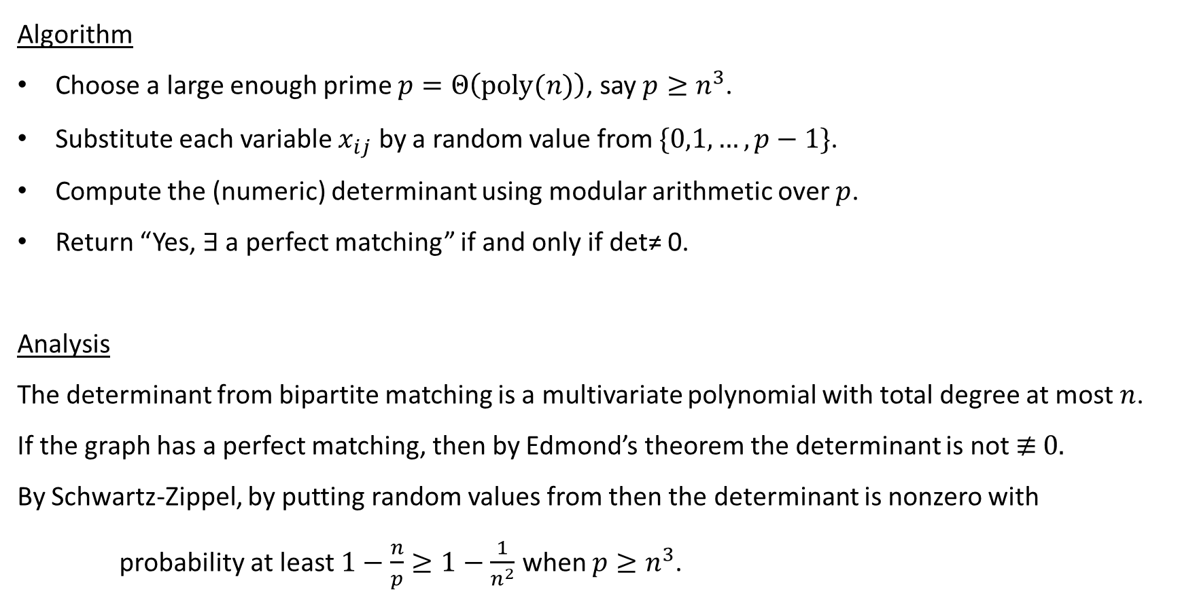
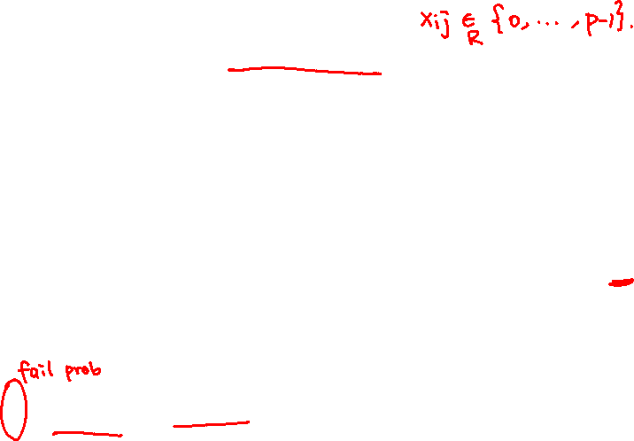
Algebraic Algorithm for Bipartite Matching
Algorithm
Choose a large enough prime $p=Θ\left(poly(n)\right)$, say $p≥n^{3}$.
Substitute each variable $x_{ij}$ by a random value from $\{0,1,…,p−1\}$.
Compute the (numeric) determinant using modular arithmetic over $p$.
Return “Yes, $∃$ a perfect matching” if and only if det≠ 0.
Analysis
The determinant from bipartite matching is a multivariate polynomial with total degree at most $n$.
If the graph has a perfect matching, then by Edmond’s theorem the determinant is not ≢ 0.
By Schwartz-Zippel, by putting random values from then the determinant is nonzero with
probability at least $1−\frac{n}{p}≥1−\frac{1}{n^{2}}$ when $p≥n^{3}$.

Slide 16

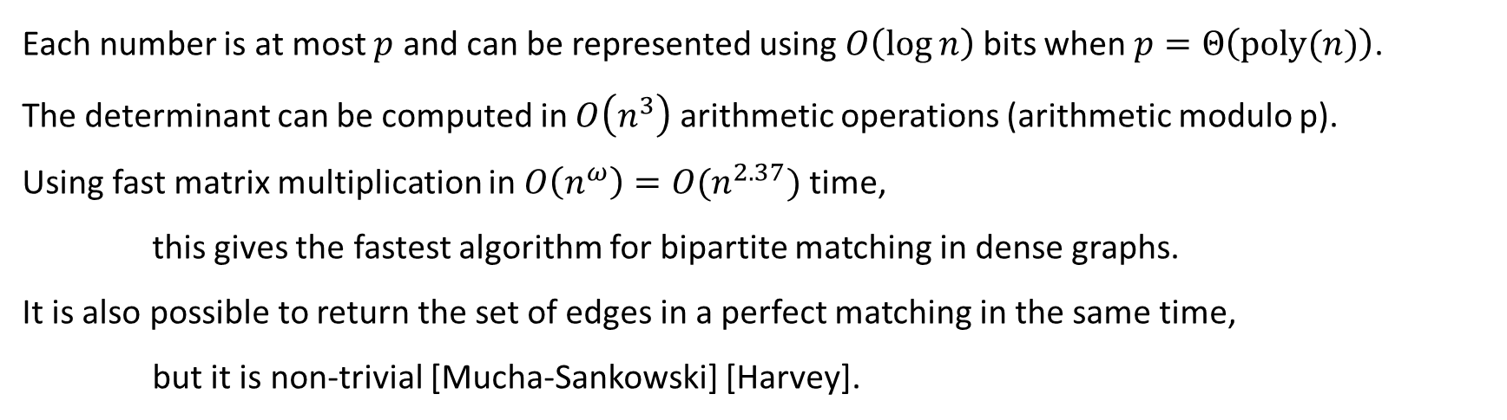
Complexity
Each number is at most $p$ and can be represented using $O\left(\log{n}\right)$ bits when $p=Θ\left(poly(n)\right)$.
The determinant can be computed in $O\left(n^{3}\right)$ arithmetic operations (arithmetic modulo p).
Using fast matrix multiplication in $O\left(n^{ω}\right)=O(n^{2.37})$ time,
this gives the fastest algorithm for bipartite matching in dense graphs.
It is also possible to return the set of edges in a perfect matching in the same time,
but it is non-trivial [Mucha-Sankowski] [Harvey].

Slide 17


Algebraic Formulation for General Matching
Theorem (Tutte) Let $A$ be an $n×n$ matrix where $A_{ij}=x_{ij}$ and $A_{ji}={−x}_{ij}$if $ij∈E$ and zero ow.
Then $G$ has a perfect matching if and only if $\det\left(A\right)≢0$.
Many combinatorial optimization problems have an algebraic formulation.

Slide 18
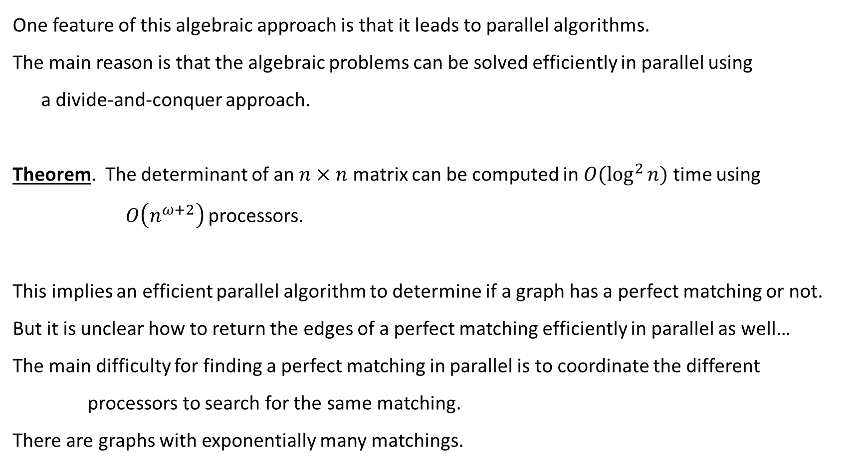
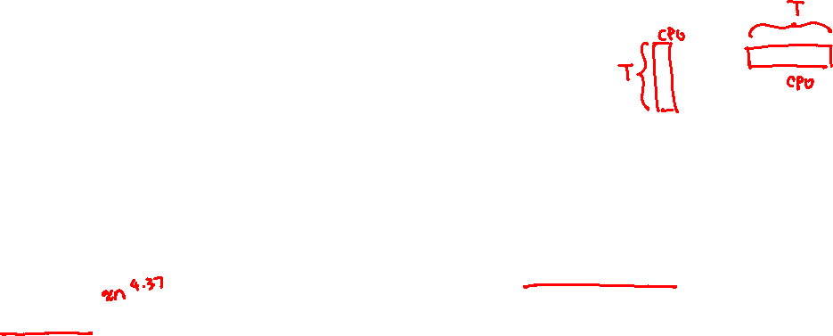
Parallel Algorithm for Algebraic Problems
One feature of this algebraic approach is that it leads to parallel algorithms.
The main reason is that the algebraic problems can be solved efficiently in parallel using
a divide-and-conquer approach.
Theorem. The determinant of an $n×n$ matrix can be computed in $O(\log^{2}{n})$ time using
$O\left(n^{ω+2}\right)$ processors.
This implies an efficient parallel algorithm to determine if a graph has a perfect matching or not.
But it is unclear how to return the edges of a perfect matching efficiently in parallel as well…
The main difficulty for finding a perfect matching in parallel is to coordinate the different
processors to search for the same matching.
There are graphs with exponentially many matchings.

Slide 19




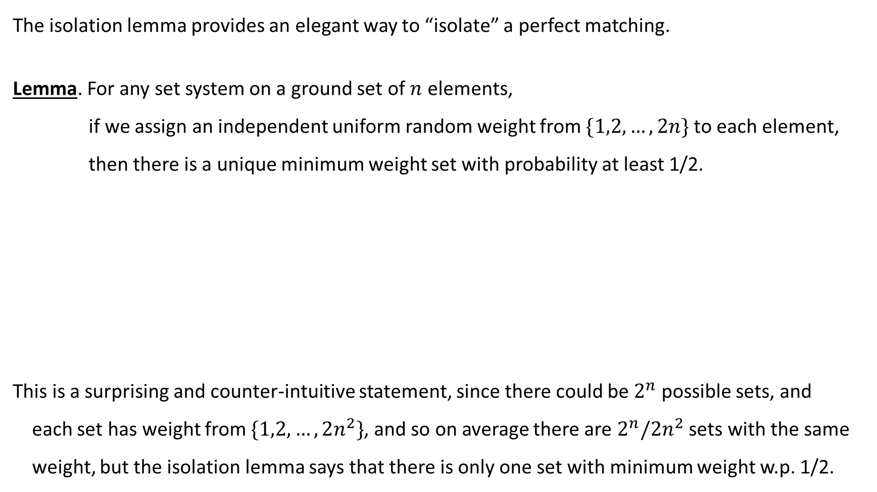




Isolation Lemma
The isolation lemma provides an elegant way to “isolate” a perfect matching.
Lemma. For any set system on a ground set of $n$ elements,
if we assign an independent uniform random weight from $\{1,2,…,2n\}$ to each element,
then there is a unique minimum weight set with probability at least 1/2.
This is a surprising and counter-intuitive statement, since there could be $2^{n}$ possible sets, and
each set has weight from $\{1,2,…,2n^{2}\}$, and so on average there are $2^{n}/2n^{2}$ sets with the same
weight, but the isolation lemma says that there is only one set with minimum weight w.p. 1/2.

Slide 20









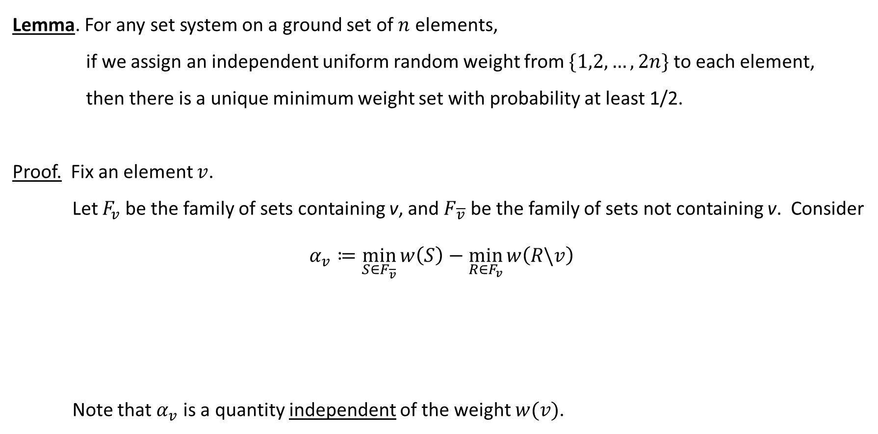
Proof of Isolation Lemma
Lemma. For any set system on a ground set of $n$ elements,
if we assign an independent uniform random weight from $\{1,2,…,2n\}$ to each element,
then there is a unique minimum weight set with probability at least 1/2.
Proof. Fix an element $v$.
Let $F_{v}$ be the family of sets containing v, and $F_{\overline{v}}$ be the family of sets not containing v. Consider
$$α_{v}≔\min_{S∈F_{\overline{v}}}{w\left(S\right)}−\min_{R∈F_{v}}{w\left(R\backslash v\right)}$$
Note that $α_{v}$ is a quantity independent of the weight $w(v)$.

Slide 21












Proof of Isolation Lemma: Ambiguous Element
$$α_{v}≔\min_{S∈F_{\overline{v}}}{w\left(S\right)}−\min_{R∈F_{v}}{w\left(R\backslash v\right)}$$

Slide 22
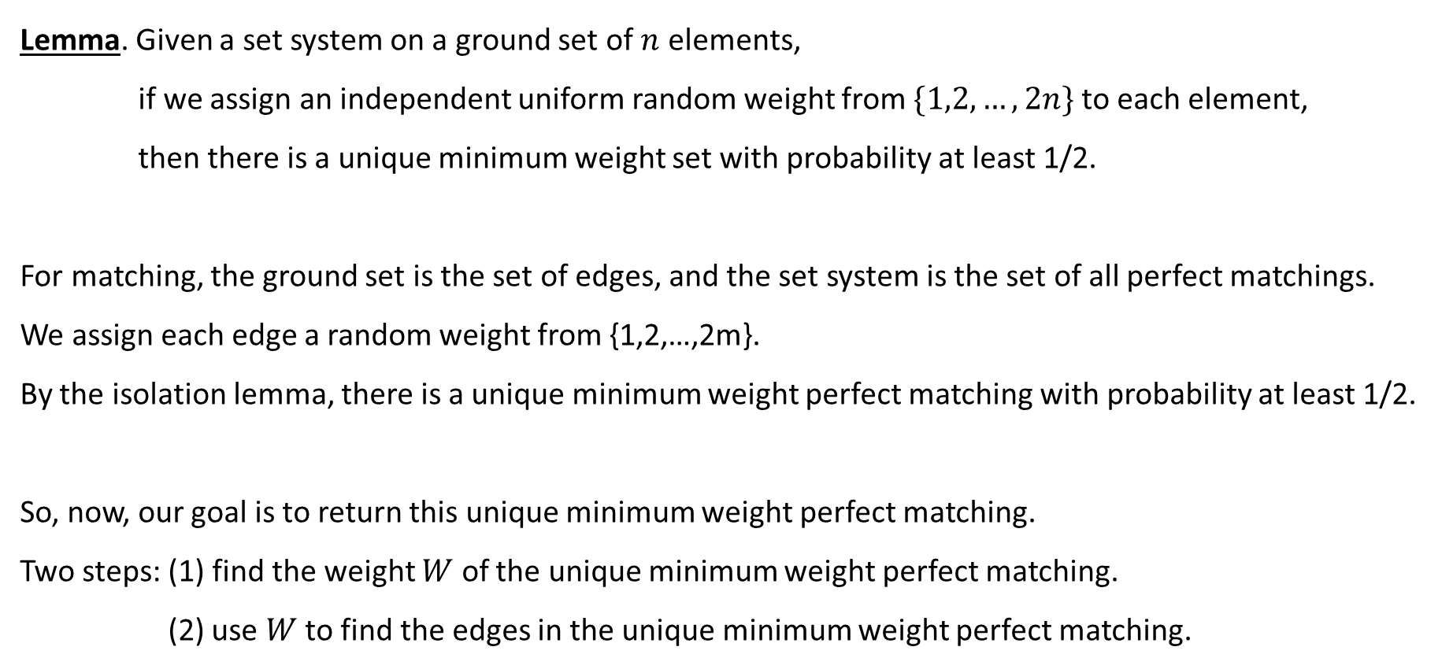

Isolation Lemma for Matchings
Lemma. Given a set system on a ground set of $n$ elements,
if we assign an independent uniform random weight from $\{1,2,…,2n\}$ to each element,
then there is a unique minimum weight set with probability at least 1/2.
For matching, the ground set is the set of edges, and the set system is the set of all perfect matchings.
We assign each edge a random weight from {1,2,…,2m}.
By the isolation lemma, there is a unique minimum weight perfect matching with probability at least 1/2.
So, now, our goal is to return this unique minimum weight perfect matching.
Two steps: (1) find the weight $W$ of the unique minimum weight perfect matching.
(2) use $W$ to find the edges in the unique minimum weight perfect matching.

Slide 23
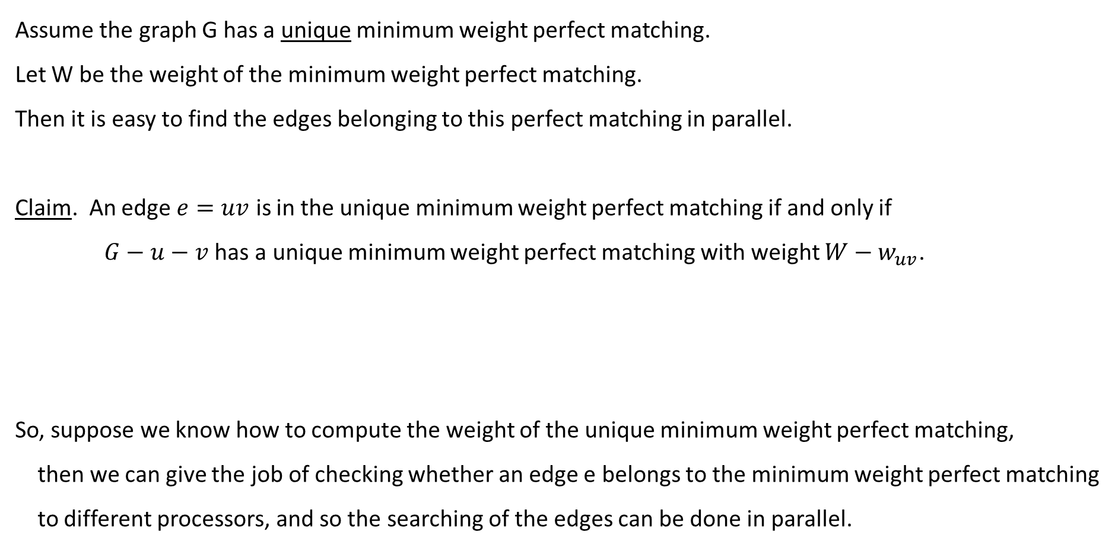
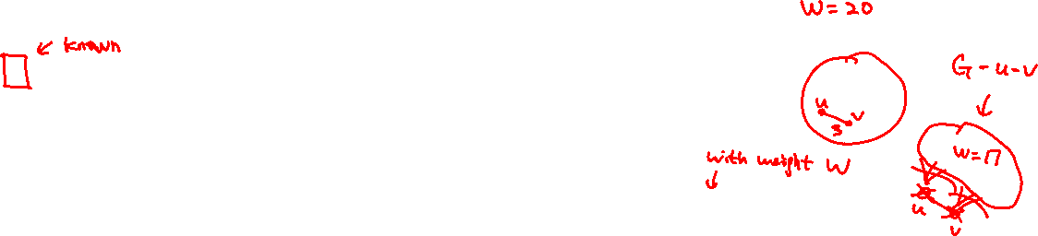
Edges in Minimum Weight Perfect Matching
Assume the graph G has a unique minimum weight perfect matching.
Let W be the weight of the minimum weight perfect matching.
Then it is easy to find the edges belonging to this perfect matching in parallel.
Claim. An edge $e=uv$ is in the unique minimum weight perfect matching if and only if
$G−u−v$ has a unique minimum weight perfect matching with weight $W−w_{uv}$.
So, suppose we know how to compute the weight of the unique minimum weight perfect matching,
then we can give the job of checking whether an edge e belongs to the minimum weight perfect matching
to different processors, and so the searching of the edges can be done in parallel.

Slide 24




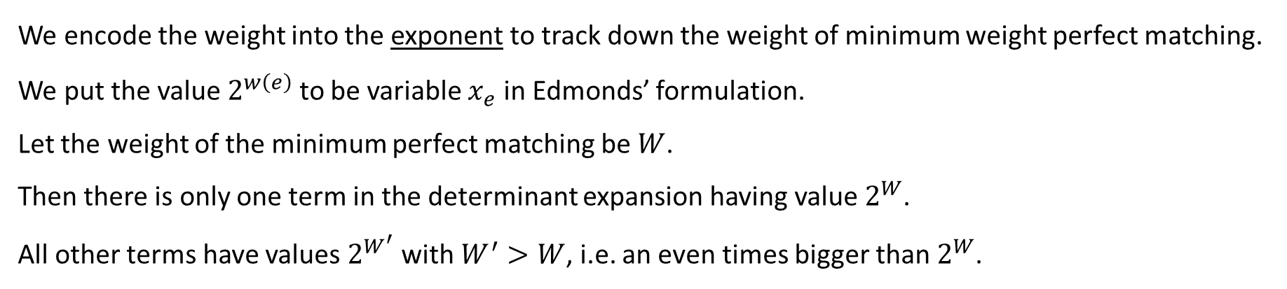
Weight of Minimum Weight Perfect Matching
We encode the weight into the exponent to track down the weight of minimum weight perfect matching.
We put the value $2^{w\left(e\right)}$ to be variable $x_{e}$ in Edmonds’ formulation.
Let the weight of the minimum perfect matching be $W$.
Then there is only one term in the determinant expansion having value $2^{W}$.
All other terms have values $2^{W^{′}}$ with $W^{′}>W$, i.e. an even times bigger than $2^{W}$.

Slide 25



Weight of Minimum Weight Perfect Matching
Note that the determinant can be computed efficiently, as each number has at most $2n$ bits.
This is where the isolation lemma is crucial, as it shows that small weights are enough to isolate
a minimum weight perfect matching.

Slide 26
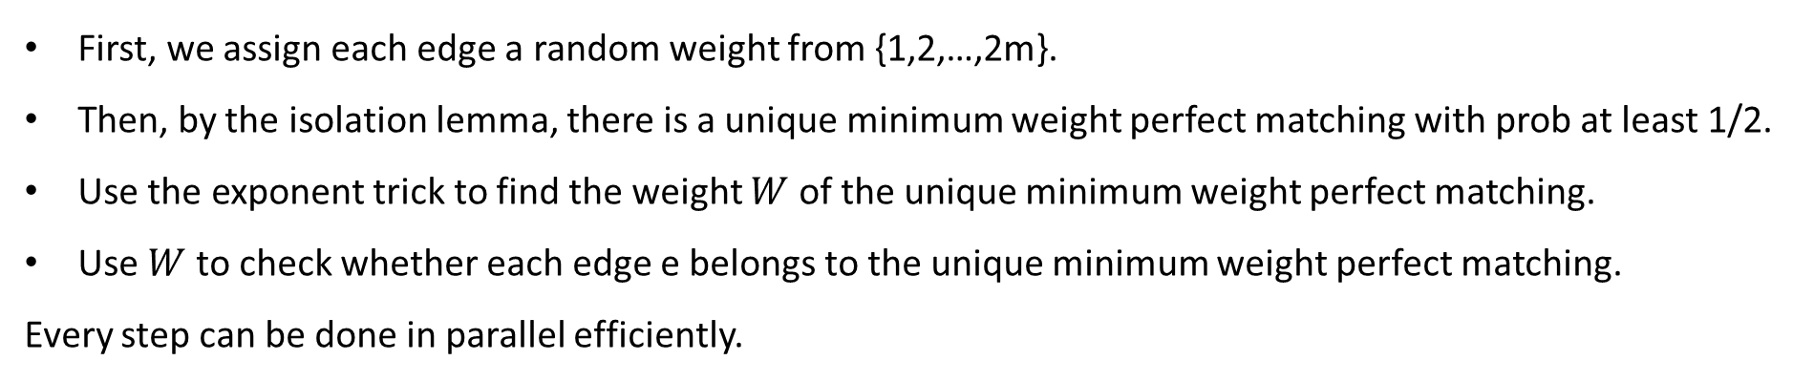
Quick Summary
First, we assign each edge a random weight from {1,2,…,2m}.
Then, by the isolation lemma, there is a unique minimum weight perfect matching with prob at least 1/2.
Use the exponent trick to find the weight $W$ of the unique minimum weight perfect matching.
Use $W$ to check whether each edge e belongs to the unique minimum weight perfect matching.
Every step can be done in parallel efficiently.

Slide 27
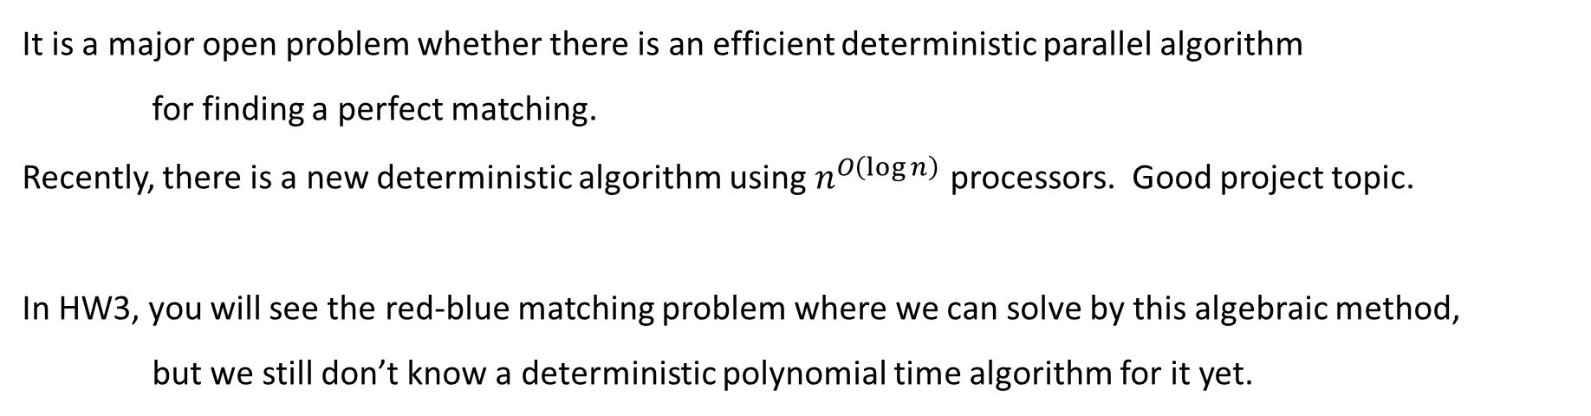
Open Question
It is a major open problem whether there is an efficient deterministic parallel algorithm
for finding a perfect matching.
Recently, there is a new deterministic algorithm using $n^{O\left(\log{n}\right)}$ processors. Good project topic.
In HW3, you will see the red-blue matching problem where we can solve by this algebraic method,
but we still don’t know a deterministic polynomial time algorithm for it yet.

