Slide 1
CS 466/666 - Algorithm Design and Analysis
Lecture 5 and 6: Hashing and Data Streaming
Waterloo, 28 May 2020

Slide 2
Today’s Plan
Finishing hashing using universal family
Perfect hashing
Reporting heavy hitters
TA office hour, Wed 11am-12pm, Fri 10pm-11pm.
HW2 will be posted on Friday.
HW difficulty?

Slide 3
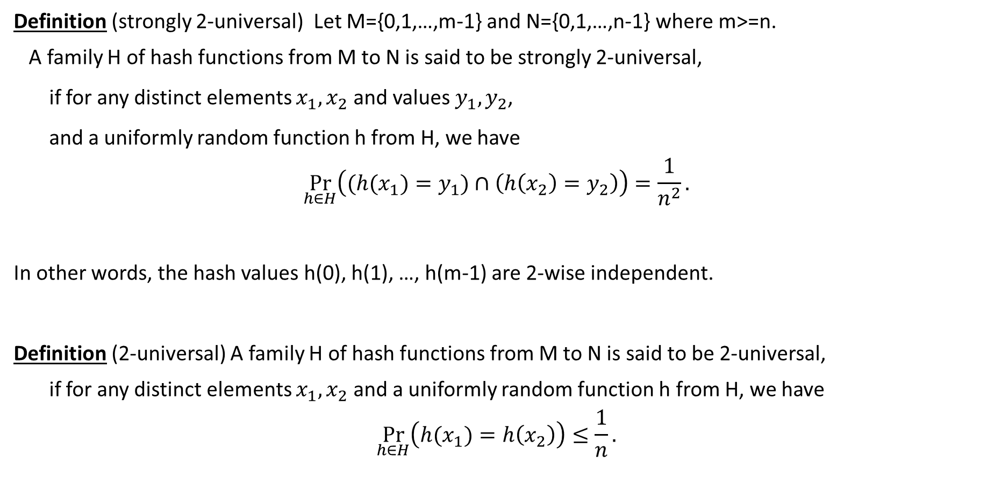

Universal Hash Functions
Definition (strongly 2-universal) Let M={0,1,…,m-1} and N={0,1,…,n-1} where m>=n.
A family H of hash functions from M to N is said to be strongly 2-universal,
if for any distinct elements $x_{1},x_{2}$ and values $y_{1},y_{2}$,
and a uniformly random function h from H, we have
$$\underset{h∈H}{Pr}\left({(h(x}_{1})=y_{1})∩\left(h\left(x_{2}\right)=y_{2}\right)\right)=\frac{1}{n^{2}}.$$
In other words, the hash values h(0), h(1), …, h(m-1) are 2-wise independent.
Definition (2-universal) A family H of hash functions from M to N is said to be 2-universal,
if for any distinct elements $x_{1},x_{2}$ and a uniformly random function h from H, we have
$$\underset{h∈H}{Pr}\left({h(x}_{1})=h\left(x_{2}\right)\right)≤\frac{1}{n}.$$

Slide 4
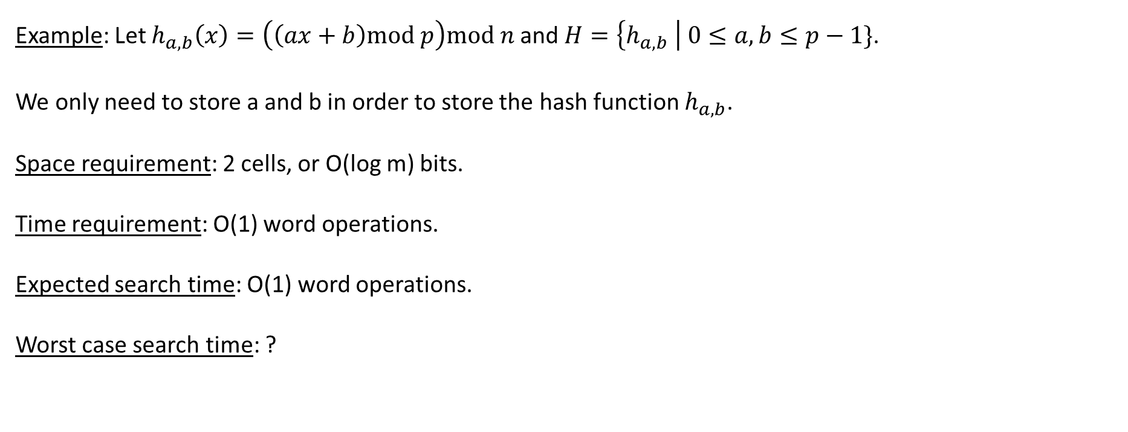

Hashing Using 2-Universal Family
Example: Let $h_{a,b}\left(x\right)=\left(\left(ax+b\right)mod p\right)mod n$ and $H=\left\{h_{a,b} \right| 0≤a,b≤p−1\}$.
We only need to store a and b in order to store the hash function $h_{a,b}$.
Space requirement: 2 cells, or O(log m) bits.
Time requirement: O(1) word operations.
Expected search time: O(1) word operations.
Worst case search time: ?

Slide 5
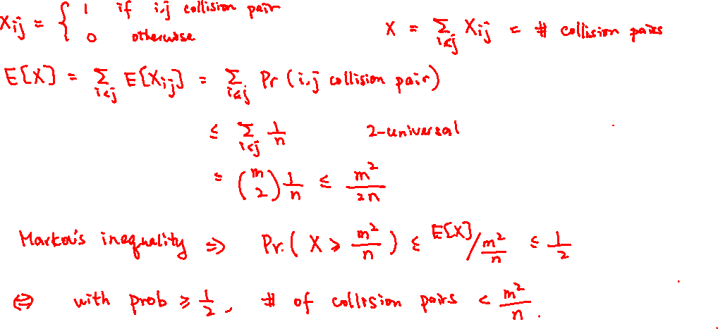
Maximum Load
We cannot guarantee that the maximum load is O(log(n)/loglog(n)) anymore.
We say a pair of elements i,j is a collision pair if i≠j but h(i)=h(j).

Slide 6
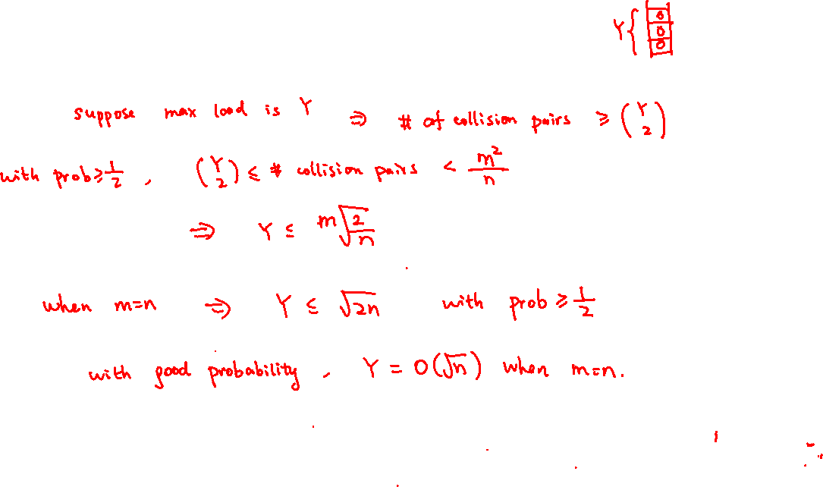
Maximum Load
We cannot guarantee that the maximum load is O(log(n)/loglog(n)) anymore.
To guarantee that the maximum load is O(log(n)/loglog(n)), we say use a O(log(n)/loglog(n))-universal
hash family (why?). But this is not a good tradeoff.

Slide 7
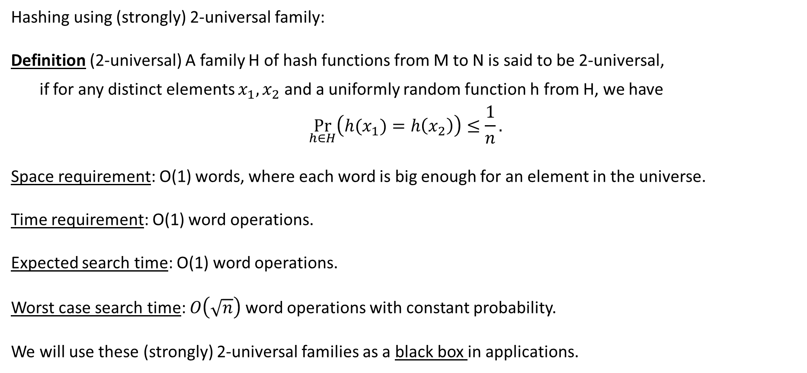
Summary
Hashing using (strongly) 2-universal family:
Definition (2-universal) A family H of hash functions from M to N is said to be 2-universal,
if for any distinct elements $x_{1},x_{2}$ and a uniformly random function h from H, we have
$$\underset{h∈H}{Pr}\left({h(x}_{1})=h\left(x_{2}\right)\right)≤\frac{1}{n}.$$
Space requirement: O(1) words, where each word is big enough for an element in the universe.
Time requirement: O(1) word operations.
Expected search time: O(1) word operations.
Worst case search time: $O\left(\sqrt{n}\right)$ word operations with constant probability.
We will use these (strongly) 2-universal families as a black box in applications.

Slide 8





Perfect Hashing
Given a fixed set S of m keys, we would like to build a data structure for searching with
excellent worst case guarantee (e.g. think of building a static dictionary, Wikipedia, etc).
Convince yourself that it is not an easy problem.
A hash function is perfect if it takes O(1) word operations to find an item or determine that
it does not exist (again assuming each key can be stored in a word).

Slide 9




Observation
The first observation is that perfect hashing is easy if we use more space.
Lemma. If we choose a random hash function h from a 2-universal family mapping the
universe into a table of size n, then, for any set S of size m with n ≥ m²,
the probability that h is perfect for S is at least 1/2.
We expect to find such an h by trying a constant number of hash functions from the family.

Slide 10
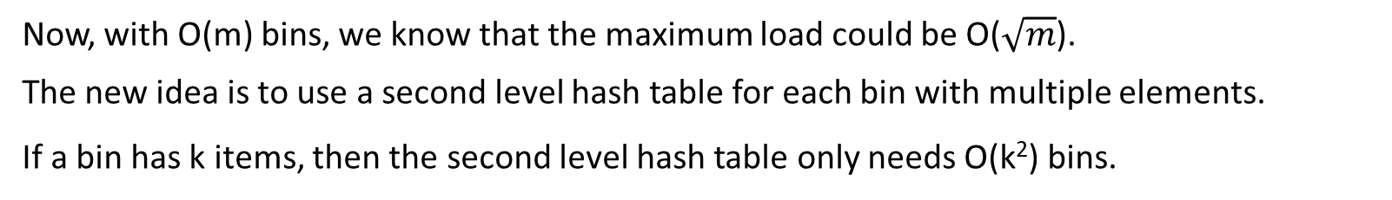
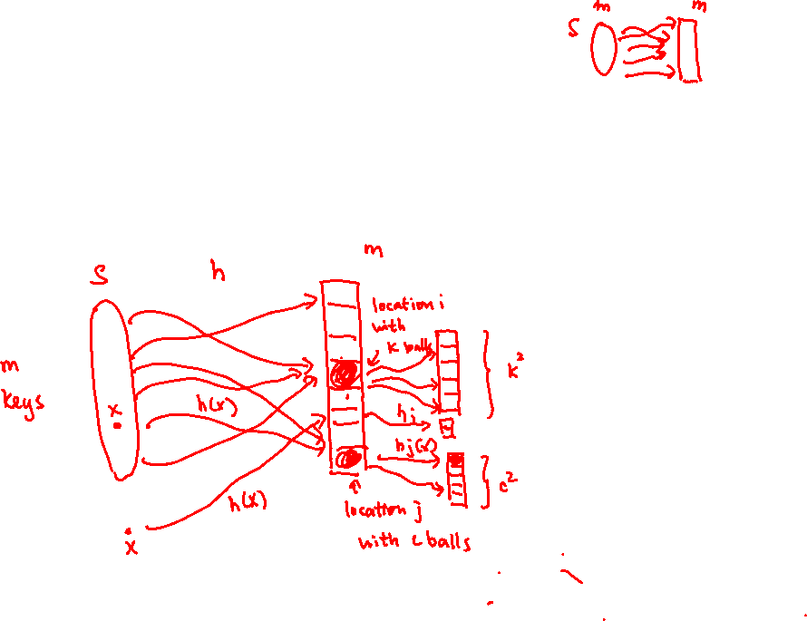
Two Level Hashing
Now, with O(m) bins, we know that the maximum load could be O($\sqrt{m}$).
The new idea is to use a second level hash table for each bin with multiple elements.
If a bin has k items, then the second level hash table only needs O(k²) bins.

Slide 11
Analysis
Theorem. The two level approach gives a perfect hashing scheme for m items using O(m) bins.

Slide 12
Analysis
Theorem. The two level approach gives a perfect hashing scheme for m items using O(m) bins.

Slide 13
Complexity
Space requirement: total O(m) cells for the hash tables (first level table + second level tables).
store at most m+1 hash functions, each requiring O(1) cells.
so total storage is still O(m) cells.
Time requirement: use two hash functions for each search operation.
one first level hash function + one second level hash function.
each requiring O(1) operations, so total O(1) operations.
Overall, this is like building an array for the m keys, even though they come from a large universe.

Slide 14
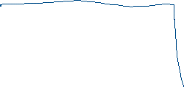



Further References
People don’t use k-universal family for hashing.
Some simple hash family (e.g. tabulation hashing, cuckoo hashing) works well in practice and in theory. These are good topics for project.
k-wise independence and “almost” k-wise independent variables are useful in derandomization
(e.g. a standard tool in derandomizing “fixed parameter algorithms”).

Slide 15
Sublinear Algorithms
Massive data set, can’t afford to read once or store all the data.
Like to design sublinear time or sublinear space algorithms with nontrivial guarantees.
Randomness is crucial, most tasks are impossible in the deterministic setting.
We study some sublinear space algorithms, in the data streaming setting.
For example, a router can’t store all the traffic data but still like to have some useful statistics.
We will see three examples in the data streaming setting, one today and two next time.

Slide 16
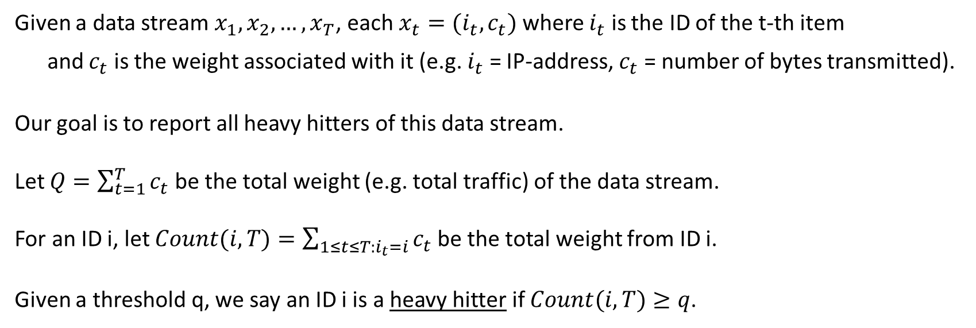

Heavy Hitters
Given a data stream $x_{1},x_{2},…,x_{T}$, each $x_{t}=(i_{t},c_{t})$ where $i_{t}$ is the ID of the t-th item
and $c_{t}$ is the weight associated with it (e.g. $i_{t}$ = IP-address, $c_{t}$ = number of bytes transmitted).
Our goal is to report all heavy hitters of this data stream.
Let $Q=\sum_{t=1}^{T}{c_{t}}$ be the total weight (e.g. total traffic) of the data stream.
For an ID i, let $Count(i,T)=\sum_{1≤t≤T:i_{t}=i}{c_{t}}$ be the total weight from ID i.
Given a threshold q, we say an ID i is a heavy hitter if $Count(i,T)≥q$.

Slide 17
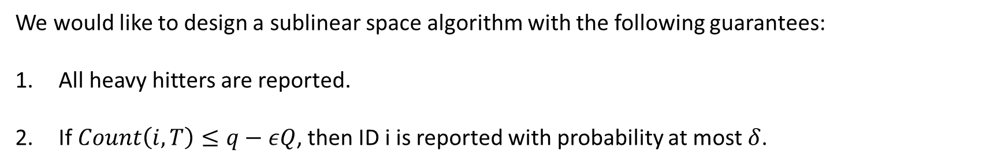
Objective
We would like to design a sublinear space algorithm with the following guarantees:
All heavy hitters are reported.
If $Count\left(i,T\right)≤q−εQ$, then ID i is reported with probability at most $δ$.

Slide 18

Hash Tables
The idea is to use 2-universal hash functions.
We will use k hash functions, each mapping the universe to {1,2,…,l}.
We will maintain kl counters, where $C_{a,j}$ is the j-th cell of the a-th hash function.

Slide 19


Algorithm
Initially, $C_{a,j }=0$ for all $1≤a≤k$ and $1≤j≤l$.
When item $x_{t}=(i_{t},c_{t})$ comes, increment $C_{a,h_{a}(i_{t})}$ by $c_{t}$ for $1≤a≤k$.
Report ID $i_{t}$ if $C_{a,h_{a}(i_{t})}≥q$ for all $1≤a≤k$

Slide 20




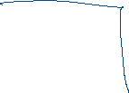
Analysis
It is clear that all heavy hitters will be reported.
So we focus on bounding the probability that ID i is reported if $Count\left(i,T\right)≤q−εQ$.
ID i is reported only if other IDs have contributed at least $εQ$ to its counters $C_{a,h_{a}(i)}$ for all $1≤a≤k$.

Slide 21

Analysis
It is clear that all heavy hitters will be reported.
So we focus on bounding the probability that ID i is reported if $Count\left(i,T\right)≤q−εQ$.
ID i is reported only if other IDs have contributed at least $εQ$ to its counters $C_{a,h_{a}(i)}$ for all $1≤a≤k$.

Slide 22
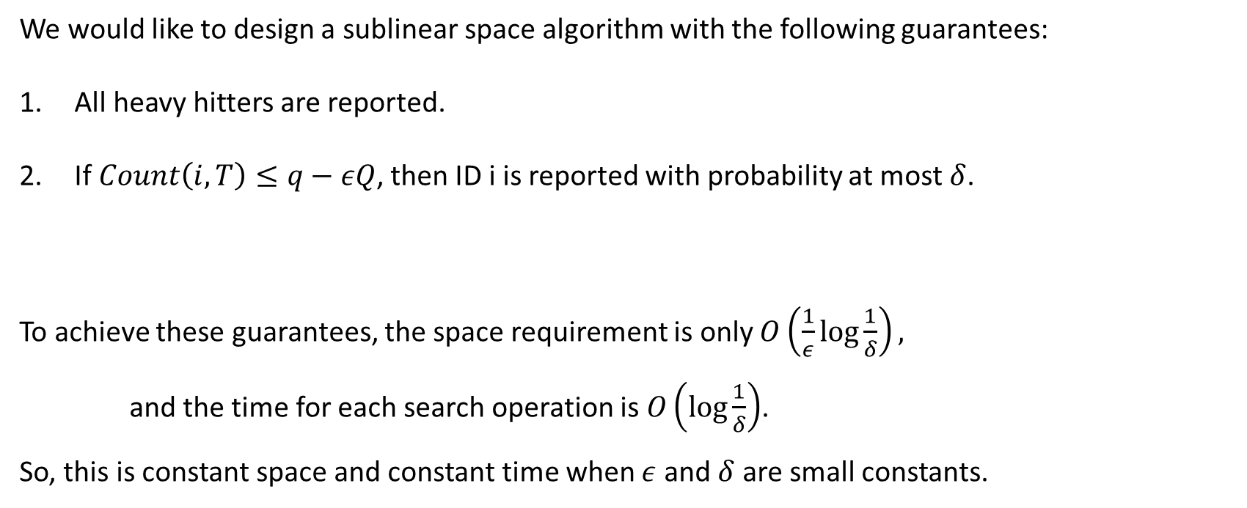
Summary
We would like to design a sublinear space algorithm with the following guarantees:
All heavy hitters are reported.
If $Count\left(i,T\right)≤q−εQ$, then ID i is reported with probability at most $δ$.
To achieve these guarantees, the space requirement is only $O\left(\frac{1}{ε}\log{\frac{1}{δ}}\right),$
and the time for each search operation is $O\left(\log{\frac{1}{δ}}\right)$.
So, this is constant space and constant time when $ε$ and $δ$ are small constants.

