Slide 1
CS 466/666 - Algorithm Design and Analysis
Lecture 5: Hashing
Waterloo, 26 May 2020

Slide 2
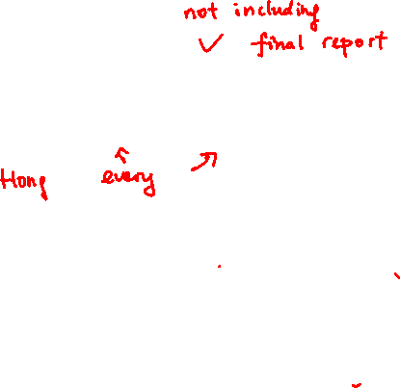
Today’s Plan
Hashing: the setup
Random hash functions?
Pairwise independent random variables
Universal hash functions
10 late days for HW and proposal, use carefully.
TA office hour, Wed 11am-12pm, Fri 10pm-11pm

Slide 3
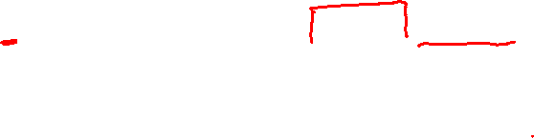
Data Structure for Searching
We would like to build a data structure to support the following operations:
Insert(x): insert element x into the data structure
Delete(x): delete element x from the data structure
Search(x): check if x is in the data structure, i.e. return yes or no.
Consider the scenario where we would like to store n keys/elements from the set/universe {0,1,…,m-1}.
Think of m >> n.
For example, m is the number of possible IP addresses,
and n is the number of IP addresses visiting Waterloo each day.

Slide 4
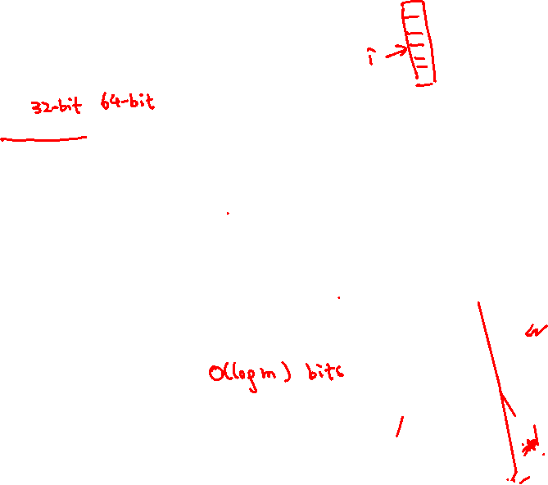
Random Access Model
We assume the following computational model, called the random access model (RAM):
We can access an arbitrary position of an array (no matter how large) in O(1) time.
Each element in the universe can be fit into one word, and each arithmetic operation involving
a word takes O(1) time, e.g. addition/multiplication of two words.
These assumptions are not necessarily realistic.
So, when we say hashing can be done in O(1) time, it is more accurate to say that
hashing can be done in O(1) array lookup operations and O(1) word operations.

Slide 5
Obvious Solution
Consider the scenario where we would like to store n keys/elements from the set/universe {0,1,…,m-1}.
With the RAM assumptions, we can easily build a data structure for searching in O(1) time.
Open an array A of m elements, initially A[i]=0 for all i.
When we insert element x, we set A[x]=1.
When we delete element x, we set A[x]=0.
When we search element x, if A[x]=1 return YES, else if A[x]=0 return NO.
With the RAM assumptions, clearly each operation can be done in O(1) time.

Slide 6

Ideal Solution
What is the problem with this data structure?
The space requirement is m bits.
This is bad when m is much larger than n, e.g. m = # of possible IP addresses.
We would like to have a data structure with O(n) space requirements and O(1) time per operation.

Slide 7







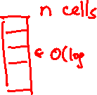


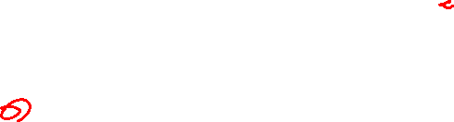
Hash Table: Deterministic Solution
A hash function is used to map the elements in the big universe to the locations in a small table.
A hash table consists of two components:
A table with n cells indexed by N={0,1,…,n-1}, each cell can store O(log m) bits.
A hash function h:M->N.
Ideally, we want the hash function h to map different keys to different cells.
But, by the pigeonhole principle, this is impossible if we do not know the keys in advance.
There is just no deterministic solution for hashing.

Slide 8
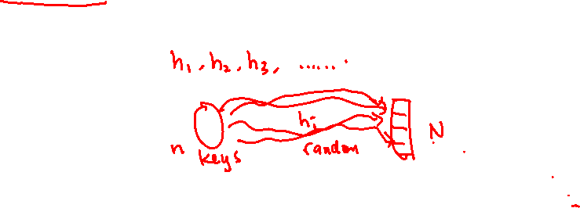
Hash Table: Randomized Solution
A hash function is used to map the elements in the big universe to the locations in a small table.
A hash table consists of two components:
A table with n cells indexed by N={0,1,…,n-1}, each cell can store O(log m) bits.
A hash function h:M->N chosen randomly from a family H of hash functions.
We assume the keys are independent of the hash function that we choose, i.e. there is no “adversary”
who knows our internal randomness and choose a bad set of keys for our hash function.

Slide 9

Analysis of Randomized Algorithms
The situation is the same when we analyze randomized algorithms.
A randomized algorithm is just a family of deterministic algorithms, one for each possible random string.
For some problems, there does not exist one single deterministic algorithm that is good for all inputs.
Instead, we relax this requirement for a randomized algorithm to:
for every input, there are say at least 90% of deterministic algorithms that are good for this input.
In the case of hashing, we relax the requirement to:
for every set of n keys, there are say at least 90% of hash functions h in the hash family H such that
there are “few” keys that are mapped to the same cell.

Slide 10


Hash Table: Random Function
A hash table consists of two components:
A table with n cells indexed by N={0,1,…,n-1}, each cell can store O(log m) bits.
A hash function h:M->N chosen randomly from a family H of hash functions.
A natural idea is to choose a random function h:M->N, i.e. H is the family of all functions from M to N.
Then, each key (ball) is mapped to a random cell (bin), and this is exactly the ball-and-bin setting.
So, we know that the expected number of keys in a cell is one, and with high probability
the maximum number of keys in a cell is Ɵ(log(n)/loglog(n)).
The keys mapped to the same location can be stored by a linked list, and this is called chain hashing.
The expected search time is O(1), and the worst case search time is Ɵ(log(n)/loglog(n)).

Slide 11
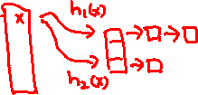
Power of Two Choices
By the idea from power of two choices, we can choose two random hash functions h₁ and h₂.
When we insert an element x, we look at two locations h₁(x) and h₂(x) and put x in the location
with fewer keys.
When we search for an element x, we look at two locations h₁(x) and h₂(x) and search x in
both linked lists.
Then, we can reduce the maximum search time to O(loglog(n)), while increasing the search time
by a factor of two.

Slide 12
Random Hash Functions?
So far so good? This is often how the analysis of hashing goes.
But what is the space requirement of storing h?
To store a random function h:M->N requires m*log(n) bits,
as we need to remember which cell that an element is mapped to.
Another way to see it, there are n^{m} possible functions from H, so we need m*log(n) bits to specify one.
We need these information to support the (fast) search operation.
But the space requirement is even higher than the obvious solution of using an m bit array!

Slide 13
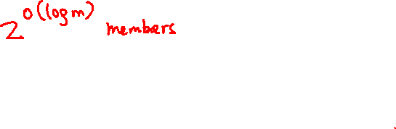
More Efficient Hash Family
To store n keys, we need to use n cells, each with log(m) bits.
It would be ideal if the space overhead for storing the hash function is minimal, using only O(1) cells.
This means that O(log m) bits can store the hash function, so there can be at most poly(m) functions
in the hash family (instead of n^{m} functions).
We will see that it is possible to have such a succinct hash family, and still achieves some properties
guaranteed by the random hash functions.
This is similar in spirit to derandomization where we want to reduce the use of randomness,
but here we do it for the sake of time and space.
For this, we need to introduce a weaker notion of randomness.

Slide 14
Quick Summary
Random access model assumptions.
No deterministic solution for hashing.
Randomized solution: choose a random function from a family of hash functions.
A random hash function h:M->N (from the family of all functions) is too expensive to store.
We want a succinct hash family with comparable properties, and will study an important new notion.

Slide 15
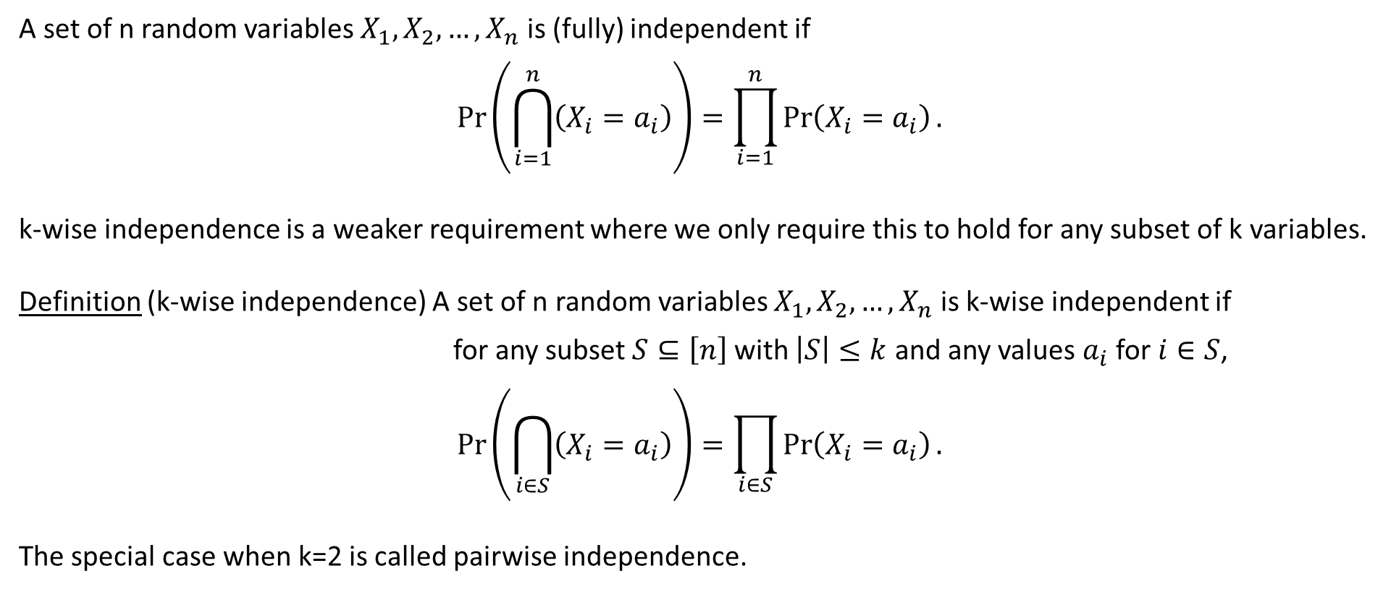
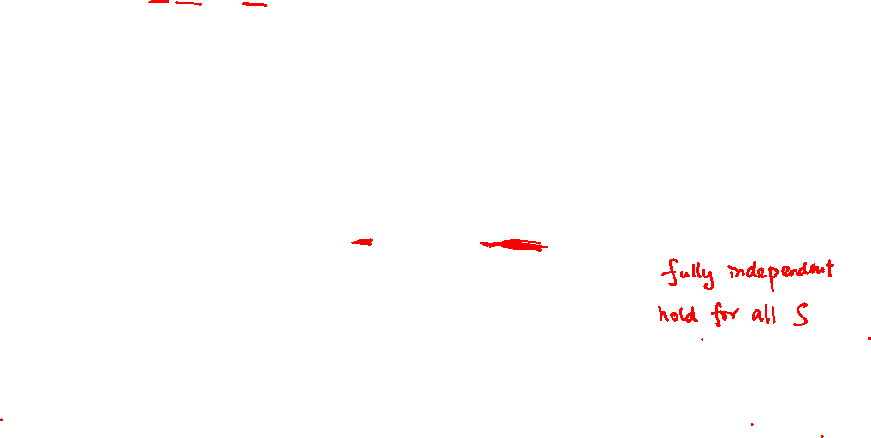
k-wise independent random variables
A set of n random variables $X_{1},X_{2},…,X_{n}$ is (fully) independent if
$$\operatorname{Pr}\left(\bigcap_{i=1}^{n}{\left(X_{i}=a_{i}\right)}\right)=\prod_{i=1}^{n}{\operatorname{Pr}\left(X_{i}=a_{i}\right)}.$$
k-wise independence is a weaker requirement where we only require this to hold for any subset of k variables.
Definition (k-wise independence) A set of n random variables $X_{1},X_{2},…,X_{n}$ is k-wise independent if
for any subset $S⊆\left[n\right]$ with $\left|S\right|≤k$ and any values $a_{i}$ for $i∈S$,
$$\operatorname{Pr}\left(\bigcap_{i∈S}{\left(X_{i}=a_{i}\right)}\right)=\prod_{i∈S}{\operatorname{Pr}\left(X_{i}=a_{i}\right)}.$$
The special case when k=2 is called pairwise independence.

Slide 16
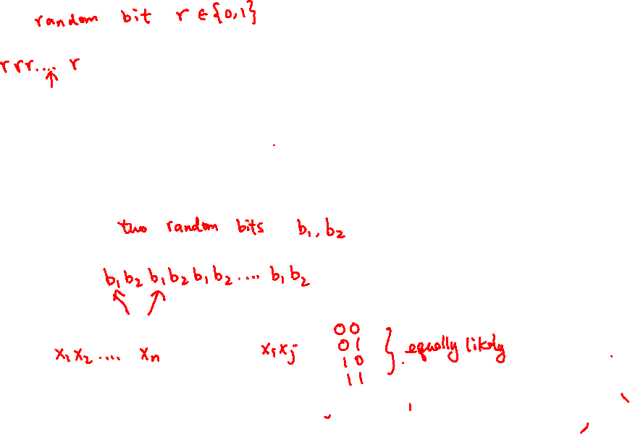
1-wise independence is trivial
What about 2-wise independence?

Slide 17

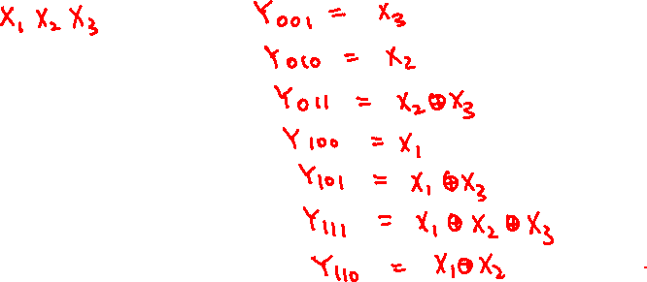
Example 1: Pairwise Independent Bits
We show that n pairwise independent bits can be generated from ~log(n) random bits.
Let $X_{1},X_{2},…,X_{b}$ be b uniformly random bits. We generate $2^{b}−1$ pairwise independent bits as follows.
For each non-empty subset $S⊆\{1,2,…,b\}$, define $Y_{S}= ⊕_{i∈S}X_{i}$, where $⊕$ is the mod 2 operation.
By the principle of deferred decision, each $Y_{S}$ is a uniformly random bit, i.e. $Pr\left(Y_{S}=1\right)=Pr\left(Y_{S}=0\right)$ = 1/2.

Slide 18
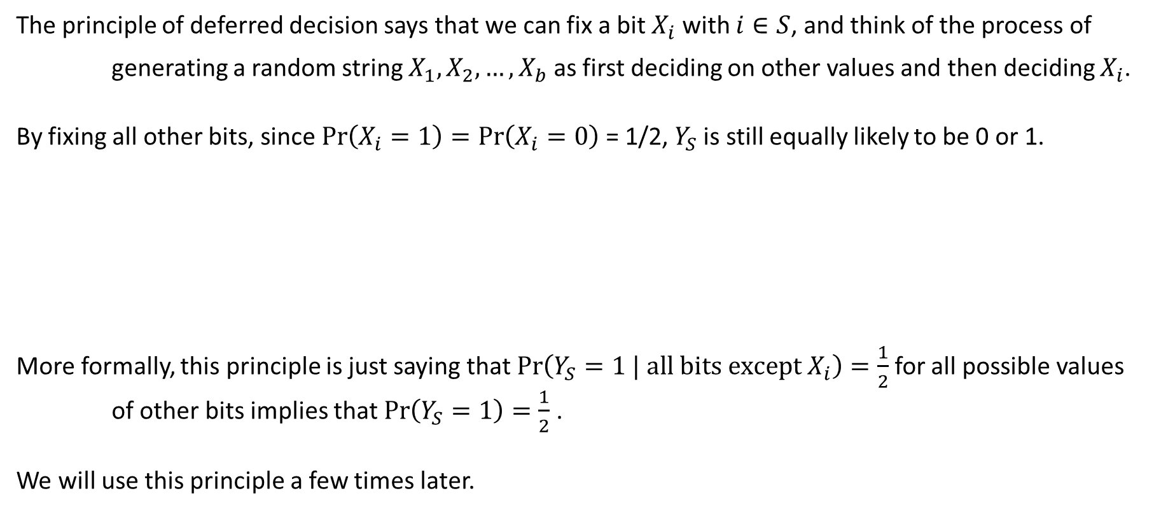
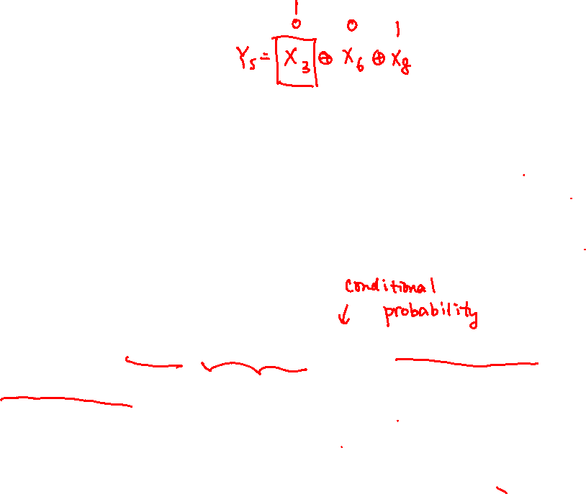

Principle of Deferred Decision
The principle of deferred decision says that we can fix a bit $X_{i}$ with $i∈S$, and think of the process of
generating a random string $X_{1},X_{2},…,X_{b}$ as first deciding on other values and then deciding $X_{i}$.
By fixing all other bits, since $Pr\left(X_{i}=1\right)=Pr\left(X_{i}=0\right)$ = 1/2, $Y_{S}$ is still equally likely to be 0 or 1.
More formally, this principle is just saying that $Pr\left(Y_{S}=1 | all bits except X_{i}\right)=\frac{1}{2}$ for all possible values
of other bits implies that $Pr\left(Y_{S}=1\right)=\frac{1}{2}$ .
We will use this principle a few times later.

Slide 19






Example 1: Pairwise Independent Bits
We show that n pairwise independent bits can be generated from ~log(n) random bits.
Let $X_{1},X_{2},…,X_{b}$ be b uniformly random bits. We generate $2^{b}−1$ pairwise independent bits as follows.
For each non-empty subset $S⊆\{1,2,…,b\}$, define $Y_{S}= ⊕_{i∈S}X_{i}$, where $⊕$ is the mod 2 operation.
By the principle of deferred decision, each $Y_{S}$ is a uniformly random bit, i.e. $Pr\left(Y_{S}=1\right)=Pr\left(Y_{S}=0\right)$ = 1/2.
Are the random variables $Y_{S}$ 3-wise independent?

Slide 20

Example 2: Pairwise Independent Values Mod p
Given two independent random variables $X_{1},X_{2}∈\left\{0,1,…,p−1\right\}$ where p is a prime number,
we generate p pairwise independent random variables $Y_{0},Y_{1},…,Y_{p−1}∈\left\{0,1,…,p−1\right\}$ as follows.
$$Y_{i}=\left(X_{1}+iX_{2}\right)mod p$$
By principle of deferred decision, $Pr\left(Y_{i}=a\right)=\frac{1}{p}$ for any $a∈\left\{0,1,…,p−1\right\}$.

Slide 21

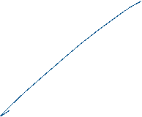


Example 2: Pairwise Independent Values Mod p
Given two independent random variables $X_{1},X_{2}∈\left\{0,1,…,p−1\right\}$ where p is a prime number,
we generate p pairwise independent random variables $Y_{0},Y_{1},…,Y_{p−1}∈\left\{0,1,…,p−1\right\}$ as follows.
$$Y_{i}=\left(X_{1}+iX_{2}\right)mod p$$
For pairwise independence, we need to show $Pr\left({(Y}_{i}=a)∩(Y_{j}=b)\right)=Pr\left(Y_{i}=a\right)Pr\left(Y_{j}=b\right)=\frac{1}{p^{2}}$.
We can think of this construction as generating a random line in a finite field.

Slide 22



Chebyshev Inequality for 2-wise Ind. Variables
For pairwise independent random variables, we cannot apply Chernoff bounds.
But we can still apply Chebyshev’s inequality.
This will be useful in analyzing data streaming algorithms next time.

Slide 23
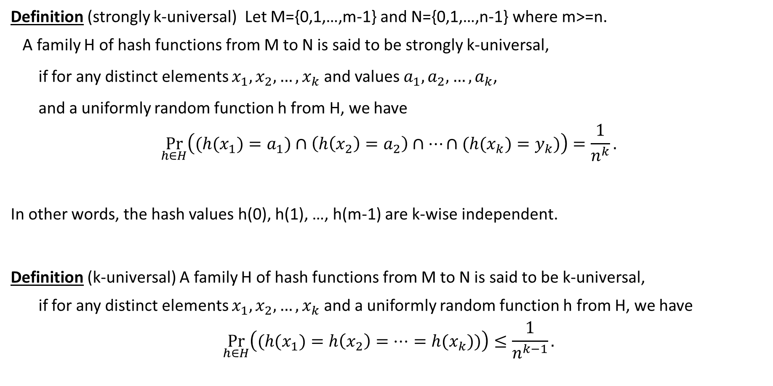
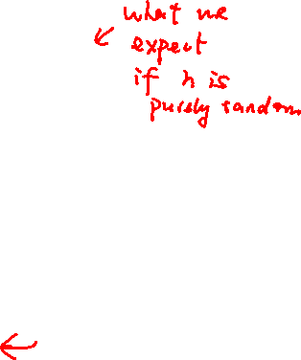
Universal Hash Functions
Definition (strongly k-universal) Let M={0,1,…,m-1} and N={0,1,…,n-1} where m>=n.
A family H of hash functions from M to N is said to be strongly k-universal,
if for any distinct elements $x_{1},x_{2},…,x_{k}$ and values $a_{1},a_{2},…,a_{k}$,
and a uniformly random function h from H, we have
$$\underset{h∈H}{Pr}\left({(h(x}_{1})=a_{1})∩\left(h\left(x_{2}\right)=a_{2}\right)∩⋯∩({h(x}_{k})=y_{k})\right)=\frac{1}{n^{k}}.$$
In other words, the hash values h(0), h(1), …, h(m-1) are k-wise independent.
Definition (k-universal) A family H of hash functions from M to N is said to be k-universal,
if for any distinct elements $x_{1},x_{2},…,x_{k}$ and a uniformly random function h from H, we have
$$\underset{h∈H}{Pr}\left({(h(x}_{1})=h\left(x_{2}\right)=…={h(x}_{k}))\right)≤\frac{1}{n^{k−1}}.$$

Slide 24



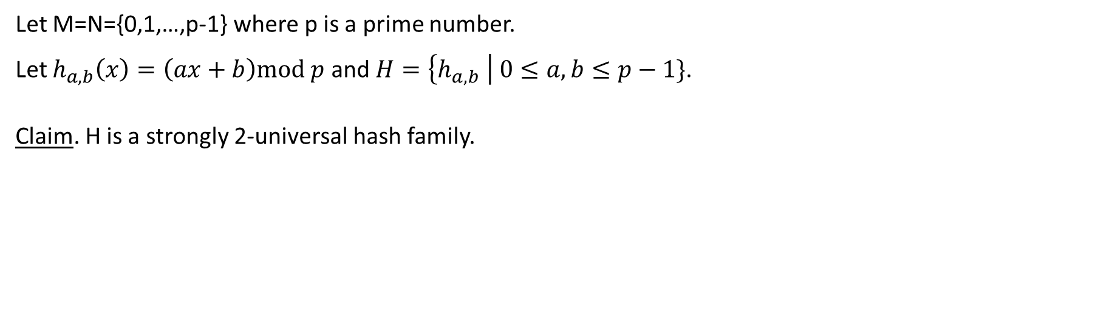
Strongly 2-Universal Hash Family
Let M=N={0,1,…,p-1} where p is a prime number.
Let $h_{a,b}\left(x\right)=\left(ax+b\right)mod p$ and $H=\left\{h_{a,b} \right| 0≤a,b≤p−1\}$.
Claim. H is a strongly 2-universal hash family.

Slide 25
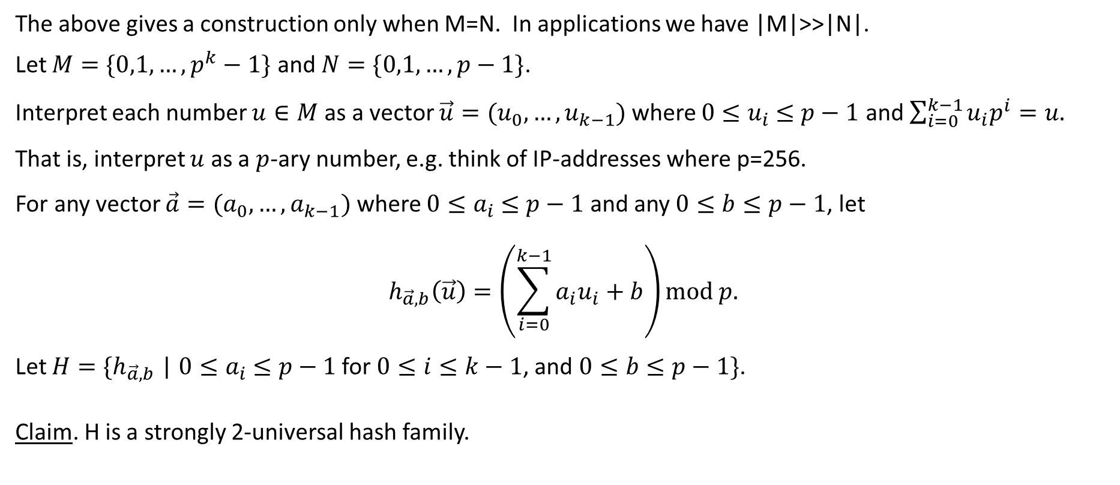
Strongly 2-Universal Hash Family
The above gives a construction only when M=N. In applications we have |M|>>|N|.
Let $M=\{0,1,…,p^{k}−1\}$ and $N=\{0,1,…,p−1\}$.
Interpret each number $u∈M$ as a vector $\vec{u}=(u_{0},…,u_{k−1})$ where $0{≤u}_{i} ≤p−1$ and $\sum_{i=0}^{k−1}{u_{i}p^{i}}=u.$
That is, interpret $u$ as a $p$-ary number, e.g. think of IP-addresses where p=256.
For any vector $\vec{a}=(a_{0},…,a_{k−1})$ where $0{≤a}_{i} ≤p−1$ and any $0≤b≤p−1$, let
$$h_{\vec{a},b}\left(\vec{u}\right)=\left(\sum_{i=0}^{k−1}{a_{i}u_{i}}+b\right)mod p.$$
Let $H=\{h_{\vec{a},b}$ | $0{≤a}_{i} ≤p−1$ for $0≤i≤k−1$, and $0≤b≤p−1\}$.
Claim. H is a strongly 2-universal hash family.

Slide 26
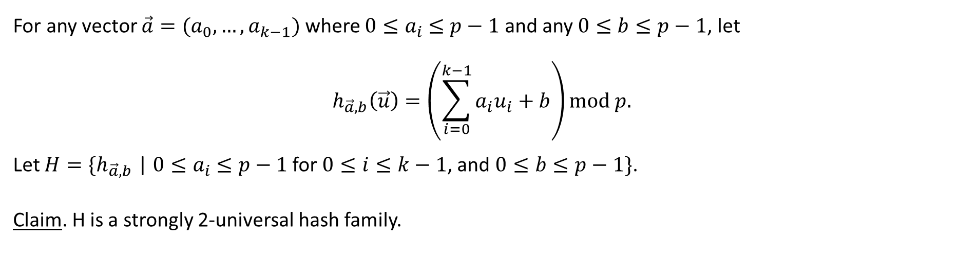
Strongly 2-Universal Hash Family
For any vector $\vec{a}=(a_{0},…,a_{k−1})$ where $0{≤a}_{i} ≤p−1$ and any $0≤b≤p−1$, let
$$h_{\vec{a},b}\left(\vec{u}\right)=\left(\sum_{i=0}^{k−1}{a_{i}u_{i}}+b\right)mod p.$$
Let $H=\{h_{\vec{a},b}$ | $0{≤a}_{i} ≤p−1$ for $0≤i≤k−1$, and $0≤b≤p−1\}$.
Claim. H is a strongly 2-universal hash family.

Slide 27


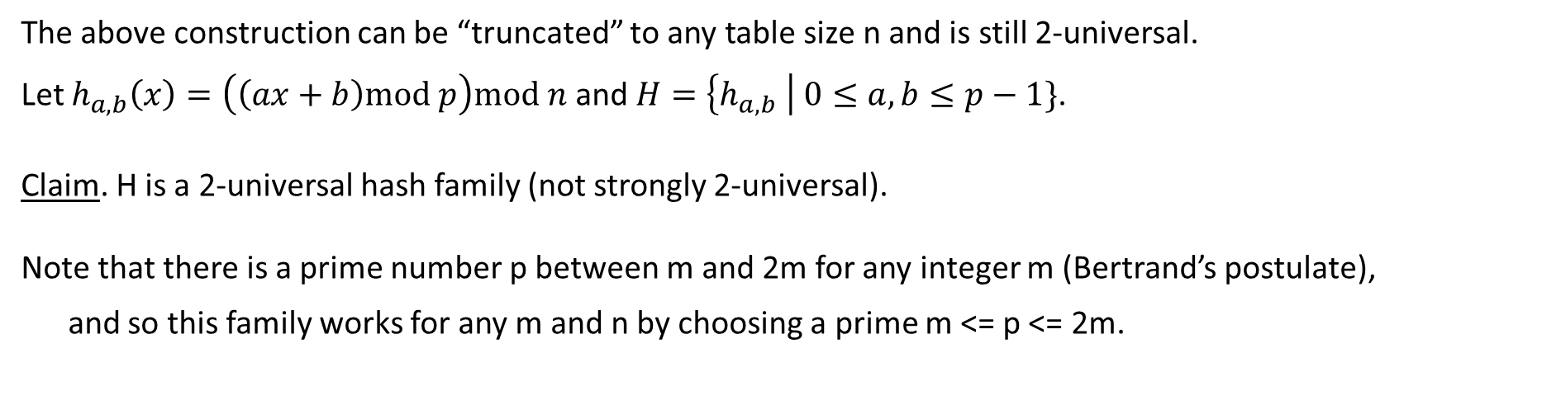
2-Universal Hash Family
The above construction can be “truncated” to any table size n and is still 2-universal.
Let $h_{a,b}\left(x\right)=\left(\left(ax+b\right)mod p\right)mod n$ and $H=\left\{h_{a,b} \right| 0≤a,b≤p−1\}$.
Claim. H is a 2-universal hash family (not strongly 2-universal).
Note that there is a prime number p between m and 2m for any integer m (Bertrand’s postulate),
and so this family works for any m and n by choosing a prime m <= p <= 2m.

Slide 28
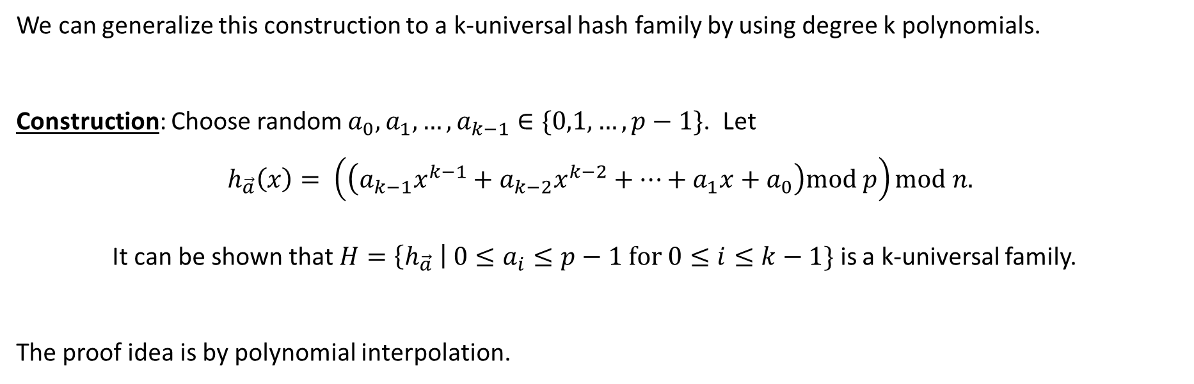
k-Universal Hash Family
We can generalize this construction to a k-universal hash family by using degree k polynomials.
Construction: Choose random $a_{0},a_{1},…,a_{k−1}∈\{0,1,…,p−1\}$. Let
$$h_{\vec{a}}\left(x\right)= \left(\left(a_{k−1}x^{k−1}+a_{k−2}x^{k−2}+…+a_{1}x+a_{0}\right)mod p\right)mod n.$$
It can be shown that $H=\left\{h_{\vec{a}} \right| 0≤a_{i}≤p−1 for 0≤i≤k−1\}$ is a k-universal family.
The proof idea is by polynomial interpolation.

Slide 29
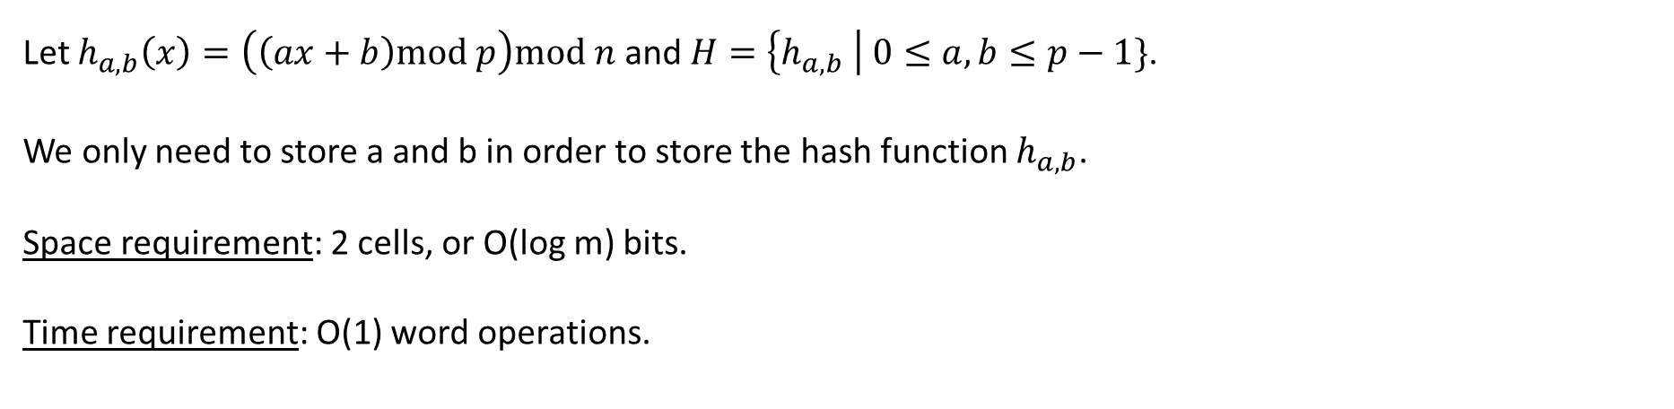
Hashing Using 2-Universal Family
Let $h_{a,b}\left(x\right)=\left(\left(ax+b\right)mod p\right)mod n$ and $H=\left\{h_{a,b} \right| 0≤a,b≤p−1\}$.
We only need to store a and b in order to store the hash function $h_{a,b}$.
Space requirement: 2 cells, or O(log m) bits.
Time requirement: O(1) word operations.

Slide 30

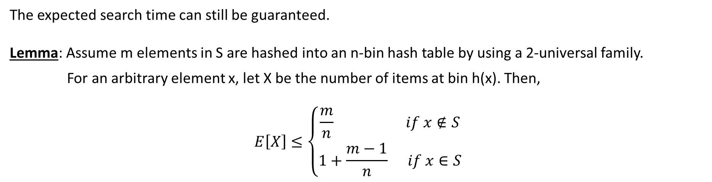
Expected Search Time
The expected search time can still be guaranteed.
Lemma: Assume m elements in S are hashed into an n-bin hash table by using a 2-universal family.
For an arbitrary element x, let X be the number of items at bin h(x). Then,
$$E\left[X\right]≤\left\{\begin{aligned}\frac{m}{n} if x∉S \\ 1+\frac{m−1}{n} if x∈S\end{aligned}\right.$$

Slide 31



Expected Search Time
The expected search time can still be guaranteed.
Lemma: Assume m elements in S are hashed into an n-bin hash table by using a 2-universal family.
For an arbitrary element x, let X be the number of items at bin h(x). Then,
$$E\left[X\right]≤\left\{\begin{aligned}\frac{m}{n} if x∉S \\ 1+\frac{m−1}{n} if x∈S\end{aligned}\right.$$

Slide 32
Maximum Load
We cannot guarantee that the maximum load is O(log(n)/loglog(n)) anymore.
We say a pair of elements i,j is a collision pair if i≠j but h(i)=h(j).

Slide 33
Maximum Load
We cannot guarantee that the maximum load is O(log(n)/loglog(n)) anymore.
To guarantee that the maximum load is O(log(n)/loglog(n)), we say use a O(log(n)/loglog(n))-universal
hash family (why?). But this is not a good tradeoff.

Slide 34
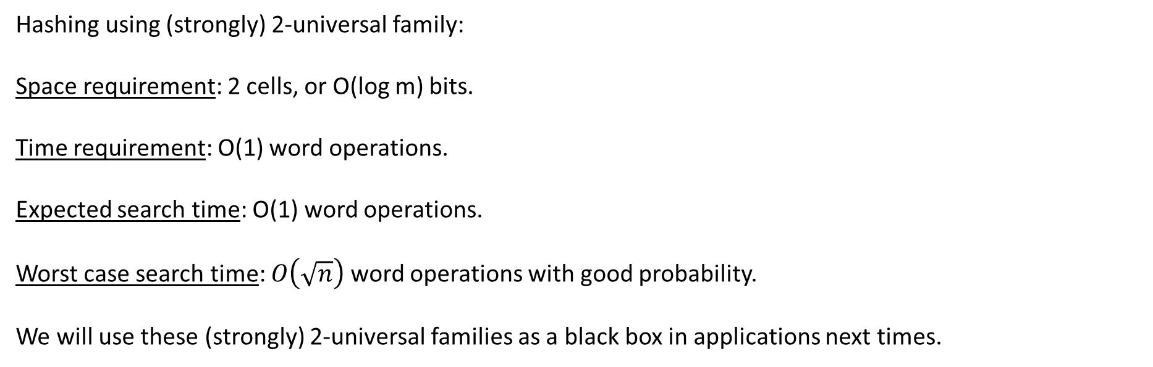
Summary
Hashing using (strongly) 2-universal family:
Space requirement: 2 cells, or O(log m) bits.
Time requirement: O(1) word operations.
Expected search time: O(1) word operations.
Worst case search time: $O\left(\sqrt{n}\right)$ word operations with good probability.
We will use these (strongly) 2-universal families as a black box in applications next times.

