Slide 1
CS 466/666 - Algorithm Design and Analysis
Lecture 4: Balls and bins
Waterloo, 21 May 2020

Slide 2
Today’s Plan
Balls and bins
Maximum load
Coupon collector
Heuristic argument
Power of two choices
Finished first topic, can do HW1.
Remember Chernoff bound.
Chernoff bound + union bound.

Slide 3


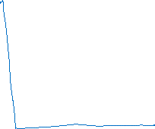
Balls and Bins
A simple random process.
m balls, n bins, each ball is thrown independently to a uniformly random bin.
We would like to understand what a typical situation looks like.

Slide 4




Expected Load
What is the expected number of balls in a bin?
When m=n, what is the probability that there are exactly one ball in each bin?

Slide 5
Expected Number of Empty Bins
What is the expected number of empty bins?
This number can be shown to have tight concentration (e.g. using negative correlation).

Slide 6

Collision
How many balls we throw until we expect to see two balls in a bin (i.e. a collision)?
The birthday paradox is the special case when n=365 (i.e. people = balls, birthday = bins).
How many people in a room until we expect to see two people having the same birthday?
This term is useful in hashing and analysis of a randomized factoring algorithm.

Slide 7
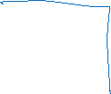



Maximum Load
When m=n, what is the maximum number of balls in a bin typically?

Slide 8

Maximum Load
When m=n, what is the maximum number of balls in a bin typically?
This O( ) term comes up in hashing and in analysis of approximation algorithms.

Slide 9
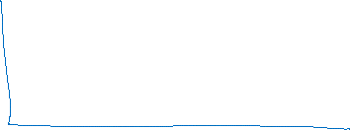

Coupon Collector
How many balls we need to throw until we expect that all bins are nonempty?

Slide 10


Coupon Collector
How many coins we need to flip until we expect to see the first head, if the head probability is p?
This bound is useful in understanding other phenomenon,
e.g. random walks in a complete graph, graph sparsification by random sampling.

Slide 11



Heuristic Argument
Are the results for maximum load and coupon collector tight?
One difficulty in analyzing balls and bins is that the random variables are not independent.
Heuristic argument
Simplify the expression that a bin has k balls.
Assume that these random variables are independent!

Slide 12

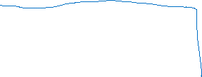
Maximum Load
We bound the probability that no bin has exactly k balls, using a heuristic argument.
If this probability is small, then some bin has exactly k balls, and thus some bin has at least k balls.

Slide 13

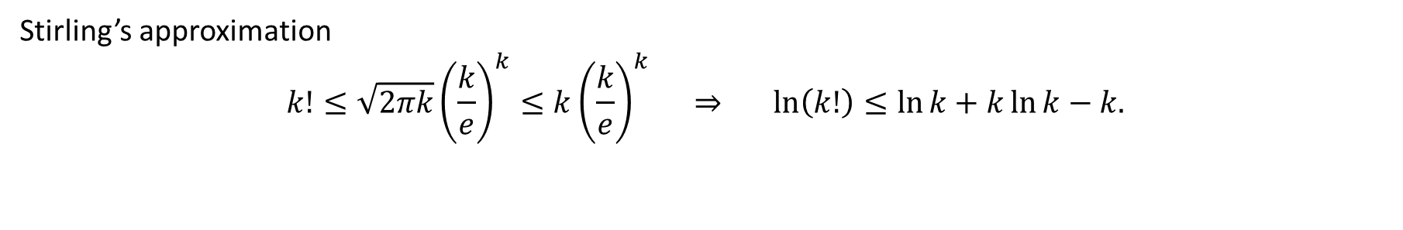

Calculation
Stirling’s approximation
$$k!≤\sqrt{2πk}{\left(\frac{k}{e}\right)}^{k}≤k{\left(\frac{k}{e}\right)}^{k} ⇒ \ln\left(k!\right)≤\ln{k}+k\ln{k}−k.$$

Slide 14
Coupon Collector
We bound the probability that some bin is empty when m = nln(n) + cn, using a heuristic argument.

Slide 15
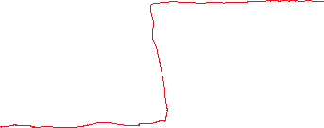
Coupon Collector
We bound the probability that some bin is empty when m = nln(n) + cn, using a heuristic argument.
This is a sharp threshold phenomenon.

Slide 16
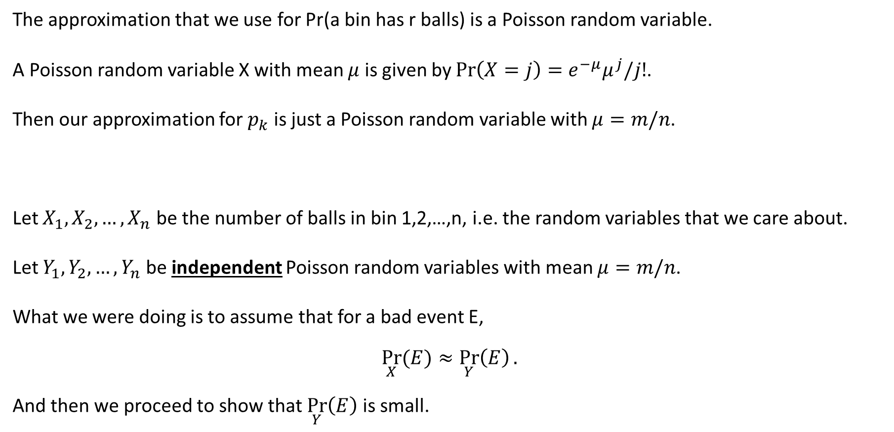
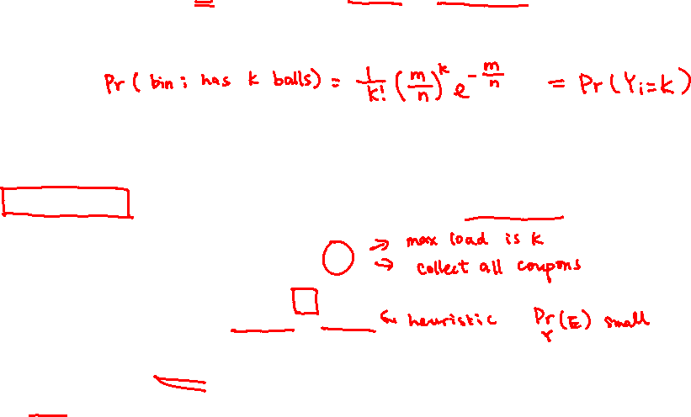
Poisson Approximation (Optional)
The approximation that we use for Pr(a bin has r balls) is a Poisson random variable.
A Poisson random variable X with mean $μ$ is given by $Pr\left(X=j\right)=e^{−μ}μ^{j}/j!$.
Then our approximation for $p_{k}$ is just a Poisson random variable with $μ=m/n$.
Let $X_{1},X_{2}, …, X_{n}$ be the number of balls in bin 1,2,…,n, i.e. the random variables that we care about.
Let $Y_{1},Y_{2}, …, Y_{n}$ be independent Poisson random variables with mean $μ=m/n$.
What we were doing is to assume that for a bad event E,
$$\underset{X}{Pr}{(E)}≈\underset{Y}{Pr}\left(E\right).$$
And then we proceed to show that $\underset{Y}{Pr}\left(E\right)$ is small.

Slide 17
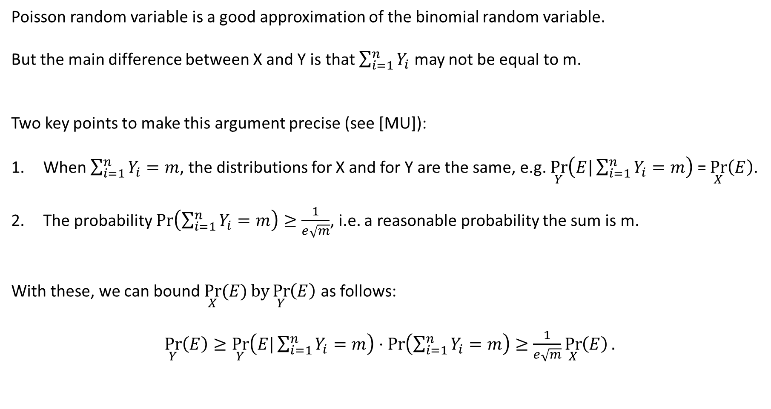
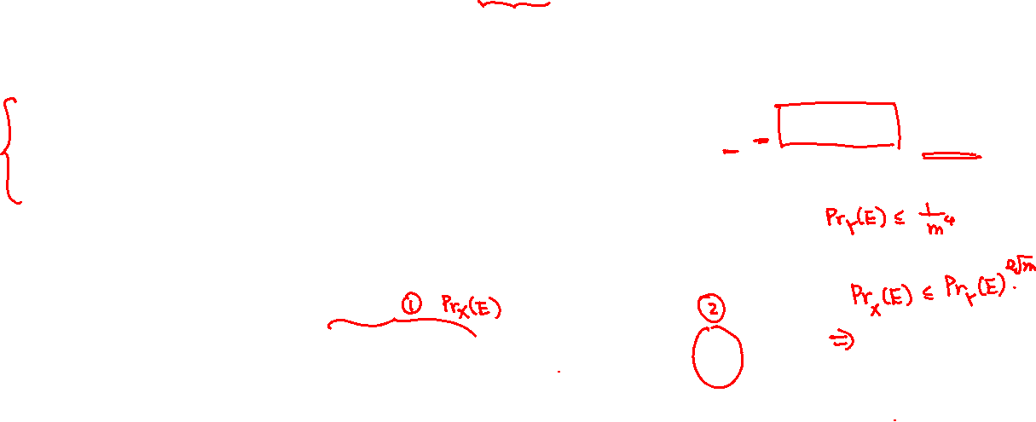
Poisson Approximation (Optional)
Poisson random variable is a good approximation of the binomial random variable.
But the main difference between X and Y is that $\sum_{i=1}^{n}{Y_{i}}$ may not be equal to m.
Two key points to make this argument precise (see [MU]):
When $\sum_{i=1}^{n}{Y_{i}}=m$, the distributions for X and for Y are the same, e.g. $\underset{Y}{Pr}\left(E|\sum_{i=1}^{n}{Y_{i}}=m\right)$ = $\underset{X}{Pr}\left(E\right)$.
The probability $Pr\left(\sum_{i=1}^{n}{Y_{i}}=m\right)≥\frac{1}{e\sqrt{m}}$, i.e. a reasonable probability the sum is m.
With these, we can bound $\underset{X}{Pr}{(E)}by\underset{Y}{Pr}\left(E\right)$ as follows:
$\underset{Y}{Pr}\left(E\right)≥\underset{Y}{Pr}\left(E|\sum_{i=1}^{n}{Y_{i}}=m\right)⋅Pr\left(\sum_{i=1}^{n}{Y_{i}}=m\right)≥\frac{1}{e\sqrt{m}}\underset{X}{Pr}\left(E\right).$

Slide 18

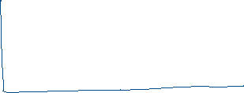




Power of two choices
Suppose every time we throw a ball, we choose two uniformly random bins,
and put the ball in the least loaded one (out of these two bins).
Would the maximum load when m=n be significantly reduced?

Slide 19

Intuition
This observation is useful in load balancing.
What if we look at d bins and put the ball in the least loaded (of the d) bin?

Slide 20
Summary
Balls and bins is a simple random process that underlies many phenomenon.
We will see some connections to hashing in the next lecture.

