Slide 1
CS 466/666 Algorithm Design and Analysis
Lecture 3
19 May 2020

Slide 2
Today’s Plan
Finishing L02
2 simple applications of Chernoff bound
Graph sparsification
near linear time minimum cut algorithm?
Dimension reduction
HW1 posted, due June 1
Some sample projects posted

Slide 3
Chernoff-Hoeffding bound for bounded variables
For any $0< ε<1$, let $μ=E\left[X\right]$, where $X=\sum_{i=1}^{n}{X_{i}}$ and each $X_{i}∈\left[0,1\right]$ is independent,
$$\operatorname{Pr}\left(\left|X−μ\right|≥εμ\right)≤{2e}^{−\frac{με^{2}}{3}}$$

Slide 4
Coin flips
Coin flipping: $n$ independent fair coins (probability ½ head, probability ½ tail)
What is the probability that there are at least $3n/4$ heads?

Slide 5
Coin flips
Coin flipping: $n$ independent fair coins (probability ½ head, probability ½ tail)
What is the typical derivation from the mean?
This $\sqrt{n}$ is an important quantity to remember, as it comes up in different places.

Slide 6
Probability Amplification, One-Sided Error
If we have an algorithm that is always correct when it says YES, but is correct with 60% only when it says NO. How can we boost the success probability?

Slide 7
Probability Amplification, Two-Sided Error
If we have an algorithm that is correct with 60% only when it says YES or NO.
How can we boost the success probability?
This $\log{n}$ term is an important quantity to remember, as it also comes up in different places.
This is where we start to expect tight concentration, i.e. error probability is inverse polynomial.

Slide 8
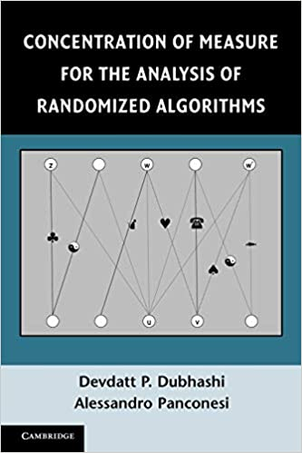
Concentration inequalities
Much more general phenomenon, not just for sums of independent random variables.
Roughly speaking, holds for any function with bounded “influence” of each variable and bounded “dependency” between the random variables.
It is a vast and beautiful mathematical topic.
Berstein’s inequality (will not see)
Martingales, Azuma’s inequality (will not see, unfortunately)
Matrix version of Chernoff bound (will see the statement at least)

Slide 9
Homework
Read chapter 3 and 4 of Mitzenmacher and Upfal.

Slide 10
Graph Sparsification
Given an undirected graph G=(V,E) with a weight w(e) on each edge e in E,
we are interested in finding a “sparse” graph H that approximates G well.
There are different notions of a sparsifier, depending on what properties to preserve.
We study a notion called cut sparsifier.

Slide 11
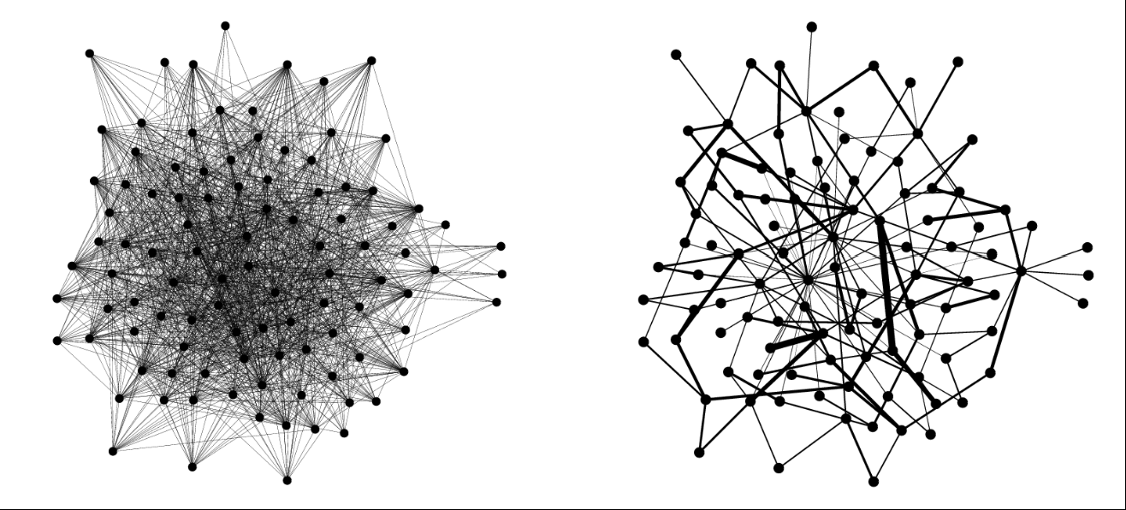
Cut Approximator
Let $δ_{G}(S)$ be the set of edges with one endpoint in S and one endpoint in V-S.
Let ${w(δ}_{G}(S))=\sum_{e∈δ_{G}(S)}{w(e)}$ be the total weight of edges in $δ_{G}(S)$.
Definition ($ε$-cut approximator)
A weighted graph H=(V,F) is an $ε$-cut approximator of G=(V,E) if for every subset $S⊆V$,
$$\left(1−ε\right)w\left(δ_{G}\left(S\right)\right)≤w\left(δ_{H}\left(S\right)\right)≤\left(1+ε\right)w\left(δ_{G}\left(S\right)\right)$$
Note that edges in G and H could have different weights.

Slide 12
First Result in Cut Sparsification
Karger came up with the first sparsification result and found surprising applications.
Assumptions: The graph G is unweighted and the min-cut value of G is $Ω\left(\log{n}\right)$.
With the assumption on the min-cut value, there is a very simple algorithm for graph sparsification.
Algorithm: Set a sampling probability p.
For each edge e, with probability p, put e in H with weight 1/p.

Slide 13
Expectation
For each edge e in G, the expected weight of e in H is one.
By linearity of expectation, for every $S⊆V$,
$$E\left[|δ_{H}\left(S\right)|\right]=p⋅\left|δ_{G}\left(S\right)\right| and E\left[w\left(δ_{H}\left(S\right)\right)\right]=\left|δ_{G}\left(S\right)\right|.$$
So, the expectation is correct for every cut S.
But does it mean that all cuts will have value close to the expectation simultaneously?

Slide 14
Karger’s Theorem
Theorem (Karger) For any $0<ε≤1$, set $p=\frac{15\ln{n}}{ε^{2}c}$, where c is the min-cut value of G.
Then H is an $ε$-cut approximator of G with $O(p⋅\left|E\left(G\right)\right|)$ edges with probability $≥1−\frac{4}{n}$.
Note that when c is less than 15ln(n), then p is at least one and there is no sparsification.
We need to prove that the weight in every cut is close to its expected value.

Slide 15
Analysis of One Cut
Consider a subset $S⊆V$. Let $\left|δ_{G}\left(S\right)\right|=k$.

Slide 16
Simple union bound won’t work

Slide 17
An important observation
The probability that a cut violates the requirement is smaller when the cut size is bigger.
The failure probability is biggest for minimum cuts.
But we know that there can be at most $O\left(n^{2}\right)$ of them!
The following is a generalization of this result.
Lemma. The number of cuts with at most $αc$ edges is at most $n^{2α}$ for any $α≥1$.
Proof. Similar to the case when $α=1$. Left as an exercise.

Slide 18
A more careful union bound would work

Slide 19
Example
An almost complete graph has an $ε$-cut approximation with $O\left(\frac{n\log{n}}{ε^{2}}\right)$ edges.

Slide 20
Improved Result via Non-Uniform Sampling
Theorem [Benczur-Karger] Any graph G has an $ε$-cut approximator with $O\left(\frac{n\log{n}}{ε^{2}}\right)$ edges.
We will see an algebraic generalization of this result in the second half of this course.

Slide 21
Standard Applications
Design a fast approximation algorithm for the minimum s-t cut problem.

Slide 22
Minimum Cuts in Near Linear Time (Sketch)
Karger came up with a highly original approach to the minimum cut problem.
Theorem (Tutte) If G has min-cut value c, then G has c/2 edge-disjoint spanning trees.
If we have these edge-disjoint trees $T_{1},…, T_{\frac{c}{2}}$, then we know that one of these trees, say T, crossed a minimum cut S at most twice.
Karger realized that if we are given T, then we can find S in near linear time using dynamic programming.

Slide 23
Minimum Cuts in Near Linear Time (Sketch)
There is an $\tilde{O}(mc)$ time algorithm to find these disjoint trees, but too slow for our purpose.
Karger’s idea, of course, is to use his graph sparsification result.
He used the uniform sampling algorithm described above to sparsify the graph
so that it’s min-cut value is $O(\log{n)}$.
Then we can use the above algorithm to find the disjoint trees in $\tilde{O}(m)$ time.
Then, one of these trees would cross a min-cut at most twice.
So, running the dynamic programming on these $O(\log{n)}$ trees, we find a min cut in $\tilde{O}(m)$ time.

Slide 24
Dimension Reduction
We have n data points in d dimensional Euclidean space.
For many algorithms, the running time depends on the dimension.
One example is the nearest neighbor search algorithm, with running time O(nd).
It would be nice if we could reduce the dimension of the data, when doing nearest neighbor search.

Slide 25
Johnson-Lindenstrauss Lemma
It turns out that the dimension can be reduced significantly, while distances are almost preserved.
This is a very useful mathematical result with diverse applications.
Theorem [Johnson-Lindenstrauss] Given any $0<ε≤\frac{1}{2}$ and any set $X=\{x_{1},…, x_{n}\}$ of n points,
there exists a linear map $A :X→R^{k}$ with $k=O\left(\frac{\log{n}}{ε^{2}}\right)$ such that
$$1−ε≤\frac{{\left\|A\left(x_{i}\right)−A\left(x_{j}\right)\right\|}_{2}^{2}}{{\left\|x_{i}−x_{j}\right\|}_{2}^{2}}≤1+ε.$$

Slide 26
Algorithm
The algorithm is very simple. It just projects the data points into a random k-dimensional subspace.
Let d be the dimension of the data points of the input.
Let M be a $k×d$ matrix, where each entry is a random $N(0,1)$ variable
(i.e. Gaussian random variables with mean 0 and variance 1, with density $f\left(x\right)={\frac{1}{\sqrt{2π}}e}^{−\frac{x^{2}}{2}}$).
Define $A\left(x\right)=\frac{1}{\sqrt{k}}Mx$.

Slide 27
Preserving the length of a vector
Since A is a linear map, A(x) – A(y) = A(x-y).
So, to preserve the distance between x and y, it is equivalent to preserving the length of the vector x-y.
Setting $δ=\frac{1}{n^{2}}$ and applying the union bound will give the Johnson-Lindenstrauss theorem.
Lemma. If $A$ is constructed by the above algorithm with $k=O\left(\frac{1}{ε^{2}}\log\left(\frac{1}{δ}\right)\right)$,
then $Pr\left[1−ε≤{\left\|A\left(x\right)\right\|}_{2}^{2} ≤1+ε\right]≥1−δ$ for any unit vector $x∈R^{d}$ and any $0<ε≤\frac{1}{2}$.

Slide 28
Proof Idea
Let’s do the “proof” when $x=e_{1}=\left(1,0,0,…,0\right)$.

Slide 29
Two differences
For general x, each entry of Mx is still a N(0,1) random variable.
We need to derive a Chernoff bound for sum of squares of independent Gaussians.

Slide 30
Applications
Approximate nearest neighbor search.
Approximate matrix multiplication.

Slide 31
Summary
We have seen two interesting and important applications of concentration inequalities.
Both are about reducing the input size while preserving some properties of interest.
They are both useful in designing fast approximation algorithms.
Chernoff bound plus union bound is already quite powerful.

Slide 32
Project Ideas
Concentration inequalities for analysis of randomized algorithms (e.g. martingale).
Graph sparsification and applications.
Algorithms for minimum cuts.
Metric embedding.
Randomized numerical linear algebra.

