Slide 1
CS 466/666 Algorithm Design and Analysis
Lecture 2
14 May 2020

Slide 2
Today’s Plan
Finishing L01
Markov’s inequality
Chebyshev’s inequality
Chernoff bounds
Quota increased
HW1 will be posted soon, due June 1

Slide 3
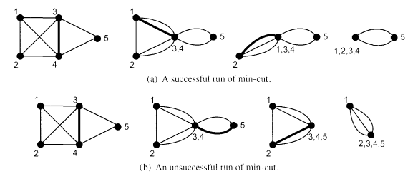
Karger’s algorithm
Idea: just choose a random edge to contract!
Karger’s Algorithm
While there are more than two vertices in the graph
choose a uniformly random edge uv and contract the two endpoints
Output the edges between the remaining two vertices.
Success probability in one execution
>= 2/n(n-1)
Repeat O(n^2) iterations =>
success probability
>= 1 – exp(-20).
Total time complexity
= O(n^4).

Slide 4
Improving running time (sketch)

Slide 5
Improving running time (sketch)

Slide 6
Combinatorial structure
How many minimum cuts can there be in an undirected graph?

Slide 7
Discussions
Minimum k-cut
Minimum s-t cut
Minimum vertex cut
Graph sparsification => near linear time algorithm

Slide 8
Homework
Practice problems on probability
Read chapter 1 and 2 of Mitzenmacher and Upfal.

Slide 9
Concentration inequalities
How do we analyze randomized algorithms if their behavior are so random/unpredictable?
Generally speaking, concentration inequalities are used to prove that a random variable is close to its expected value with high probability.
These are very important tools in analyzing randomized algorithms, because they can be used to show that a randomized algorithms behaves almost deterministically, i.e. very close to what we “expect”.
Hence, a very common strategy to analyze randomized algorithms is to look at the right random variables, then compute their expected values, and use concentration inequalities to prove that the outcomes are close to the expectation with high probability, and then proceed as if their behavior is deterministic.

Slide 10
Bounding probability
Suppose someone claims that they have an algorithm for sorting with expected running time 2nlog(n).
Suppose we have no further information about the algorithm.
What bound can we give for the runtime of this algorithm to be more than 4nlog(n)?
If you know how to answer this question, then you already know Markov’s inequality.

Slide 11
Markov’s inequality
Let $X$ be a non-negative (discrete) random variable.
Then, for any $a≥0,\operatorname{Pr}\left( X≥a \right)≤ E[X] / a$.
Coin flipping: $n$ independent fair coins (probability ½ head, probability ½ tail)
What is the probability that there are at least $3n/4$ heads?

Slide 12
Questions
Just before you think Markov’s inequality is too easy, let’s make sure we understand it well.
Can Markov’s inequality be tight? Can you give an example?
Does it hold for general random variables (i.e. not only non-negative)?
Can it be modified to bound $Pr⁡( X≤a )$ (e.g. bound $Pr⁡( X≤E[X]/2 )$ )?

Slide 13
Moments and Variance
Markov’s inequality is most useful when there is no more information, or it is already enough.
To prove better concentration, we need more information about the random variables.
The most commonly used quantity is the variance.
$k$-th moment is defined as $E[X^{k}]$, second moment is $E[X^{2}]$.
$Var[X]$is defined as $E[{\left(X−E\left[X\right]\right)}^{2}]$
Standard derivation is defined as $σ\left(X\right)=\sqrt{Var\left(X\right)}$.

Slide 14
Covariance
Given two random variables $X$ and $Y$, $Cov(X,Y)$ is defined as $E[\left(X−E\left[X\right]\right)\left(Y−E\left[Y\right]\right)]$.
$X$ and $Y$ are called positive correlated if $Cov\left(X,Y\right)>0$ , and negatively correlated if $Cov\left(X,Y\right)<0$.
Two basic facts:
$Var\left[X+Y\right]=Var\left[X\right]+Var\left[Y\right]+Cov(X,Y)$.
If $X$ and $Y$ are independent, then $Var\left[X+Y\right]=Var\left[X\right]+Var\left[Y\right]$.

Slide 15
Chebyshev’s inequality
For any $a≥0,\operatorname{Pr}\left( \left|X−E\left[X\right]\right|≥a \right)≤Var\left[X\right] /{ a}^{2}$.

Slide 16
Coin flips
Coin flipping: $n$ independent fair coins (probability ½ head, probability ½ tail)
What is the probability that there are at least $3n/4$ heads?
Chebyshev is most useful when we only have the second moment.
This will be very important when we analyze data streaming algorithms.

Slide 17
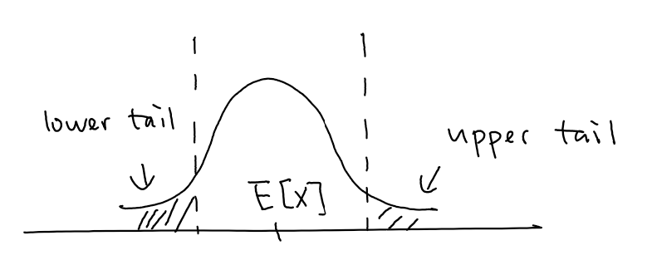
Sum of independent random variables
Our goal is to bound $\operatorname{Pr}\left[ X≥\left(1+ε\right)E\left[X\right]\right]$ and $\operatorname{Pr}\left[ X≤\left(1−ε\right)E\left[X\right]\right]$.
We consider the setting when $X$ is the sum of independent random variables.
The law of large numbers says that the sum of $n$ identically distributed random variables is
approximately $nμ$, where $μ$ is the mean of a random variable.
The central limit theorem says that
$$\frac{X −nμ}{\sqrt{nσ^{2}}}→N\left(0,1\right),$$
where $σ$ is the standard derivation of a random variable.
So the typical derivation from the mean is of the order $\sqrt{n}σ$.
Chernoff bound is to give us quantitative estimate of the probability $X$ is far from $E[X]$ for any $n$.

Slide 18
First Approach
Consider the simpler setting when there are $n$ independent coin flips, each with probability $p$ head.
A direct approach is to bound $Pr⁡(X≥k)$.
This is possible but difficult to be generalized.

Slide 19
Approach using Markov’s inequality
Instead, we generalize the approach in proving Cherbyshev’s inequality.
$2k$-th moment:
Chernoff:

Slide 20
Moment Generating Functions
$M_{X}\left(t\right)≔E[e^{tX}]$ is called the moment generating function of the random variable $X$.
We can use it to compute all moments of $X$.
It is very easy to compute when $X$ is the sum of independent random variables.

Slide 21
Chernoff bound for heterogenous coin flips
Let $X_{1},…, X_{n}$ be independent random variables where $X_{i}=1$ with probability $p_{i}$ and $X_{i}=0$ otherwise.

Slide 22
Chernoff bound for upper tail
For any $ε>0$, let $μ=E\left[X\right]$, where $X$ is sum of independent heterogenous coin flips,
$$\operatorname{Pr}\left(X≥\left(1+ε\right)μ\right)≤{\left(\frac{e^{ε}}{{\left(1+ε\right)}^{1+ε}}\right)}^{μ}$$

Slide 23
Chernoff bound for upper tail, a useful form
For any $0< ε<1$, let $μ=E\left[X\right]$, where $X$ is sum of independent heterogenous coin flips,
$$\operatorname{Pr}\left(X≥\left(1+ε\right)μ\right)≤e^{−\frac{με^{2}}{3}}$$

Slide 24
Chernoff bound for lower tail, a useful form
For any $0< ε<1$, let $μ=E\left[X\right]$, where $X$ is sum of independent heterogenous coin flips,
$$\operatorname{Pr}\left(X≤\left(1−ε\right)μ\right)≤e^{−\frac{με^{2}}{2}}$$
Combining the upper tail and the lower tail, we obtain the following form which will be used frequently.
For any $0< ε<1$, let $μ=E\left[X\right]$, where $X$ is sum of independent heterogenous coin flips,
$$\operatorname{Pr}\left(\left|X−μ\right|≥εμ\right)≤{2e}^{−\frac{με^{2}}{3}}$$

Slide 25
Hoeffding extension for bounded variables
All the bounds still hold when each $X_{i}∈[0,1]$ with mean $p_{i}$.
In particular, the following one that we will use all the time.
For any $0< ε<1$, let $μ=E\left[X\right]$, where $X=\sum_{i=1}^{n}{X_{i}}$ and each $X_{i}∈\left[0,1\right]$ is independent,
$$\operatorname{Pr}\left(\left|X−μ\right|≥εμ\right)≤{2e}^{−\frac{με^{2}}{3}}$$

Slide 26
Remarks
The same method applies for other (not necessarily bounded) random variables, e.g. Poisson, Gaussian, etc. We will see this in L03.
Often, it is easier to compute the moments by computing the moment generating function.
Chernoff bounds also hold for negatively correlated random variables, e.g. edges in random spanning tree.

Slide 27
Coin flips
Coin flipping: $n$ independent fair coins (probability ½ head, probability ½ tail)
What is the probability that there are at least $3n/4$ heads?
This $\sqrt{n}$ is an important quantity to remember, as it comes up in different places.

Slide 28
Probability Amplification, One-Sided Error
If we have an algorithm that is always correct when it says YES, but is correct with 60% only when it says NO. How can we boost the success probability?

Slide 29
Probability Amplification, Two-Sided Error
If we have an algorithm that is correct with 60% only when it says YES or NO.
How can we boost the success probability?
This $\log{n}$ term is an important quantity to remember, as it also comes up in different places.
This is where we start to expect tight concentration, i.e. error probability is inverse polynomial.

Slide 30
Concentration inequalities
Much more general phenomenon, not just for sums of independent random variables.
Roughly speaking, holds for any function with bounded “influence” of each variable and bounded “dependency” between the random variables.
It is a vast and beautiful mathematical topic.

Slide 31
Homework
Read chapter 3 and 4 of Mitzenmacher and Upfal.

