Slide 1
CS 341 – Algorithms
Lecture 20 – Hard Partitioning Problems
30 July 2021

Slide 2
Today’s Plan
3-Dimensional Matching
Subset-Sum
Concluding Remarks

Slide 3
3-Dimensional Matching
3-Dimensional Matching (3DM)
Input: Disjoint sets $X,Y,Z$, each of size $n$, a set $T⊆X×Y×Z$ of triples.
Output: Does there exist a subset of $n$ disjoint triples in $T$?
A subset of $n$ disjoint triples is called a perfect 3D-matching.

Slide 4
3DM is NP-complete
Theorem. 3DM is NP-complete.
Proof. It is easy to check that 3DM is in NP.
To prove that it is NP-complete, we will prove that 3SAT $≤_{p}$ 3DM.
Given a 3SAT instance with $n$ variables $x_{1},x_{2},…,x_{n}$ and $m$ clauses $C_{1},C_{2},…,C_{m}$, we would like to
construct a 3DM instance so that the formula is satisfiable iff there is a perfect 3D-matching.

Slide 5
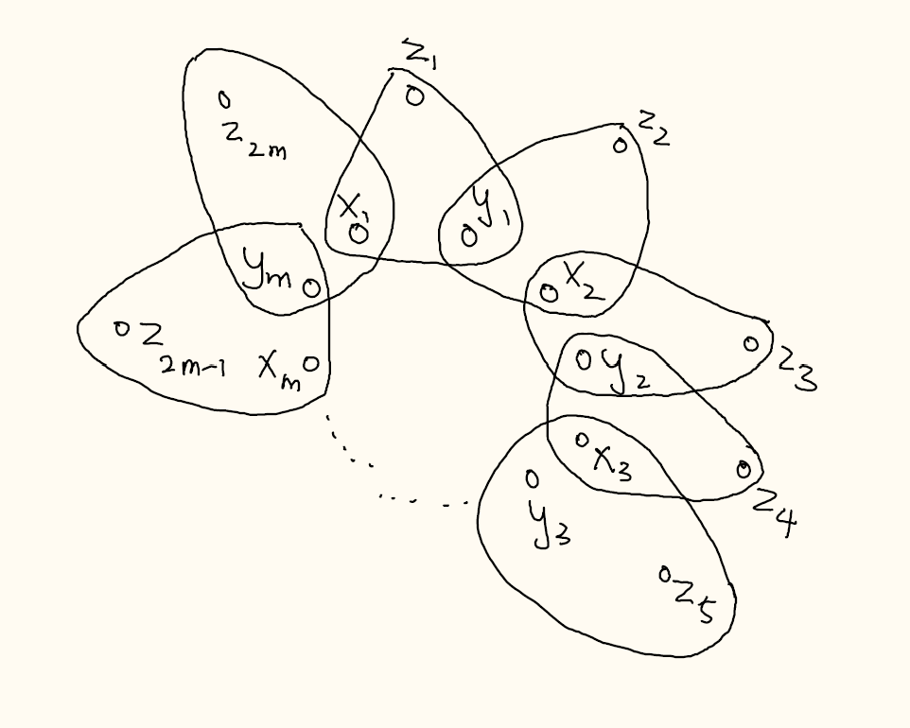
Variable Gadget
We create some variable gadgets to capture the binary decision of a Boolean variable.

Slide 6
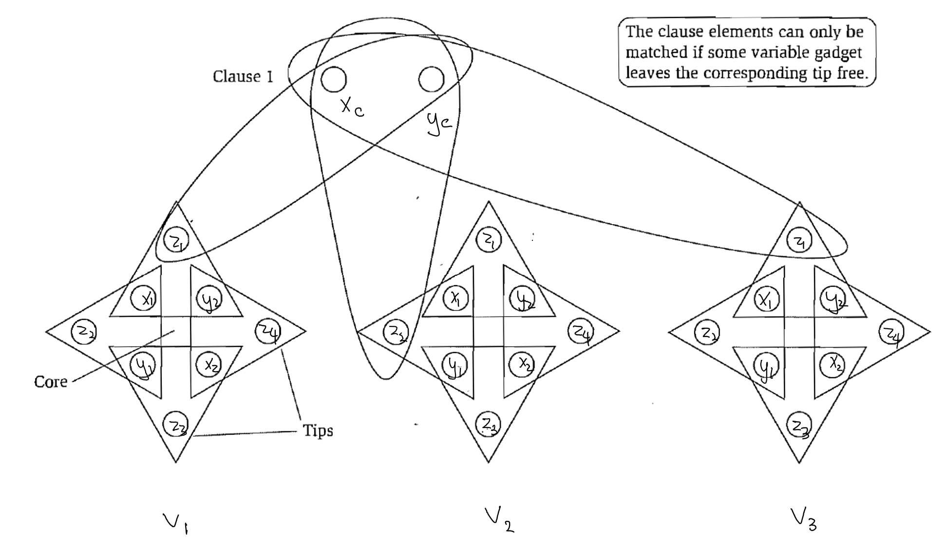
Clause Structure
Now we add some clause structure to the 3DM instance so that only satisfying assignments “survive”.

Slide 7
Reduction
We create $n$ variable gadgets, each with $2m$ “tips”.
Each clause has 3 different triples. Note that different clauses use different “tips” of the variable gadgets.

Slide 8
Proof
Claim. The formula is satisfiable if and only if there is a perfect 3D-matching.

Slide 9
Proof
Claim. The formula is satisfiable if and only if there is a perfect 3D-matching.

Slide 10
Today’s Plan
3-Dimensional Matching
Subset-Sum
Concluding Remarks

Slide 11
Subset-Sum
Input: $n$ positive integers $a_{1},a_{2},…,a_{n}$ and an integer $K$.
Output: Does there exist a subset $S⊆[n]$ with $\sum_{i∈S}{a_{i}}=K$?
Theorem. Subset-Sum is NP-complete.
Proof. It is easy to check that Subset-Sum is in NP.
To prove that it is NP-complete, we will prove that 3DM $≤_{p}$ Subset-Sum.
Given a 3DM instance, we would like to construct a Subset-Sum instance so that there is a perfect
3D-matching if and only if there is a subset of certain sum $K$ (value to be determined later).
(It requires some new idea to solve a problem about numbers.)

Slide 12
Vector Representation of 3DM
To see the connection between 3DM and Subset-Sum, it is easier to use a different way to see 3DM.

Slide 13
Reduction Idea
A very natural idea is to interpret the 0-1 vector as the binary representation of a number.

Slide 14
Actual Reduction
There is a simple trick to get around this “carrying” problem, so that the above plan would work.

Slide 15
Proof
Claim. There is a perfect 3D-matching if and only if there is a subset with sum $K=\sum_{i=1}^{3n}{b^{i}}$.
Corollary. Knapsack is NP-complete.

Slide 16
Today’s Plan
3-Dimensional Matching
Subset-Sum
Concluding Remarks

Slide 17
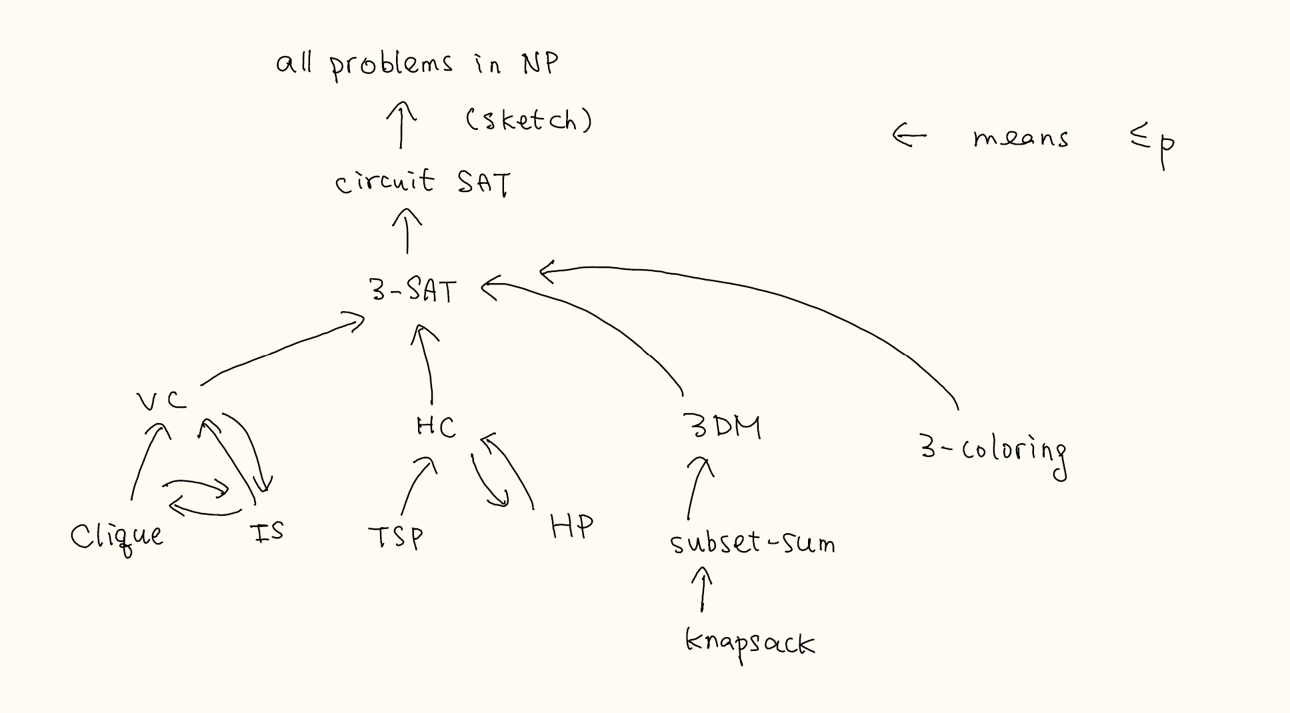
Map
In NP-completeness, we showed you the difficult reductions and ask you to do the easier ones.
You can only use problems from this map to do homework and exam.

Slide 18
Techniques for Doing Reductions
It requires practices to search for the right problem Y to prove Y $≤_{p}$X for our problem X.
There are three common techniques in proving NP-completeness.
Specialization:
Local Replacement:
Gadget Design:

Slide 19
2 vs 3

Slide 20
Decision Problems vs Search Problems

Slide 21
Final Exam
Good luck in your final exam.

Slide 22
Learning Outcome (from L01)
Know basic techniques and well-known algorithms well.
Have the skills to design new algorithms for simple problems.
Have the skills to prove correctness and analyze time complexity of an algorithm.
Use reductions to solve problems and to prove hardness.

Slide 23
What is Ahead
Probability: Randomized Algorithms, Probabilistic Methods, Random Sampling
Linear Algebra: Linear Equations, Matrix Algorithms, Spectral Methods
Optimization (Calculus): Linear Programming, Approximation Algorithms, Convex Optimization
Complexity: Hardness of Approximation, Fine-Grained Hardness

