Slide 1
CS 341 – Algorithms
Lecture 18 – NP-completeness
23 July 2021

Slide 2
Today’s Plan
The Class NP
NP-completeness
Cook-Levin Theorem

Slide 3
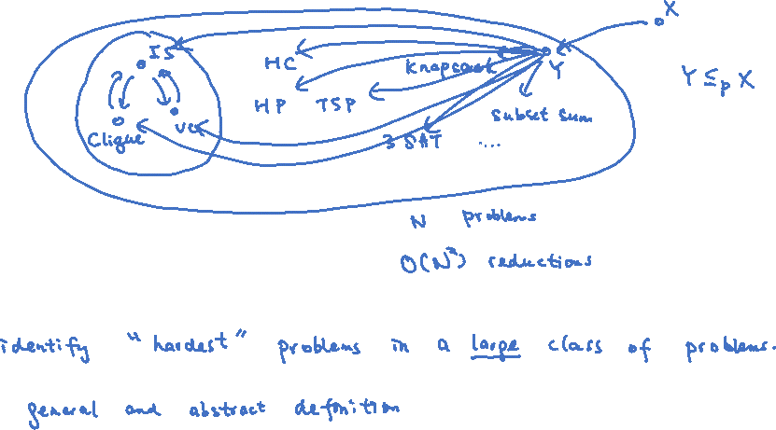
The Class NP
As we discussed last time, we could do reductions between different problems and slowly build up
a huge map showing the relations of all known problems.

Slide 4
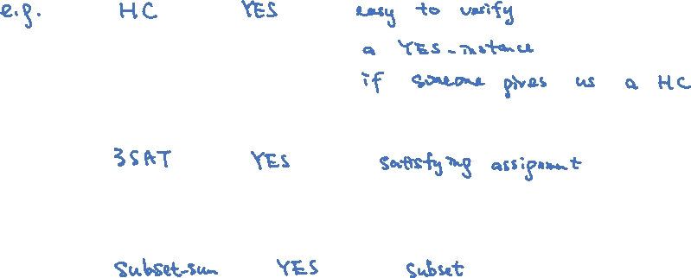
Short Proofs
A general feature of the problems is that there is a short “proof/solution” of a YES-instance.

Slide 5

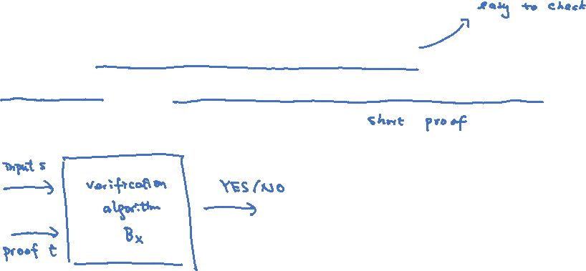
Formal Definition of NP
Definition (NP): For a problem $X$, each instance of $X$ is represented by a binary string $s$.
A problem $X$ is in the class NP if there is a polynomial time verification algorithm $B_{X}$ such that
the input $s$ is a YES-instance if and only if there is a proof $t$ which is a binary string of length $poly\left(\left|s\right|\right)$
so that $B_{X}(s,t)$ returns YES.
The key points are $B_{X}$ is a polynomial time algorithm and $t$ is a short proof of length $poly\left(\left|s\right|\right)$.
In most problems, $t$ is simply a solution and $B_{X}$ is an efficient algorithm to check if $t$ is indeed a solution.

Slide 6
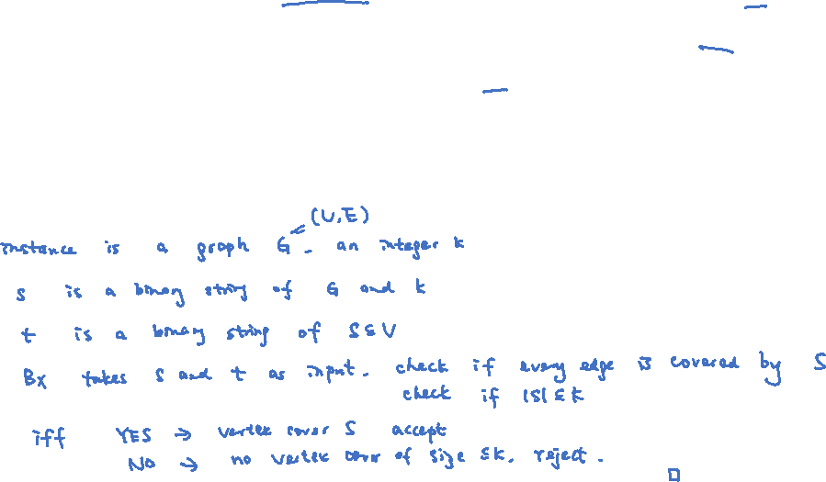
Example
Definition (NP): For a problem $X$, each instance of $X$ is represented by a binary string $s$.
A problem $X$ is in the class NP if there is a polynomial time verification algorithm $B_{X}$ such that
the input $s$ is a YES-instance if and only if there is a proof $t$ which is a binary string of length $poly\left(\left|s\right|\right)$
so that $B_{X}(s,t)$ returns YES.
Claim. Vertex Cover is in NP.

Slide 7
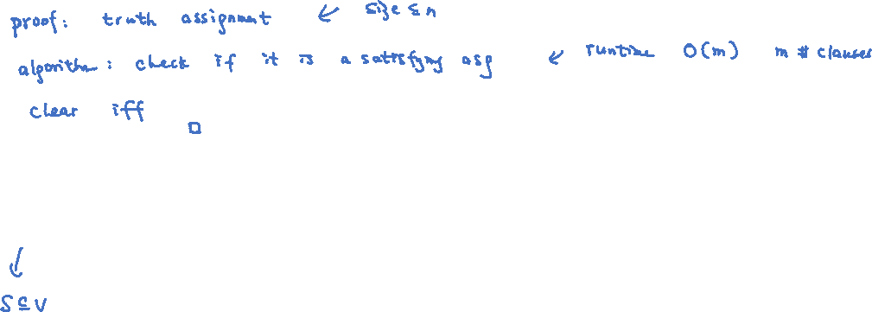
More Examples
Claim. 3SAT is in NP.
Exercises: Clique, IS, HC, HP, Subset-Sum are all in NP.

Slide 8
Remark 1: Non-Examples

Slide 9
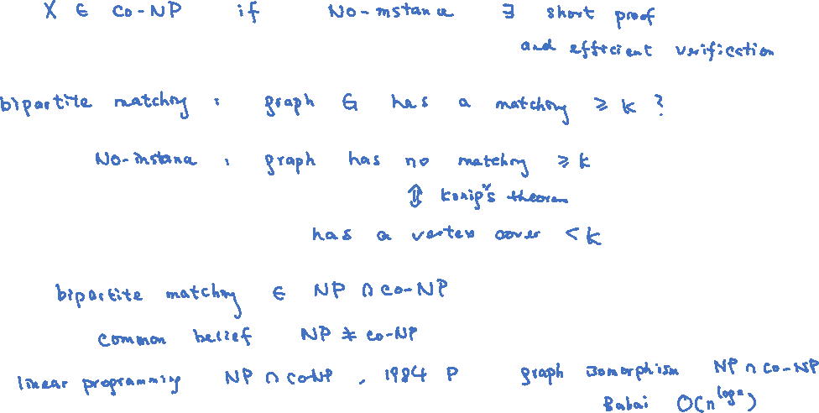
Remark 2: co-NP

Slide 10
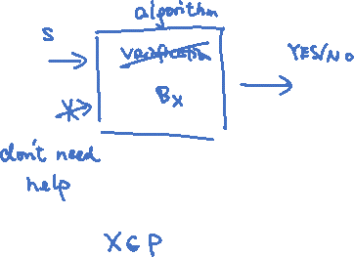
Remark 3: $P⊆NP$

Slide 11
Remark 4: Non-Deterministic Polynomial Time

Slide 12
Remark 5: P=NP?

Slide 13
Today’s Plan
The Class NP
NP-completeness
Cook-Levin Theorem

Slide 14
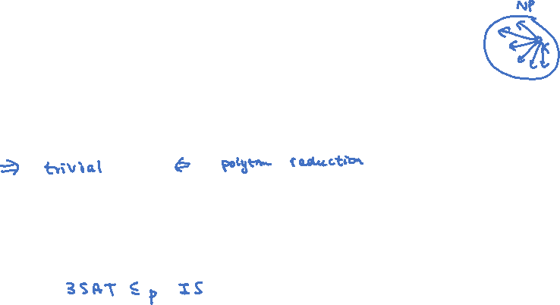
NP-completeness
Informally, we say a problem is NP-complete if it is a hardest problem in NP.
Definition. A problem $X∈$ NP is NP-complete if ${Y≤}_{p}X$ for all $Y∈$ NP.
Proposition. P=NP if and only if an NP-complete problem can be solved in polynomial time.
Theorem. (Cook-Levin) 3-SAT is NP-complete.

Slide 15
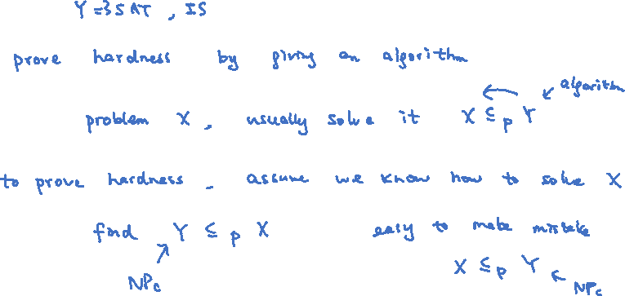
Proving NP-completeness
To prove that a problem $X$ is NP-complete, we first prove that $X$ is in NP,
and then we find an NP-complete problem $Y$ and prove that $Y≤_{p}X$.

Slide 16
Today’s Plan
The Class NP
NP-completeness
Cook-Levin Theorem

Slide 17
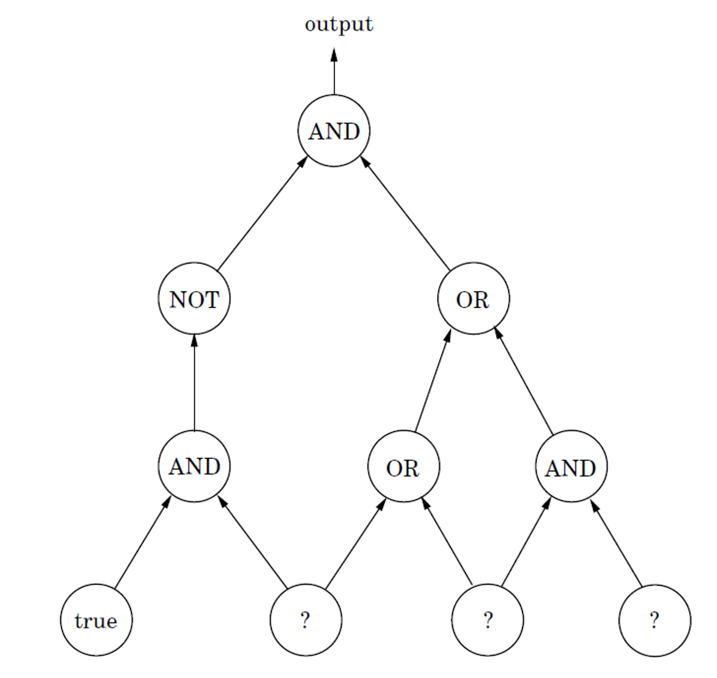
Cook-Levin Theorem
We introduce an intermediate problem in order to prove that 3SAT is NP-complete.
Circuit-SAT
Input: A circuit with AND/OR/NOT gates, some known input gates, and some unknown input gates.
Output: Is there a truth assignment on the unknown input gates so that the output is True?
We can assume that the input circuit is a directed acyclic graph,
and each AND/OR gate has only two incoming edges.
Theorem. Circuit-SAT is NP-complete.

Slide 18
Proof Sketch
Theorem. Circuit-SAT is NP-complete.
Proof sketch. We start from the abstract definition of NP to prove that $X≤_{p}$ Circuit-SAT for any $X∈$ NP.
The main conceptual idea is that a circuit is as general as an algorithm.
The original proofs of Cook and Levin directly transforms a non-deterministic Turing machine into a formula.

Slide 19
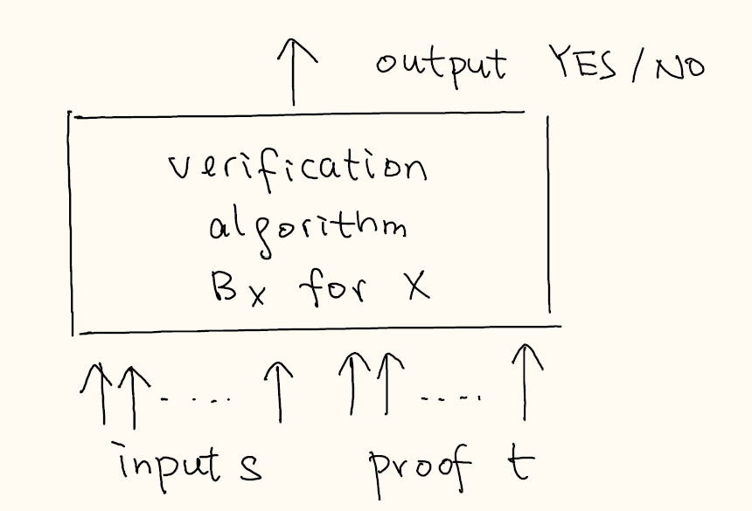
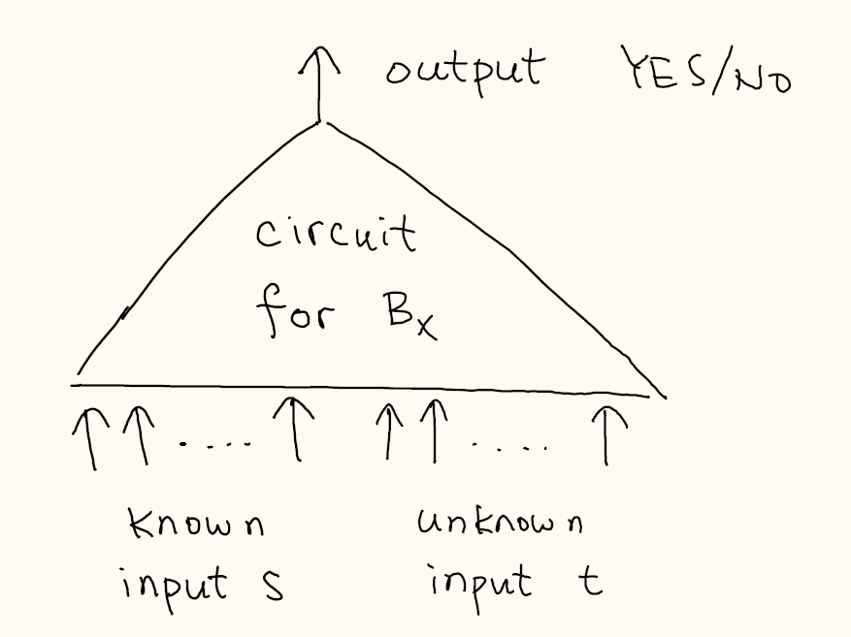

Proof Sketch Continued
Claim. Input $s$ is a YES-instance if and only if there is a satisfying assignment for Circuit-SAT.

Slide 20
From Circuit to Formula
Now we show that a Boolean formula has the same expressive power as a Boolean circuit.
Theorem. Circuit-SAT $≤_{p}$ 3-SAT.
Proof. Given a circuit of $n$ gates, we will construct a formula with $O\left(n\right)$ variables so that
the circuit is satisfiable if and only if the formula is satisfiable.

Slide 21
From Circuit to Formula
Now we show that a Boolean formula has the same expressive power as a Boolean circuit.
Theorem. Circuit-SAT $≤_{p}$ 3-SAT.
Proof. Given a circuit of $n$ gates, we will construct a formula with $O\left(n\right)$ variables so that
the circuit is satisfiable if and only if the formula is satisfiable.

Slide 22
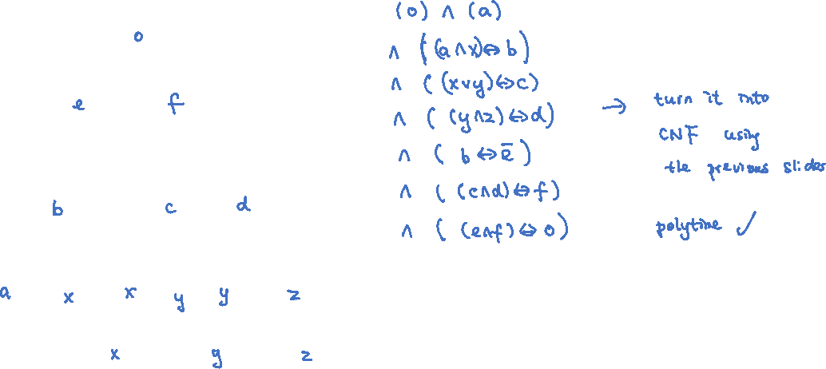
Example
Claim. The circuit is satisfiable if and only if the formula is satisfiable.

Slide 23
Concluding Remarks
With the Cook-Levin theorem, we have a firm foundation to prove that a problem is NP-complete.
We will grow our list of NP-complete problems in the next two lectures.

