Slide 1
CS 341 – Algorithms
Lecture 17 – Polynomial Time Reductions
21 July 2021

Slide 2
Today’s Plan
Polynomial Time Reductions
Simple Reductions
More Simple Reductions
A Non-Trivial Reduction

Slide 3
Polynomial Time Reductions
Once we have learned more and more algorithms, they become our building blocks and we may not
need to design algorithms for new problems from scratch.
So it becomes more and more important to be able to use existing algorithms to solve new problems.
We have already seen a few reductions.
For examples, we have reduced subset-sums to knapsack, longest increasing subsequence to longest
common subsequences, and basketball league winner to maximum bipartite matching, etc.
In general, if there is an efficient reduction from problem A to problem B and there is an efficient
algorithm to solve problem B, then we have an efficient algorithm to solve problem A.

Slide 4
Decision Problems
To formalize the notion of a reduction, it is more convenient to restrict our attention to decision problems,
for which the output is either YES or NO, so that every problem has the same output format.
For example, instead of finding a maximum matching, we consider the decision version of the problem
“Does the input graph $G$ have a matching of size at least $k$?”.
As we will discuss later, for all the problems that we will consider, if we know how to solve the
decision version of our problem in polynomial time, then we can use the decision algorithm as a
blackbox/subroutine to solve the search version of our problem in polynomial time.

Slide 5
Definition (Polynomial Time Reductions)
Definition. We say a decision problem $A$ is polynomial time reducible to a decision problem $B$
if there is a polynomial time algorithm $F$ that maps/transforms any instance $I_{A}$ of $A$
into an instance $I_{B}$ of $B$ (that is, $F\left(I_{A}\right)=I_{B}$) such that
$I_{A}$ is a YES-instance of problem $A$ if and only if $I_{B}$ is a YES-instance of problem $B$.
We use the notation $A≤_{p}B$ to denote that such a polynomial time reduction exists, intuitively saying
that problem $A$ is not more difficult than problem $B$ in terms of polynomial time solvability.

Slide 6
Algorithm (Solving Problem A by Reduction)

Slide 7
Proving Hardness Using Reductions
We showed $A≤_{p}B$ and use an efficient algorithm for problem $B$ to solve problem $A$.
This is the usual direction, but now we explore the other implication of the inequality $A≤_{p}B$.
Suppose problem $A$ is known to be impossible to be solved in polynomial time.
Then $A≤_{p}B$ implies that problem $B$ cannot be solved in polynomial time either.
Therefore, if $A$ is computationally hard and $A≤_{p}B$, then $B$ is also computationally hard.
By our current knowledge, however, we know almost nothing about proving a problem cannot be
solved in polynomial time, so we could not draw such a strong conclusion from $A≤_{p}B$.

Slide 8
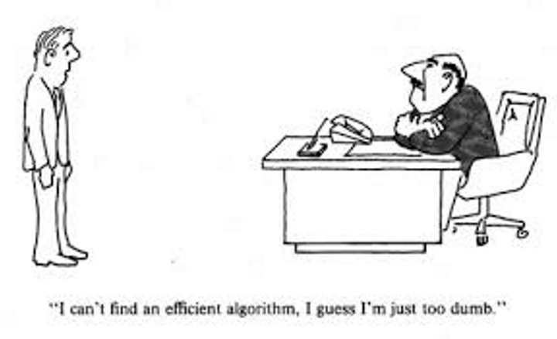
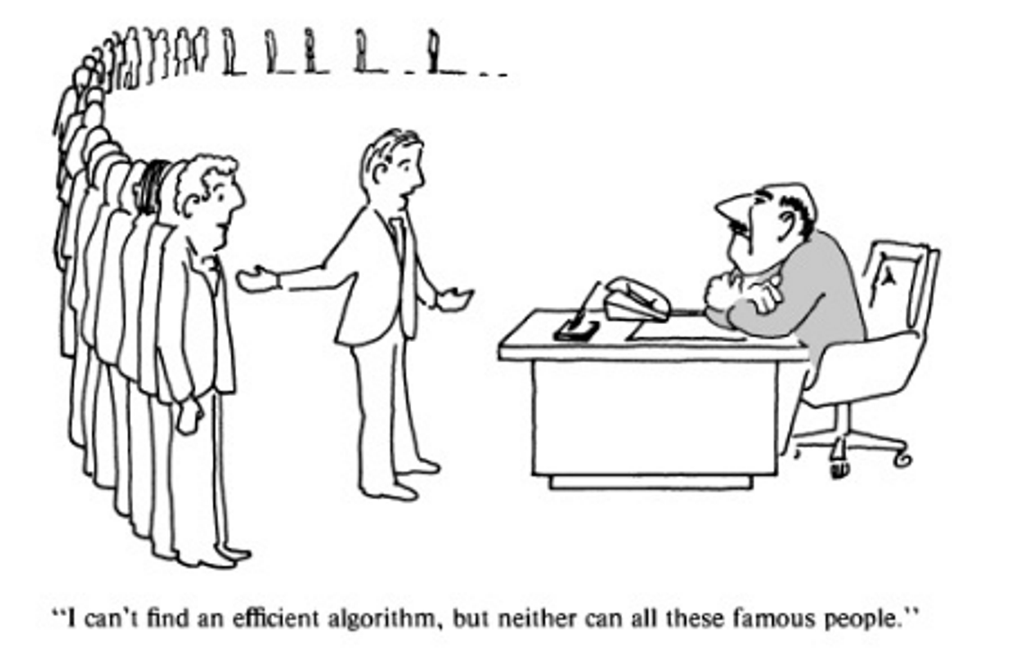
Cartoon (from book by Garey and Johnson)
Suppose our boss gives us a problem $C$, but we don’t know how to solve it in polynomial time.
It would be much more convincing if you could prove e.g. TSP $≤_{p}C$.
Dream

Slide 9
Today’s Plan
Polynomial Time Reductions
Simple Reductions
More Simple Reductions
A Non-Trivial Reduction

Slide 10
Three Problems
Maximum Clique (Clique): A subset $S⊆V$ is a clique if $uv∈E$ for all $u,v∈S$.
Input: A graph $G=(V,E)$, an integer $k$.
Output: Is there a clique with at least $k$ vertices?
Maximum Independent Set (IS): A subset $S⊆V$ is an independent set if $uv∉E$ for all $u,v∈S$.
Input: A graph $G=(V,E)$, an integer $k$.
Output: Is there an independent set with at least $k$ vertices?
Minimum Vertex Cover (VC): A subset $S⊆V$ is a vertex cover if $\{u,v\}∩S≠∅$ for all $uv∈E$.
Input: A graph $G=(V,E)$, an integer $k$.
Output: Is there a vertex cover with at most $k$ vertices?

Slide 11
Cliques and Independent Sets
Proposition. Clique $≤_{p}$ IS and IS $≤_{p}$Clique.

Slide 12
Independent Sets and Vertex Cover
Observation. In $G=(V,E)$, a subset $S⊆V$ is a vertex cover if and only if $V−S$ is an independent set.
Proposition. VC $≤_{p}$ IS and IS $≤_{p}$VC.

Slide 13
Polynomial Time Reductions are Transitive
Proposition. If $A≤_{p}B$ and $B≤_{p}C$, then $A≤_{p}C$.
Therefore, Clique, IS, and VC are all equivalent in terms of polynomial time solvability.

Slide 14
Today’s Plan
Polynomial Time Reductions
Simple Reductions
More Simple Reductions
A Non-Trivial Reduction

Slide 15
Hamiltonian Problems
Hamiltonian Cycle (HC): A cycle is a Hamiltonian cycle if it touches every vertex exactly once.
Input: A graph $G=(V,E)$.
Output: Does $G$ have a Hamiltonian cycle?
Hamiltonian Path (HP): A path is a Hamiltonian path if it touches every vertex exactly once.
Input: A graph $G=(V,E)$.
Output: Does $G$ have a Hamiltonian path?
Traveling Salesman Problem (TSP):
Input: A graph $G=(V,E)$, with an edge length $l_{e}$ for each edge $e∈E$, and an integer $L$.
Output: Is there a Hamiltonian cycle with total length at most $L$?

Slide 16
HP $≤_{p}$ HC
Proposition. HP $≤_{p}$ HC.

Slide 17
HC $≤_{p}$ HP
Proposition. HC $≤_{p}$ HP.

Slide 18
Traveling Salesman Problem
A common technique in doing reduction is to show that one problem is a special case of another problem.
We call this technique specialization.
Proposition. HC $≤_{p}$ TSP.

Slide 19
Today’s Plan
Polynomial Time Reductions
Simple Reductions
More Simple Reductions
A Non-Trivial Reduction

Slide 20
3-Satisfiability (3SAT)
This is an important problem in the theory of NP-completeness.
We are given $n$ Boolean variables $x_{1},x_{2},…,x_{n}$, each can be set to be either True or False.
We are also given a formula in conjunctive normal form (CNF), where it is an AND of the clauses,
where each clause is an OR of the literals, where a literal is either $x_{i}$ or $\overline{x_{i}}$.
3-Satisfiability (3SAT)
Input: A CNF-formula in which each clause has at most three literals.
Output: Is there a truth assignment to the variables that satisfies all the clauses?

Slide 21
3SAT $≤_{p}$ IS
Theorem. 3SAT $≤_{p}$ IS.
Proof. Given a 3SAT formula, we’d like to construct a graph $G$ so that the formula is satisfiable
if and only if the graph has an independent set of size $m$ where $m$ is the number of clauses.
Idea: We would like the independent set to tell us how to satisfy the formula.
Reduction:

Slide 22
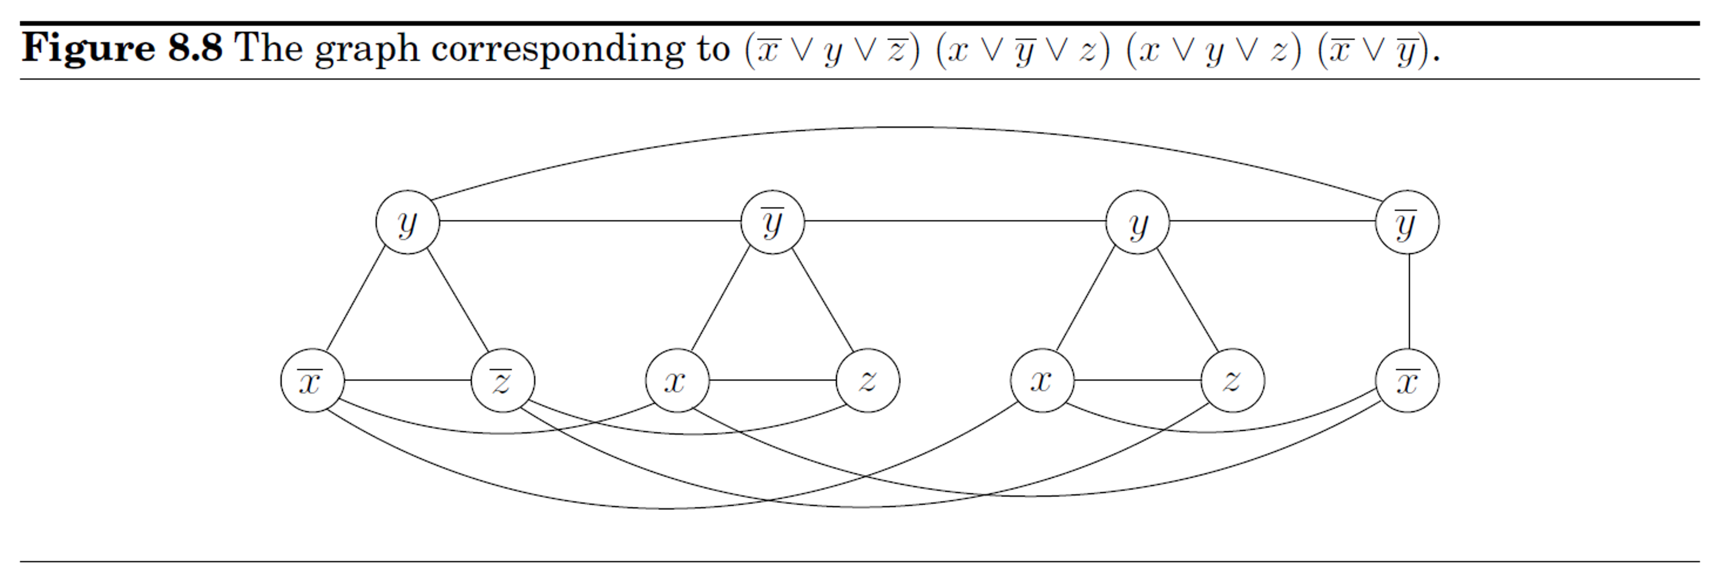
3SAT $≤_{p}$ IS
Theorem. 3SAT $≤_{p}$ IS.
Proof. Given a 3SAT formula, we’d like to construct a graph $G$ so that the formula is satisfiable
if and only if the graph has an independent set of size $m$ where $m$ is the number of clauses.
Idea: We would like the independent set to tell us how to satisfy the formula.
Reduction:

Slide 23
Proof
Lemma. The formula is satisfiable iff
there is an independent set of size $m$.

Slide 24
Proof
Lemma. The formula is satisfiable iff
there is an independent set of size $m$.

Slide 25
Concluding Remarks
We have introduced the notion of a polynomial time reduction, and use it to establish connections
between different problems, and so far we have
In principle, we can add new problems to relate to these problems, and slowly build up a big web
of all computational problems.
As $≤_{p}$ is transitive, any strongly connected components of this big graph forms an equivalent class
of problems in terms of polynomial time solvability.
Is there a better way to do it than to consider the problems one by one?

