Slide 1
CS 341 – Algorithms
Lecture 16 – Bipartite Vertex Cover
16 July 2021

Slide 2
Today’s Plan
Min-Max Theorem
Good Characterizations
Applications and Looking Forward

Slide 3
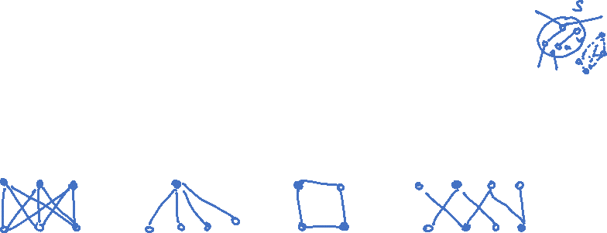
Bipartite Vertex Cover
Given a graph $G=(V,E)$, a subset of vertices $S⊆V$ is a vertex cover if $\left\{u,v\right\}∩S≠∅$ for all $uv∈E$.
Input: A bipartite graph $G=(X,Y;E)$.
Output: A vertex cover of minimum cardinality.

Slide 4
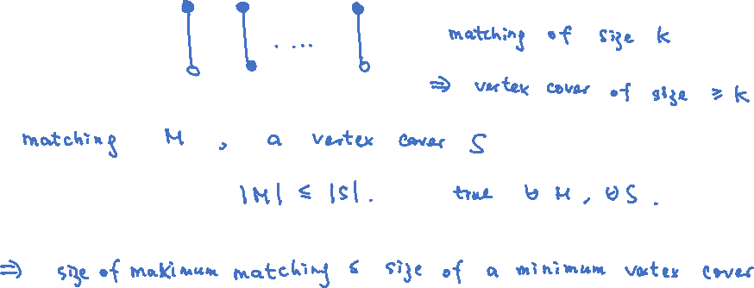
Dual Problems
The bipartite vertex cover problem doesn’t seem to be related to the bipartite matching problem,
but they are actually “dual” of each other in a precise and meaningful way.

Slide 5
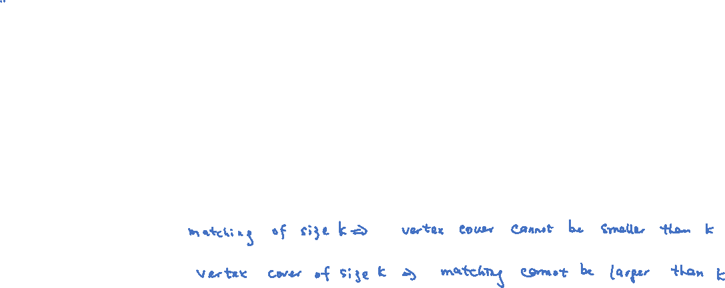
Min-Max Theorem
Konig’s Theorem: In a bipartite graph, the max size of a matching is equal to the min size of a vertex cover.
Proof plan: We will provide an algorithmic proof of Konig’s theorem.
We will prove that given the current matching $M$ of size $k$, if we couldn’t find an augmenting path of $M$,
then we can find a vertex cover $S⊆V$ of size $k$.
This will prove that $M$ is a maximum matching and $S$ is a minimum vertex cover.

Slide 6
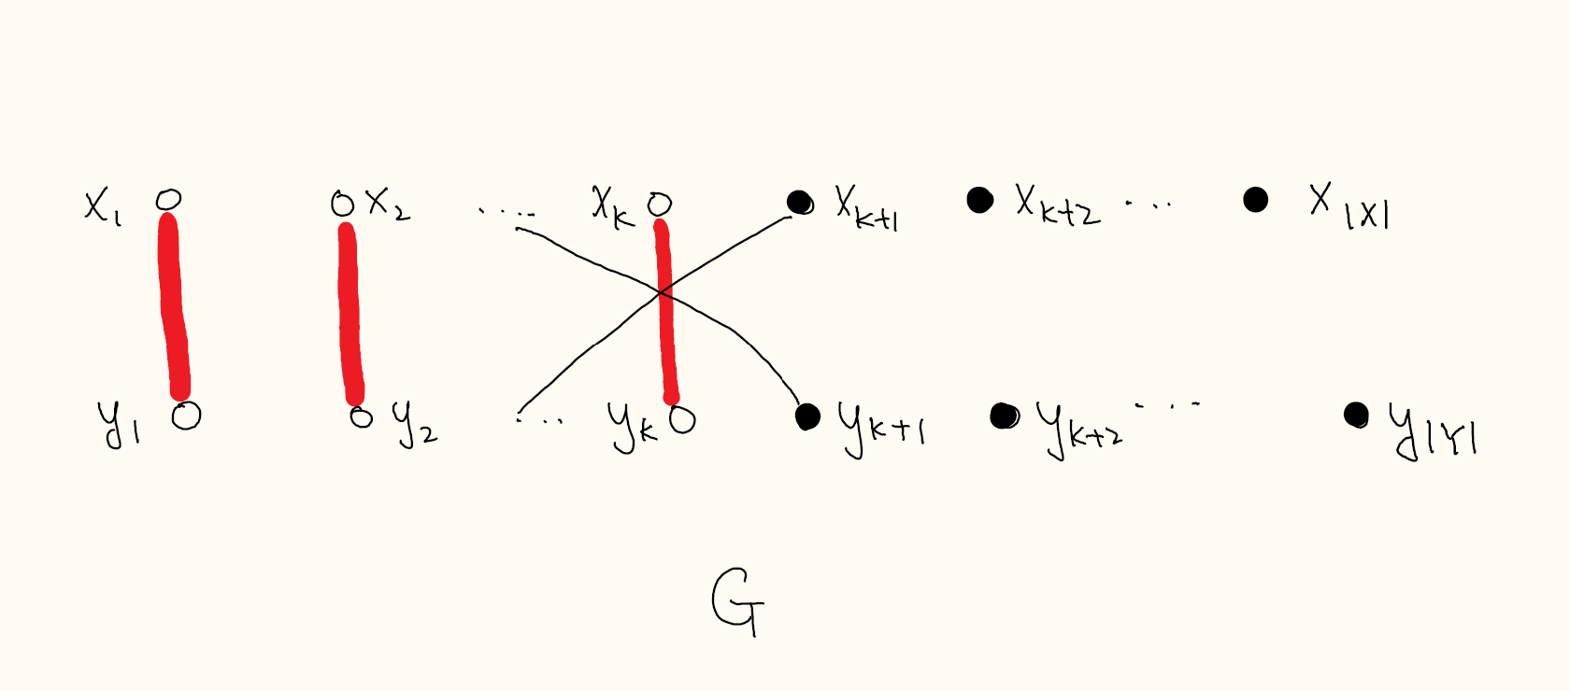
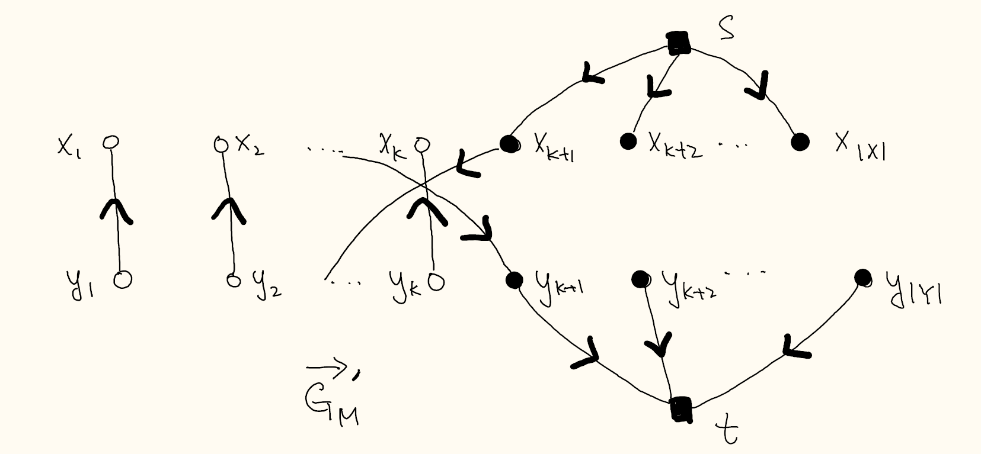
Algorithmic Proof
There is no augmenting path of $M$ in $G$ if and only if there is no directed path from $s$ to $t$ in $\vec{G_{M}}′$.

Slide 7
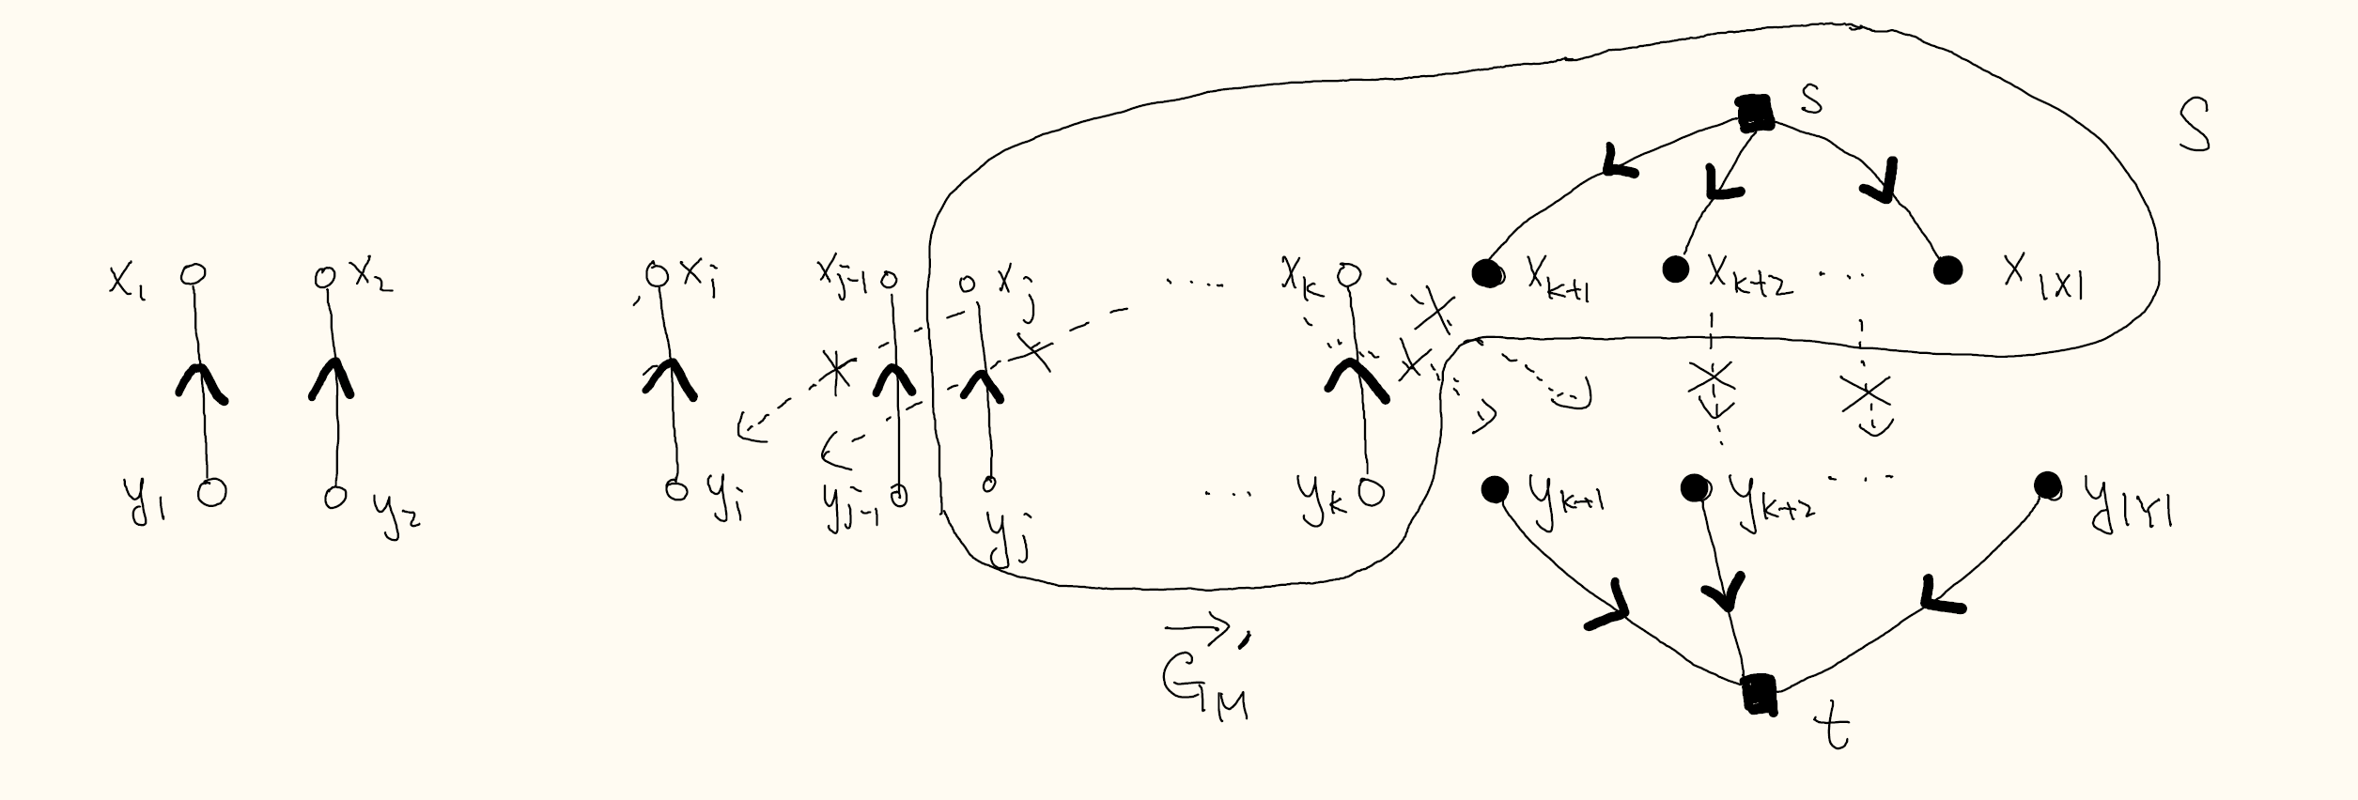

Algorithmic Proof
Let $S$ be the set of vertices reachable from $s$. Note that there are no edges with tail in $S$ and head in $V−S$.
Claim: $\left\{x_{1},…,x_{j−1}\right\}∪\left\{y_{j},…,y_{k}\right\}$ is a vertex cover of $G$.

Slide 8
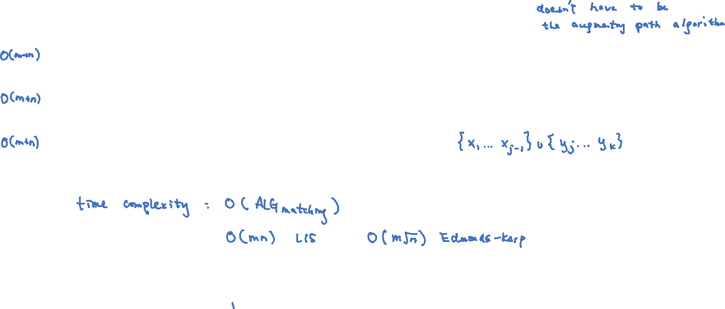
Algorithm and Complexity

Slide 9
Today’s Plan
Min-Max Theorem
Good Characterizations
Applications and Looking Forward

Slide 10
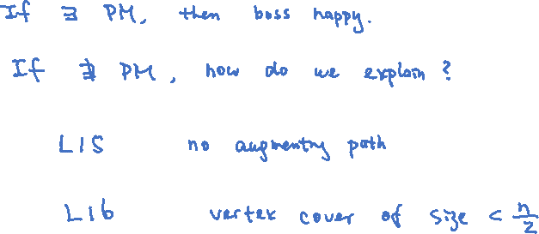
Good Characterization
Imagine that we work for a company and our boss asks us to find a maximum bipartite matching.

Slide 11
Min-Max Theorems
These min-max theorems are some of the most beautiful results in combinatorial optimization,
providing both succinct “proofs” from both the YES-instances and NO-instances.
This shows the non-existence of a solution by the existence of a simple obstruction.
Remark: Contrast this with dynamic programming algorithms.

Slide 12
Hall’s Theorem
Hall’s theorem characterizes when a bipartite graph has a perfect matching or not.
Hall’s Theorem: A bipartite graph $G=(X,Y;E)$ with $\left|X\right|=\left|Y\right|$ has a perfect matching if and only if
for all $S⊆X,$ it holds that $\left|N\left(S\right)\right|≥\left|S\right|$ where $N(S)$ is the neighbor set of $S$ in $Y.$

Slide 13
Perfect Matching in Regular Bipartite Graphs
Corollary: Every $d$-regular bipartite graph $G=(X,Y;E)$ has a perfect matching.
Remark: There is a very interesting $O\left(n\log{n}\right)$ time algorithm to find such a perfect matching
using random walks! (See CS 466 notes if interested.)

Slide 14
Today’s Plan
Min-Max Theorem
Good Characterizations
Applications and Looking Forward

Slide 15
Applications
There are many interesting and non-trivial applications of bipartite matching and network flows.
We don’t have time, so we will just do one example, and we break the problem into two parts.
Capacitated job assignment. There is a small generalization of the job assignment problem.
Each person has a capacity $c_{i}$ to handle at most $c_{i}$ jobs.
The task is to assign all jobs to people, so that no person is overloaded.

Slide 16
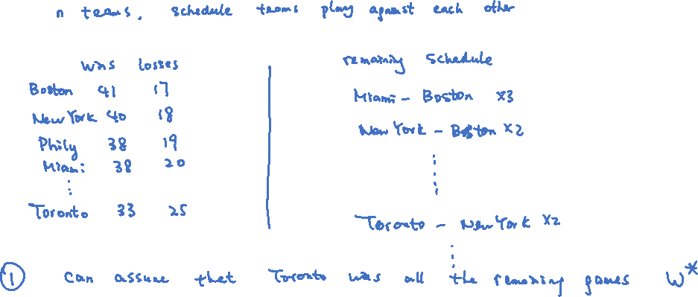
Basketball League Winner
Input: The current standing, and the remaining schedule.
Output: Whether it is possible that our favorite team can still win the league.

Slide 17
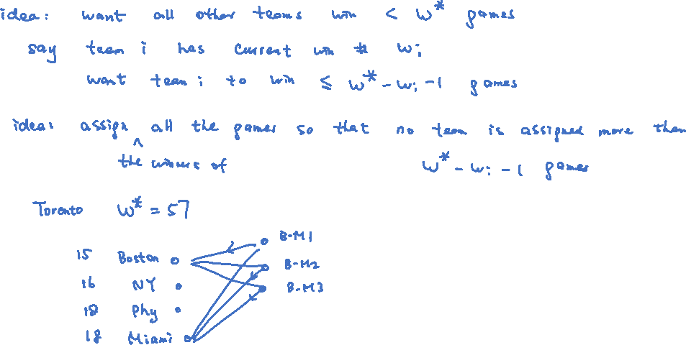
Reduction to Capacitated Assignment
Remark: It is an NP-hard problem to determine if our favorite football team can still win the league.

Slide 18
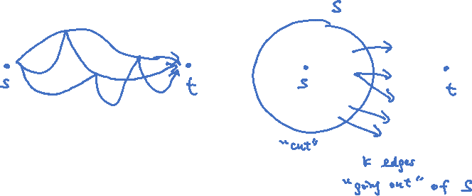
Max-Flow Min-Cut
The network flow problem can be solved using the augmenting path method for bipartite matching.
One useful application is to find the maximum number of edge-disjoint paths between two vertices $s$ and $t$.
The famous “max-flow min-cut” theorem is a very important result with many applications.

Slide 19
General Matching
The maximum matching problem can be solved in polynomial time.
Even the maximum weighted version, where every edge has a weight, can be solved in polynomial time.
This was a ground-breaking result by Edmonds in the 70s, still considered difficult 50 years later.
The maximum weighted matching problem can be used to solve the Chinese postman problem in L01.

Slide 20
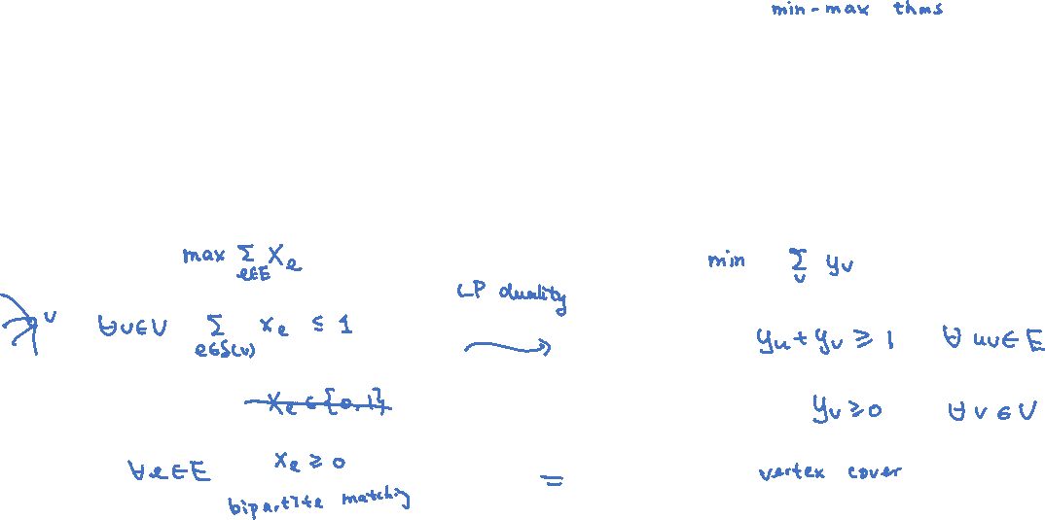
Duality
Why bipartite vertex cover is the dual problem of bipartite matching?
How do we come up with it?
There is a systematic way to define the dual problem of an optimization problem,
through the use of linear programming.
Many beautiful min-max theorems can be derived systematically through linear programming duality!

Slide 21
Linear Programming
Most combinatorial optimization problems can be solved in the general framework of linear programming.
This is one of the most, if not the most, powerful algorithmic framework for polynomial time computation.
The augmenting path method can be understood as the simplex method of solving linear programs.

