Slide 1
CS 341 – Algorithms
Lecture 15 – Bipartite Matching
14 July 2021

Slide 2
Today’s Plan
Problem
Augmenting Path Algorithm
Finding an Augmenting Path

Slide 3
Introduction
The bipartite matching problem is an important problem both in practice and in theory.
We will learn a new algorithmic technique called the “augmenting path method” to solve the problem.
This is an important technique that underlies many algorithms for combinatorial optimization problems,
including the network flow problem that you can learn in CO351.
This technique can be understood more broadly as a “local search method”,
in which we keep moving to a better solution using some simple operations.
All of these can be understood using the general framework of linear programming.

Slide 4
Bipartite Matching
Input: A bipartite graph $G=(X,Y;E)$.
Output: A maximum cardinality subset of edges that are vertex disjoint.

Slide 5
Terminology
A subset of edges $M⊆E$ is called a matching if edges in $M$ are pairwise vertex disjoint.
Given a matching $M$, we say a vertex $v$ is matched if $v$ is the endpoint of some edge $e∈M$;
otherwise we say $v$ is unmatched or free.
We say a matching $M$ is a perfect matching if every vertex is matched in $M$.
Clearly, a perfect matching is the best one can hope for in the bipartite matching problem.
In the next lecture, we will see a nice characterization of when a graph does not have a perfect matching.

Slide 6
Job Assignment
A standard application of bipartite matching is the job assignment problem.
Input: We are given $n$ jobs and $m$ people. Each person is only capable of doing a subset of jobs.
Output: Our task is to assign all the jobs to people, without assigning more than one job to a person.

Slide 7
Today’s Plan
Problem
Augmenting Path Algorithm
Finding an Augmenting Path

Slide 8
Greedy Algorithm
A first natural approach is to go greedy: Always add a “free” edge to the current partial solution.

Slide 9
Augmenting Path
A path $v_{1},v_{2},…,v_{2k}$ is an augmenting path with respect to a matching $M$ if
$v_{1}$ and $v_{2k}$ are free vertices,
$v_{2i−1}v_{2i}∈M$ for $1≤i≤k$,
$v_{2i}v_{2i+1}∉M$ for $1≤i≤k−1.$

Slide 10
Main Observation
Proposition. $M$ is a maximum matching if and only if there is no augmenting path with respect to $M$.
Equivalently, $M$ is not a maximum matching if and only if there is an augmenting path with respect to $M$.

Slide 11
Main Observation
Proposition. $M$ is a maximum matching if and only if there is no augmenting path with respect to $M$.
Equivalently, $M$ is not a maximum matching if and only if there is an augmenting path with respect to $M$.

Slide 12
Algorithm
The proposition suggests a “local search” algorithm for finding a maximum matching.

Slide 13
Time Complexity
Let $T(m,n)$ be the time complexity to find an augmenting path of $M$ if it exists,
or report that no such paths exist, in a graph with $n$ vertices and $m$ edges.
Faster Algorithm: There is an algorithm by Edmonds and Karp which solves the problem in $O\left(m\sqrt{n}\right)$ time.

Slide 14
Today’s Plan
Problem
Augmenting Path Algorithm
Finding an Augmenting Path

Slide 15
Idea
The bipartite graph structure allows us to design a simple algorithm to find an augmenting path.

Slide 16
Directed Graph
The idea is to encode the color information on the edges by directions.

Slide 17
Reachability
The claim allows us to reduce the problem of finding an augmenting path to a reachability problem.

Slide 18
Algorithm

Slide 19
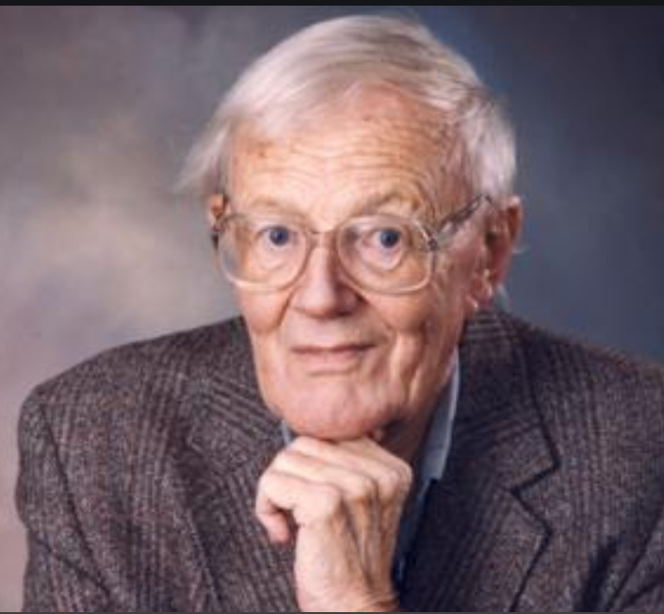
Concluding Remarks
Time Complexity: $O(m+n)$.
Challenge: Can you solve the maximum matching problem in general (non-bipartite) graphs?
Which step of the bipartite matching algorithm breaks?
History: Edmonds designed a famous “blossom” algorithm to solve the maximum matching problem.
Tutte also done important work in the maximum matching problem.

