Slide 1
CS 341 – Algorithms
Lecture 14 – Dynamic Programming on Graphs
7,9 July 2021

Slide 2
Today’s Plan
Shortest Paths with Negative Edges
Dynamic Programming and Bellman-Ford Algorithm
Negative Cycles
All-Pairs Shortest Paths and Floyd-Warshall Algorithm
Traveling Salesman Problem

Slide 3
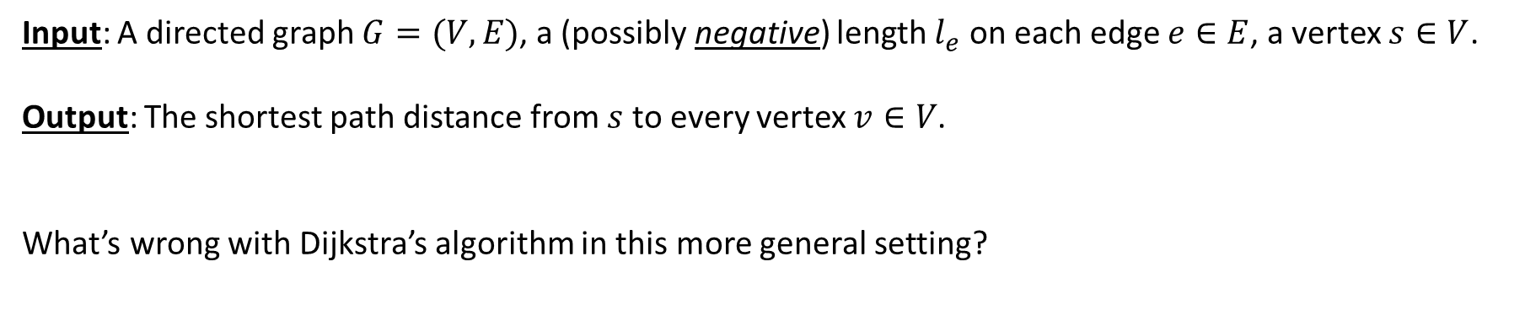
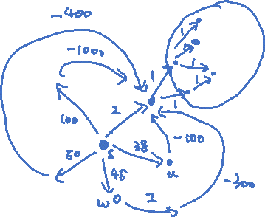
Shortest Paths with Negative Edges
Input: A directed graph $G=(V,E)$, a (possibly negative) length $l_{e}$ on each edge $e∈E$, a vertex $s∈V$.
Output: The shortest path distance from $s$ to every vertex $v∈V$.
What’s wrong with Dijkstra’s algorithm in this more general setting?

Slide 4
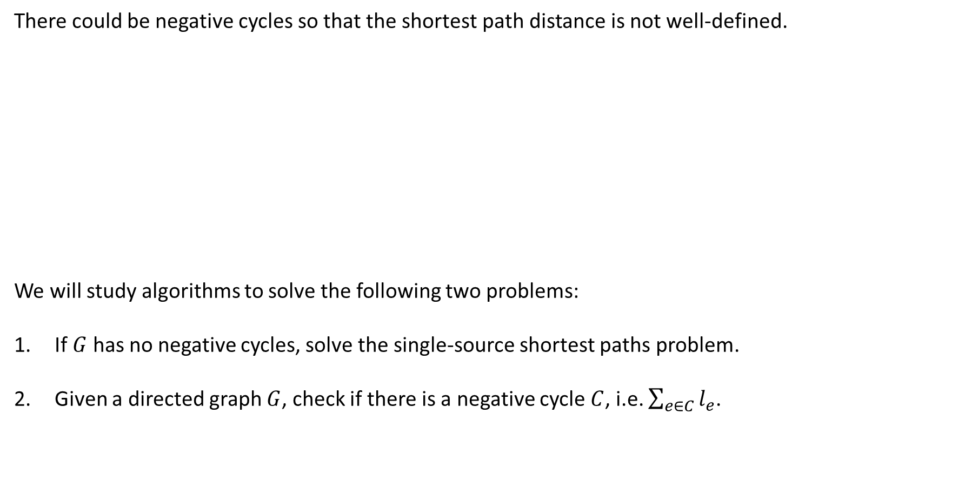

Negative Cycles
There could be negative cycles so that the shortest path distance is not well-defined.
We will study algorithms to solve the following two problems:
If $G$ has no negative cycles, solve the single-source shortest paths problem.
Given a directed graph $G$, check if there is a negative cycle $C$, i.e. $\sum_{e∈C}{l_{e}}$.

Slide 5
Today’s Plan
Shortest Paths with Negative Edges
Dynamic Programming and Bellman-Ford Algorithm
Negative Cycles
All-Pairs Shortest Paths and Floyd-Warshall Algorithm
Traveling Salesman Problem

Slide 6
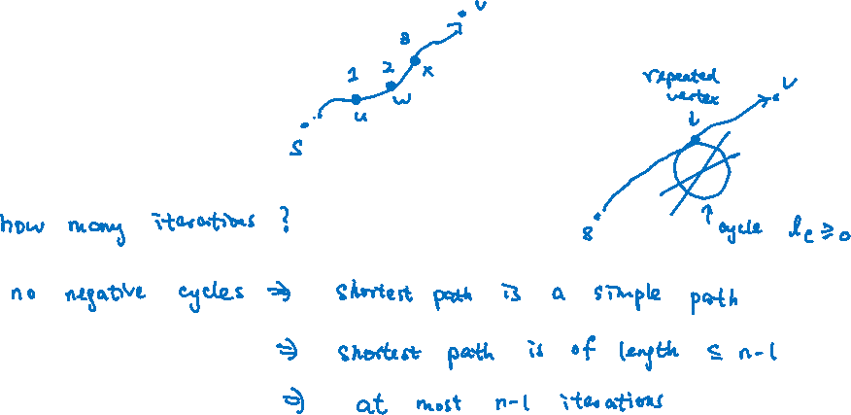
Intuition
Although Dijkstra’s algorithm may not compute all distances in one pass,
it will compute the distance to some vertices correctly, e.g. first vertex on a shortest path.

Slide 7
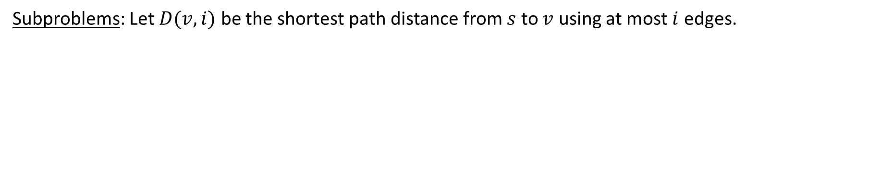
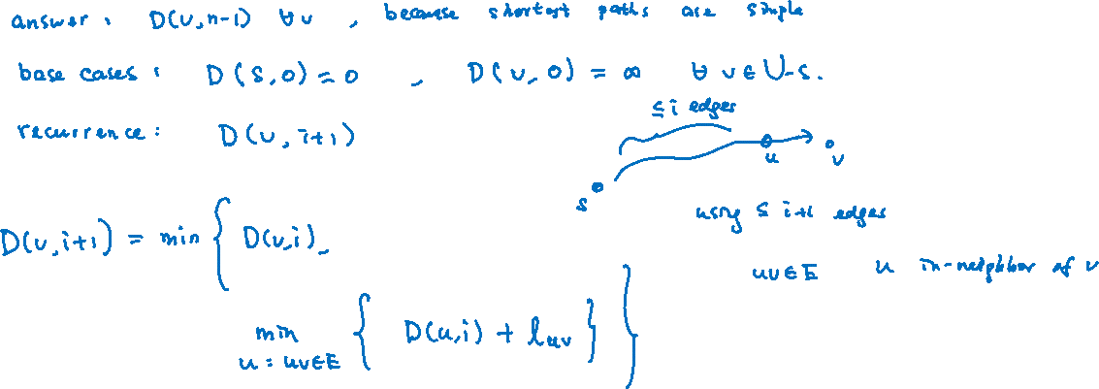
Dynamic Programming
Subproblems: Let $D(v,i)$ be the shortest path distance from $s$ to $v$ using at most $i$ edges.

Slide 8
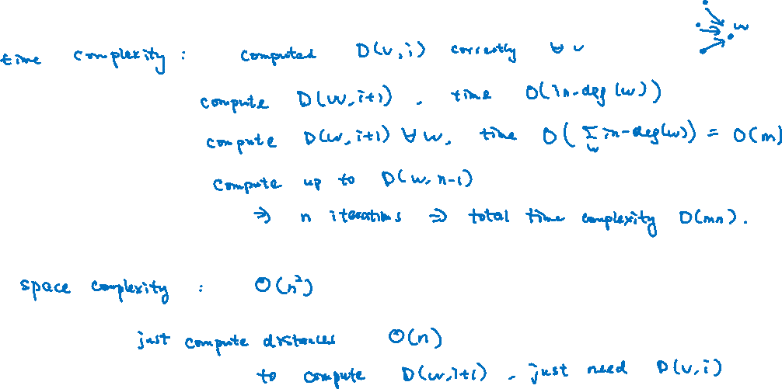
Analysis

Slide 9
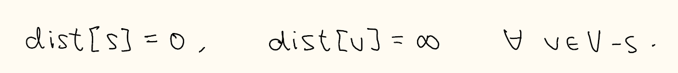



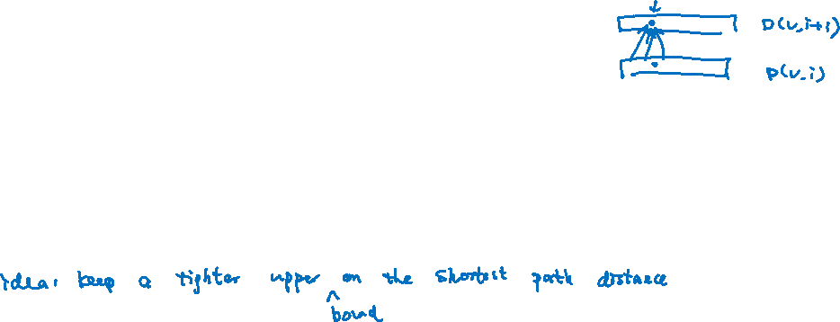
Bellman-Ford Algorithm
The algorithm can made simpler, by using just one array instead of two.

Slide 10
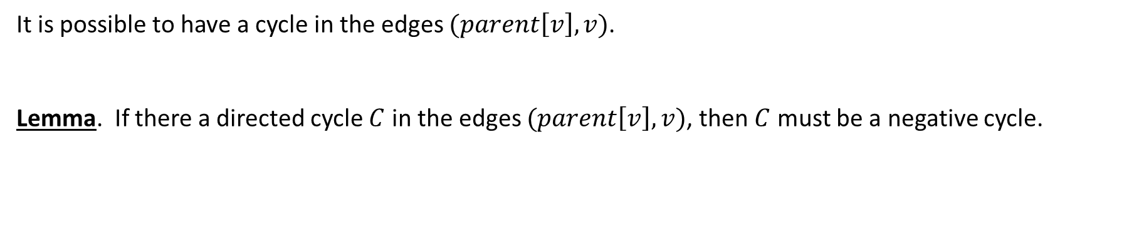
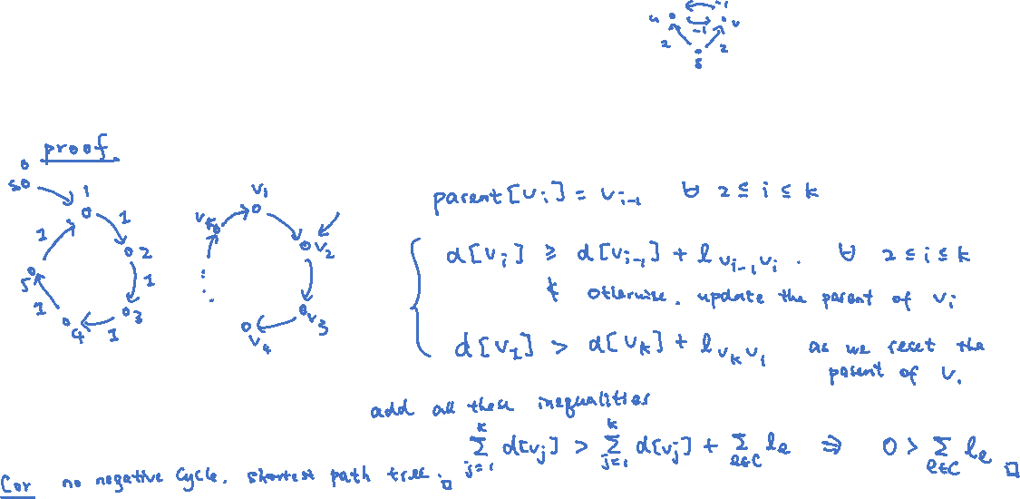
Shortest Path Tree
It is possible to have a cycle in the edges $(parent\left[v\right],v)$.
Lemma. If there a directed cycle $C$ in the edges $(parent\left[v\right],v)$, then $C$ must be a negative cycle.

Slide 11
Today’s Plan
Shortest Paths with Negative Edges
Dynamic Programming and Bellman-Ford Algorithm
Negative Cycles
All-Pairs Shortest Paths and Floyd-Warshall Algorithm
Traveling Salesman Problem

Slide 12

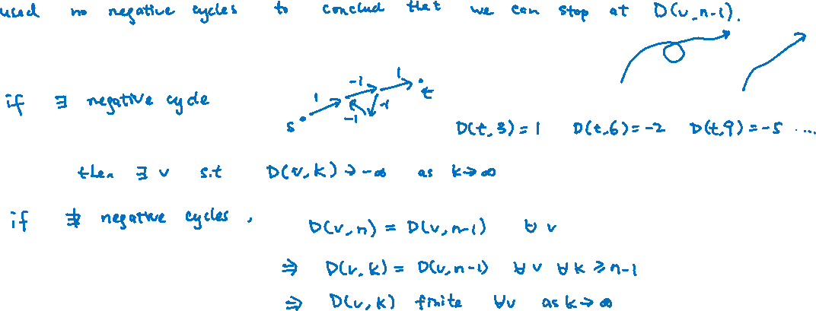
Ideas
Note that $D(v,i)$ is computed correctly even though the graph has negative cycles for any $v$ and any $i≥0$.
Assumption: Every vertex can be reached from vertex $s$.
This is without loss of generality for finding negative cycles, as the problem can be restricted to a SCC.

Slide 13
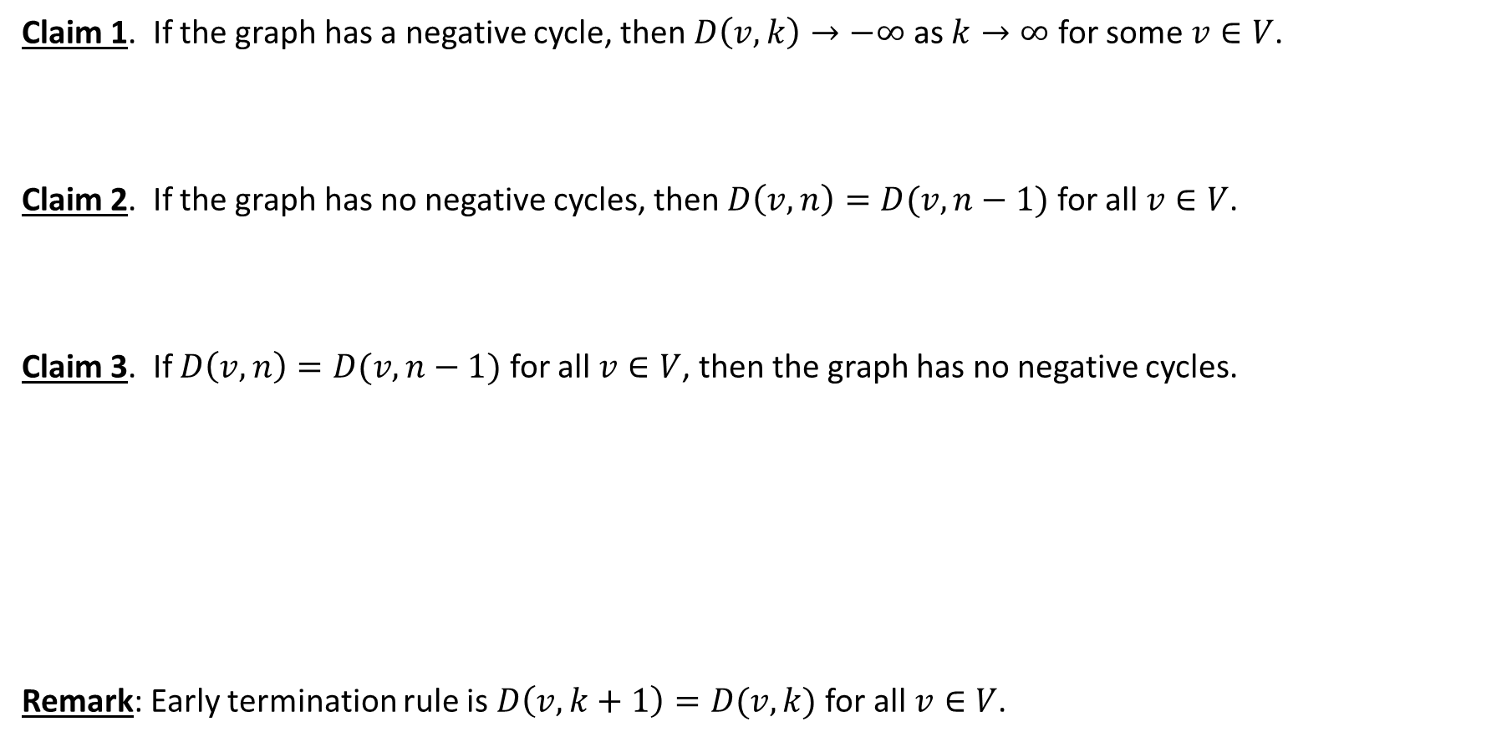
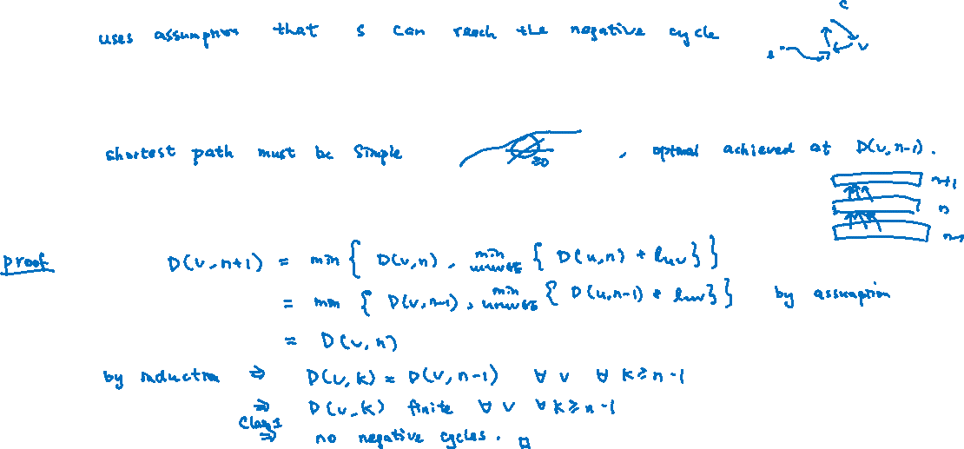
Observations
Claim 1. If the graph has a negative cycle, then $D\left(v,k\right)→−∞$ as $k→∞$ for some $v∈V$.
Claim 2. If the graph has no negative cycles, then $D\left(v,n\right)=D(v,n−1)$ for all $v∈V$.
Claim 3. If $D\left(v,n\right)=D(v,n−1)$ for all $v∈V$, then the graph has no negative cycles.
Remark: Early termination rule is $D\left(v,k+1\right)=D(v,k)$ for all $v∈V$.

Slide 14
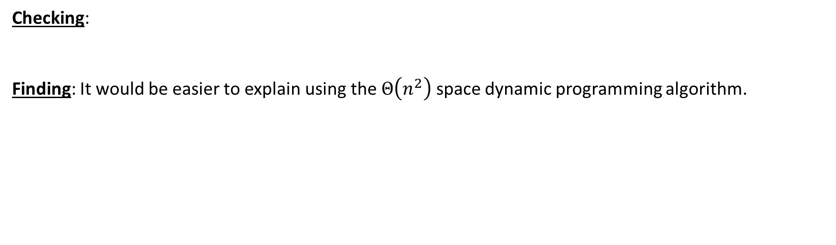
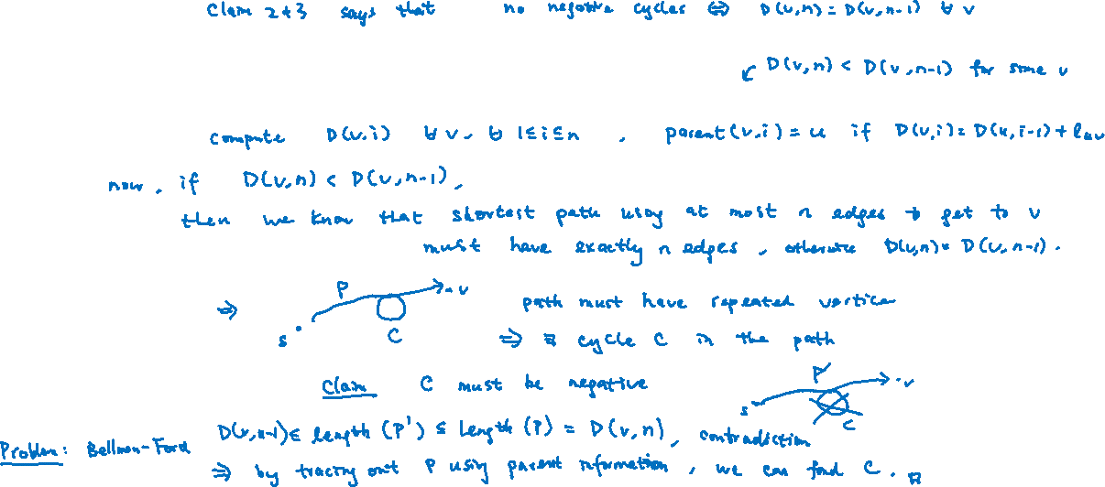
Algorithms
Checking:
Finding: It would be easier to explain using the $Θ\left(n^{2}\right)$ space dynamic programming algorithm.

Slide 15
Today’s Plan
Shortest Paths with Negative Edges
Dynamic Programming and Bellman-Ford Algorithm
Negative Cycles
All-Pairs Shortest Paths and Floyd-Warshall Algorithm
Traveling Salesman Problem

Slide 16
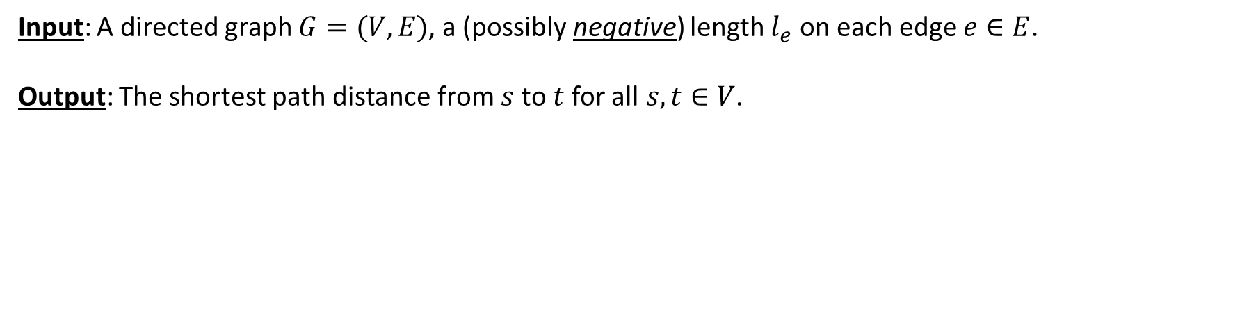
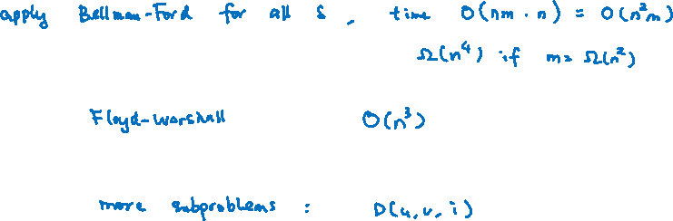
All-Pairs Shortest Paths
Input: A directed graph $G=(V,E)$, a (possibly negative) length $l_{e}$ on each edge $e∈E$.
Output: The shortest path distance from $s$ to $t$for all$s,t∈V$.

Slide 17
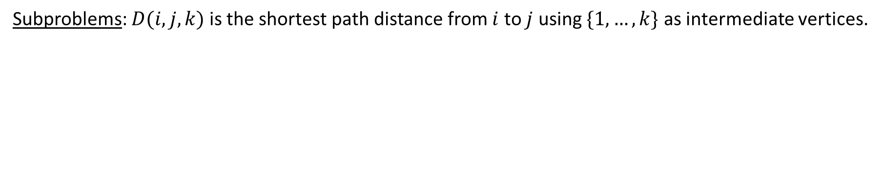
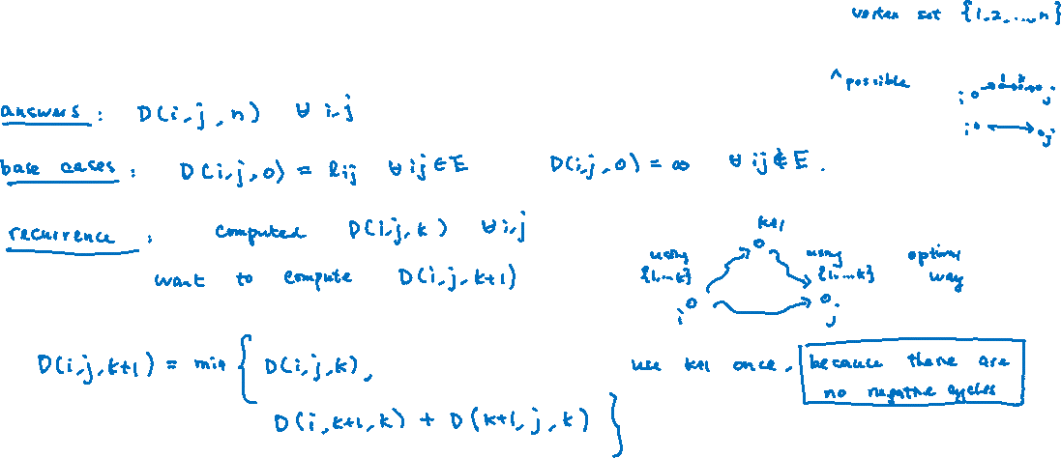
Dynamic Programming
Subproblems: $D(i,j,k)$ is the shortest path distance from $i$ to $j$ using $\{1,…,k\}$ as intermediate vertices.

Slide 18




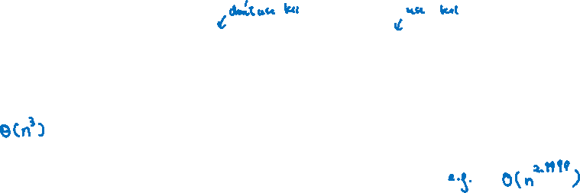
Floyd-Warshall Algorithm
Time Complexity:
Open Problem: Is there an $O(n^{3−ε})$ algorithm for all-pairs shortest paths?

Slide 19
Today’s Plan
Shortest Paths with Negative Edges
Dynamic Programming and Bellman-Ford Algorithm
Negative Cycles
All-Pairs Shortest Paths and Floyd-Warshall Algorithm
Traveling Salesman Problem

Slide 20

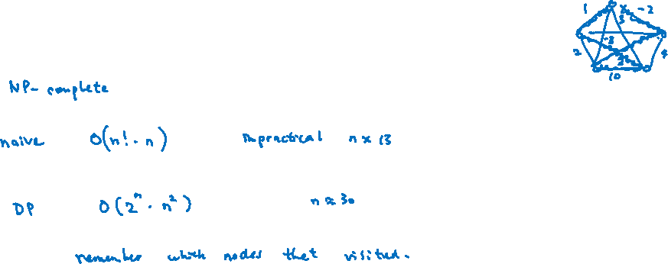
Traveling Salesman Problem
Input: A directed graph $G=(V,E)$, a (possibly negative) length $l_{ij}$ for all $i,j∈V$.
Output: A directed cycle $C$ that visits every vertex exactly once that minimizes $\sum_{e∈C}{l_{e}}$.
It is one of the most famous problems in combinatorial optimization.

Slide 21
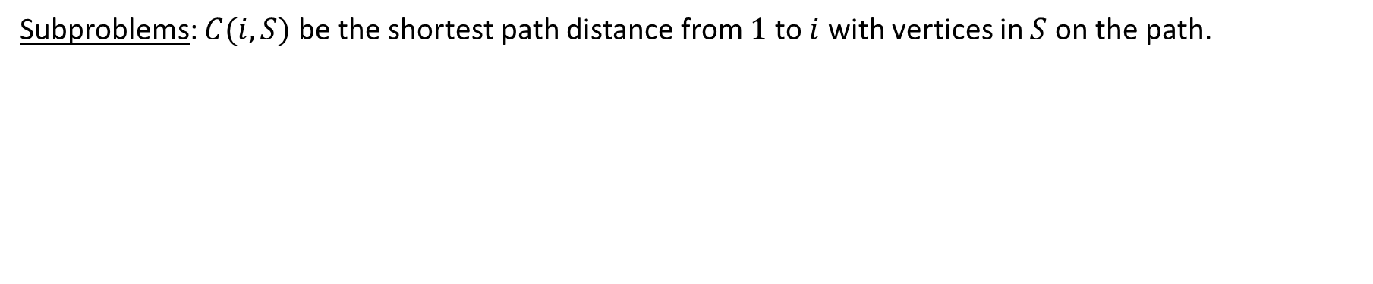
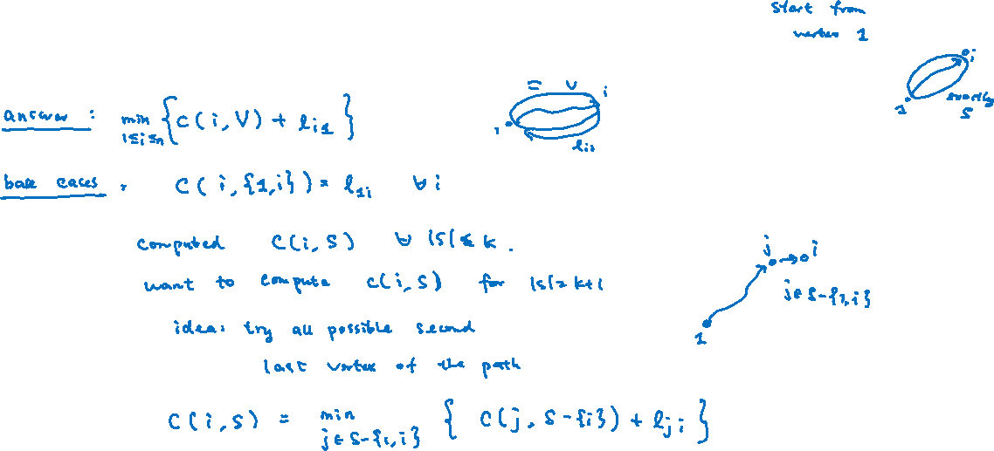
Dynamic Programming
Subproblems: $C(i,S)$ be the shortest path distance from $1$ to $i$ with vertices in $S$ on the path.

Slide 22
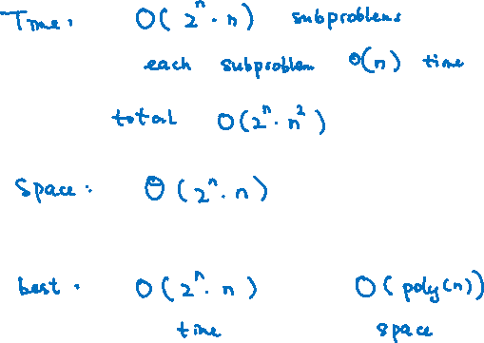
Analysis

Slide 23
Concluding Remarks
We have seen many examples and structures to design dynamic programming algorithms,
from lines to trees to graphs.
I hope that you will be familiar with this technique, and be able to solve new problems with ease!

