Slide 1
CS 341 – Algorithms
Lecture 13 – Dynamic Programming on Trees
30 June 2021

Slide 2
Today’s Plan
Maximum Independent Sets on Trees
Optimal Binary Search Tree

Slide 3
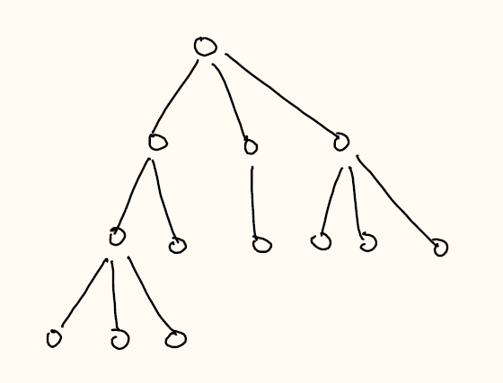
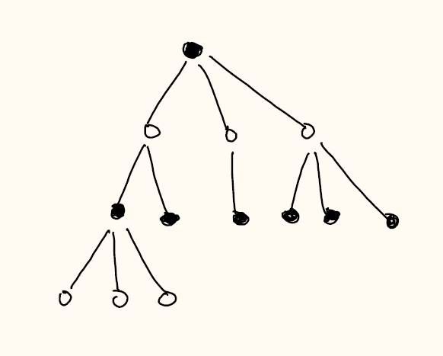
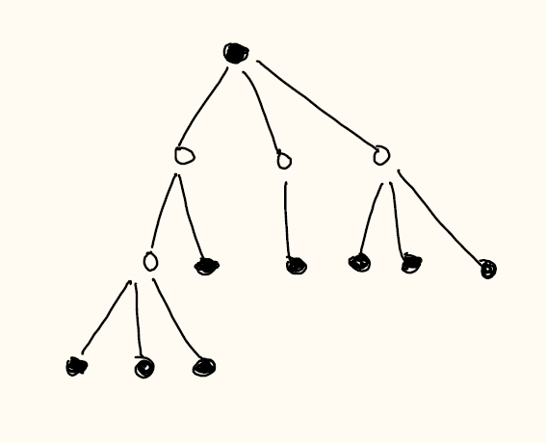

Maximum Independent Sets on Trees
Given a graph $G=(V,E)$, a subset of vertices $S⊆V$ is an independent set if $uv∉E$ for all $u,v∈S$.
Input: a tree $T=(V,E)$.
Output: an independent set of maximum cardinality.
In the last part of the course, we will see maximum independent set is NP-hard on general graphs.

Slide 4
Tree Structure
Have a tree structure gives a natural way to use dynamic programming.
We will define subproblems on each subtree.
The key point is that since there are no edges between different subtrees,
we can solve the problem separately and reduce to smaller subproblems.
Then we can write a recurrence relation between a parent and its children.
We have already used this idea before in computing all cut vertices.
The low[] array we maintained is an example of doing dynamic programming on trees.

Slide 5
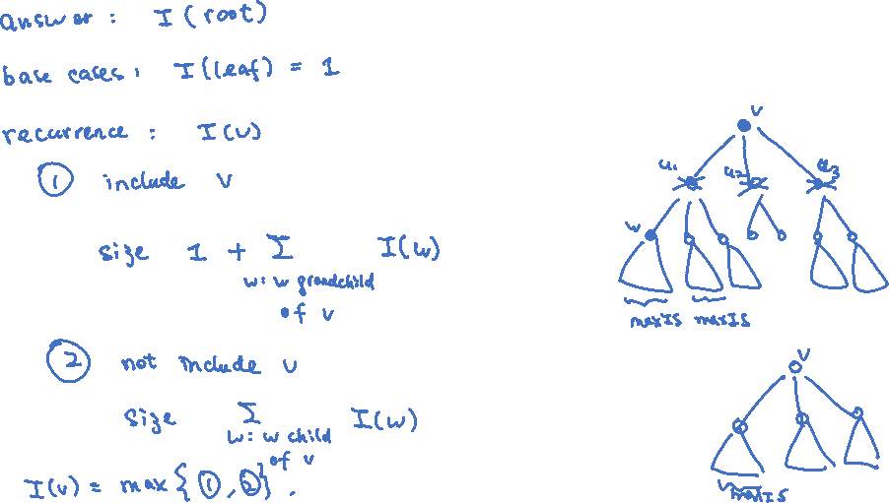
Recurrence
Subproblems: Let $I(v)$ be the size of a maximum independent set in the subtree rooted at vertex $v$.

Slide 6
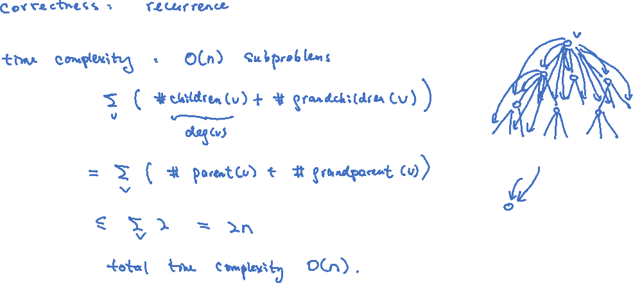
Analysis
Exercise: Extend the algorithm to solve the maximum weighted independent set problem on trees.

Slide 7
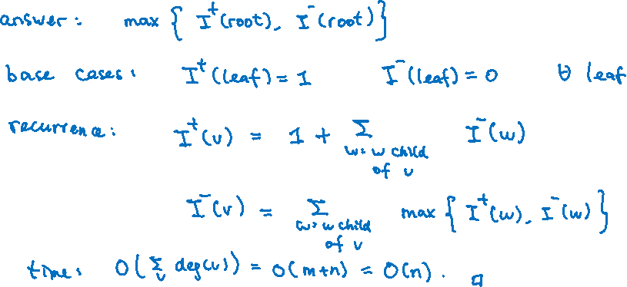
Alternative Recurrence
We can also write a recurrence involving children only (i.e. no grandchildren).
Subproblems: Let $I^{+}(v)$ be the size of a maximum independent set with $v$ included.
Let $I^{−}(v)$ be the size of a maximum independent set with $v$ excluded.

Slide 8
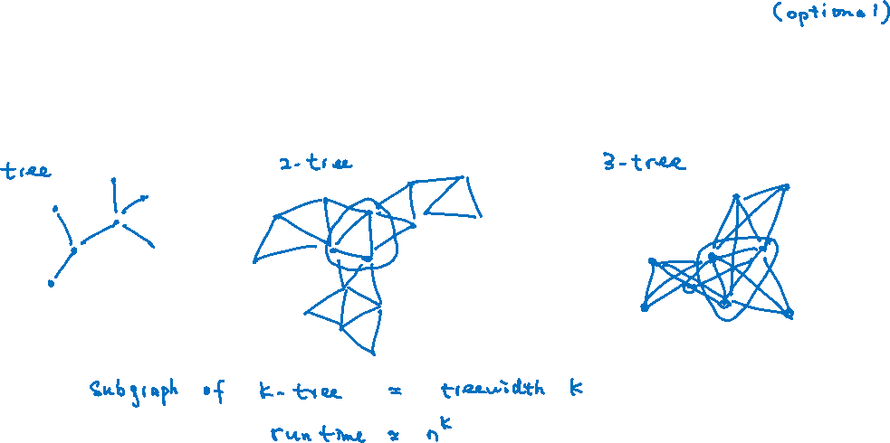
Dynamic Programming on Tree-Like Graphs
It is possible to generalize the idea to use dynamic programming on “tree-like” graphs.
There is a notion called “tree-width” which is very popular in theoretical computer science.

Slide 9
Today’s Plan
Independent Sets on Trees
Optimal Binary Search Tree

Slide 10
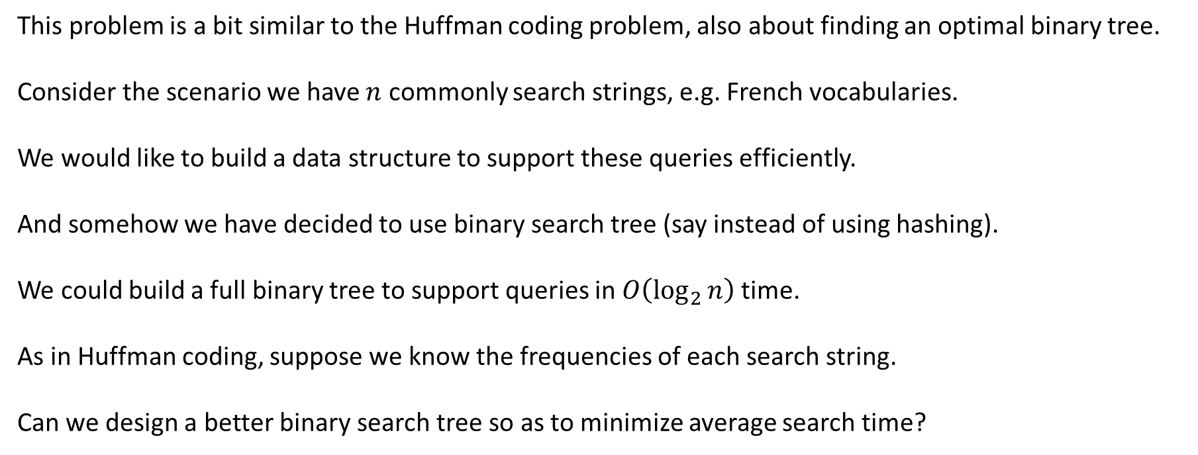
Setup
This problem is a bit similar to the Huffman coding problem, also about finding an optimal binary tree.
Consider the scenario we have $n$ commonly search strings, e.g. French vocabularies.
We would like to build a data structure to support these queries efficiently.
And somehow we have decided to use binary search tree (say instead of using hashing).
We could build a full binary tree to support queries in $O\left(\log_{2}{n}\right)$ time.
As in Huffman coding, suppose we know the frequencies of each search string.
Can we design a better binary search tree so as to minimize average search time?

Slide 11
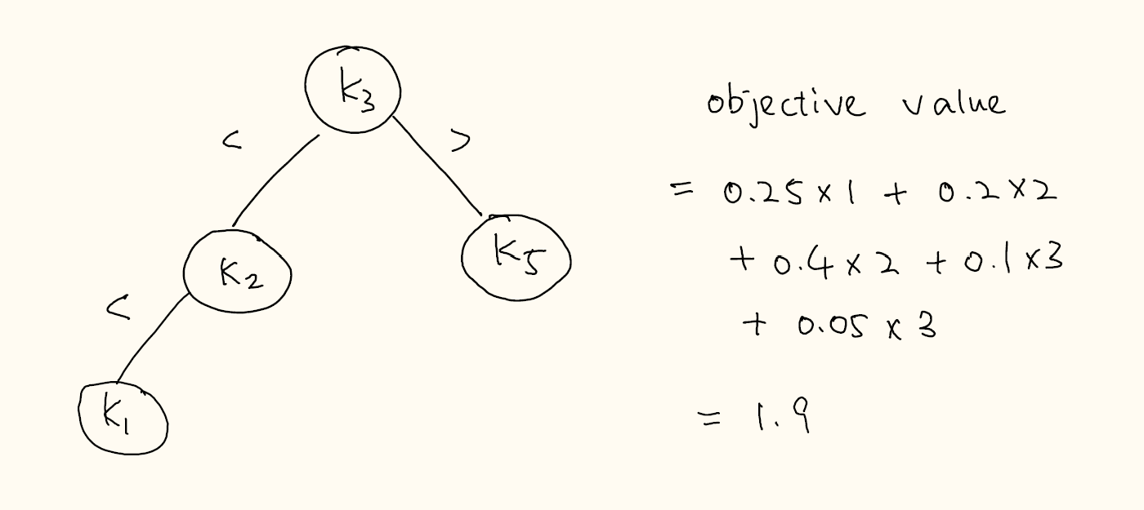
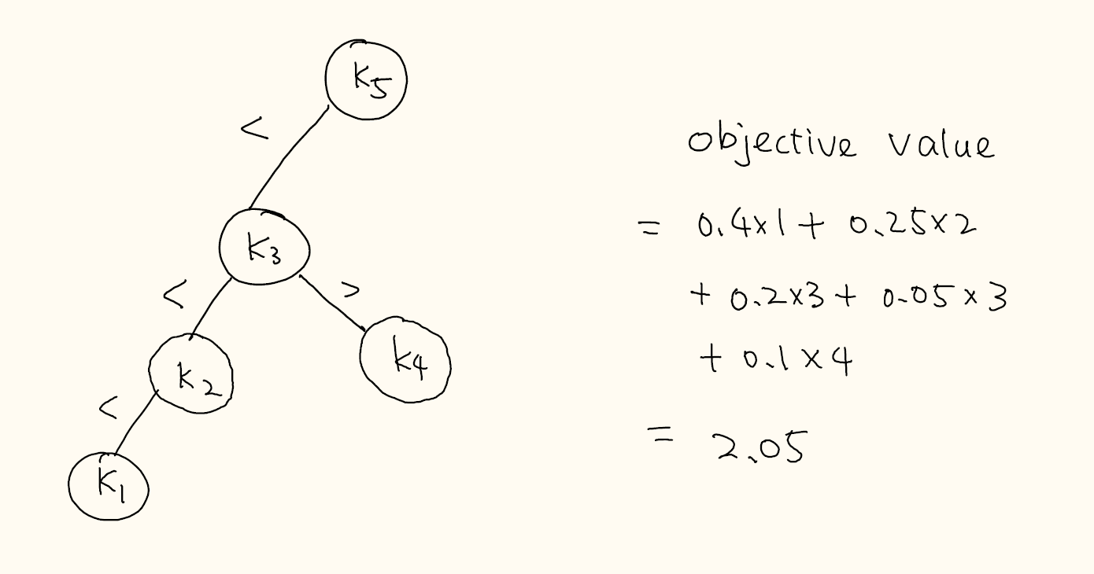
Optimal Binary Search Tree
Input: $n$ keys $k_{1}<k_{2}<…<k_{n}$, frequencies $f_{1},f_{2},…,f_{n}≥0$ with $\sum_{i=1}^{n}{f_{i}}=1$.
Output: a binary search tree $T$ that minimizes the objective value $\sum_{i=1}^{n}{f_{i}⋅depth_{T}(i)}$.
Example: $f_{1}=0.1, { f}_{2}=0.2, f_{3}=0.25, f_{4}=0.05, f_{5}=0.4$.

Slide 12
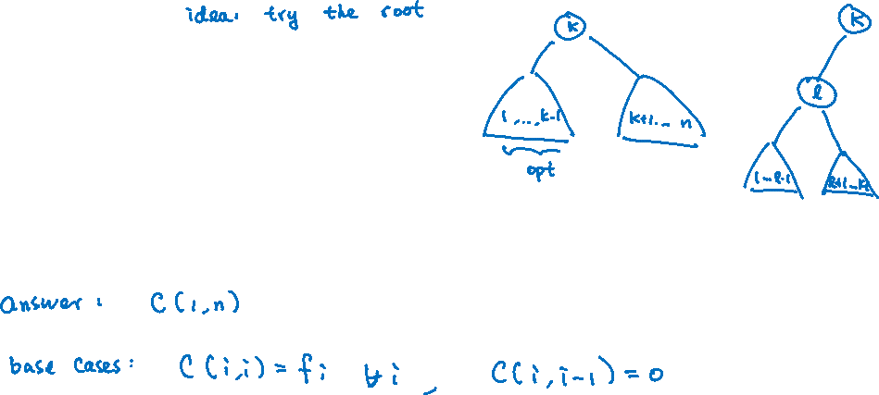
Dynamic Programming
The restriction of maintaining a binary tree structure leads to a nice recurrence relation.
Subproblems: Let $C(i,j)$ be the objective value of an optimal binary search tree with keys $k_{i}<…<k_{j}$.

Slide 13
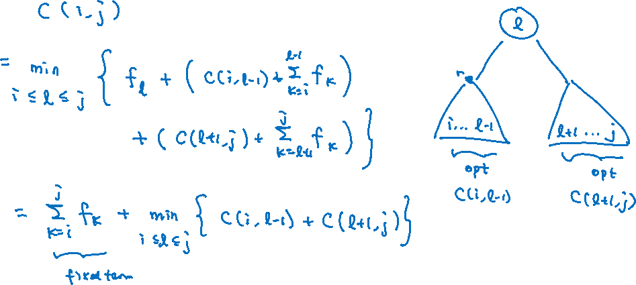
Recurrence

Slide 14

Analysis
Faster Algorithm: Knuth gave a $O(n^{2})$-time algorithm using the same subproblems,
but proved additional properties to achieve faster computation.

Slide 15
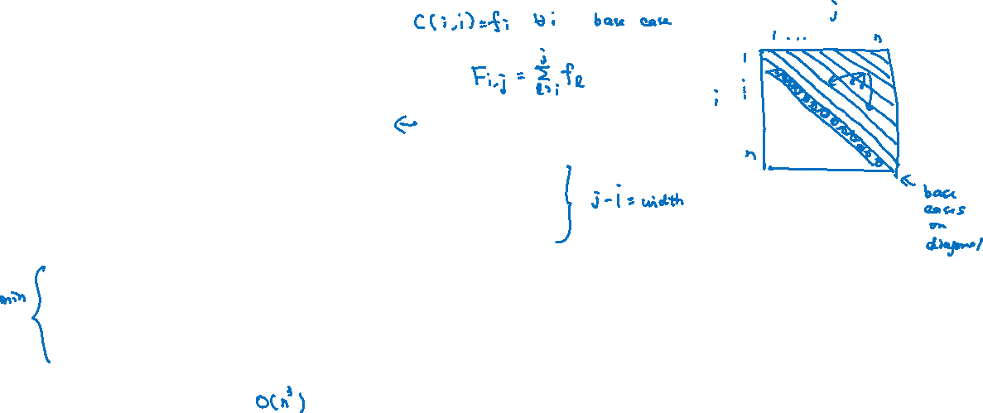
Bottom-Up Implementation
Time Complexity:
Exercise: Trace out an optimal solution.

