Slide 1
CS 341 – Algorithms
Lecture 12 – Dynamic Programming II
25 June 2021

Slide 2
Today’s Plan
Longest Increasing Subsequence (LIS)
Faster Algorithm for LIS
Longest Common Subsequence (LCS)
Edit Distance

Slide 3
Longest Increasing Subsequence
Given $n$ numbers $a_{1},…,a_{n}$, a subsequence is a subset $a_{i_{1}},a_{i_{2}},…,a_{i_{k}}$ with $i_{1}<i_{2}<…<i_{k}$.
A subsequence is increasing if $a_{i_{1}}<a_{i_{2}}<…<a_{i_{k}}$.
Input: $n$ numbers $a_{1},…,a_{n}$.
Output: an increasing subsequence of maximum length.

Slide 4
Recurrence
Subproblems: Let $L\left(i\right)$ be the length of a longest increasing subsequence starting at $a_{i}$
and using the numbers in $\{a_{i},a_{i+1},…,a_{n}\}$ only.

Slide 5
Bottom-Up Implementation
Time complexity:
Example: 3, 8, 7, 2, 6, 4, 12, 14, 9

Slide 6
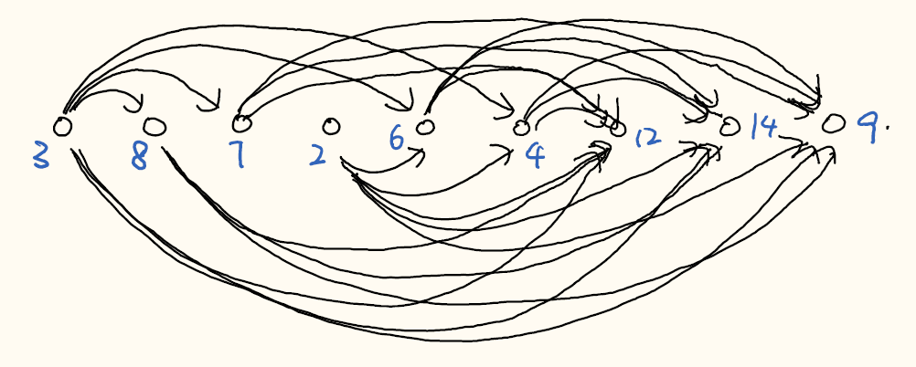
Longest Path in Directed Acyclic Graphs
Printing a solution:
The longest increasing subsequence can be reduced to finding a longest path in a directed acyclic graph.
Exercise: Design a dynamic programming algorithm to find a longest path in a directed acyclic graph.

Slide 7
Today’s Plan
Longest Increasing Subsequence (LIS)
Faster Algorithm for LIS
Longest Common Subsequence (LCS)
Edit Distance

Slide 8
Faster Algorithm: Overview
Now we present a clever implementation that solves LIS in $O(n\log{n})$ time.
The bottleneck is to find an increasing subsequence to extend $a_{i}$, which takes $O\left(n\right)$ times.
The observation is that we don’t need to store all the subproblems for future computation,
because some subproblems are “dominated” by other subproblems.
For each length $k$, we will only store the “best” position to start an increasing subsequence of length $k$.
Then, these “best subproblems” satisfy a monotone property, which allows us to use binary search.
For example, given …………, 3, 8, 7, 2, 6, 4, 12, 14, 9

Slide 9
Best Subproblems
Suppose we have already computed $L\left(i+1\right),…,L(n)$, and we would like to compute $L(i)$.
Suppose $L\left(i_{1}\right)=…=L\left(i_{l}\right)=k$, what is the best subproblem to keep for computation of $L\left(1\right),…,L\left(i\right)?$
Define $pos\left[k\right]=\arg{\max_{j>i }\left\{a_{j} | L\left(j\right)=k\right\}}$ to be the best position to extend a subsequence of length $k$.
Let $m=\max_{i+1≤j≤n}\left\{L(j)\right\}$ be the length of a longest subsequence we have computed so far.
Then we will only store the subproblems $L\left(pos\left[1\right]\right),L\left(pos\left[2\right]\right),…,L(pos\left[m\right])$ for future computations.
For example, ……, 2, 7, 6, 1, 4, 8, 5, 3

Slide 10
Monotonicity
Once we only keep the best subproblems, then we have the following useful property.
Claim. $a\left(pos\left[1\right]\right)>a\left(pos\left[2\right]\right)>…>a(pos\left[m\right])$.
Intuition: A longer increasing subsequence is harder to be extended than a shorter increasing subsequence.

Slide 11
Updating the Best Subproblems by Binary Search
Claim. $a\left(pos\left[m\right]\right)<a\left(pos\left[m−1\right]\right)<…<a\left(pos\left[2\right]\right)<a(pos\left[1\right])$.

Slide 12
Fast Algorithm

Slide 13
Example
10, 18, 25, 6, 70, 32, 2, 40, 11, 38, 21, 33, 86, 17, 51, 24, 57
7 | 6 | 5 | 6 | 2 | 4 | 6 | 3 | 5 | 3 | 4 | 3 | 1 | 3 | 2 | 2 | 1
18 | 18 | 6 | 6 | 2 | 2 | 2
25 | 25 | 25 | 11 | 11 | 11 | 11 | 11 | 11
32 | 32 | 32 | 32 | 32 | 32 | 21 | 21 | 21 | 21 | 21
40 | 40 | 40 | 40 | 40 | 40 | 40 | 40 | 38 | 38 | 33 | 33 | 17 | 17
70 | 70 | 70 | 70 | 70 | 51 | 51 | 51 | 51 | 51 | 51 | 51 | 51 | 51 | 51 | 24
86 | 86 | 86 | 86 | 86 | 86 | 86 | 86 | 86 | 86 | 86 | 86 | 86 | 57 | 57 | 57 | 57

Slide 14
Example
10, 18, 25, 6, 70, 32, 2, 40, 11, 38, 21, 33, 86, 17, 51, 24, 57
7 | 6 | 5 | 6 | 2 | 4 | 6 | 3 | 5 | 3 | 4 | 3 | 1 | 3 | 2 | 2 | 1
18 | 18 | 6 | 6 | 2 | 2 | 2
25 | 25 | 25 | 11 | 11 | 11 | 11 | 11 | 11
32 | 32 | 32 | 32 | 32 | 32 | 21 | 21 | 21 | 21 | 21
40 | 40 | 40 | 40 | 40 | 40 | 40 | 40 | 38 | 38 | 33 | 33 | 17 | 17
70 | 70 | 70 | 70 | 70 | 51 | 51 | 51 | 51 | 51 | 51 | 51 | 51 | 51 | 51 | 24
86 | 86 | 86 | 86 | 86 | 86 | 86 | 86 | 86 | 86 | 86 | 86 | 86 | 57 | 57 | 57 | 57

Slide 15
Today’s Plan
Longest Increasing Subsequence (LIS)
Faster Algorithm for LIS
Longest Common Subsequence (LCS)
Edit Distance

Slide 16
Longest Common Subsequence
Input: Two string $a_{1}a_{2}…a_{n}$ and $b_{1}b_{2}…b_{m}$, where each $a_{i},b_{j}$ is a symbol.
Output: The largest $k$ such that there exist $i_{1}<…<i_{k}$ and $j_{1}<…<j_{k}$ so that $a_{i_{l}}=b_{j_{l}}$ for $1≤l≤k$.
One example is that we are given two DNA sequences and want to identify common structure.
Note that longest increasing subsequence (LIS) is a special case of longest common subsequence (LCS).

Slide 17
Recurrence
Subproblems: Let $C(i,j)$ be the length of a longest common subsequence of $a_{i}…a_{n}$ and $b_{j}…b_{m}$.

Slide 18
Analysis

Slide 19
Bottom-Up Implementation

Slide 20
Today’s Plan
Longest Increasing Subsequence (LIS)
Faster Algorithm for LIS
Longest Common Subsequence (LCS)
Edit Distance

Slide 21
Edit Distance
Input: Two string $a_{1}a_{2}…a_{n}$ and $b_{1}b_{2}…b_{m}$, where each $a_{i},b_{j}$ is a symbol.
Output: The minimum $k$ s.t. we can do $k$ add/delete/change operations to transform $a_{1}…a_{n}$ to $b_{1}…b_{m}$.

Slide 22
Recurrence
Subproblems: Let $D(i,j)$ be the edit distance of $a_{i}…a_{n}$ and $b_{j}…b_{m}$.

Slide 23
Analysis
Important Exercise: Bottom-up implementation.
Recent Result: Edit Distance Cannot Be Computed in Strongly Subquadratic Time (unless SETH is false)

Slide 24
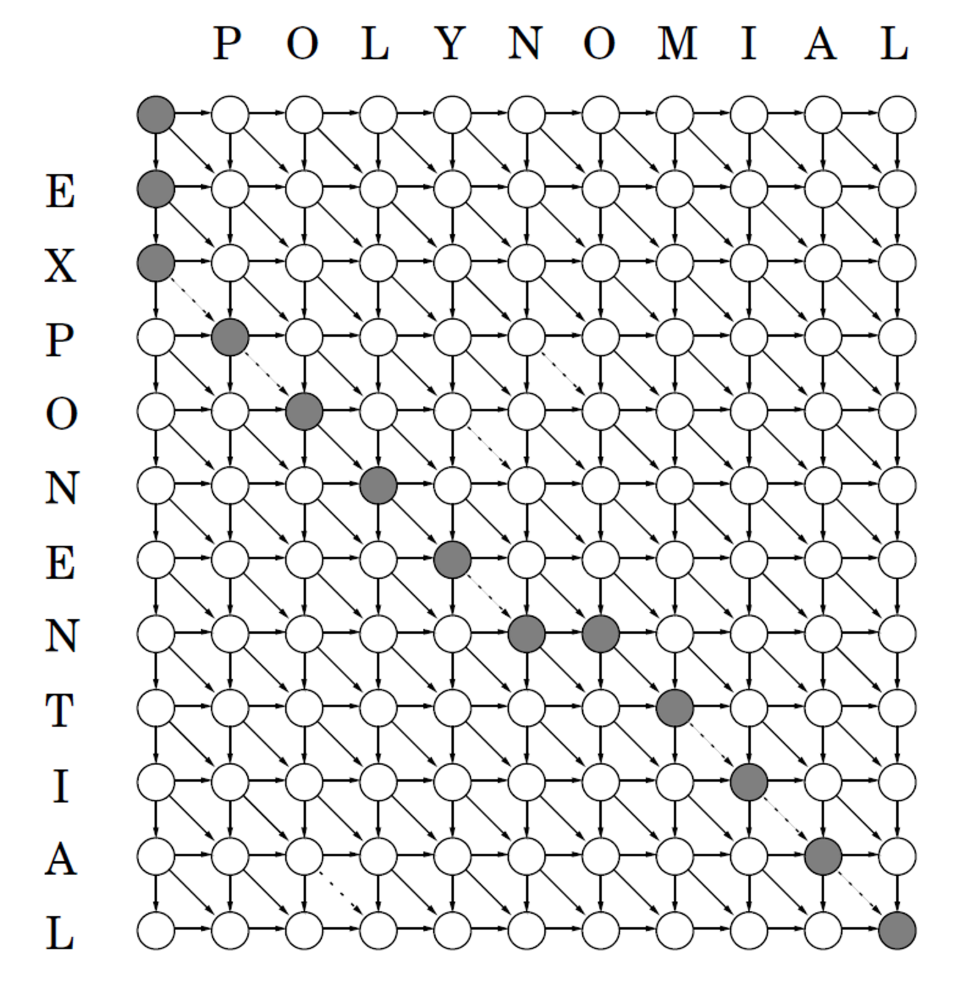
Graph Searching

