Slide 1
CS 341 – Algorithms
Lecture 11 – Dynamic Programming I
23 June 2021

Slide 2
Today’s Plan
Framework
Weighted interval scheduling
Subset-sum and knapsack

Slide 3
Introduction
On a high level, we can solve a problem by dynamic programming if there is a recurrence relation
with only a polynomial number of subproblems.
This is a general and powerful technique, and is also easy to use as it is more systematic.
It extends the ideas in the previous topics including divide and conquer, graph searches, and greedy.
Once you learnt it, you will feel much more confident as a problem solver, as then you can solve
interesting and nontrivial problems that were out of reach in a rather routine way.
So this is a topic that I hope you can learn well, and we will do many examples to achieve this goal.

Slide 4
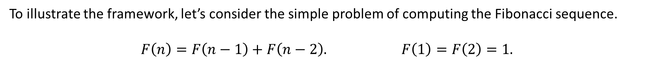
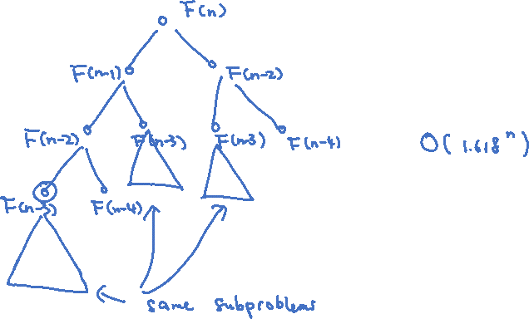
Toy Example
To illustrate the framework, let’s consider the simple problem of computing the Fibonacci sequence.
$$F\left(n\right)=F\left(n−1\right)+F\left(n−2\right). F\left(1\right)=F\left(2\right)=1.$$

Slide 5
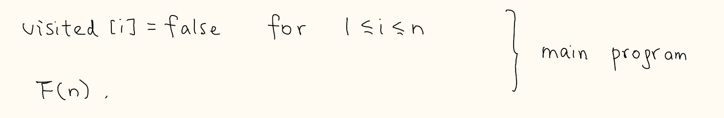
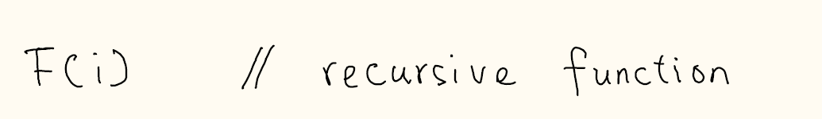
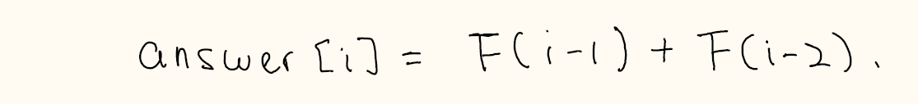
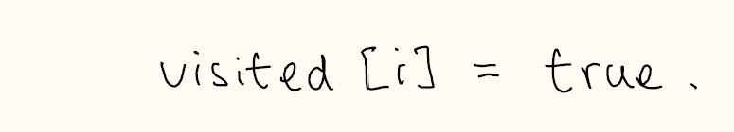
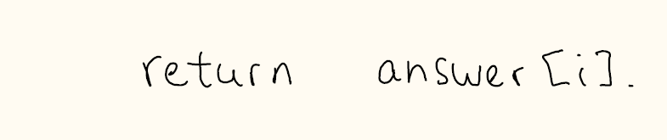
Top-Down Memorization
As in BFS/DFS, we can use an array visited[i] to ensure that each subproblem is computed at most once,
and also we use an array answer[i] to store the value $F(i)$ for future lookup.

Slide 6
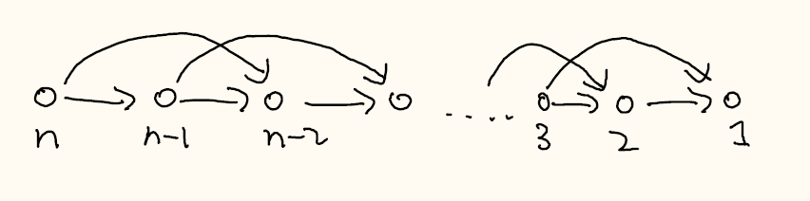
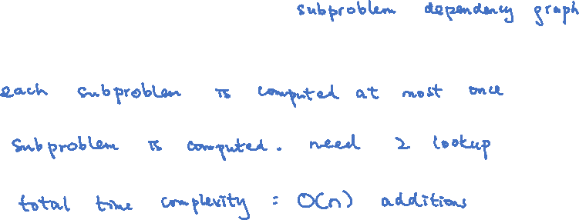
Time Complexity of Top-Down Memorization
The analysis is similar to what we did in BFS/DFS.

Slide 7
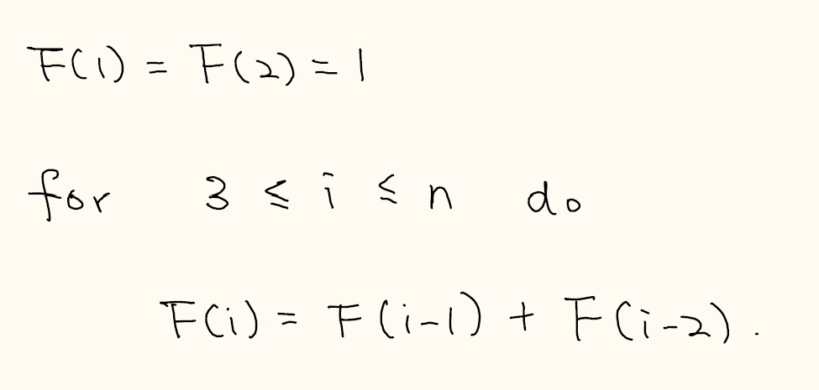

Bottom-Up Computation

Slide 8

Dynamic Programming
So, this is basically the framework of dynamic programming, to store the intermediate values
so that we don’t need to compute the subproblems again.
From the top-down approach, as long as there is a recurrence with only a polynomial number of
subproblems (and polytime processing), then the problem can be solved in polynomial time.
So, the key to designing a dynamic programming algorithm is to come up with a nice recurrence.
We will see that many interesting and seemingly difficult problems have such a nice recurrence.
We will study many examples so that you will acquire the skills to come up with these recurrences.

Slide 9

Top-Down vs Bottom-Up
In practice, the bottom-up implementation is preferred as it requires no recursion and so more efficient.
In principle, to come up with a bottom-up implementation, we just need to use a topological ordering
of the “subproblem dependency graph” to have a correct order to solve the subproblems.
Usually, it is rather straightforward. Sometimes, it requires us to think clearly.
Our main focus will be to come up with the recurrence, as this already implies a polytime algorithm.
We will also mention the bottom-up implementations as much as possible.

Slide 10
Today’s Plan
Framework
Weighted interval scheduling
Subset-sum and knapsack

Slide 11

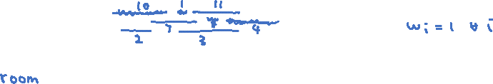
Weighted Interval Scheduling
Input: $n$ intervals $\left[{s_{1},f}_{1}\right],\left[{s_{2},f}_{2}\right],…,\left[{s_{n},f}_{n}\right]$, and a weight $w_{i}$ for each interval $i$.
Output: a subset of disjoint intervals that maximizes the total weight.
This is a generalization of the interval scheduling problem in L08.pdf.
Unlike the special case, there are no known greedy algorithms for this problem.

Slide 12
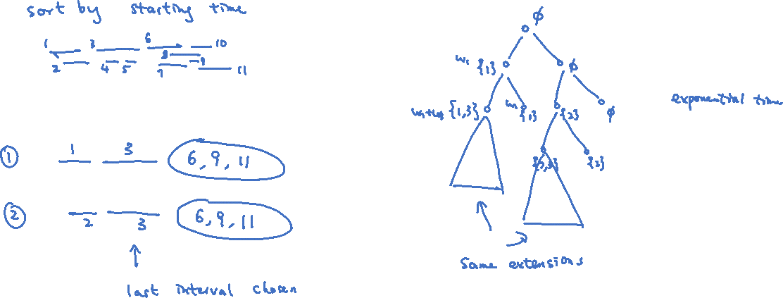
Exhaustive Search
To come up with a good recurrence, first we see how exhaustive search is wasteful and how to improve it.

Slide 13
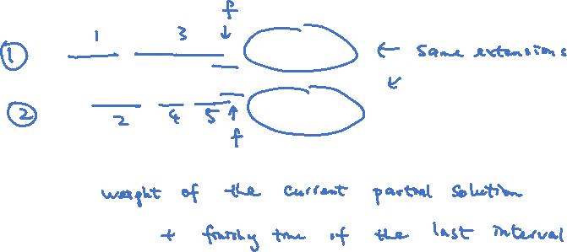
Extending Partial Solutions
We do not need to remember the partial solution that we have chosen so far.
What really matters is the last interval of the current partial solution.
This suggests that there should be a recurrence with only one parameter!

Slide 14
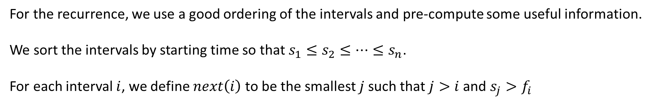
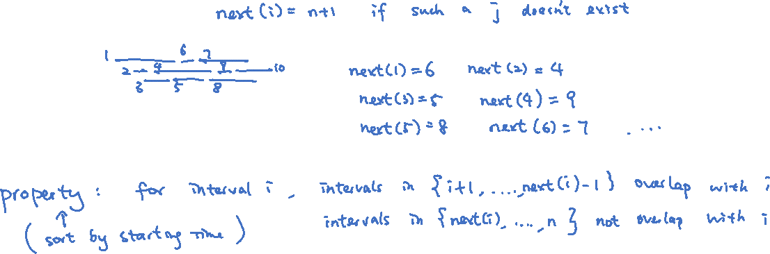
Good Ordering
For the recurrence, we use a good ordering of the intervals and pre-compute some useful information.
We sort the intervals by starting time so that $s_{1}≤s_{2}≤…≤s_{n}$.
For each interval $i$, we define $next\left(i\right)$ to be the smallest $j$such that $j>i$and $s_{j}>f_{i}$

Slide 15
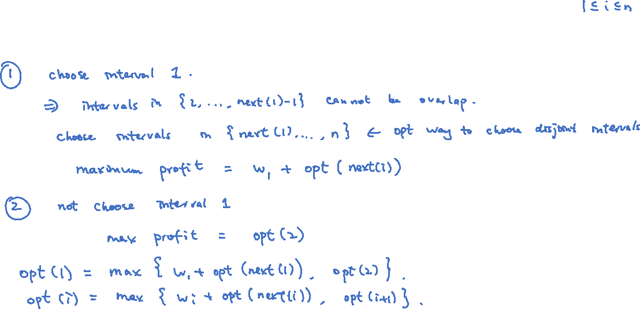
Better Recurrence
Let $opt(i)$ be the maximum total weight of disjoint intervals using intervals in $\{i,…,n\}$ only.
So, $opt(1)$ is the answer that we would like to compute.

Slide 16
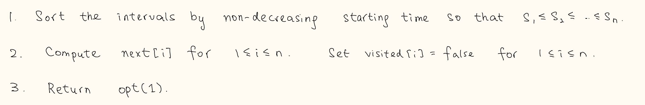
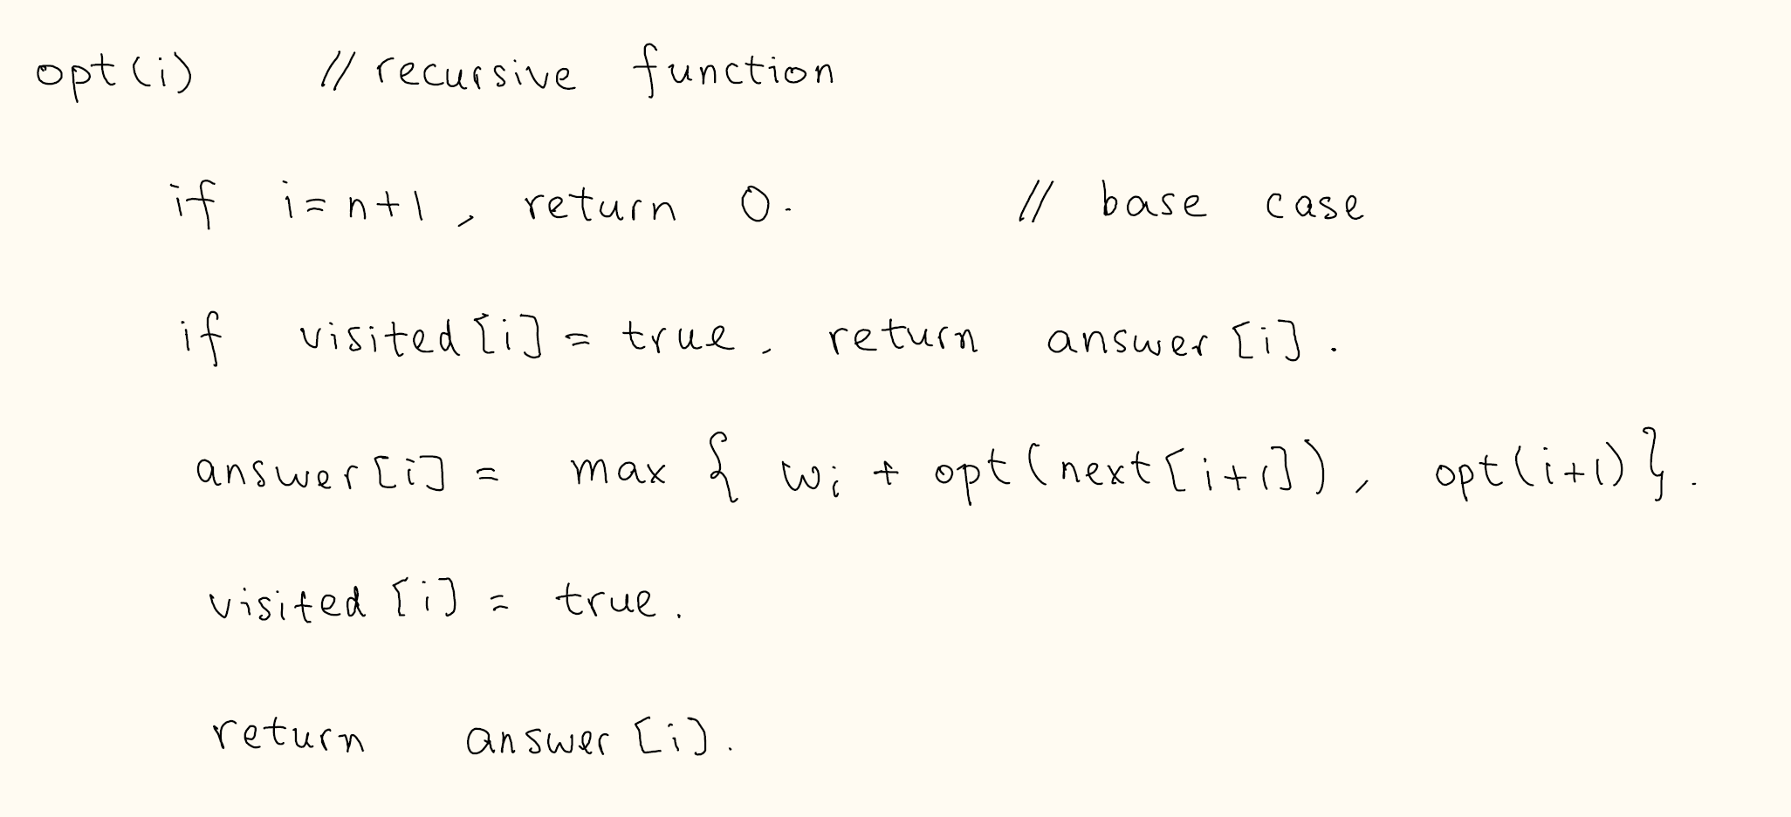
Algorithm

Slide 17
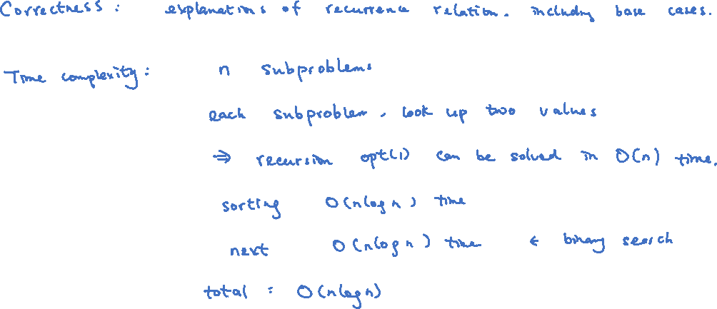
Analysis

Slide 18
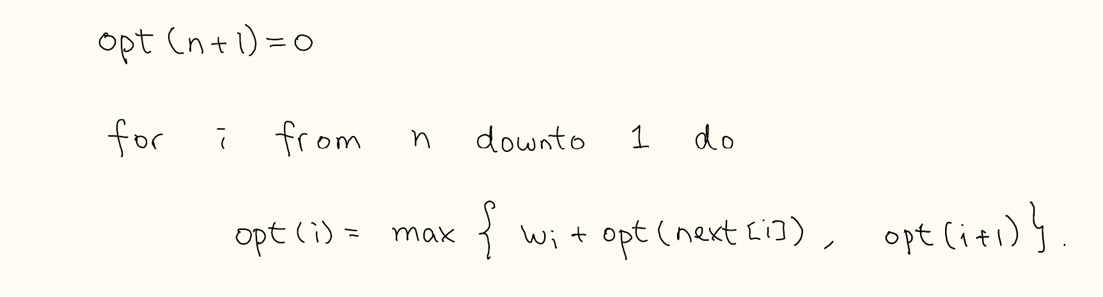
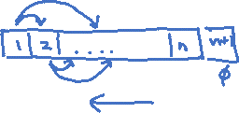
Bottom-Up Computation
This has the same time complexity as the greedy algorithm!
Somehow we can implement an exhaustive search algorithm as efficient as a greedy algorithm!
This is why dynamic programming is so useful and powerful, because it is very systematic
and yet it provides very competitive algorithms.
Exercise: Write a program to print out an optimal solution (i.e. the disjoint intervals).

Slide 19
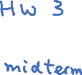
Today’s Plan
Framework
Weighted interval scheduling
Subset-sum and knapsack

Slide 20
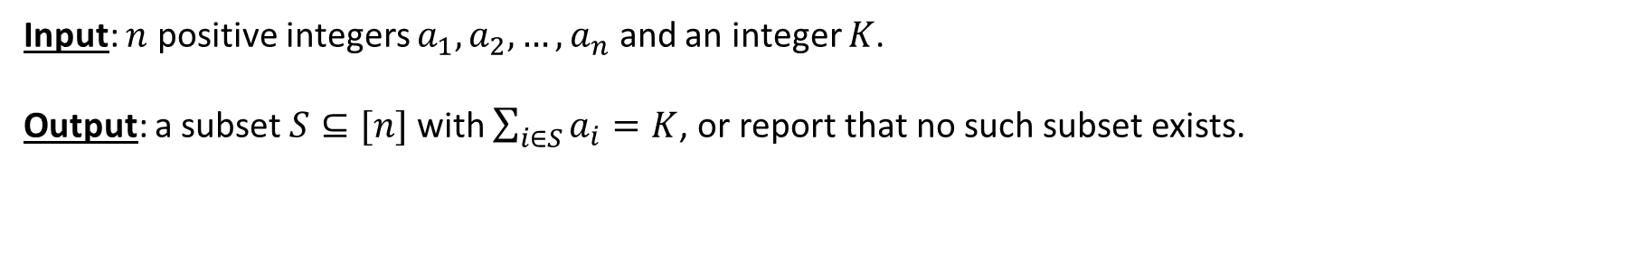

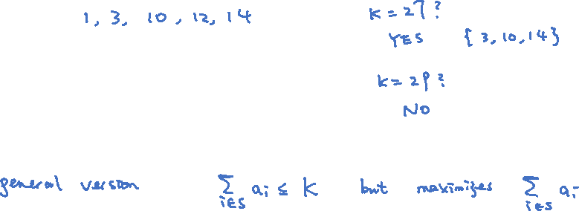
Subset-Sum
Input: $n$ positive integers $a_{1},a_{2},…,a_{n}$ and an integer $K$.
Output: a subset $S⊆[n]$ with $\sum_{i∈S}{a_{i}}=K$, or report that no such subset exists.

Slide 21
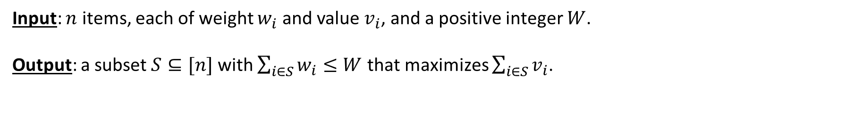
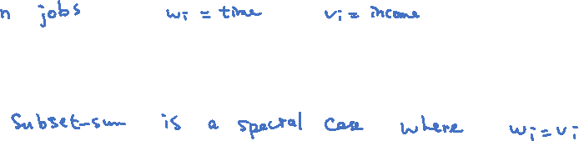
Knapsack
Input: $n$ items, each of weight $w_{i}$ and value $v_{i}$, and a positive integer $W$.
Output: a subset $S⊆[n]$ with $\sum_{i∈S}{w_{i}}≤W$ that maximizes $\sum_{i∈S}{v_{i}}$.

Slide 22
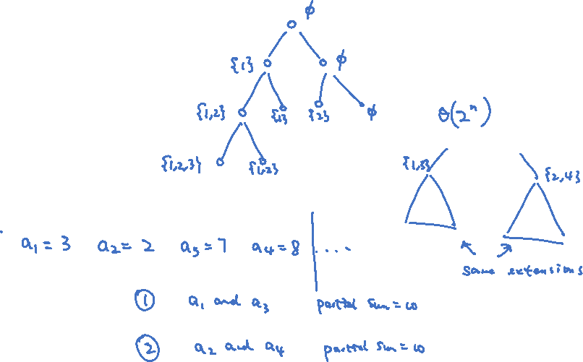
Exhaustive Search

Slide 23
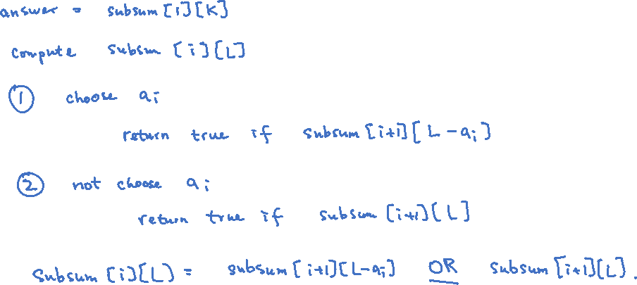
“Better” Recurrence
The subproblems are $subsum\left[i\right][L]$ for $1≤i≤n$ and $1≤L≤K,$
where $subsum\left[i\right]\left[L\right]=true$ iff there is a subset in $\left\{i,…,n\right\}$ whose sum is $L$.

Slide 24
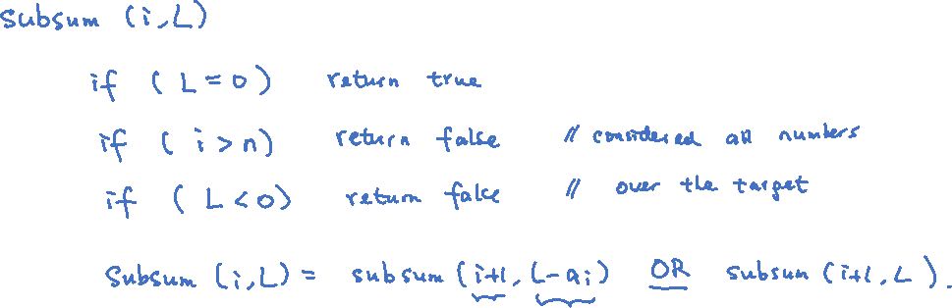
Algorithm

Slide 25
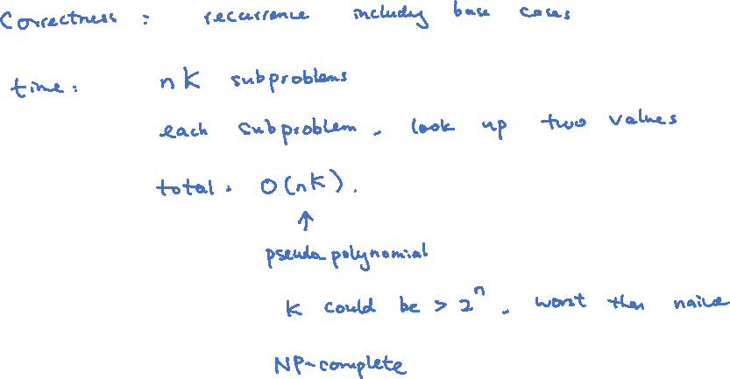
Time Complexity

Slide 26
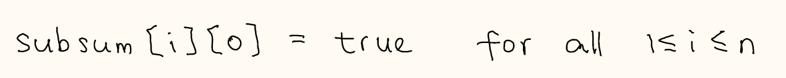
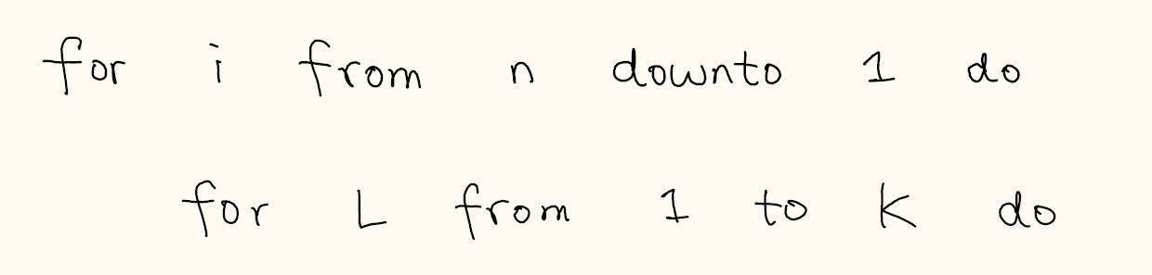
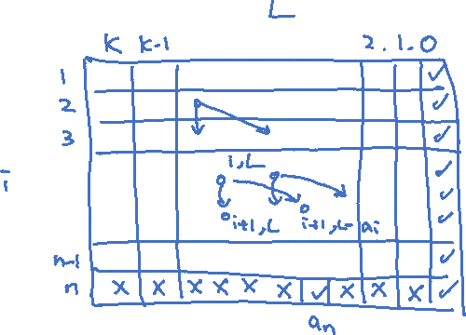
Bottom-Up Computation

Slide 27

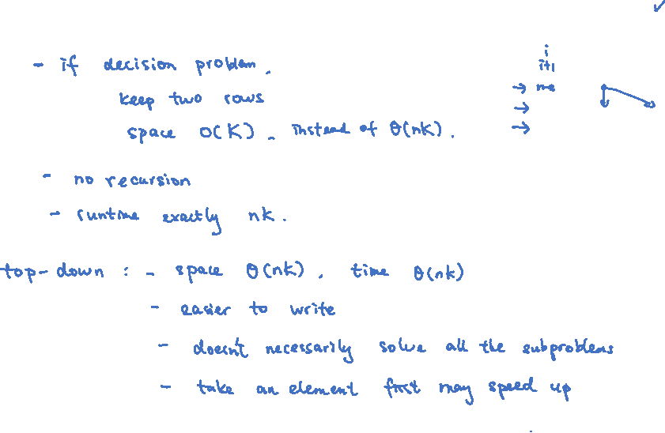
Top-Down vs Bottom Up
Bottom-up: space efficient implementation

Slide 28
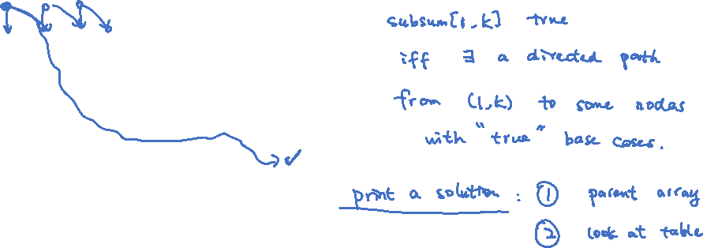
Dynamic Programming and Graph Search
This algorithm can be understood as doing a graph search on the “subproblem dependency graph”.

Slide 29
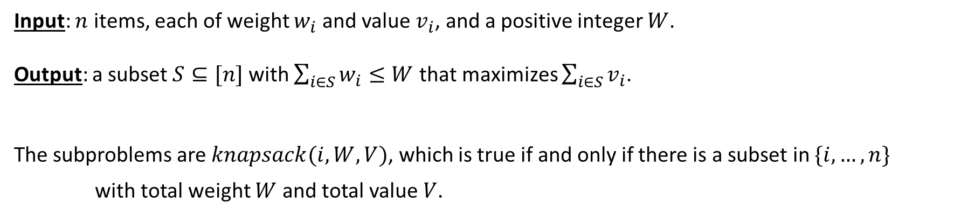
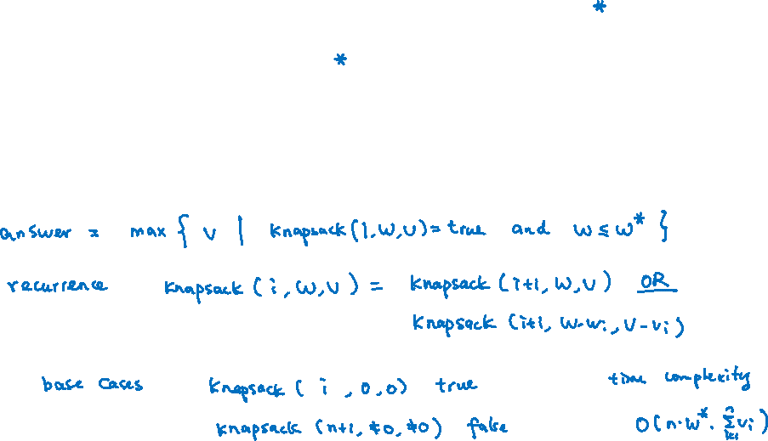
Knapsack: First Approach
Input: $n$ items, each of weight $w_{i}$ and value $v_{i}$, and a positive integer $W$.
Output: a subset $S⊆[n]$ with $\sum_{i∈S}{w_{i}}≤W$ that maximizes $\sum_{i∈S}{v_{i}}$.
The subproblems are $knapsack(i,W,V)$, which is true if and only if there is a subset in $\{i,…,n\}$
with total weight $W$ and total value $V$.

Slide 30
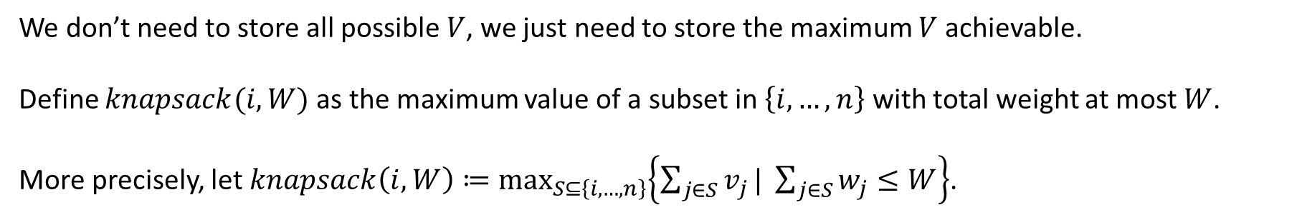
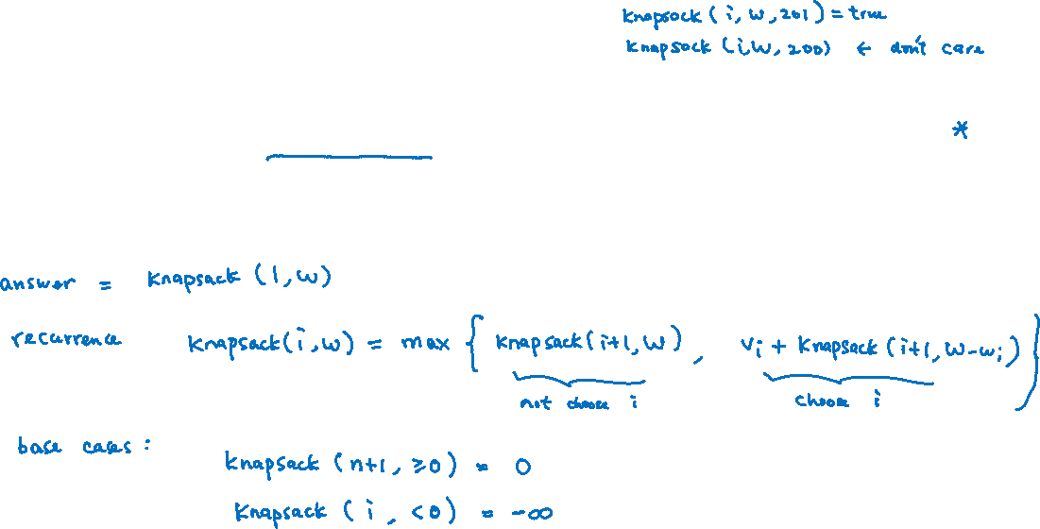
Better Recurrence
We don’t need to store all possible $V$, we just need to store the maximum $V$ achievable.
Define $knapsack(i,W)$ as the maximum value of a subset in $\left\{i,…,n\right\}$ with total weight at most $W$.
More precisely, let $knapsack\left(i,W\right)≔\max_{S⊆\left\{i,…,n\right\}}\left\{\sum_{j∈S}{v_{j}}| \sum_{j∈S}{w_{j}}≤W\right\}$.

Slide 31
Remaining Steps
The following details are left as exercises.
Base cases.
Correctness.
Time Complexity.
Top-down implementation.
Bottom-up implementation.
Printing a solution.

Slide 32
Check List for Dynamic Programming Solution
The following is a check list for designing a dynamic programming algorithm.
Starting with exhaustive search to get an idea (we may skip this step).
Coming up with good subproblems.
Write down how to get the answer from the subproblems.
Write down the recurrence relations including base cases, with explanation as correctness proof.
Write down the algorithm (enough to say top-down memorization).
Analyze the time complexity.
Print out a solution if necessary.
Bottom-up implementation if necessary (e.g. to avoid stack overflow).

