Slide 1
CS 341 – Algorithms
Lecture 10 – Single Source Shortest Paths
18 June 2021

Slide 2
Today’s Plan
Dijkstra’s algorithm as simulating BFS
Dijkstra’s algorithm as a greedy algorithm

Slide 3
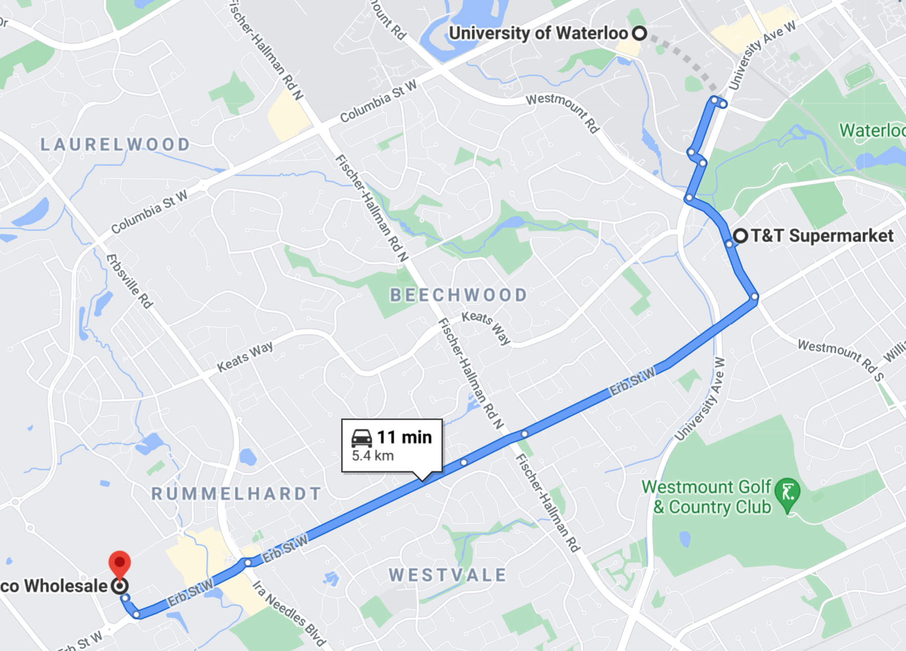
Single Source Shortest Paths
Input: A directed graph $G=(V,E)$, a non-negative length $l_{e}$ for each edge $e∈E$, and two vertices $s,t∈V.$
Output: A shortest path from $s$ to $t$, where the length of a path is equal to the sum of the length of its edges.
Input: A directed graph $G=(V,E)$, a non-negative length $l_{e}$ for each edge $e∈E$, and a vertex $s∈V.$
Output: A shortest path from $s$ to $v$, for every vertex $v∈V$.

Slide 4
Breadth First Search
In L05.pdf, we see that if every edge has length one, then the problem can be solved by BFS.
We can reduce the non-negative length problem to this special case.

Slide 5
The Reduction
What is wrong with the reduction?

Slide 6
Physical Process
We can think of the process of BFS in $G^{′}$ as follows.
We start a fire at vertex $s$ at time $0$.
It takes one unit of time to burn an edge $e$ in $G′$.
Claim. The shortest path distance from $s$ to $t$ is just the first time when vertex $t$ is burnt.

Slide 7
Efficient Simulation
The idea is that we just need to be able to keep finding out what is the next vertex to be burnt and when,
by keeping track of an upper bound on the time a vertex to be burnt.

Slide 8
Dijkstra’s Algorithm as BFS Simulation

Slide 9
Analysis

Slide 10
Today’s Plan
Dijkstra’s algorithm as simulating BFS
Dijkstra’s algorithm as a greedy algorithm

Slide 11
Traditional Approach
Here we follow a more traditional approach to prove the correctness of Dijkstra’s algorithm.
Besides being more formal, the proof technique is also useful in analyzing other problems, e.g. MST.
We think of Dijkstra’s algorithm as a greedy algorithm.
The idea is to grow a subset $R⊆V$ so that $dist\left(v\right)$ for $v∈R$ are computed correctly.
Initially, $R=\{s\}$, and then at each iteration we add one more vertex to $R$.
Which vertex to be added in an iteration?
We will add the vertex which is closest to $R$ to $R$, so in this sense the algorithm is greedy.

Slide 12
Dijkstra’s Algorithm as Greedy Algorithm
Note that $u∉R$ is a vertex with $dist\left(u\right)=\min_{v∈R,w∉R}\left\{dist\left(v\right)+l_{vw}\right\}$.

Slide 13
Correctness by Induction
Invariant: For any $v∈R$, $dist(v)$ is the shortest path distance from $s$ to $v$.
Note that $u∉R$ is a vertex with $dist\left(u\right)=\min_{v∈R,w∉R}\left\{dist\left(v\right)+l_{vw}\right\}$.

Slide 14
Correctness by Induction
Invariant: For any $v∈R$, $dist(v)$ is the shortest path distance from $s$ to $v$.
Note that $u∉R$ is a vertex with $dist\left(u\right)=\min_{v∈R,w∉R}\left\{dist\left(v\right)+l_{vw}\right\}$.

Slide 15
Shortest Path Tree
From the proof, when a vertex $v$ is added to $R$, any vertex $u∈R$ that
minimizes $dist\left(u\right)+l_{uv}$ is the parent of $v$ on a shortest path from $s$ to $v$.
We keep track of these parent information, which can be used to trace back a shortest path from $s$.
As in BFS tree, these edges $\left(v, parent\left[v\right]\right)$ form a tree.
So, we have a succinct way to store all the shortest paths from $s$ using only $n−1$ edges.
The shortest path tree is a nice structure and is very useful algorithmically.

Slide 16
Negative Edge Length?
Question: How the algorithm will fail if there are some negative edge lengths?
We will come back to this more general setting after we introduce dynamic programming.

Slide 17
Concluding Remarks
We have seen a few greedy algorithms.
The exchange argument is useful because it allows us to compare two similar solutions.
This is the end of the third topic of the course, exactly finishing half of the lectures.
Next time, we will introduce the technique of dynamic programming.
The second half of the course will be more advanced and interesting.

