Slide 1
CS 341 – Algorithms
Lecture 9 – Huffman Coding
16 June 2021

Slide 2
Today’s Plan
Compression, Optimal Prefix Code
Huffman’s Algorithm, Proof of Correctness

Slide 3
Compression
Suppose a text has $26$ letters a,b,c,…,z. We can use 5 bits to represent each letter.
If each letter appears equally likely, then we cannot do much better than using $5n$ bits to store $n$ letters.
Now suppose we have some statistics about the frequencies of each letter.
Let’s say that we know that some letters appear with much higher frequencies.
Can we do better by using variable-length coding scheme?
The idea is to use fewer bits for more frequent letters, and more bits for less frequent letters,
so that the average number of bits used is fewer.

Slide 4
Decoding
If we use fixed-length encoding, then it is easy to decode.
But it may not be clear how to decode if we use variable-length encoding.
For example, suppose a=01, b=001, c=011, d=110, e=10.
Then how do we decode the compressed text such as 00101110?

Slide 5
Prefix Coding
To allow for easy decoding, we will construct prefix code,
so that no encoding string is a prefix of another encoded string.
The previous example was ambiguous because a=01 and c=011.
Suppose we use a prefix code for the five letters, a=11, b=000, c=001, d=01, e=10.
Then we encode the text “cabde” as 001110000110.
And this can be decoded uniquely easily and efficiently.

Slide 6
Decoding Tree
It is useful to represent a prefix code as a binary tree.
In the previous example, a=11, b=000, c=001, d=01, e=10
We can use the decoding tree to decode 001110000110.
Another example, a=0, b=101, c=110, d=101, e=110
It should be clear that there is a one-to-one correspondence
between binary decoding trees and binary prefix codes.

Slide 7
Optimal Prefix Code
Input: $n$ symbols, with frequencies $f_{1},f_{2},…,f_{n}$ so that $\sum_{i=1}^{n}{f_{i}}=1$.
Output: a binary decoding tree $T$ with $n$ leaves that minimizes $\sum_{i=1}^{n}{f_{i}}⋅depth_{T}\left(i\right)=1$.
This problem doesn’t look easy as the output space is more complicated.
It is also not clear how to make decisions greedily.

Slide 8
Full Binary Tree
A binary tree is full if every internal node has two children.
Observation. Any optimal binary decoding tree is full.
Corollary. There are at least two leaves of maximum depth that are siblings (i.e. having the same parent).

Slide 9
Exchange Argument
Suppose we know the shape of an optimal binary tree (which we don’t know yet).
Observation. There is an optimal solution in which the two symbols with lowest frequencies
are assigned to leaves of maximum depth, and furthermore they are siblings.

Slide 10
Today’s Plan
Compression, Optimal Prefix Code
Huffman’s Algorithm, Proof of Correctness

Slide 11
Huffman’s Idea
So far, we have deduced little information about how an optimal binary decoding tree should look like.
We know that there are 2 leaves of max depth, and we can assign symbols with lowest frequencies there.
We don’t know the shape of the tree, and don’t know how to use the frequencies to make decisions yet.
Perhaps surprisingly, Huffman realized that this is enough to design an efficient algorithm for the problem.
His idea is to reduce the problem size by one, by combining two symbols with lowest frequencies into one,
knowing that they can be assumed to be siblings of maximum depth.
How the tree should look like will become apparent when the problem size becomes small enough.
And then we can construct back a bigger tree from a smaller tree one step at a time.

Slide 12
Huffman’s Algorithm

Slide 13
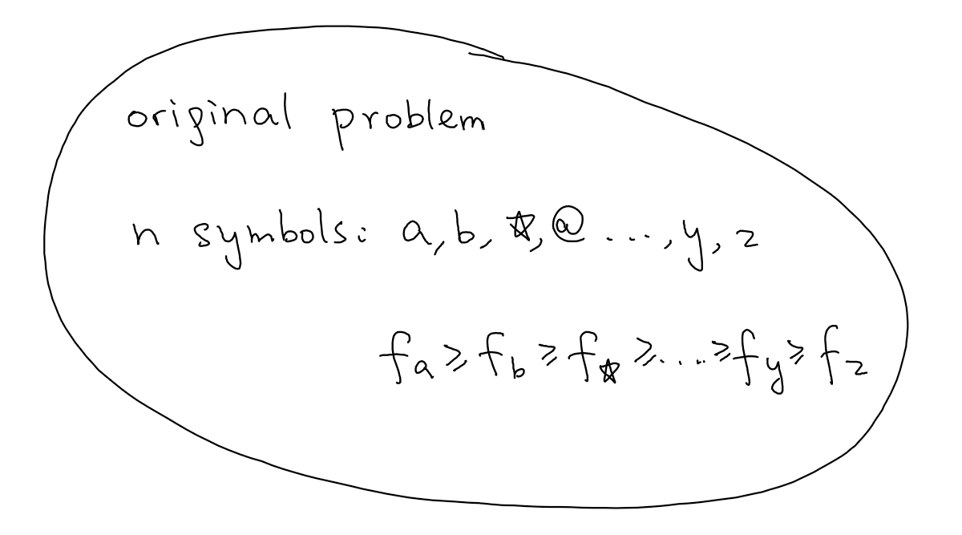
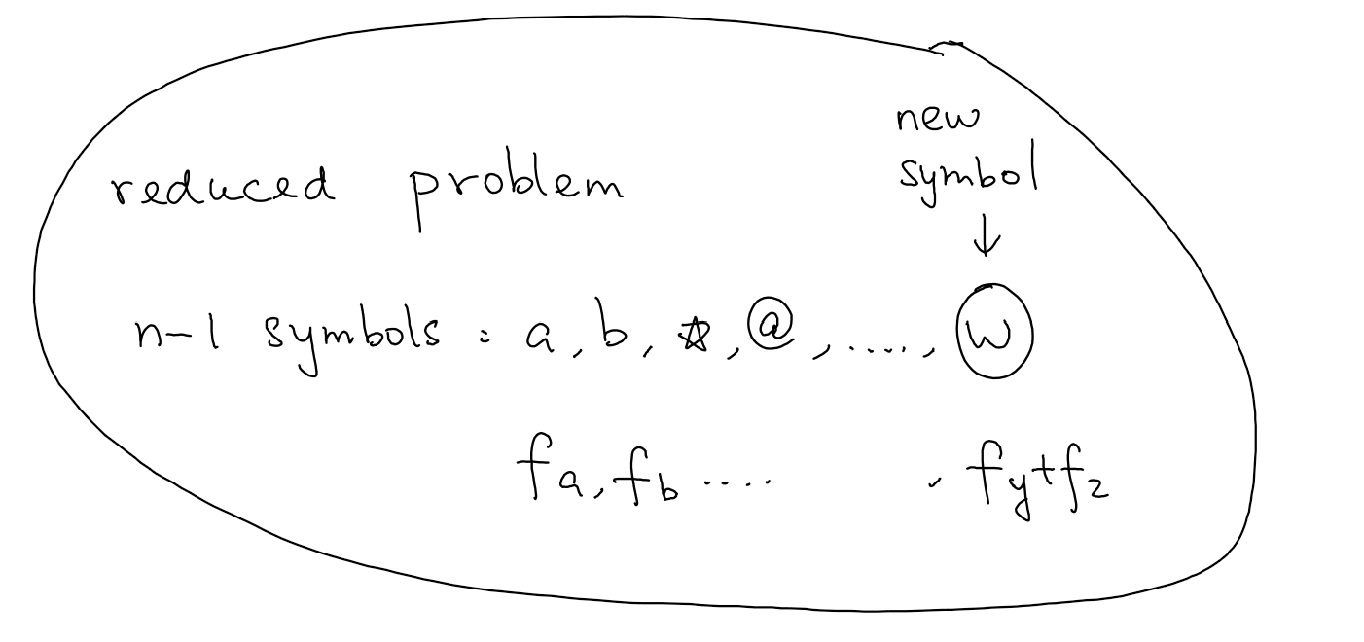
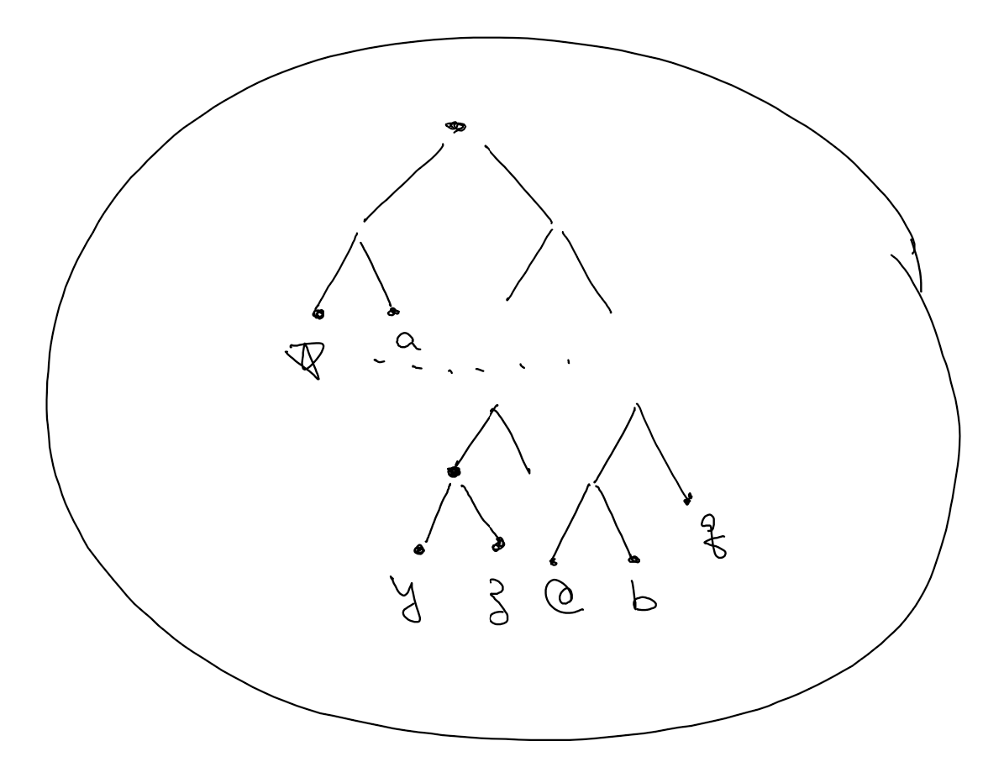
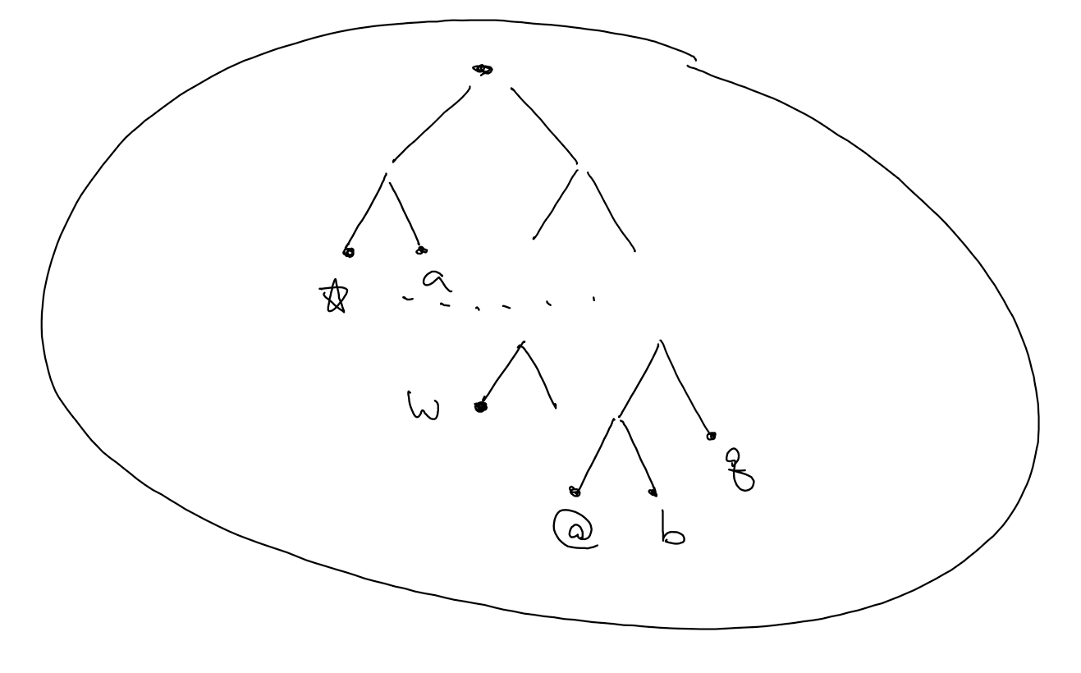
Reduction Scheme

Slide 14
Example 1
Five symbols $a,b,c,d,e,$ with $f_{a}=0.3, f_{b}=0.2, f_{c}=0.4, f_{d}=0.05, f_{e}=0.05$.

Slide 15
Example 2
Five symbols $a,b,c,d,e,$ with $f_{a}=0.18, f_{b}=0.24, f_{c}=0.26, f_{d}=0.2, f_{e}=0.12$.

Slide 16
Correctness Proof
First we compute the objective value of our greedy solution.

Slide 17
Correctness Proof
Next we compute the objective value of any solution.

Slide 18
Implementation
In each iteration, we need to find two symbols of lowest frequencies,
delete them and add a new symbol with the frequency as their sum.

