Slide 1
CS 341 – Algorithms
Lecture 8 – Greedy Algorithms
11 June 2021

Slide 2
Today’s Plan
Minimizing Total Completion Time
Interval Scheduling
Interval Coloring

Slide 3
Greedy Algorithms
We will have three lectures about greedy algorithms.
Generally speaking, greedy algorithms work by using simple and/or local rules to make decisions
and then commit on them, an analogy to making maximum profit in short term.
Greedy algorithms are usually easy to propose, but may not work or not easy to analyze.
Today we will use scheduling problems as examples to analyze greedy algorithms.
Then we will talk about Hoffman coding, and then Dijkstra’s algorithm for single source shortest paths.
We won’t study the minimum spanning tree problem, solved by a classical greedy algorithm.

Slide 4
Minimizing Total Completion Time
We start with a problem which has a very intuition solution.
Input: $n$ jobs, with processing times $p_{1},p_{2},…, p_{n}$.
Output: an ordering of the jobs to finish so as to minimize the total completion time,
where the completion time of a job is defined as the time when it is finished.

Slide 5
Algorithm
Imagine we are in a supermarket.
It is very intuitive that we should process the jobs in increasing order of processing times.
That’s the algorithm.
How to prove that it is correct?
Again just imagine that we are in a supermarket.

Slide 6
Exchange Argument
We use an exchange argument to prove the correctness of the greedy algorithm.

Slide 7

Generalization
The following is a generalization where the greedy approach still works.
Input: $n$ jobs, each with a processing time $p_{i}$ and a weight $w_{i}$.
Output: an ordering of the jobs to finish so as to minimize the total weighted completion time.
where the weighted completion time of a job is defined as its weight times its completion time.
We leave it as a problem for you to think about.

Slide 8
Today’s Plan
Minimizing Total Completion Time
Interval Scheduling
Interval Coloring

Slide 9
Interval Scheduling
Input: $n$ intervals $\left[{s_{1},f}_{1}\right],\left[{s_{2},f}_{2}\right],…,\left[{s_{n},f}_{n}\right]$
Output: a maximum subset of disjoint intervals
Imagine we have a room and we would like to use it to hold as many activities as possible.

Slide 10
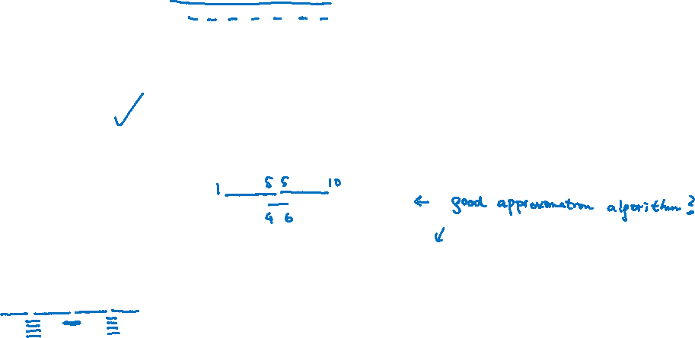
Greedy Algorithms
There are multiple natural greedy algorithms for this problem.
Earliest starting time
Earliest finishing time
Shortest intervals
Minimum conflicts (i.e. choose an interval which overlaps with fewest other intervals)

Slide 11
Algorithm
Sort the intervals so that $f_{1}≤f_{2}≤…≤f_{n}$. Initial solution $S=∅$.
For $1≤i≤n$
If interval $[s_{i},f_{i}]$ is disjoint from all intervals in $S$, then $S ≔S+i$.
Output $S$.

Slide 12
Proof of Correctness
We argue that any (optimal) solution would do no worse by using the interval with earliest finishing time.
Claim. There exists an optimal solution with $[s_{1},f_{1}]$ chosen.

Slide 13
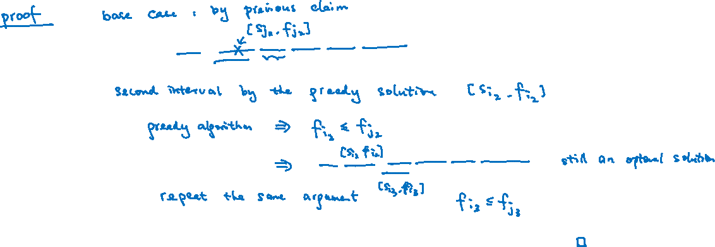
Proof of Correctness
Then, we can extend this exchange argument to show that the greedy solution always “stays ahead”.
Lemma. There is an optimal solution using the first $k$ intervals of the greedy solution for any $k$.

Slide 14
Proof of Correctness
Lemma. There is an optimal solution using the first $k$ intervals of the greedy solution for any $k$.
With the lemma, it is easy to finish the proof.

Slide 15
Today’s Plan
Minimizing Total Completion Time
Interval Scheduling
Interval Coloring

Slide 16
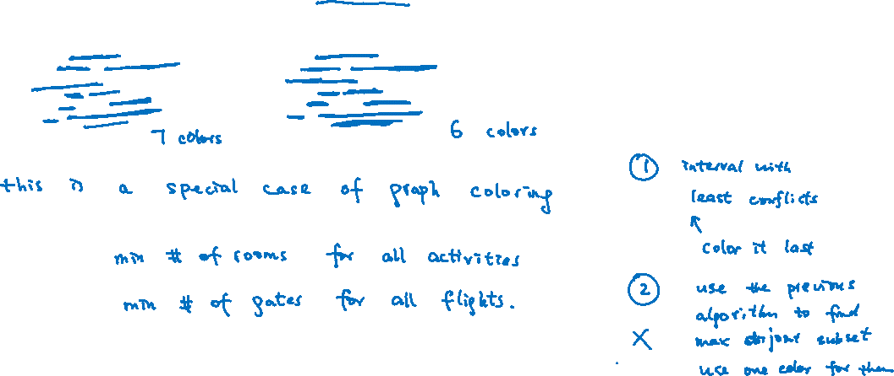
Interval Coloring
Input: $n$ intervals $\left[{s_{1},f}_{1}\right],\left[{s_{2},f}_{2}\right],…,\left[{s_{n},f}_{n}\right]$
Output: a coloring of the intervals using the minimum number of colors possible,
so that each interval gets one color and any two overlapping intervals get different colors.

Slide 17
Algorithm
Sort the intervals so that $s_{1}≤s_{2}≤…≤s_{n}$. Initial solution $S=∅$.
For $1≤i≤n$
Use the minimum available color to color the $i$-th interval.

Slide 18
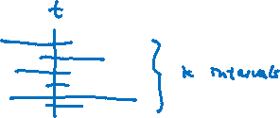
Analysis
To prove the correctness, if our algorithm uses $k$ colors, we need to prove that there are no other ways
to color the intervals using less than $k$ colors satisfying the constraints.
How to argue that?
One way is to show that when the algorithm uses $k$ colors,
there is a time $t$such that it is contained in $k$ intervals.
Then these $k$ intervals are pairwise overlapping,
and so any algorithm needs to use $k$ colors just for these $k$ intervals.
This would prove that our algorithm is optimal.

Slide 19
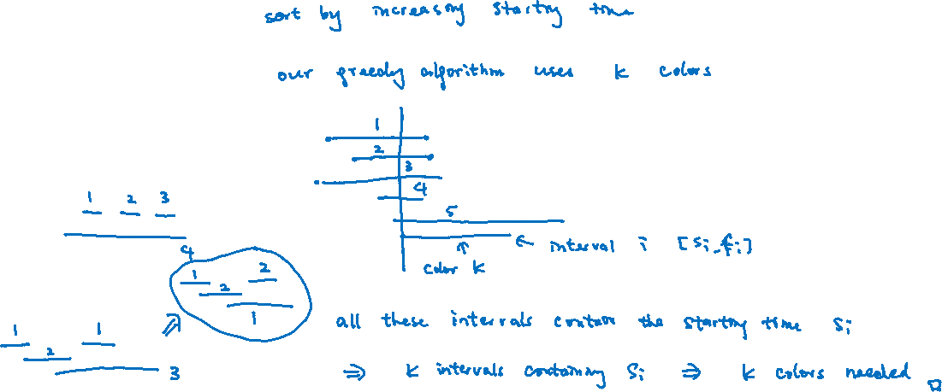
Proof of Correctness
Find a counterexample showing that using an arbitrary ordering of the intervals would not work.

