Slide 1
CS 341 – Algorithms
Lecture 7 – Directed Graphs
2 June 2021

Slide 2
Today’s Plan
Directed Graphs, Reachability, BFS/DFS
Strongly Connected Graphs
Directed Acyclic Graphs
Strongly Connected Components

Slide 3
Directed Graphs
If $uv$ is a directed edge, then $u$ is the tail of the edge and $v$ is the head of the edge.
The in-degree of a vertex $v$, denoted by $indeg(v)$, is the number of edges with $v$ being the head.
The out-degree of a vertex $v$, denoted by $outdeg(v)$, is the number of edges with $v$ being the tail.
Directed graphs are useful in modeling asymmetric relations (e.g. web links, one-way streets).
A directed graph $G$ is a directed acyclic graph if there is no directed cycles in $G$.

Slide 4
Connectivity in Directed Graphs
Given two vertices $s,t$, we say $t$ is reachable from $s$ if there is a directed path from $s$ to $t$.
A directed graph $G=\left(V,E\right)$ is strongly connected if for every pair of vertices $u,v∈V$,
$u$ is reachable from $v$ and $v$ is reachable from $u$.
A subset $S⊆V$ is called strongly connected if for every pair of vertices $u,v∈S$,
$u$ is reachable from $v$ and $v$ is reachable from $u$.
A subset $S⊆V$ is called a strongly connected component if $S$ is a maximally strongly connected subset,
i.e. $S$ is strongly connected but $S+v$ is not strongly connected for any $v∈V−S$.

Slide 5
Questions
We are interested in designing efficient algorithms for the following basic questions:
Determine if an input graph is a strongly connected graph.
Determine if an input graph is a directed acyclic graph.
Find all strongly connected components of a directed graph.
It will turn out that all these problems can be solved in $O(m+n)$ time,
but they are not as easy to solve as in the undirected analogs especially Q3.

Slide 6
Data Structures
Both adjacency matrix and adjacency list can be defined for directed graphs.
We will only use adjacency list in this lecture, as only this allows us to design $O(m+n)$ time algorithms.

Slide 7
DFS
Both DFS and BFS are defined as in undirected graphs, except that we only explore out-neighbors.

Slide 8
BFS and DFS
We can also define BFS for directed graphs analogously, by only exploring out-neighbors.
When a vertex $v$ is first visited, we remember its parent as the vertex $u$ when $v$ is first visited from.
The edges $(v,parent\left[v\right])$ from a tree, and both BFS tree and DFS tree are defined this way.
Exercises
Time Complexity is $O(m+n)$.
A vertex $t$ is reachable from $s$ if and only if $visited\left[t\right]=true$.
The set of vertices reachable from $s$ forms a “directed cut”.
BFS can be used to compute a shortest path from $s$ to all other vertices in $O(m+n)$ time.

Slide 9
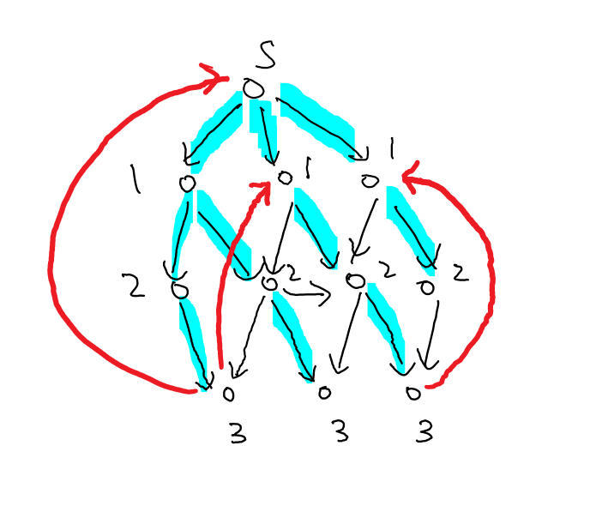
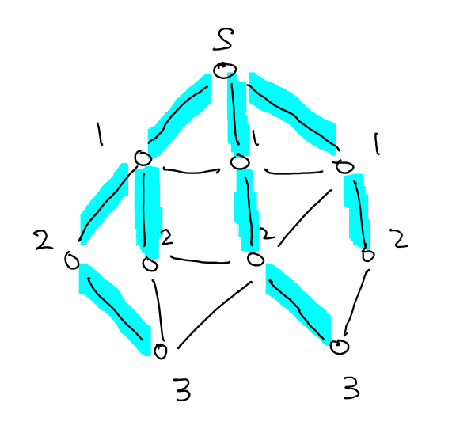
BFS Tree
By setting $dist\left[v\right]=dist\left[u\right]+1$, we can compute all shortest path distances from $s$.
In undirected graphs, for all non-tree edges $uv$, $dist\left[u\right]−1≤dist\left[v\right]≤dist\left[u\right]+1$.
In directed graphs, there could be non-tree edges $uv$ with large difference between $dist\left[u\right]$ and $dist[v]$,
but they must be “backward edges”.

Slide 10
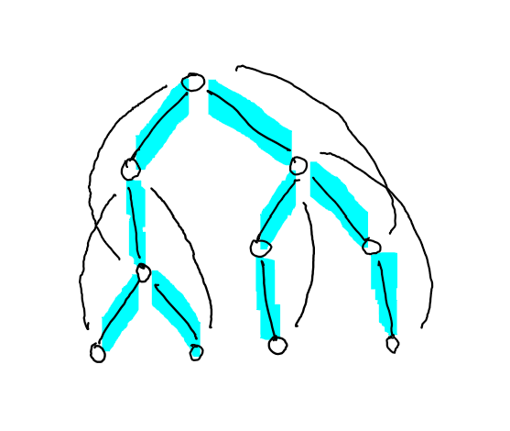
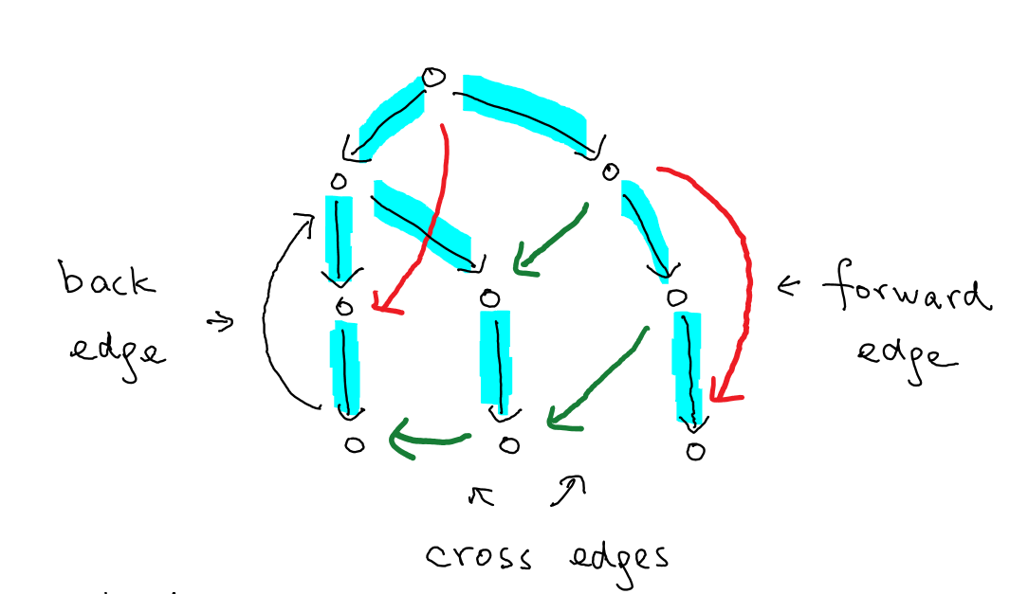
DFS Tree
In undirected graphs, all non-tree edges are back edges as we proved in L06.
In directed graphs, some non-tree edges could be “cross edges” or “forward edges”.
Structures in directed graphs are a bit more complicated.

Slide 11
Today’s Plan
Directed Graphs, Reachability, BFS/DFS
Strongly Connected Graphs
Directed Acyclic Graphs
Strongly Connected Components
Homework 2 is posted

Slide 12
Strongly Connected Graphs
Input: A directed graph $G=(V,E)$.
Output: Yes if $G$ is strongly connected; no otherwise.
What did we do for undirected graphs?
What is a “succinct” condition to check for directed graphs?

Slide 13
Observation
Claim. $G$ is strongly connected if and only if every vertex $v∈V$ is reachable from $s$
and $s$ is reachable from every vertex $v∈V$, where $s$ is an arbitrary vertex.
How do we check whether $s$ is reachable from every vertex $v∈V$?

Slide 14
Trick
Idea: Reverse the graph!
Claim: Given $G=(V,E)$, we reverse the direction of all the edges to obtain $G^{R}=\left(V,E^{←}\right)$.
Then, there is a path from $v$ to $s$ in $G$ if and only if there is a path from $s$ to $v$ in $G^{R}$.
So, $s$ is reachable from every $v∈V$ in $G$ if and only if every $v∈V$ is reachable from $s$ in $G^{R}$.

Slide 15
Algorithm

Slide 16
Today’s Plan
Directed Graphs, Reachability, BFS/DFS
Strongly Connected Graphs
Directed Acyclic Graphs
Strongly Connected Components

Slide 17
Directed Acyclic Graphs
Directed acyclic graphs are useful in modeling dependency relations (e.g. course prerequisites).
In such situations, it is useful to find an ordering of the vertices so that all the edges go forward.
This is called a topological ordering of the vertices.

Slide 18
Topological Ordering
Proposition. A directed graph is acyclic if and only if there is a topological ordering of the vertices.

Slide 19
Topological Ordering
Proposition. A directed graph is acyclic if and only if there is a topological ordering of the vertices.

Slide 20
First Approach
Just follow the above proof.

Slide 21
Second Approach
This is probably less intuitive, but the idea will be useful in the next problem as well.
Idea: Do a DFS on the whole graph.

Slide 22
Finishing Times
We will use the parenthesis property of starting and finishing times, which still holds for directed graphs.
Lemma. If $G$ is directed acyclic, then for any edge $uv$, $finish\left[v\right]<finish[u]$ for any DFS.

Slide 23
Finishing Times
We will use the parenthesis property of starting and finishing times, which still holds for directed graphs.
Lemma. If $G$ is directed acyclic, then for any edge $uv$, $finish\left[v\right]<finish[u]$ for any DFS.

Slide 24
Algorithm

Slide 25
Example

Slide 26
Today’s Plan
Directed Graphs, Reachability, BFS/DFS
Strongly Connected Graphs
Directed Acyclic Graphs
Strongly Connected Components
Homework 2 is posed, due on June 14
Discuss take-home midterm on June 28

Slide 27
Strongly Connected Components
Now we consider the more difficult problem of finding all connected components of a directed graph.
We will combine and extend the previous ideas to obtain an $O(m+n)$-time algorithm.
First, we understand better the structure of a general directed graph.
Claim. Two strongly connected components must be vertex disjoint.

Slide 28
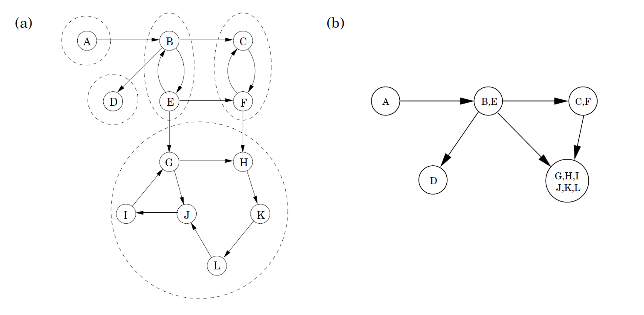
Structure of a Directed Graph
Observation. When every strongly connected component is “contracted” into a single vertex,
then the resulting directed graph is acyclic.
So, a general directed graph is a directed acyclic graph on its strongly connected components.

Slide 29
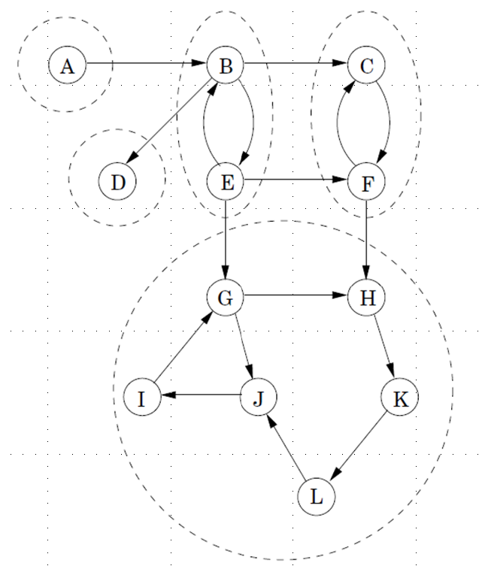
Idea 1
How do we identify the vertices in a
strongly connected component easily?
One natural attempt is do a BFS/DFS on a vertex $v$,
and hope that it identifies the SCC containing $v$.
But this doesn’t always work.
Observation. Suppose we start a BFS/DFS on a “sink component” (a component with no outgoing edges),
then we can identify the vertices in that sink component.

Slide 30
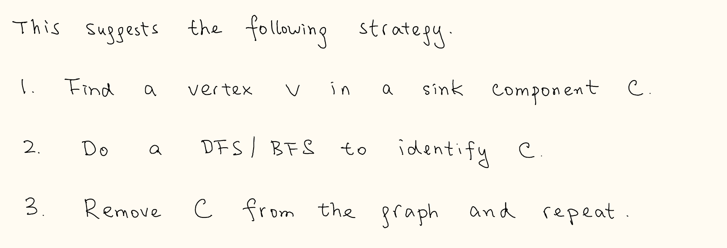
Idea 1: Cut Out Sink Components
How do we find a vertex in a sink component efficiently?
It doesn’t look easy, especially we have to find such a vertex many times (one for each component),
and yet the total time complexity should be $O(n+m)$.

Slide 31
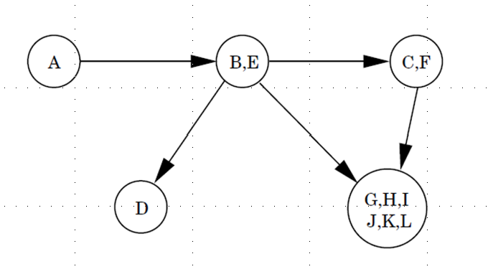
Idea 2: Topological Sort
Recall that a directed graph is a directed acyclic graph on its strongly connected component.
For directed acyclic graphs, if we do a DFS on the whole graph,
then the vertex with the smallest finishing time is a sink.
Let’s try this in a general directed graph.

Slide 32
A Counterexample
This is a nice strategy, but unfortunately it doesn’t always work.
If we look at the proof about finishing times of vertices in a DAG,
then we realize that the proof still works in one way.

Slide 33
Idea 3
Lemma. If $C_{1}$ and $C_{2}$ are strongly connected components and there are directed edges from $C_{1}$ to $C_{2}$,
then the largest finishing time in $C_{1}$ is larger than the largest finishing time in $C_{2}$.

Slide 34
Idea 3: Source Components
So, if we do a DFS on the whole graph, and then sort the vertices in decreasing finishing time.
And then do a DFS again using this ordering.
Then we will always first visit an “ancestor component” before we first visit a “descendant component”
But this is not what we want, we want to first visit a descendant component before we first visit
an ancestor component, so that we can cut out the sink components one at a time.

Slide 35
Idea 4: Reverse the Graph
The strongly connected components in $G$ and $G^{R}$ are the same.
The source components in $G$ become the sink components in $G^{R}$ and vice versa.
So, the ordering in $G$ visiting ancestor components before descendant components
is an ordering in $G^{R}$ visiting descendant components before ancestor components.
This is exactly what we want (although in $G^{R}$, it doesn’t matter as SCCs in $G$ and $G^{R}$ are the same).

Slide 36
Algorithm

Slide 37
Algorithm

Slide 38
Example

Slide 39
Take-Home Midterm
Content from L01.pdf to L07.pdf.
Will be posted on piazza on June 28 9am EST, and the deadline is on June 29 9am EST.
No late submission.
Will post more information on piazza.
Will post midterm questions from previous years.
Midterm questions will be easier than those in homework.
Allowed to use lecture notes, tutorials notes, and information on piazza.
Not allowed to use any other references (including the reference books).
Definitely no communications with others and no looking up of other resources (e.g. internet).

