Slide 1
CS 341 – Algorithms
Lecture 6 – Depth First Search
28 May 2021

Slide 2
Today’s Plan
Depth First Search
DFS Tree, Back Edges, Starting and Finishing Time
Cut Vertices and Cut Edges

Slide 3
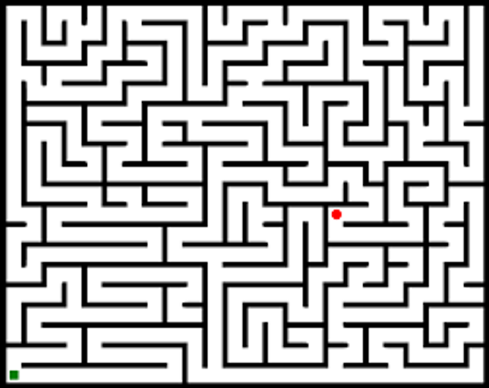
Motivating Example
Imagine we are in a maze searching for the exit.
This can be modeled as an $s$-$t$ connectivity problem.
How would you search for a path in the maze?

Slide 4
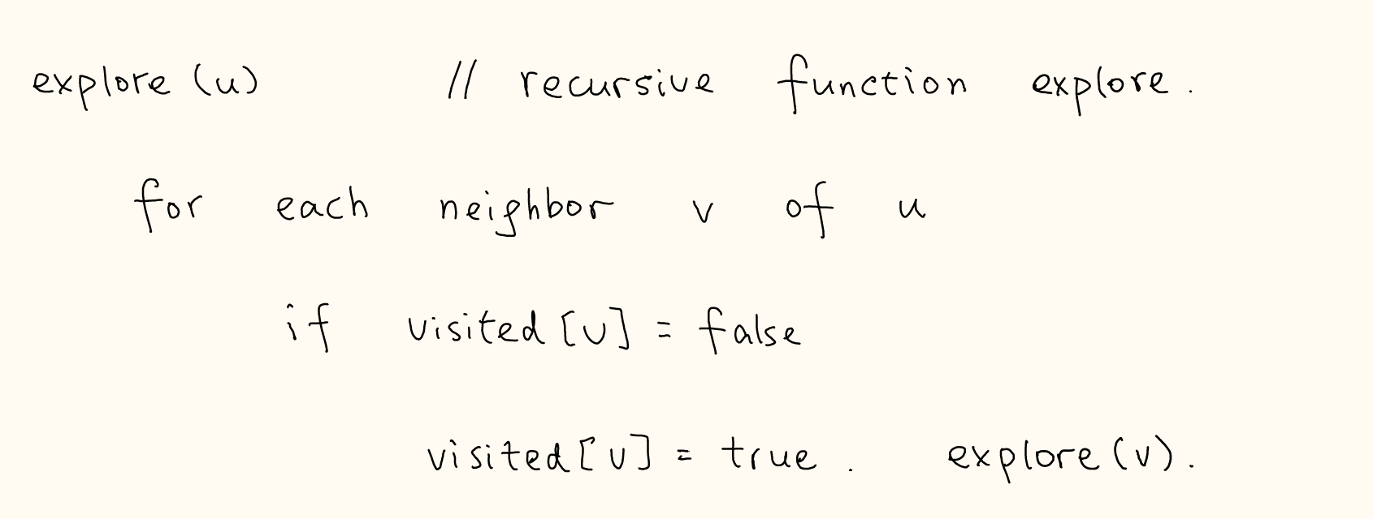
Depth First Search

Slide 5
DFS and BFS
Time Complexity:
Stack and Queue:
Graph Connectivity:

Slide 6
Today’s Plan
Depth First Search
DFS Tree, Back Edges, Starting and Finishing Time
Cut Vertices and Cut Edges

Slide 7
DFS Tree
As for BFS, we can construct a DFS tree to trace out the paths from $s$.

Slide 8
Definitions/Terminology for DFS Tree

Slide 9
Back Edges
Property (back edges). In an undirected graphs, all non-tree edges are back edges.

Slide 10
Starting Time and Finishing Time
We record the time when a vertex is first visited and when a vertex finished exploring.

Slide 11
Parenthesis Property
Property (parenthesis). The intervals [start[u],finish[u]] and [start[v],finish[v]] are
either disjoint or one interval contains the other.

Slide 12
Today’s Plan
Depth First Search
DFS Tree, Back Edges, Starting and Finishing Time
Cut Vertices and Cut Edges

Slide 13
Cut Vertices and Cut Edges
A vertex $v$ is a cut vertex if $G−v$ is not a connected graph.
An edge $e$ is a cut edge if $G−e$ is not a connected graph.
We would like to design an algorithm to identify all cut vertices and cut edges of a given graph.

Slide 14
Idea and Observation
The idea is to use a DFS tree to help us identify all cut vertices and cut edges.
Claim. A subtree $T_{i}$ below $v$ is a connected component in $G−v$ if and only if
there are no edges with one endpoint in $T_{i}$ and another endpoint in an ancestor of $v$.

Slide 15
Characterization for a Non-Root Vertex
The argument applies to every subtree gives a characterization for a non-root vertex to be a cut vertex.
Lemma. For a non-root vertex $v$ in a DFS tree, $v$ is a cut vertex if and only if
there is a subtree below $v$ with no edges going to an ancestor of $v$.

Slide 16
Characterization for the Root Vertex
The characterization for the root vertex is simple.
Lemma. For the root vertex $v$ in a DFS tree, $v$ is a cut vertex if and only if $v$ has at least two children.

Slide 17
Algorithm

Slide 18
Computing the low[] in Linear Time
To have an efficient implementation, we process the DFS tree using a bottom-up ordering.

Slide 19
Identify Cut Vertices Using low[]
Exercise: Identify all cut edges in linear time.

