Slide 1
CS 341 – Algorithms
Lecture 5 – Breadth First Search
26 May 2021

Slide 2
Today’s Plan
Graph Connectivity
Breadth First Search
BFS Tree and Shortest Path
Bipartite Graphs
First tutorial on Tuesday

Slide 3
Graph Representation
Many problems in computer science can be modeled as graph problems.
There are two standard representations of an undirected graph $G=(V,E)$ with $n=|V|$ and $m=\left|E\right|$.
One is the adjacency matrix, and the other is the adjacency list.
We will mostly use adjacency list, as this allows us to design $O(n+m)$-time algorithm.

Slide 4
Graph Connectivity
We say two vertices $u,v$ are connected if there is a path from $u$ to $v$.
A subset of vertices $S⊆V$ is connected if $u,v$ are connected for all $u,v∈S$.
A graph is connected if $u,v$ are connected for all $u,v∈V$.
A connected component is a maximally connected subset of vertices.
Some of the most basic algorithmic questions about a graph are:
To determine whether a given graph is connected.
To find all the connected components of a given graph.
To determine whether two vertices $u,v$ are connected.
To find a shortest path between two vertices $u,v$.
Breadth first search (BFS) can be used to answer all these questions in $O(n+m)$ time.

Slide 5
Today’s Plan
Graph Connectivity
Breadth First Search
BFS Tree and Shortest Path
Bipartite Graphs

Slide 6
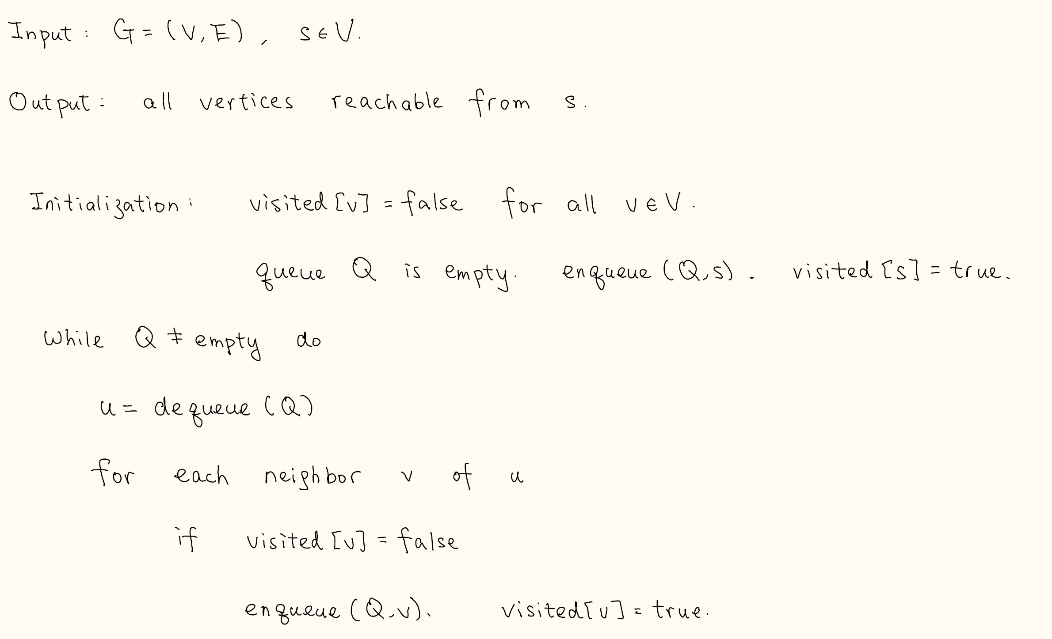
Breadth First Search
To motivate BFS, imagine that we are searching a person in a social network.
A natural strategy is to ask for friends, then friends of friends, then friends of friends of friends, etc.

Slide 7
Time Complexity

Slide 8
Correctness
Lemma. There is a path from $s$ to $v$ if and only if $visited\left[v\right]=true$ at the end.

Slide 9
Correctness
Lemma. There is a path from $s$ to $v$ if and only if $visited\left[v\right]=true$ at the end.

Slide 10
Graph Connectivity
To determine whether a given graph is connected.
To find all the connected components of a given graph.
To determine whether two vertices $u,v$ are connected.
To find a shortest path between two vertices $u,v$.

Slide 11
Today’s Plan
Graph Connectivity
Breadth First Search
BFS Tree and Shortest Path
Bipartite Graphs
Homework 1 due on Monday
Homework 2 to be posted early next week

Slide 12
BFS Tree
How to trace out a path from $s$ to $v$ (if such a path exists)?
Why the edges (v, parent[v]) form a tree?

Slide 13
Shortest Path
Proposition. The path from $v$ to $s$ on a DFS tree is a shortest path from $v$ to $s$.

Slide 14
BFS with Shortest Path Distances

Slide 15
Today’s Plan
Graph Connectivity
Breadth First Search
BFS Tree and Shortest Path
Bipartite Graphs

Slide 16
Bipartite Graphs
A graph $G=(V,E)$ is bipartite if there is a bipartition $(L,R)$ of $V$ such that
all edges have one endpoint in $L$ and one endpoint in $R$.
Question: Design an efficient algorithm to check whether a graph is bipartite.

Slide 17
Algorithm

Slide 18
Correctness

Slide 19
Remarks
This provides an algorithmic proof that a graph is bipartite if and only if it has no odd cycles.
The BFS algorithm is also a linear time algorithm to find an odd cycle in an undirected graph.
Having an odd cycle is a “short” proof that a graph is non-bipartite.
Remember BFS and its main feature is to find shortest paths.

