Slide 1
CS 341 – Algorithms
Lecture 4 – Divide and Conquer II
21 May 2021

Slide 2
Today’s Plan
Closest Pair
Arithmetic Problems
Homework 1 posted
Supplementary exercises
First tutorial on Tuesday

Slide 3
Closest Pair
Input: $n$ points $\left(x_{1},y_{1}\right), \left(x_{2},y_{2}\right), …,(x_{n},y_{n})$ on the 2-D plane.
Output: a pair $1≤i<j≤n$ that minimizes $\sqrt{{\left(x_{i}−x_{j}\right)}^{2}+{\left(y_{i}−y_{j}\right)}^{2}}$.
Assumption: all the $x$-values are distinct.

Slide 4
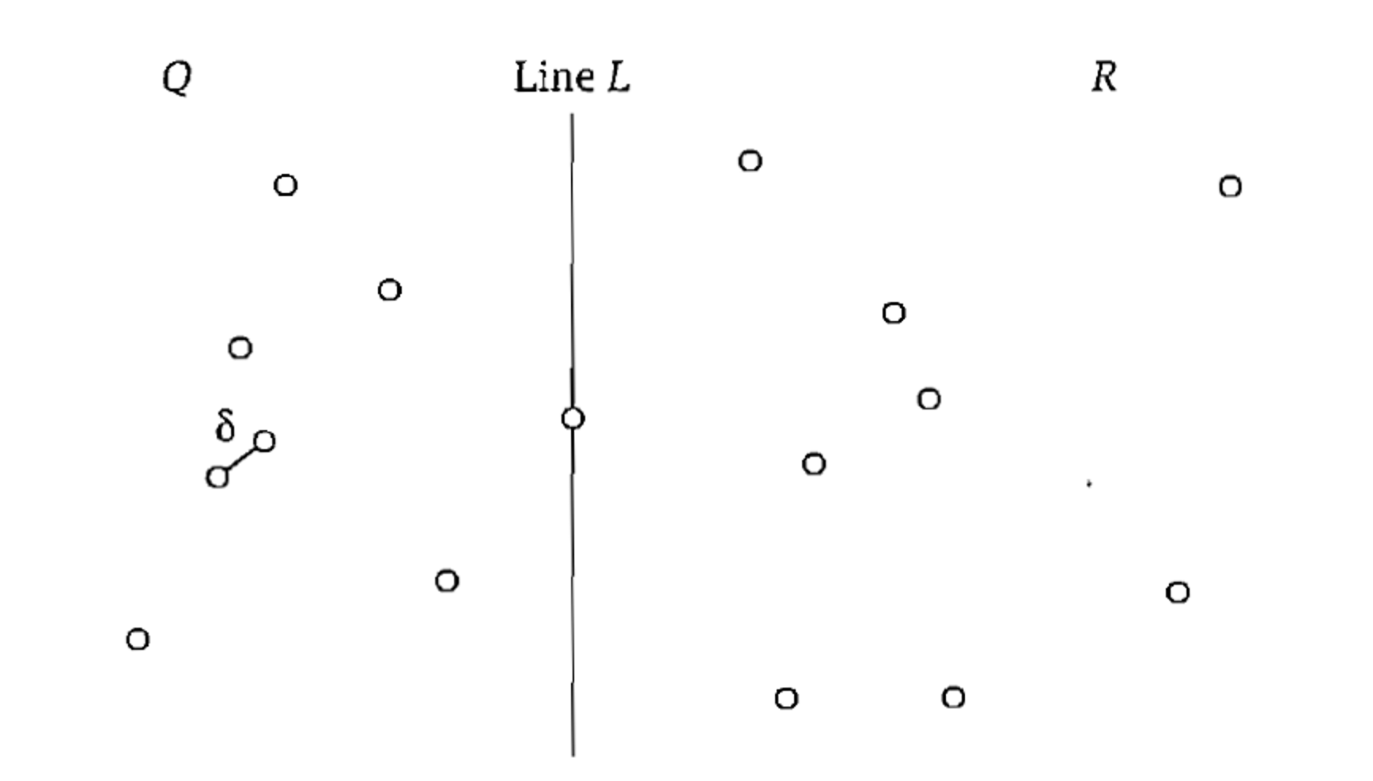
Divide and Conquer
Divide into two halves. Find a closest pair within Q. Find a closest pair within R.
Let $δ$ be the minimum distance that we have found so far.

Slide 5
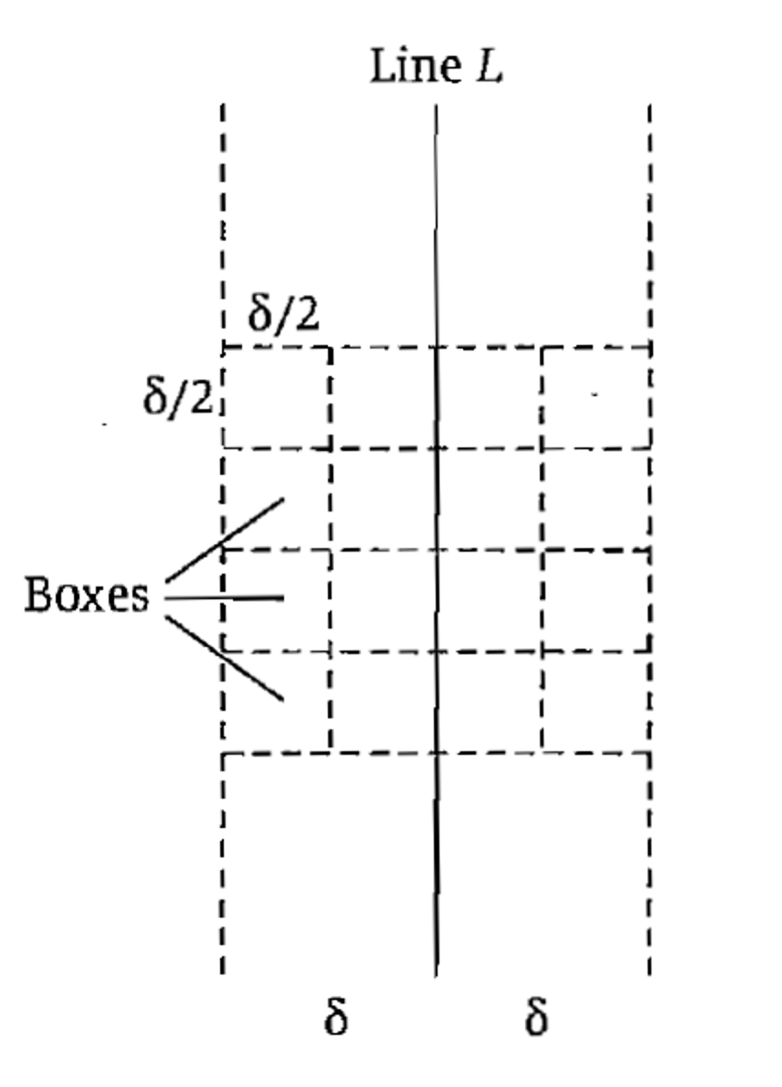
Crossing Pair with Distance $<δ$
It remains to find out whether there is a pair with $(x_{i},y_{i})∈Q$ and $(x_{j},y_{j})∈R$ with distance $<δ$.

Slide 6
Algorithm

Slide 7
Time Complexity
Question: Where did we use the assumption that all the $x$-values are distinct?
Question: Where do we need to change so that the algorithm would work without this assumption?
Remark: There is a randomized algorithm with $O(n)$ expected time. See [KT 13.7].

Slide 8
Today’s Plan
Closest Pair
Arithmetic Problems

Slide 9
Integer Multiplication
Input: two $n$-bit numbers $a=a_{1}a_{2}…a_{n}$ and $b=b_{1}b_{2}…b_{n}$.
Output: the product $ab$

Slide 10
Divide and Conquer
Suppose we know how to multiply $n$-bit numbers. Now we want to multiply $2n$-bit numbers.

Slide 11
Karatsuba’s Algorithm
A clever way to combine only $3$ subproblems.

Slide 12
Polynomial Multiplication
Input: two degree $n$ polynomials $A\left(x\right)=a_{n}x^{n}+a_{n−1}x^{n−1}+…+a_{1}x+a_{0}$ and $B\left(x\right)=b_{n}x^{n}+b_{n−1}x^{n−1}+…+b_{1}x+b_{0}$.
Output: their product $A⋅B(x)$
Assumption: Each $a_{i}⋅b_{j}$ can be done in one word operation.

Slide 13
Matrix Multiplication
Input: two $n×n$ matrices $A$ and $B$.
Output: their product $AB$

Slide 14
Strassen’s Algorithm
Strassen surprised the world by his magic formula.

Slide 15
Progress and Applications
It is still an active research topic to design faster algorithms for matrix multiplication.
Many combinatorial problems can be reduced to matrix multiplication to obtain fastest known algorithms.

Slide 16
Concluding Remarks
Fast Fourier Transform gives $O(n\log{n})$-time algorithms for integer and polynomial multiplications.
Arithmetic problems are where divide-and-conquer is most powerful.

