Slide 1
CS 341 – Algorithms
Lecture 3 – Divide and Conquer
19 May 2021

Slide 2
Today’s Plan
Counting Inversion Pairs
Maximum Sum Subarray
Computing the Median

Slide 3
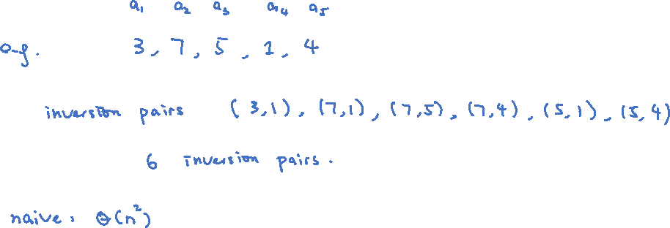
Counting Inversion Pairs
Input: $n$ distinct numbers $a_{1},a_{2},…,a_{n}$
Output: the number of “inversion” pairs with $i<j$ but $a_{i}>a_{j}$

Slide 4
Divide and Conquer
Again assume that $n$ is a power of two.

Slide 5
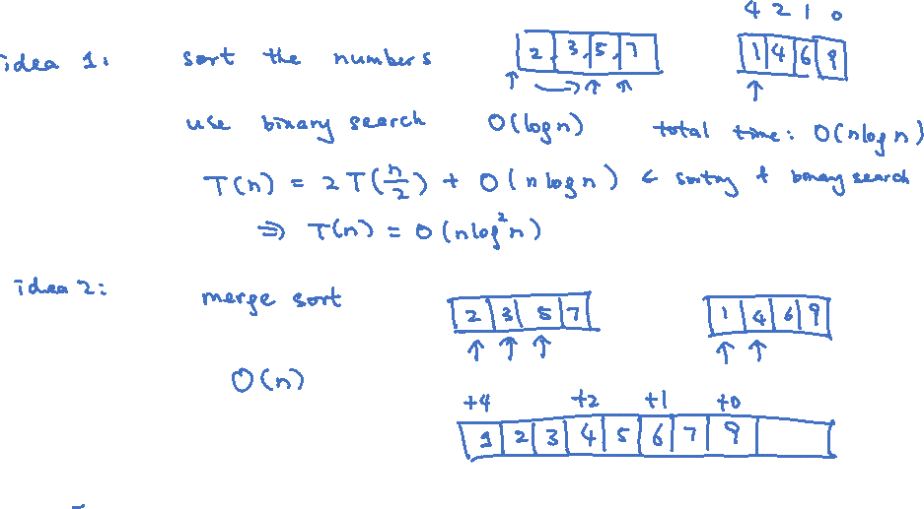
Counting “Crossing” Inversion Pairs
How to count the number of crossing inversion pairs efficiently?

Slide 6
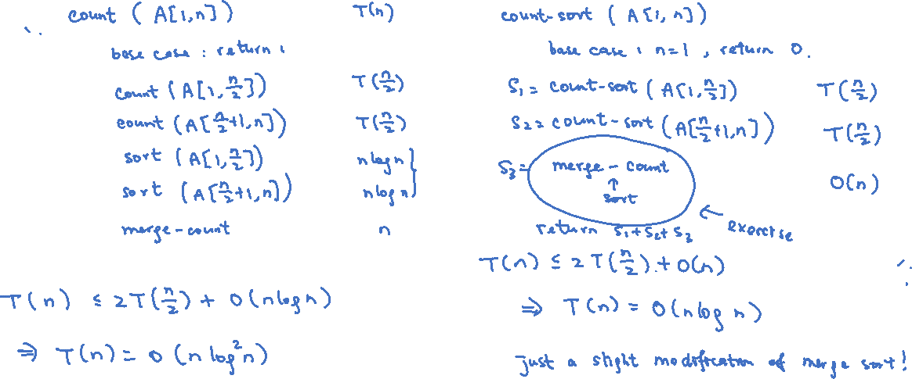
Recursive Algorithms

Slide 7
Today’s Plan
Counting Inversion Pairs
Maximum Sum Subarray
Computing the Median

Slide 8
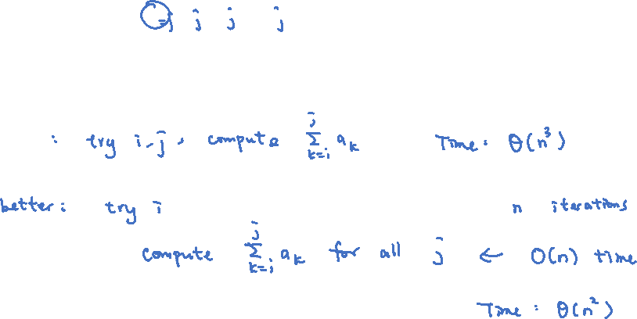
Maximum Sum Subarray
Input: $n$ numbers $a_{1},a_{2},…,a_{n}$
Output: $i,j$ that maximizes $\sum_{k=i}^{j}{a_k}$

Slide 9
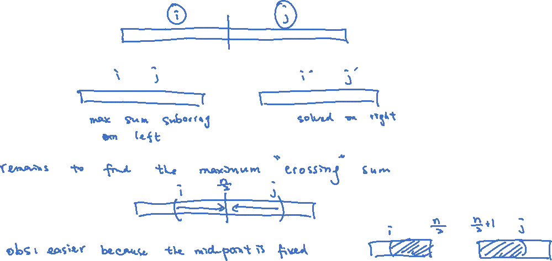
Divide and Conquer
Again assume that $n$ is a power of two.

Slide 10
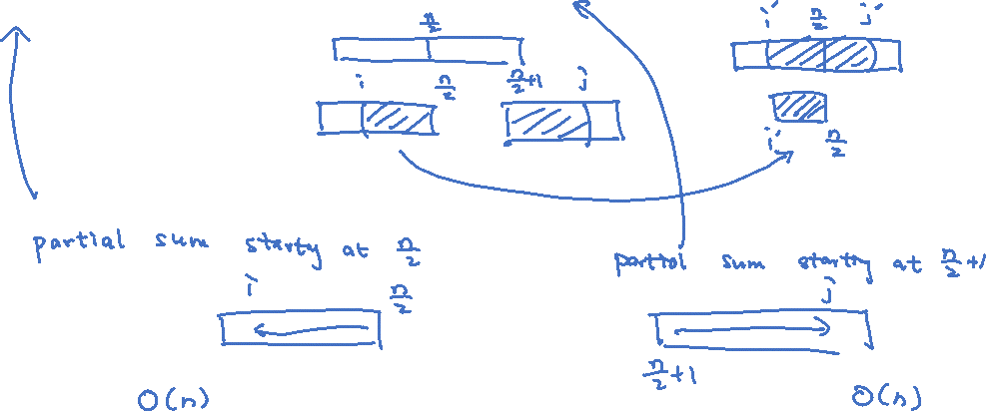
Maximum Crossing Sum
Claim. For $i≤\frac{n}{2}<j$, $[i,j]$ is a maximum sum subarray crossing the mid-point if and only if
$[i,\frac{n}{2}]$ is a max sum subarray ending at $\frac{n}{2}$ and $[\frac{n}{2}+1,j]$ is a max sum subarray starting at $\frac{n}{2}+1$.

Slide 11
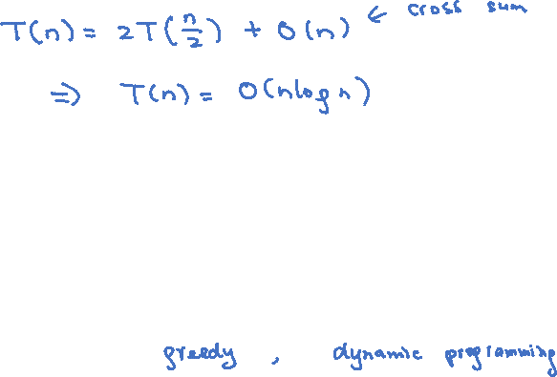
Time Complexity and Questions
Challenge: Design a $O(n)$ time algorithm for the maximum sum subarray problem.

Slide 12
Today’s Plan
Counting Inversion Pairs
Maximum Sum Subarray
Computing the Median

Slide 13
Finding the Median
Input: $n$ distinct numbers $a_{1},a_{2},…,a_{n}$
Output: the median of these numbers
Input: $n$ distinct numbers $a_{1},a_{2},…,a_{n}$ and an integer $k≤n$
Output: the $k$-th smallest number in $a_{1},a_{2},…,a_{n}$

Slide 14
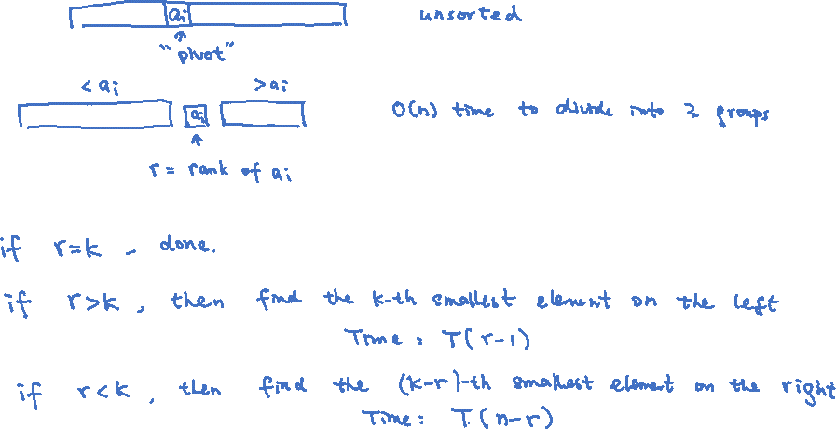
Divide and Conquer
The idea is similar to that in quicksort (which is a divide and conquer algorithm).

Slide 15
Finding a Good Pivot
We have made some progress in the median problem, by reducing the problem of finding the
middle number to the easier problem of finding a number not too far from the middle.

Slide 16
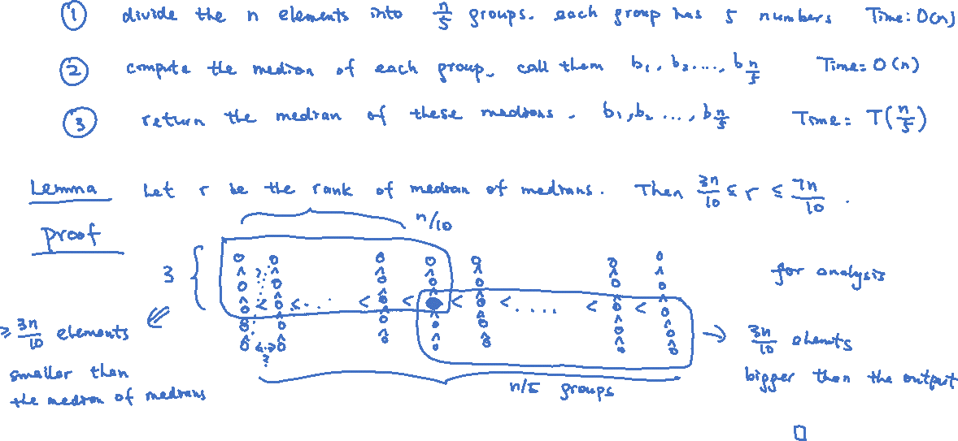
Median of Medians

Slide 17
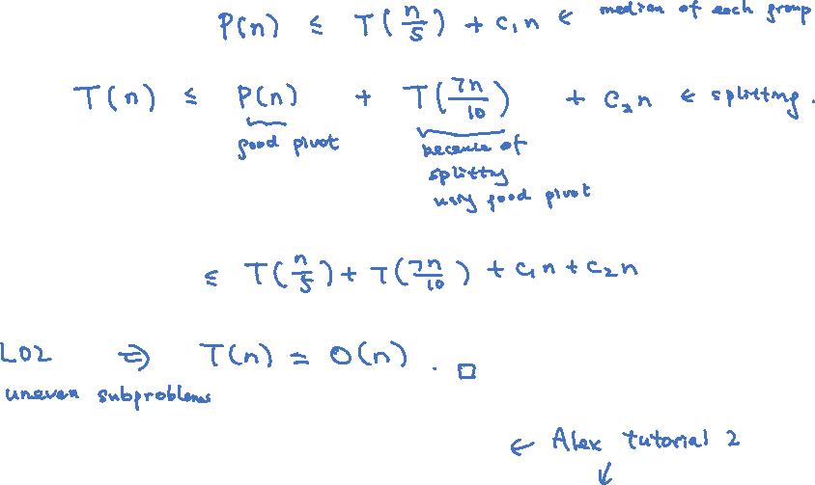
Time Complexity
Exercise: What if we divide into groups of 3, 7, 9,…,$\sqrt{n}$?
Exercise: Unfold the recursion to understand the algorithm better.

