Slide 1
CS 341 – Algorithms
Lecture 2 – Solving Recurrence
14 May 2021

Slide 2
Today’s Plan
Merge Sort
Master Theorem
More Recurrences

Slide 3
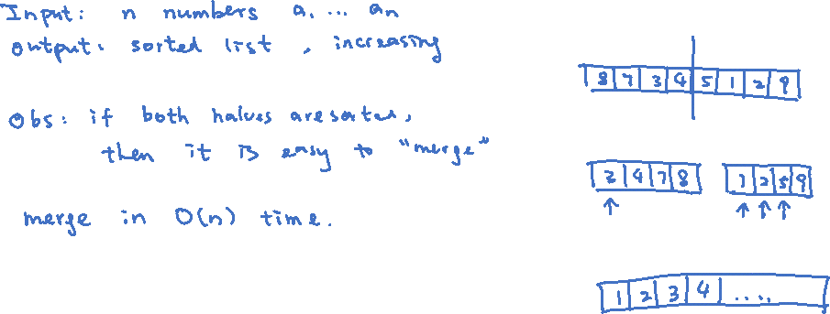
Merge Sort
This is a classical algorithm using the idea of divide and conquer.

Slide 4
Recursive Algorithm
How do we assume that each halve is already sorted? The idea is to apply the same procedure recursively.

Slide 5
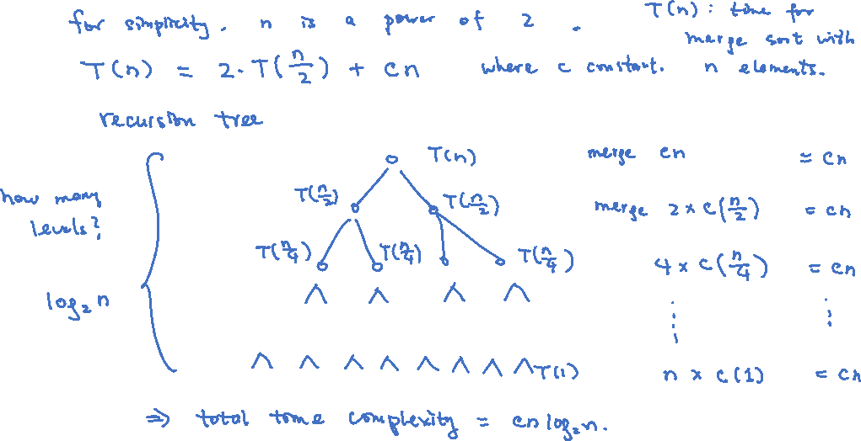
Solving the Recurrence Relation
To analyze the time complexity, we need to solve the recurrence relation.

Slide 6
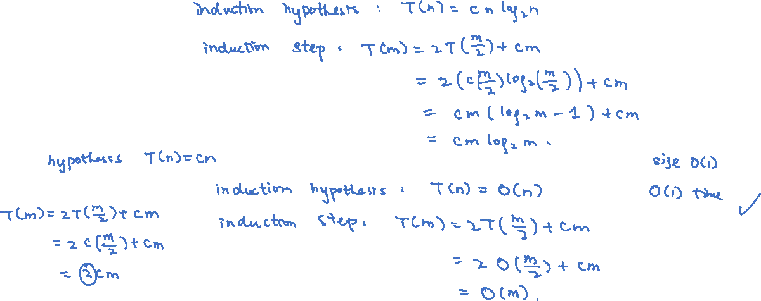
Proving by Induction

Slide 7
Today’s Plan
Merge Sort
Master Theorem
More Recurrences
Homework 1 posted
TA office hours, Tuesdays 8:30-9:30pm
Thursdays 3:30-4:30pm
Tutorials, Mondays 1-2pm
First week on May 25 because of Victoria Day

Slide 8
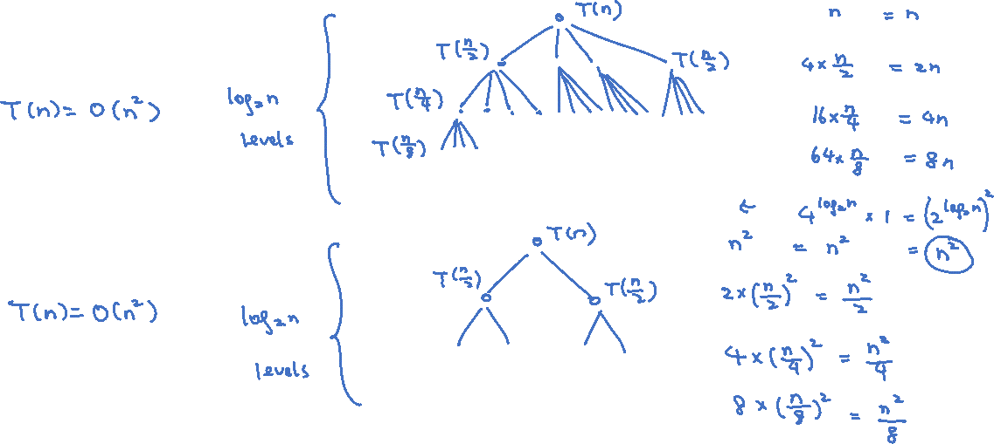
Exercises
$T\left(n\right)=4T\left(\frac{n}{2}\right)+n$
$T\left(n\right)=2T\left(\frac{n}{2}\right)+n^{2}$

Slide 9
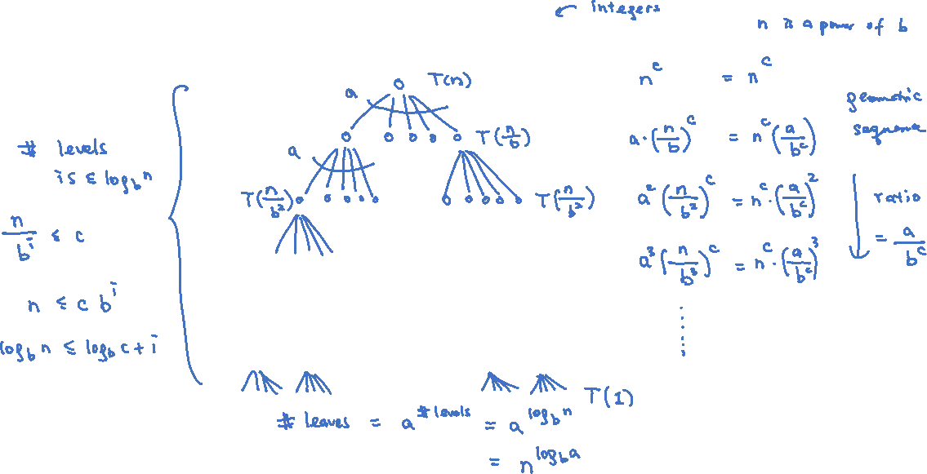
Recursion Tree in the General Setting
Consider the recurrence relation $T\left(n\right)=a⋅T\left(\frac{n}{b}\right)+n^{c}$ where $a≥1, b>0,c≥0$.

Slide 10
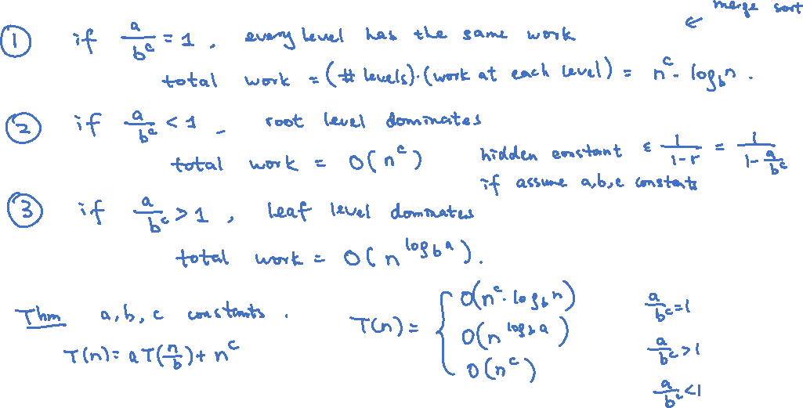
Master Theorem
There are three cases to consider, depending on the ratio in the geometric sequence.

Slide 11
Today’s Plan
Merge Sort
Master Theorem
More Recurrences

Slide 12
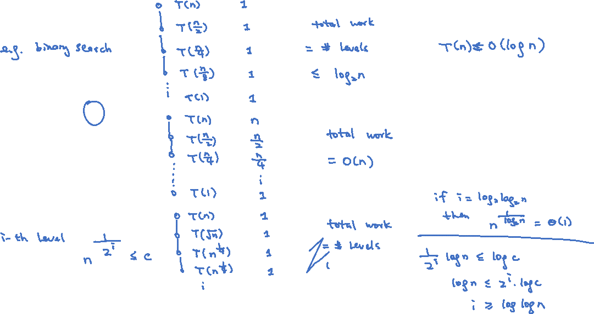
Single Subproblem
$T\left(n\right)=T\left(\frac{n}{2}\right)+1$
$T\left(n\right)=T\left(\frac{n}{2}\right)+n$
$T\left(n\right)=T\left(\sqrt{n}\right)+1$

Slide 13
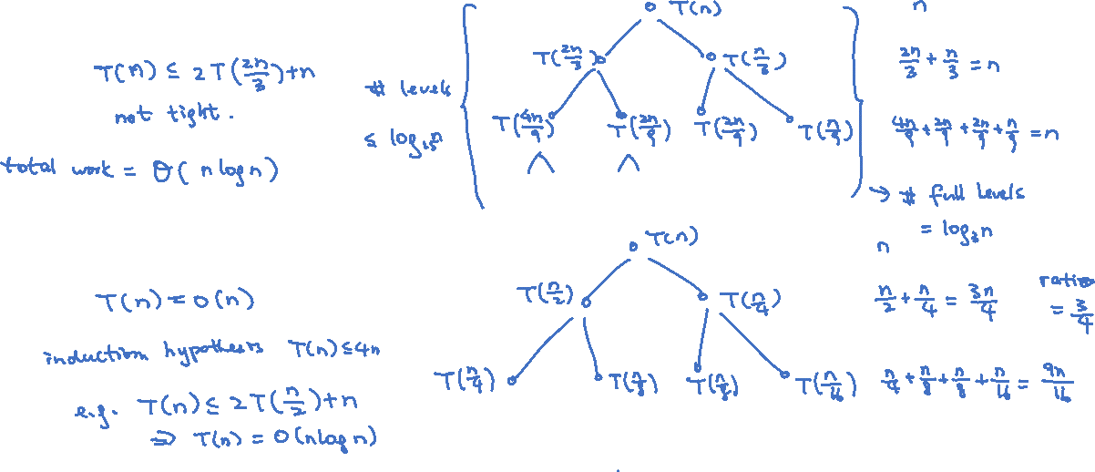
Uneven Subproblems
$T\left(n\right)=T\left(\frac{2n}{3}\right)+T\left(\frac{n}{3}\right)+n$
$T\left(n\right)=T\left(\frac{n}{2}\right)+T\left(\frac{n}{4}\right)+n$
We will see an interesting problem later with this kind of recurrence relation.

Slide 14
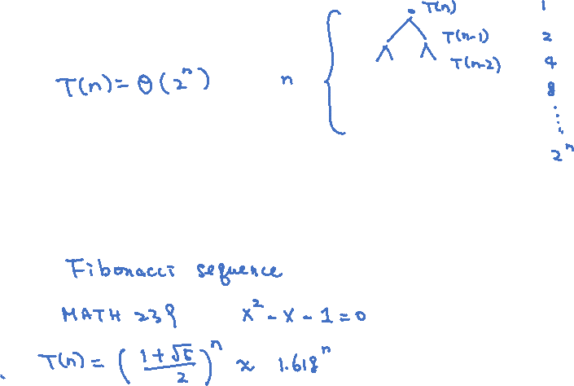
Exponential Time
$T\left(n\right)=2T\left(n−1\right)+1$
$T\left(n\right)=T\left(n−1\right)+T\left(n−2\right)+1$ (Optional)

Slide 15
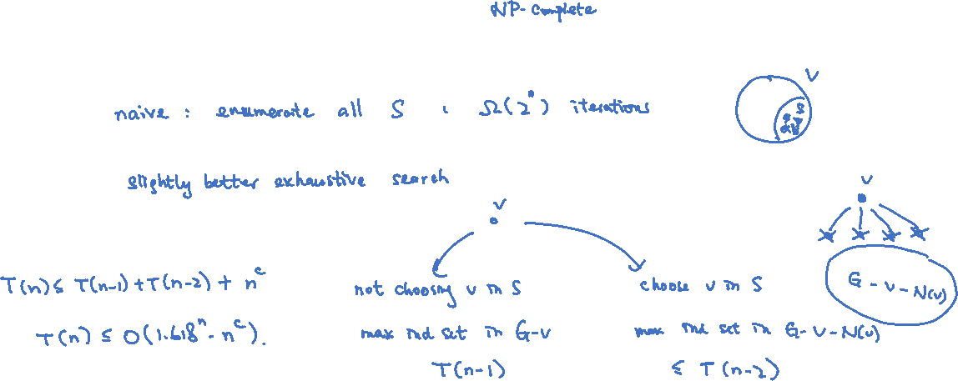
Analyzing Maximum Independent Set (Optional)
Input: Graph $G=(V,E)$
Output: An independent set $S⊆V$of maximum size (where $S$ is independent if $uv∉E$ for all $u,v∈S$)

Slide 16
Summary
Understand the recursion tree method.
This will be accepted as a correct solution. Of course, inductive solution will also be accepted.
We will apply this to analyzing time complexity of divide and conquer algorithms.

