Slide 1
CS 341 – Algorithms
Lecture 1 – Course Introduction
11 May 2021

Slide 2
Today’s Plan
Course information/administration
Course overview
Time complexity and computation model
3-SUM

Slide 3
Course Information
Course homepage: https://cs.uwaterloo.ca/~lapchi/cs341/.
You can find the course outline, course notes, slides, and homework there.
We have a piazza page for Q&A: https://piazza.com/uwaterloo.ca/spring2021/cs341.
You can also see the course homepage of my past offerings in Winter 2016 and Spring 2017.

Slide 4
Course Requirements
Homework 50%
5 problem sets, each 10%
one programming problem in each homework
Take home midterm 20%
Take home final exam 30%
Please find the tentative schedule in the course outline (e.g. midterm ~June 28, HW1 due ~May 31).
Academic honesty is very important.

Slide 5
Online Lectures
We have online live lectures via Zoom, probably on Wed and Fri 11:10am-12:40pm (TBA).
The lectures will be recorded and posted on YouTube afterwards.
You are encouraged to show your video so that I could get some visual response.
You are encouraged to interrupt me to ask questions directly.
You are also encouraged to ask and answer questions in chat. I will check from time to time.

Slide 6
References
Course notes will be provided and usually posted the day before the lecture.
Slides will be provided and the unannotated version will be posted the day before the lecture,
and the annotated version will be posted after the lecture.
We will mostly use the problems discussed in the following three reference books.
[DPV] Algorithms, by Dasgupta, Papadimitriou, and Vazirani, McGraw-Hill.
[KT] Algorithm Design, by Kleinberg and Tardos, Pearson.
[CLRS] Introduction to Algorithms, by Cormen, Leiserson, Rivest and Stein, MIT Press.

Slide 7
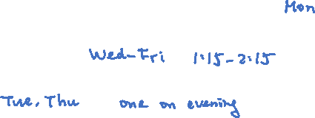
Course Resources and Support
Lectures (live on Zoom and recorded videos).
Course notes.
Slides.
Homework and supplementary exercises.
Tutorials (live on Zoom and recorded videos). Worked out sample problems.
Office hours (live on Zoom): time TBA, after lectures.
TA office hours (live on Zoom): time TBA.
Piazza Q&A.
Hope these can support and accommodate different styles of learning.

Slide 8
Today’s Plan
Course information/administration
Course overview
Time complexity and computation model
3-SUM

Slide 9
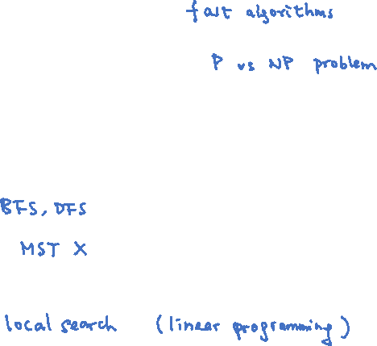
Syllabus
The main focus is on the design and analysis of algorithms.
We will also study the theory of NP-completeness in the end.
The tentative schedule is:
divide and conquer (~4 lectures).
graph algorithms (~4 lectures).
greedy algorithms (~3 lectures).
dynamic programming (~4 lectures).
bipartite matching (~3 lectures).
NP-completeness (~4 lectures).

Slide 10
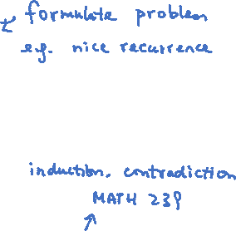
Course Style
There are a few steps to develop an efficient algorithm useful in practice.
Understand the structures and mathematical properties of the problem.
Use these observations to design an algorithm. Prove correctness and analyze time complexity.
Efficient implementation, with the use of good data structures.
This course is theoretically oriented.
We will focus on the first two steps, and spend most of the time in writing mathematical proofs.
Standard data structures will be enough (e.g. queue, stack, heap, balanced search tree, etc).
The programming problems are to practice your implementation skills.

Slide 11
Two Classical Problems
We are given a graph $G=\left(V,E\right)$ with a non-negative cost $c_{e}$ on each edge.
The traveling salesman problem askes us to find a minimum cost tour visiting every vertex at least once.
The Chinese postman problem askes us to find a minimum cost tour visiting every edge at least once.

Slide 12
Learning Outcome
Know basic techniques and well-known algorithms well.
Have the skills to design new algorithms for simple problems.
Have the skills to prove correctness and analyze time complexity of an algorithm.
Use reductions to solve problems and to prove hardness.

Slide 13
Today’s Plan
Course information/administration
Course overview
Time complexity and computation model
3-SUM

Slide 14
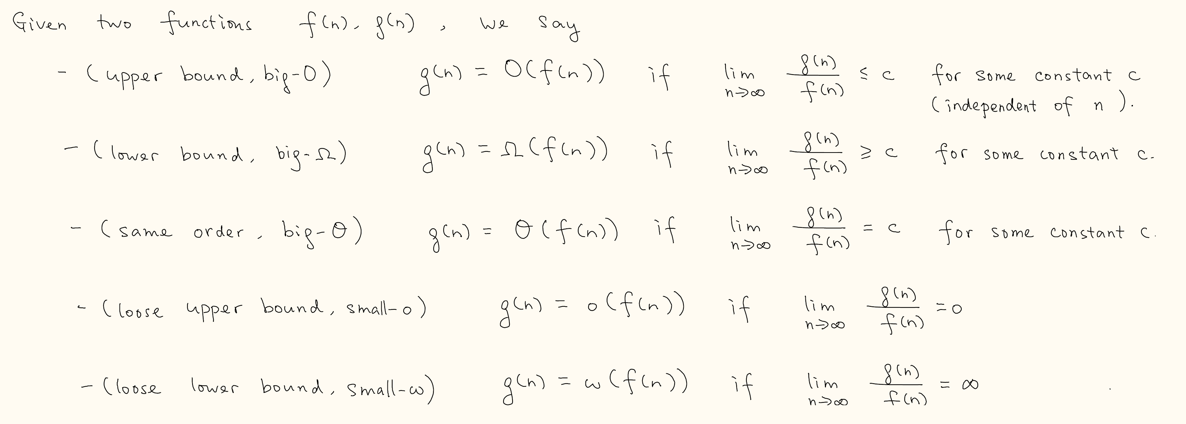
Time Complexity
Roughly speaking, we count the number of operations that the algorithm requires.
But instead of counting precisely, we use the asymptotic time complexity to analyze algorithms.

Slide 15
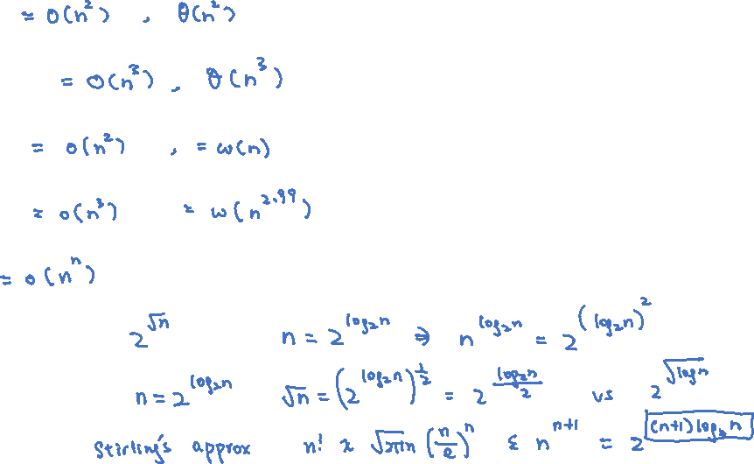
Examples and Exercises
$100n^{2}$
$2n^{3}+\frac{n^{3}}{\log{n}}$
$n\log{n}$
$\frac{n^{3}}{\log{\log{n}}}$
$2^{n}$
$2^{\sqrt{n}}$ vs $n^{\log{n}}$
$\sqrt{n}$ vs $2^{\sqrt{\log{n}}}$
$2^{n^{1.1}}$ vs $n!$

Slide 16
Worst Case Time Complexity
We say an algorithm has time complexity $O\left(f\left(n\right)\right)$ if it requires at most $O\left(f\left(n\right)\right)$ primitive operations
for all inputs of size $n$ (e.g. $n$ bits, $n$ numbers, $n$ vertices, etc).
$2^{2^{100}}n^{2}$ vs $n^{3}$?

Slide 17
Polynomial Time Algorithms
“Good” algorithms: worst case time complexity $O\left(poly\left(n\right)\right)$.

Slide 18
Computation Model
Word-RAM model
Access an arbitrary position of an array in constant time.
Each word operation (e.g. addition, multiplication, read/write) can be done in constant time.
Non-trivial example: computing determinant.
Be aware of what we are assuming!

Slide 19
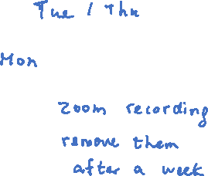
Today’s Plan
Course information/administration
Course overview
Time complexity and computation model
3-SUM
TA office hours
Tutorials
Video recordings

Slide 20
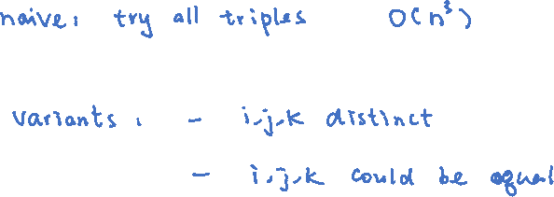
3-SUM
Input: $n$ numbers $a_{1},a_{2},…,a_{n}$, and a target number $c$
Output: indices $i,j,k$ such that $a_{i}+a_{j}+a_{k}=c$, or report that such triples do not exist.

Slide 21
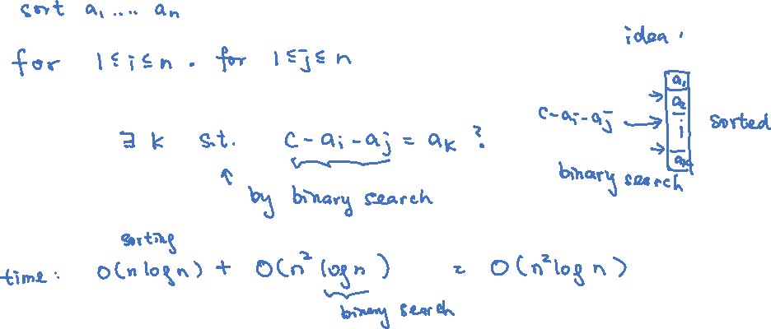
3-SUM: Algorithm 2
Observe that $a_{i}+a_{j}+a_{k}=c$ can be rewritten as $c −a_{i}−a_{j}=a_{k}$.
Idea: Enumerate all pairs $a_{i},a_{j}$ and check whether $c −a_{i}−a_{j}=a_{k}$ for some $k$.

Slide 22
3-SUM: Algorithm 3
Note that $a_{i}+a_{j}+a_{k}=c$ can also be rewritten as $a_{i}+a_{j}=c−a_{k}$.
Idea: Enumerate all $a_{k}$ and check whether $a_{i}+a_{j}=c−a_{k}$ for some pair $i,j$.
We reduce the 3-SUM problem to $n$ instances of the 2-SUM problem.

Slide 23
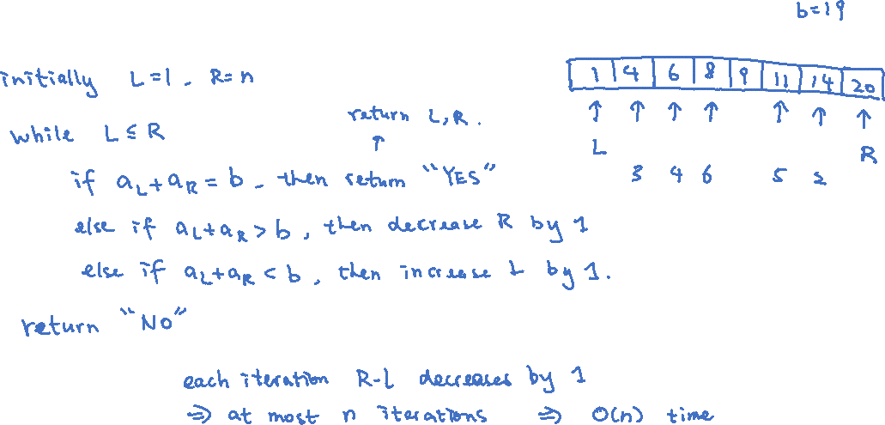
2-SUM: Algorithm
Input: $n$ numbers $a_{1}≤a_{2}≤…≤a_{n}$, and a target number $b$.
Output: indices $i,j$ such that $a_{i}+a_{j}=b$, or report that such pairs do not exist.
Time complexity:

Slide 24
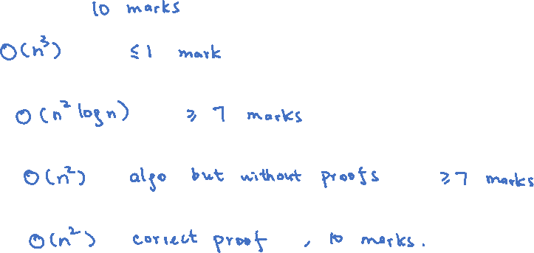
2-SUM: Proof of Correctness

Slide 25
If this question was in the exam…

Slide 26
Literature (Optional)
Conjecture: $O\left(n^{2}\right)$ algorithm is optimal for 3-SUM.
Researchers started to use this conjecture to prove hardness for other problems!

