Slide 1
What the ‘Trolley Problem’ can (and can’t) teach us about ethics
CS 486/686
Sept. 13, 2019

Slide 3
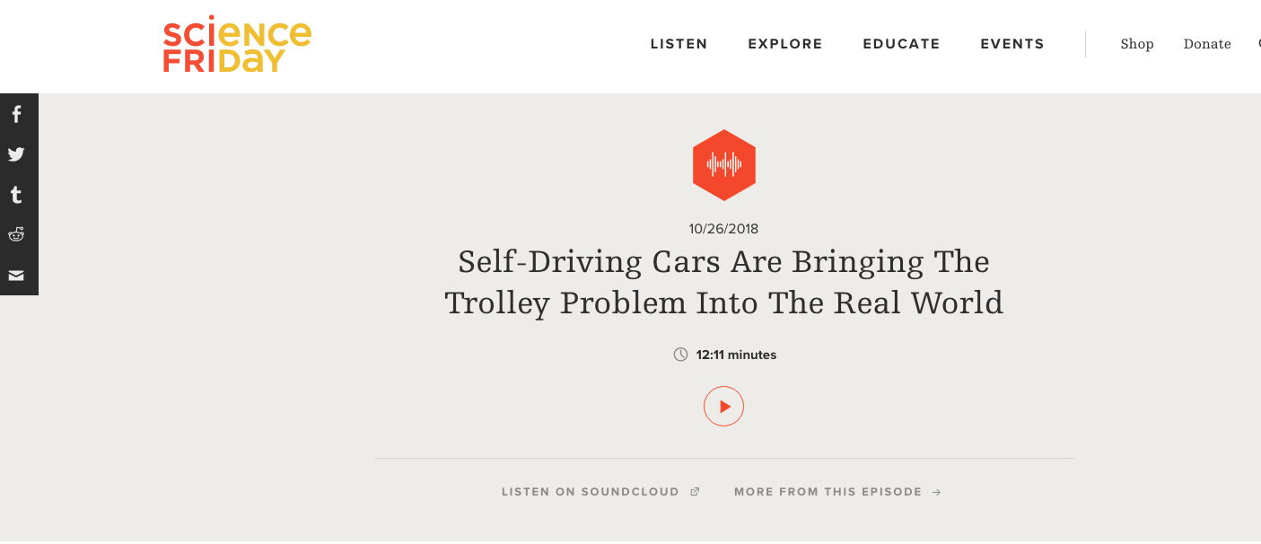

Slide 4
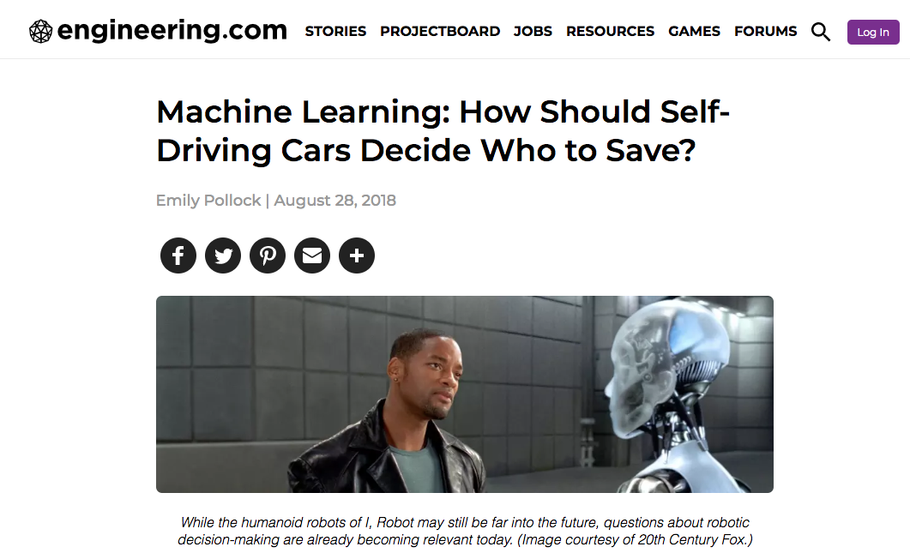

Slide 6
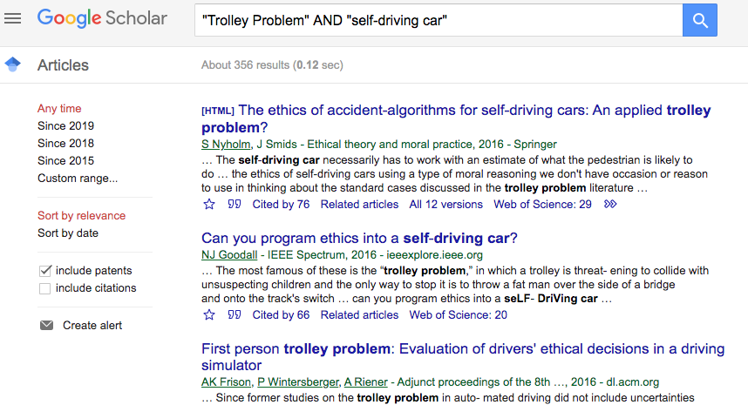

Slide 7
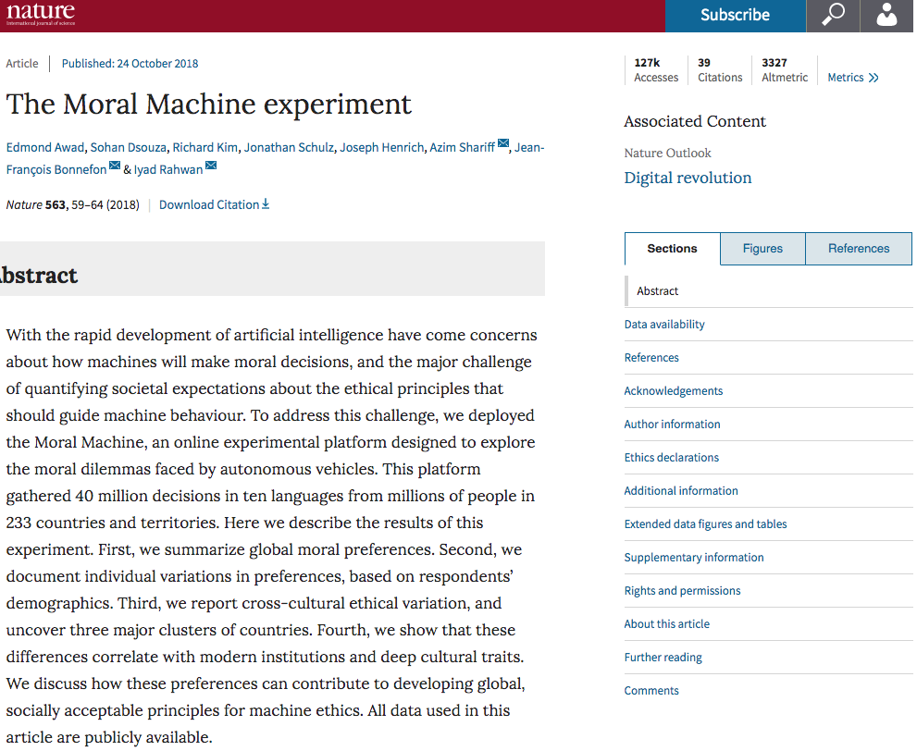

Slide 8
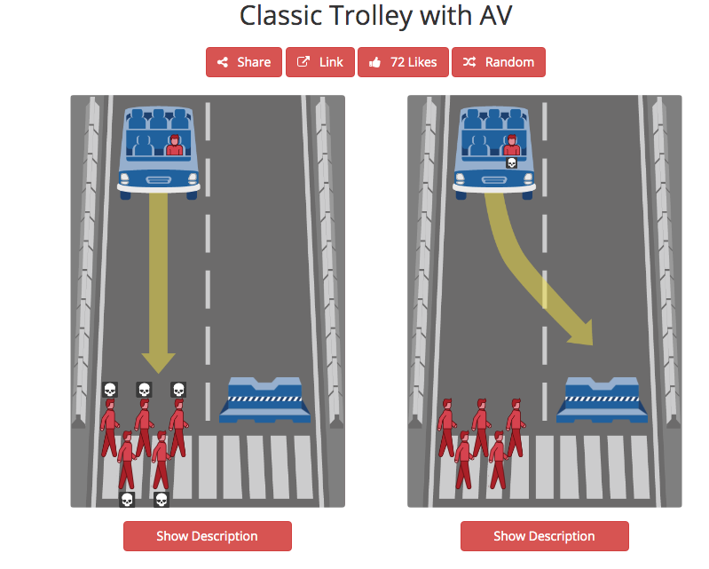

Slide 9
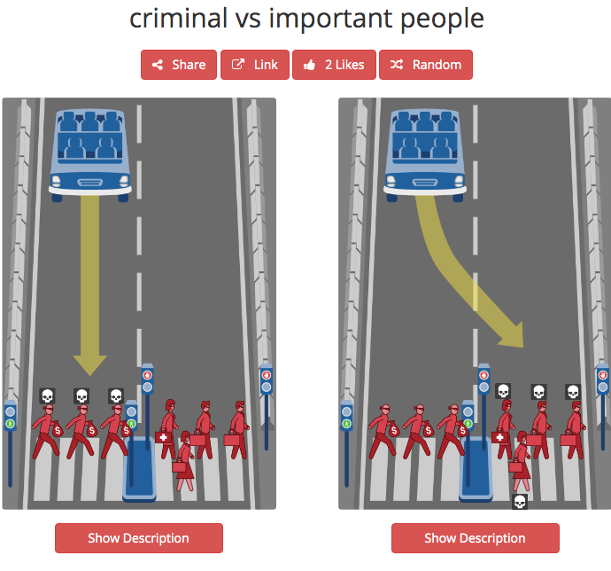

Slide 10
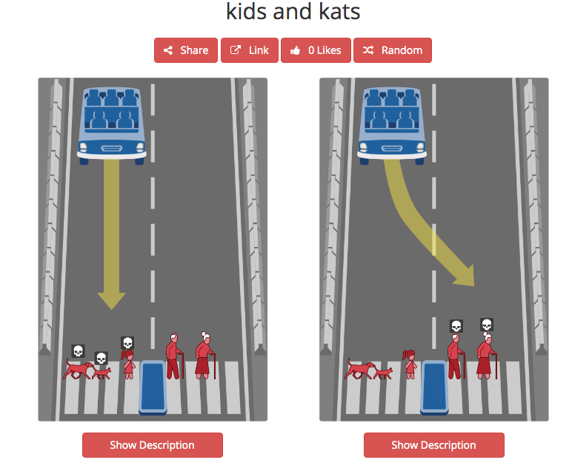

Slide 11
These results are fascinating; they reveal a lot about what we value and how we reason about moral decisions.
Still, these results are close to irrelevant to the ethical challenges facing those designing the systems in Autonomous Vehicles.
Why?

Slide 12
Two Distinct Processes
For these data to be relevant, an autonomous vehicle would need to be able to perform two distinct processes. Each process requires answering different questions and solving different problems.

Slide 13
Two Distinct Processes
Perception: Can the system actually distinguish e.g. men from women, dogs from children, young from old, fit from unhealthy, criminals from doctors?
That’s a technical/design question.
Action: Once the system make these perceptual distinctions, what should we tell the system to do with that information?
That’s a policy/ethical question.

Slide 14
Assuming the Problem Away
Many popular discussions of the Trolley Problem and AVs assume that we’ve entirely solved the technical/design question. (Or at least that it needs to be solved in order to put AVs on road.)
But this design problem is nowhere close to being solved! It’s not the design problem AV designers are trying to solve! It’s hard to see how it could be solved!
‘Doctor vs criminal’ is not discernible from appearance. Neither is ‘age/gender/health status of medium sized-person wearing a winter coat and hat.’

Slide 15
What’s a Good Solution?
A better question: In order to permit AVs on the roads, how good do perception systems need to be at:
Distinguishing people from garbage cans (for example)?
Predicting the behaviour of other road users?
That’s also an ethical/policy question, but it’s one about what counts as a good solution to a series of design/technical problems. Any such solution will involve trade-offs.
The standard ‘Trolley Problem and AVs’ discussion assumes this question is solved and no design trade-offs are required.

Slide 16
Whose Safety?
Another better question: in general, how should vehicle design (and road design) balance between:
The safety of people in the vehicle.
The safety of people not in the vehicle, including both people in other vehicles and vulnerable road users (pedestrians, cyclists).

Slide 17
Whose Safety?
But notice: there’s nothing distinct about AVs or AI here.
Balancing the safety of car occupants with other road users is relevant to vehicle and road design even in the absence of any autonomous systems.
The Trolley Problem scenario doesn’t really help answer this question.
Our current approach to design prioritizes the safety and even the comfort and convenience of people in vehicles at the expense of the safety of those not in vehicles.

Slide 18
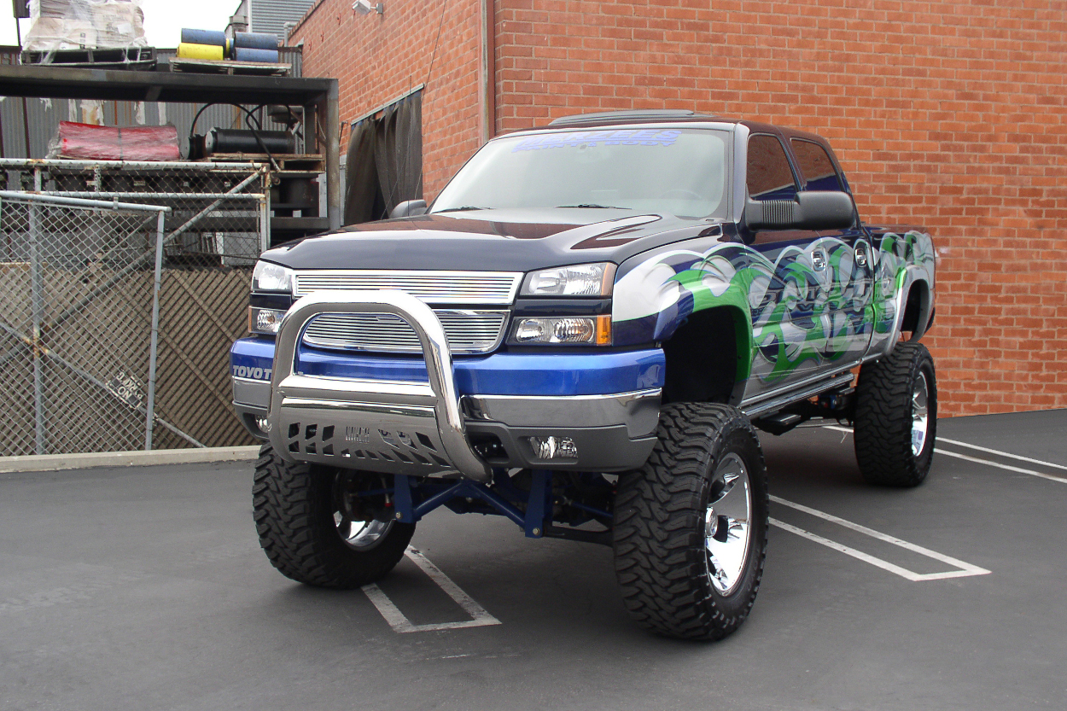

Slide 19
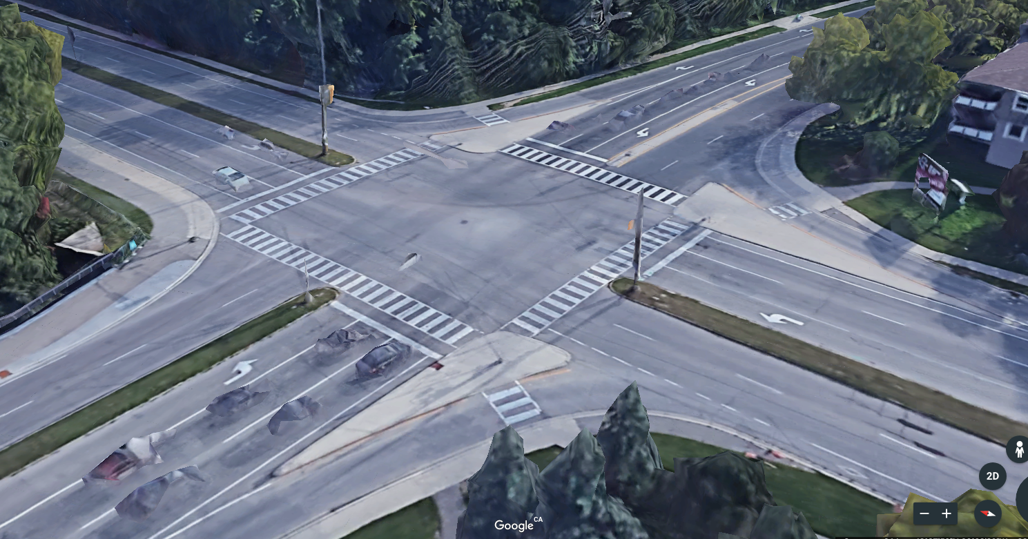

Slide 20
Why Trolleys are a Distraction
The Trolley Problem distracts us from two interesting questions related to AVs:
An ethical question specific to designing AI systems for AVs: what counts as good solutions to the technical/design problems it generates?
The general ethical question of how we should balance the safety of different people.

Slide 21
Why Trolleys are Interesting
So: what does the Trolley Problem have to teach us?
Something important about the complexity of moral decision-making.
The traditional version of the Trolley Problem contrasts two different cases.

Slide 22
The Trolley Problem: Switch

Slide 23
The Trolley Problem: Switch
Should you divert the trolley in order to save 5 people, thereby causing the death of a single person?
Around 80% of people judge that diverting the trolley is at least permissible of not obligatory.
A natural explanation: when faced with a choice, it is better to save more lives rather than fewer. Switching saves 4 net lives.

Slide 24
The Trolley Problem: Footbridge

Slide 25
The Trolley Problem: Footbridge
Should you push and kill the heavy man in order to save 5 people?
Around 80% of people judge that it is impermissible to push the heavy man.
A natural explanation: murder is morally wrong, and if you push him aren’t you effectively murdering him?

Slide 26
The Trolley Problem
These two cases are very similar: Should you take action to save the lives of 5 people if that will result in the death of 1 person?
Turns out that answers differ depending on what the action is.
Switch: 80% say it’s at least permissible
Footbridge: 80% say it is impermissible

Slide 27
The Philosophical Problem
The problem (for philosophers) is that these two answers seem inconsistent.
Why is saving five OK in Switch and not in Push? (The one is just as dead in both.)
There seems to be something wrong with a set of beliefs that are internally inconsistent: at least one of them must be false.
So: how to solve this problem?

Slide 28
Two Broad Approaches
Treat both cases the same, and so change your answer in one of them.
Identify a morally significant difference between the cases.
Philosophers who work in the Trolley Problem have spent the last several decades arguing about these approaches.

Slide 29
Why it’s a Problem
The problem is not: “should you save 5 people rather than 1 person?”
The problem is instead: “How do we resolve the apparent inconsistency between the standard reaction to what seem to functionally identical cases?”
In other words, the “Trolley Problem” is not a problem about what to do if you’re dropped into an implausible fictional scenario; it’s a problem about the potential for irrationality in our moral thinking.

Slide 30
One Source of the Problem
Hard moral problems involve conflicts between important values. For example, we care about:
Overall levels of happiness or well-being: suffering and death are bad, and we want to prevent as much of it as possible.
Fairness: we care about how happiness or suffering is distributed, and about who gains and loses. (But which distributions are fair?)
Individual rights and personal autonomy: we think personal freedoms are important, and that there are ways we cannot treat people even if it would increase overall happiness. (But rights do we have, exactly? And what limits do they set?)

Slide 31
Multiple Values
These values are all important, but they can conflict.
For example, in Footbridge it looks as the value of saving as many lives as possible conflicts with the man on the bridge’s right not to be killed.
Moral judgment often involves navigating these conflicts and deciding:
Whether and how to make trade-offs between the values
Whether any of these values should trump or dominate the others
We want these decisions to be principled and well-justified.

Slide 32
Multiple Values
People working on ethical development and use of AI systems recognize that there are multiple, potentially conflicting values to balance.
For instance…

Slide 33
Montreal Declaration for a Development of Responsible AI
Well Being
Respect for Autonomy
Protection of Privacy and Intimacy
Solidarity
Democratic Participation
Equity
Diversity and Inclusion
Prudence
Responsibility
Sustainability

Slide 34
Google’s Objectives for AI Applications
Be socially beneficial
Avoid creating or reinforcing unfair bias
Be built and tested for safety
Be accountable to people
Incorporate privacy into designs
Uphold high standards of scientific excellence
Be made available for uses that accord with these principles

Slide 35
To Sum Up
These values are all important
Figuring out what each one requires in any given context is not simple
Figuring out whether they conflict in any given context is complicated
Figuring out which trade-offs between them are acceptable in any given context can be very complicated
We can be misled about all of this if we don’t think systematically and consider ethical implications of design decisions at each step in the design process

