Slide 1
Clearing Algorithms for Barter Exchange Markets: Enabling Nationwide Kidney Exchanges
Hyunggu Jung
Computer Science University of Waterloo Oct 6, 2008

Slide 2
Notes:
How many students have you heard about the role of kidney?
The role of kidney is to filter waste from blood.
Kidney failure results in accumulation of this waste, which leads to death in months.

Slide 3
Kidney Transplants
Dialysis??
Kidney Transplants
- The demand for kidneys far outstrips supply
- Seen as the only ethical way to significantly reduce the 4,000 deaths per year attributed to kidney disease
Notes:
One treatment option is dialysis, in which the patient goes to a hospital to have his/her blood filtered by an external machine.
Several visits are required per week, and each takes several hours.
The quality of life on dialysis can be extremely low, and in fact many patients opt to withdraw from dialysis, leading to a natural death.
Instead, the preferred treatment is a kidney transplant.
Kidney transplants are by far the most common transplant. Unfortunately, the demand for kidneys far outstrips supply.
In the United States in 2005, 4,052 people died waiting for a life-saving kidney transplant.
During this time, almost 30,000 people were added to the national waiting list, while only 9,913 people left the list after receiving a deceased-donor kidney.

Slide 4
Kidney Transplants
Difficult!
Finding a living donor
Why?
Compatible or incompatible
Blood type and tissue type

Slide 5
Outline
Key Insight
Problem
Solution approaches
Experimental Results
Contribution
Future works

Slide 6
Outline
Key Insight
Problem
Solution approaches
Experimental Results
Contribution
Future works

Slide 7
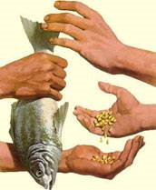
Key Insight
Barter-exchange market
Agents seek to swap their items with one another in order to improve their own utilities
Swaps consist of cycles of agents, with each agent receiving the item of the next agent in the cycle

Slide 8
Key Insight
Kidney exchange market
Barter exchange market
Clearing problem

Slide 9
Outline
Key Insight
Problem
Solution approaches
Experimental Results
Contribution
Future works

Slide 10
Design
Encode a barter exchange market as a directed graph G = (V, E)
Construct one vertex for each agent
Add a weighted edge e from one agent Vi to another Vj, if Vi wants the item of Vj

Slide 11
Terms and Definition
Terms | Definition
Weight We of a edge e | Utility to Vi of obtaining Vj ’s item
Cycle c | A possible swap, with each agent in the cycle obtaining the item of the next agent
Weight Wc of a cycle c | The sum of its edge weights
Exchange | A collection of disjoint cycles
Weight of an exchange | The sum of its cycle weights

Slide 12
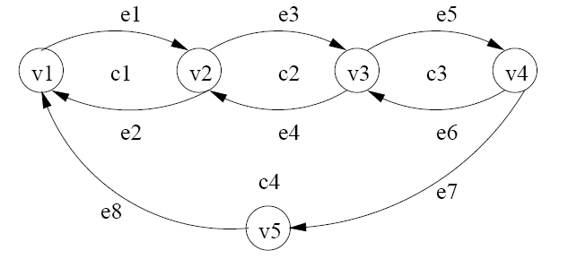
Graph

Slide 13
Components
5 agents
4 cycles
2 (inclusion) maximal exchanges
{v1, v2, … , v5}, in which all edges have weight 1
c1 = <v1, v2>, c2 = <v2, v3>, c3 = <v3, v4>, c4 = <v1, v2, v3,v4, v5>
M1 = {c4}, M2 = {c1, c3}
Notes:
Maximal: largest with respect to set inclusion
Example {a}, {a,b}, {a,c}, {a,b,d}
maximal: {a, b, d}, {a, c}

Slide 14
Clearing Problem
To find a maximum-weight exchange consisting of cycles with length at most some small constant L
Is everything OK if we solve a clearing problem?
No, a kidney exchange market is a barter-exchange market having some constraints
Notes:
Is everything OK if we solve a clearing problem?
No, a kidney exchange market is a barter-exchange market having some constraints

Slide 15
Constraints
All operations in a cycle have to be performed simultaneously
The upcoming national kidney exchange market will likely allow only cycles of length 2 and 3
If the cycle fails to exchange, fewer agents are affected
Notes:
Otherwise, a donor might back out after his incompatible partner has received a kidney.
This gives rise to a logistical constraint on cycle size.
For example, last-minute testing in a kidney exchange often reveals new incompatibilities that were not detected in the initial testing.
More generally, an agent may drop out of a cycle if his preference changed, or he/she simply fails to fulfill his obligagion

Slide 16
Outline
Key Insight
Problem
Solution approaches
Experimental Results
Contribution
Future works

Slide 17
Solution Approaches
The clearing problem is NP-complete for L ≥ 3
Heuristic or approximation algorithm
However, an exact algorithm based on an integer-linear program (ILP) formulation, which we solve using specialized tree search
Notes:
First, any loss of optimality could lead to unnecessary patient deaths.
Second, an attractive feature of using an ILP formulation is that it allows one to easily model a number of variations on the objective, and To add additional constraints to the problem.

Slide 18
Integer-Linear Program
What is ILP?
If the unknown variables are all required to be integers, then the problem is called an integer-linear program (ILP) problem
ILPs are in many practical situations (those with bounded variables) NP-hard

Slide 19
Solution Approaches
A formation of the clearing problem as an ILP with one variable for each edge
Solving the directed cycle cover problem with no cycle-length constraints
A formation of the clearing problem as an ILP with one variable for each cycle
Solving the directed cycle cover problem when cycles have length 2

Slide 20
Incremental Problem formulation
Too large to construct on current hardware
The key, incremental problem formulation
Two paradigms for the task:
Constraint generation
Column
generation

Slide 21
Constraint generation
Construct a subgraph of edges with positive value
In the first constraint generator, search for length-L paths with value sum more than L-1
In the second constraint generator, add on constraint for such cycles
Notes:
Please refer to the section, 4.2
This generator made the algorithm slower.

Slide 22
Column generation
Start with a restricted LP containing only a small number of columns (variables, i.e., cycles)
Repeatedly add columns until an optimal solution to this partially formulated LP is an optimal solution to the original LP
Notes:
Please refer to the section, 5.2

Slide 23
Solution Approaches
THEOREM 2. The LP relaxation of the cycle formulation weakly dominates the LP relaxation of the edge formulation
The cycle formulation is tighter than the edge formulation
For a graph with m edges, the edge formulation requires O(m³) constraints, while the cycle formulation requires only O(m²)
Notes:
Please refer to the section, 5.1

Slide 24
Solution Approaches
The edge formulation approach cannot clear a kidney exchange with 100 vertices in the time the cycle formulation can clear on with 10,000 vertices
Column generation based approaches are better than constraint generation based approaches
Focus on the cycle formulation and the column generation based approaches

Slide 25
Solution Approaches
The edge formulation approach cannot clear a kidney exchange with 100 vertices in the time the cycle formulation can clear on with 10,000 vertices
Column generation based approaches are better than constraint generation based approaches
Focus on the cycle formulation and the column generation based approaches

Slide 26
Solution Approaches
The clearing problem is NP-complete for L ≥ 3
Heuristic or approximation algorithm
However, an exact algorithm based on an integer-linear program (ILP) formulation, which we solve using specialized tree search

Slide 27
Tree Search
Performs a branch-and-price tree search to find an optimal integral solution
Explores the search tree in depth-first order
Primal heuristics and cycle brancher
Notes:
Before branching on a fractional variable, we use primal heuristics to construct a feasible integral solution
Branching by certainty, randomly select a variable form those whose lp value is closest to 1.
Second strategy, branching by uncertainty, randomly select a variable whose LP value is close to 0.5
Two child

Slide 28
Outline
Key Insight
Problem
Solution approaches
Experimental Results
Contribution
Future works

Slide 29
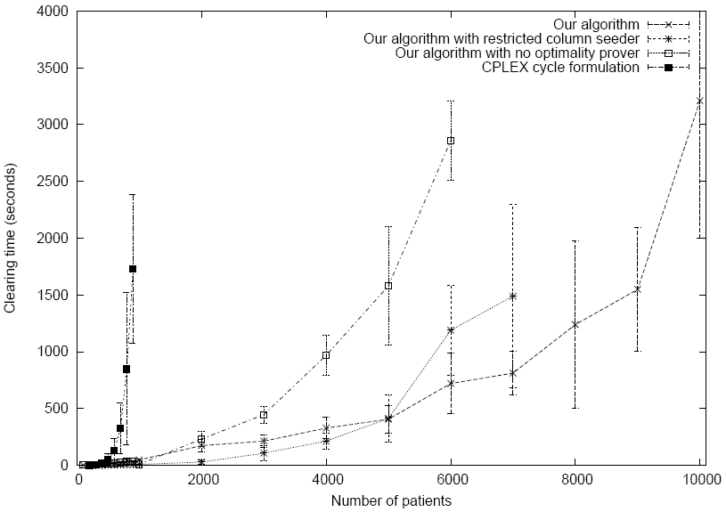
Experimental Results
In Linux (Red Hat 9.0), using a Dell PC with a 3GHz Intel Pentium 4 processor, and 1GB of RAM
Randomly generated 10 markets, and attempted to clear then using each of the algorithms
Average runtime with standard deviation bars

Slide 30
Experimental Results
Notes:
Runtime performance of four clearing algorithms
Average runtime with standard deviation bars
1. CPLEX on the full cycle formulation
Fails to clear any markets with 1000 patients or more
Its Running time on markets smaller than this is significantly worse than the other algorithms
2. Algorithm with restricted column seeder
Restrict the seeder so that it only begins with 10,000 cycles
This setting is faster for smaller instances, since the LP relaxations are smaller, and faster to solve
At 5000 vertices, this effect starts to be offset by the additional column generation that must be performed
3. Algorithm with no optimality prover
Restore the seeder to its optimized setting, but this time, remove the optimality prove
4. Algorithm
- By taking advantage of the properties of our problem, we manage to clear a market with 10,000 patients in about the same time it would otherwise have taken to clear a 6000 patient market.

Slide 31
Experimental Results
CPLEX
Fails to clear any markets with 1000 patients or more
Running time on markets smaller than this is significantly worse than the other algorithms
Proposed algorithm
Manages to clear a market with 10,000 patients in about the same time it would otherwise have taken to clear a 6000 patient market

Slide 32
CPLEX
An optimization software package
It is named for the simplex method and the C programming language, although today it contains interior point methods and interfaces in the C++ , C Sharp, and Java languages
Developed by Robert E. Bixby and sold via CPLEX Optimization Inc., which was acquired by ILOG in 1997
Solves integer programming problems, very large linear programming problems, quadratic programming problems, and has recently added support for problems with convex quadratic constraints
Notes:
ILOG CPLEX (often informally referred to simply as CPLEX) is an optimization software package. It is named for the simplex method and the C programming language, although today it contains interior point methods and interfaces in the C++ , C Sharp, and Java languages. It was originally developed by Robert E. Bixby and sold via CPLEX Optimization Inc., which was acquired by ILOG in 1997. CPLEX solves integer programming problems, very large^{[1]} linear programming problems, quadratic programming problems, and has recently added support for problems with convex quadratic constraints (solved via Second-order cone programming, or SOCP). It has a modeling layer called Concert and is also available with several modeling systems like AIMMS, AMPL, GAMS, MPL, OPL Development Studio, and TOMLAB.

Slide 33
Outline
Key Insight
Problem
Solution approaches
Experimental Results
Contributions
Future works

Slide 34
Contributions: to Society
Presented the first algorithm capable of clearing kidney-exchange markets on a nationwide scale
Supported generalizations, as desired by real-world kidney exchanges
Replaced CPLEX as the clearing algorithm of the Alliance for Paired Donation in Dec 2006

Slide 35
Contributions: to Field
Developed the most scalable exact algorithms for barter exchanges to date
Treated the kidney exchange as a batch problem with full information
Incremental problem formulation:
Constraint generation and column generation
Outperforms CPLEX experimentally

Slide 36
Outline
Key Insight
Problem
Solution approaches
Experimental Results
Contributions
Future works

Slide 37
Future works
Online aspect
Limited-information aspect
Donees and donors will be arriving into the system over time, and it may be best to not execute the myopically optimal exchange now
Save part of the current market for later matches
The graph provided as input is not complete correct
It would be desirable to perform an optimization with the fact in mind

Slide 38
Reference
http://www.paireddonation.org
http://www.ilog.com/products/cplex
http://en.wikipedia.org/wiki/Linear_programming
http://en.wikipedia.org/wiki/CPLEX

Slide 39
Thank you

