Slide 1
Playing Games for Security: An Efficient Exact Algorithm for Solving Bayesian Stackelberg Games
Praveen Paruchuri, Jonathan P. Pearce, Sarit Kraus

Slide 2
Outline
Introduction
Problem Definition
DOBSS Approach
Mixed-Integer Quadratic Program
Decomposed MIQP
Arriving at DOBSS: Decomposed MILP
Experiments
Experimental Domain
Experimental Results
Conclusion

Slide 3
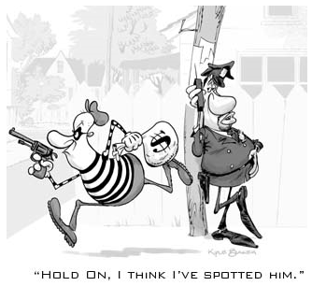
Introduction

Slide 4
Introduction
Stackelberg Game
One agent (the leader) must commit to a strategy that can be observed by the other agent (the follower)
Bayesian Stackelberg Game
Stackelberg Game
+ Leader’s uncertainty about the types of adversary he may face

Slide 5
Introduction
Example of Stackelberg Game
Security Problem
1. Simultaneous Moves: Nash Equilibrium (a,c)- Leader’s payoff=2
2. Let’s play Stackelberg Game!
 | c | d
a | 2,1 | 4,0
b | 1,0 | 3,2
 | Leader’s Committed Strategy | Follower’s Pure Strategy | Leader’s Payoff
Case 1 | Pure Strategy: b | d | 3
Case 2 | Mixed Strategy: (a-0.5,b-0.5) | d | 4*0.5+3*0.5=3.5
Notes:
Little Discussions
There is often an advantage for the leader over the games which require agents’ simultaneous moves.

Slide 6
Introduction
Our Target
To determine the optimal strategy for a leader to commit to in a Bayesian Stackelberg game
What is the Problem?
Choosing an optimal strategy for the leader to commit to in a Bayesian Stackelberg game is NP-hard!
Existing Solutions
Idea 1: Harsanyi Transformation
Reference: J.C.Harsanyi and R.Selten. A generalized Nash solution for two-person bargaining games with incomplete information. Management Science, 18(5):80-106, 1972.
Idea 2: MIP-Nash
Reference: T. Sandholm, A. Gilpin, and V. Conizer. Mixed-integer programming methods for finding nash equilibria. In AAAI, 2005.
Idea 3: ASAP
Preference: P. Paruchuri, J.P.Pearce, M.Tambe, G.Ordonez, and S.Kraus. An efficient heuristic approach for security against multiple adversaries. In AAMAS, 2007.

Slide 7
Introduction
ADVANTAGES of DOBSS
[Compared to Harsanyi Transformation and MIP Nash]
1. Compact form of Bayesian game
2. Only 1 mixed-integer linear program required to be solved
3. Direct search for an optimal leader strategy rather than a Nash equilibrium

Slide 8
Problem Definition
Two agents: the leader and the follower
Set of possible types for the leader:
Set of possible types for the follower:
Agent’s set of strategies:
Agent’s Utility function Un:
Target:
Find the optimal mixed strategy for the leader to commit to, given that the follower may know this mixed strategy when choosing his own strategy

Slide 9
DOBSS
Mixed-Integer Quadratic Program
Decomposed MIQP
Arriving at DOBSS: Decomposed MILP

Slide 10
Mixed-Integer Quadratic Program
Single follower type scenario
The Follower
A reward-maximizing pure strategy
The Leader
Mixed strategy that gives the highest payoff, given follower’s strategy
REASON
 | c | d
a | 2,1 | 4,0
b | 1,0 | 3,2

Slide 11
Mixed-Integer Quadratic Program
Notions
: the proportion of times in which the leader’s pure strategy i is used in the policy
X: the index sets of the leader’s pure strategies
Q: the index sets of the follower’s pure strategies
R: the leader’s payoff matrix
: the reward of the leader when the leader takes pure strategy i and the follower takes pure strategy j
C: the follower’s payoff matrix
: the reward of the follower when the leader takes pure strategy i and the follower takes pure strategy j

Slide 12
Mixed-Integer Quadratic Program
The Optimal Problem for the Follower
Primal Problem
s.t. (1)
Dual problem Linear Programming
s.t. (2)
Complementary Slackness Linear Programming

Slide 13
Linear Programming
Dual Problem
Every linear programming problem, referred to as a primal problem, can be converted into a dual problem, which provides an upper bound to the optimal value of the primal problem.
We can express the Primal problem (P) as:
The corresponding Dual problem (D) is:
Complementary Slackness
Suppose x and y are feasible solutions to (P) and (D). Then x and y are optimal if and only if the following conditions are satisfied:

Slide 14
Mixed-Integer Quadratic Program
The Optimal Problem for the Leader
(4)
s.t.
Constraints:
(1)(4): Enforce a feasible mixed policy for the leader
(2)(5): Enforce a feasible pure strategy for the follower
(3): Leftmost inequality: Enforces dual feasibility of the follower’s problem
Rightmost inequality: Complementary slackness constraint for an optimal pure strategy q for the follower
Notes:
M is some large constant, a is the follower’s maximum reward value as defined in Problem (2)

Slide 15
Decomposed MIQP
Notions
: a priori probability that a follower of type will appear
L: the set of follower types
X: the index sets of the leader’s pure strategies
Q: the index sets of the follower ’s pure strategies
: the leader’s payoff matrix ( )
: the follower’s payoff matrix ( )
Formula
(5)
s.t.

Slide 16
Decomposed MIQP
Example: Entry Deterrence Problem
Follower Types
 |  | Incumbent
 |  | Expand | Don’t Expand
Entrant | Enter | -1,α | 1,1
 | Stay Out | 0, β | 0,3
Scenario 1 (prob- 2/3): α=2, β=4 | Scenario 2 (prob- 1/3): α=-1, β=0
Incumbent is a low cost firm (type ) | Incumbent is a high cost firm (type )
Notes:
Multiple follower types scenario:
Entrant doesn’t know the precise values of α and β, but knows that there are two possibilities.
Entrant believes that there are two different games.

Slide 17
Decomposed MIQP
Followers’ optimal strategies
Incumbent has a dominant strategy: Incumbent has a dominant strategy:
Expand! Don’t Expand!
Leader’s Optimal Strategy, given followers’ optimal choices
 | Expand | Don’t Expand
Enter | -1,2 | 1,1
Stay Out | 0,4 | 0,3
 | Expand | Don’t Expand
Enter | -1,-1 | 1,1
Stay Out | 0,0 | 0,3
Notes:
Multiple follower types scenario:
Entrant doesn’t know the precise values of α and β, but knows that there are two possibilities.
Entrant believes that there are two different games.

Slide 18
Decomposed MIQP
Question:
Does this decomposition cause any suboptimality?
Proposition 1.
Problem (5) is equivalent to Problem (4) with the payoff matrix from the Harsanyi transformation for a Bayesian Stackelberg game.

Slide 19
Decomposed MIQP
Proof of Proposition 1
[Decomposed MIQP]
Leader’s optimal strategy:
[Harsanyi Transformation]
Incumbent has 4 strategies:
For the leader: Stay Out
Nash Equilibrium:
 |  | Incumbent
 |  | Expand | Don’t Expand
Entrant | Enter | -1,α | 1,1
 | Stay Out | 0, β | 0,3
 | (Ex, Ex) | (Ex, Don’t) | (Don’t, Ex) | (Don’t, Don’t)
Enter | -1, (2,-1) | , (2,1) | , (1,-1) | 1, (1,1)
Stay Out | 0, (4,0) | 0, (4,3) | 0, (3,0) | 0, (3,3)
Notes:
By all dominated by (Ex, Don’t), we mean for the followers.

Slide 20
Arriving at DOBSS:MILP
Decomposed MIQP
(5)
s.t.
DOBSS: MILP
(7)
s.t.

Slide 21
Arriving at DOBSS:MILP
Proposition 2.
Problem (5) and Problem (7) is equivalent
Proposition 3.
The DOBSS procedure exponentially reduces the problem over the Multiple-LPs approach in the number of adversary types.
Notes:
Proof of Proposition 3: associated with the small example
[Proof]
Intuitively, the DOBSS method achieves an exponential reduction in the problem that must be solved over the multiple-LPs approach due to the following reasons: The multiple-LPs method solves an LP over the exponentially blown harsanyi transformed matrix for each joint strategy of the adversaries (also exponential in number). In contrast, DOBSS solves a problem that has one integer variable per strategy for every adversary.

Slide 22
Experiments
Experimental Domain
Experimental Results

Slide 23
Experimental Domain
A Stackelberg game in the experimental domain consisting of:
1. Two players: the security agent, the robber
2. A world consisting of m houses, 1…m
3. The security agent’s set of pure strategies consists of possible routes of d houses to patrol
4. The robber will know the mixed strategy the security agent has chosen

Slide 24
Experimental Results
Three sets of experiments
Comparison with runtimes of the four methods: DOBSS, ASAP, the multiple-LPs method and MIP-Nash
Infeasibility issue of ASAP
Quality results for ASAP & MIP-Nash

Slide 25
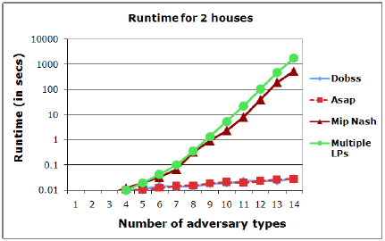
Experimental Results
DOBSS, ASAP, the multiple-LPs method and MIP-Nash
A. Runtime results from two, three and four houses for all the four methods
Notes:
For MIP-Nash and Multiple-LPs, exponential increase
For ASAP and DOBSS, linear increase

Slide 26
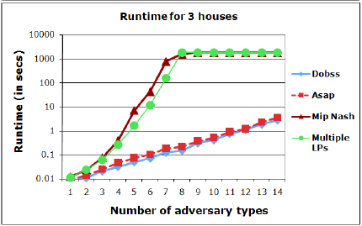
Experimental Results
DOBSS, ASAP, the multiple-LPs method and MIP-Nash
A. Runtime results from two, three and four houses for all the four methods
Notes:
Within the cutoff time of 1800s, MIP-Nash and Multiple-LPs end until 7 adversary types.

Slide 27
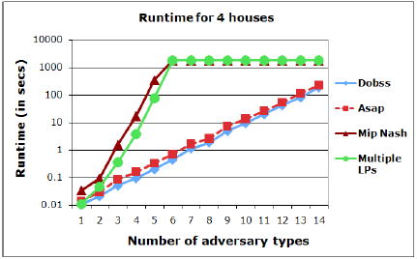
Experimental Results
DOBSS, ASAP, the multiple-LPs method and MIP-Nash
A. Runtime results from two, three and four houses for all the four methods

Slide 28
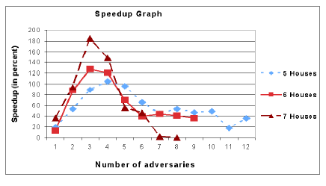
Experimental Results
DOBSS, ASAP, the multiple-LPs method and MIP-Nash
B. Runtimes of DOBSS and ASAP for five to seven houses
Speedup:
Notes:
From the graph we obtain that DOBSS has a faster algorithm runtime than ASAP in all the cases since there is always a positive speedup.
We can notice that the speedups obtained were highest when the numbers of adversary types are between 2 to 5.
Explanations are in the note!

Slide 29
Conclusion
DOBSS and ASAP outperform the other two procedures with respect to runtimes
DOBSS has a faster algorithm runtime than ASAP

Slide 30
Take-home Message
A new game: Bayesian Stackelberg Game
Value of the game:
Modeling domains involving security (patrolling, setting up checkpoints, network routing, and transportation systems)
New Solution: DOBSS
Mixed-Integer Quadratic Program → Decomposed MIQP→Decomposed MILP-DOBSS
Why DOBSS?
a). DOBSS and ASAP outperform the other two procedures with respect to runtimes
b). DOBSS has a faster algorithm runtime than ASAP

