Slide 1
SCALING LAWS FOR
NEURAL LANGUAGE MODELS
Kaplan et al. (2020)
Krish Patel
CS 886 SEC-004
Notes:
Slide 1: Scaling Laws for Neural Language Models
Target time: 25 seconds
SPEAKING NOTES
I am Krish Patel, presenting for CS 886 SEC-004. Today I am presenting Kaplan and colleagues’ 2020 paper on scaling laws for neural language models. The paper asks how model size, training data, and compute affect next-token prediction loss, and then uses those measurements to decide how to spend a fixed training budget. I will first explain the experimental evidence and then work through the compute-allocation argument.
SOURCE
Jared Kaplan, Sam McCandlish, Tom Henighan, Tom B. Brown, Benjamin Chess, Rewon Child, Scott Gray, Alec Radford, Jeffrey Wu, and Dario Amodei. Scaling Laws for Neural Language Models. arXiv:2001.08361v1, 23 January 2020.
https://arxiv.org/abs/2001.08361v1

Slide 2
THE TRAINING BUDGET QUESTION
A larger model?
More training tokens?
More optimization steps?
Goal: the lowest held-out loss for a given amount of compute.
Kaplan et al. (2020) · §1 and §6
Notes:
Slide 2: THE TRAINING BUDGET QUESTION
Target time: 45 seconds
SPEAKING NOTES
Imagine that you have a fixed amount of compute for training a language model. You could make the model larger, process more tokens, or change the number of optimization steps. These choices are coupled: every token costs more to process in a larger model. The paper’s goal is to replace trial-and-error scaling decisions with empirical predictions. The first question is how loss changes with each resource. The second is which combination gives the lowest loss under the same compute budget. Keep that second question in mind as we look at the individual scaling curves.
SOURCE
Kaplan et al. (2020), Scaling Laws for Neural Language Models, arXiv:2001.08361v1. §1 and §6
https://arxiv.org/abs/2001.08361v1
Original figures are cropped from the supplied PDF. Numerical examples are calculations from the reported exponents, not additional experimental results.

Slide 3
MEASURING NEXT-TOKEN PREDICTION
Probability of observed token | Token loss
0.50 | 0.69 nats
0.10 | 2.30 nats
N Non-embedding parameters
D Dataset tokens
C Training compute
T Evaluated tokens
Natural logarithms give loss in nats per token.
Lower loss means better next-token prediction.
Kaplan et al. (2020) · §1.3 and §2
Notes:
Slide 3: MEASURING NEXT-TOKEN PREDICTION
Target time: 65 seconds
SPEAKING NOTES
The main metric is held-out cross-entropy: how surprised the model is by the next token. For one token, the loss is minus the natural logarithm of the probability assigned to the correct token. We average that quantity over many tokens. Lower is better. If the model gives the correct token probability 0.5, its loss is about 0.69 nats; probability 0.1 gives about 2.30 nats. A nat is the unit obtained with natural logarithms. This is not an accuracy percentage. Throughout the talk N is the number of non-embedding parameters, D is the number of tokens in the dataset, and C is estimated training compute.
The symbol q_theta is the model’s predicted distribution, with theta denoting its learned parameters. T counts the evaluated tokens, x_t is the observed token at position t, and x_<t is its preceding context. The target token comes from the held-out text, even when another token has higher predicted probability. Natural logarithms give loss in nats.
EXTRA EXPLANATION / POSSIBLE QUESTIONS
Full metric: L = -(1/T) sum_t log p_theta(x_t | x_<t). Natural logarithms give nats per token. Perplexity = exp(L). A 5% reduction in loss does not mean a five-percentage-point accuracy improvement. N excludes token and positional embeddings.
SOURCE
Kaplan et al. (2020), Scaling Laws for Neural Language Models, arXiv:2001.08361v1. §1.3 and §2
https://arxiv.org/abs/2001.08361v1
Original figures are cropped from the supplied PDF. Numerical examples are calculations from the reported exponents, not additional experimental results.
NATS
A nat is the information unit associated with the natural logarithm. A probability of exp(-1), approximately 0.368, gives a single-token loss of exactly 1 nat. A probability of 0.5 gives -ln(0.5) = 0.693 nats. Averaging these single-token losses gives nats per token. With logarithms to base 2 the unit would be bits, and 1 nat = 1/ln(2), approximately 1.443 bits. Nats are not an accuracy percentage.
LATEX EQUATIONS
\[
L=-\frac{1}{T}\sum_{t=1}^{T}\ln q_{\theta}\!\left(x_t\mid x_{<t}\right)
\]

Slide 4
WHAT THE AUTHORS TRAINED
Quantity | Experimental setting
Model size | 768 to 1.5B non-embedding parameters
Dataset size | 22M to approximately 23B tokens
Architecture | Primarily decoder-only Transformers
Text and context | WebText2 with 1,024-token contexts
Compare held-out loss while controlling the other bottlenecks.
Kaplan et al. (2020) · §2–3, pp. 6–7
Notes:
Slide 4: WHAT THE AUTHORS TRAINED
Target time: 65 seconds
SPEAKING NOTES
The authors primarily train decoder-only Transformers on WebText2, an expanded version of WebText. The corpus contains approximately 22.9 billion tokens in total, with 660 million held out, leaving roughly 22 billion for training. They vary the model size from tiny models with 768 non-embedding parameters to models with 1.5 billion. Dataset experiments range from about 22 million to 23 billion tokens. Most runs use a 1,024-token context and a 50,257-token BPE vocabulary. They also vary model shape and batch size. The key methodological idea is to vary one resource while supplying enough of the other resources, or to fit a model of their joint effects.
EXTRA EXPLANATION / POSSIBLE QUESTIONS
Default training: 250,000 steps; batch size 512 sequences × 1,024 tokens = 524,288 tokens. Adam for most models; Adafactor for models above 1B parameters. Most runs use 3,000 warmup steps followed by cosine decay. Dataset-size runs use early stopping. Not every experiment has exactly the same controls.
SOURCE
Kaplan et al. (2020), Scaling Laws for Neural Language Models, arXiv:2001.08361v1. §2–3, pp. 6–7
https://arxiv.org/abs/2001.08361v1
Original figures are cropped from the supplied PDF. Numerical examples are calculations from the reported exponents, not additional experimental results.

Slide 5
HOW A POWER LAW WORKS
Model-size multiplier | Predicted relative loss
1× | 1.00×
2× | 0.95×
10× | 0.84×
The exponent controls the rate of improvement.
Kaplan et al. (2020) · §1.2; example calculated from Eq. (1.1)
Notes:
Slide 5: HOW A POWER LAW WORKS
Target time: 65 seconds
SPEAKING NOTES
A power law says that multiplying a resource by a fixed factor gives the same proportional change in loss, within the regime where the fit applies. Taking logarithms turns the relationship into a straight line: log loss equals an intercept minus alpha times log scale. The exponent alpha is the magnitude of that downward slope. For the model-size fit, alpha is approximately 0.076. Doubling the model predicts about 95% of the original loss, while multiplying its size by ten predicts about 84%. These are relative losses, not accuracy scores. The improvements are smooth, but obtaining another fixed improvement requires another multiplicative increase in resources.
EXTRA EXPLANATION / POSSIBLE QUESTIONS
Calculated ratios: 2^-0.076 = 0.9487 and 10^-0.076 = 0.8395. The table is an illustration of the fitted equation, not measured runs. A straight line here means log-log axes, not ordinary linear axes. The law only applies when the other resources do not bottleneck performance.
SOURCE
Kaplan et al. (2020), Scaling Laws for Neural Language Models, arXiv:2001.08361v1. §1.2; example calculated from αN = 0.076
https://arxiv.org/abs/2001.08361v1
Original figures are cropped from the supplied PDF. Numerical examples are calculations from the reported exponents, not additional experimental results.
LATEX EQUATIONS
\[
L(X)=A\,X^{-\alpha}
\]
\[
\ln L=\ln A-\alpha\ln X
\]

Slide 6
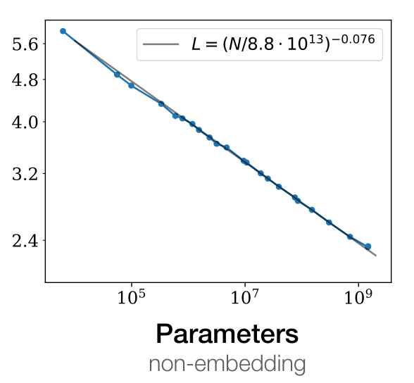
LOSS SCALES WITH MODEL SIZE
Test loss (nats)
Enough data
Training near convergence
The other resources must
not be the bottleneck.
Kaplan et al. (2020) · Figure 1, right; §3.2; Eq. (1.1)
Notes:
Slide 6: LOSS SCALES WITH MODEL SIZE
Target time: 70 seconds
SPEAKING NOTES
Read this graph from the axes first. The horizontal axis is the number of non-embedding parameters, and the vertical axis is test loss; both use logarithmic scaling. The blue points are measured results, and the line is the fitted power law. As model size increases, loss follows a remarkably smooth downward trend. The exponent is approximately 0.076. Importantly, this is the parameter-limited regime: the models are trained near convergence with enough data. It is not a guarantee that increasing model size alone helps when the training budget or dataset is fixed. The exclusion of embeddings makes the cross-architecture trend cleaner.
EXTRA EXPLANATION / POSSIBLE QUESTIONS
Reported form: L(N) = (Nc/N)^αN, with αN approximately 0.076 and Nc approximately 8.8 × 10^13. Nc is a fitted normalization tied to the dataset and tokenization. It is not a recommended model size or a number of parameters that the authors actually trained. Figure 6 shows why removing embeddings helps reveal the trend.
SOURCE
Kaplan et al. (2020), Scaling Laws for Neural Language Models, arXiv:2001.08361v1. Figure 1, right; §3.2; Eq. (1.1)
https://arxiv.org/abs/2001.08361v1
Original figures are cropped from the supplied PDF. Numerical examples are calculations from the reported exponents, not additional experimental results.
LATEX EQUATIONS
\[
L(N)=\left(\frac{N_c}{N}\right)^{\alpha_N}
\]
\[
\alpha_N\simeq0.076,\quad N_c\simeq8.8\times10^{13}
\]

Slide 7
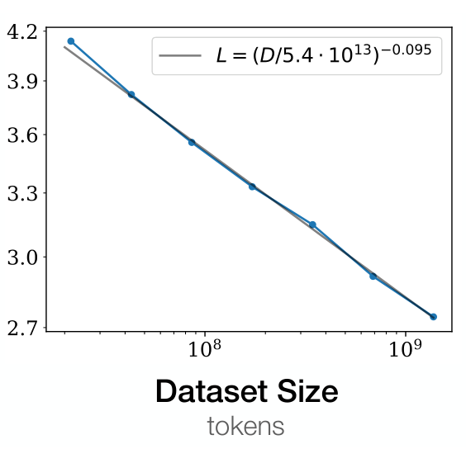
LOSS SCALES WITH DATASET SIZE
Test loss (nats)
Large enough model
Early stopping on held-out loss
A fixed small model eventually
runs into a capacity limit.
Kaplan et al. (2020) · Figure 1, middle; §3.3; Eq. (1.2)
Notes:
Slide 7: LOSS SCALES WITH DATASET SIZE
Target time: 65 seconds
SPEAKING NOTES
This panel varies dataset size. The authors train a large Transformer on fixed subsets of WebText2 and stop when held-out loss no longer improves. On log-log axes, loss again follows an approximately straight line, now with exponent 0.095. The important qualification is that the model must be large enough to use the available data. If we kept a very small model fixed and gave it more and more data, its capacity would eventually become the limiting factor. We will see that saturation explicitly when we combine model size and data in one equation.
EXTRA EXPLANATION / POSSIBLE QUESTIONS
For the one-variable D sweep, §3.3 specifies 36 layers and width 1,280. Reported form: L(D) = (Dc/D)^αD with αD approximately 0.095 and Dc approximately 5.4 × 10^13 tokens. This exponent differs slightly from the joint fit’s αD = 0.103. The fits use different data configurations and objectives.
SOURCE
Kaplan et al. (2020), Scaling Laws for Neural Language Models, arXiv:2001.08361v1. Figure 1, middle; §3.3; Eq. (1.2)
https://arxiv.org/abs/2001.08361v1
Original figures are cropped from the supplied PDF. Numerical examples are calculations from the reported exponents, not additional experimental results.
LATEX EQUATIONS
\[
L(D)=\left(\frac{D_c}{D}\right)^{\alpha_D}
\]
\[
\alpha_D\simeq0.095,\quad D_c\simeq5.4\times10^{13}
\]

Slide 8
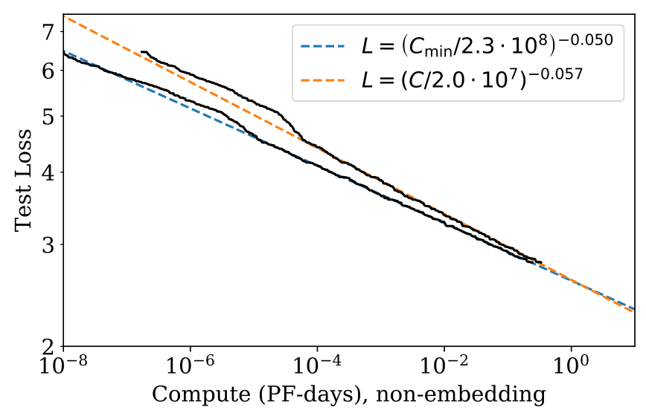
THE COMPUTE-EFFICIENT FRONTIER
Kaplan et al. (2020) · Figure 13; §6.1; PF-day definition in §1.3
Notes:
Slide 8: THE COMPUTE-EFFICIENT FRONTIER
Target time: 70 seconds
SPEAKING NOTES
For each compute budget, ask which model and stopping point achieve the lowest loss. The lower boundary of those choices is the compute-efficient frontier. This figure compares the raw fixed-batch result with a batch-adjusted estimate, C-min. The adjusted exponent is approximately 0.050, compared with 0.057 for the fixed-batch curve. C-min estimates the minimum non-embedding compute needed to reach a target loss after accounting for batch inefficiency. It is not simply the elapsed runtime of the experiment. Compute is measured in petaflop-days: one petaflop sustained for a day is 8.64 times 10 to the 19 floating-point operations. We will return to the batch adjustment shortly.
EXTRA EXPLANATION / POSSIBLE QUESTIONS
PF-day is an amount of computation, not a monetary price or a guaranteed one-day runtime. 1 PF-day = 10^15 FLOP/s × 86,400 s. Figure 13’s normalization constants differ slightly from the paper’s summary tables; this slide uses only the reported slopes and does not infer an absolute training budget from those constants.
SOURCE
Kaplan et al. (2020), Scaling Laws for Neural Language Models, arXiv:2001.08361v1. Figure 13; §6.1; PF-day definition in §1.3
https://arxiv.org/abs/2001.08361v1
Original figures are cropped from the supplied PDF. Numerical examples are calculations from the reported exponents, not additional experimental results.
The full scaling function displays C_c^min as a symbolic fitted normalization. Figure 13 reports 2.3 × 10^8 PF-days while Eq. (1.3) and Table 5 report 3.1 × 10^8. The paper does not explain the discrepancy, so the slide does not choose a numerical normalization.
LATEX EQUATIONS
\[
L(C_{\min})=\left(\frac{C_c^{\min}}{C_{\min}}\right)^{\alpha_C^{\min}}
\]
\[
\alpha_C^{\min}\simeq0.050
\]
\[
C_{\min}=\frac{C}{1+B/B_{\mathrm{crit}}(L)}
\]
\[
1\;\mathrm{PF\!\!-\!day}=8.64\times10^{19}\;\mathrm{FLOPs}
\]

Slide 9
WHERE THE EXPONENTS COME FROM
The authors fit equations to held-out loss from training experiments.
Fitted relationship | Exponent | Evidence
Model size | 0.076 | Parameter sweep
Dataset size | 0.095 | Data-subset sweep
Adjusted compute | 0.050 | Efficient frontier
The fitted values depend on the experimental regime.
Kaplan et al. (2020) · §3–6, Appendix D.7 and Table 5
Notes:
Slide 9: WHERE THE EXPONENTS COME FROM
Target time: 80 seconds
SPEAKING NOTES
These numbers are empirical estimates. The researchers run many training experiments, measure held-out loss, and fit a functional relationship to those measurements. For a simple power law, the straight-line slope in log-log space is minus alpha. The model-size, data-size, and compute laws come from different experimental comparisons. The authors then test richer equations that jointly describe multiple factors. We should distinguish the reported fit from an explanation of why that exponent has that value. The paper does not derive 0.076 from Transformer architecture or from a universal theorem. It also reports slightly different coefficients for some joint fits, which is expected when the fitted model and observations change.
EXTRA EXPLANATION / POSSIBLE QUESTIONS
Do not claim that the PDF specifies one universal optimizer, fitting loss, confidence interval, or exact number of runs for every reported exponent. The paper reports the experimental sweeps, fitting relationships, fitted parameters, and figures, but does not supply a complete reproducibility specification for every fit. The log-log slope is a useful interpretation, not a claim about an undocumented regression implementation.
ADDITIONAL METHOD DETAIL
For the dataset sweep, §3.3 uses a 36-layer, width-1280 Transformer trained on subsets of WebText2 and stops when held-out loss ceases to decrease. The N fit uses near-converged models with sufficient data. Appendix D.7 excludes one-layer models from the N and C fits and excludes the largest unconverged models from the N fit. It compares other functions, including a logarithmic form, but does not state a complete fitting objective, weighting rule, or raw data table for reproducing every decimal.
SOURCE
Kaplan et al. (2020), Scaling Laws for Neural Language Models, arXiv:2001.08361v1. §3–6; Figures 1 and 13; Table 5
https://arxiv.org/abs/2001.08361v1
Original figures are cropped from the supplied PDF. Numerical examples are calculations from the reported exponents, not additional experimental results.

Slide 10
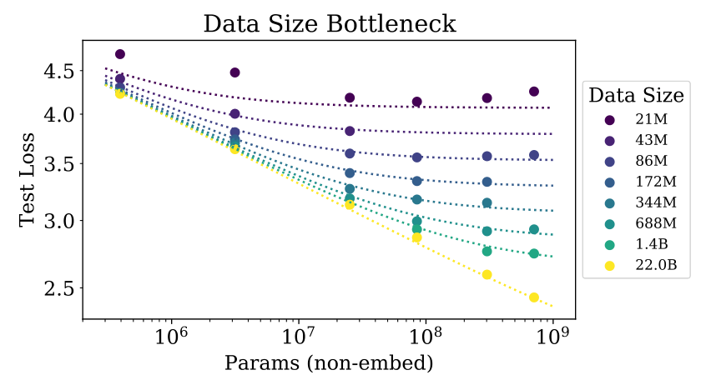
MODEL AND DATA BOTTLENECKS
Fixed small dataset:
more parameters
eventually help less.
Joint fit
Kaplan et al. (2020) · Figure 9, left; Eq. (4.1); Table 2
Notes:
Slide 11: MODEL AND DATA BOTTLENECKS
Target time: 100 seconds
SPEAKING NOTES
So far we have considered limiting cases. What happens if both model size and dataset size are finite? The authors propose this joint equation. One term represents finite model capacity; the other represents limited data. Raising their sum to alpha-D makes the equation recover the separate power laws in the corresponding limits. In the figure, each color fixes a dataset size while model size increases. With lots of data, larger models keep helping. With a small fixed dataset, the curve flattens. The joint fit estimates alpha-N at 0.076 and alpha-D at 0.103. The latter is slightly different from the earlier data-only exponent of 0.095 because this is a different joint fit.
EXTRA EXPLANATION / POSSIBLE QUESTIONS
The authors motivate the functional form with loss rescaling under tokenization, the correct N→∞ and D→∞ limits, and an expansion in integer powers of 1/D. The third assumption is explicitly more speculative. Table 2 also gives Nc = 6.4 × 10^13 and Dc = 1.8 × 10^13. The fit is weaker for the smallest, approximately 21M-token dataset.
SOURCE
Kaplan et al. (2020), Scaling Laws for Neural Language Models, arXiv:2001.08361v1. Figure 9, left; Eq. (4.1); Table 2
https://arxiv.org/abs/2001.08361v1
Original figures are cropped from the supplied PDF. Numerical examples are calculations from the reported exponents, not additional experimental results.
LATEX EQUATIONS
\[
L(N,D)=\left[\left(\frac{N_c}{N}\right)^{\alpha_N/\alpha_D}+\frac{D_c}{D}\right]^{\alpha_D}
\]
\[
\alpha_N=0.076
\]
\[
\alpha_D=0.103
\]

Slide 11
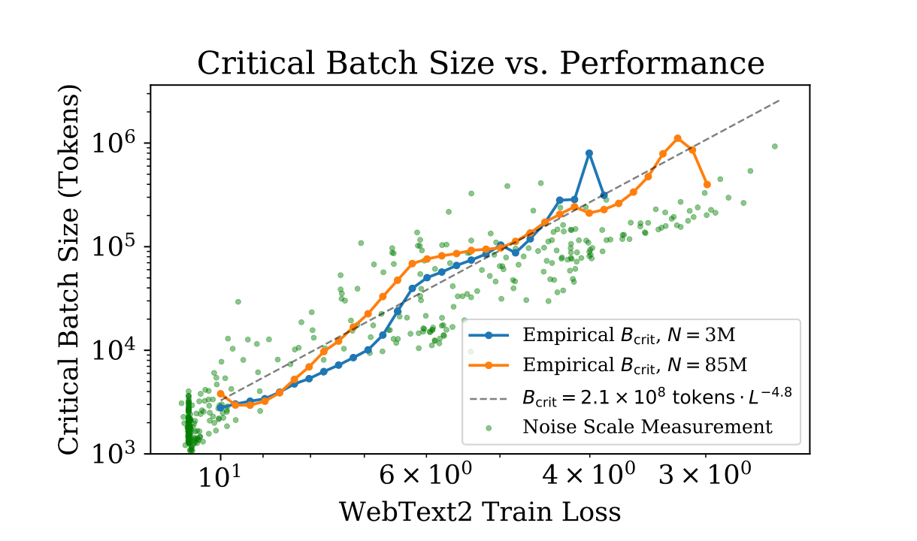
BATCH SIZE AND TRAINING EFFICIENCY
B: tokens per update S: updates
Small batches minimize compute. Large batches minimize serial steps.
Kaplan et al. (2020) · Figure 10; §5.1; Eq. (5.3)–(5.5)
Notes:
Slide 14: BATCH SIZE AND TRAINING EFFICIENCY
Target time: 100 seconds
SPEAKING NOTES
Batch size B counts the tokens processed per optimizer update; S counts the updates. Total non-embedding compute is estimated as six times N times B times S. Increasing the batch gives more parallel work per update and can reduce the number of serial updates. Beyond the critical batch, additional tokens per update give diminishing reductions in steps and consume extra compute. The critical batch size summarizes that tradeoff. Empirically it grows as loss decreases, approximately as L to the minus 4.8. Small batches minimize compute to reach a target loss, while very large batches minimize serial steps. Training near the critical batch balances the two. The authors use these measurements to adjust fixed-batch runs into estimates of C-min and S-min. These are two limiting quantities, not two minima that one run simultaneously attains.
EXTRA EXPLANATION / POSSIBLE QUESTIONS
Exact adjustments: Cmin = C / (1 + B/Bcrit(L)); Smin = S / (1 + Bcrit(L)/B). At B = Bcrit, C = 2Cmin and S = 2Smin. Bcrit = B*/L^(1/αB), with B* approximately 2.1 × 10^8 tokens and αB approximately 0.21, so 1/αB approximately 4.8. §2.1 estimates roughly 2N FLOPs per token forward and 4N backward; embeddings and some context-dependent terms are omitted. E = BS is processed tokens; E need not equal unique dataset size D when examples are reused.
SOURCE
Kaplan et al. (2020), Scaling Laws for Neural Language Models, arXiv:2001.08361v1. Figure 10; §5.1; Eq. (5.3)–(5.5)
https://arxiv.org/abs/2001.08361v1
Original figures are cropped from the supplied PDF. Numerical examples are calculations from the reported exponents, not additional experimental results.
LATEX EQUATIONS
\[
C\simeq6NBS
\]
\[
B_{\mathrm{crit}}(L)=B_*L^{-1/\alpha_B}
\]
\[
\alpha_B\simeq0.21,\quad B_{\mathrm{crit}}\propto L^{-4.8}
\]
\[
C_{\min}=\frac{C}{1+B/B_{\mathrm{crit}}(L)}
\]
\[
S_{\min}=\frac{S}{1+B_{\mathrm{crit}}(L)/B}
\]

Slide 12
THE COMPUTE ALLOCATION EXPONENTS
Quantity | Exponent | How it is obtained
Optimal model size | 0.73
Critical batch size | 0.24
Minimum serial steps | 0.03
The exponents describe scaling rates, not budget percentages.
Kaplan et al. (2020) · §6.1; Eq. (6.1)–(6.2); Table 6
Notes:
Slide 16: THE COMPUTE ALLOCATION EXPONENTS
Target time: 110 seconds
SPEAKING NOTES
If we get a larger compute budget, how should model size, batch size, and training steps grow to achieve the best loss?
Where did $0.73$come from?
The authors compared different model sizes at different compute budgets. For each budget, they identified which model size performed best. They then fitted a power law to those optimal sizes.
Thus, $0.73$comes from an experimental fit.
These three exponents have related but different origins. First, 0.73 comes from fitting optimal model size against adjusted compute, as shown in Figure 14. Second, we already measured that loss scales as C-min to the minus 0.050 and critical batch size scales as loss to the minus 4.8. Substituting one into the other gives a batch exponent of approximately 0.050 times 4.8, which is 0.24. Finally, the adjusted compute relationship is proportional to N times B-critical times S-min. The exponents must therefore add to one. The remaining step exponent is one minus 0.73 minus 0.24, which is 0.03. It is also checked against the adjusted step measurements in Figure 14. The authors caution that this last exponent is small enough to be consistent with zero.
EXTRA EXPLANATION / POSSIBLE QUESTIONS
These are multiplicative scaling exponents, not a literal allocation of 73%, 24%, and 3% of dollars. The cleaner identity from Eq. (5.4)–(5.5) is Cmin = 6 N Bcrit Smin. An alternative predictive calculation in §6.2 gives αC,min = 1/(1/αS + 1/αB + 1/αN) approximately 0.054, then pN approximately 0.71. The empirical and model-based estimates agree approximately, not exactly.
SOURCE
Kaplan et al. (2020), Scaling Laws for Neural Language Models, arXiv:2001.08361v1. §6.1; Eq. (6.1)–(6.2); Table 6
https://arxiv.org/abs/2001.08361v1
Original figures are cropped from the supplied PDF. Numerical examples are calculations from the reported exponents, not additional experimental results.
LATEX EQUATIONS
\[
C_{\min}=6N B_{\mathrm{crit}}S_{\min}
\]
\[
N_{\mathrm{opt}}\propto C_{\min}^{0.73}\quad(\mathrm{fit})
\]
\[
0.050\times4.8\simeq0.24
\]
\[
1-0.73-0.24=0.03
\]

Slide 13
WHAT DOES 10× MORE COMPUTE BUY?
Quantity | Calculation | Multiplier
Model size |  | 5.37×
Critical batch size |  | 1.74×
Minimum serial steps |  | 1.07×
Tokens processed |  | 1.86×
Most of the growth is in model size.
Kaplan et al. (2020) · Calculated from the empirical exponents in Table 6
Notes:
Slide 17: What does 10× more compute buy?
Target time: 65 seconds
SPEAKING NOTES
Let us make the exponents concrete. Suppose our adjusted compute budget increases by a factor of ten while we stay in the same fitted regime. The predicted optimal model grows by ten to the 0.73, about 5.37 times. Critical batch size grows by about 1.74 times. The estimated minimum serial steps grow only about 1.07 times. Multiplying those three factors gives ten. The corresponding processed-token scaling is about ten to the 0.27, or 1.86 times. At a fixed ratio of actual batch size to the critical batch size, these exponents also describe the actual training configuration. The table uses relative factors to avoid claiming an absolute prescription for an unmeasured modern training run.
EXTRA EXPLANATION / POSSIBLE QUESTIONS
Exact displayed calculations: 10^0.73 = 5.3703; 10^0.24 = 1.7378; 10^0.03 = 1.0715; 10^0.27 = 1.8621. The 1.86× value is data processed; it equals growth in required unique data only if tokens are not reused. Table 6 gives 0.27, while §6.3 uses 0.26 from another fitted expression. Use the internally consistent rounded Table 6 values for this worked example.
SOURCE
Kaplan et al. (2020), Scaling Laws for Neural Language Models, arXiv:2001.08361v1. Calculated from the empirical exponents in Table 6
https://arxiv.org/abs/2001.08361v1
Original figures are cropped from the supplied PDF. Numerical examples are calculations from the reported exponents, not additional experimental results.
LATEX EQUATIONS
\[
10^{0.73}
\]
\[
10^{0.24}
\]
\[
10^{0.03}
\]
\[
10^{0.27}
\]

Slide 14
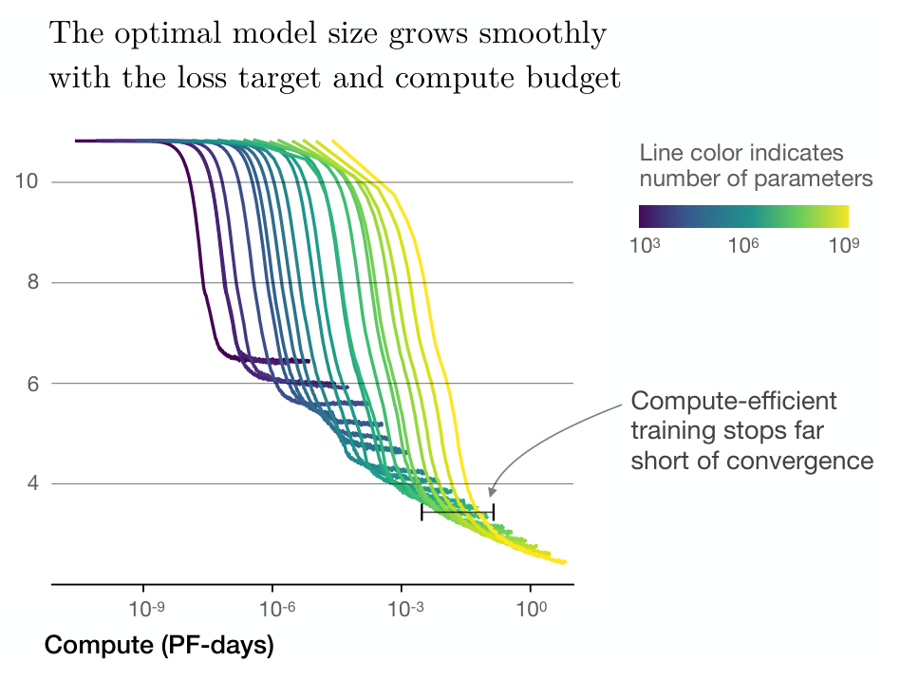
WHY STOP BEFORE CONVERGENCE?
Larger models can reach
a target loss with
fewer training tokens.
Test loss
The best stopping point
depends on the
compute budget.
Kaplan et al. (2020) · Figure 2, right; §1.1 and §6
Notes:
Slide 18: WHY STOP BEFORE CONVERGENCE?
Target time: 80 seconds
SPEAKING NOTES
The main practical conclusion is surprising if we are used to training every model until its loss levels off. Each colored curve here is a different model size. The most compute-efficient point can occur while a larger model is still improving. Spending more compute on the last increments of a small model’s convergence can be less effective than training a larger model for less time. The paper argues that larger models are more sample-efficient: they can reach a given loss with fewer tokens. Each token costs more compute in a larger model, so fewer tokens alone does not guarantee lower total compute. Compare the complete training costs at the same loss, or compare loss at the same compute budget. “Stop before convergence” here is a choice about a limited compute budget. It should not be confused with stopping a finite-data run because held-out loss has begun to rise.
EXTRA EXPLANATION / POSSIBLE QUESTIONS
Two distinct stopping ideas occur in the paper: validation-based early stopping to limit overfitting in finite-data experiments, and intentionally stopping short of convergence for compute efficiency. Figure 2 supports the second. Deployment or inference cost can change the choice of model size, as noted in Appendix B.4.
SOURCE
Kaplan et al. (2020), Scaling Laws for Neural Language Models, arXiv:2001.08361v1. Figure 2, right; §1.1 and §6
https://arxiv.org/abs/2001.08361v1
Original figures are cropped from the supplied PDF. Numerical examples are calculations from the reported exponents, not additional experimental results.

Slide 15
LIMITATIONS AND OPEN QUESTIONS
Empirical fits
No complete theory explains the exponents.
Measured setting
Data, tokenization, architecture, and training choices matter.
Objective
Next-token loss and training FLOPs leave other costs and capabilities open.
Extrapolation
The laws must eventually change or level off.
Kaplan et al. (2020) · §6.3, §8, Appendix B.4 and Appendix C
Notes:
Slide 19: LIMITATIONS AND OPEN QUESTIONS
Target time: 75 seconds
SPEAKING NOTES
There are several limits to the conclusions. First, the fitted laws do not provide a mechanistic theory explaining the exponents. Second, the numerical values depend on the data, model family, tokenizer, and training setup; the study is not proof of universal constants. Third, smooth improvement in next-token loss does not by itself establish equivalent improvement in every language capability. Fourth, the optimum concerns estimated training compute. Hardware utilization, inference cost, and deployment constraints can favor a different model. Finally, the authors themselves show that their extrapolated data and compute laws eventually conflict. Their distant intersection is highly uncertain, so it should not be treated as a proven language-model ceiling.
EXTRA EXPLANATION / POSSIBLE QUESTIONS
Appendix C discusses uncertain Bcrit extrapolation, weaker small-data fits, unoptimized regularization, omitted context-dependent compute, and incomplete hyperparameter tuning. §6.3 gives a speculative intersection near 10^12 parameters and 10^12 tokens but explicitly describes order-of-magnitude sensitivity. No later-paper findings are needed to make these caveats. If asked about Chinchilla, say that subsequent work revisits compute allocation; avoid giving the impression that Kaplan’s 2020 optimum is current universal practice.
SOURCE
Kaplan et al. (2020), Scaling Laws for Neural Language Models, arXiv:2001.08361v1. §6.3, §8, Appendix B.4 and Appendix C
https://arxiv.org/abs/2001.08361v1
Original figures are cropped from the supplied PDF. Numerical examples are calculations from the reported exponents, not additional experimental results.

Slide 16
TAKEAWAYS AND THE NEXT PAPER
Loss scales predictably when bottlenecks are controlled.
Joint fits connect model size, data, and training progress.
The fitted compute optimum favors larger models
trained short of convergence.
Kaplan et al. (2020), arXiv:2001.08361v1
Notes:
Slide 20: TAKEAWAYS AND THE NEXT PAPER
Target time: 45 seconds
SPEAKING NOTES
The paper contributes a quantitative framework for reasoning about scale. Loss follows predictable empirical trends when the relevant bottlenecks are controlled. Joint equations connect model capacity, data limitations, and training progress. Under this paper’s fitted compute optimum, scaling prioritizes model size and stops short of convergence. These are useful predictive relationships within an experimental regime, with limitations that matter when extrapolating. This leads to the next required reading, Hoffmann et al. (2022), Training Compute-Optimal Large Language Models. The next presenter will revisit how model size and training data should grow together as compute increases. A useful handoff is: Kaplan gives a quantitative answer, but how much of that answer depends on the experimental design?
EXTRA EXPLANATION / POSSIBLE QUESTIONS
Possible discussion directions: alternative data quality or domain; better hyperparameter tuning; the batch correction; long contexts and the 6N-per-token approximation; the mapping from loss to downstream capability; inference costs. Total planned speaking time across the 20 slides is approximately 24 minutes 20 seconds, leaving about 5 minutes 40 seconds within a 30-minute slot.
SOURCE
Kaplan et al. (2020), Scaling Laws for Neural Language Models, arXiv:2001.08361v1. Kaplan et al. (2020), arXiv:2001.08361v1
https://arxiv.org/abs/2001.08361v1
Original figures are cropped from the supplied PDF. Numerical examples are calculations from the reported exponents, not additional experimental results.
DO NOT KNOW ANSWER:
I don’t recall whether the authors examine that specific case. I’d need to check before attributing an explanation to them.
I understand the relationship they observed, but I haven’t fully worked through why it arises.
I don’t recall that detail off the top of my head. I’d need to check the paper to give you a precise answer.

