Slide 1
The Neural Basis of Emotion
Seth Winward

Slide 2
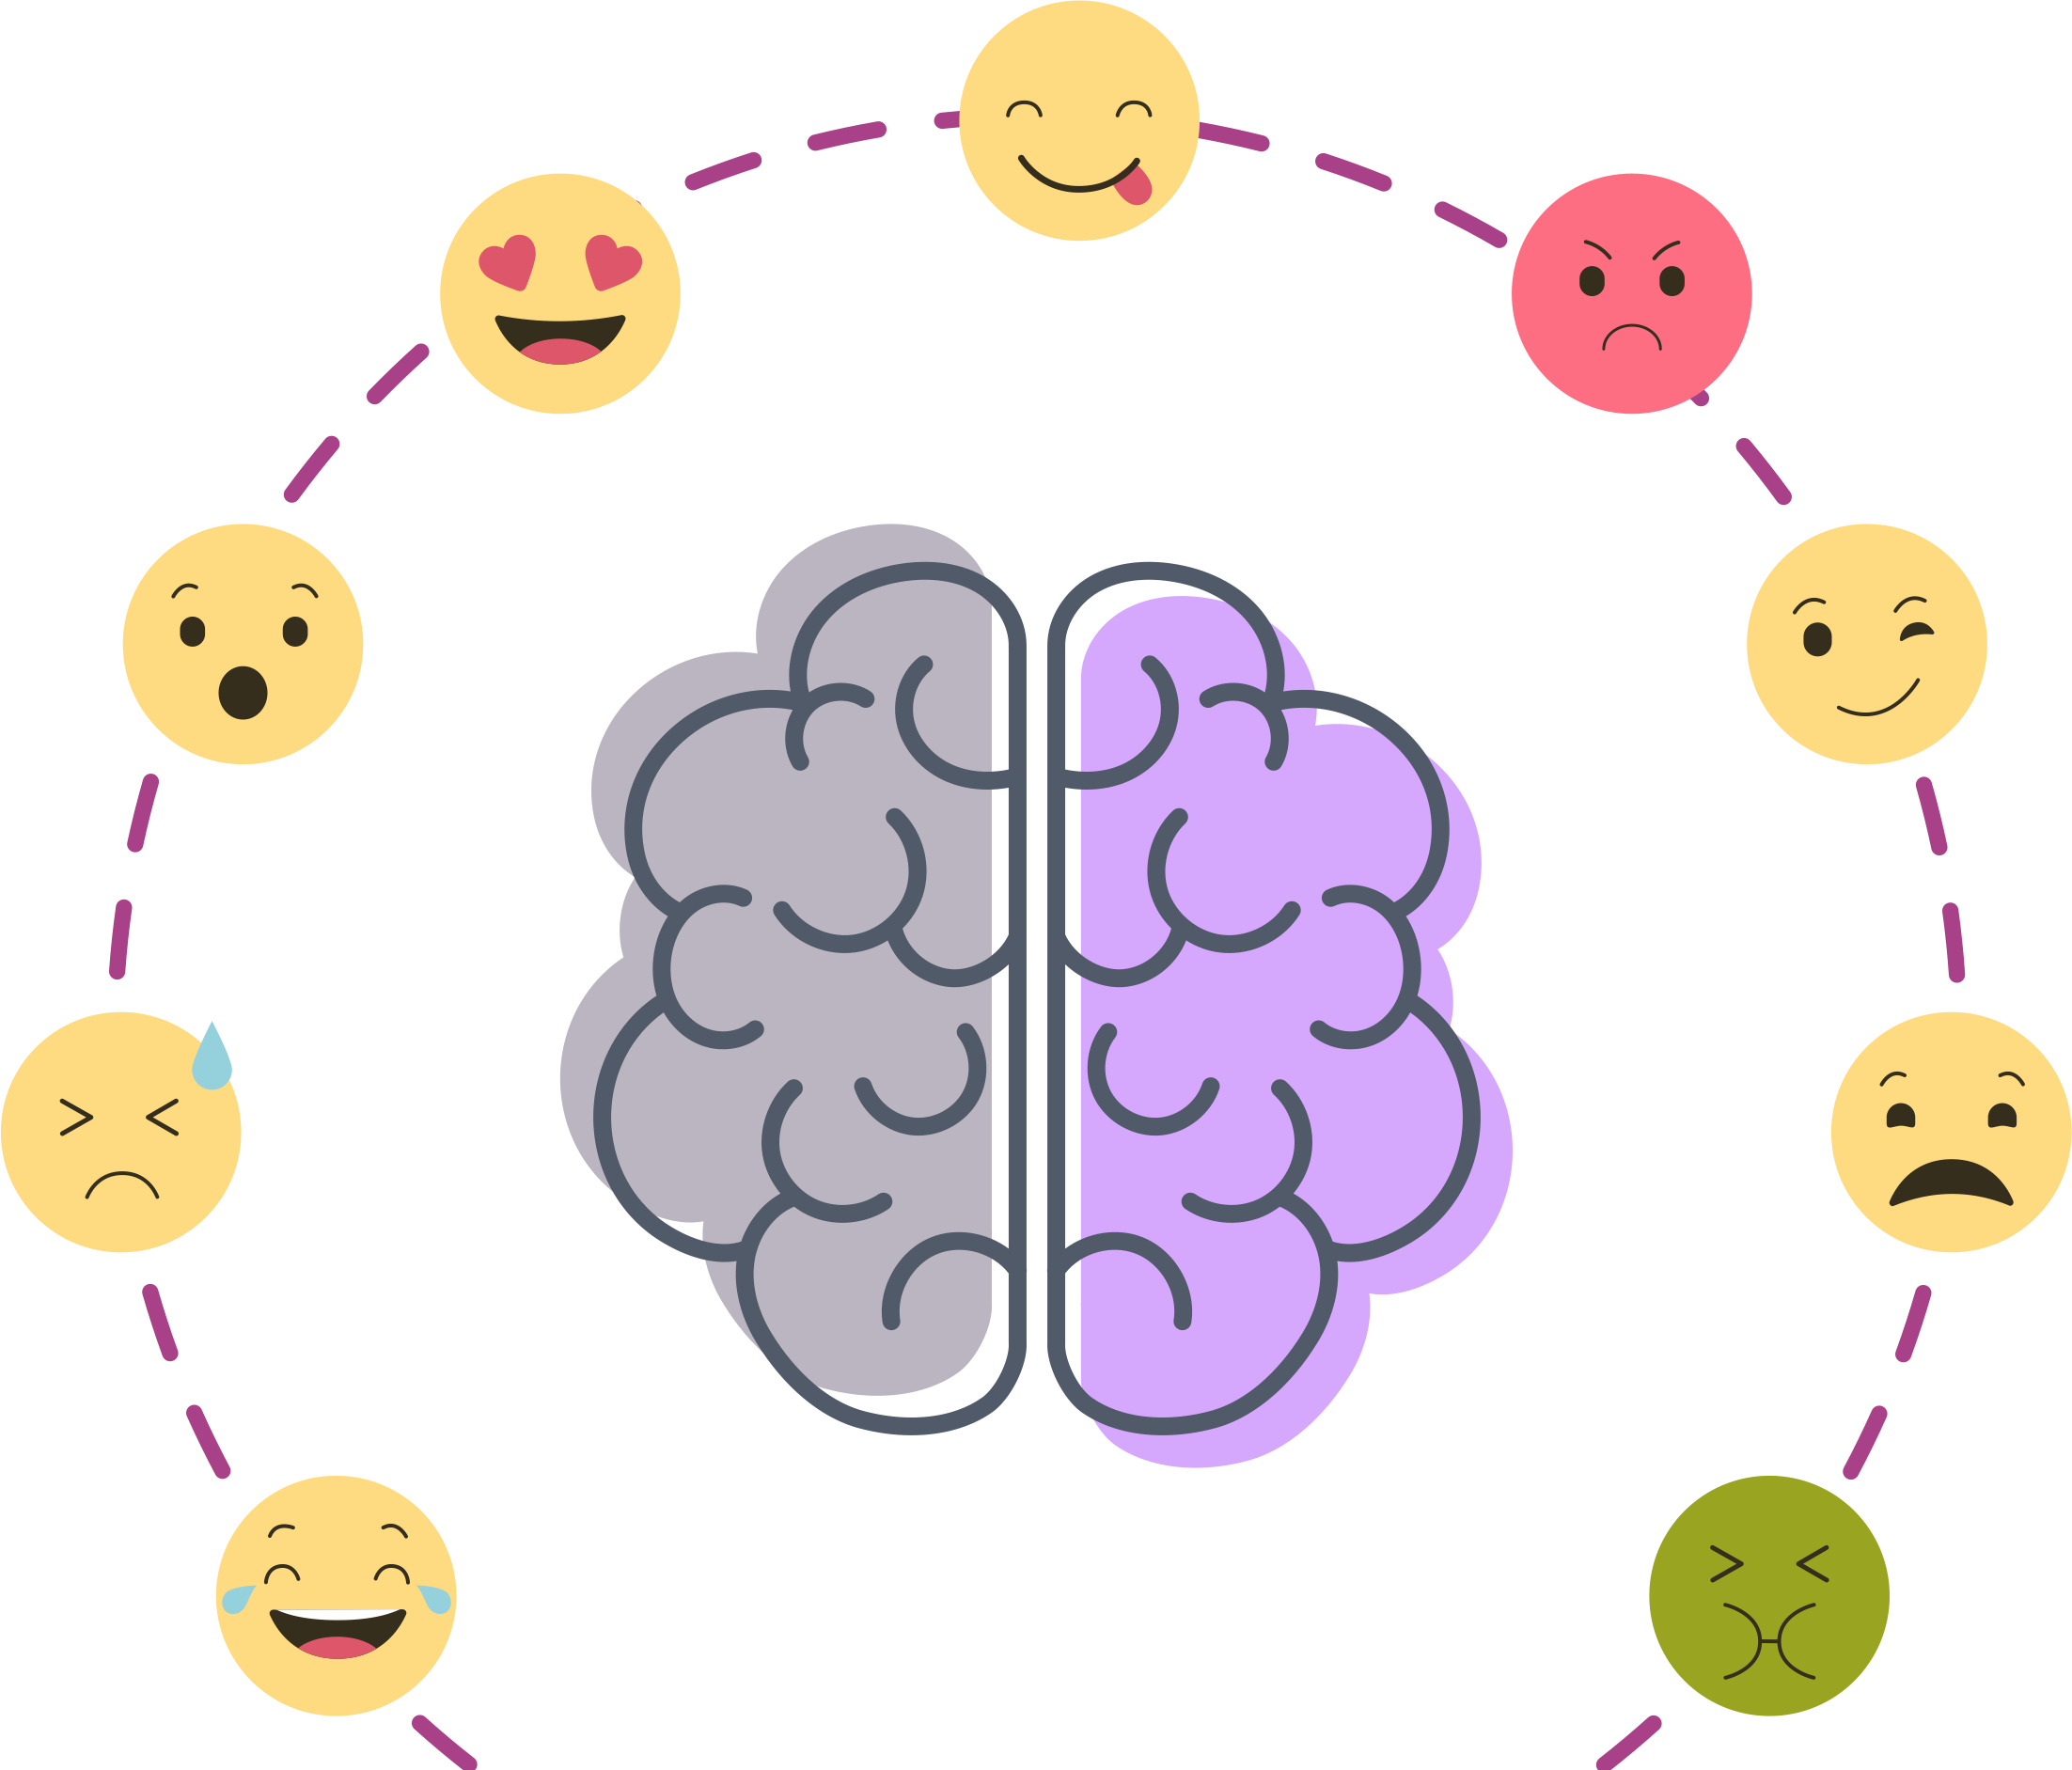
Overview
Theories of Emotion
  Activity: Subjective Activation
Subcortical Networks and Emotion
  Activity: Human Lesion Cases
Cortical Involvement in Emotion
  Activity: Valence and Arousal
Emotion and Cognition
Summary and Conclusion

Slide 3
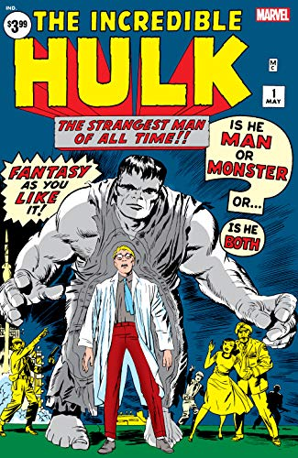
What is an emotion?
“I have a gut feeling I know what an emotion is”
“I know in my heart what an emotion is”
Visceral feelings often accompany emotions
We use emotions in our cognition
Is emotion of the body or of the mind?
Or is it both?

Slide 4

What is an emotion?
Evolved reward-and-punishment (conditioning) circuits
Neural overlap between emotion and conditioning
But we are aware of emotions and conditioning
Are emotions just a form of conditioned response?

Slide 5
The James-Lange Theory
Stimulus
Cortex
W. James (1884) & C. Lange (1885)
Perception
Somatosensation
“. . . the bodily changes follow directly from the PERCEPTION of the exciting fact, and that our feeling of the same changes as they occur IS the emotion.”
James (1884, p. 189-190)
Subjective Emotion
Body
Autonomic Response
Somatic Response

Slide 6
Evidence For and Against
Evidence For:
Pure autonomic failure
Facial feedback hypothesis
Botox cases
Evidence Against:
Quadriplegic cases
Capgras syndrome
Conclusion: Emotions are not solely conditioned, sensations provide cues that must be interpreted correctly

Slide 7
Cannon-Bard Theory
Stimulus
Cortex
W. Cannon (1927)
Perception
Subjective Emotion
Somatosensation
“. . . the peculiar quality of the emotion is added to simple sensations when the thalamic processes are roused.”
Cannon (1927, p. 120)
Thalamus
Body
Autonomic Response
Somatic Response

Slide 8
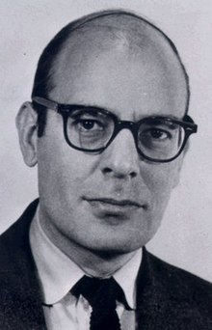
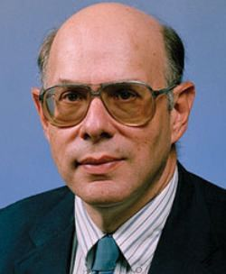
Two-Factor Theory
Schachter and Singer induced physiological arousal chemically
Modified context (rude vs pleasant experimenter)
Different emotions reported depending on context

Slide 9
Two-Factor Theory
Cortex
Body
Stimulus
Perception
Autonomic Response
Somatosensation
Somatic Response
Schacter & Singer (1962)
Cognitive Appraisal
“. . . emotional states may be considered a function of a state of physiological arousal and of a cognition appropriate to this state of arousal.”
Schacter & Singer (1962, p. 398)
Subjective Emotion

Slide 10
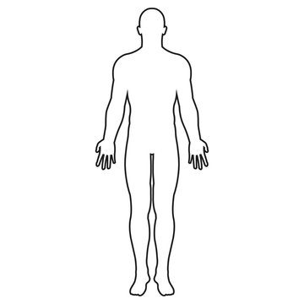
Activity: Subjective Activation
Use the silhouettes to indicate the bodily sensations you experience when you feel ___
For this body, please colour the regions whose activity becomes stronger/faster
For this body, please colour the regions whose activity becomes weaker/slower

Slide 11
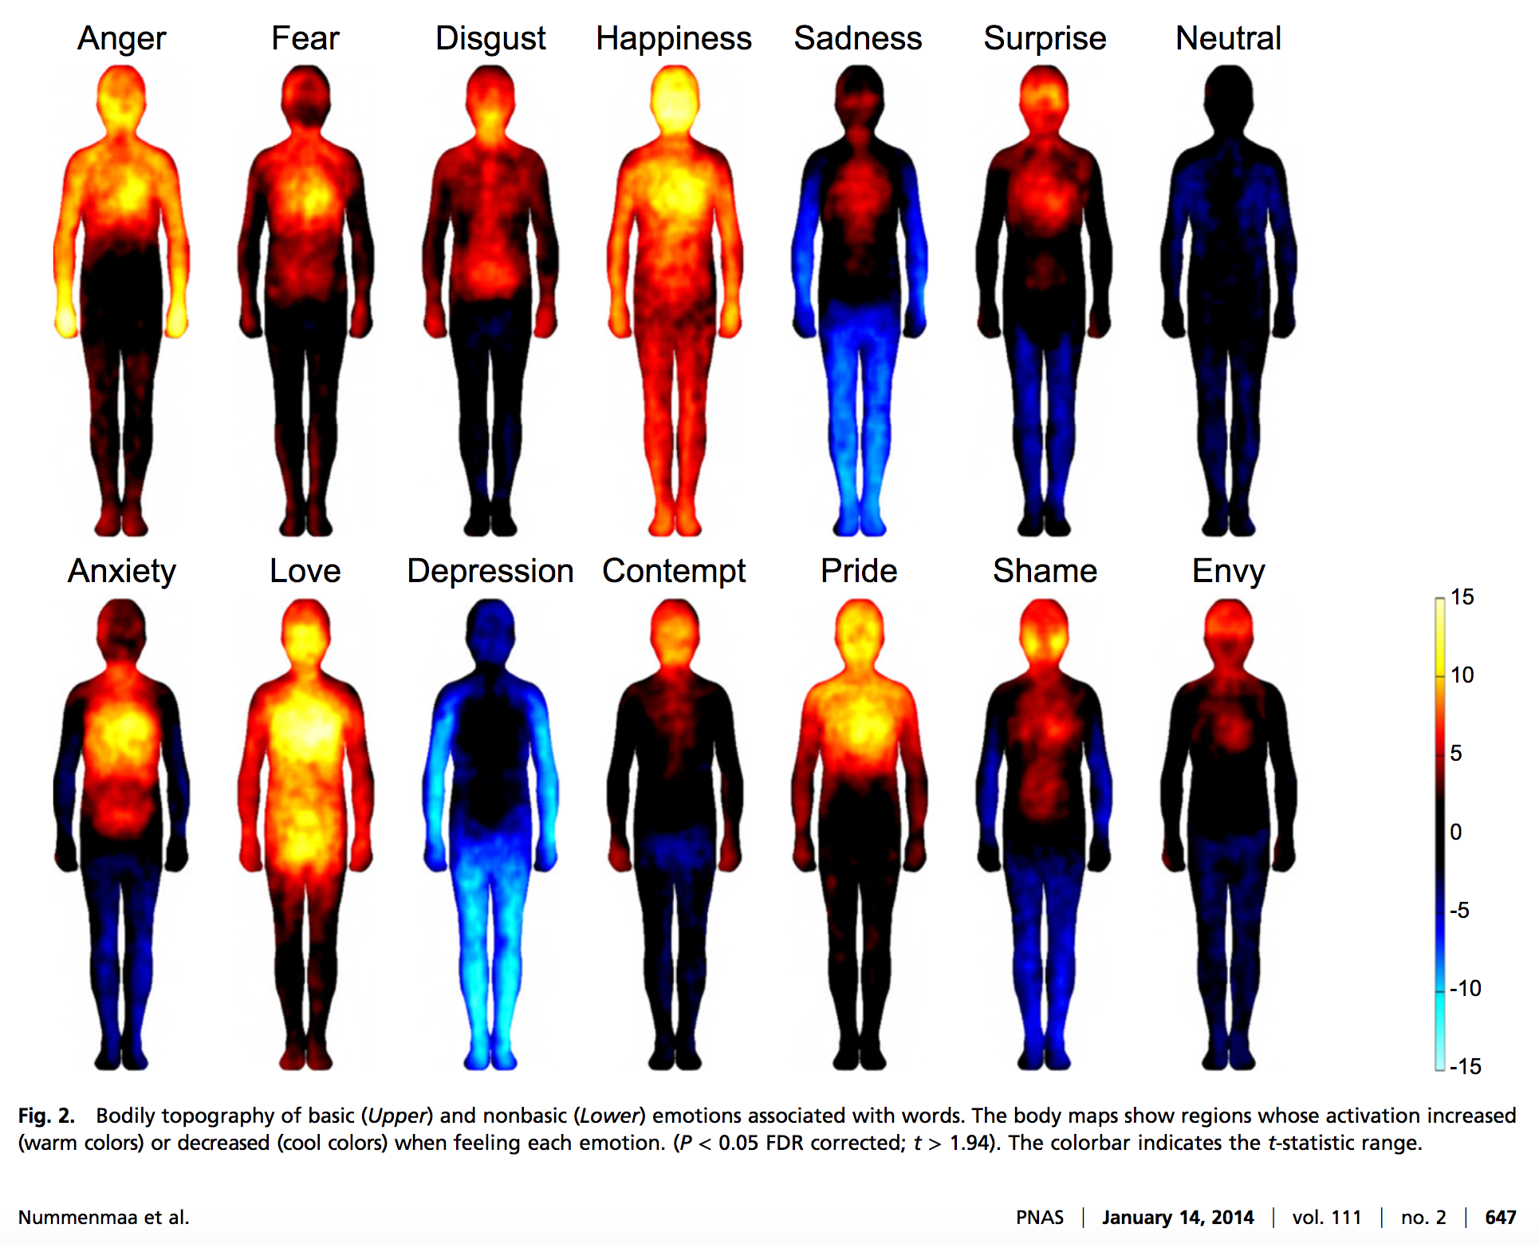
Activity: Subjective Activation
How do your maps compare?
What surprises you?
What account for feeling “(de)activated”?
Nummenmaa, L., Glerean, E., Hari, R., & Hietanen, J.K. (2014). Bodily maps of emotion. Proceedings of the National Academy of Sciences, 111(2), 646-651. https://doi.org/10.1073/pnas.1321664111

Slide 12

Break for Questions

Slide 13
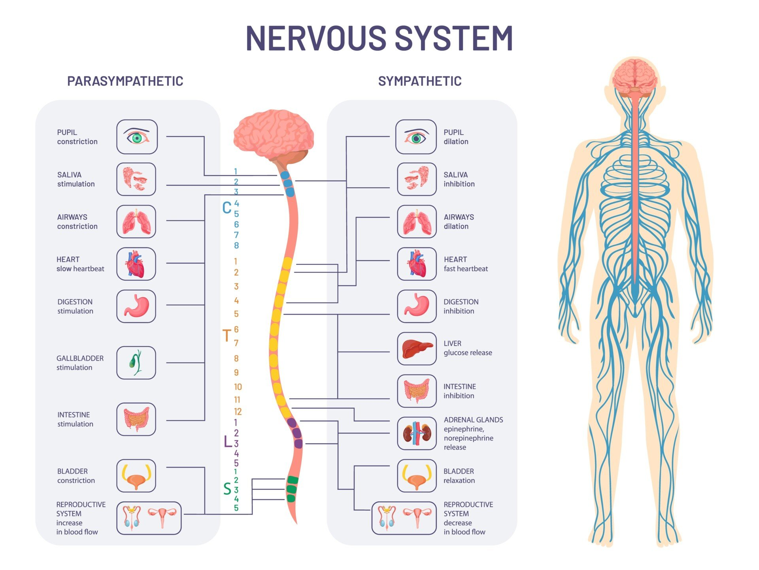

Slide 14
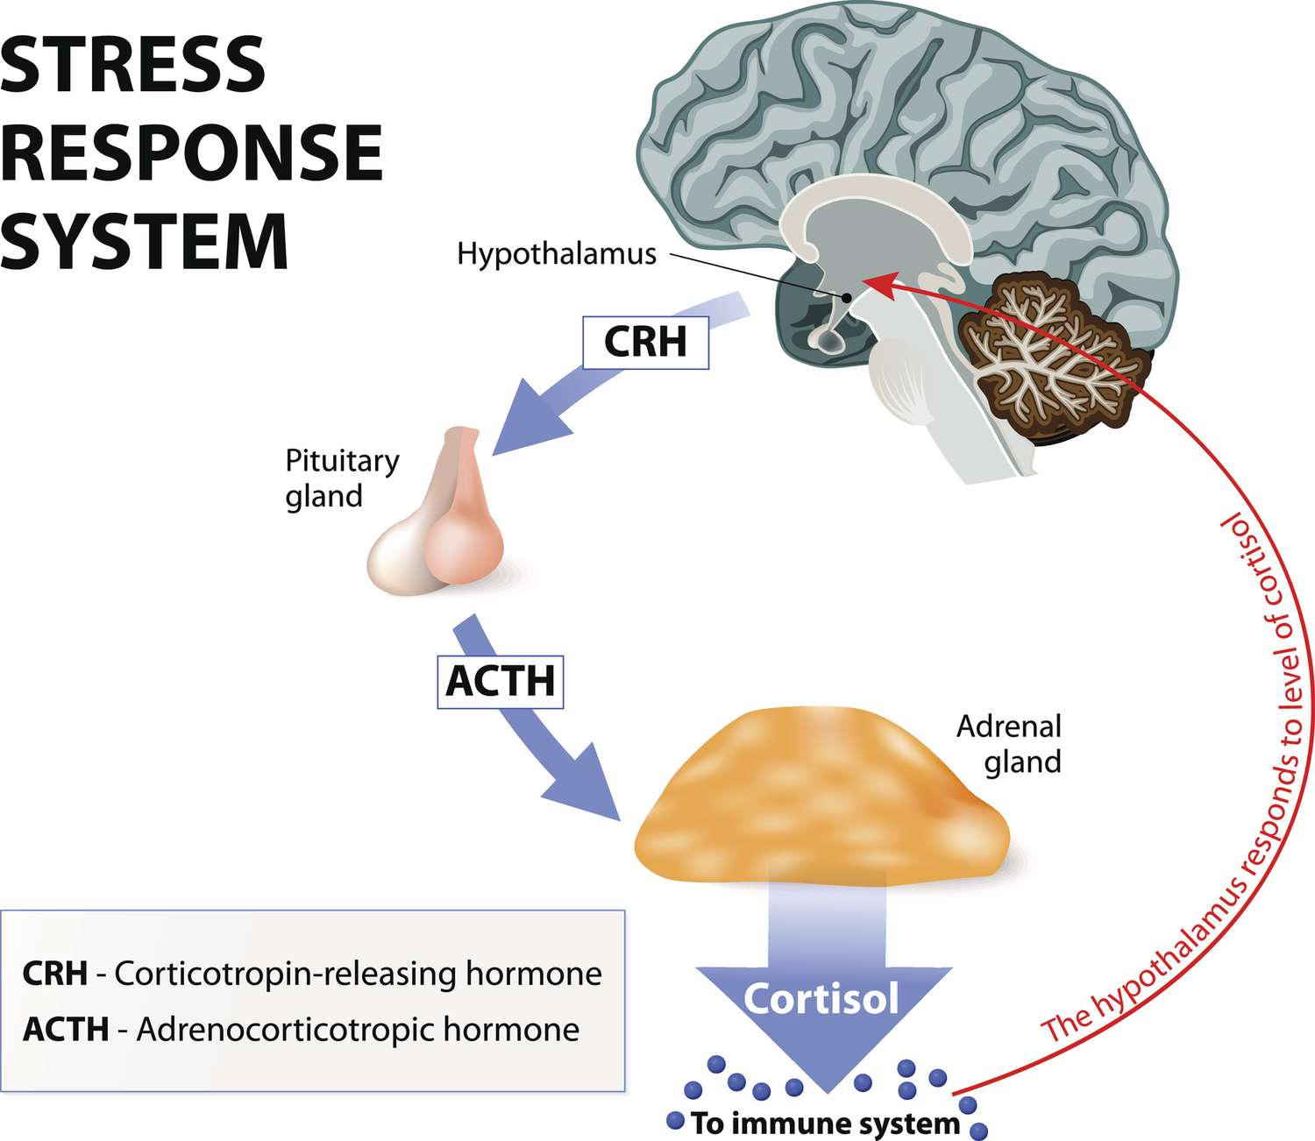
Endocrine System

Slide 15
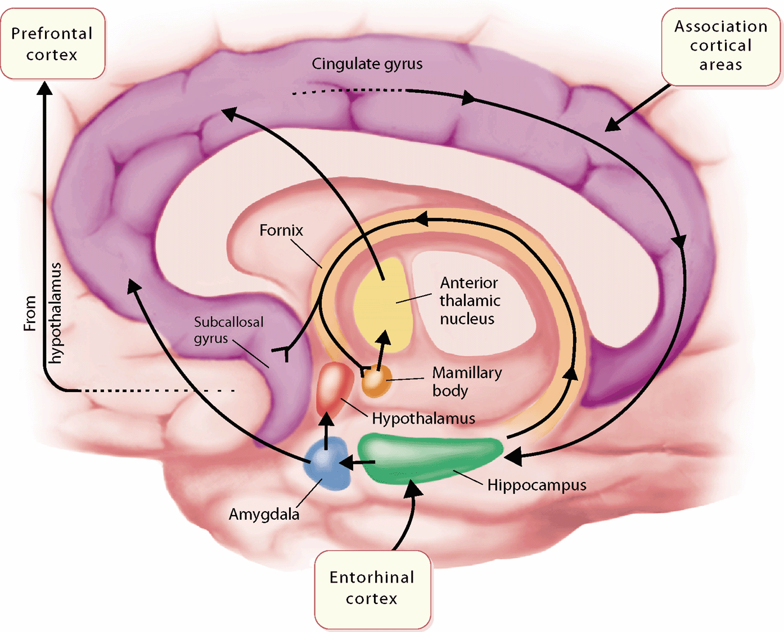
Limbic System

Slide 16
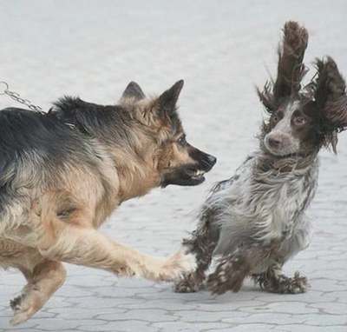
Limbic System
Subcortical structures are evolutionarily ancient
Involved in automatic emotional responses
Kluver-Bucy syndrome
  Diminished fear response, low aggression
  Hyperorality, hypersexuality

Slide 17
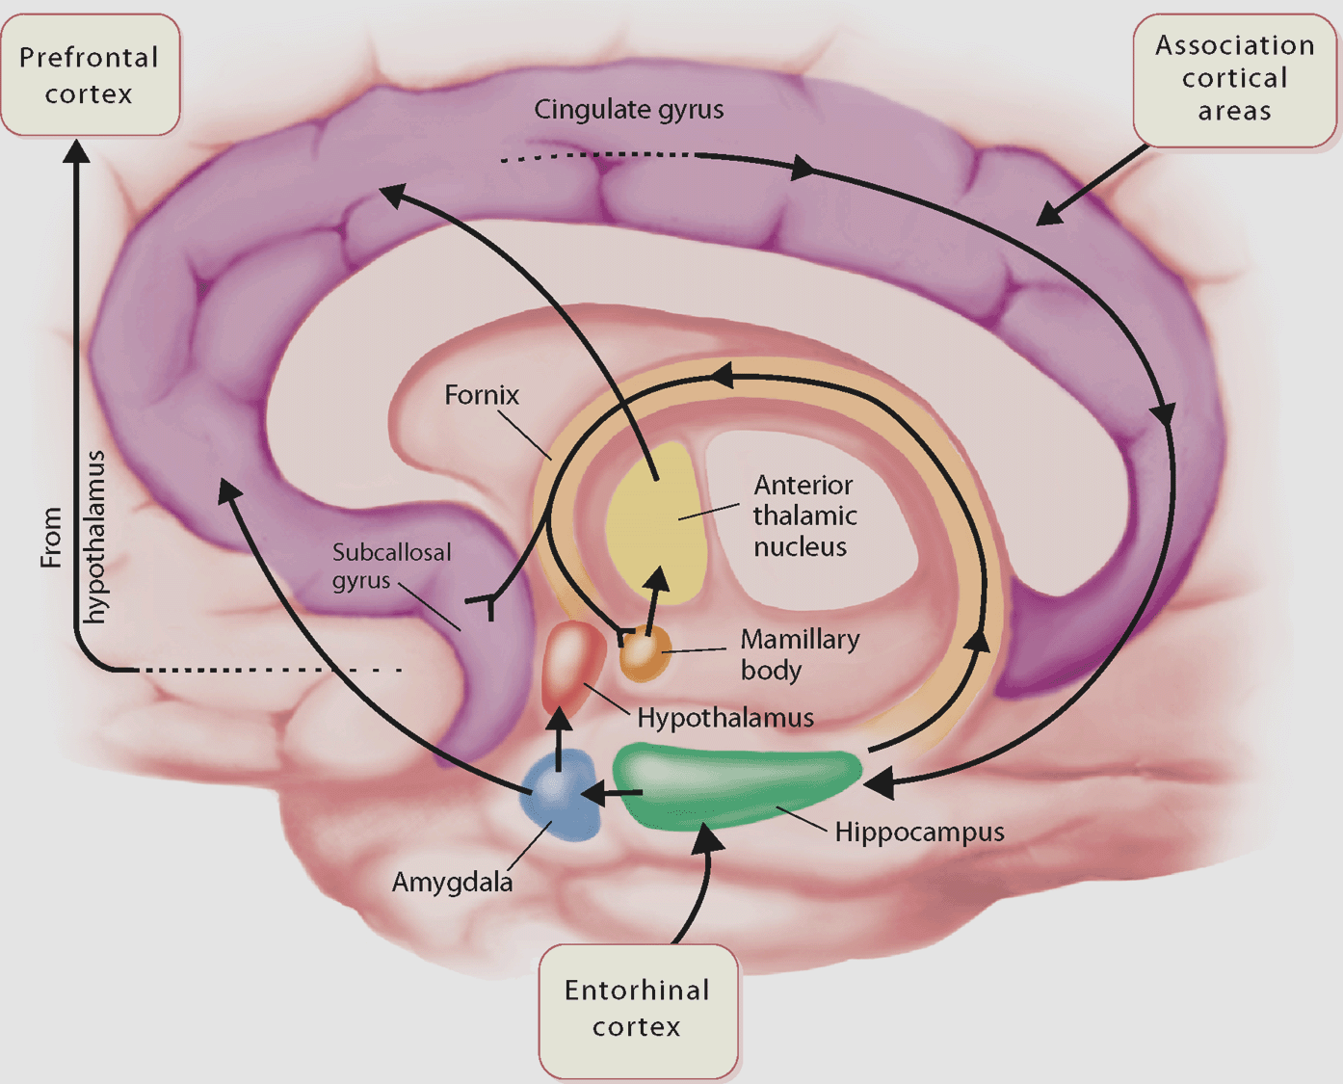
Amygdala and Fear Learning
Amygdala is highly connected
Consists of several nuclei
Fear conditioning involves changes to lateral amygdala cells
Destruction of central amygdala eliminates fear conditioning

Slide 18
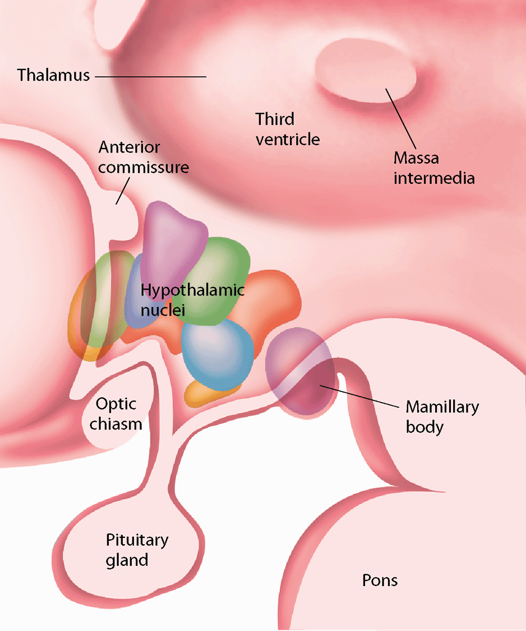
Amygdala and Fear Learning
Severing pathway to lateral hypothalamus interferes with autonomic fear response
But not behavioural fear response
Amygdala is not a “one size fits all” fear center
Different pathways involved in different aspects of emotion

Slide 19
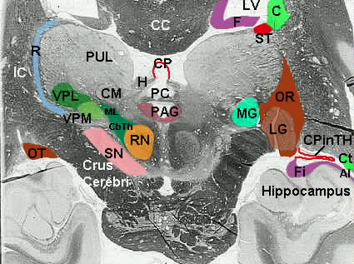
Amygdala and Fear Learning
Destruction of PAG interfered with freezing
But not autonomic response
Amygdala is a “choke point” for fear processing
But it’s not a “fear center”

Slide 20
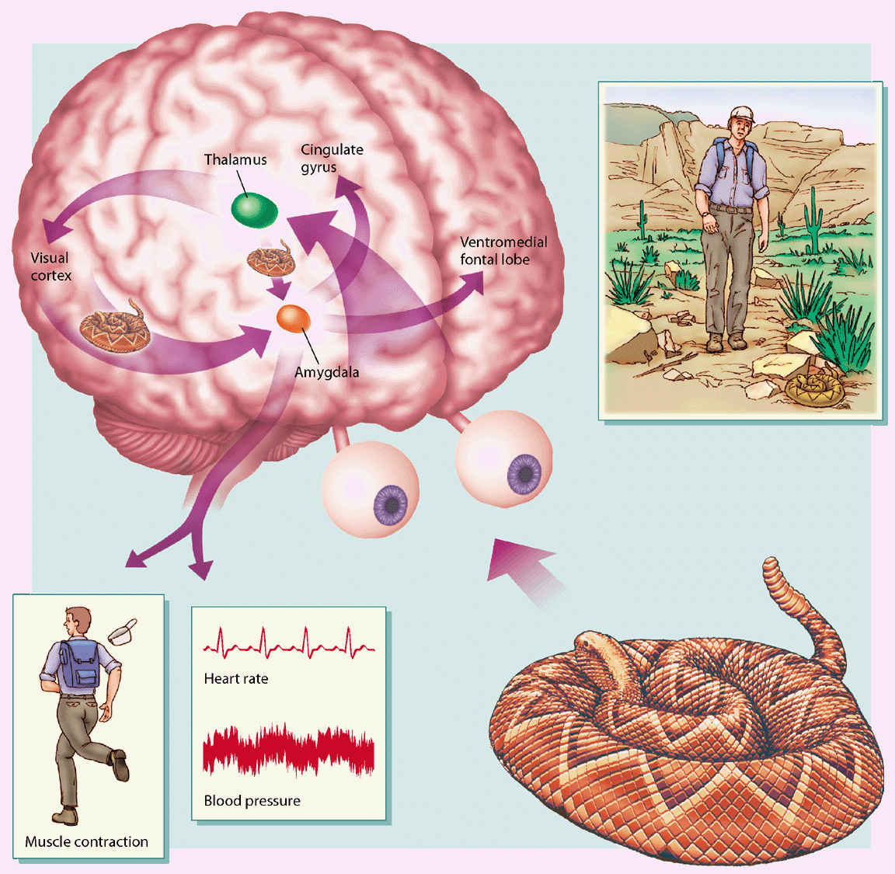
Three Stages of Emotion?
Sensory Processing
Low Road (Subcortical)
High Road (Cortical)

Slide 21
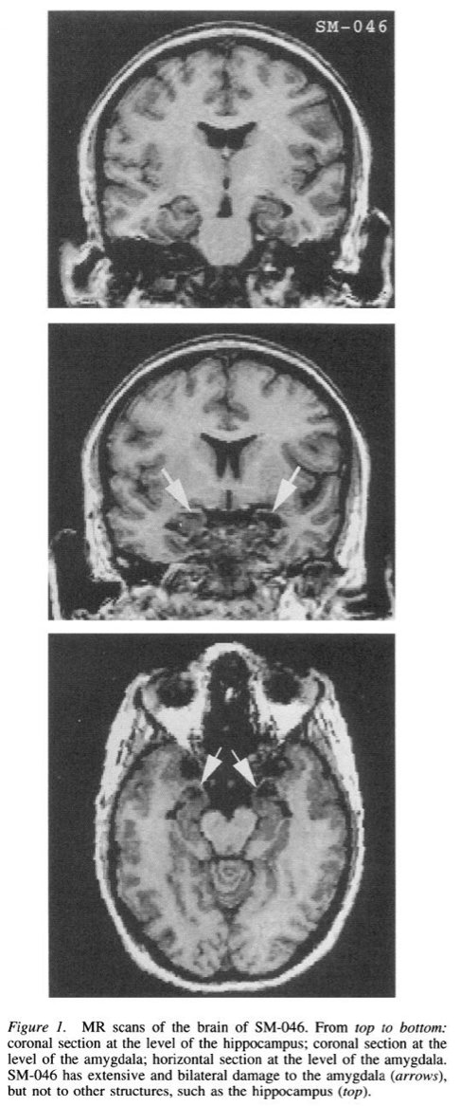
Activity: Human Lesion Cases
What would happen if you lesioned the human amygdala?
Write down a response
Discuss with partner
Share with class

Slide 22
Break for Questions

Slide 23
Cortex and Emotion
Cortical Roles:
Perception of emotion (interpretation)
Expression of emotion (face, tone)
Experience of emotion (subjective)
Functions of Emotion:
Immediate response to stimuli
Influencing social behaviours
Communication of intent
Subjective feelings

Slide 24



Perception of emotion
Perception of prosody impaired after right hemisphere lesions
Poor discrimination of emotions

Slide 25
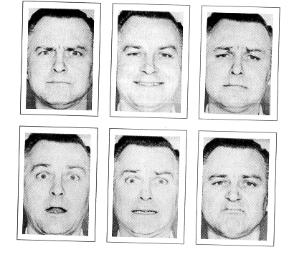
Perception of emotion
Ekman Faces:
Anger
Happiness
Sadness
Surprise
Fear
Disgust

Slide 26
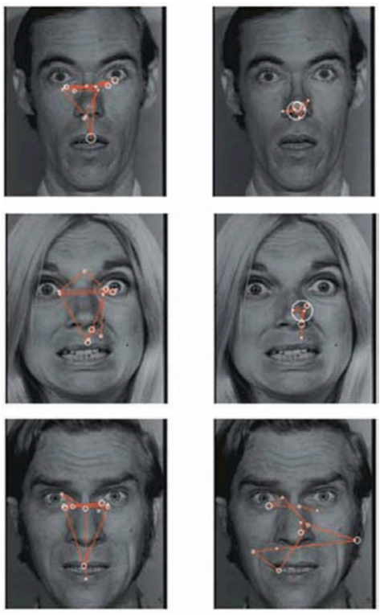
Perception of emotion
RH dominance for perceiving emotional expressions
Perception of facial expressions not affected by prosopagnosia
Amygdala involved in perception of fearful faces
SM doesn’t focus on the eyes (without prompting)
Attending to eyes eliminates deficits!

Slide 27
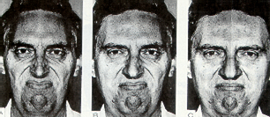
Expression of emotion
RH dominance for emotional expressions
Left side perceived as more expressive
Negative emotions judged asymmetrically
Positive emotions judged symmetrically
Left
Right
Original

Slide 28
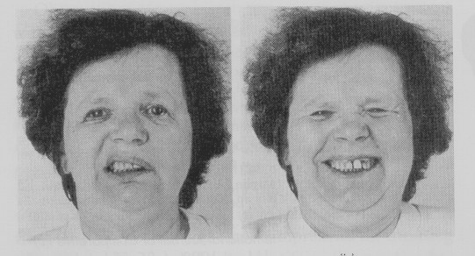
Innate vs voluntary expression
Volitional facial paresis
  Difficulty in voluntary facial movement
  Damage to motor cortex and subcortical connections
No damage to Duchenne’s muscle, for example

Slide 29
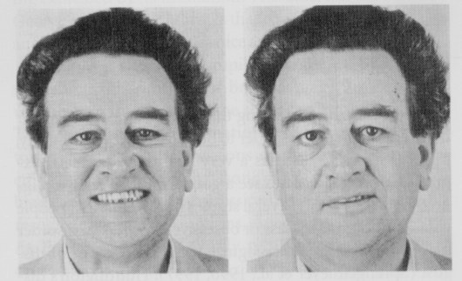
Innate vs voluntary expression
Emotional facial paresis
  Natural expressions impaired
  Damage to PFC, thalamus, subcortical white matter in frontal lobe
Duchenne’s muscle is paralyzed

Slide 30
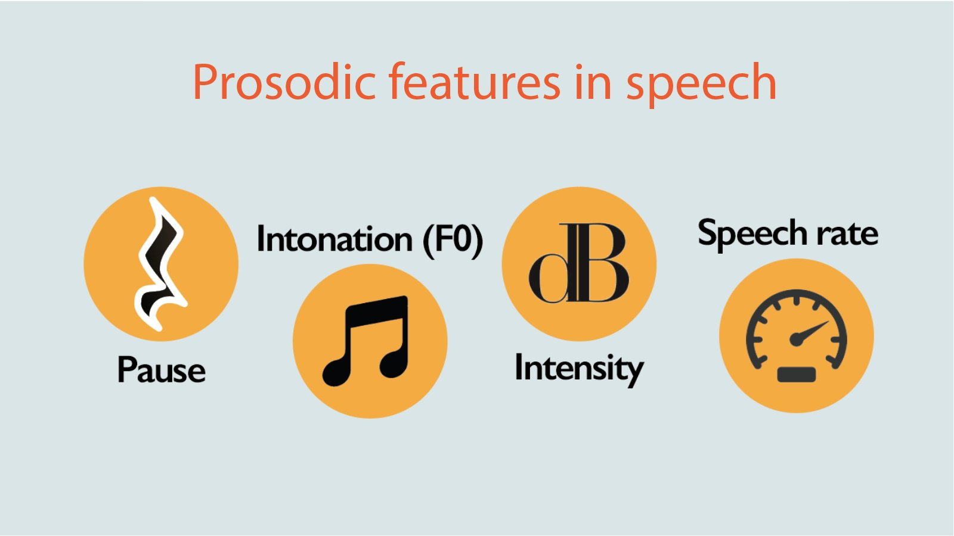
Expression of Prosody
Prosody – tone of voice
Affective prosody – emotional tone
  “My mother-in-law is coming to dinner”
Propositional prosody – semantic information
  “What’s that in the road ahead?”
  “What’s that in the road, a head?”

Slide 31
Experience of Emotion
Adynamia – lack of modulation of emotional expression (flat affect)
Anhedonia – loss of feelings of pleasure from normally pleasurable experiences
Similar profile of symptoms
Differentiated by whether actual emotional state matches

Slide 32

Experience of Emotion
Emotional valence – Positive and negative
Emotional arousal – Strength of valence
RH specialized for negative affect, LH for positive
  RH damage leads to euphoric indifference
  LH damage leads to emotional lability

Slide 33
Activity: Valence and Arousal
Pull an emotion from the hat
Draw a valence/arousal graph and plot your emotion
When you are called, plot your emotion on the board

Slide 34
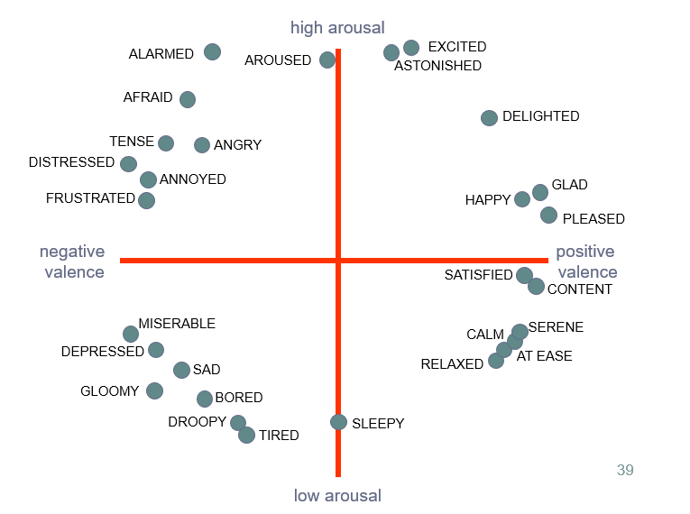
Activity: Valence and Arousal

Slide 35
Break for Questions

Slide 36
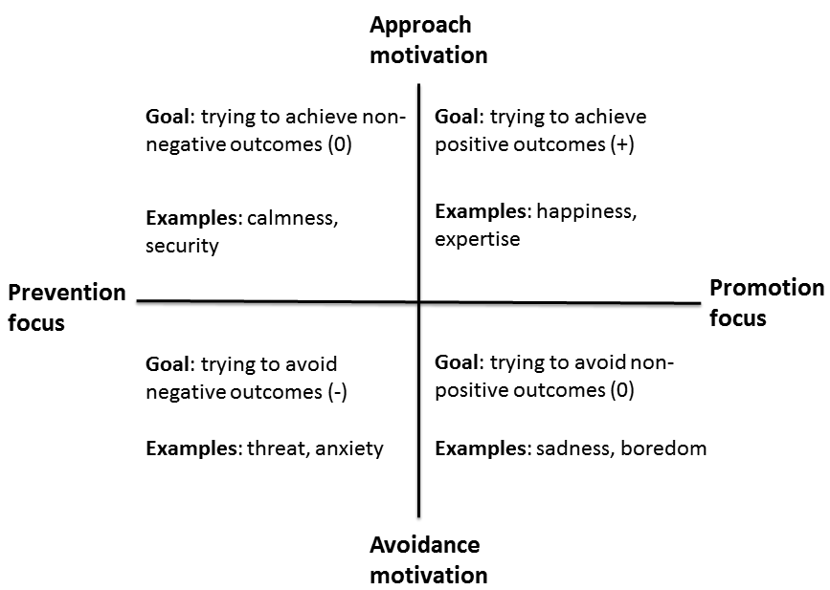

Slide 37
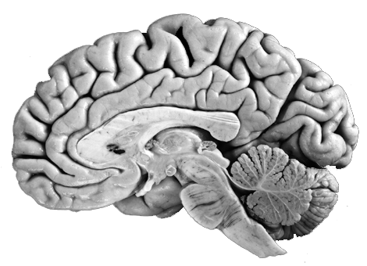
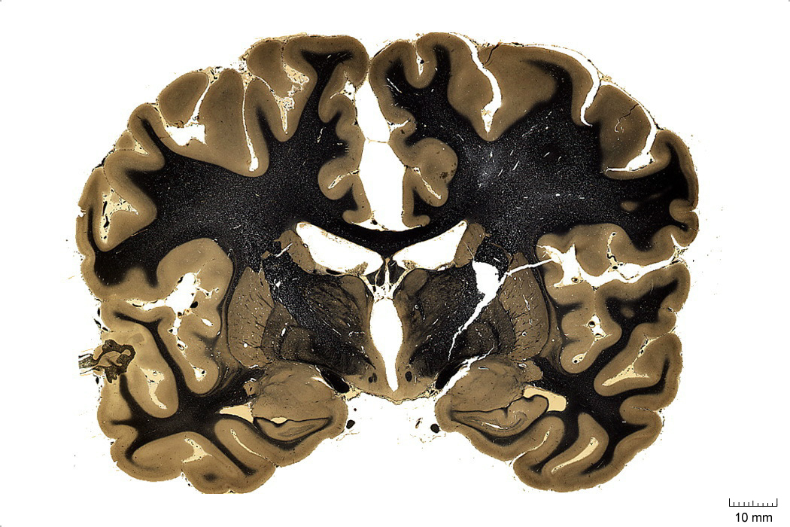
Somatic Marker Hypothesis
“Decision-making is […] influenced by visceral and somatosensory markers that arise in bioregulatory processes, including those that express themselves in emotions” (Poppa & Bechara, 2018)
Insula
vmPFC
Amygdala

Slide 38
Iowa Gambling Task
A
B
C
D
Bad Decks
(high return, very high loss)
Good Decks
(low return, lower loss)
Best long-term strategy: Choose from good decks

Slide 39
Normal Controls
Prefrontal Damage Patients
Epochs
Baseline
Pre-Hunch
Hunch
Conceptual
Baseline
Pre-Hunch
Hunch
Conceptual
Subjects Reaching Epoch (%)
100%
100%
100%
70%
100%
100%
0%
50%
Bad Decks
Good Decks
Bad Decks
Good Decks
Mean Number of Cards Selected
20
20
*
10
*
*
10
*
*
0
0
Bad Decks
Good Decks
Bad Decks
Good Decks
0.8
*
*
*
0.8
Mean Magnitude of SCRs (μs)
0.4
0.4
0.0
0.0
Bechara, A., Damasio, H., Tranel, D., & Damasio, A. R. (1997). Deciding Advantageously Before Knowing the Advantageous Strategy. Science, 275(5304), 1293–1295. Figure 1, p. 1294.
Bechara, A., Damasio, H., Tranel, D., & Damasio, A. R. (1997). Deciding Advantageously Before Knowing the Advantageous Strategy. Science, 275(5304), 1293–1295. Figure 1, p. 1294.

Slide 40
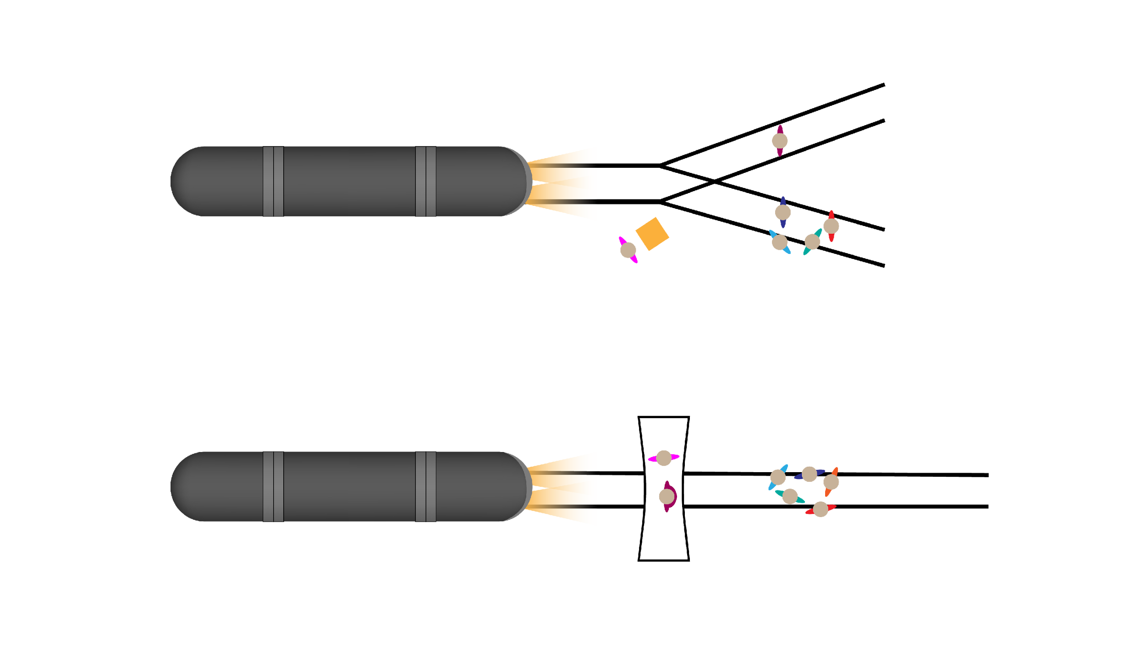
The Railroad Switch Problem
Impersonal
One Person
Side Track
Streetcar
You
Main Track
Switch
Five People
The Footbridge
Problem
Personal
Footbridge
You
Five People
Streetcar
Heavy Guy

Slide 41
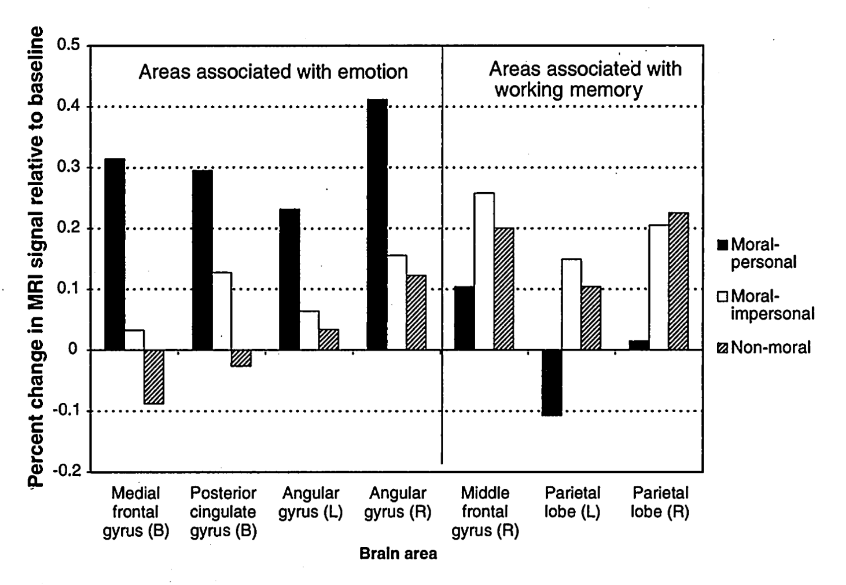
Areas Associated with
Emotions
Areas Associated with
Working Memory
0.5
0.5
0.4
0.4
0.3
0.3
Moral-personal
Percentage change in fMRI signal
relative to baseline
Moral-impersonal
0.2
0.2
Non-moral
0.1
0.1
0.0
0.0
-0.1
-0.1
Right
middle
frontal
gyrus
Medial
frontal
gyrus
Posterior
cingulate
gyrus
Left
Angular
Gyrus
Right
Angular
Gyrus
Left
parietal
lobe
Right
parietal
lobe
-0.2
-0.2
Greene, J. D., Sommerville, R. B., Nystrom, L. E., Darley, J. M., & Cohen, J. D. (2001). An fMRI investigation of emotional engagement in moral judgment. Science, 293(5537), 2105-2108.

Slide 42
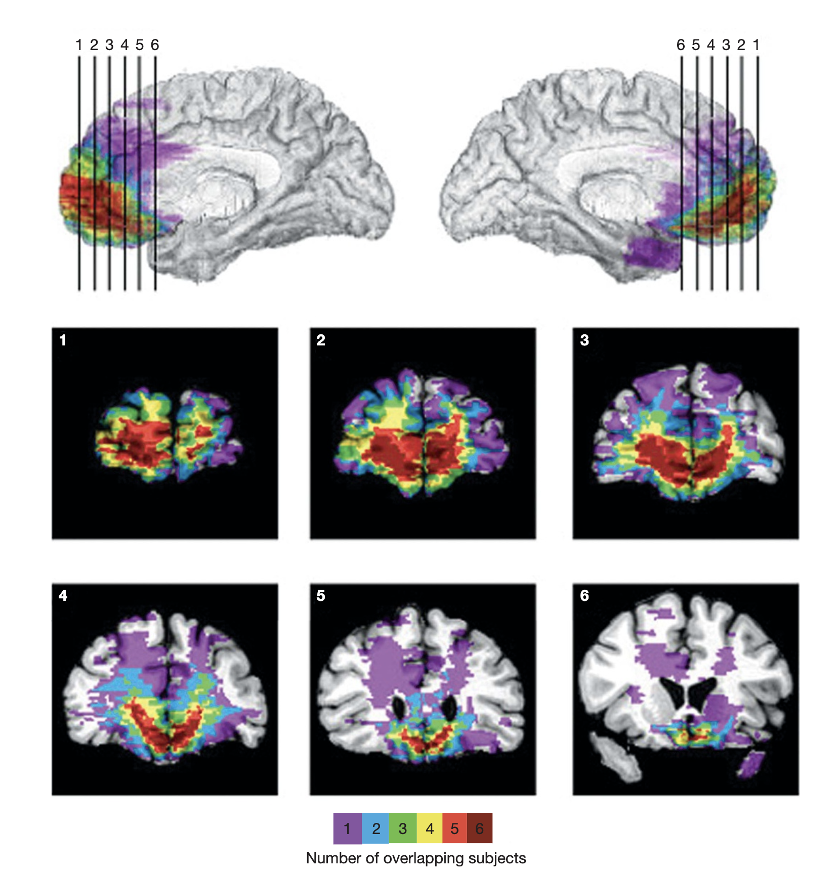
Lesions to Ventromedial Prefrontal Cortex (VMPFC)

Slide 43
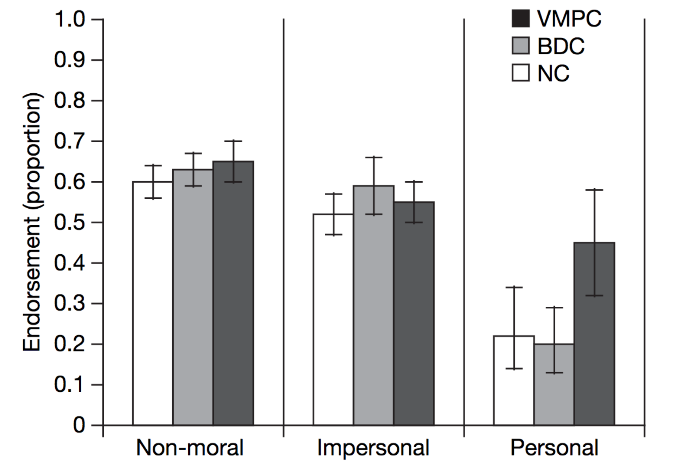
Moral Decision-Making
Koenigs, M., Young, L., Adolphs, R., Tranel, D., Cushman, F., Hauser, M., & Damasio, A. (2007). Damage to the prefrontal cortex increases utilitarian moral judgements. Nature, 446(7138), 908. Figure 2, p. 910

Slide 44
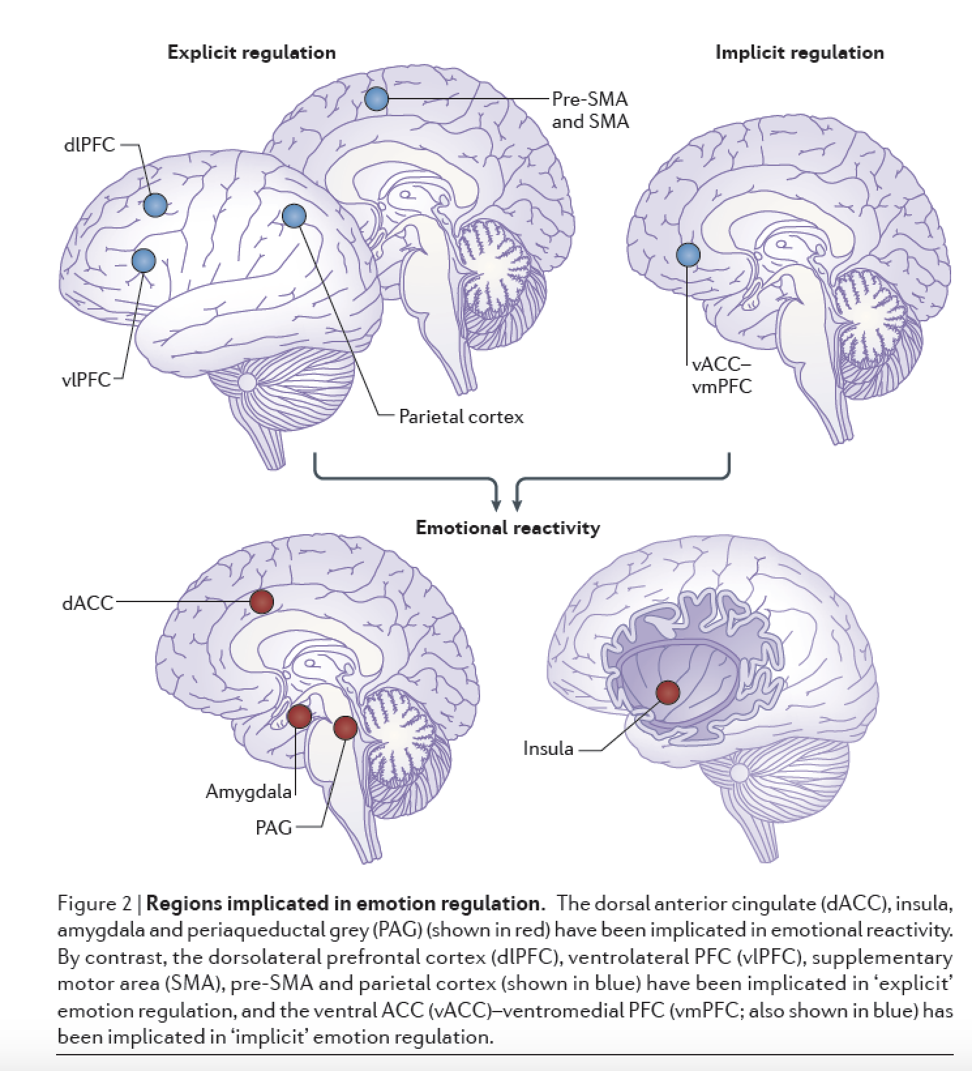
Emotion Reactivity
Dorsal Anterior Cingulate Cortex
Insula
Amygdala
PAG

Slide 45
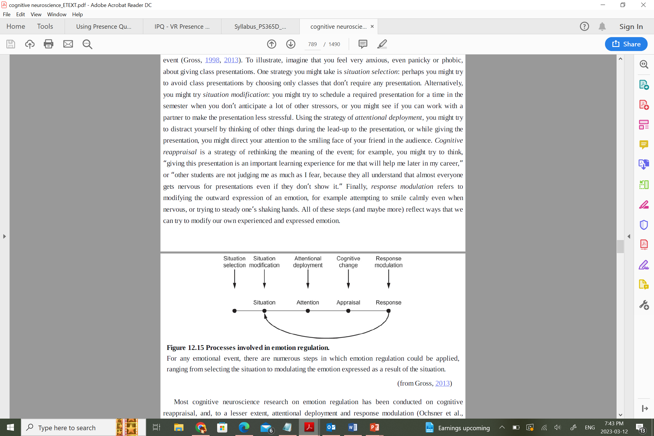
Emotion Regulation
Keeps emotions socially appropriate
Facilitates adaptation
Can be used at any stage

Slide 46
Emotion Regulation
Explicit Regulation
Implicit Regulation
Dorsolateral Prefrontal Cortex
Pre/Somatosensory Cortex
Ventrolateral Prefrontal Cortex
Ventral Anterior Cingulate Cortex
&
Ventromedial Prefrontal Cortex
Parietal Cortex

Slide 47
Break for Questions

Slide 48
Summary
Emotions are derived from cognitive appraisal of autonomic signals and surrounding context
Basic emotional responses depend on complex subcortical networks
Emotion perception, expression, and experience rely on dissociable cortical circuits
Embodied emotions are essential to “higher” cognitive processes

Slide 49

Conclusion
Clearest/muddiest point exercise
Thanks to Dr. Hoey for inviting me
I hope this was useful
I’ll stick around for the next few minutes
Please email me at swinward@uwaterloo.ca for further questions

