Slide 1

Affective Computing
CS 886
Dr. Matthew Silk (msilk@uwaterloo.ca)

Slide 2
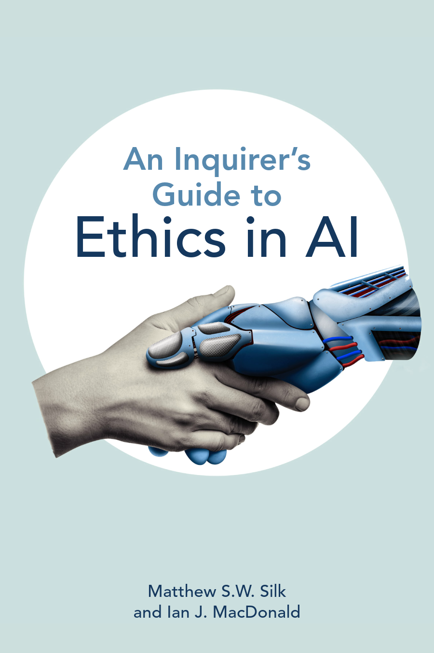
Matthew Silk
Ph.D. – Philosophy
BA – Political Science & Philosophy
Philosophy of science
Value theory
Ethics of Artificial Intelligence
Outer Space Ethics

Slide 3

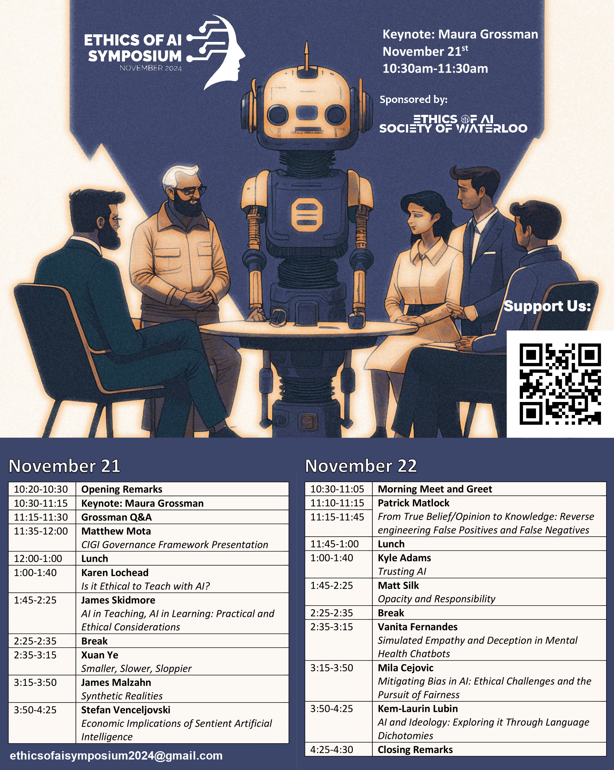
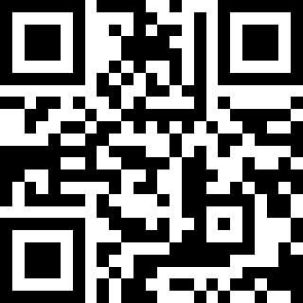
Ethics of AI Society of Waterloo

Slide 4
Good AF
Better emotional expression
Predict strokes/heart attacks
Improved human-computer interactions
Support in caregiver rolls
Emotional coaching
Advertising
Entertainment

Slide 5

Workforce Surveillance
Imagine that research you developed to detect emotions was used by corporations to surveil their workforce. Would you be morally responsible?
“Emotion surveillance is considered important in settings where workers are required to demonstrate pro-social attitudes, which is cited as a reason for failure to achieve targets. Despite the claims made by workers that the failure owed to systemic reasons of inadequate data, slow systems, or inaccurate data, they were forced to go through a ‘performance counseling scheme.’” - 8

Slide 6
Ethical situations
How do you know you are dealing with an ethical situation?
Reflective moral thought emerges when we are “confronted with situations in which different desires promise opposed goods in which incompatible courses of action seem to be morally justified.”
-John Dewey, Ethics
“the only force of appeal to us … is found in the ‘everlasting ruby vaults’ of our own human hearts.”
- William James, The Moral Philosopher and the Moral Life

Slide 7
Value Judgments
If ethics is about determining what we ought to given incompatible goods, then ethics is fundamentally about value judgments.
End: A goal or objective.
Means: The resources/steps required to obtain an end.
Means
Plane ticket
End
Go on vacation.
Means
Hire movers
End
Go on vacation.
Means
Rent truck

Slide 8

Car Insurance Algorithm
Means
End
Biometric Data
(AC)
Build model
Calculate risk for each driver
and determine appropriate premium.
Past driving experience
Credit rating

Slide 9
Car Insurance Algorithm
Means
End
Consequences
Better crash detection
Biometric Data
(AC)
Bias against the poor
Build model
Calculate risk for each driver
and determine appropriate premium.
Past driving experience
More anxious drivers
Credit rating
Feedback loops

Slide 10
Ends-in-view
An end goal considered in terms of the means (resources, steps) required and the consequences produced from achieving in the end in the way.
End-in-View
Consequences
Car model
Bias against the poor
Means
End
Build model
Calculate risk for each driver
and determine appropriate premium.
Past driving experience
Bias against racial minorities
Feedback loops
Credit rating
Don’t exacerbate income inequality.

Slide 11
Ends-in-view
An end goal considered in terms of the means (resources, steps) required and the consequences produced from achieving in the end in the way.
“Ends are appraised in the same evaluations in which things as means are weighed. For example, an end suggest itself. But, when things are weighed as means toward that end, it is found that it will take too much time or too great an expenditure of energy to achieve it, or that, if it were attained it would bring with it certain accompanying inconveniences and the promise of future troubles, it is then appraised and rejected as a ‘bad’ end.”
– Dewey, Theory of Valuation

Slide 12
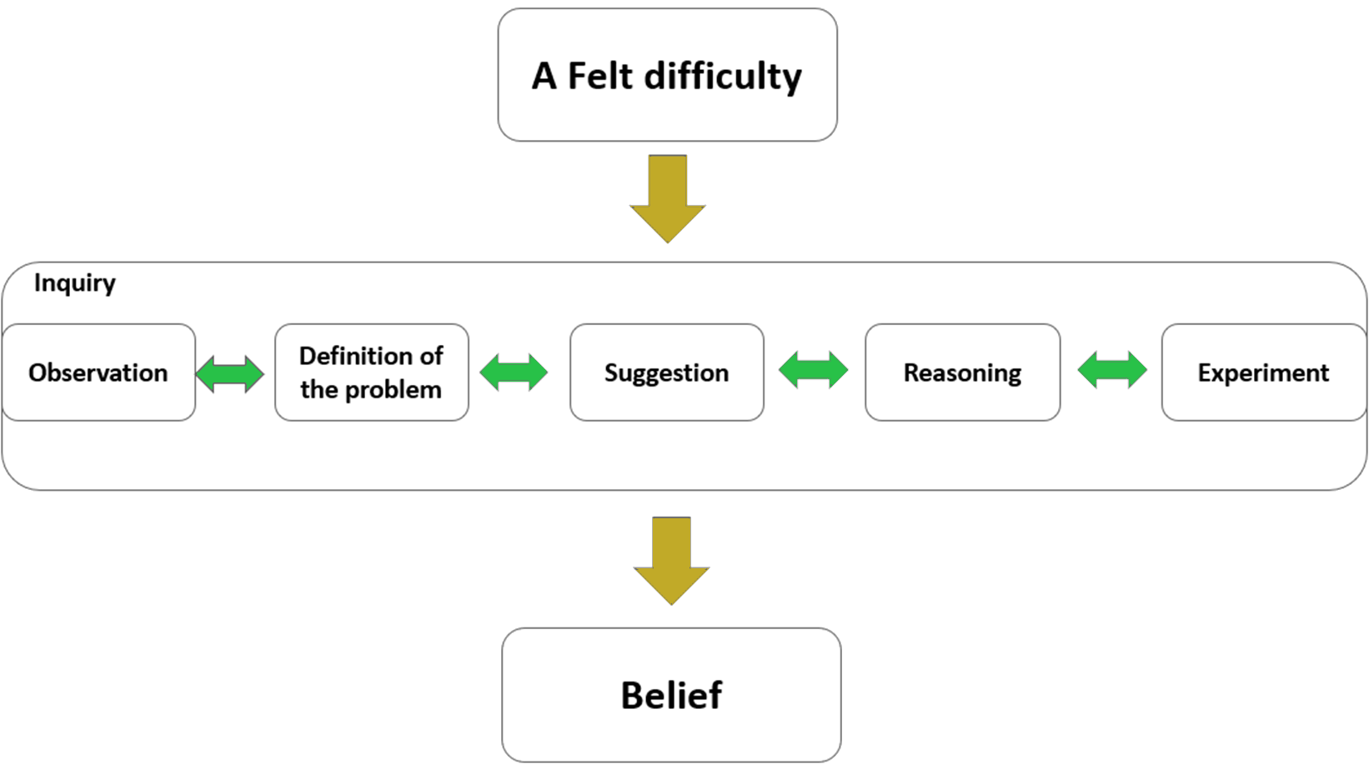
Moral Inquiry
Pattern of Inquiry
A felt difficulty
Definition of the problem
Solution suggestion
Reasoning
Experiment
Judgment

Slide 13
Ethics and AI
Many of the ethical problems associated with the development of affective computing and artificial intelligence involves either problematic assumptions or problematic data.
To what extent is an AC developer responsible for either?

Slide 14
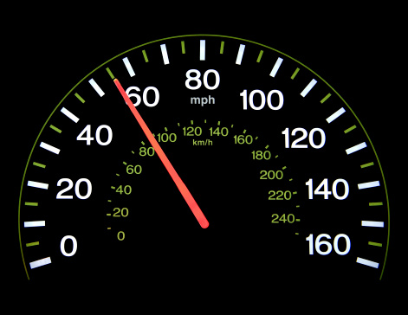
Evidential Reasoning
Imagine a cop pulled you over and claimed that you were exceeding the speed limit.
You do not believe that you were speeding. What evidence might you cite to justify your claim?

Slide 15
Evidential Reasoning
“States of affairs, that is, do not carry labels indicating that for which for which they can be taken as evidence.”
-Helen Longino
“States of affairs are taken as evidence in light of regularities discovered, believed, or assumed to hold.”
-Longino

Slide 16

Background assumptions
“A given item…can be described in different ways depending on the points of view and interests of those describing it…The consequences of emphasizing one aspect of the hat rather than another include the possibility of its receiving under one description an evidential assessment different from that received in a context in which some other aspect is emphasized.”
-Helen Longino, Science as Social Knowledge
“The grey hat”
“The hat on the stairs”

Slide 17
Confirming Background Assumptions
Longino: We cannot, nor is it prudent, to directly test and verify every background assumption in science.
Impractical/undesirable
Unobservable particles
Non directly measurable things
“When a theory is being developed, the criterion for inclusion…is not that they are directly confirmed…but that they are relevant to the explanation of the phenomena”
-Longino
In cases where there is not direct confirmation of background assumptions, choices may depend on values.

Slide 18
Background assumptions
Are affects dependent on the physicality of the body or on context and social background.
Emotions as static vs dynamic elements of experience.
Emotional communication.
Classifications of emotion.
Universality of emotions.
Facial expression vs muti-modal (gestures, perspiration, pupil dilation).
“This raises crucial epistemic questions regarding the interpretability of emotions, their adequate classification and the possibilities or not of misrecognition, misidentification, and misinterpretation.”
-Kumar et. al

Slide 19
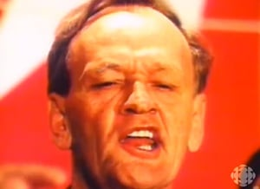
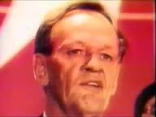
Background assumptions
“If an AC system is unable to read the problem correctly, it will offer the wrong solution. Its epistemic state will be compromised in the process, compromising the standing of the person vis-a-vis the system. Thus, AC systems potentially hold possibilities of misrecognition and wrong characterization, which will have crucial implications the more these systems are integrated into society and in crucial decisional spaces.” –Kumar et al. 8
Is this a Prime Minister?

Slide 20

Clinical Depression
Let’s say you wanted to design an algorithm that predicts of someone has clinical depression. What metrics would you use as data to teach it to do this?

Slide 21
Clinical Depression
“If it makes sense to understand mental disorders as arising from the causal interplay of symptoms and other factors in a network structure, there may be no reductive biological explanation that awaits discovery. This is because, contrary to quite widely shared current opinion, mental disorders are not brain disorders at all.”
"Psychopathology should be conceptualized in terms of what they call mechanistic property clusters: constellations of properties than hang together because they are connected by a diverse set of mechanisms.”
-Borsboom et. Al, Behavioral and Brain Sciences

Slide 22
Clinical Depression
Determining what clinical depression is and what counts as a symptom of it is determined by background assumptions.
These background assumptions will tell us how to measure the concept. What symptoms and how severe.
Acceptance of some of these background assumptions will sometimes be based on value judgments.
Any biases in those assumptions would govern how we understand a successful model.
“If clinical depression is defined in terms of its symptoms, what criteria should be used to distinguish clinical depression from the common blues?”
“These symptoms all involve feelings of sadness that impair these vital functions….determining which functions are central to human flourishing involves making value judgments”
-Kristen Intemann, Science and Values.

Slide 23
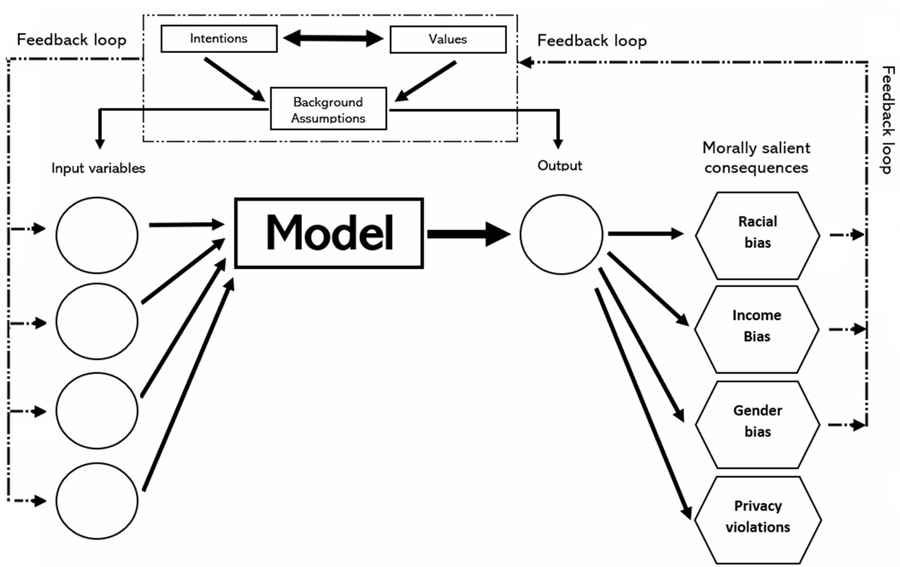
Values and facts
Values (how things ought to be) can influence how we understand and define a concept. This can influence:
How we may ideally think about operationalizing the concept for measurement.
What proxies we may decide to use when direct measurements are not available.
Whether our model is “successful.”

Slide 24
Assumptions in Affective Computing
“This process rests on assumptions about the nature of emotions, the criteria used to classify them, and the allocation of these into categories. This raises crucial epistemic questions regarding the interpretability of emotions, their adequate classification, and the possibilities or not of misrecognition, misidentification, and misinterpretation.”
“Affective computing […] assumes that humans demonstrate patterns that have physical giveaways such as fluctuating heart rate, pupil dilation, and muscle tension and convert these effects into observable data.”
“Affect capture is normative judgment based on a theory that affects are natural and universality;” w/ fixed relations between inner states and behavioral display (so, can’t build in context).”

Slide 25
Assumptions in Affective Computing
“Hirevue, an interview tool used by companies, employs algorithms that learn from a 25000 database of previous successful interviews, including affects such as voice tone modulation, talking speed, raised chin, smiling, raised brows, wide or closed eyes, and tightened lips.”
“This system assumes a uniform
distribution of attributes while only being trained on attributes of
mostly white men. Cues such as confidence and self-assurance in successful applicants are a product of social construct and are distributed differently among various genders, races, ethnicities, and religions.”
-Kumar et. al

Slide 26
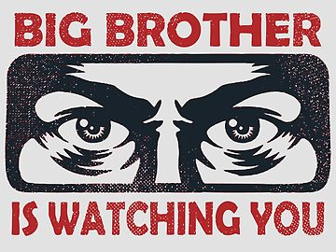
Workforce Surveillance
Are researchers responsible for all the morally salient consequences that follow from their work?

Slide 27
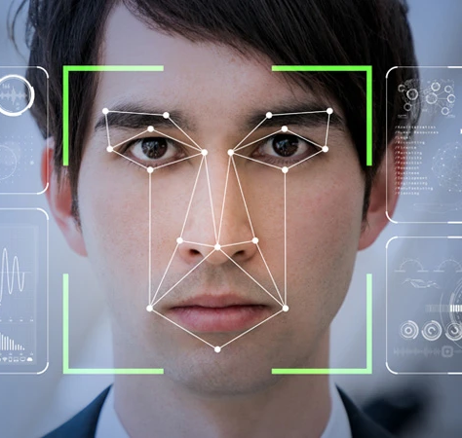
Scientific Responsibility
“Expression of Concern: Facial feature discovery for ethnicity recognition”
Data Mining and Knowledge Discovery

Slide 28
Wiley Publishing
Should Wiley have retracted the article?
Should the researchers have published?
Is there an ethical distinction between the development of science and technology and its applications?
“We are aware of the persecution of the Uyghur communities [...] However, this article is about a specific technology and not an application of that technology.”
-Wiley Publishing

Slide 29
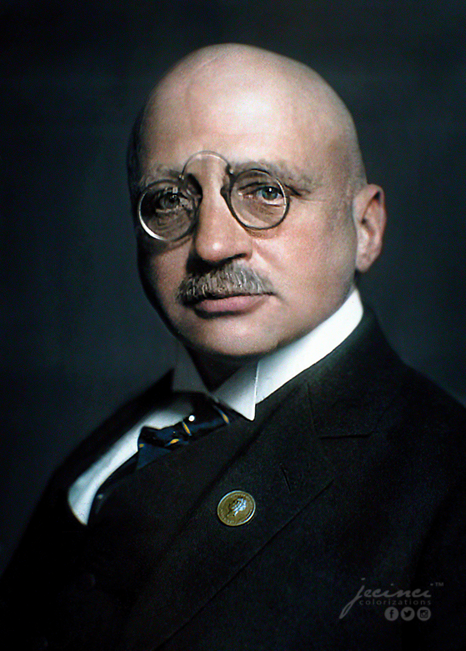
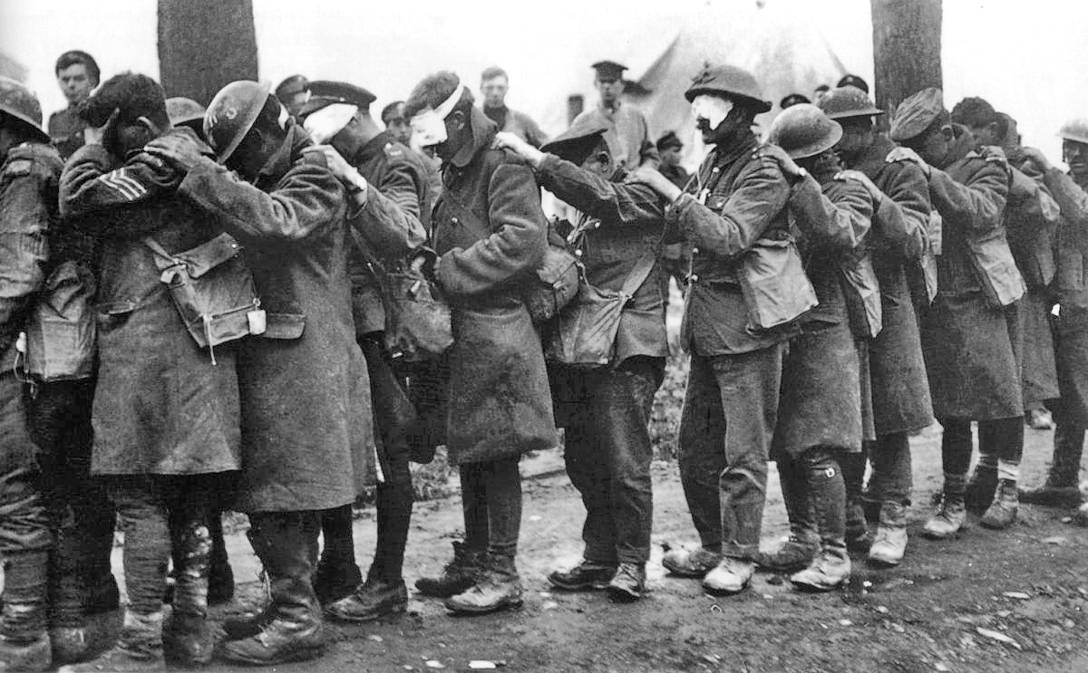
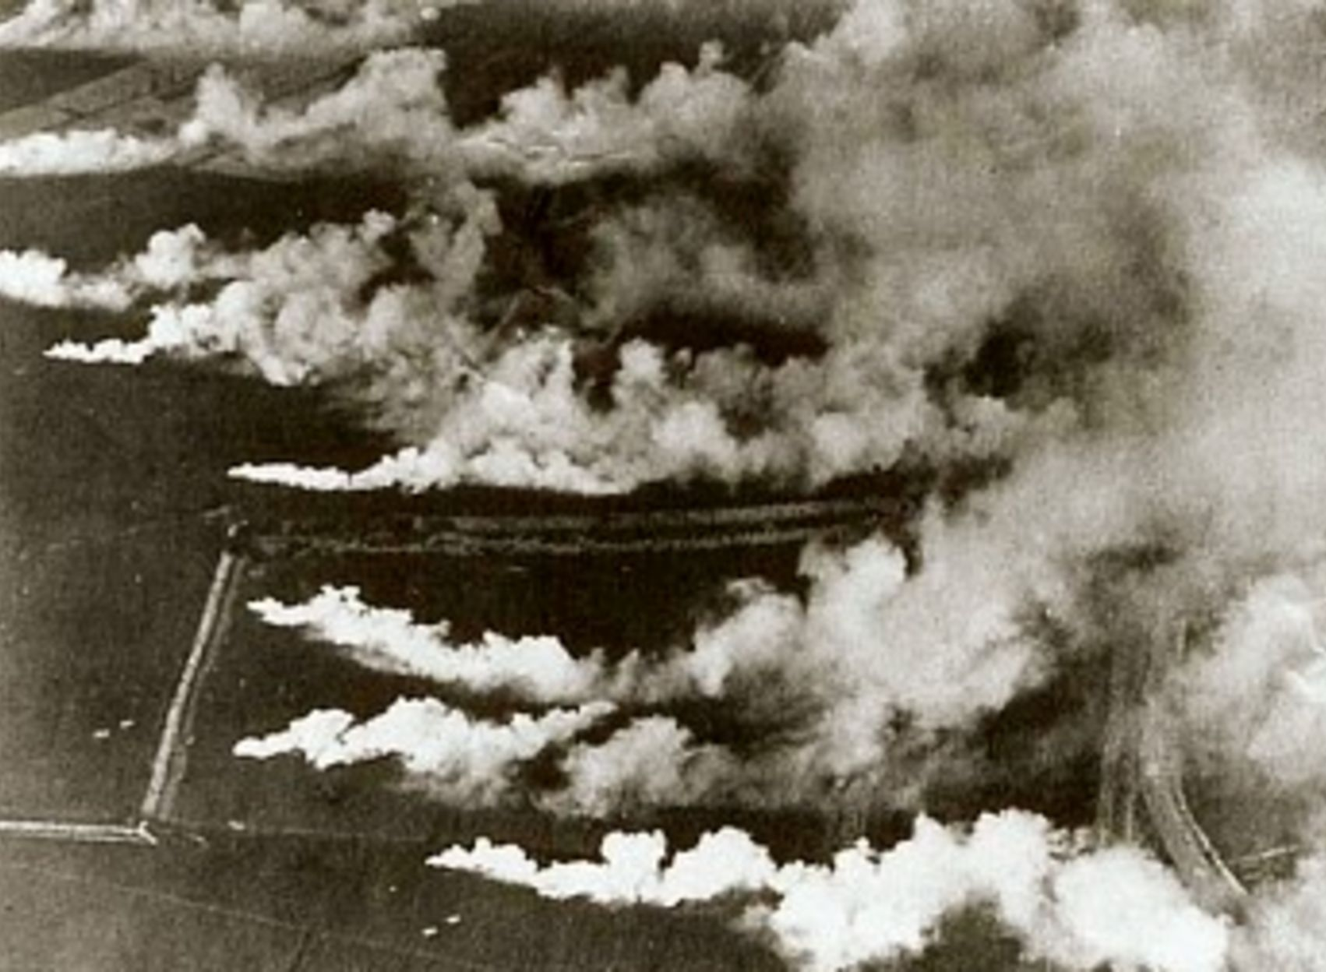

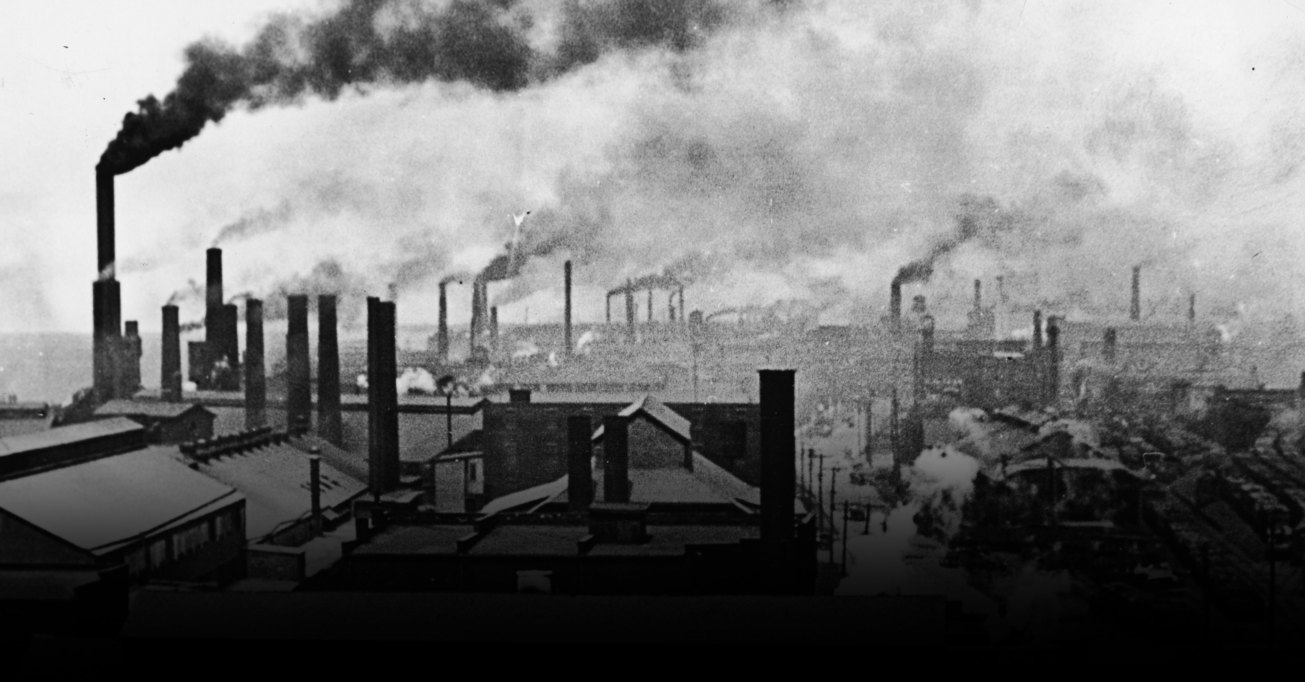
Scientific Responsibility

Slide 30
Scientific Responsibility
“Scientists, with few notable exceptions, are the worst citizens of the Republic … they sneer at politics and politicians … They sell their services to exploiters of human life… They produce powerful mechanisms and proudly proclaim that they ‘do not care how they are used—leave that to the moralists … The ‘pure’ scientist has to be a moral eunuch or a civic hermit.”
-Read Bain, 1933

Slide 31
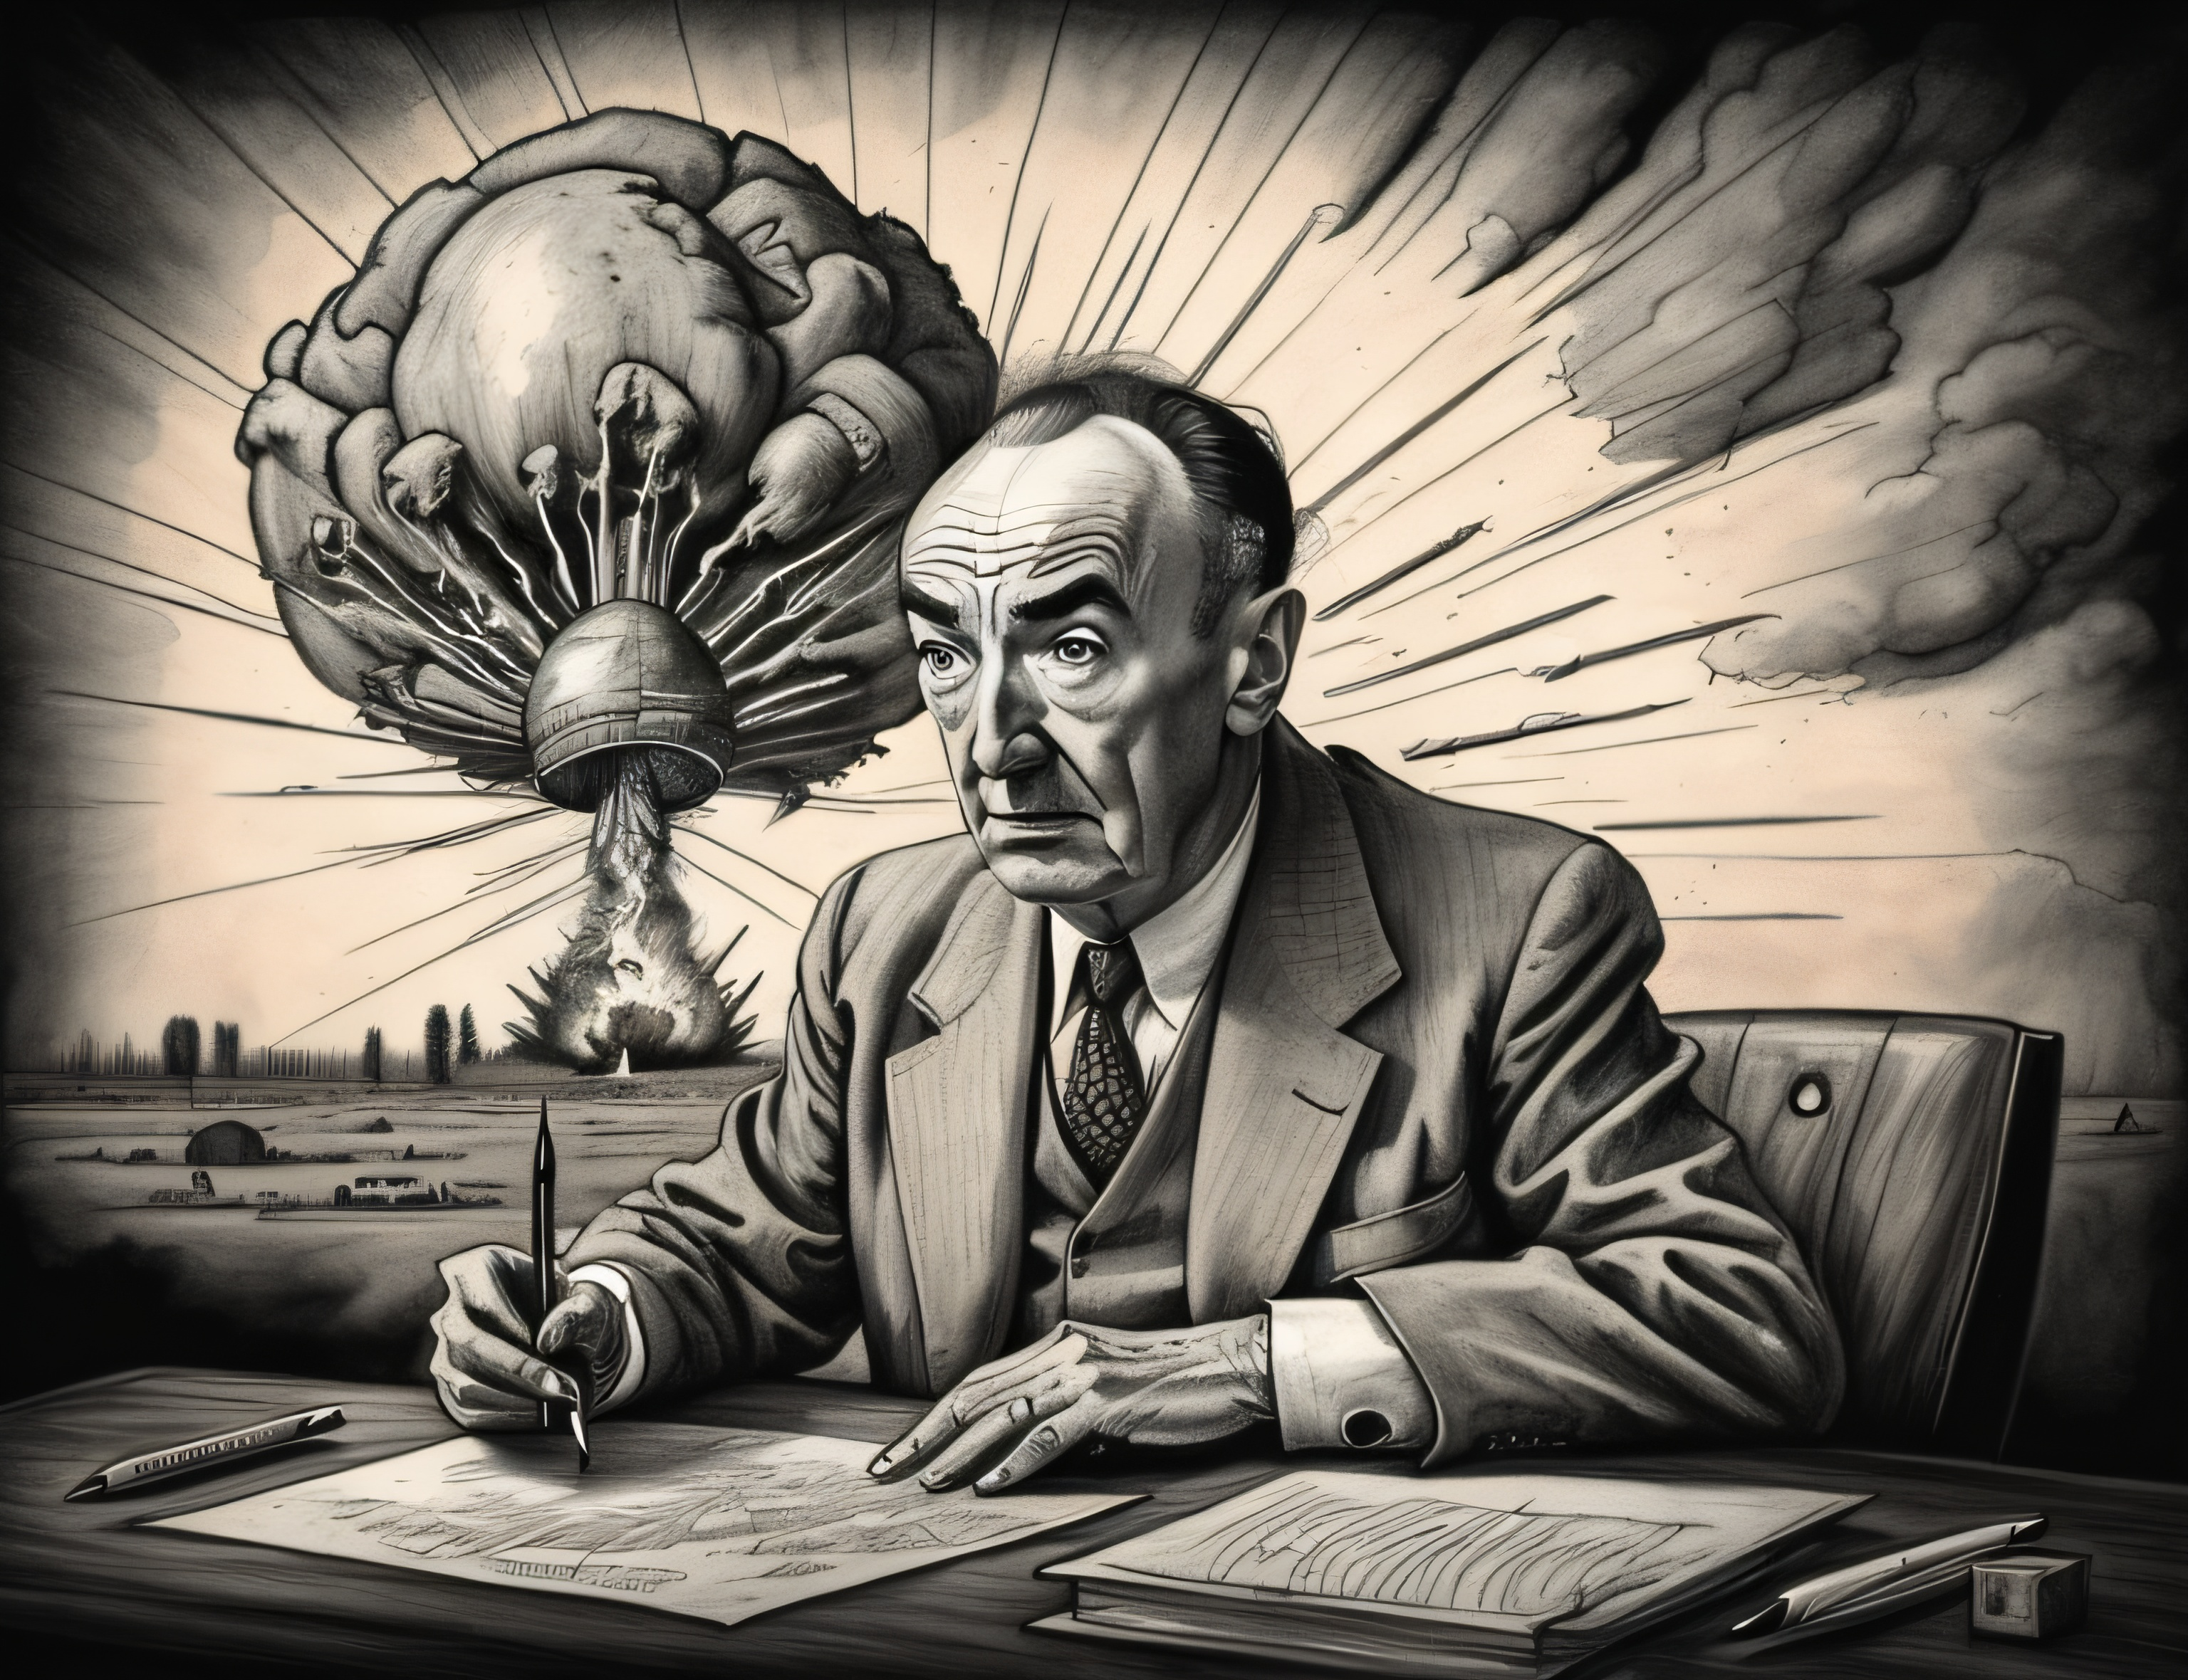
Science and Society
To what extent are scientists for the consequences of the application of their research?
Should society hold scientists responsible for bad consequences?
Should some kinds of research be prohibited?

Slide 32
Causal vs Moral Responsibility
“In the great majority of cases of dangerous research-results it is absurd…to designate the researcher as the subject responsible for these results” - Hermann Lübbe, 1986
“In more common situations individual responsibility is not considered to extend to all the consequences that may be initiated by the act of the individual. The miner of iron ore is not expected to see to it that none of the scrap iron…is sold to the Japanese to be used against his country.”
-Bridgman, 1947

Slide 33
Causal vs Moral Responsibility
Someone is causally responsible for something if they directly or indirectly cause something to happen, but we don’t hold them accountable.
Someone is morally responsible when someone causes something to happen, and they are held responsible (praised or blamed) for doing so.

Slide 34
Bridgman & Scientific Freedom
“The application of scientific discoveries are very seldom made by scientists themselves, but are usually made by industrialists. If is the manufacture and sale of the invention that should be controlled rather than the act of inventing. If [society] had not wanted to construct an atomic bomb, it need not have signed the check for the two billion dollars which alone made it possible.”
“It is society as a whole that is in a position to provide a mechanism of control rather than the individual discoverer, so that it is therefore, the responsibility of society to see that discoveries in pure science are properly exploited, not the responsibility of the discoverer.”
-Percy Bridgman, 1947

Slide 35
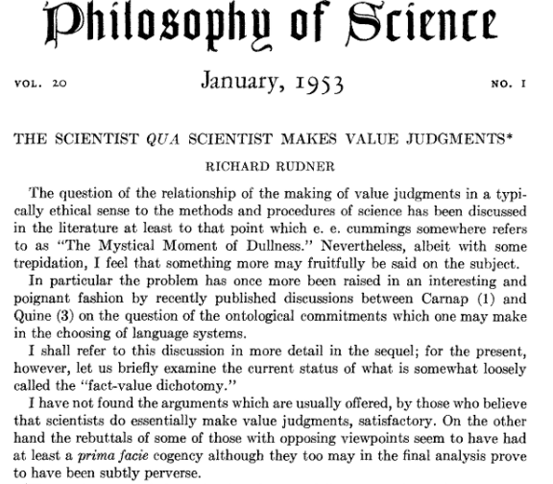
Arguments Against Scientific Freedom
Inductive Risk
Is science really value-free?
Richard Rudner “The Scientist Qua Scientist Makes Value Judgments”
Scientists must consider the risks
of error when deciding how much
evidence is sufficient.

Slide 36
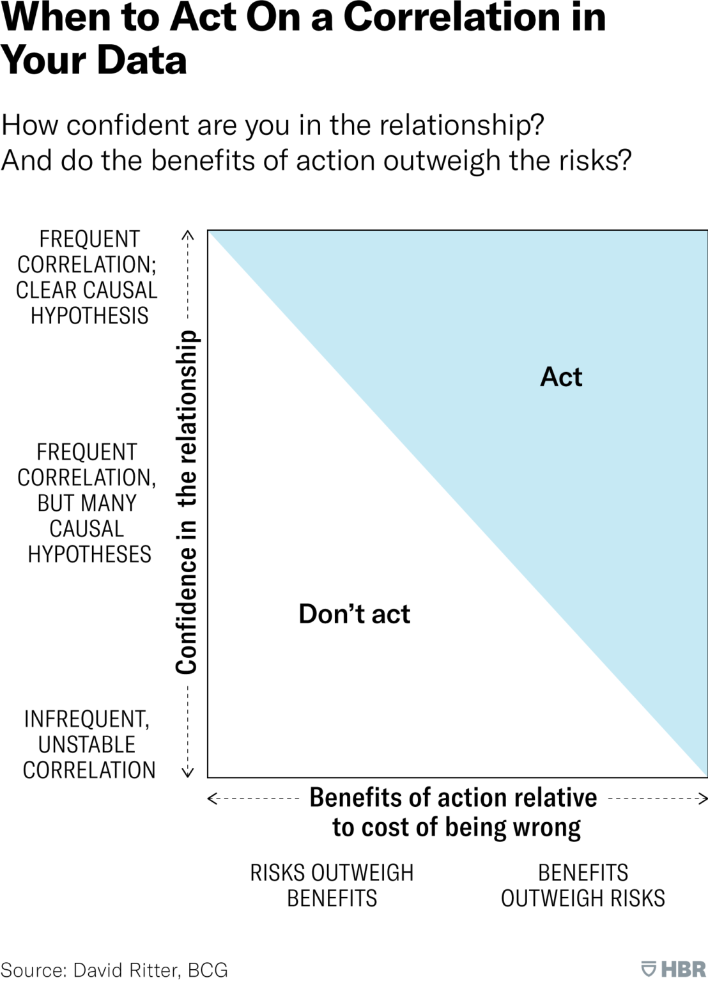
Inductive Risk
What are the ethical consequences if I am wrong about my conclusion?
Should I demand a higher standard of evidence? (greater concern for type I error)
Should I set a low standard of evidence? (greater concern for type II error)

Slide 37
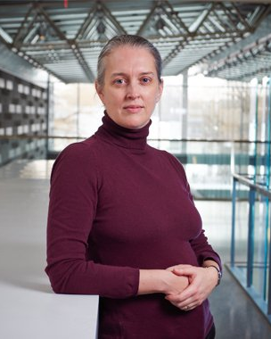
Arguments Against Scientific Freedom
The value of Science and the role of the scientist
Recklessness: One is fully aware of the risks they are taking or imposing on others and those risks are unjustified.
Negligence: One is not aware of the risk of harm they are taking or imposing on others, but they should be.

Slide 38
Scientific Responsibility
While we may not expect scientists to predict the future, we do expect them to foresee the reasonably foreseeable and to act appropriately.
If your research is error-prone, you are responsible for those errors if that research is applied.
“How much foresight and careful deliberation should we expect the individual to have? Often, this question is answered through an examination of community standards, couched in terms of what a reasonable person would have done in like circumstances.” - Douglas.

Slide 39
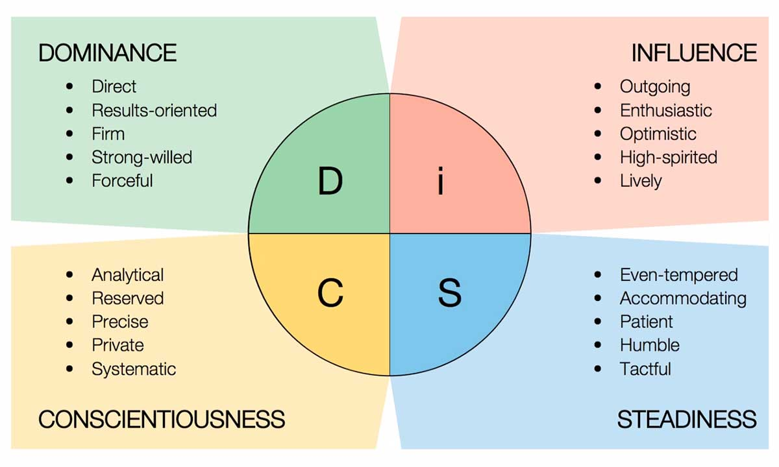
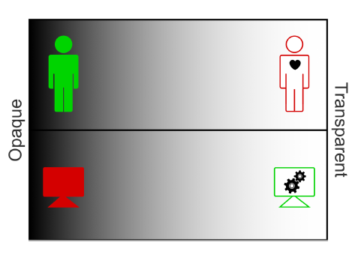
Inductive Risk and Opacity
“Profiling is a form of classification that categorizes individuals into groups based on some similarity of attributes and then targets them similarly.”
“We need to consider (a) whether the profiling is done accurately and (b) whether the user is aware of such a classification.”

Slide 40
Opacity and the ethically salient consequences
Surrender
Credulity
Manipulation
Advertising

Slide 41
Opacity and the ethically salient consequences
“humans with access to these technologies
can exercise power over the ones who do not. Humans
thus, stop being ends in themselves and rather become means to those who have access to these technologies who can then exercise power over them.”
“These systems may exert a normative influence by guiding emotions to suit the particularities of the context and conformity with a norm, a profile, thus presenting sites of conflict that may require users to adapt their natural, intrinsic emotions according to the needs of an artificial machine. For example, in cases where interviewees are aware of an AC tracking their emotions, they tend to game the system based on its expectations and start behaving in unnatural ways, like machines themselves.” –Kumar et. al
Autonomy and playing the part
Testimonial injustice
Surveillance & trust

Slide 42
Opacity and the ethically salient consequences
Are researchers responsible for all the morally salient consequences that follow from their work?

