Slide 1
Moral psychology and the emotions
Sam Johnson
Affective Computing – Guest Lecture
October 31, 2024

Slide 2
Overview of today
What constitutes right and wrong?
Evolutionary logic of cooperation and altruism
The strategic role of emotions

Slide 3
Overview of today
What constitutes right and wrong?
Evolutionary logic of cooperation and altruism
The strategic role of emotions

Slide 4
Philosophical standards of right and wrong
Consequentialism: Outcome-based morality
Morality is producing “the greatest good for the greatest number”
Utilitarianism: We measure ‘good’ in human happiness
Jeremy Bentham

Slide 5
Philosophical standards of right and wrong
Deontology: Rule-based morality
Morality is following a set of moral duties
Categorical imperative: Only act on moral rules that would work if universalized
Immanuel Kant

Slide 6
Philosophical standards of right and wrong
Virtue ethics: Character-based morality
Morality is cultivating ‘moral virtues’ such as honesty, prudence, loyalty
Virtues aim toward ‘true’ happiness (eudaimonia)
Aristotle

Slide 7
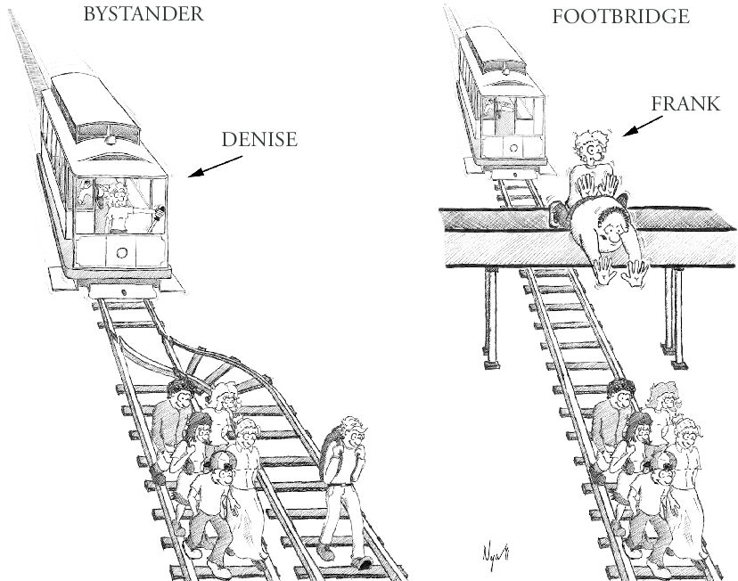
Do people use these standards?
Utilitarian intuitions vary depending on context (Hauser et al., 2007)
85% in “bystander” case
12% in “footbridge” case
Intuitions might be downstream of more basic cognitive processes (Greene et al., 2001)
Reason (numbers) → Utilitarianism
Emotion (vivid images) –> Deontology
So people don’t have a single moral theory, but different theories triggered by context?
Waldmann, Nagel, & Wiegmann (2014)

Slide 8
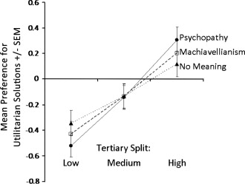
Do people use these standards?
It gets worse!
These dilemmas may not even measure utilitarianism
More psychopathic and Machiavellian people are more “utilitarian” in trolley dilemmas (Bartels & Pizarro, 2011)
They don’t translate well into behavior (Bostyn et al., 2018)
Philosophical utilitarianism is actually two things:
Instrumental harm (sacrificing others to the greater good)
Impartial beneficence (equal concern for all)
When measured separately, these are uncorrelated! (Kahane et al., 2018)
Maybe people don’t have coherent moral theories at all?

Slide 9
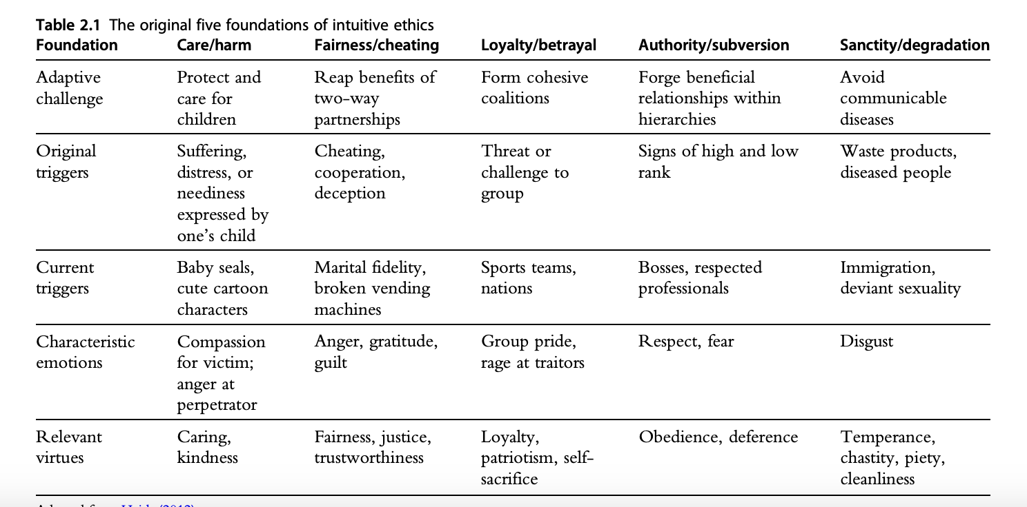
Moral Foundations Theory
Several distinct categories of moral intuition evolved to solve discrepant adaptive challenges
Common thread is social regulation (function), not any coherent theory about how this ought to work (content)
Graham et al., 2013

Slide 10
Overview of today
What constitutes right and wrong?
Evolutionary logic of cooperation and altruism
The strategic role of emotions

Slide 11
How did morality evolve?
From an evolutionary perspective, we should be selfish
“Nature, red in tooth and claw” - Tennyson

Slide 12
How did morality evolve?
From an evolutionary perspective, we should be selfish
“Nature, red in tooth and claw” - Tennyson
Nice
Guys
Jerks

Slide 13
How did morality evolve?
From an evolutionary perspective, we should be selfish
“Nature, red in tooth and claw” - Tennyson
Nice
Guys
Nice
Guys
Jerks
Jerks

Slide 14
How did morality evolve?
From an evolutionary perspective, we should be selfish
“Nature, red in tooth and claw” - Tennyson
Nice
Guys
Nice
Guys
Jerks
Jerks
Jerks

Slide 15
Cooperation and altruism
Cooperation
Taking actions that maximize joint payoffs
Socially optimal action (maximizing joint payoffs) may conflict with individually optimal action
Altruism
Taking actions that benefit a social partner at a personal cost
These behaviors are often explored through economic games
Stylized situations that crystallize features of real-world situations
Explored through mathematical models (game theory) and lab experiments (behavioral science)
Examples include Prisoner’s dilemma, ultimatum game, dictator game, public goods game, trust game

Slide 16
Ultimatum game (UG)
1. Proposed division of $100
My
Choice
Fair
Offer
(50/50)
Unfair
Offer
(99/1)
Me
(Proposer)
Jesse
(Receiver)

Slide 17
Ultimatum game (UG)
1. Proposed division of $100
My
Choice
2. Accepts or rejects offer
Fair
Offer
(50/50)
Unfair
Offer
(99/1)
Me
(Proposer)
Jesse
(Receiver)
Jesse’s
Choice
Jesse’s
Choice
Accepts
Rejects
Accepts
Rejects
Me: $50
Jesse: $50
Me: $0
Jesse: $0
Me: $99
Jesse: $1
Me: $0
Jesse: $0

Slide 18
Ultimatum game (UG)
1. Proposed division of $100
My
Choice
2. Accepts or rejects offer
Fair
Offer
(50/50)
Unfair
Offer
(99/1)
Me
(Proposer)
Jesse
(Receiver)
We can use ‘backward induction’ to solve this game
Jesse’s
Choice
Jesse’s
Choice
Accepts
Rejects
Accepts
Rejects
Me: $50
Jesse: $50
Me: $0
Jesse: $0
Me: $99
Jesse: $1
Me: $0
Jesse: $0

Slide 19
Ultimatum game (UG)
1. Proposed division of $100
My
Choice
2. Accepts or rejects offer
Fair
Offer
(50/50)
Me
(Proposer)
Jesse
(Receiver)
We can use ‘backward induction’ to solve this game
If I give a fair offer, what maximizes Jesse’s payoff?
Jesse’s
Choice
Accepts
Rejects
Me: $50
Jesse: $50
Me: $0
Jesse: $0

Slide 20
Ultimatum game (UG)
1. Proposed division of $100
My
Choice
2. Accepts or rejects offer
Fair
Offer
(50/50)
Me
(Proposer)
Jesse
(Receiver)
We can use ‘backward induction’ to solve this game
If I give a fair offer, what maximizes Jesse’s payoff?
Accepting the offer
Jesse’s
Choice
Accepts
Me: $50
Jesse: $50

Slide 21
Ultimatum game (UG)
1. Proposed division of $100
My
Choice
2. Accepts or rejects offer
Unfair
Offer
(99/1)
Me
(Proposer)
Jesse
(Receiver)
We can use ‘backward induction’ to solve this game
If I give an unfair offer, what maximizes Jesse’s payoff?
Jesse’s
Choice
Accepts
Rejects
Me: $99
Jesse: $1
Me: $0
Jesse: $0

Slide 22
Ultimatum game (UG)
1. Proposed division of $100
My
Choice
2. Accepts or rejects offer
Unfair
Offer
(99/1)
Me
(Proposer)
Jesse
(Receiver)
We can use ‘backward induction’ to solve this game
If I give an unfair offer, what maximizes Jesse’s payoff?
Still accepting!
Jesse’s
Choice
Accepts
Me: $99
Jesse: $1

Slide 23
Ultimatum game (UG)
1. Proposed division of $100
My
Choice
2. Accepts or rejects offer
Fair
Offer
(50/50)
Unfair
Offer
(99/1)
Me
(Proposer)
Jesse
(Receiver)
We can use ‘backward induction’ to solve this game
Given Jesse’s optimal choices, what is my optimal choice?
Jesse’s
Choice
Jesse’s
Choice
Accepts
Accepts
Me: $50
Jesse: $50
Me: $99
Jesse: $1

Slide 24
Ultimatum game (UG)
1. Proposed division of $100
My
Choice
2. Accepts or rejects offer
Fair
Offer
(50/50)
Unfair
Offer
(99/1)
Me
(Proposer)
Jesse
(Receiver)
We can use ‘backward induction’ to solve this game
Given Jesse’s best moves, what is my best move?
Jesse’s
Choice
Jesse’s
Choice
Accepts
Accepts
Me: $50
Jesse: $50
Me: $99
Jesse: $1

Slide 25
Ultimatum game (UG)
1. Proposed division of $100
My
Choice
2. Accepts or rejects offer
Unfair
Offer
(99/1)
Me
(Proposer)
Jesse
(Receiver)
We can use ‘backward induction’ to solve this game
Given Jesse’s best moves, what is my best move?
Making an unfair offer
Jesse’s
Choice
Accepts
Me: $99
Jesse: $1

Slide 26
Ultimatum game (UG)
1. Proposed division of $100
2. Accepts or rejects offer
Me
(Proposer)
Jesse
(Receiver)
Econ 101 prediction:
Proposers should always make unfair offers
Receivers should always accept them
Actual experiments (in Western countries):
Most common offer is 50/50
Unfair offers frequently rejected

Slide 27
Dictator game (DG)
1. Proposed division of $100
My
Choice
2. Must accept
offer!
Fair
Offer
(50/50)
Unfair
Offer
(99/1)
Me
(Proposer)
Jesse
(Receiver)
Econ 101 prediction:
Proposers should always make unfair offers
Jesse’s
Choice
Jesse’s
Choice
Accepts
Accepts
Me: $50
Jesse: $50
Me: $99
Jesse: $1

Slide 28
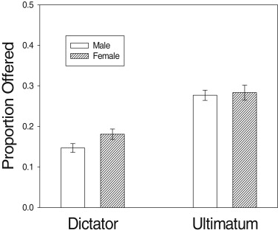
Dictator game (DG)
1. Proposed division of $100
2. Must accept
offer!
Me
(Proposer)
Jesse
(Receiver)
Econ 101 prediction:
Proposers should always make unfair offers
Actual experiments (in Western countries):
Offers of both 0% and 50% common
Average offer lower than in UG
Proposers must be worried about rejection
Bechler et al. (2015)

Slide 29
Prisoner’s dilemma (PD)
Jesse and I robbed a bank, but we botched it
The DA is offering us plea deals – in separate rooms
Jesse’s
Choice
Don’t
Confess
Confess
Me: 2 years
Jesse: 2 years
Me: 0 years
Jesse: 5 years
Confess
My
Choice
Me: 5 years
Jesse: 0 years
Me: 1/2 year
Jesse: 1/2 year
Don’t
Confess

Slide 30
Prisoner’s dilemma (PD)
Jesse and I robbed a bank, but we botched it
The DA is offering us plea deals – in separate rooms
Social rationality:
Both don’t confess (‘cooperate’)
Would agree to cooperate if we could collude
Jesse’s
Choice
Don’t
Confess
Confess
Me: 2 years
Jesse: 2 years
Me: 0 years
Jesse: 5 years
Confess
My
Choice
Me: 5 years
Jesse: 0 years
Me: 1/2 year
Jesse: 1/2 year
Don’t
Confess

Slide 31
Prisoner’s dilemma (PD)
Individual rationality:
Whatever Jesse does, I’m better off confessing
If he confesses, I get 2 (vs 5)
Jesse’s
Choice
Don’t
Confess
Confess
Me: 2 years
Jesse: 2 years
Me: 0 years
Jesse: 5 years
Confess
My
Choice
Me: 5 years
Jesse: 0 years
Me: 1/2 year
Jesse: 1/2 year
Don’t
Confess

Slide 32
Prisoner’s dilemma (PD)
Individual rationality:
Whatever Jesse does, I’m better off confessing
If he confesses, I get 2 (vs 5)
If he doesn’t, I get 0 (vs ½)
Jesse’s
Choice
Don’t
Confess
Confess
Me: 2 years
Jesse: 2 years
Me: 0 years
Jesse: 5 years
Confess
My
Choice
Me: 5 years
Jesse: 0 years
Me: 1/2 year
Jesse: 1/2 year
Don’t
Confess

Slide 33
Prisoner’s dilemma (PD)
Individual rationality:
Whatever Jesse does, I’m better off confessing
If he confesses, I get 2 (vs 5)
If he doesn’t, I get 0 (vs ½)
He faces the same situation
Jesse’s
Choice
Don’t
Confess
Confess
Me: 2 years
Jesse: 2 years
Me: 0 years
Jesse: 5 years
Confess
My
Choice
Me: 5 years
Jesse: 0 years
Me: 1/2 year
Jesse: 1/2 year
Don’t
Confess

Slide 34
Prisoner’s dilemma (PD)
Individual rationality:
Whatever Jesse does, I’m better off confessing
If he confesses, I get 2 (vs 5)
If he doesn’t, I get 0 (vs ½)
He faces the same situation
Jesse’s
Choice
Don’t
Confess
Confess
Me: 2 years
Jesse: 2 years
Me: 0 years
Jesse: 5 years
Confess
My
Choice
Me: 5 years
Jesse: 0 years
Me: 1/2 year
Jesse: 1/2 year
Don’t
Confess

Slide 35
Prisoner’s dilemma (PD)
Individual rationality:
Whatever Jesse does, I’m better off confessing
If he confesses, I get 2 (vs 5)
If he doesn’t, I get 0 (vs ½)
He faces the same situation
Both confess (‘defect’)
Two reasons to defect:
I’m selfish
I think Jesse is selfish
Jesse’s
Choice
Don’t
Confess
Confess
Me: 2 years
Jesse: 2 years
Me: 0 years
Jesse: 5 years
Confess
My
Choice
Me: 5 years
Jesse: 0 years
Me: 1/2 year
Jesse: 1/2 year
Don’t
Confess

Slide 36
Prisoner’s dilemma (PD)
Econ 101 prediction:
Both defect (always)
Actual experiments:
Defection is most common response in anonymous, one-shot settings
But 20–40% cooperate!
Jesse’s
Choice
Don’t
Confess
Confess
Me: 2 years
Jesse: 2 years
Me: 0 years
Jesse: 5 years
Confess
My
Choice
Me: 5 years
Jesse: 0 years
Me: 1/2 year
Jesse: 1/2 year
Don’t
Confess

Slide 37
How did morality evolve?
Evolutionary game theory provides more sophisticated models that aim to explain altruism and cooperation
Key move: Finding ways that seemingly selfless behavior is actually selfish
Aligns individual and social incentives
Explanation differs for:
Family (genetic relationship)
Friends (repeated interactions)
Strangers (within a larger social group)

Slide 38
How did morality evolve?
1. Kin selection
Natural selection operates at the gene level
So your genes can benefit from sacrificing you if it helps to create more copies of your genes
Source: Brembs (2001)
“Would I lay down my life to save my brother? No, but I would to save two brothers or eight cousins.” – J.B.S. Haldane
Hamilton (1964)

Slide 39
How did morality evolve?
2. Reciprocal altruism
A helps B with the expectation that B will help A later on
Useful because we have access to different resources or at different times
But also risky due to risk of exploitation or free-riding
Repeated games: Cooperation much higher (>50% in repeated PD)
Source: Anandi Sharan
Trivers (1971)

Slide 40
How did morality evolve?
3. Reputation signaling (“indirect reciprocity”)
A helps B because C might observe the helping behavior
This communicates to C that one is a reliable social partner, increasing chance of future cooperation with C
Or with others that C gossips with
Nowak & Sigmund (1998)

Slide 41
Proximal vs ultimate causation
None of this means we are consciously making cost/benefit trade-offs
Ultimate causation: The adaptive value of a behavior
Proximate causation: The psychological mechanisms giving rise to that behavior
Despite our big brains, there’s no guarantee that conscious calculation is actually the optimal way to implement evolutionary logic (Sperber & Baumard, 2012)

Slide 42
Overview of today
What constitutes right and wrong?
Evolutionary logic of cooperation and altruism
The strategic role of emotions

Slide 43
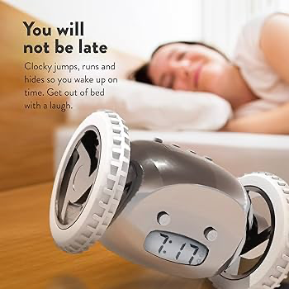
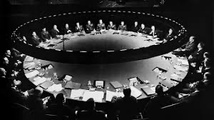
What do these have in common?

Slide 44
Commitment devices
Mechanisms voluntarily adopted now that remove future options
Why would we ever want to do this?
Because we think our preferences might change
Alarm clocks, pensions
Because it changes others’ behavior
Encourages long-term cooperation (binding contracts, wedding rings)
Deters future aggression (long jail sentences, Doomsday machines)

Slide 45
Prisoner’s dilemma revisited
Suppose before we robbed the bank, Jesse and I hired a hitman:
If either of us confesses, the hitman shoot them as soon as they get out of prison
This credibly precommits us both to cooperating
If Jesse confesses, I shouldn’t confess (5 yrs > 2 yrs + death)
If Jesse doesn’t confess, I still shouldn’t confess (1/2 year > 0 years + death)
Jesse’s
Choice
Don’t
Confess
Confess
Me: 2 years + death
Jesse: 2 years + death
Me: 0 years + death
Jesse: 5 years
Confess
My
Choice
Me: 5 years
Jesse: 0 years + death
Me: 1/2 year
Jesse: 1/2 year
Don’t
Confess

Slide 46
Commitment devices
These examples require formal institutions or innovations
Governments, courts, technology... professionals
Can commitment devices promote cooperation in the state of nature?
Prehistoric (stateless) humans
Modern hunter-gatherers
Nonhuman animals

Slide 47
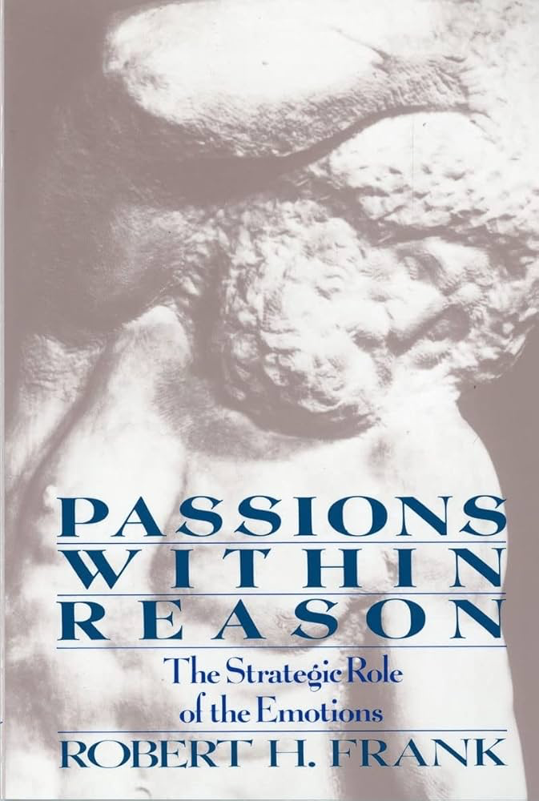
Emotions as commitment devices
Emotions can commit us to courses of action that are outside our short-term interest, but by doing so precommit us to courses of action
Anger: Credible threats (as in UG)
Guilt: Credible promises (as in PD)
For this to hold:
Emotions must be involuntary
Emotions must be knowable by partner
Amazingly, Darwin himself anticipated this argument (Expression of Emotions in Man and Animals)

Slide 48
Ultimatum game revisited
1. Proposed division of $100
My
Choice
2. Accepts or rejects offer
Fair
Offer
(50/50)
Unfair
Offer
(99/1)
Me
(Proposer)
Jesse
(Receiver)
Jesse’s
Choice
Jesse’s
Choice
Anger can precommit Jesse to retaliation
This changes my incentives – so Jesse doesn’t need to carry out the threat
Accepts
Rejects
Accepts
Rejects
Me: $50
Jesse: $50
Me: $0
Jesse: $0
Me: $99
Jesse: $1
Me: $0
Jesse: $0

Slide 49
Prisoner’s dilemma revisited (again)
Guilt can have a similar function to the hitman (changing my payoff structure)
Jesse’s
Choice
Don’t
Confess
Confess
Me: 2 years + guilt
Jesse: 2 years + guilt
Me: 0 years + guilt
Jesse: 5 years
Confess
My
Choice
Me: 5 years
Jesse: 0 years + guilt
Me: 1/2 year
Jesse: 1/2 year
Don’t
Confess

Slide 50
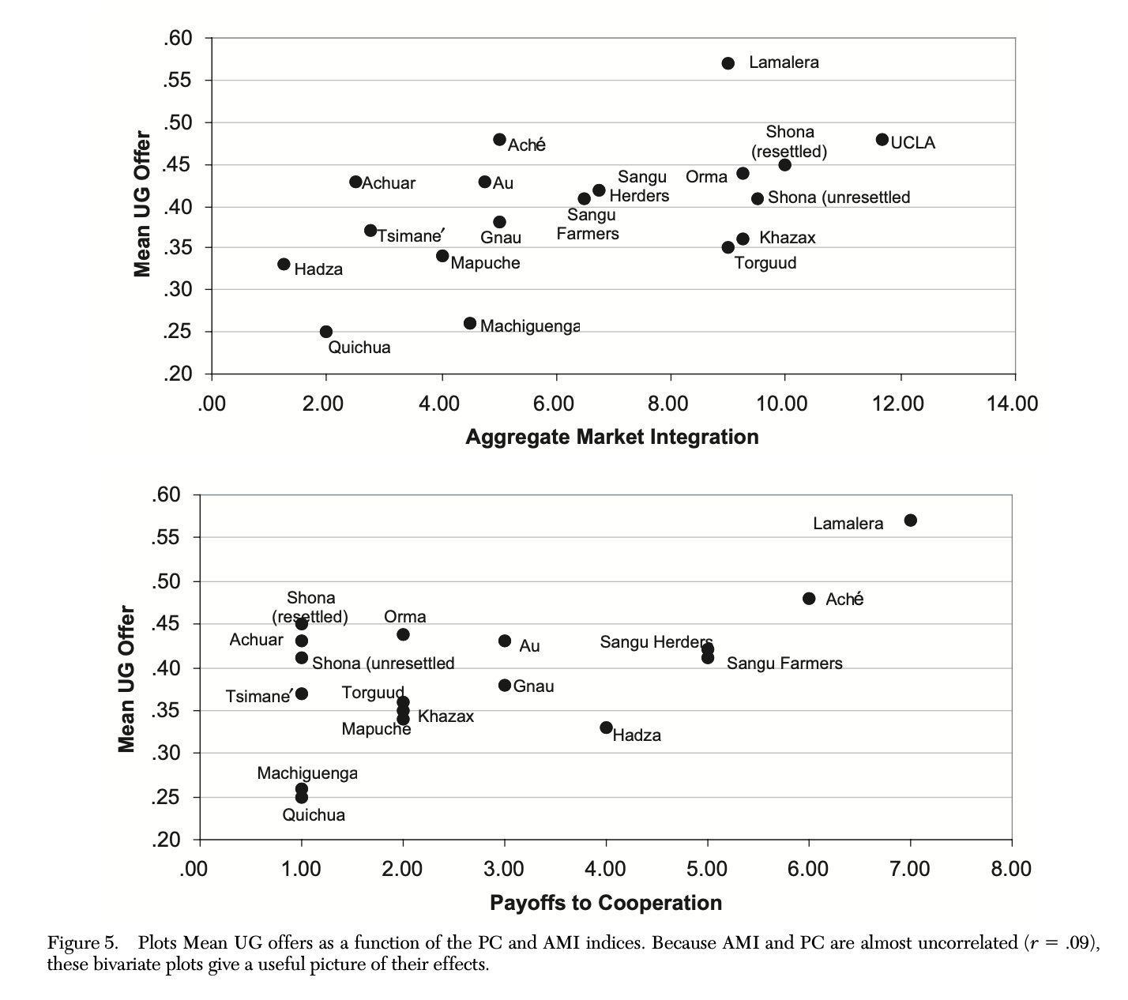
What about culture?
Behavior in economic games varies dramatically across the world
Doesn’t this challenge the evolutionary theory?
(Henrich et al., 2005)

Slide 51
What about culture?
Grand unified theory of social science: Dual inheritance theory (Boyd & Richerson, 1985)
Culture: Information transmitted laterally within a group, which can accumulate across generations
Three central claims:
Our ability to create culture is itself a biological/genetic adaptation
Mechanisms such as imitation, pedagogy, epistemic vigilance, norm enforcement
Culture itself evolves in a process analogous to natural selection
Ideas are the unit of selection, not the gene
Culture becomes part of the environment, in turn affecting genetic evolution

Slide 52
What about culture?
Cooperation and social institutions
Institutions can change incentives to promote cooperation such as market exchange (e.g., legally enforceable property rights)
Experiences of cooperation with strangers – as we have in Western liberal democracies – seem to promote cooperative norms even in situations where the incentives are taken away (e.g., one-shot economic games)
Honor cultures (Nisbett & Cohen, 1996)
Place particular emphasis on preserving reputation
Southern US originally settled by cattle herders who settled disputes using retribution-based mechanisms in the absence of government institutions that could enforce contracts or protect against theft
Shame vs guilt cultures
Primary emotional levers used for social regulation may differ across more individualistic (guilt) vs collectivist (shame) cultures

Slide 53
Overview of today
What constitutes right and wrong?
People probably don’t have coherent theories like philosophers – even unstable ones triggered by different situations
Instead, we seem to rely on domain-specific intuitions (moral foundations)
Evolutionary logic of cooperation and altruism
People cooperate much more than Econ 101 models predict
Several evolutionary mechanisms explain why cooperation and altruism can be adaptive (kin selection, reciprocity, reputation)
The strategic role of emotions
Emotions like anger and guilt are outside our conscious control, allowing us to make credible threats (to retaliate) and promises (to cooperate)
Natural selection for strategic emotions does not rule out cultural influences – this capacity is itself a biological adaptation (dual inheritance theory)

