Slide 1
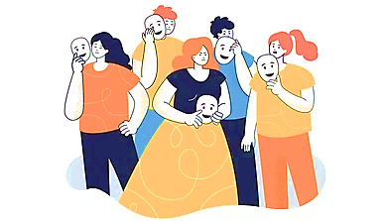
Social Effects of Emotions
Annika Hillebrandt, PhD
Affective Computing guest lecture – Nov 7, 2024

Slide 2
A bit about myself…
Annika Hillebrandt
  Industrial-Organizational Psychology
  Justice, Affect, and Morality (JAM) lab

Slide 3
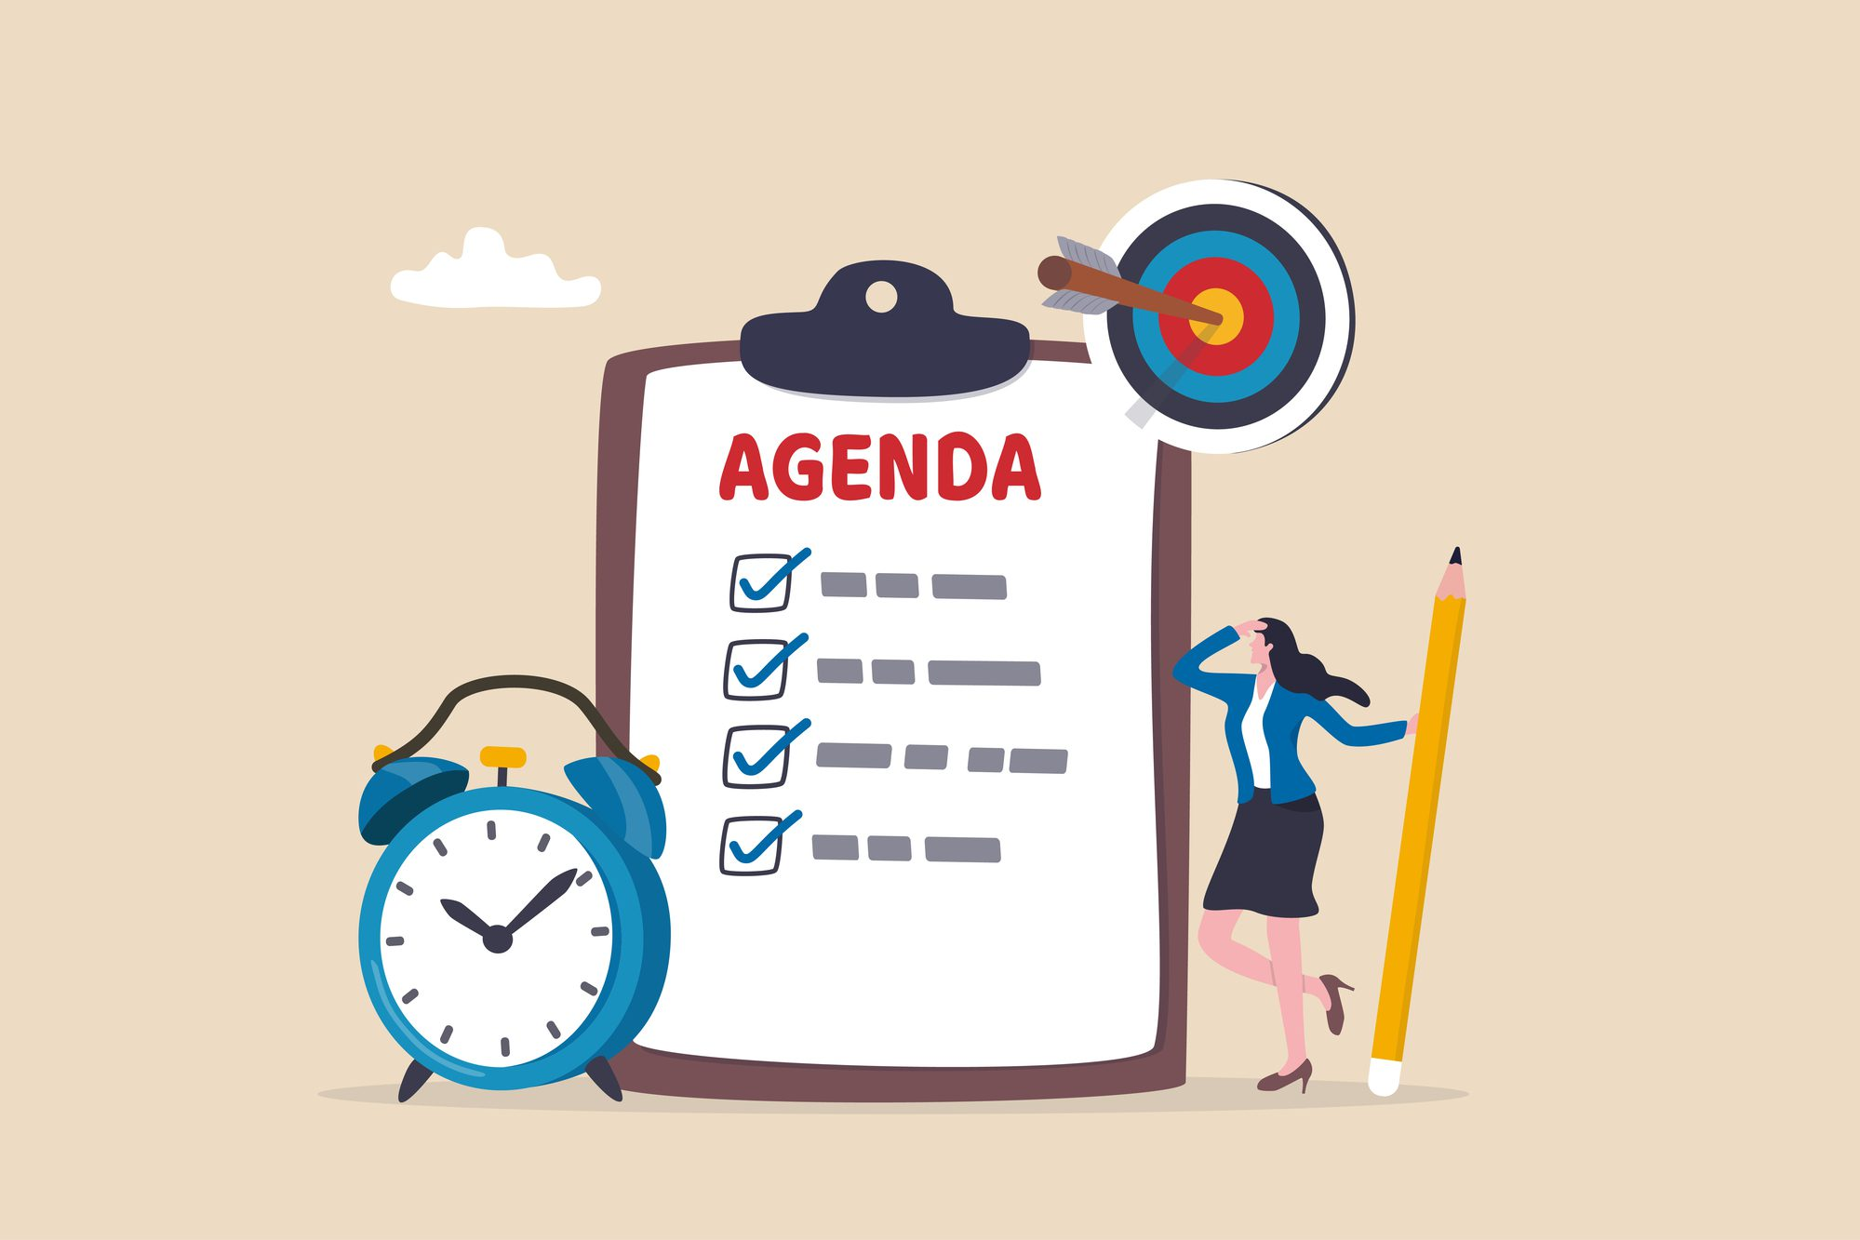
Overview
Discrete emotions – what are they?
Intrapersonal perspective
Interpersonal/social perspective
  Social functional theories
  Emotions as Social Information (EASI) theory
    Affective reactions and inferential processes
  Emotions in negotiation, customer service, leadership
  Social norms, suppressing/faking emotions, emotional labour, …

Slide 4
Discrete emotion – some characteristics
Valenced response to a specific stimulus (e.g., person, object, event)
Follows from a distinct appraisal pattern (i.e., evaluations of a stimulus in relation to one’s goals/concerns)
  E.g., anger arises when one’s goals are being frustrated and one blames someone else for it
Relatively intense
Relatively brief
Associated with subjective experiences, physiological reactions, action tendencies, expressions (e.g., facial, vocal, bodily, verbal)
Frijda et al. 1989; Lazarus 1991; Levenson et al. 1990

Slide 5
Emotions are experienced
Intrapersonal processes
  Neural basis
  Cognitive appraisals
  Physiological changes
  Action tendencies
Emotions provide information to the self Schwarz & Clore, 1983

Slide 6
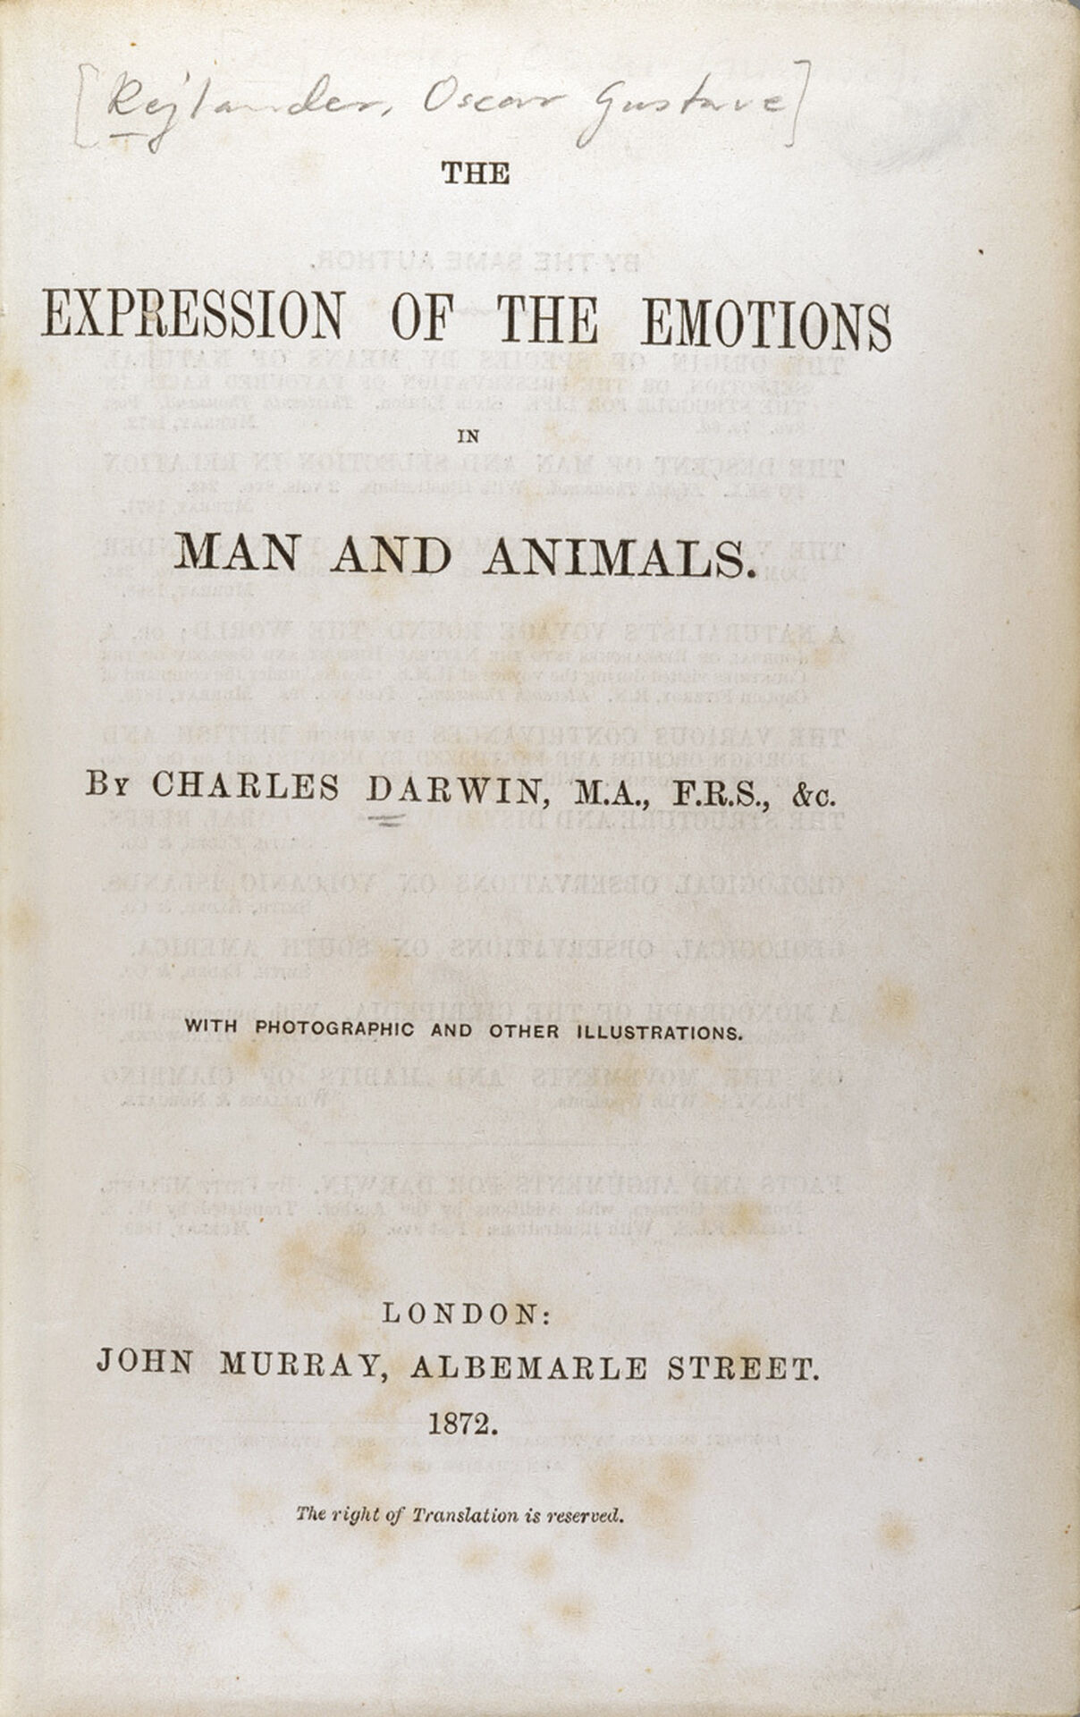
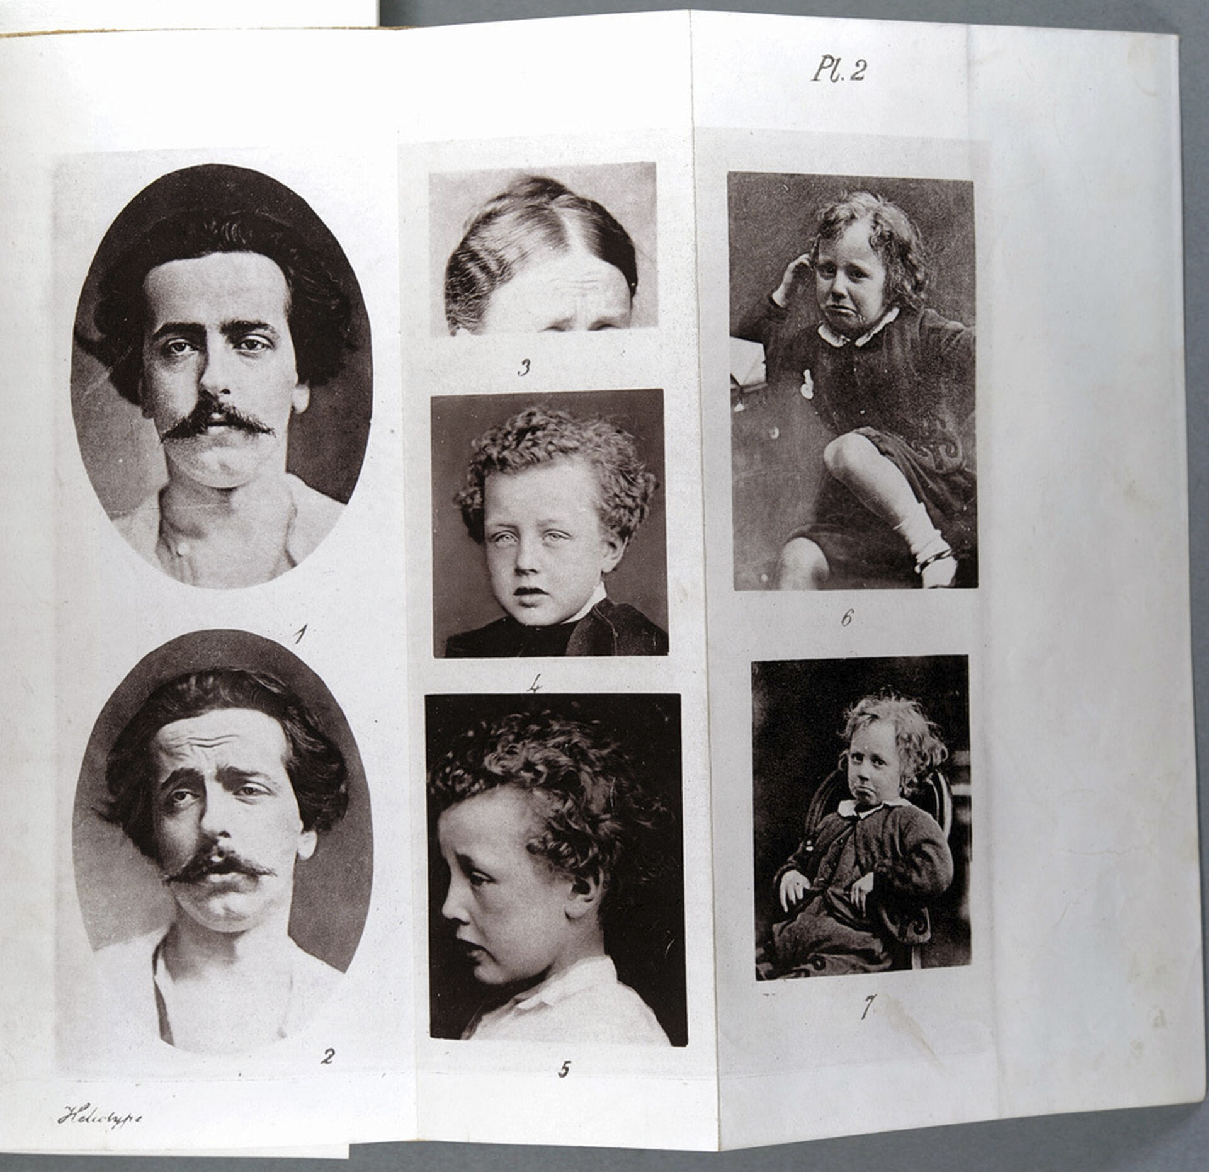
Social functional approach to emotion
Emotions may also be expressed and influence others
  Darwin (1872)
  Frijda (1986)
  Keltner & Haidt (1999)

Slide 7

Emotions as Social Information (EASI) Theory
Van Kleef, 2009

Slide 8
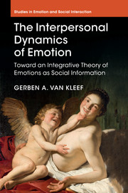
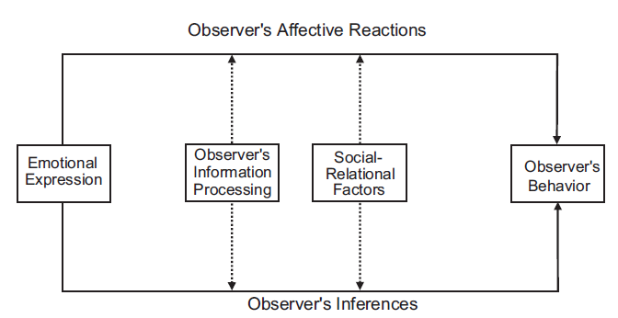
Emotions as Social Information (EASI) Theory
Van Kleef, 2009, 2016; Van Kleef, De Dreu, & Manstead, 2010
Van Kleef, 2009, Fig 1

Slide 9
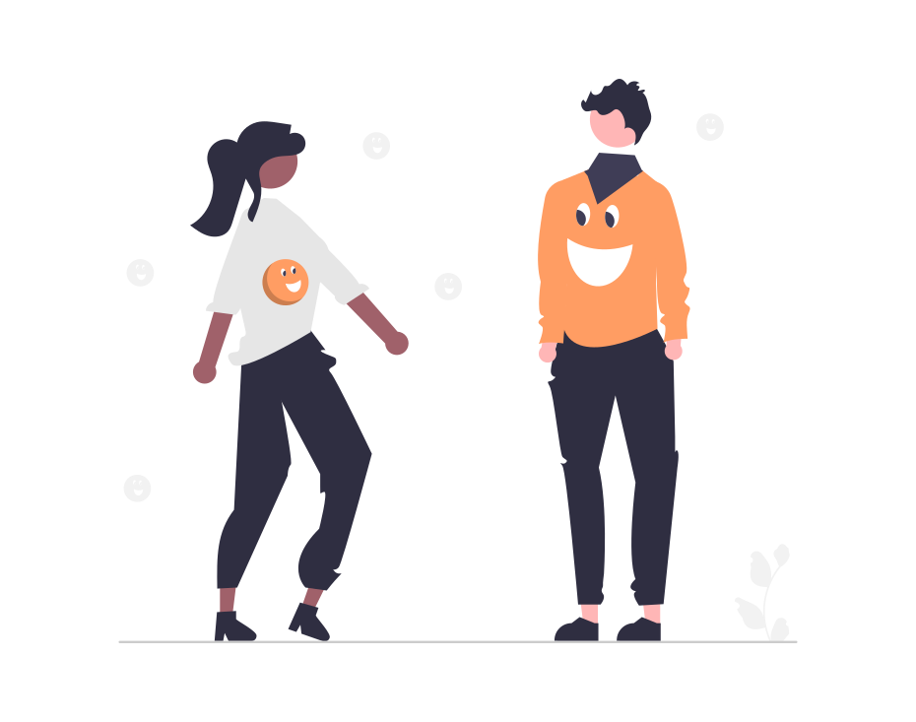
Affective reactions to others’ emotions
Reciprocal reactions
  Observer experiences the same emotion as shown by the expresser
  Emotional contagion Elfenbein 2014; Hatfield et al. 1994;
    Mirror-neuron activity, automatic mimicry, afferent feedback
    Perspective-taking, social appraisal
Complementary reactions
  Observer experiences an emotion that is different from yet “matches” that of the observer
  E.g., sympathy in response to sadness; fear in response to anger

Slide 10
Inferring information from others’ discrete emotions
Discrete emotion e.g., Frijda, 1994; Lazarus, 1991
  Targeted at a specific object/event
  Follows from specific appraisals (evaluations)
  Associated with specific behavioral motivations
Example: Anger
  Follows from the appraisal that another person is to be blamed for blocking one’s goals
  Readiness to harm
An observer can infer and use this information
  Infers from another person’s anger that this person blames the observer for blocking goals
  Observer may adjust own behavior to prevent harm

Slide 11
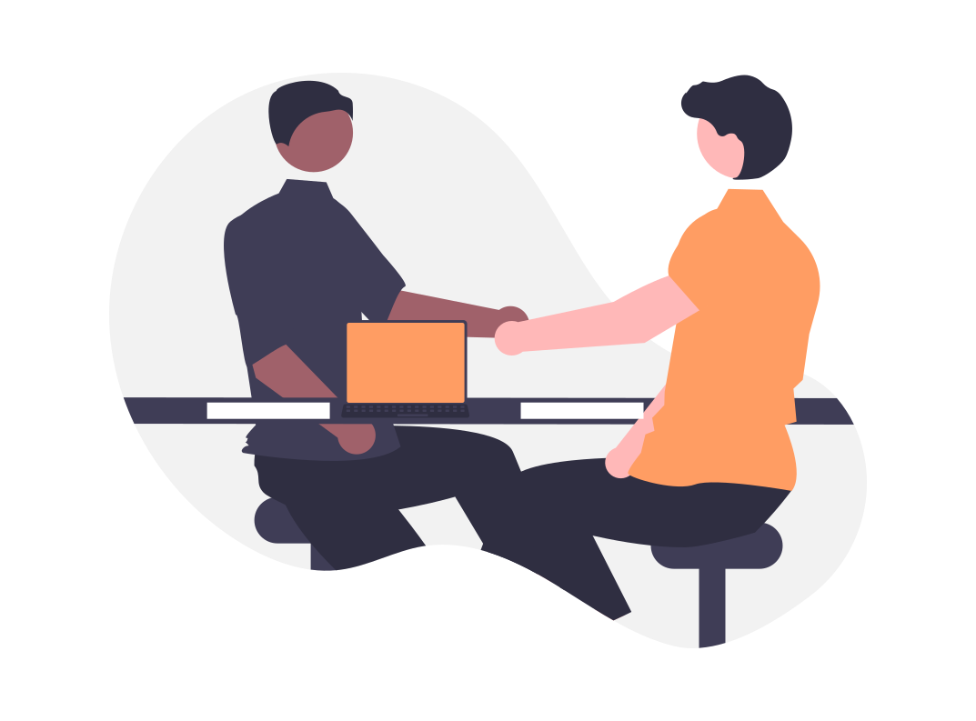
Inferences from emotions in a negotiation context
Anger
  Communicates to an observer that one is unsatisfied with offers
  Observers typically lower demands in response to an opponent’s anger to prevent an impasse Sinaceur & Tiedens, 2006; Van Kleef et al., 2004a, 2004b
Happiness
  Communicates to an observer that one is satisfied
  Observer may pursue own interests (withhold concessions)
  without risking an impasse Van Kleef et al., 2004a

Slide 12
Example: Emotion inference in negotiation
Van Kleef, de Dreu, & Manstead, 2004. https://doi.org/10.1037/0022-3514.86.1.57
Previous studies had shown intrapersonal effects of emotions
  Experiencing positive affect increases concession-making, use of cooperative strategies, increases joint gains, etc.; negative affect has the opposite effects
What about interpersonal effects of emotions?
  Contagion hypothesis: Expressing anger makes one’s counterpart angry and competitive; expressing happiness makes one’s counterpart happy and cooperative
  Inference hypothesis: Negotiators infer information from each other’s emotions. They lower their demands when the other appears demanding (angry), and increase their demands when other appears conciliatory (happy)

Slide 13

Example: Emotion inference in negotiation

Slide 14
Example: Emotion inference in negotiation
This offer makes me really angry.
I think I will offer x–y–z.

Slide 15
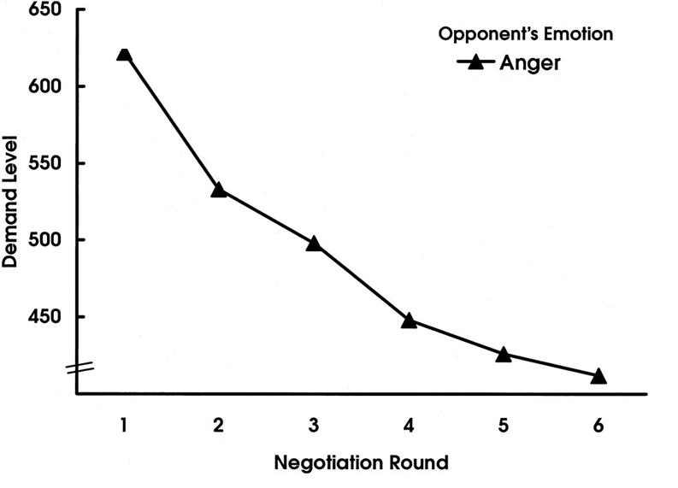
Example: Emotion inference in negotiation
Adapted from Van Kleef, de Dreu, & Manstead, 2004

Slide 16
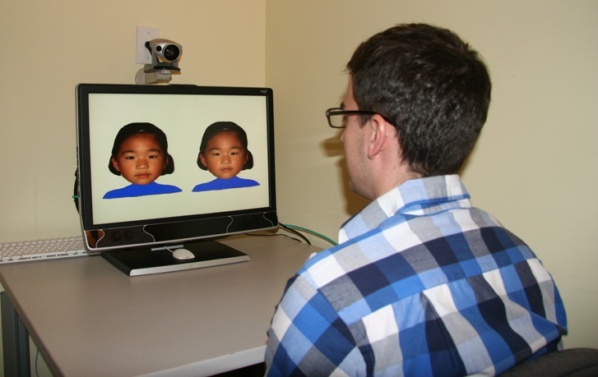
Example: Emotion inference in negotiation
This offer makes me really happy.
I think I will offer x–y–z.

Slide 17


Example: Emotion inference in negotiation
I think I will offer x–y–z.

Slide 18
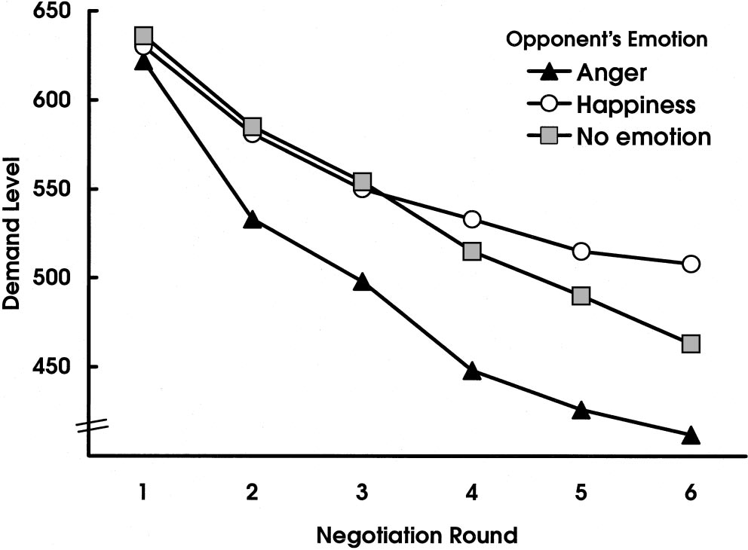
Van Kleef, de Dreu, & Manstead, 2004
Figure 1

Slide 19
Other emotions in negotiation contexts
Van Kleef, de Dreu, & Manstead, 2006. https://doi.org/10.1037/0022-3514.91.1.124
Inferences from supplication versus appeasement emotions
  Negotiators infer from appeasement emotions (guilt and regret) that the opponent has claimed too much; increase their own demands in response
  Negotiators infer from supplication emotions (disappointment and worry) that the other has received too little; reduce their own demands in response
    Especially when they have high dispositional trust

Slide 20
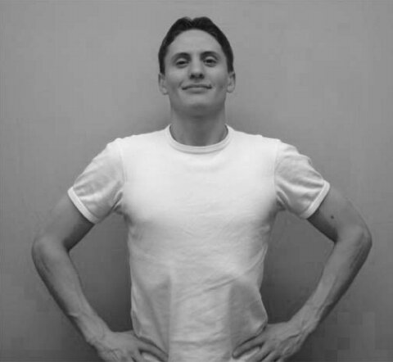
Does it matter HOW the emotion is expressed?
Emotions can be expressed - and observed - across various modalities
  People can correctly label facial expressions of many emotions (e.g., anger, disgust, fear, amusement, contentment, embarrassment, and pride)
  Cordaro et al., 2020; Ekman & Friesen, 1971; Ekman, Sorenson, & Friesen, 1969
  Many emotions (e.g., pride, joy, shame/embarrassment, fear, anger,
  disgust, sadness) can also be inferred from bodily cues Witkower & Tracy, 2019
  … or from vocal cues (e.g., changes pitch, loudness, screams)
  e.g., Hawk, Van Kleef, Fischer, & Van der Schalk, 2009; Sauter, Eisner, Ekman, Scott, 2010
  … and even from specific forms of touch (e.g., squeezing, stroking)
  Hertenstein, Holmes, McCullough, & Keltner, 2009
  … and even in digital communication (e.g., written statements, typos,
  emoticons) Blunden & Brodsky, 2021; Cherbonnier & Michinov, 2021; Cheshin, Rafaeli, & Bos, 2011
“The social effects of emotions are functionally equivalent across expressive modalities” Van Kleef, 2017
Tracy & Robins, 2008

Slide 21
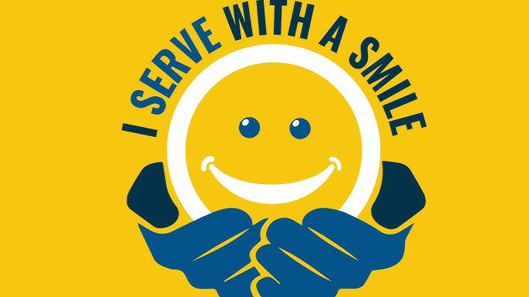
Consumer behaviour and customer service
Emotions expressed by service providers affect customers’ behaviour
  E.g., service satisfaction, tipping, word-of-mouth, revisiting Brown & Sulzer-Azaroff, 1994; Pugh, 2001; Tidd & Lockard, 1978
Emotions expressed by customers affect service providers
Salesperson’s expressed positive affect
+
Customer behavioral intentions
+
Customer positive affect
Tsai & Huang, 2002
Customer’s expressed anger
Service provider emotional exhaustion
+
Service provider job satisfaction, turnover
+
E.g., Grandey et al., 1994; Karatepe et al., 2009

Slide 22
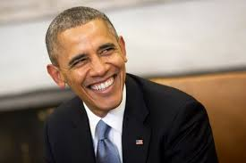
Leadership
Followers generally prefer emotionally expressive leaders
  Emotion signals that an event is relevant to a leader’s goals; can mobilize followers
Leaders’ positive emotions positively affect follower mood and perceived leader effectiveness Bono & Ilies, 2006
  Especially among followers who are susceptible to emotional contagion Johnson, 2008
Negative leader emotions generally associated with lower favourability ratings
For a review, see Van Kleef, 2016

Slide 23

Leadership: discrete emotions
Anger signals decisiveness, competence, assertiveness, power Tiedens, 2001
  Enhances perceived leadership ability Anderson & Kilduff, 2009; Lord, De Vader, & Alliger, 1986
Angry (versus happy) feedback can promote learning Van Doorn, Van Kleef, & Van der Pligt, 2014
… but anger can also backfire
  Expressing disappointment elicits guilt, whereas anger elicits reciprocal anger Johnson & Connelly, 2014
Effect of anger versus happiness depends on the task
  Expressing positive emotions may put followers in a good mood, which enhances creativity Visser et al., 2013
… and on the follower
  Followers who are more motivated to process information respond better to anger
  Van Kleef et al., 2009, 2010, 2014

Slide 24
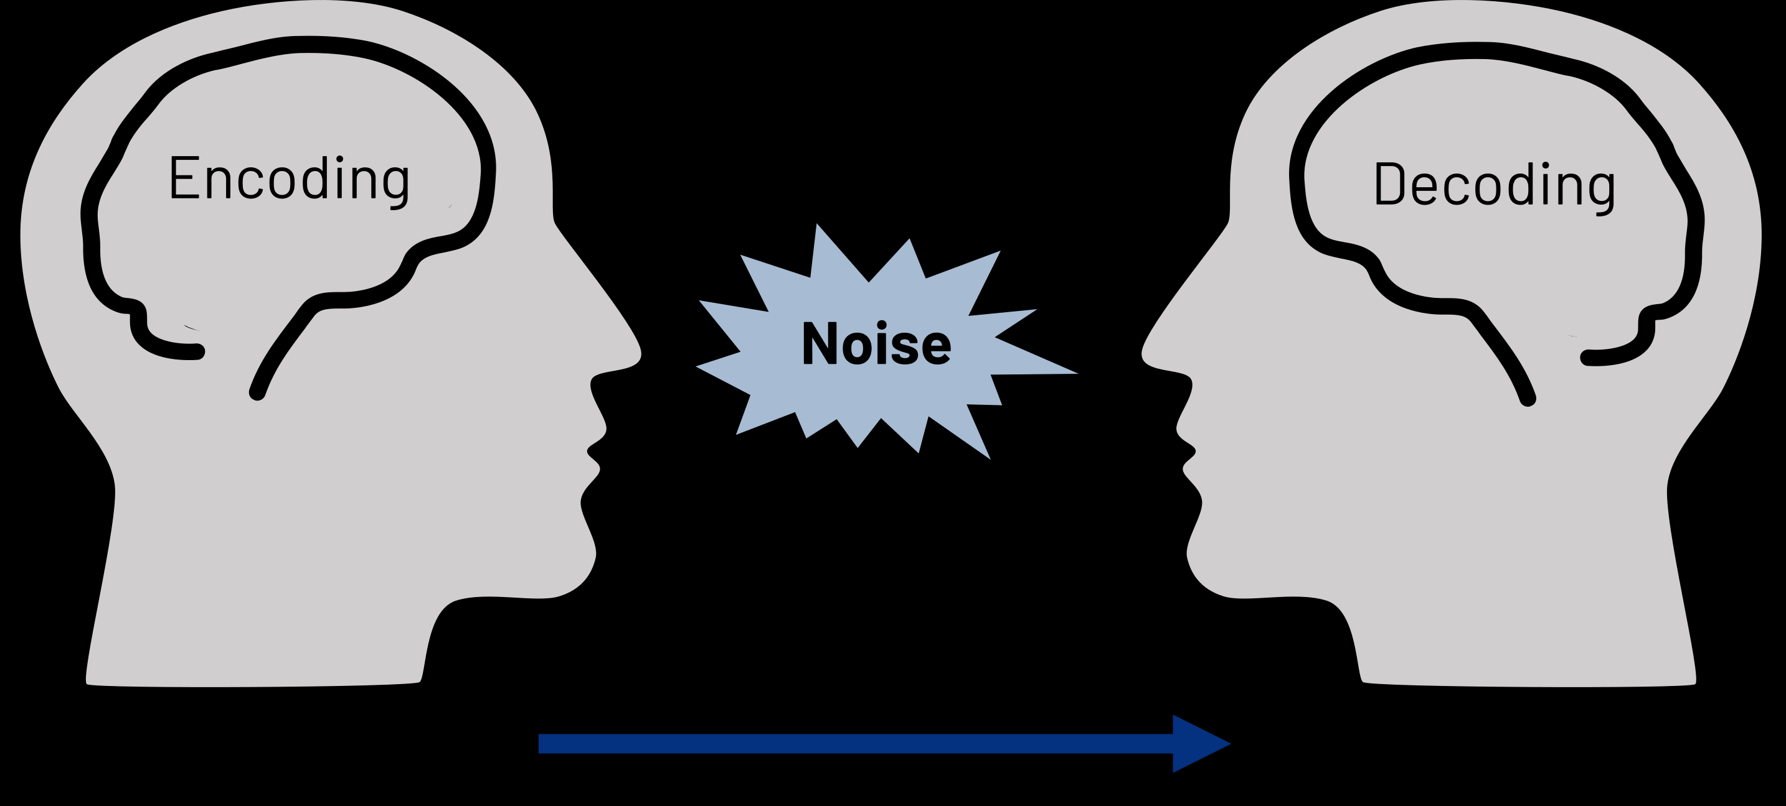
WHEN do these social effects occur?
Emotional communication may be hampered by noise at the encoding and/or decoding stage
Van Kleef, 2016
Subclinical variations in emotional expressivity (encoding) and emotion perception ability (decoding)
“Emotional intelligence” Mayer & Salovey, 1997; Salovey & Mayer, 1990
  Capacity to recognize others’ facial, vocal, and postural emotion expressions
  Capacity to understand others’ emotions (antecedents, meaning, implications, etc.)

Slide 25
Inferential Processes versus Affective Reactions
Motivation to engage in information processing positively predicts inferential processing
  Epistemic motivation
    Need for Cognition; Need for Cognitive Closure; Need for Structure; Openness to experience
    Personal significance; personal accountability
    Low power; competitive situation
  Processing ability
    General intelligence; working memory capacity
    Time pressure
    Cognitive load
  For a review, see Van Kleef, 2016

Slide 26
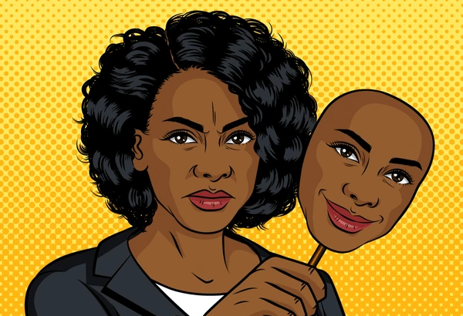
Appropriateness
Display rules – social rules re: which emotions should be expressed versus hidden
Ekman, 1993; Rafaeli & Sutton, 1987
  Negotiators concede to angry opponents when the anger is considered appropriate, but retaliate when the anger violates a display rule (especially when they have high power)
  Van Kleef & Côté, 2007
  Anger elicits larger concessions from European Americans, but smaller concessions from Asians and Asian Americans; due to cultural norms about the appropriateness of anger in negotiation
  Adam, Shirako, & Maddux, 2010
  Negotiators cooperate with (i.e., concede to) angry opponents when the anger is directed at their offers, but become more competitive when the anger is directed at them personally
  Steinel, Van Kleef, & Harinck, 2008
Different rules for different people
  Gender, group membership, status

Slide 27

Emotional labour
Regulating one’s own emotional expressions e.g., Grandey, 2003; Gross, 1998; Hochschild, 1983
Deep acting
  Antecedent-focused
  Regulating internal feelings (e.g., through re-appraising the situation)
  Results in consistency between felt versus expressed emotions
Surface acting
  Response-focused
  Manipulating emotion expressions without changing internal
  feelings

Slide 28
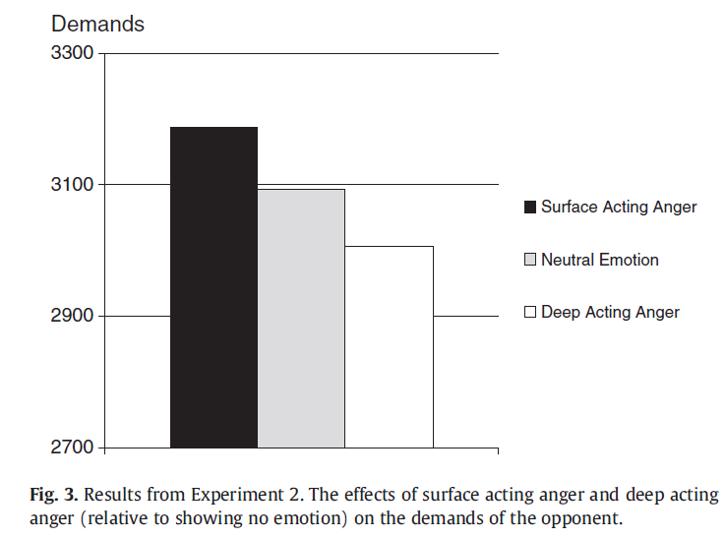
Suppressing and faking emotions
Observers respond differently to surface acting versus deep acting
E.g., in a negotiation context Côté, Hideg, & Van Kleef, 2013
  “For the surface acting anger condition, we instructed the confederates to remain emotionally neutral inside but express anger in their faces. They followed these instructions by manipulating only their facial muscles without modifying their thoughts, subjective experiences of emotions, or vocal cues such as vocal tone and intensity. …
  For the deep acting anger condition, the actors
  were instructed to recall an event that had truly
  made them feel angry.”
  Surface acting increased demands via reduced trust
  Deep acting decrease demands via increased
  perceptions of toughness

Slide 29
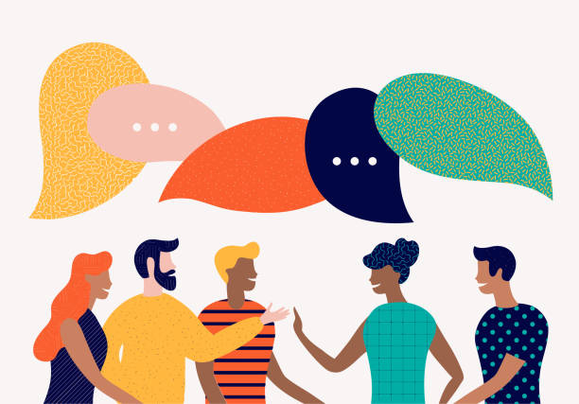
Discussion
Connections with previous weeks?
Practical implications?
Research ideas?

