Slide 1




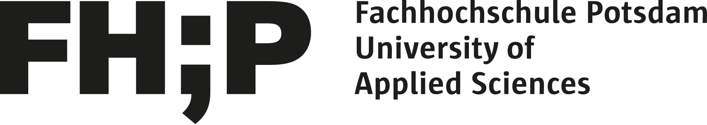
Affect Control Theory:
Basic Concepts and
Political Applications
Jesse Hoey
Tobias Schröder
@drjessehoey
bayesact.ca
jhoey@uwaterloo.ca
@tobiascanada
fh-potsdam.de/person/person-action/tobias-schroeder/
post@tobiasschroeder.de

Slide 2
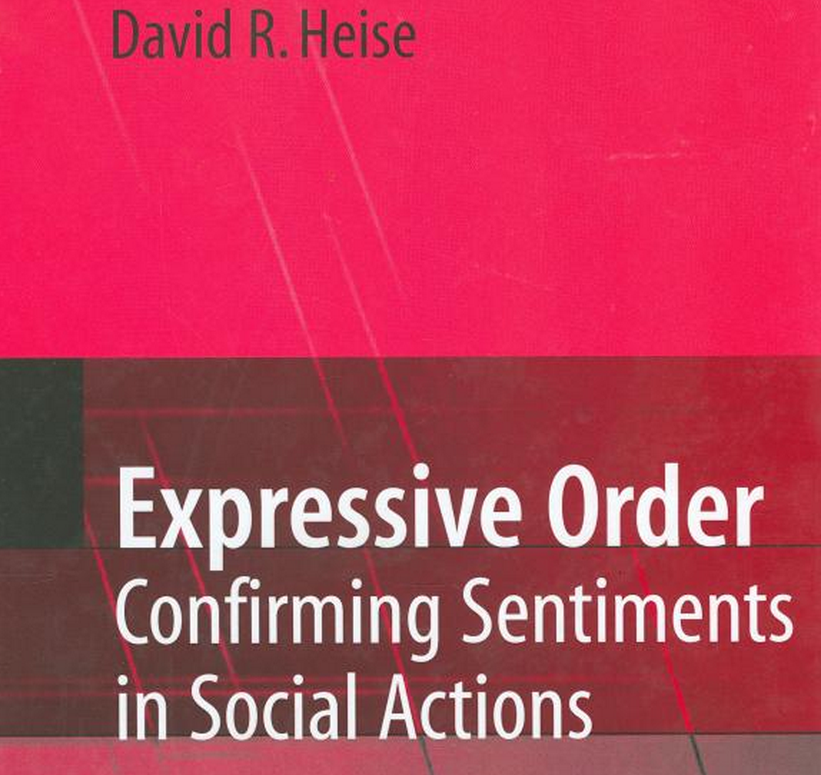
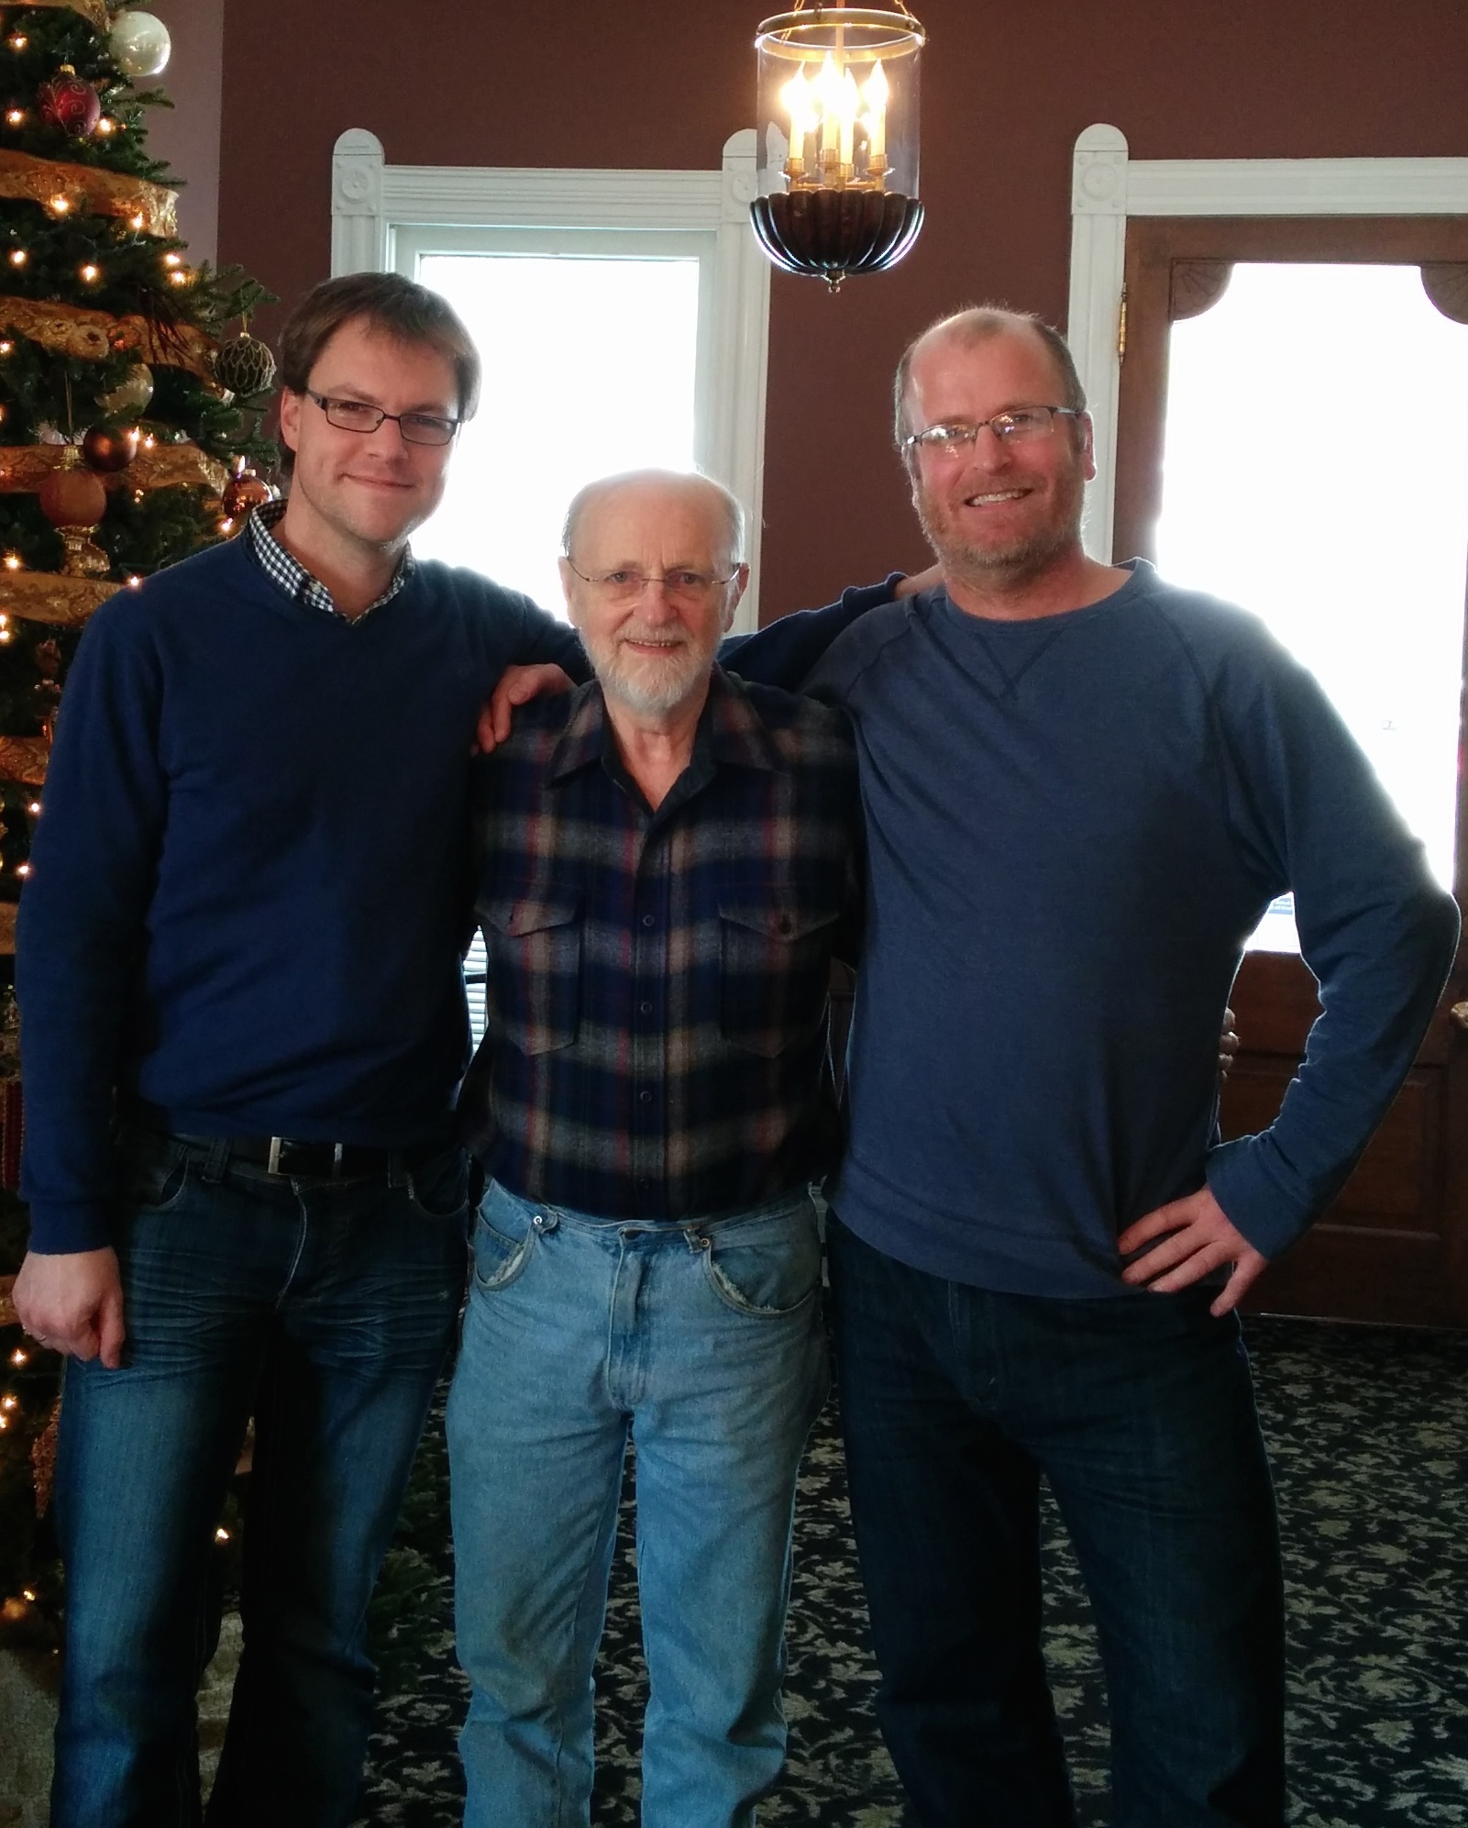
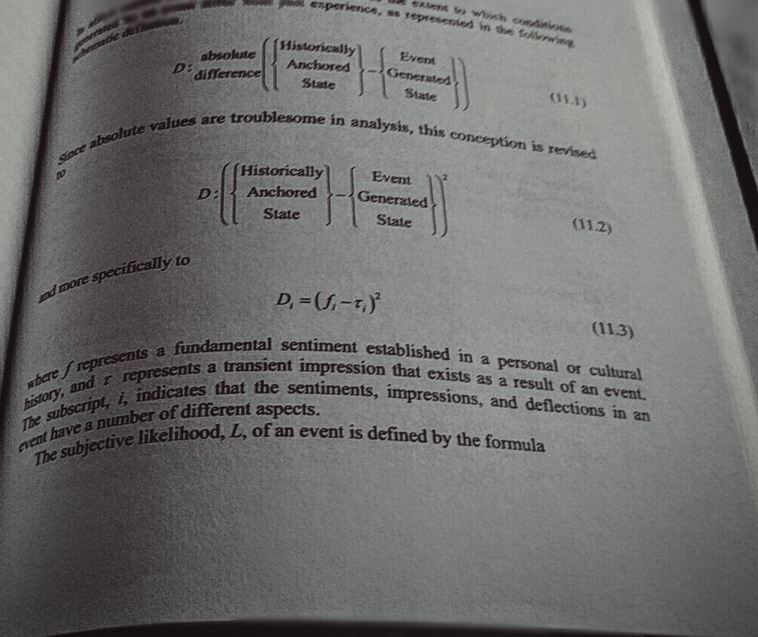

Slide 3
Affect Control Theory
…describes the affective regulation of social interaction in a cultural context
Multi-level approach:
individual person-perception, emotion, action
dyadic/small-group-level interactions
alignment with the symbolic cultural order
Mathematical formalization, computer simulation
Heise, D. R. (2007). Expressive order: Confirming sentiments in social action. New York: Springer.
MacKinnon, N. J. (1994). Symbolic interactionism as affect control. Albany: SUNY Press.

Slide 4
The EPA Model of the Affective Space
(e.g., Ertel, 1964; Fontaine, Scherer, Roesch, & Ellsworth, 2007; Mehrabian, 1995;
Morgan & Heise, 1988; Osgood, 1962, 1969; Osgood, May, & Miron, 1975)

Slide 5
Measuring EPA: Semantic Differential
(Heise, 1969, 2010; Osgood, Suci, & Tannenbaum, 1957)

Slide 6
Affective Meaning and the Social Order
(Ambrasat, v. Scheve, Schauenburg, Conrad, & Schröder, 2014, PNAS)
Method:
Measured EPA of 910 concepts
with semantic differential
N=2,849 (representative of
German population)

Slide 7
The Control of Action: Coherence
(e.g., Heider, 1946; Osgood & Tannenbaum, 1955; Festinger, 1957; Thagard, 2000)
Modern
Art
Modern
Art
+
➲
-
-
✓
-
Peter
+
Mary
Peter
+
Mary
Basic human motive: “orderly representations”
Incoherent representations motivate corrective action
The role of identity: Align experiences and actions with situational self sentiments: Who am I?

Slide 8
Affect Control Theory at a Glance
(Heise, 1979; 2007; MacKinnon & Heise, 2010)
Self Sentiment
E P A
Affective Deflection:
Discrepancy of fundamental identity sentiments and transient affective impressions after a social event
ought to confirm
select
Identity
E P A
ought to confirm
Emotion
E P A
institutional
constraints
select
Behaviour
E P A
results in

Slide 9
Affect Control Theory
David Heise, 1979
Powers, 1973 people minimize
incongruence by controlling perception
f: fundamentals • τ: transients
deflection D = ∑ w_{i} (f_{i} − τ_{i} )²
Affect Control Principle:
actors work to experience
  in-context sentiments (transients)
  that are consistent with their
  out-of-context sentiments (fundamentals)
emotion ε ∝ f − τ
bureaucrat
trainee
Notes:
Returning to ACT – here is a better picture of it and let’s dig into more details

Slide 10
Limitations of Affect Control Theory
Uncertainty in social interactions
The consensus paradox: People agree on meanings, but there are subtle differences and political disagreements
Identities and their meanings change
Multiple identities
Bayesian Affect Control Theory (BayesACT)

Slide 11
BayesACT: Identities and Emotions as Probability Distributions in EPA Space
(Hoey et al., 2016; Schröder et al., 2016)

Slide 12
Bayesian RL: General Model
O’_{y}
Backchannel observations -- emotional signaling
Parameter or model space -- group dynamics & values
Y’
abstractum
Action space
a
Transform functions -- Neural/Bayes Nets
time
X’
concretum
State space
M. Gilead, Y. Trope, and N. Liberman. 2020. Above and beyond the concrete: The diverse representational substrates of the predictive brain.
Behavioral and Brain Sciences 43, e121(2020),1–74.
O’_{x}
Evidence/observations -- sensors

Slide 13
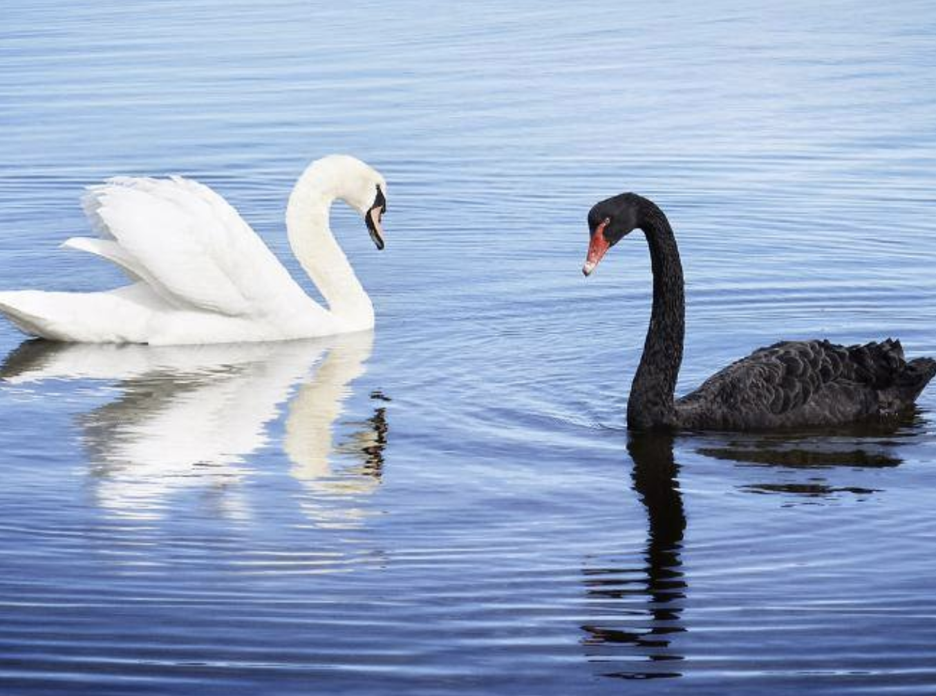
White Swans … Black Swans
Notes:
First I’m going to talk about Swans
Before discovering Australia, Europeans had *never seen* a swan that was not white, so if you asked them what color the next swan they’d see was, they’d say 100% guaranteed to be white. This would be like asking you what color the next Bald Eagle’s head you see will be
But then they saw a Black Swan in Australia, but had no way of interpreting what kind of animal it was.
Statistical machine learning is based *by definition* on historical data only. Its based on the dataset that you have or can get.
IF the dataset you have covers only part of the things that can actually happen, you will be surprised and your model will break and fail

Slide 14
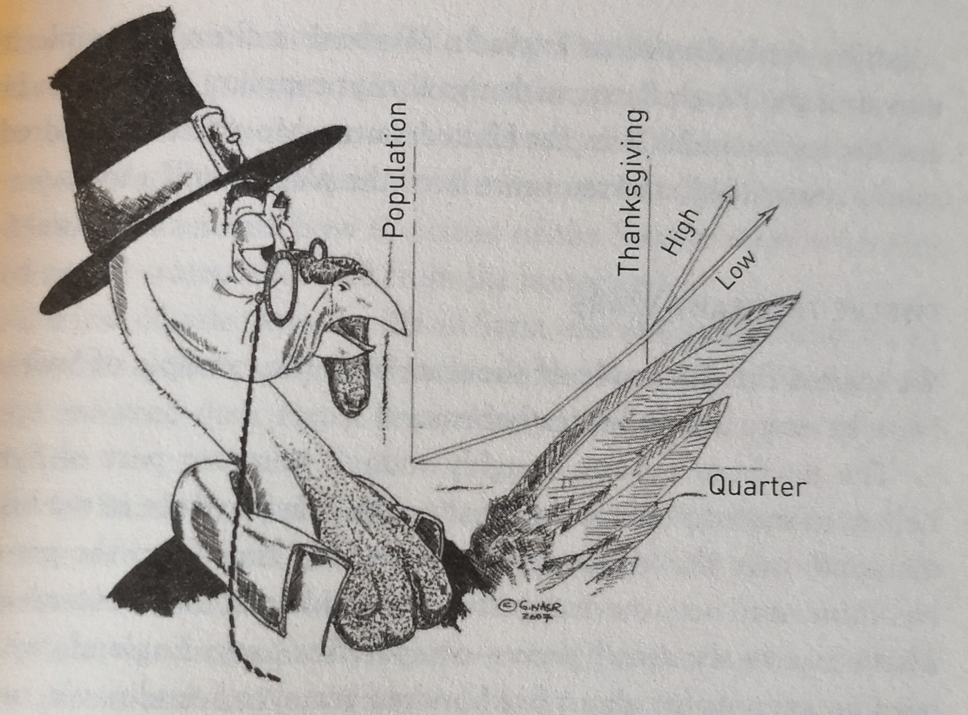
Black Swan Events
From N.N. Taleb “AntiFragile” p. 93
Notes:
So this is fine for categorizing swans, but this over-reliance on models can lead to much more dangerous outcomes if it happens
In financial forecasing, or perhaps worse, in public policy.
Important thing to realize is that you might be wrong
And not just wrong because your model is insufficiently trained
Wrong because your model SPACE is wrong. You will never be able to predict what happens next – accept it.

Slide 15
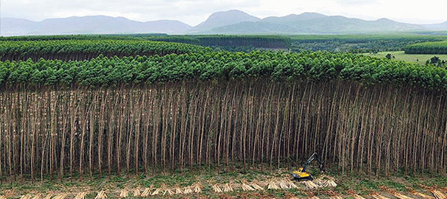
Monoculture…
Prussia 1765-1800: took 100 years before the damage was apparent (J.C.Scott Seeing like a State, 1998)

Slide 16
Efficient Crickets…
Computers and sensors will track everything from environmental factors like heat and humidity, to cricket growth, waste production, and even check for sick or dead insects.
“You need a lot of data with AI, and with living organisms how do I get enough examples of sick crickets for the algorithm to learn? You obviously don’t want to create that for ethical reasons ... so it is a technical hurdle we’ll have to overcome.”
Fernandez, whose company has already partnered with German automotive giant Audi and U.S. defence contractor Lockheed Martin, acknowledged that tracking the health and well-being of living, breathing crickets will be different from analyzing automotive or aerospace components.
“Using artificial intelligence to raise better crickets and help save the world”
Waterloo Record By James Jackson Record Reporter Mon., Feb. 22, 2021

Slide 17
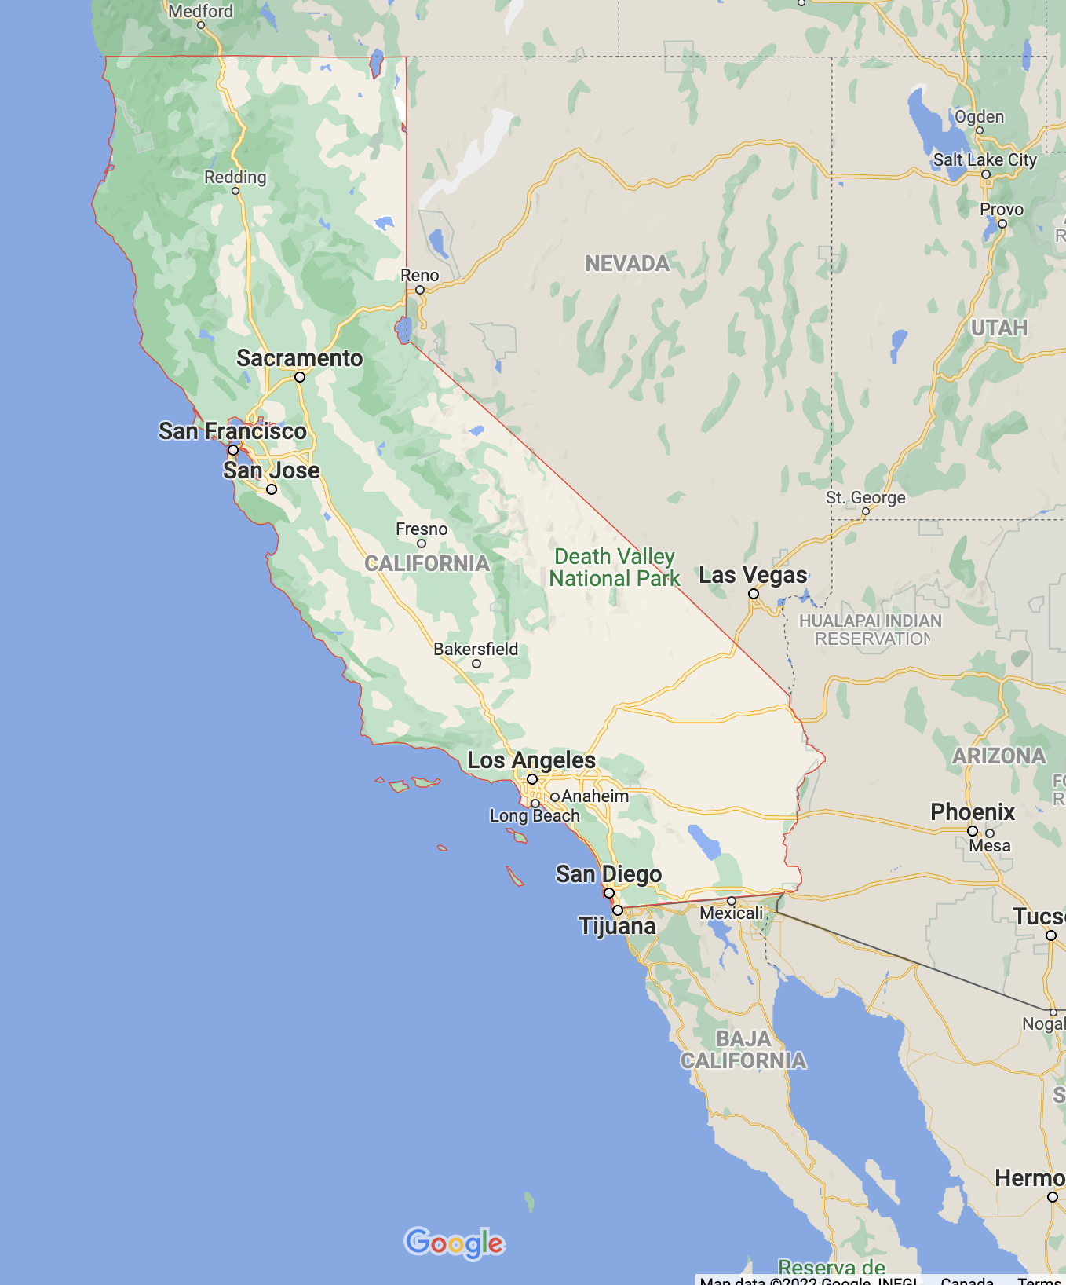
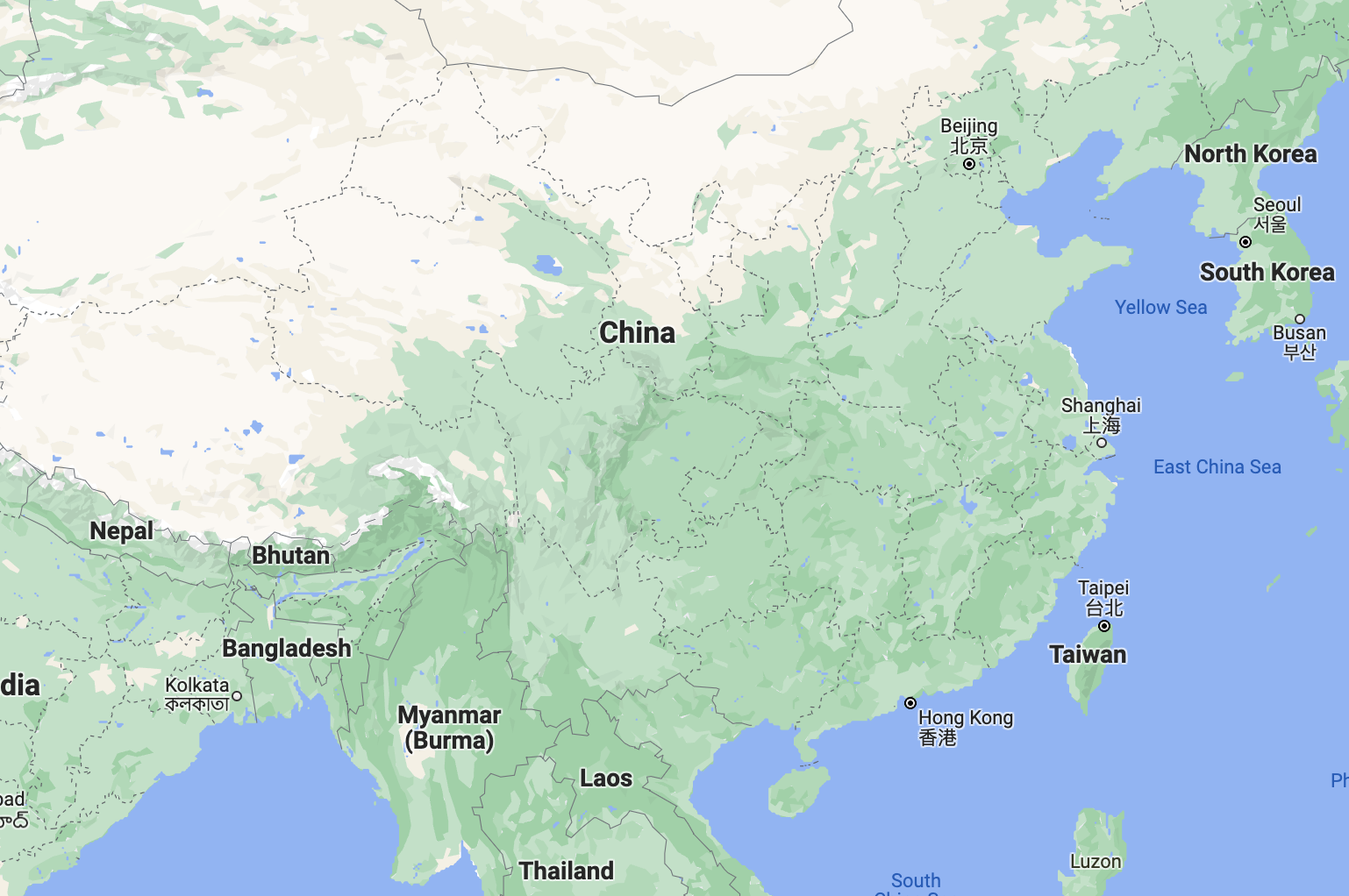
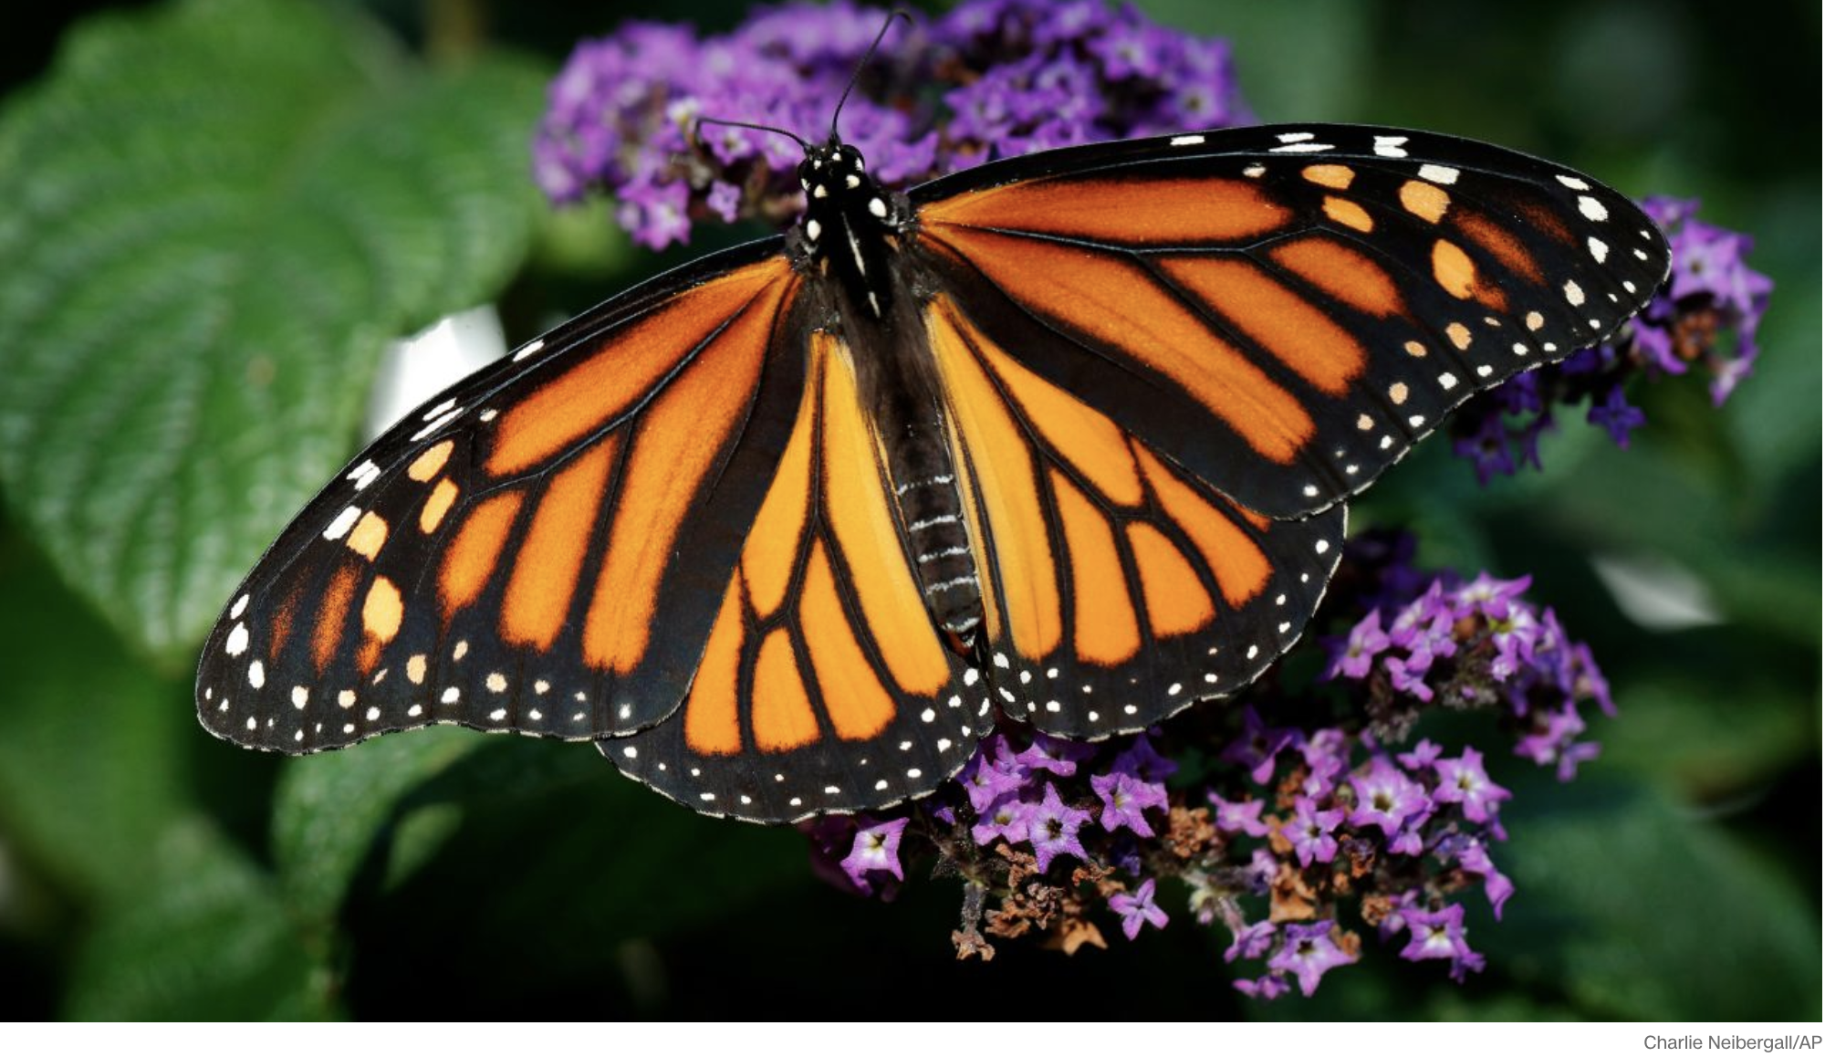
Complexity: Black Swans arise
Many interacting parts, long distance, path-based effects

Slide 18
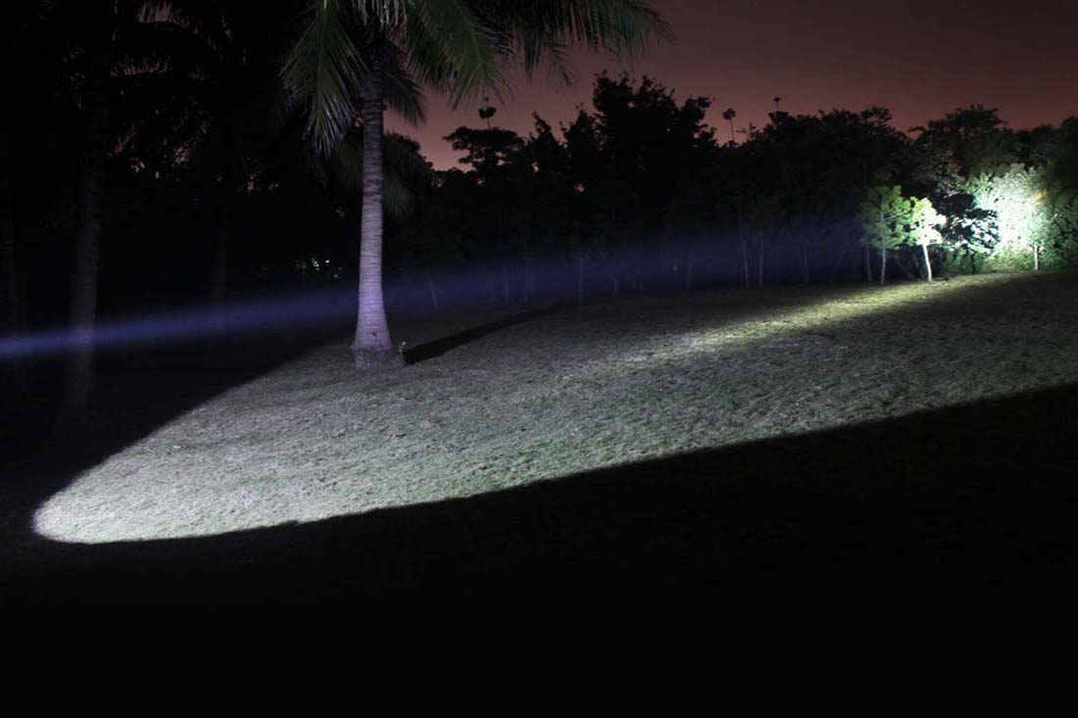

Beam Search
Need a small enough beam to see what you are looking at …
… but a big enough beam not to miss the black swan.
Notes:
So your machine learning model is like a flashlight – wide beam or narrow beam, it never illuminates what is outside the beam
I think this is still true – although deep nns have vastly expanded the beam, the amount covered is still trivial
Dark forest – set of all datasets – somewhere in there is the dataset with the black swan
Wide beams are going to hit the black swan, but only dimly
Narrow beams are going to miss the black swan
Had this quote at first:
“…the proportion of relevant reality which we can represent by any such model or models in studying say, a foreign policy decision, appears to be almost trivial.”
(Charles Hitch, head of Economics at RAND, quoted in Charles E. Lindblom, “The Science of Muddling Through”, 1959)

Slide 19
Bayesian Learning
Bayesian Reinforcement Learning:
learn P(y|m,x) and P(m|d)
Suppose:
d = {x₁,y₁,x₂,y₂,...,x_{N},y_{N}} is evidence (data),
x_{i} is input feature, and y_{i} is target feature,
x is a new input,
we want the corresponding output y.
We sum over all models, m ∈ M.
To learn the model, we compute.
M: class of models
$$P\left(y | x,d\right) =\sum_{m}{P\left(y,m | x,d\right) m∈} M$$
$= \sum_{m}{P\left(y | m,x,d\right)P(m|x,d)}$
$= \sum_{m}{P\left(y | m,x\right) P\left(m | d\right)}$
$$P\left(m|d\right)= \frac{P\left(d | m\right)P(m)}{\sum_{m}{P\left(d | m\right)P(m)}}$$
Output is conditionally independent of dataset given the model
Model is conditionally independent of the new input given the data
P(d): Evidence, partition function or
e^{–free energy} is hard to compute

Slide 20
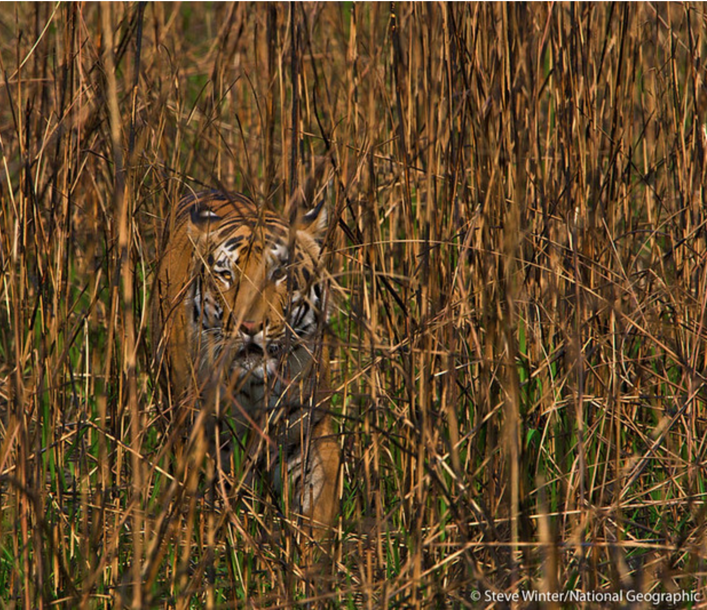
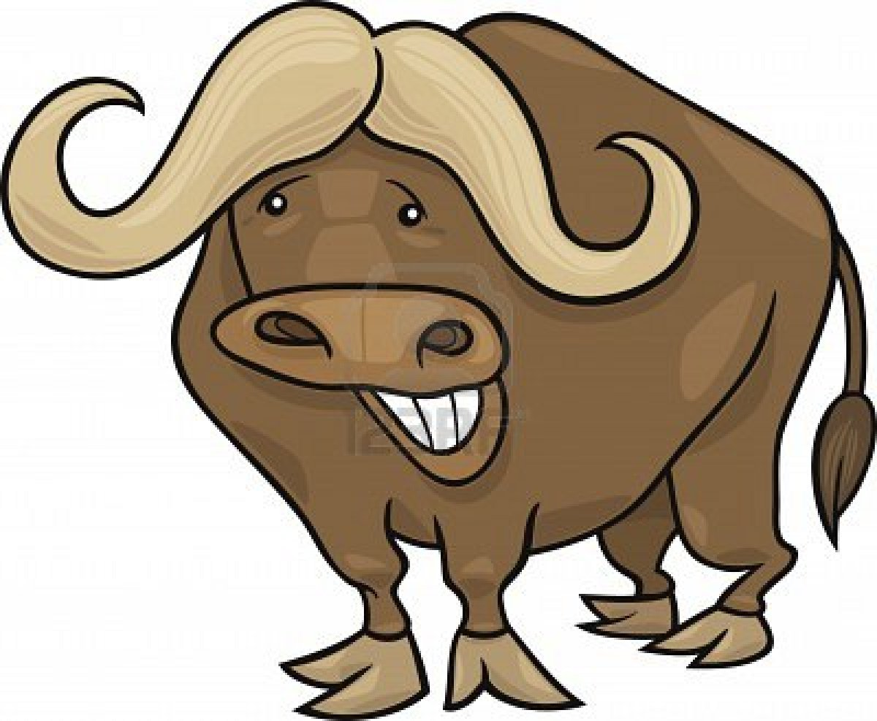
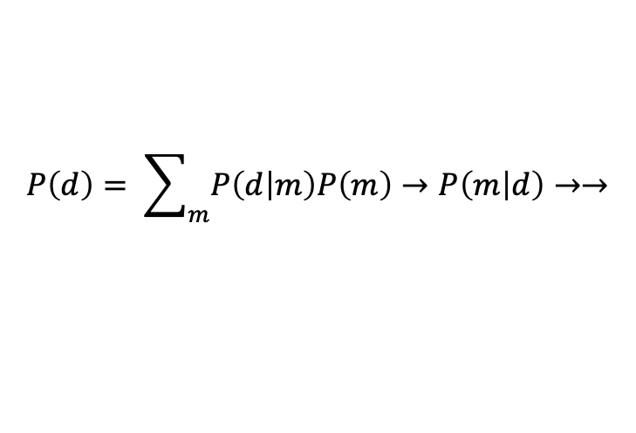
?
$$P\left(d\right)= \sum_{m}{P\left(d | m\right)P\left(m\right)→P\left(m | d\right)→→}$$
free energy
realization
expectation
Notes:
The realization of the world should meet the animals expectations
Therefore either
A) the expectations have to have sufficient capacity for the world, -------- learning – increase model capacity such that expectations meet realizations --- increase flashlight beam width
B) Or the world has to be simple enough for the expectations ------------ fleeing – keep narrow beam flashlight, run away
Just like the Turkey on thanksgiving day – this guy would be wrong if you asked him what would come next (Tiger)
First his world is only grass/nograss so he learns the distinction
Has certain expectations with respect to that distinction
Difference is partition functiojn – free energy
Now put in tiger
The animal that survives will be the one that rapidly handles the new state. Doing this inductively based on a model may be the only way forward for the animal.
Therefore, characterizing P(d) is a key step for the animal to compute P(m|d), which it can use to inductively sort out what is the right action to take
Even more basic – the partition function, if the free energy grows larger, must necessarily grow smaller – thus it must be enlarged to take into account the new states and this should shrink the free energy again
When the free energy grows, there is more information hidden in the environment…. To be used
Can change its model of the world (to include tigers) or its actions (run away back to just grass!)
Free energy is the \sum_m P(d,m) - the probability of everything – for all models. P(d) – the evidence.
If you knew this you could deduce everything
Now you want this to be as small as possible – as few models as possible
But you need to have enough to deal with the fat tails – the unexpected and unknowable
Water Buffalo just sees grass, just models grass.
Expectations are perfectly satisfied
Tiger
Realization is different than expectation
Free energy is the information to be had by the agent –
This comes from basic physics – 2nd law --- go to bowl –total energy has increased but less so inside the bowl – macro states etc.

Slide 21
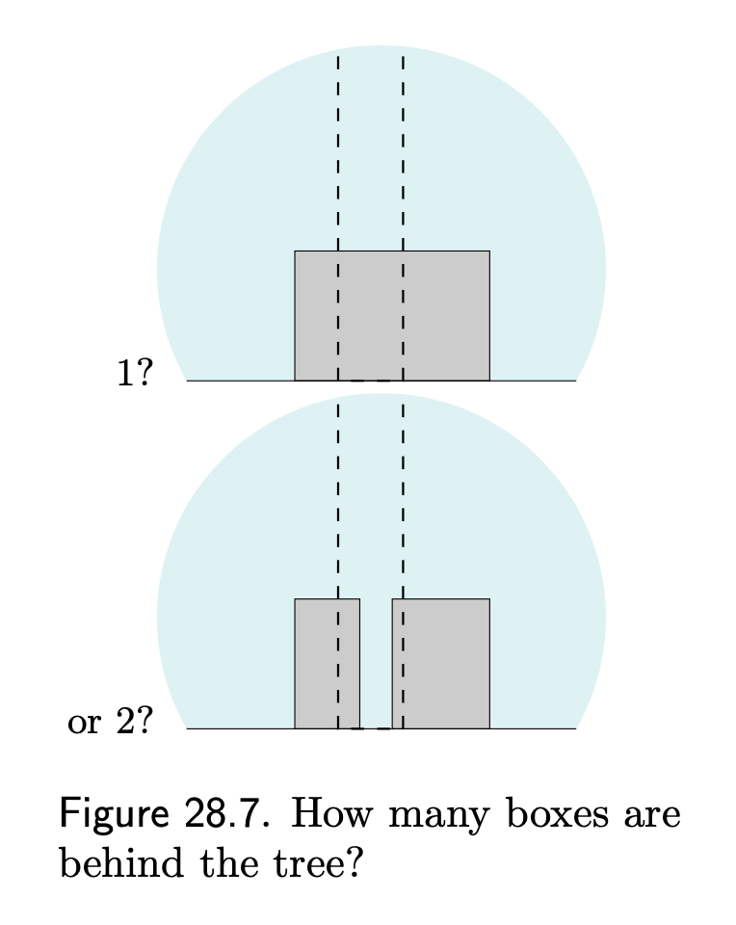
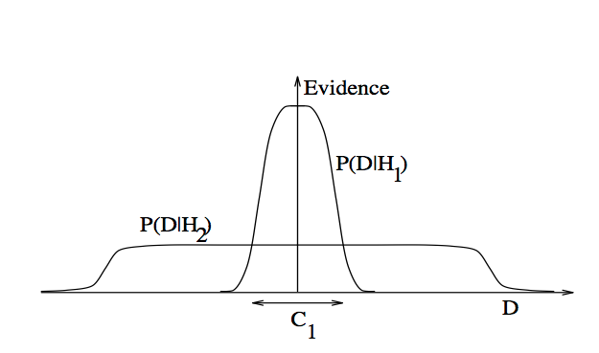
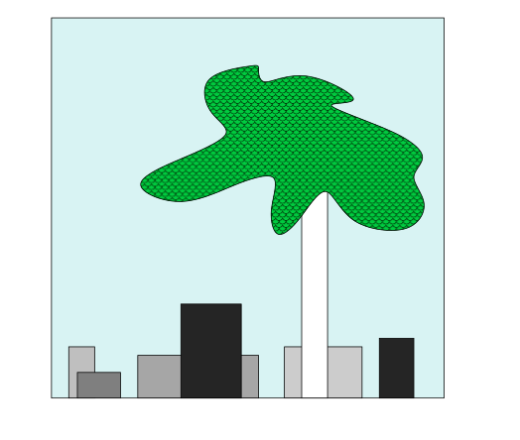
Occam’s Razor
Quantifying size of M
Size of : $P\left(d\right)=\sum_{m}{P(d,m)}$ = -log(free energy)
Or, how much free energy should be converted
into information useful for action?
H_{1,}H₂ are M: sets of all models
Likelihood function has built-in simplicity bias
even if you’re not Bayesian!
High bias, low variance
low bias, high variance
H₁ explains fewer datasets, but does each better,
H₂ explains more datasets, but each less well
From MacKay 2005 www.inference.phy.cam.ac.uk/mackay/itila/book.html
Notes:
Many more ways of arranging two boxes behind the tree so they look like that than one box
Neural Networks are GREAT at being low bias, high variance. But the variance is NOT BIG ENOUGH – somehow the human brain can operate in a zero bias mode when needed – how?
So you’d like to have a low bias and low variance model, but you can’t – these variables are complementary.
So in the end are trading off the flexibility to handle the black swans with the safety knowing what is going to happen.
Need to know in the end how much of this free energy are you going to run into – and make sure your model space \sum_M is big enough to handle it - this means you are constantly considering models that account for a certain degree of black-swanness, so that should one come along, it can be properly consideried

Slide 22
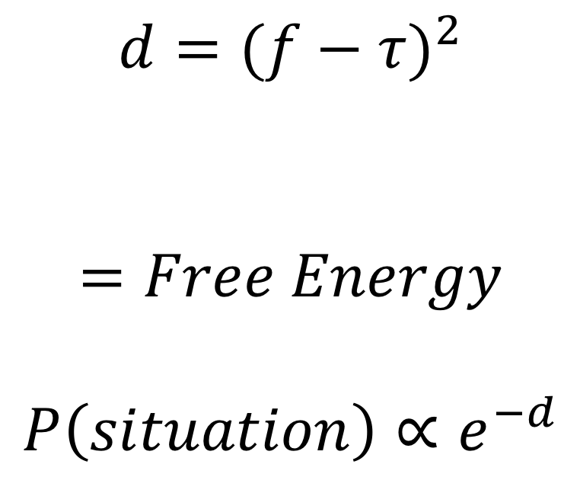
Enter Sentiment and Deflection
$$d={(f−τ)}^{2}$$
$$=Free Energy$$
$$P\left(situation\right)∝e^{−d}$$
expect
realize
Notes:
The free energy – like the balls in the air (potential energy) – is something that a physical system can reach out and take hold of, and turn into order.

Slide 23

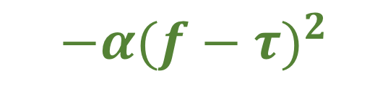


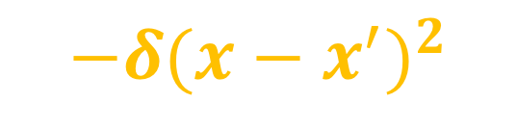
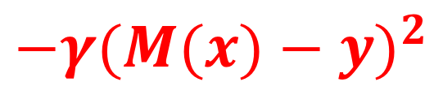
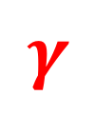
EMOTIONAL SIGNALS (IN)
EMOTIONAL SIGNALS (OUT)
EMOTIONAL SIGNALS
CONNOTATIVE
$$Y=\{f,τ\}$$
$$−α{(f−τ)}^{2}$$
$$α$$
FREE
coherence
SOMATIC TRANSFORM
$$−γ{(M(x)−y)}^{2}$$
connotative precision
ENERGY
DENOTATIVE
$$X=\{x,a,o\}$$
$$γ$$
$$−δ{(x−x^{′})}^{2}$$
validity/homogeneity
ACTIONS/BEHAVIOURS
OBSERVATIONS/EVIDENCE
EVIDENCE/ACTIONS
denotative precision
Notes:
Normativity = connotative
Homogeneity = denotative

Slide 24
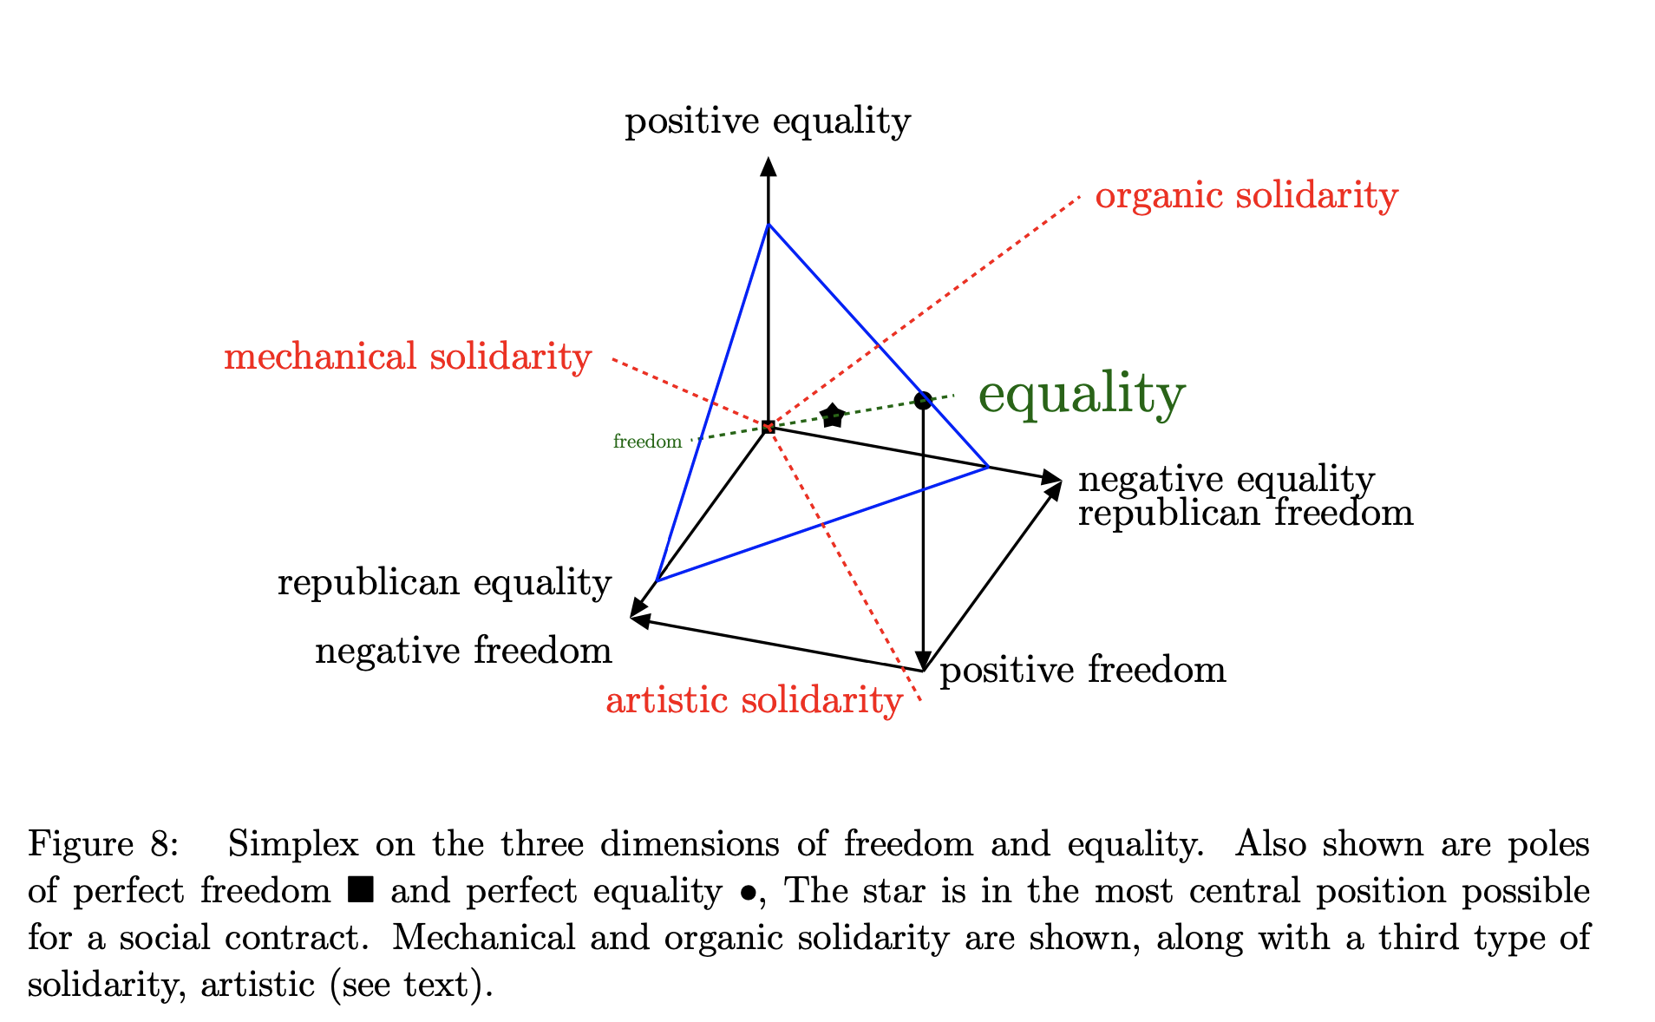
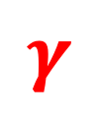


$$δ$$
$$α$$
$$γ$$

Slide 25
Hank: 0.5 Citizen
0.5 Environmentalist
Tom: 0.5 Citizen
0.5 Culprit
Tom: 0.5 Citizen
0.5 Coal miner
Hank: 0.5 Citizen
0.5 Prosecutor
α: 0.1
γ: 0.15
aligned
α : 0.1
γ : 0.15
TEST
d: 0.0
d: 0.0
Hank (Environmentalist)
Tom (Ex- coal miner)

Slide 26
Tom: 0.4 Coal miner
0.1 Miner
0.1 Laborer
Hank: 0.8 Prosecutor
0.0 Colleague
α : 0.1
γ : 0.15
α : 0.1
γ : 0.15
Hank: 0.7 Environmentalist
Tom: 0.9 Culprit
APPEASE
d: 3.0
d: 1.1
Hank (Environmentalist)
Tom (Ex- coal miner)

Slide 27
Tom: 0.3 Coal miner
0.3 Miner
Hank: 0.9 Prosecutor
Hank: 0.6 Colleague
Tom: 0.6 Crane operator
α : 0.1
γ : 0.15
α : 0.1
γ : 0.15
PACIFY
d: 1.9
d: 3.0
Hank (Environmentalist)
Tom (Ex- coal miner)

Slide 28
Hank: 0.4 Citizen
0.3 Colleague
Tom: 0.4 Citizen
0.3 Colleague
Tom: 0.3 Citizen
0.2 Colleague
0.2 Peer
Hank: 0.3 Citizen
0.3 Colleague
α : 0.1
γ : 0.15
α : 0.1
γ : 0.15
REWARD
d: 1.8
d: 1.8
Hank (Environmentalist)
Tom (Ex- coal miner)

Slide 29
Hank: 0.5 Citizen
0.5 Environmentalist
Tom: 0.5 Citizen
0.5 Culprit
Tom: 0.5 Citizen
0.5 Coal miner
Hank: 0.5 Citizen
0.5 Prosecutor
α : 0.01
γ : 0.25
misaligned
α : 0.5
γ : 0.01
TEST
d: 0.0
d: 0.0
Hank (Environmentalist)
Tom (Ex- coal miner)

Slide 30
Hank: 0.4 Environmentalist
0.2 Peer
Tom: 0.6 Culprit
Tom: 1.0 Coal miner
Hank: 1.0 Prosecutor
α : 0.01
γ : 0.25
α : 0.5
γ : 0.01
TEST
d: 3.0
d: 1.3
Hank (Environmentalist)
Tom (Ex- coal miner)

Slide 31
Hank: 0.2 Colleague
0.1 Worker
0. Wage earner
0. Peer
Tom: 0.1 Culprit
0.Crane operator
0.Peer
0.Citizen
0.1 Liberal
α : 0.01
γ : 0.25
α : 0.5
γ : 0.01
Tom: 1.0 Coal miner
Hank: 1.0 Prosecutor
PACIFY
d: 2.4
d: 4.0
Hank (Environmentalist)
Tom (Ex- coal miner)

Slide 32
Hank: 0.2 Nonconformist
0.1 Crane operator
0.1 Union member
0.1 Foreman
Tom: 0.2 Crane operator
0.1 Foreman
0.1 Citizen
0.1 Colleague
α : 0.01
γ : 0.25
α : 0.5
γ : 0.01
Tom: 1.0 Coal miner
Hank: 1.0 Prosecutor
OBEY
d: 2.2
d: 5.3
Hank (Environmentalist)
Tom (Ex- coal miner)

Slide 33
Hank: 0.2 Nonconformist
0.1 Crane operator
0.1 Union member
0.1 Citizen
Tom: 0.2 Crane operator
0.1 Foreman
0.1 Citizen
0.1 Colleague
α : 0.01
γ : 0.25
α : 0.5
γ : 0.01
Tom: 1.0 Coal miner
Hank: 1.0 Prosecutor
DISCIPLINE
d: 2.2
d: 7.0
Hank (Environmentalist)
Tom (Ex- coal miner)

Slide 34




$$α:0.1$$
$$α:0.1$$
Tom: 0.5 Citizen
0.5 Coal Miner
Hank: 0.5 Citizen
0.5 Environmentalist
$$γ:0.15$$
$$γ:0.15$$
Tom: 0.5 Citizen
0.5 Culprit
Hank: 0.5 Citizen
0.5 Prosecutor
TEST
d: 0.0
d: 0.0
HANK (Environmentalist)
TOM (Ex- coal miner)

Slide 35
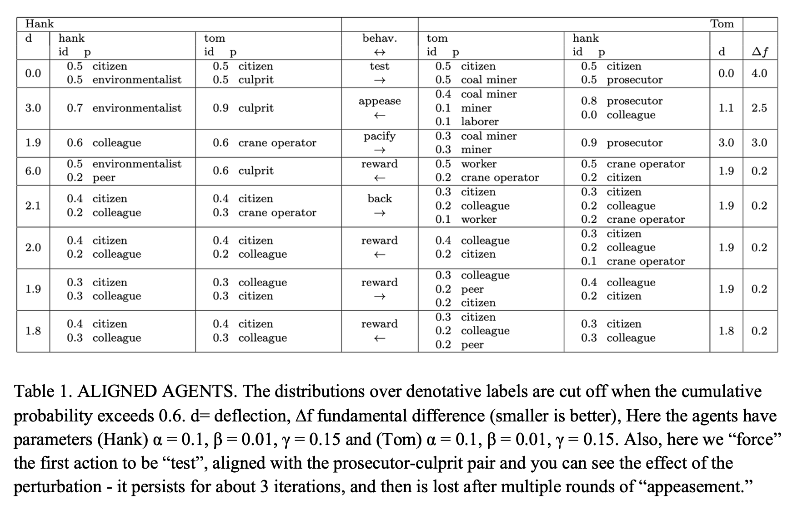

Slide 36
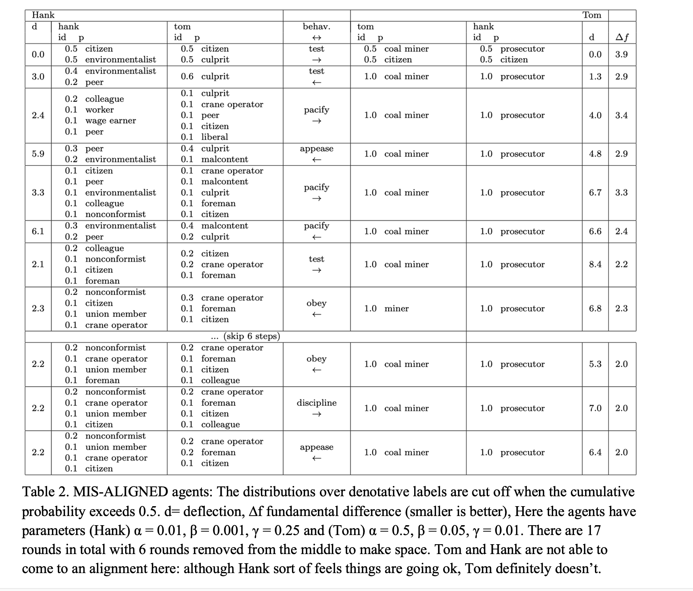

Slide 37
Freedom and Equality
Elizabeth Anderson. 2017. Private Government. Princeton University Press.
Three types
Freedom
Equality
Positive
exploration, opportunity
control of information: rational plans
capitalism
communism
Republican
disobedience, liberty
control of violence: guns, retributive punishment
oligarchy
dictatorship
Negative
independence, freedom from others
decentralized control of identity, habits, rituals: restitutive punishment
aristocracy
religion/democracy

Slide 38
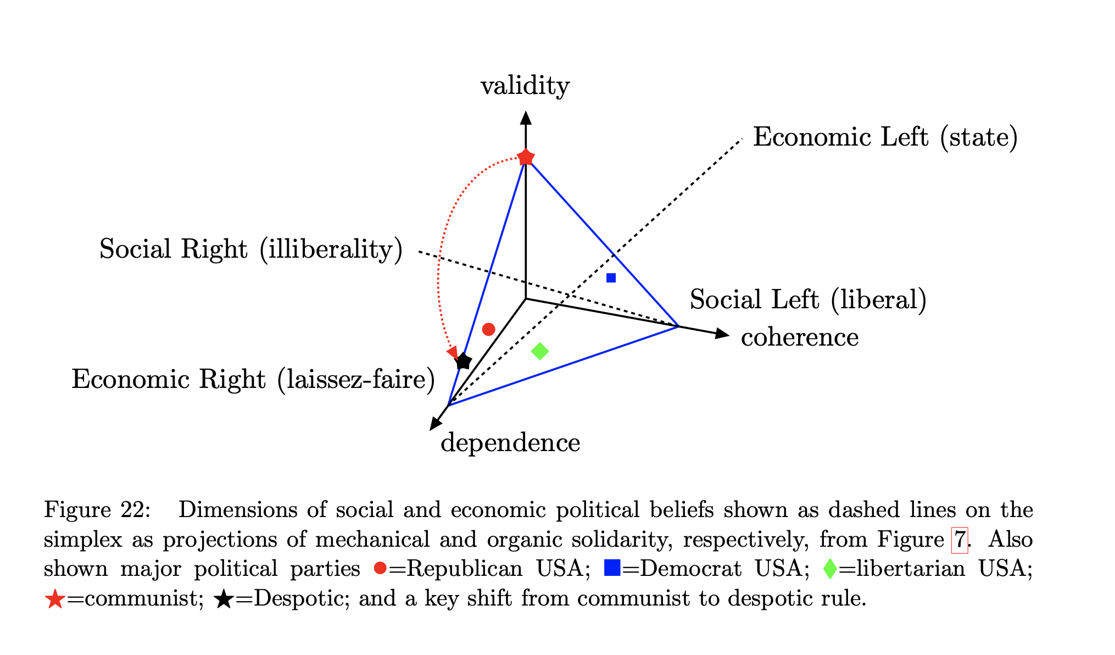



$$δ$$
$$α$$
$$γ$$

Slide 39
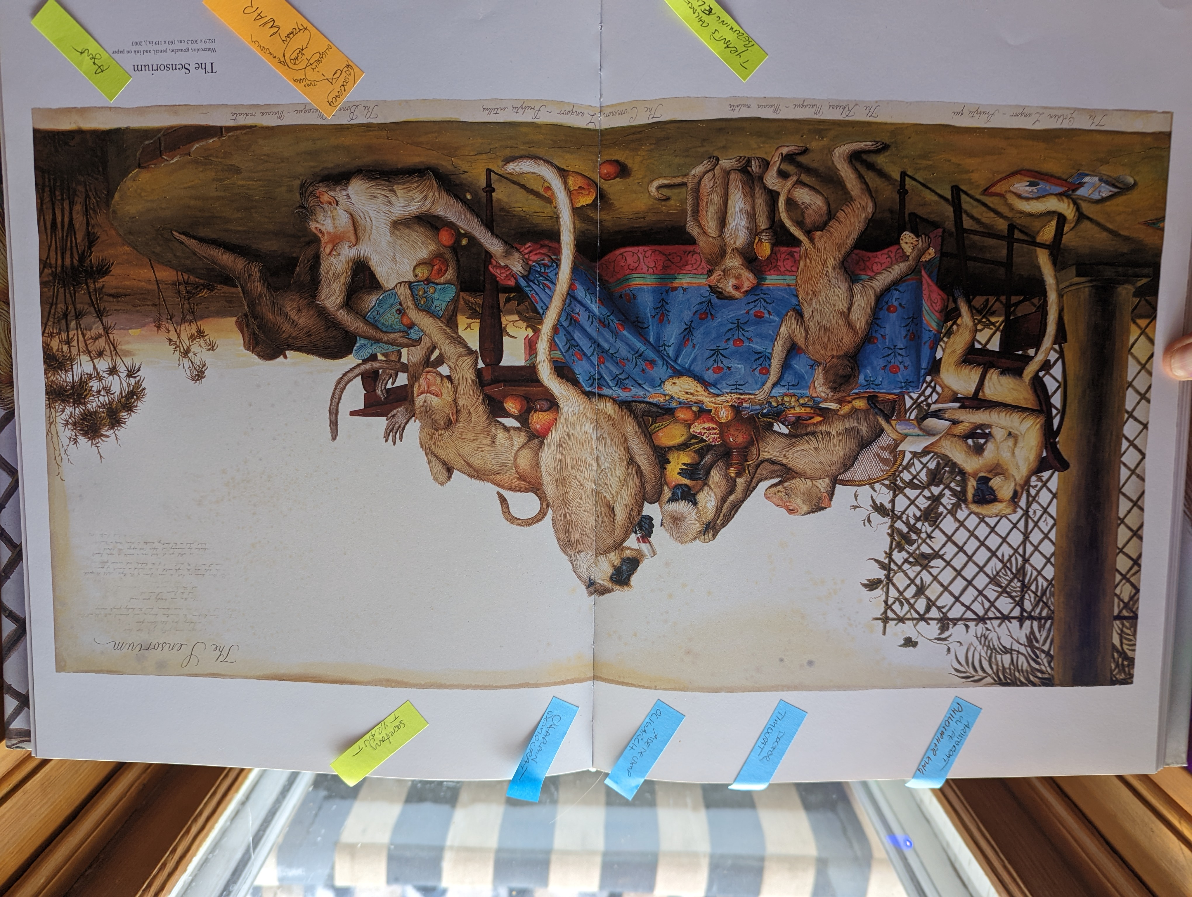
Plato – The Republic
OLIGARCHY
Scrooge
DEMOCRACY
Social Contract
TIMOCRACY
Idealist
TYRANNY
Dictator
ARISTOCRACY
Phillosopher King
CHAOS
Anarchy
Walton Ford –The Sensorium

Slide 40
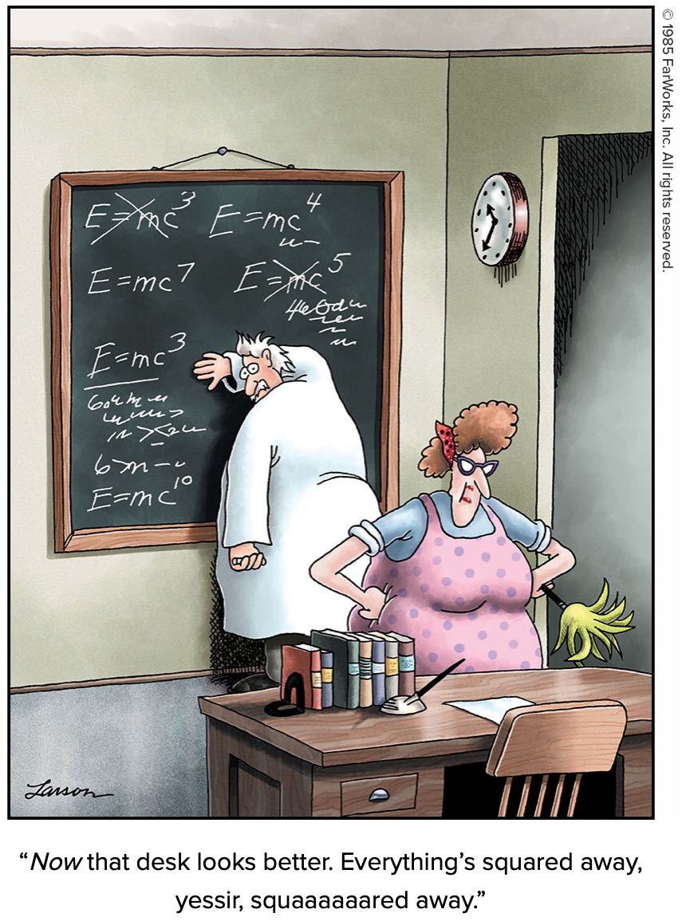
Funding
-Trans-Atlantic Partnership (TAP)
- Deutsche Forschungsgemeinschaft (DFG)
-Natural Science and Engineering Research
Council, (SSHRC, Canada)
-Social Science and Humanities Research
Council, (SSHRC, Canada)
Coordinates
bayesact.ca
@drjessehoey, @tobiascanada
jhoey@uwaterloo.ca
post@tobiasschroeder.de

