Slide 1
Modeling Cognitive-Affective Processes with Appraisal and Reinforcement Learning
Jiayi Eurus Zhang, Joost Broekens, Jussi Jokinen
IEEE Trans. Affective Computing, 2025
ArXiv: https://doi.org/10.48550/arXiv.2309.06367

Slide 2
Component Process Model
Scherer (2009)
Four appraisal check classes:
Relevance: novelty and intrinsic pleasantness
Implications: goal conduciveness
Coping potential: capacity to manage outcomes
Normative significance: event’s compatibility with social norms
14 appraisal checks, of which 4 used here:
Suddenness
Goal relevance
Conduciveness
Power

Slide 3
Same situation, different ”power,” different emotion

Slide 4
Basic Model overview

Slide 5
Reinforcement Learning
Markov Decision Process
S: set of states
A: set of actions
T(s,a,s’): transition function or world model
R(s,a,s’): reward or utility function
𝛄: discount factor
Q(s,a): value of being in state s and taking action a
𝛂: learning rate
TD error 𝚫= $α[R\left(s,a\right)+{}_{ a^{′} }^{max}{ q\left(s^{′},a^{′}\right)−q(s,a)]}$

Slide 6
Appraisal “checks” based on RL
Suddenness
Goal relevance
Conduciveness
Power
Low probability of s’ = high suddenness
Scale of TD error = relevance
New information about a state’s expected utility is relevant
Discrepancy between anticipated and actual outcomes
(TD error scaled to [0,1])
Missing a’
Difference of AVERAGE q-value minus from MIN q-value

Slide 7
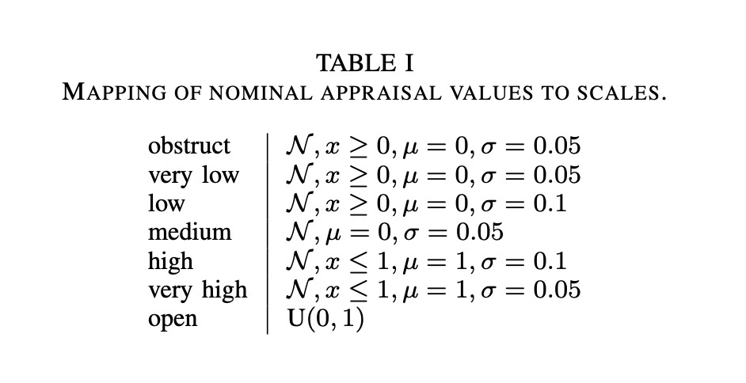
Map appraisal checks to emotions
obs = obstruct

Slide 8
Example MDP and Appraisal Profiles

Slide 9
Basic idea
emotion label
compare
Scherer
appraisals
HUMAN RATED EMOTION
constructed
sort of vague
RL components
compare?
experiment
definition of MDP
MDP
STORY
Notes:
From emotion label infer appraisal variables (Scherer)
From appr
Construct MDPs that will elicit emotion Y (from the set of 11)
Show that RL does elicit that emotion Y (by construction)
Construct story based on that MDP
Ask humans to rate the story on same set of 11 emotions
Show that humans choose the same emotion as the MDP
But…this sounds circular

Slide 10
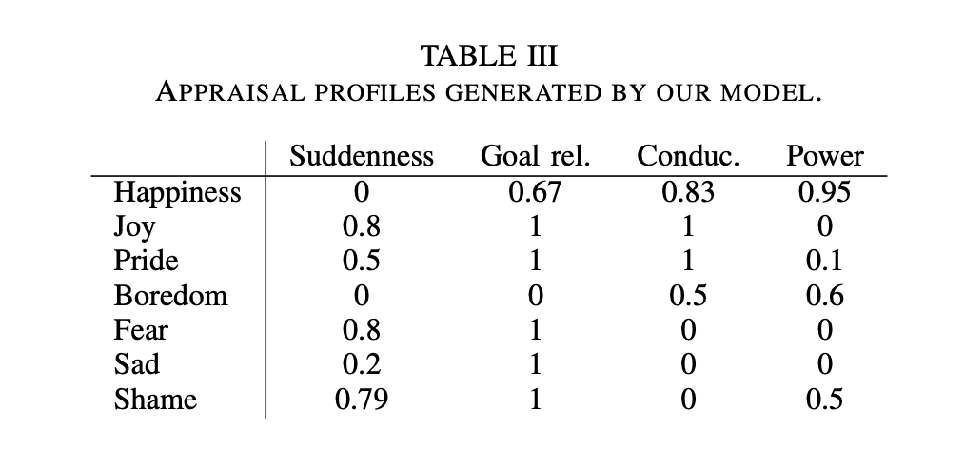
Results – Experiment 1
Design choice: build the MDP exactly so it has the corresponding RL components for each emotion
E.g. “fear” MDP has a high transition probability (0.8), and a high negative TD-error (Something happens) but low conduciveness (it has low utility), and low power (agent has no power over problem state P).

Slide 11
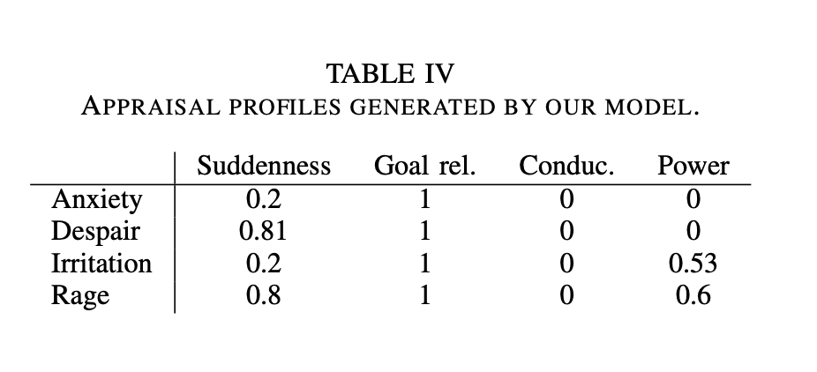
Results – experiment II

